Slide 1
Chilean volcano - Lightning tears the sky apart above the glow of the volcano
Beginning 6th June 2011
There are four volcanoes in the chain, but it was unclear which one has erupted because of the ash cover and weather conditions. The chain last saw a major eruption in 1960.

Slide 2
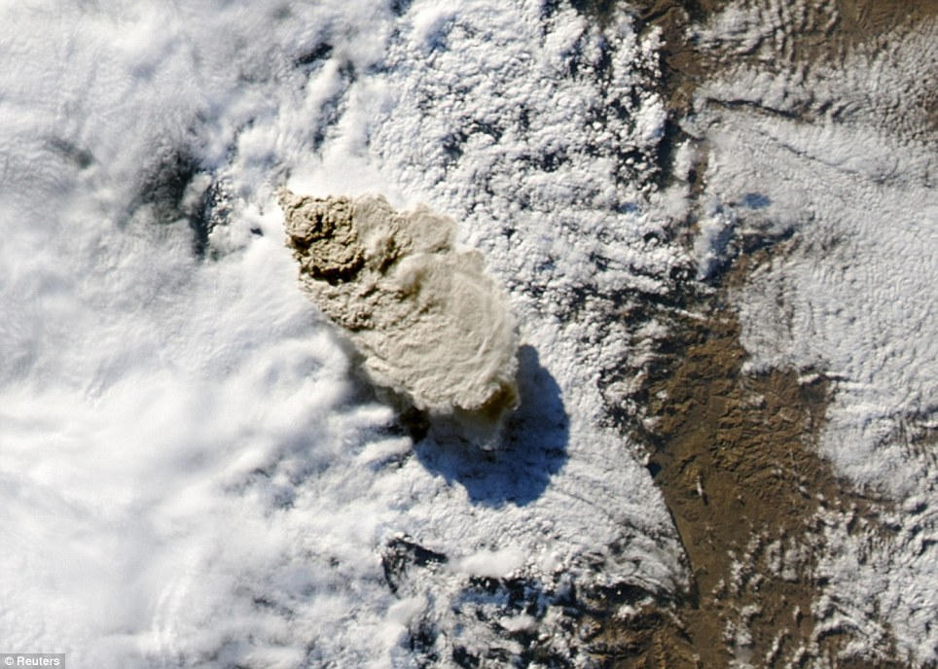

Slide 3
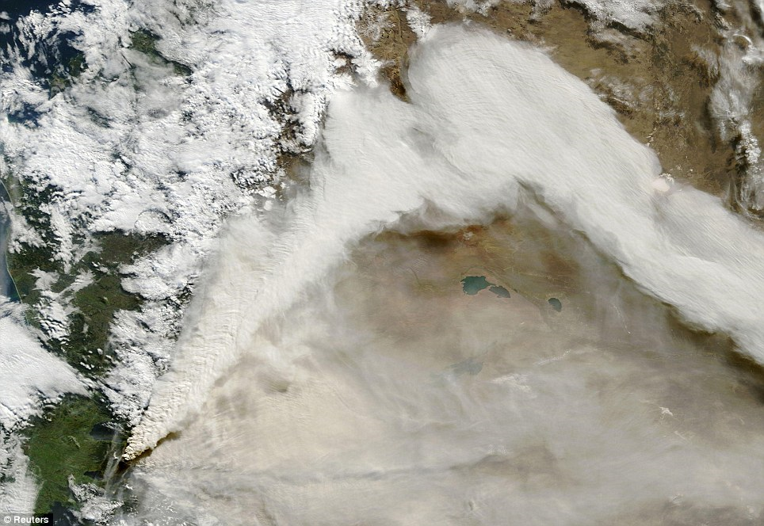
Scale: The plume of ash has reached as far as the Atlantic thanks to winds blowing it towards Buenos Aires

Slide 4
The Situation
Flames reach up to the heavens as lightning flashes criss-cross the sky. These extraordinary images show the full force of Mother Nature as a Chilean volcano erupts for the first time in 50 years. Ash has been thrown six miles up into the sky and the South American government has ordered the evacuation of thousands of residents. Winds fanned the ash toward neighbouring Argentina, darkening the sky in the ski resort city of San Carlos de Bariloche, in the centre of the country, and its airport has also been closed.

Slide 5
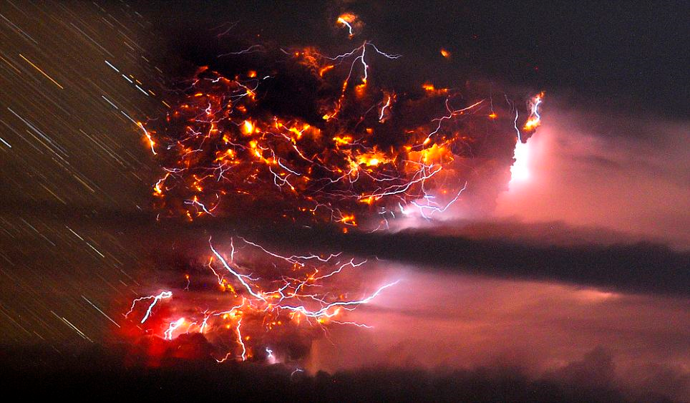
A time-lapse photo shows lightning bolts striking around the Puyehue-Cordon Caulle volcanic chain

Slide 6
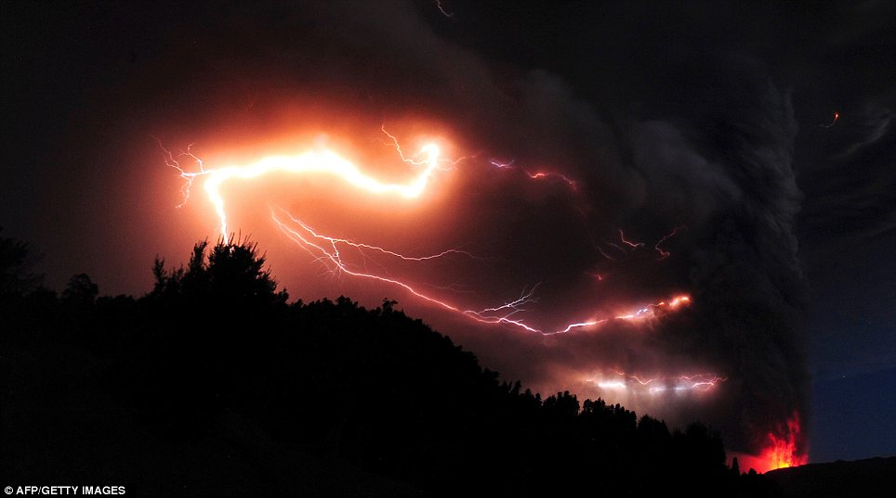
Lightning and volcanic fire is seen amid and underneath a towering cloud of ash.

Slide 7
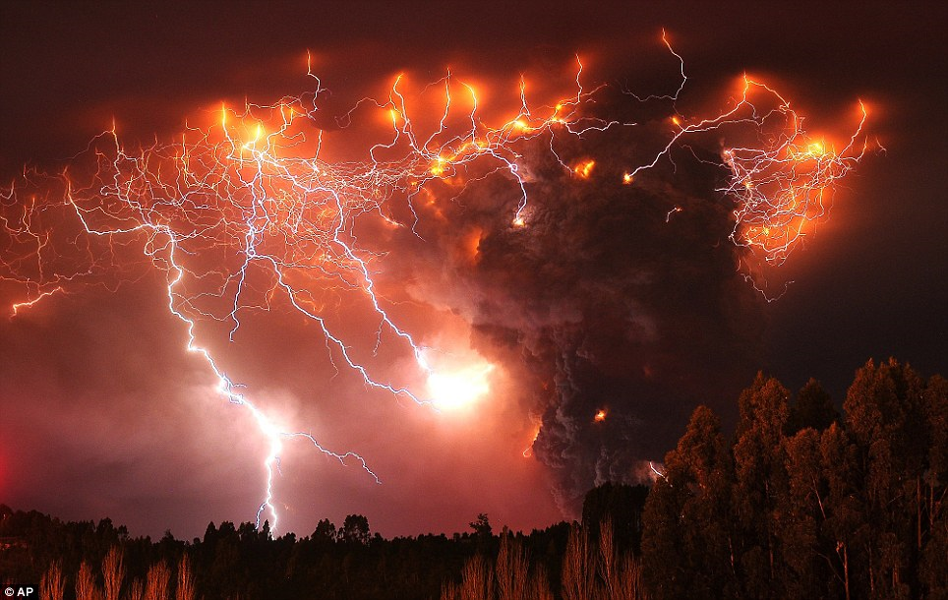

Slide 8
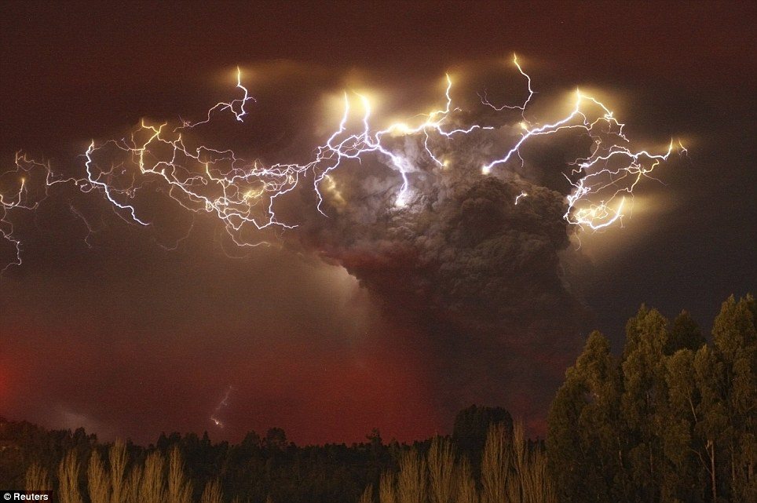

Slide 9
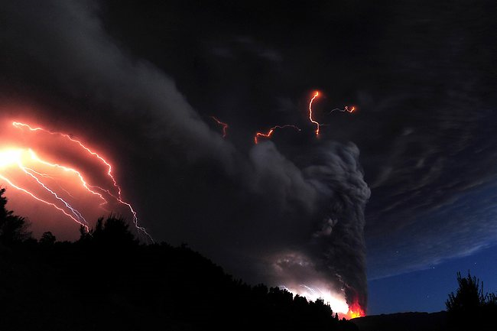

Slide 10
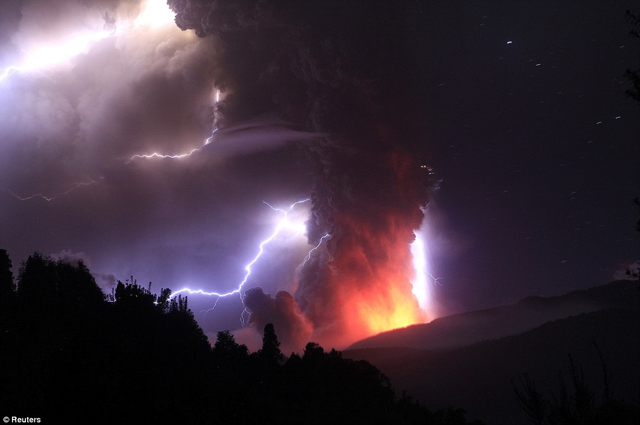

Slide 11
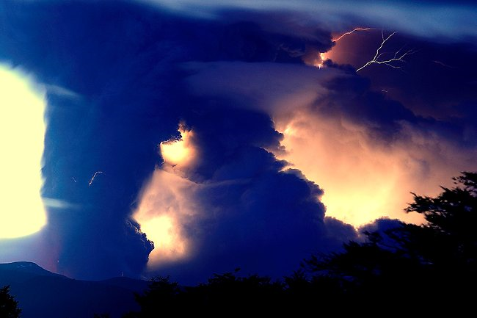

Slide 12
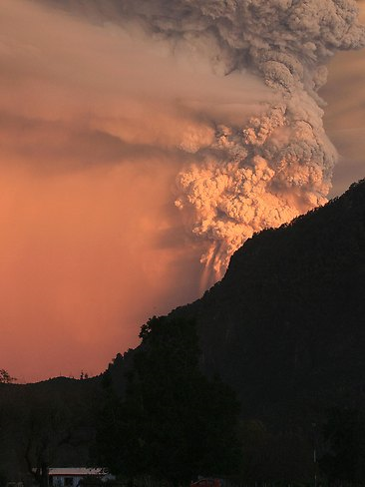

Slide 13
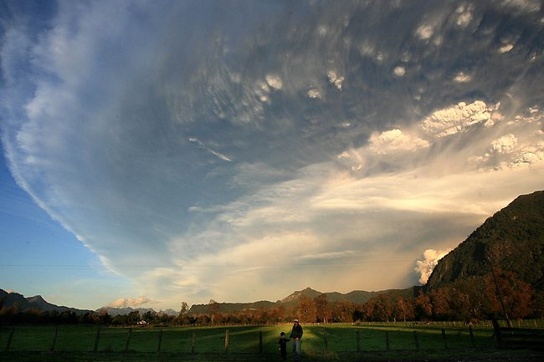

Slide 14
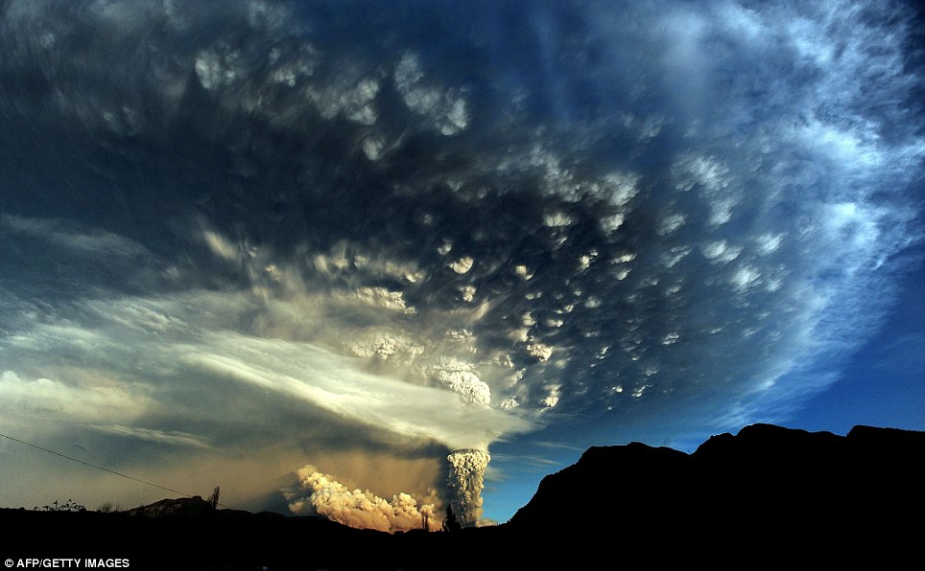
An extraordinary cloud formation is created by the ash rising several miles into the atmosphere

Slide 15
The eruption in the Puyehue-Cordon Caulle volcanic chain, about 575 miles south of the capital, Santiago, also prompted authorities to close a busy border crossing into Argentina. It was not immediately clear which of the chain's four volcanoes had erupted because of ash cover and weather conditions. The chain last saw a major eruption in 1960. Local media said the smell of sulphur hung in the air and there was constant seismic activity. 'The Cordon Caulle (volcanic range) has entered an eruptive process, with an explosion resulting in a 10-kilometre-high gas column,' the state emergency office ONEMI said. As a precaution, the government said it was evacuating 3,500 people from the surrounding area.

Slide 16
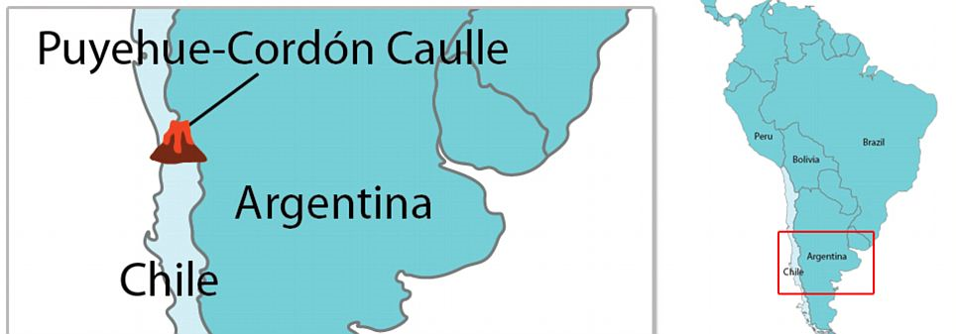

Slide 17
This development is the latest volcanic activity to affect the country. Three years ago, Chile's Chaiten volcano erupted spectacularly for the first time in thousands of years, spewing molten rock and a vast cloud of ash that reached the stratosphere and was visible from space. It also drifted over neighbouring Argentina, coating towns. Chile's Llaima volcano, one of South America's most active, also erupted that year and again in 2009. Chile's chain of about 2,000 volcanoes is the world's second largest after Indonesia. Some 50 to 60 are on record as having erupted, and 500 are potentially active.

Slide 18
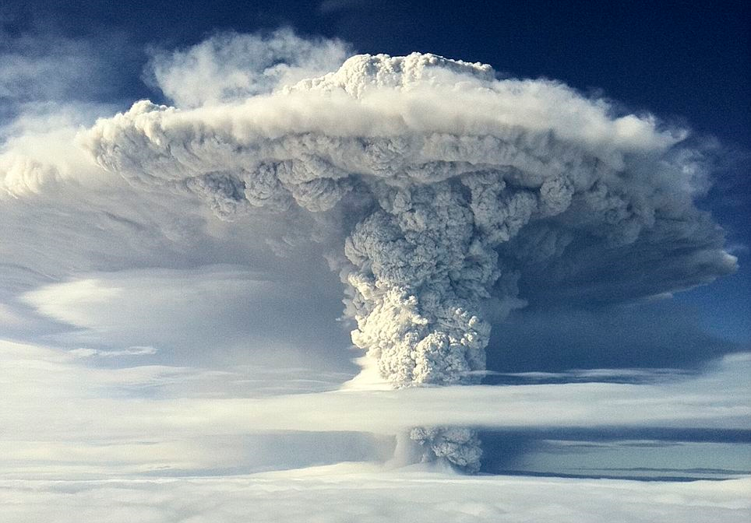

Slide 19
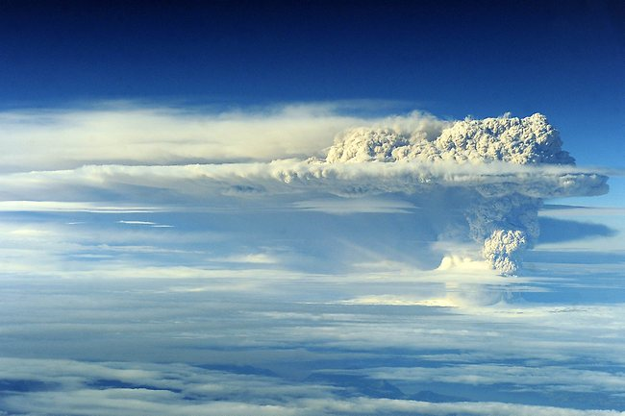

Slide 20
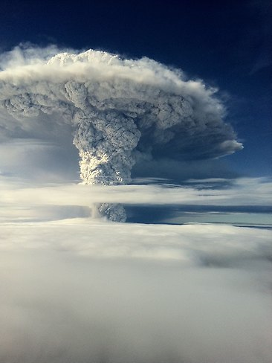

Slide 21
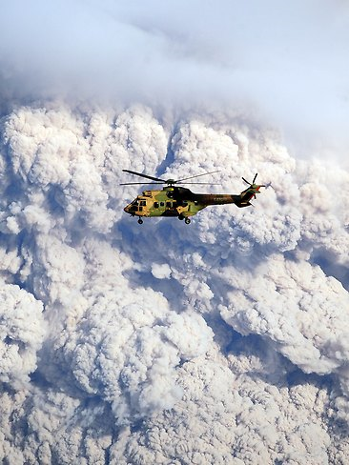

Slide 22
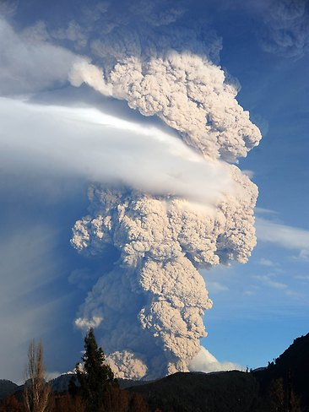

Slide 23
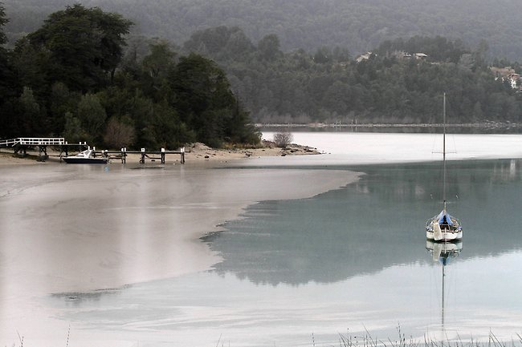
Lake covered with ash

Slide 24
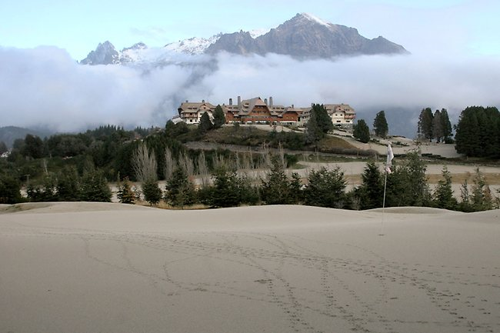
A view of the 9th hole green at the Llao Llao hotel golf course in Bariloche.

Slide 25
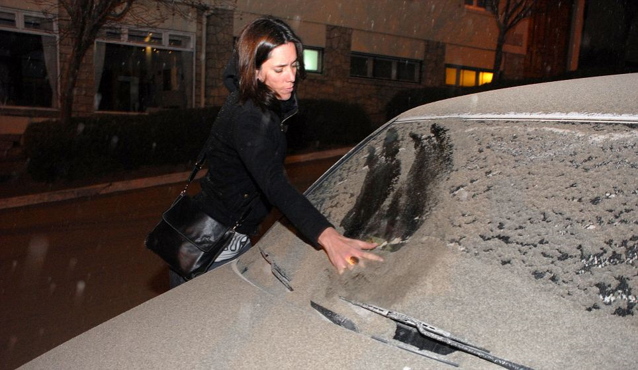
A woman wipes a thick layer of volcanic ash away from the windscreen of her car

Slide 26
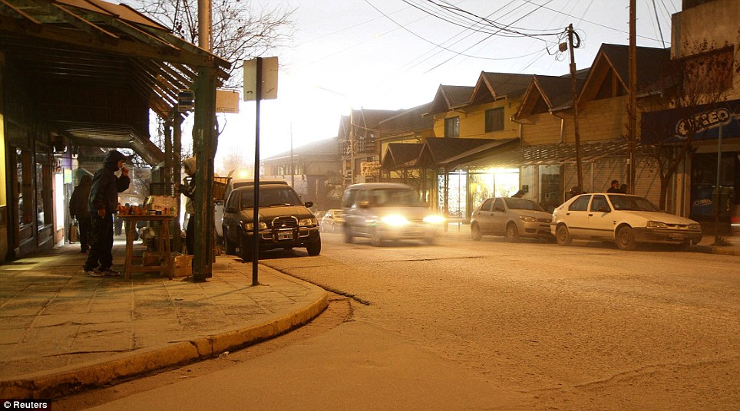
Headlights on, a car creeps through a street covered in ash.

Slide 27
It was the latest in a series of volcanic eruptions in Chile in recent years. Chile's Chaiten volcano erupted spectacularly in 2008 for the first time in thousands of years, spewing molten rock and a vast cloud of ash that reached the stratosphere. The ash also swelled a nearby river and ravaged a nearby town of the same name. The ash cloud from Chaiten coated towns in Argentina and was visible from space. Chile's Llaima volcano, one of South America's most active, erupted in 2008 and 2009. Chile's chain of about 2,000 volcanoes is the world's second largest after Indonesia. Some 50 to 60 are on record as having erupted, and 500 are potentially active.

Slide 28
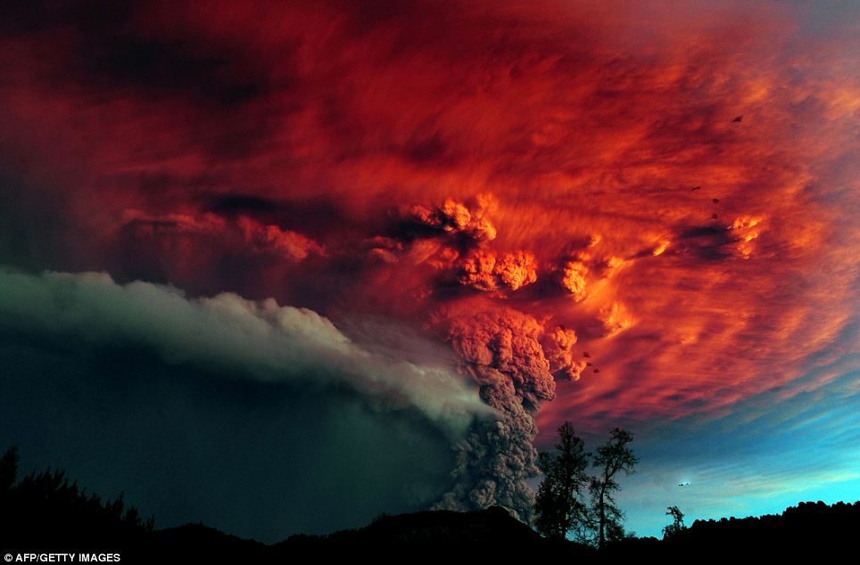

Slide 29
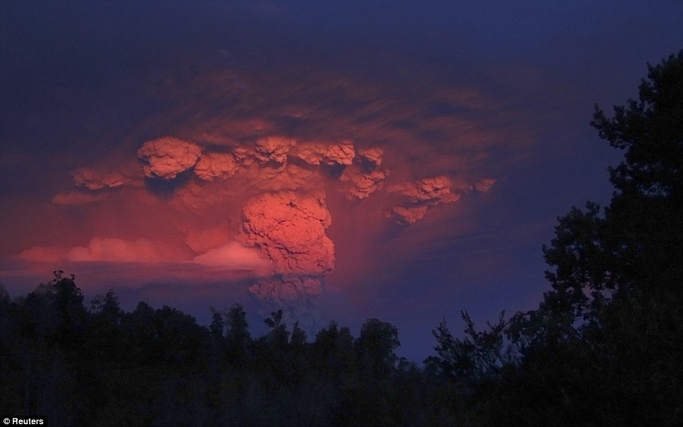

Slide 30
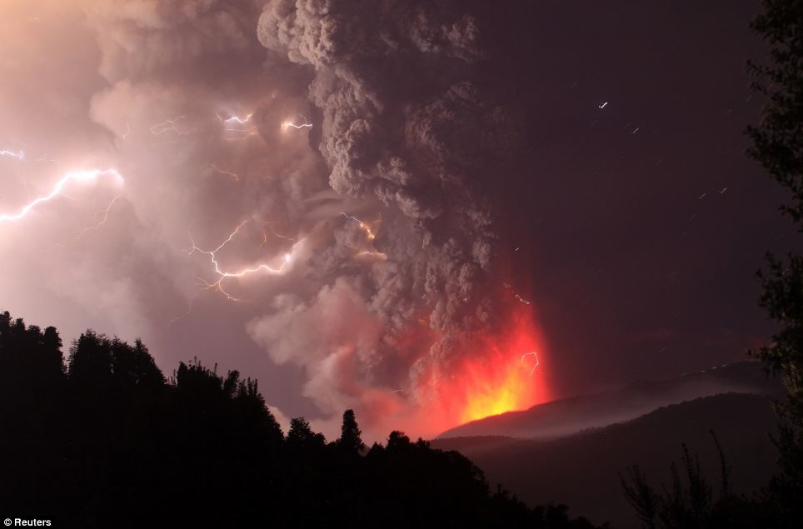

Slide 31
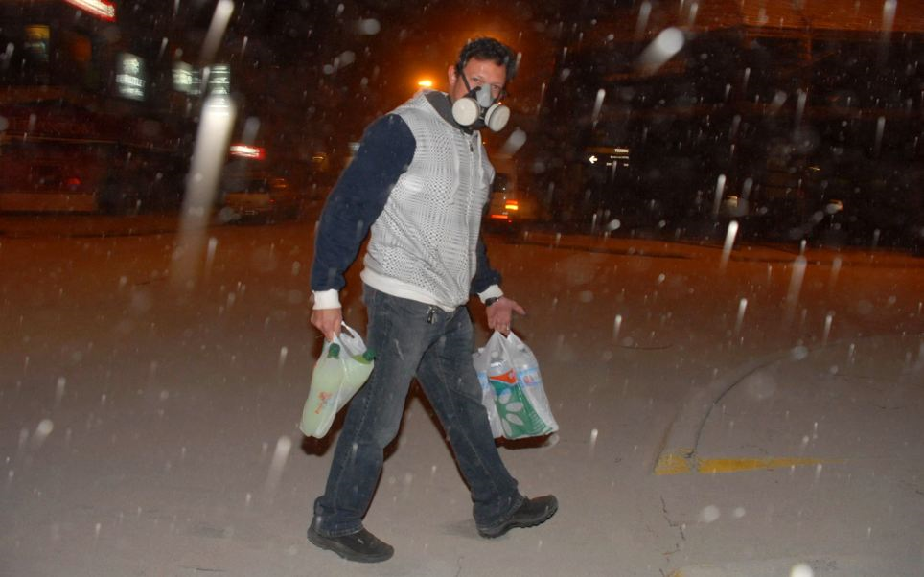
Carrying bottles of water and soft drinks this man wears a gas mask to avoid breathing in ash

Slide 32
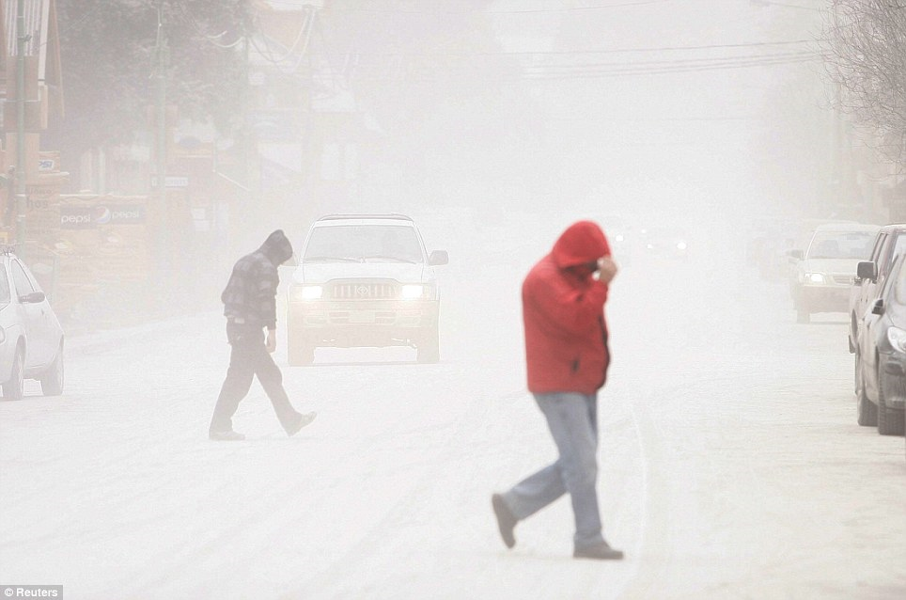

Slide 33
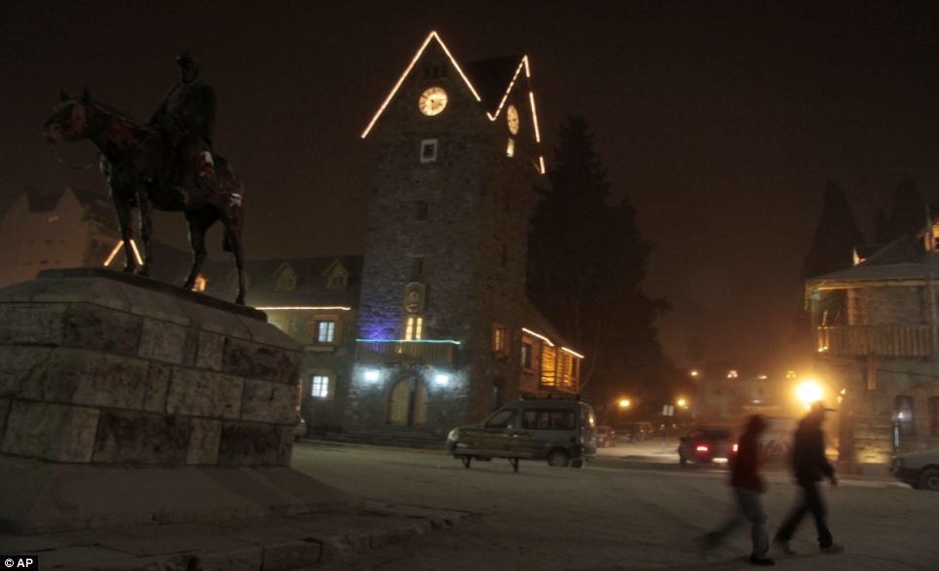

Slide 34
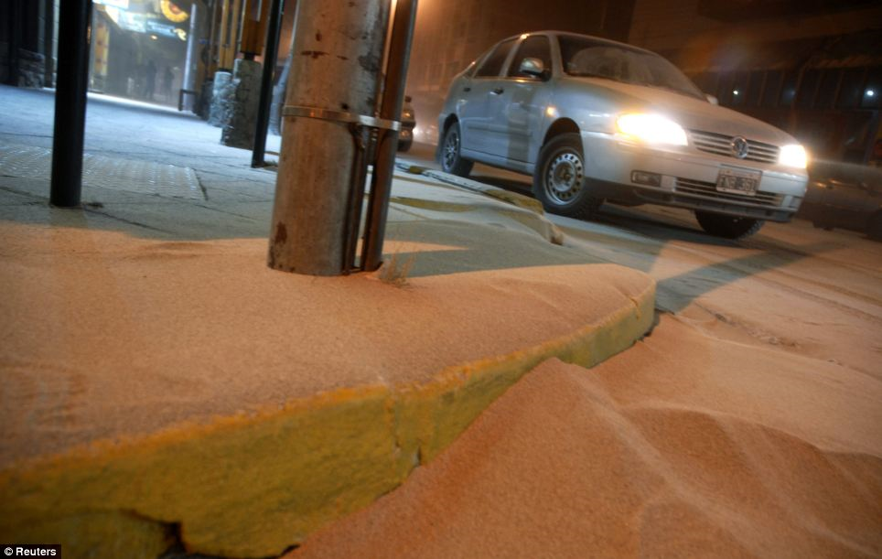

Slide 35
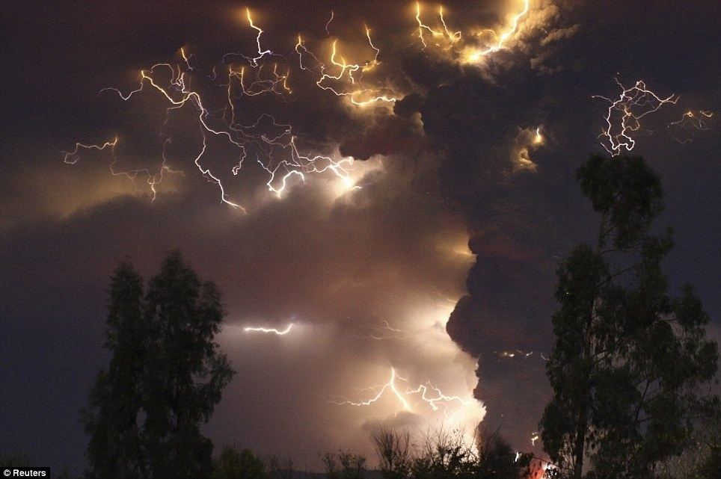
Streams clogged with ash may flood

Slide 36
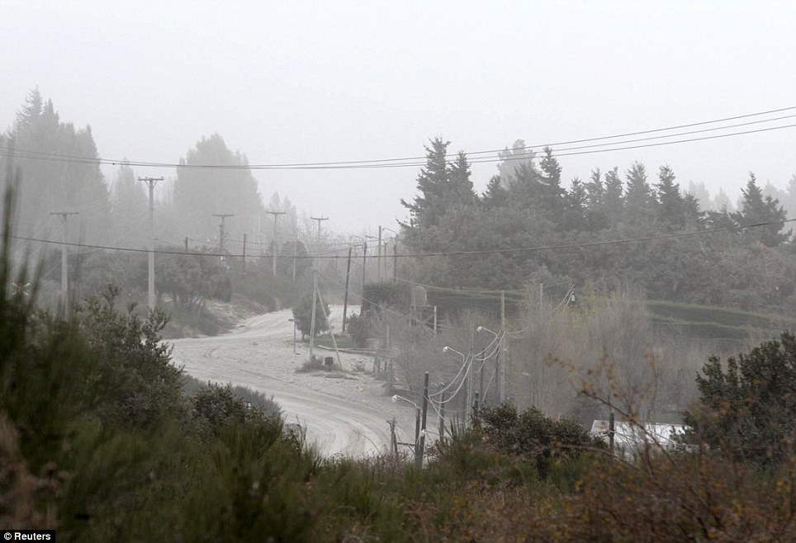
Ski resort shut down

Slide 37
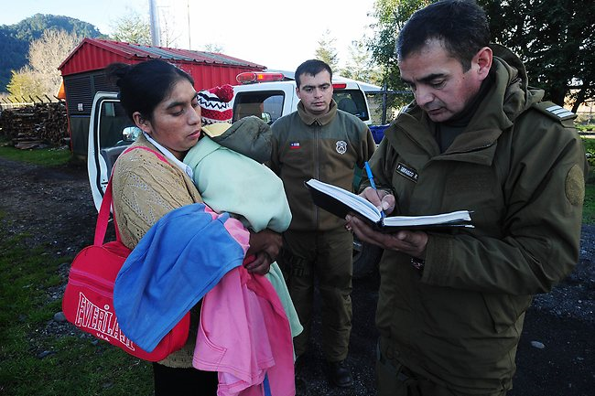
woman evacuated from the village of Rininahue

Slide 38
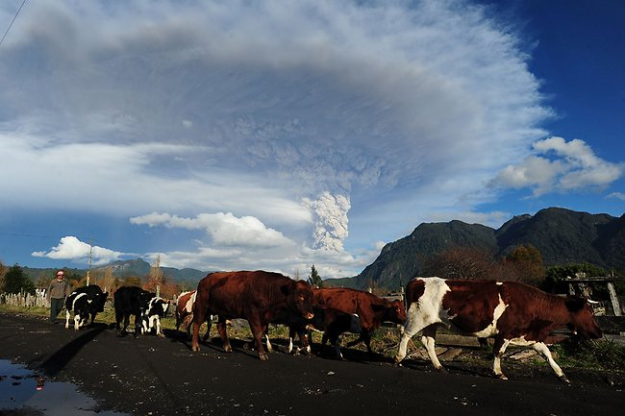
Pastoralist herding his cattle way from Rininahue

Slide 39
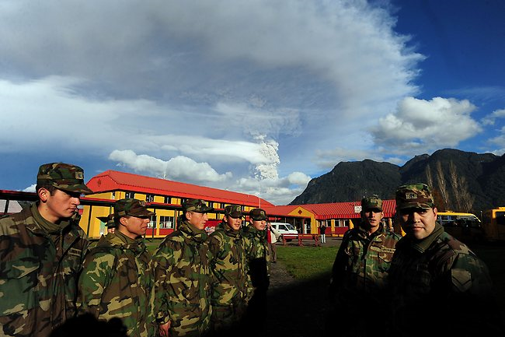
Soldiers in the village of Rininahue.

Slide 40
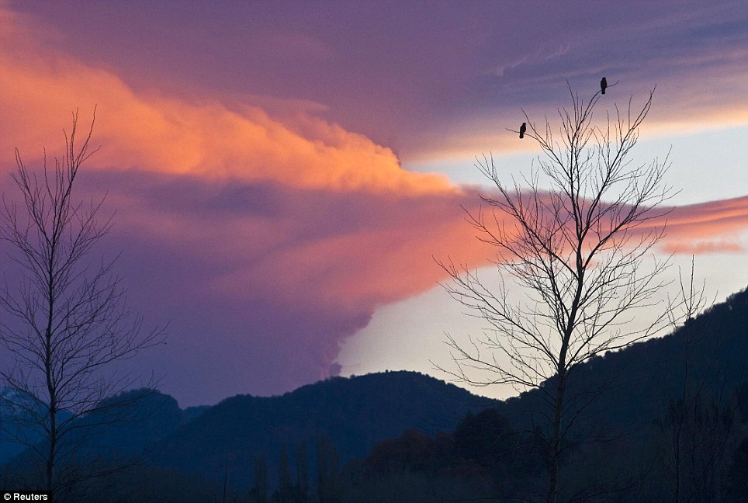
Beauty amid the horror

