Slide 1
Blue Holes

Slide 2
Blue Holes
A blue hole is a submarine cave or underwater sinkhole. They are also called vertical caves. There are many different blue holes located around the world, from Belize and the Bahamas to the Red Sea. Blue holes are roughly circular, steep-walled depressions, and so named for the dramatic contrast between the dark blue, deep waters of their depths and the lighter blue of the shallows around them.

Slide 3
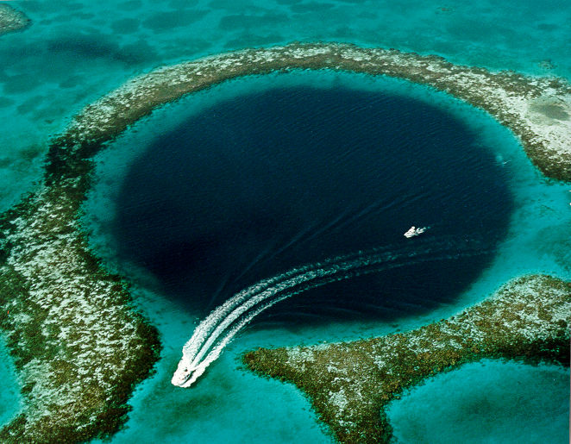
The Great Blue Hole, located near Ambergris Caye, Belize.

Slide 4
Their water circulation is poor, and they are commonly anoxic below a certain depth; this environment is unfavorable for most sea life, but nonetheless can support large numbers of bacteria. The deepest blue hole in the world—at 663 ft.—is Dean's Blue Hole, located in a bay west of Clarence Town on Long Island, Bahamas. Other blue holes are about half that depth at around 330–390 ft.

Slide 5
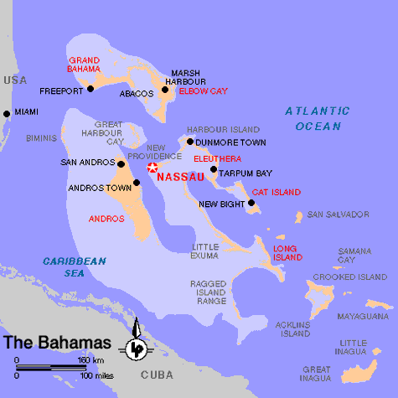

Slide 6
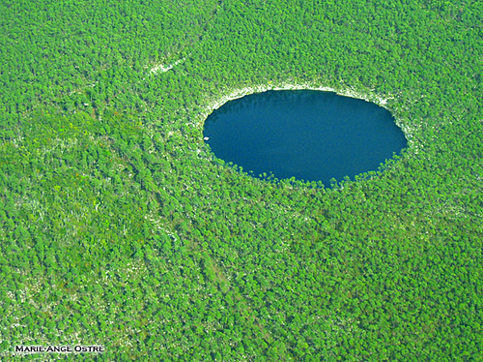
Blue holes in Andros island (Bahamas) are most appreciated by scuba divers

Slide 7
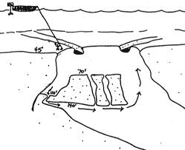
Diagram of a Blue Hole

Slide 8
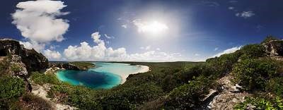

Slide 9
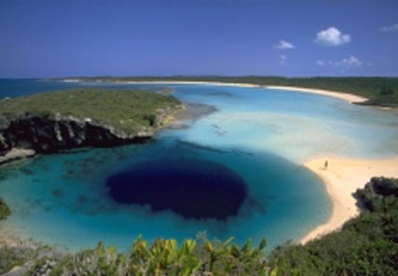

Slide 10
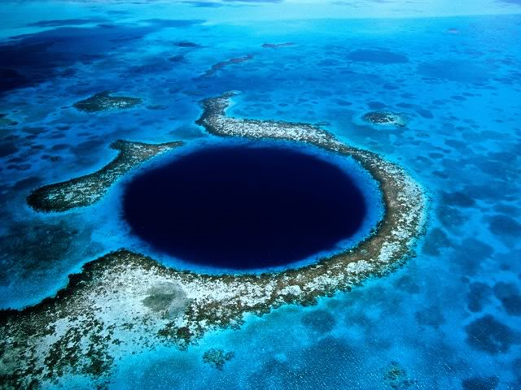

Slide 11
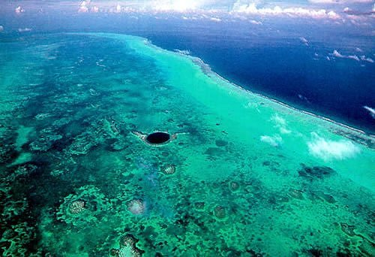

Slide 12
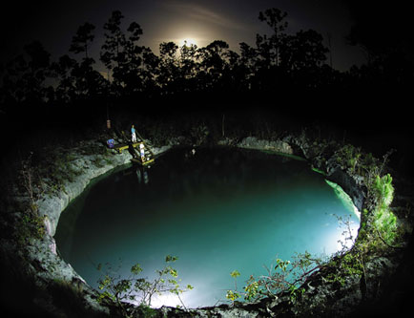

Slide 13
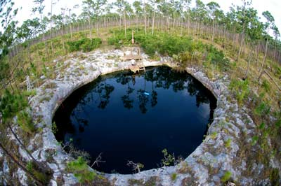

Slide 14
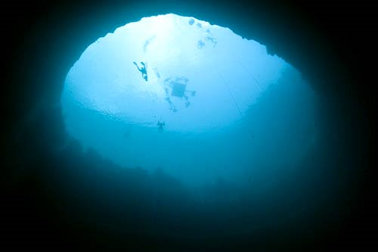
Photo from within a Blue Hole

Slide 15
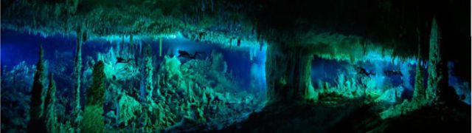
Underwater Cave System

Slide 16
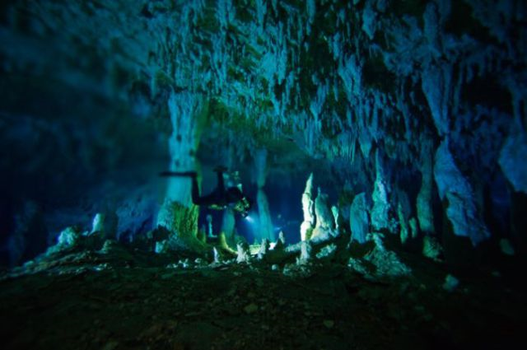

Slide 17
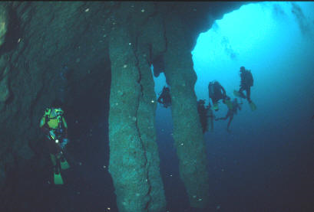

Slide 18
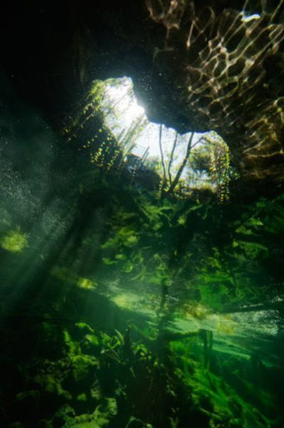
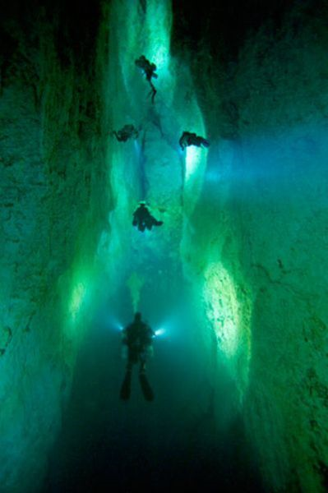

Slide 19
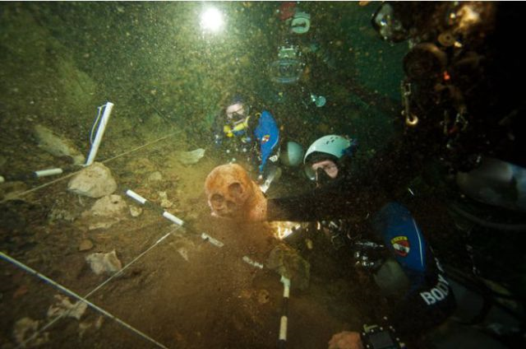
Underwater Archaeology

Slide 20
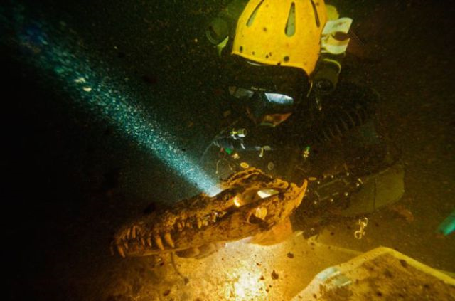

Slide 21
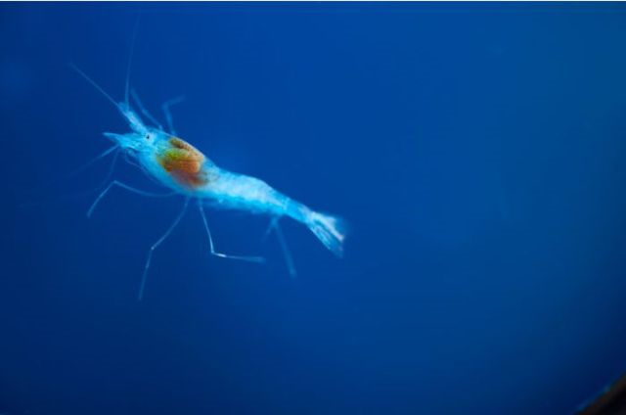
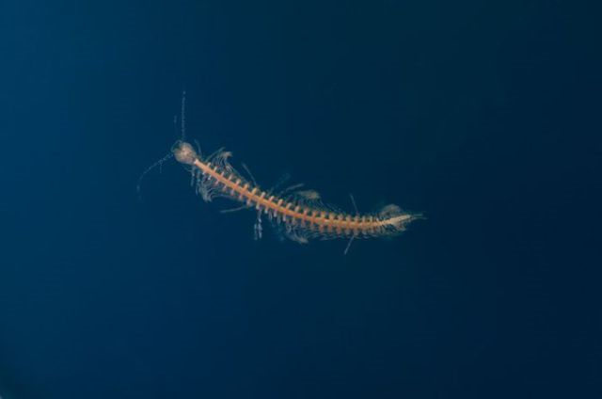
Life in a Blue Hole

Slide 22
