Slide 1
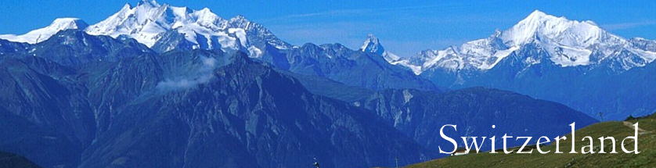
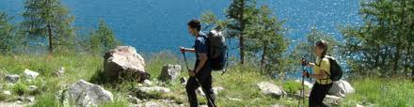
Alpine Mountains And Hiking Trails

Slide 2
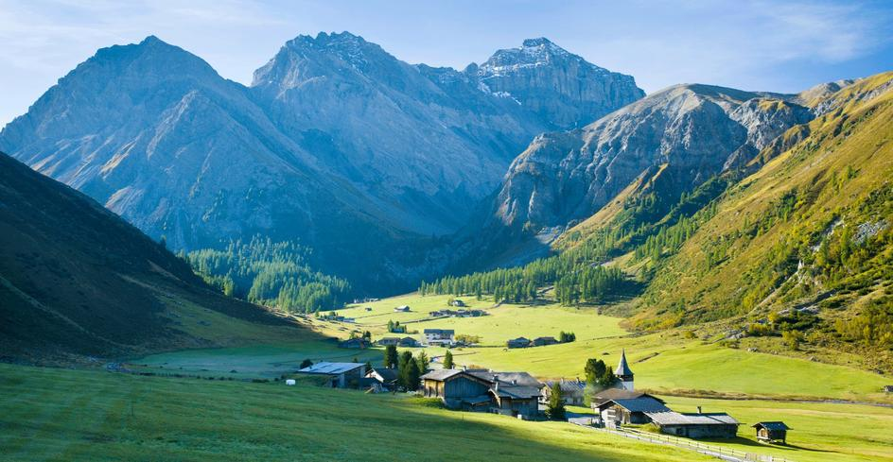
Hiking trails in Austria and Switzerland link old Walser herding villages. The settlers migrated to Sertig Valley in the 13th century.

Slide 3
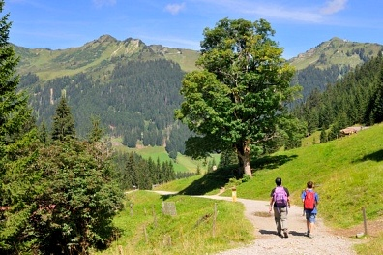

Slide 4
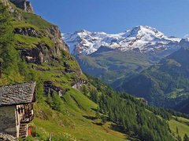
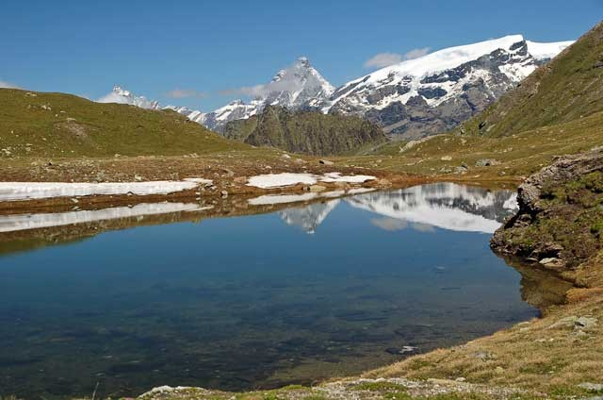
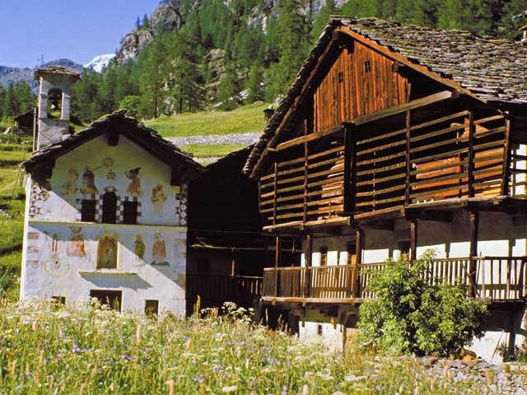

Slide 5
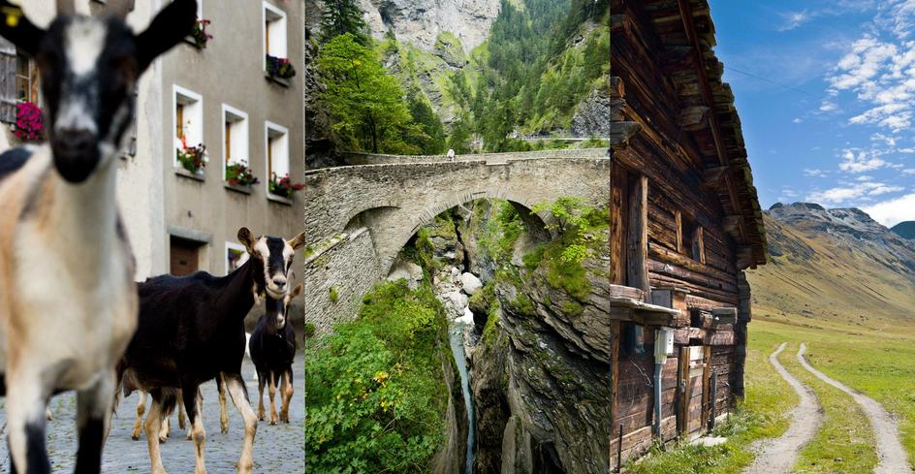
Twenty miles from Juf, the trail crosses a gorge known as Via Mala – the Evil Road (centre). Goats pass through Hinterrhein on their way to pasture (left). The last barn in Juf, Europe’s highest settlement (right).

Slide 6
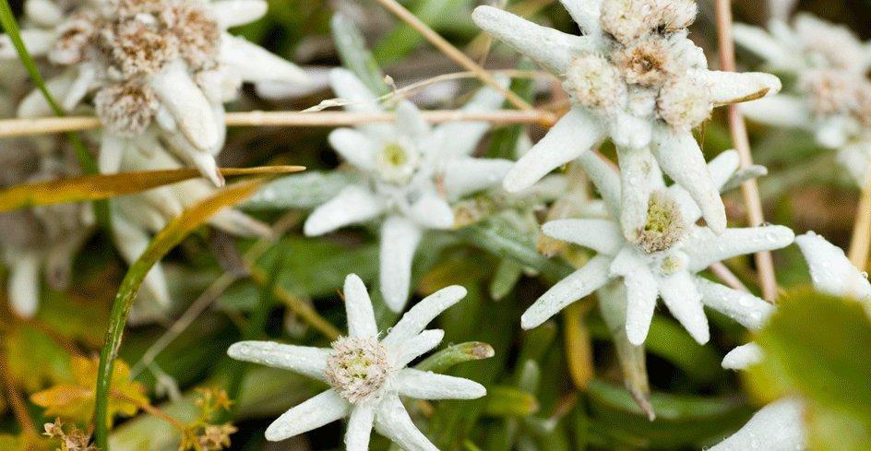
Edelweiss, curious white flowers rarely seen growing wild, prefer high altitude climates and can be found along the Walserweg.

Slide 7
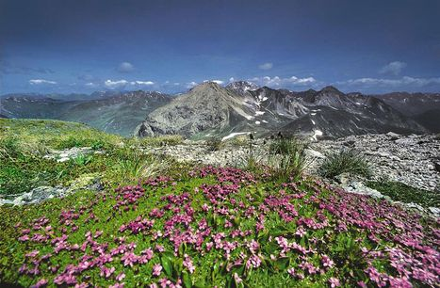

Slide 8
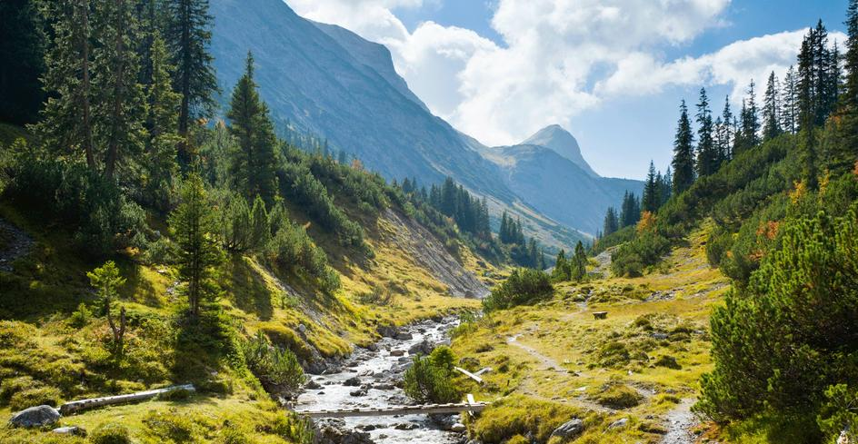
The headwaters of the River Lech, after which the village along the trail is named.

Slide 9
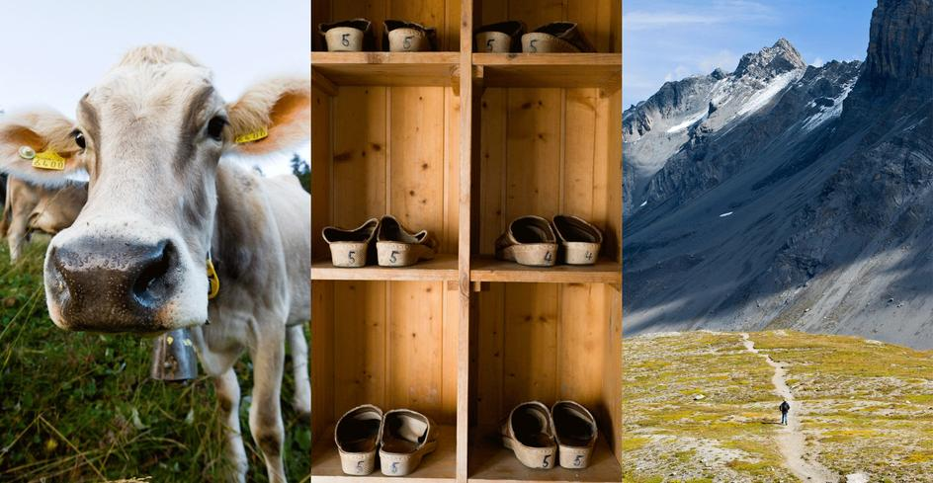
Swap hiking boots for slippers when you enter a mountain hut (centre). The Ducantal Valley, on the walk to Sertig (right).

Slide 10
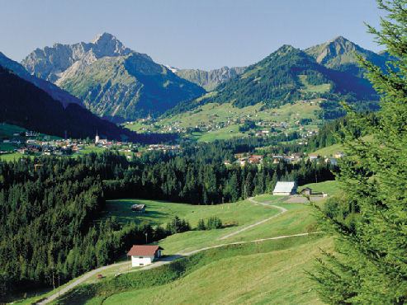

Slide 11
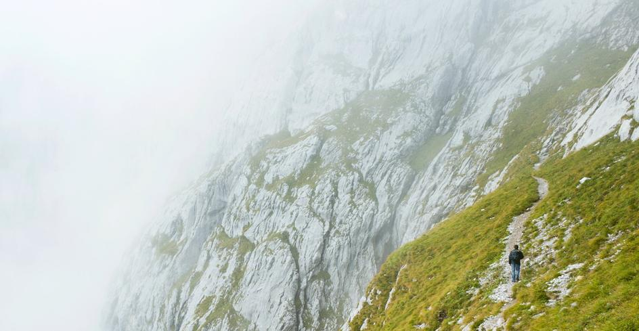
The walk up to the Schweizertor (“The gate of Switzerland”) is one of the most challenging stretches of the Walserweg.

Slide 12
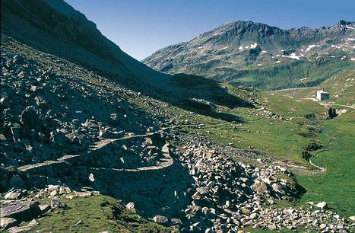

Slide 13
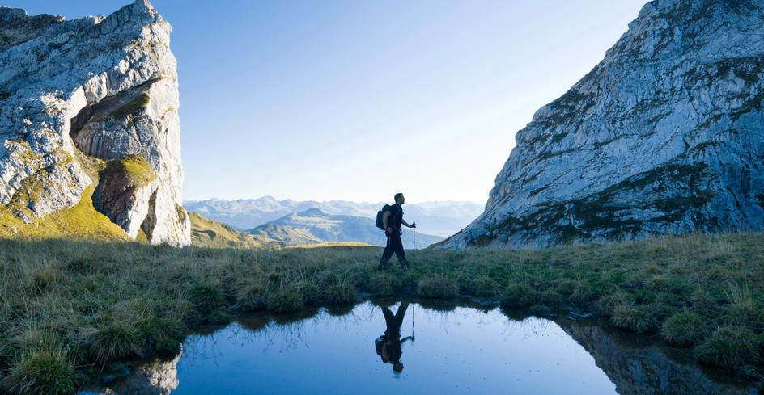
The border between Austria and Switzerland runs along the Schweizertor pass.

Slide 14
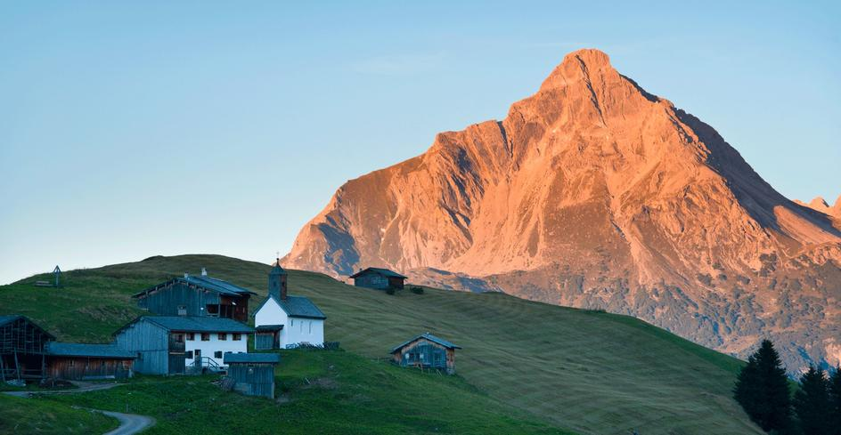
The Biberkopf forms the backdrop to the final stop on the Walser’s path.

Slide 15
