Slide 1
Brides – Cultural Reflections & Globalization

Slide 2
Reflection of Culture
Traditionally, different cultures had different concepts of the appropriate dress for weddings, particularly for the brides. The dress of brides varied in color and style, usually reflecting that culture’s concept of beauty and purity. In the 20th century, the influence of European/American wedding dress could be seen in other cultures - globalization.

Slide 3
Indian Brides

Slide 4
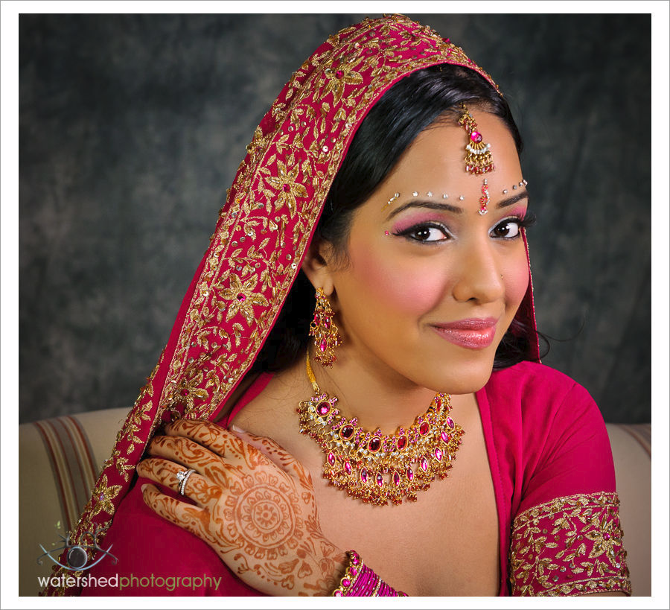

Slide 5
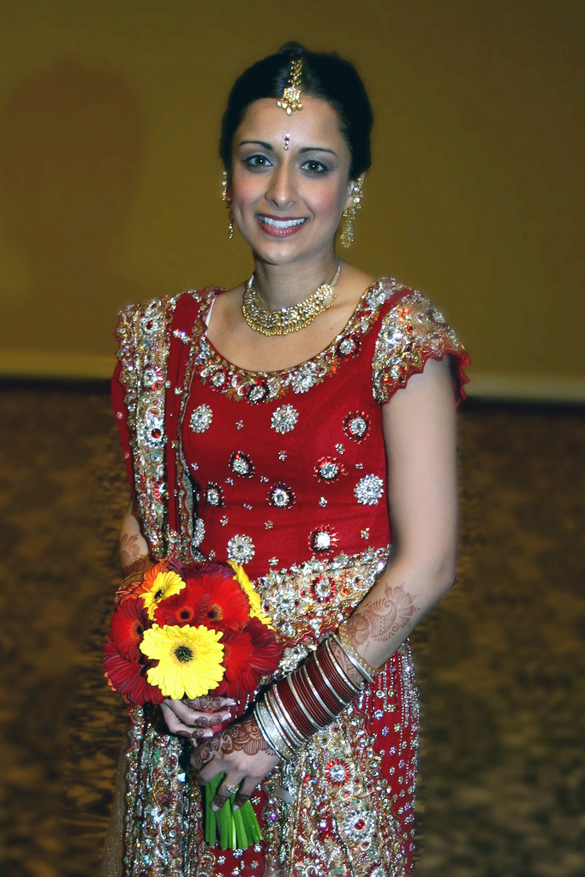

Slide 6
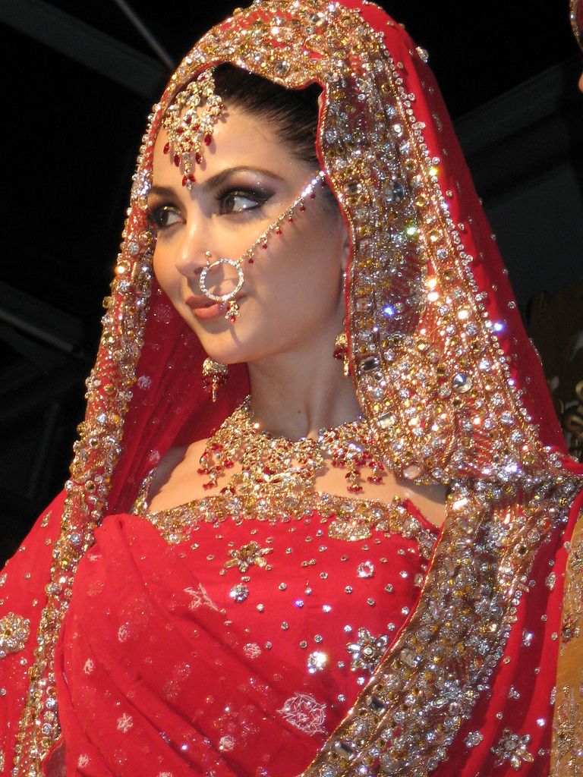

Slide 7
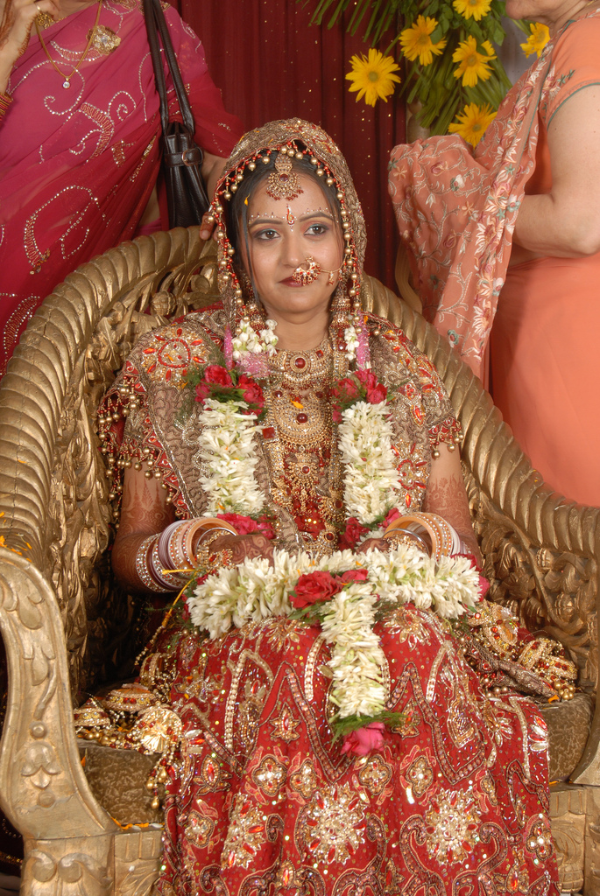

Slide 8
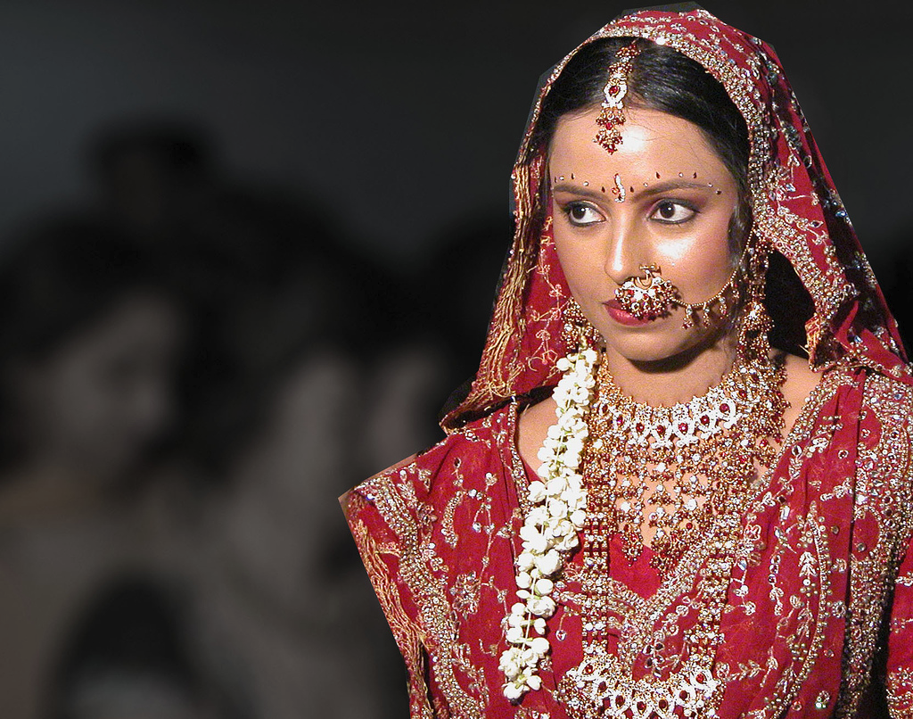

Slide 9
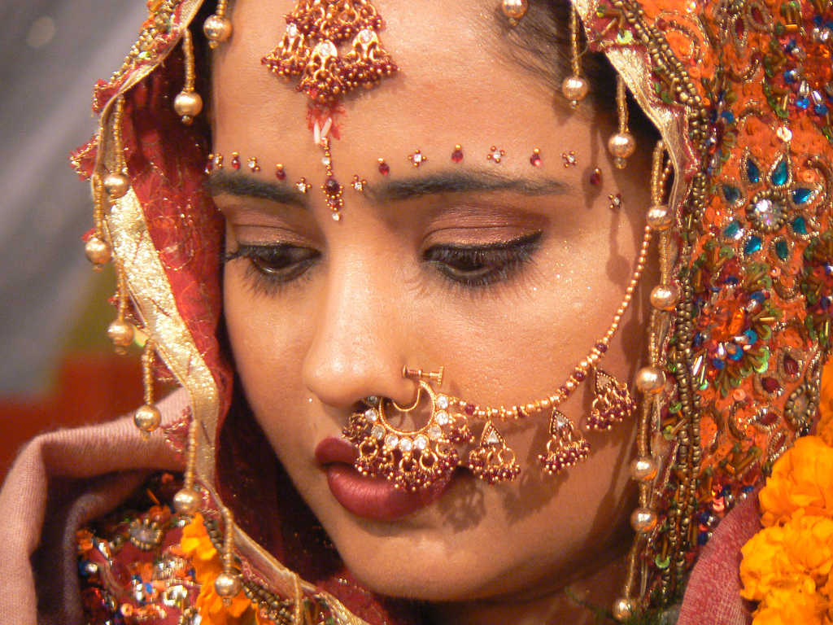

Slide 10
Asian brides

Slide 11
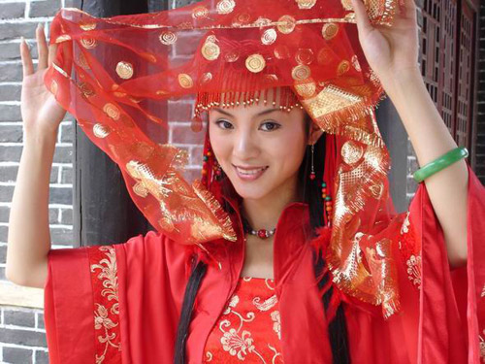
China

Slide 12
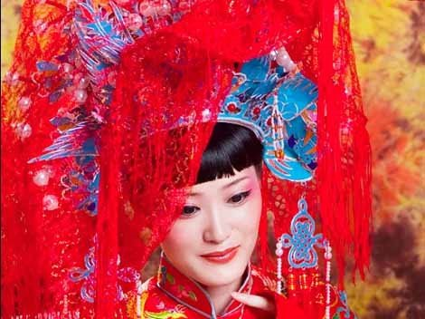

Slide 13
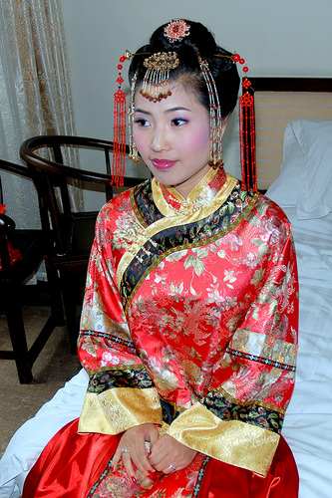

Slide 14
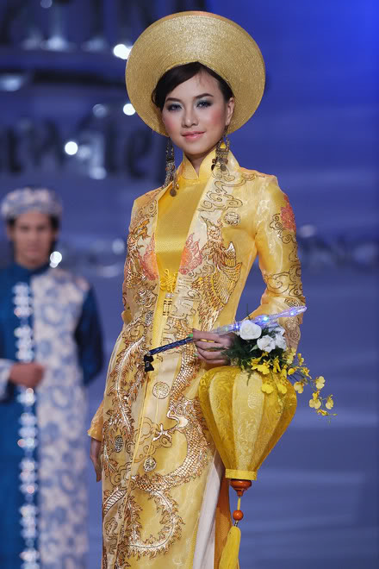
Vietnam

Slide 15
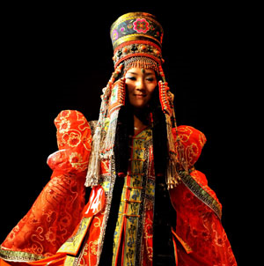
Mongolia

Slide 16
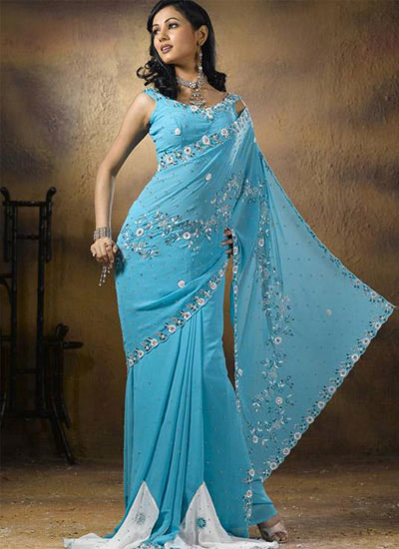
Thailand

Slide 17
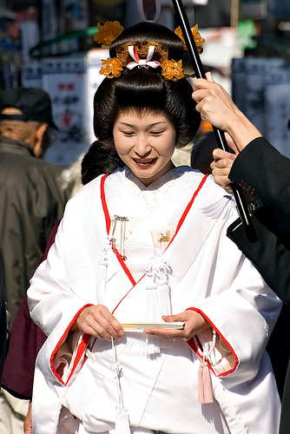
Japan

Slide 18
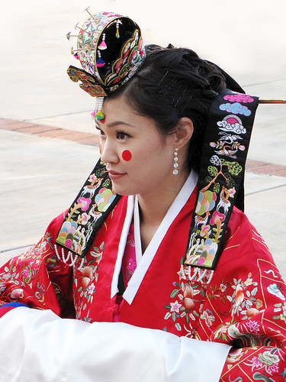
Korea

Slide 19
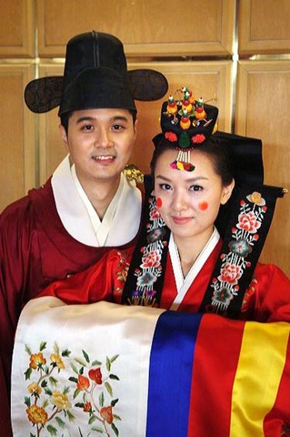

Slide 20
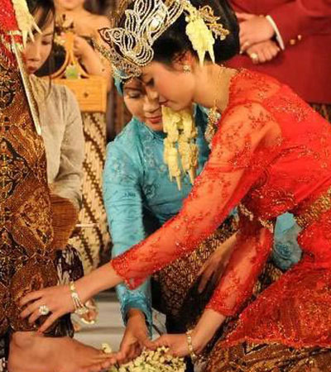
Indonesia

Slide 21
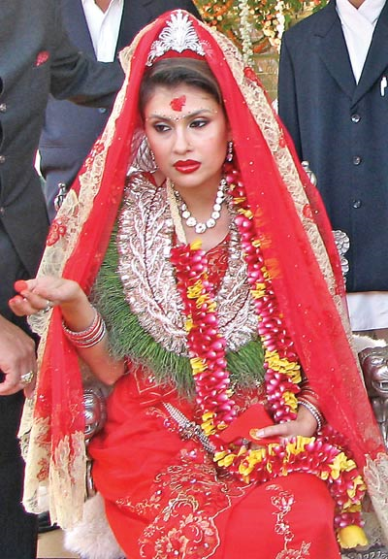
Nepal

Slide 22
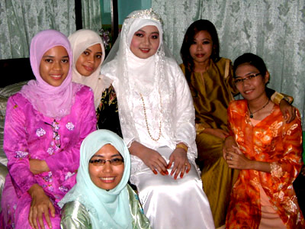
Malaysia

Slide 23
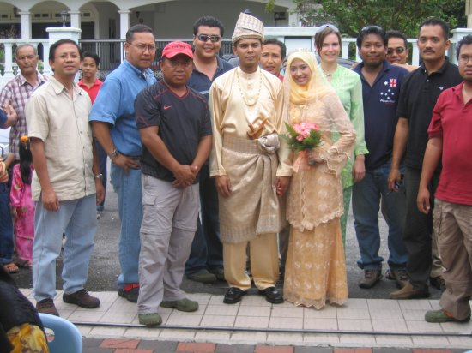

Slide 24
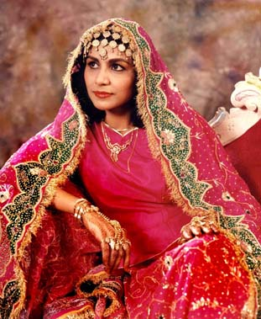
Turkey

Slide 25
African brides

Slide 26
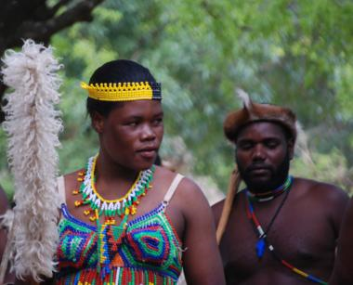
Zulu bride – South Africa

Slide 27
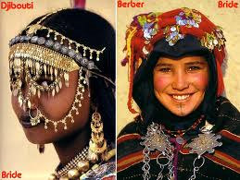
Sudan

Slide 28
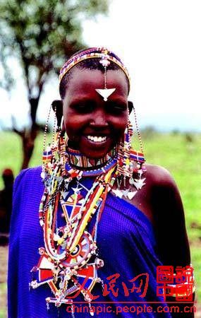
Kenya

Slide 29
Other places

Slide 30
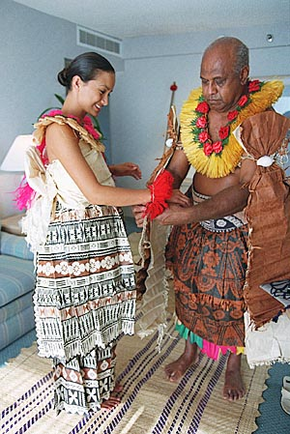
Fiji

Slide 31
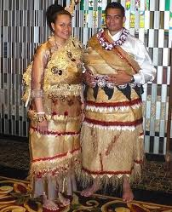
Samoa

Slide 32
“Western” brides

Slide 33

USA

Slide 34
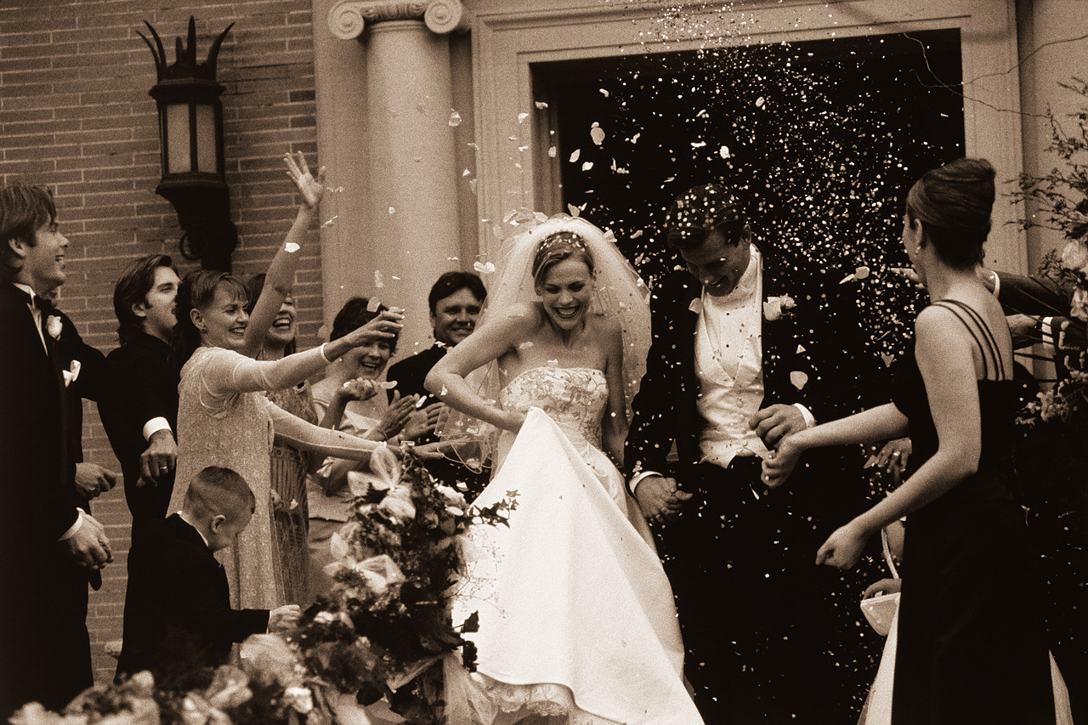
USA

Slide 35

Italy

Slide 36
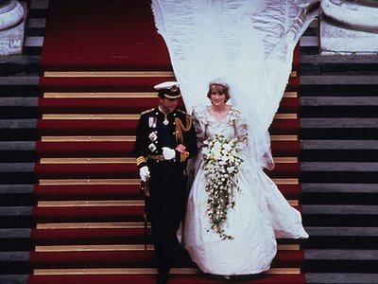
United Kingdom

Slide 37
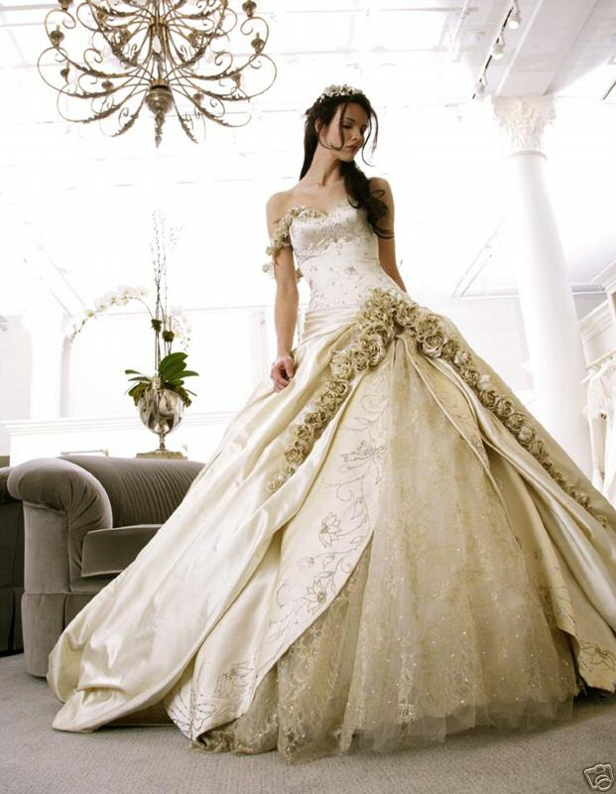
Europe

Slide 38
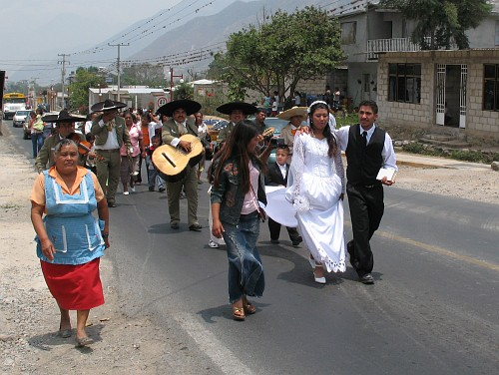
Mexico

Slide 39
globalization
Western Influences

Slide 40
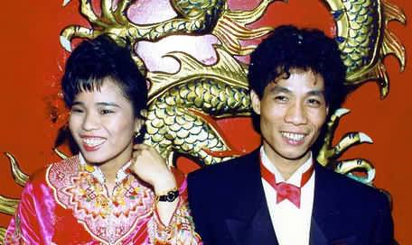
China: Groom’s dress

Slide 41
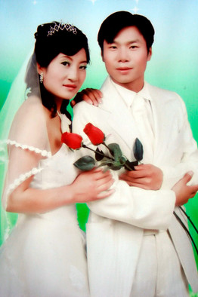
China: Bride & Groom

Slide 42
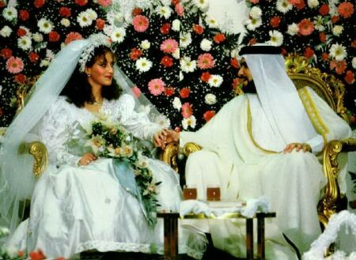
Saudi Arabia

Slide 43
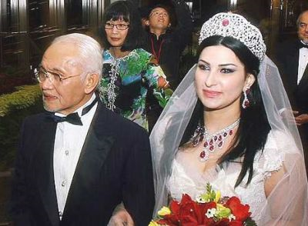
Malaysia

Slide 44
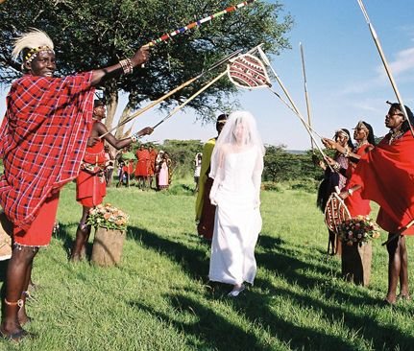
Masai in Kenya

Slide 45
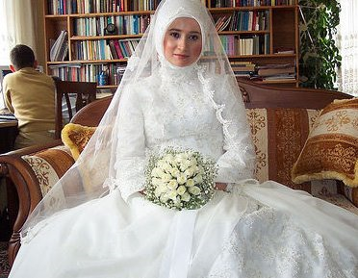
Turkey

