Slide 1
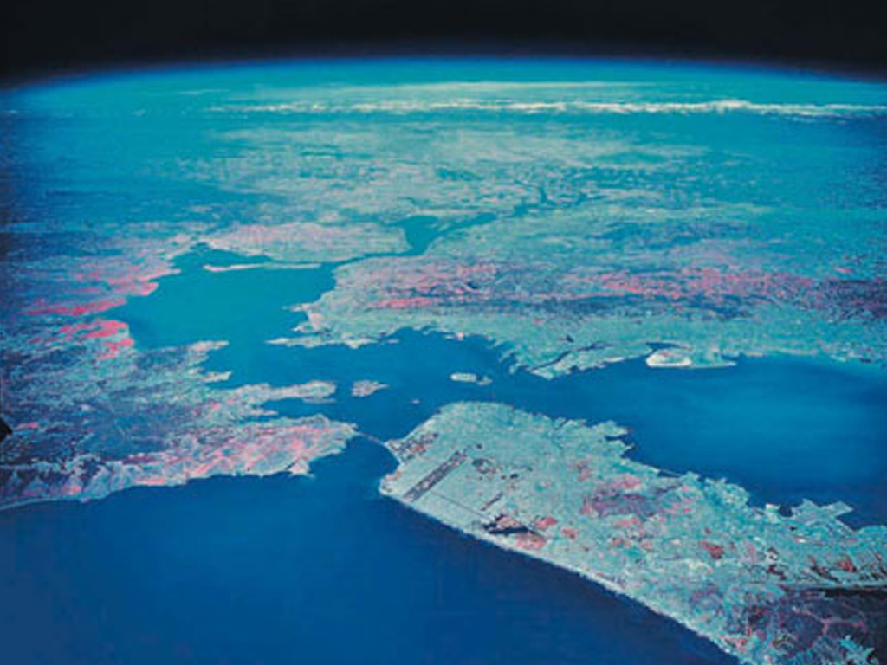
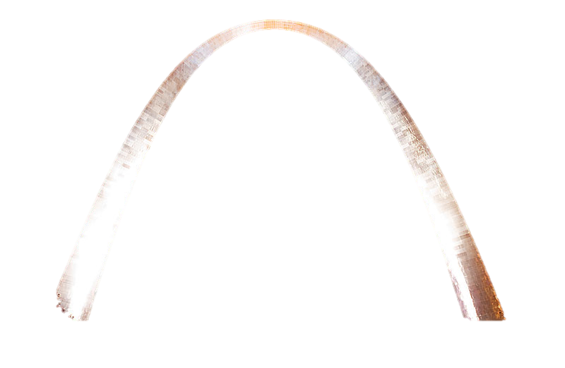
Landmarks and Relative Location

Slide 2
World-wide Recognition
When a natural or man-made feature of the earth is widely recognized beyond the place of its origin the sight of that feature or the mention of it causes this reaction in most educated people:
I know the city where that is located . . .
I know the country where that is located . . .
I know the region where that is located . . .

Slide 3
A few examples
The “Arch” in St. Louis, Missouri in the U.S.A.
The “Great Wall” in China
The “Grand Canyon” in the U.S. Southwest
St. Peter’s Basilica in Vatican City
The Colosseum in Rome, Italy
Now, let us view some . . . . . . .

Slide 4
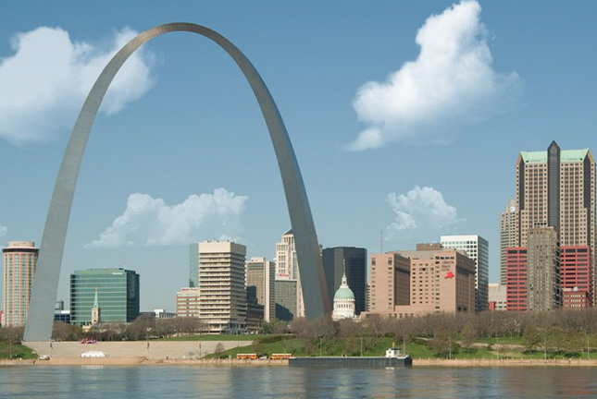

Slide 5
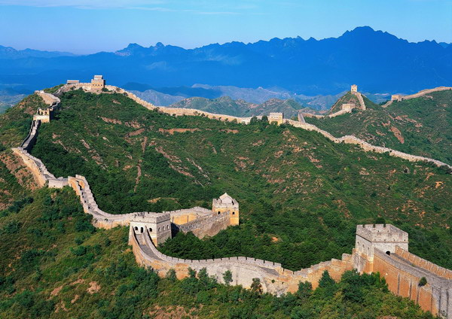

Slide 6
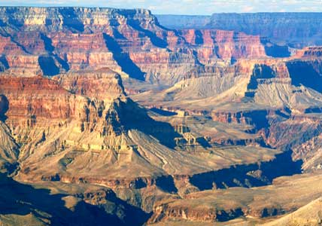

Slide 7
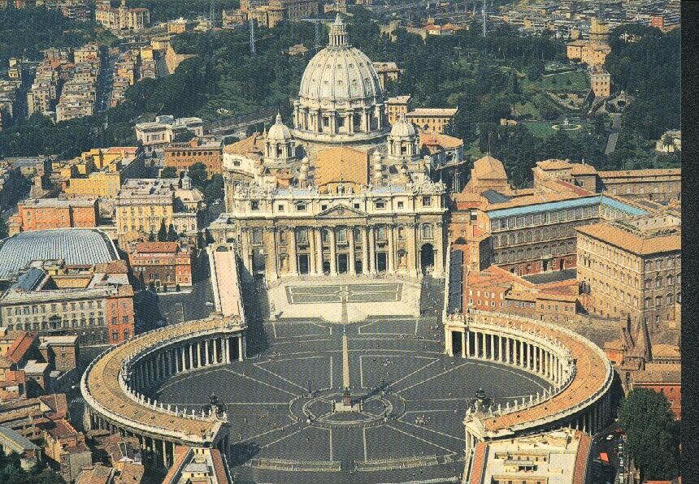

Slide 8
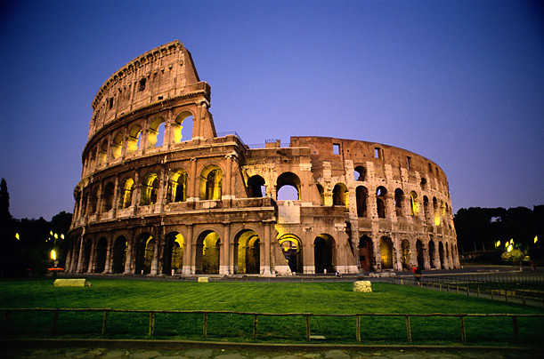

Slide 9
Other examples

Slide 10
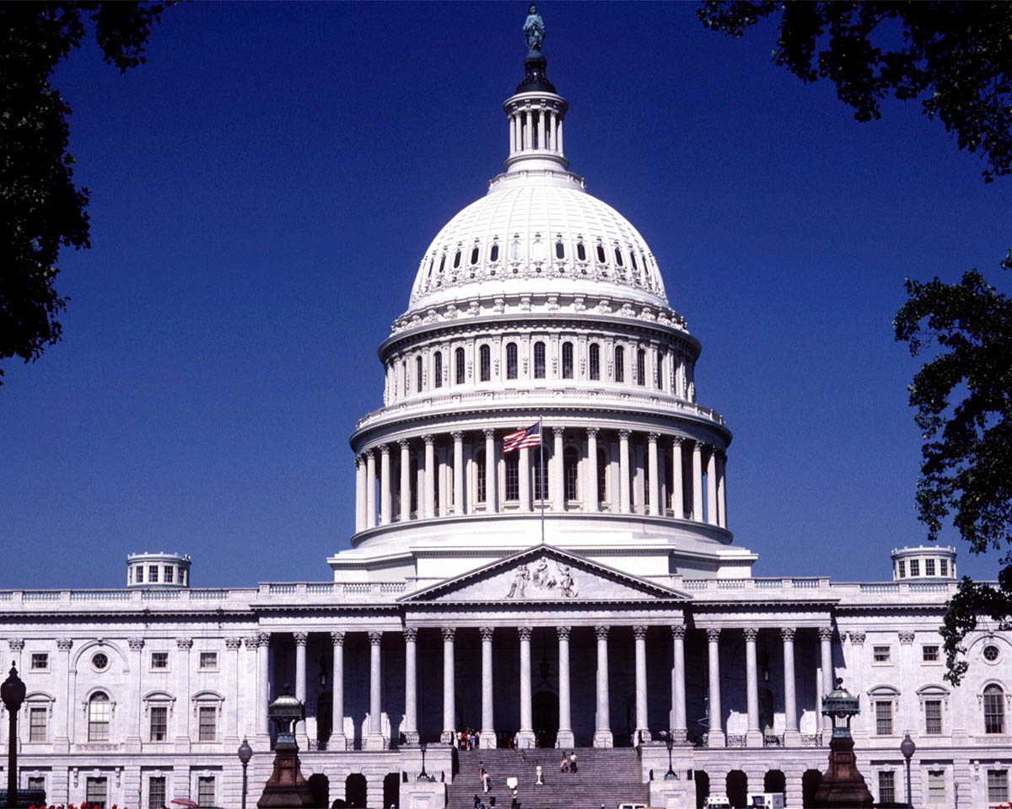
U.S. Capital Building, Washington, D.C.

Slide 11
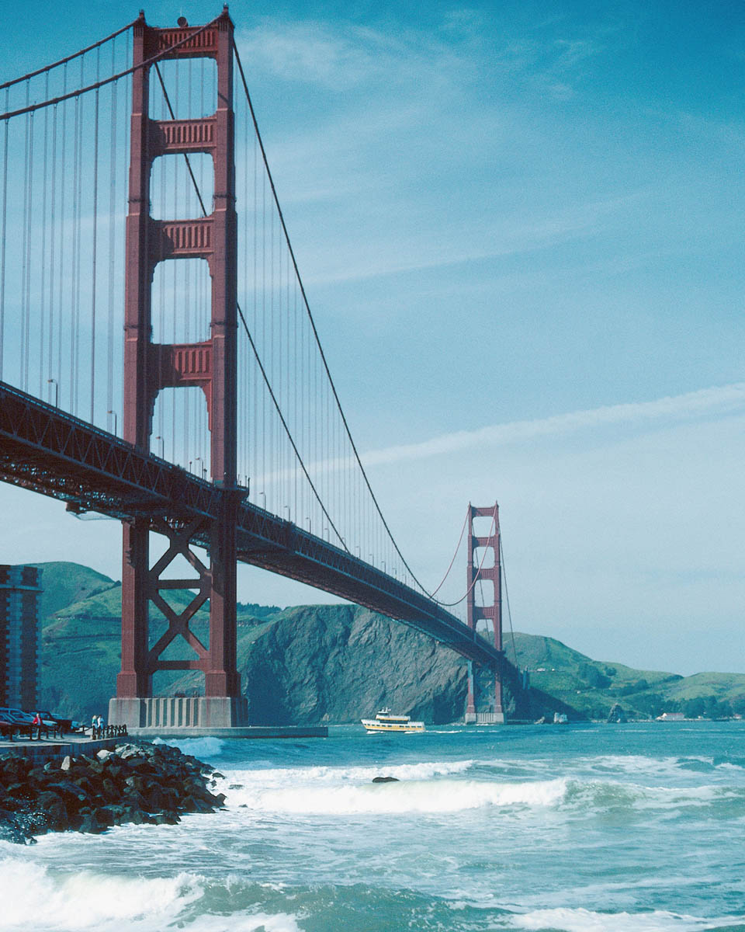
Golden Gate Bridge in San Francisco, California in the U.S.A.

Slide 12
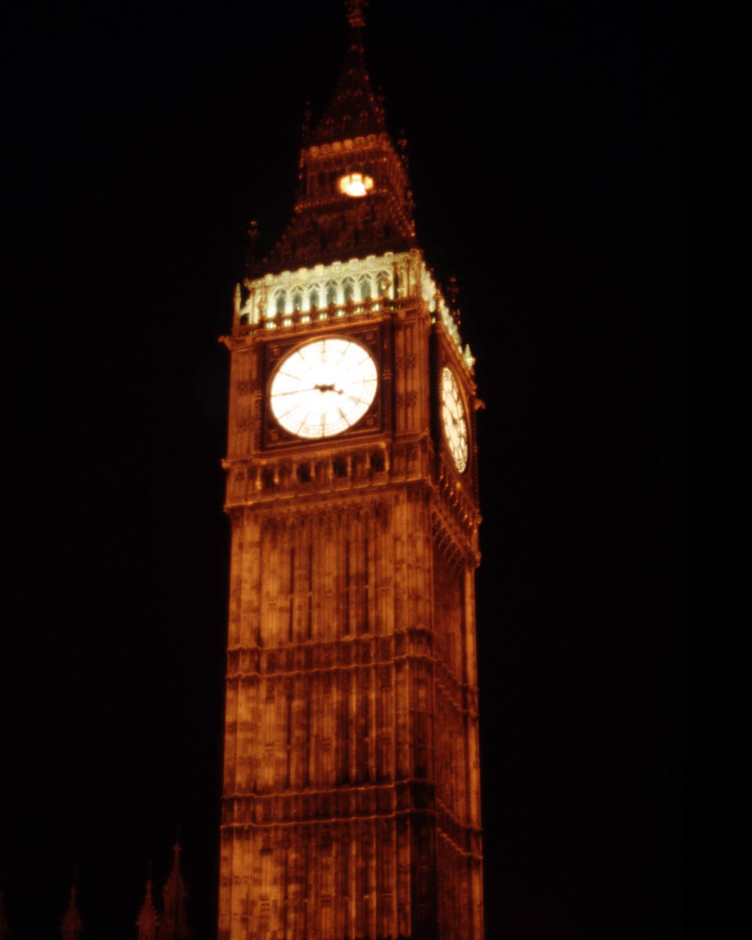
Big Ben in London, UK

Slide 13
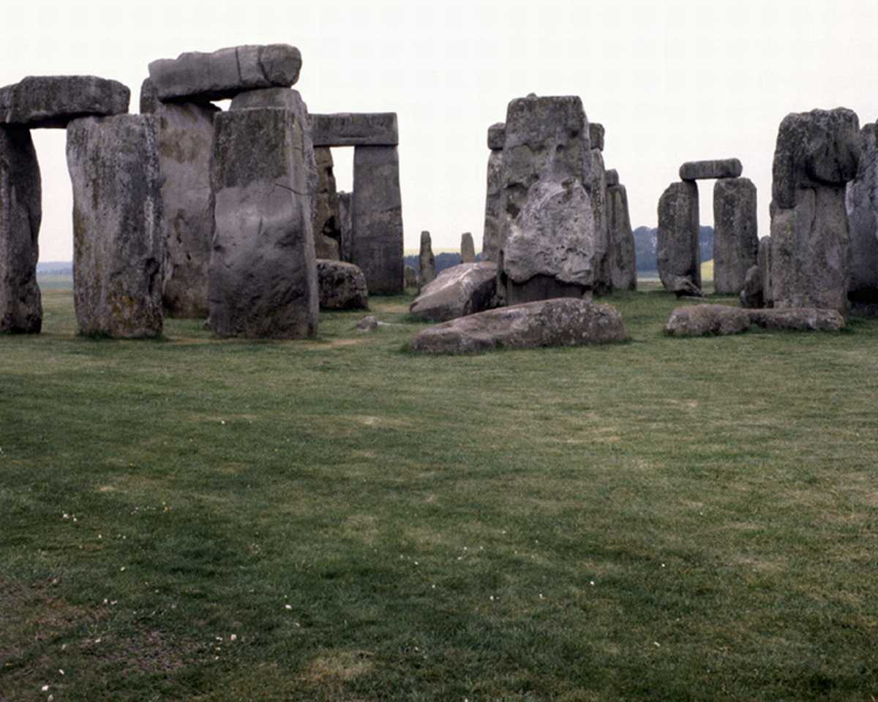
Stonehenge, UK

Slide 14
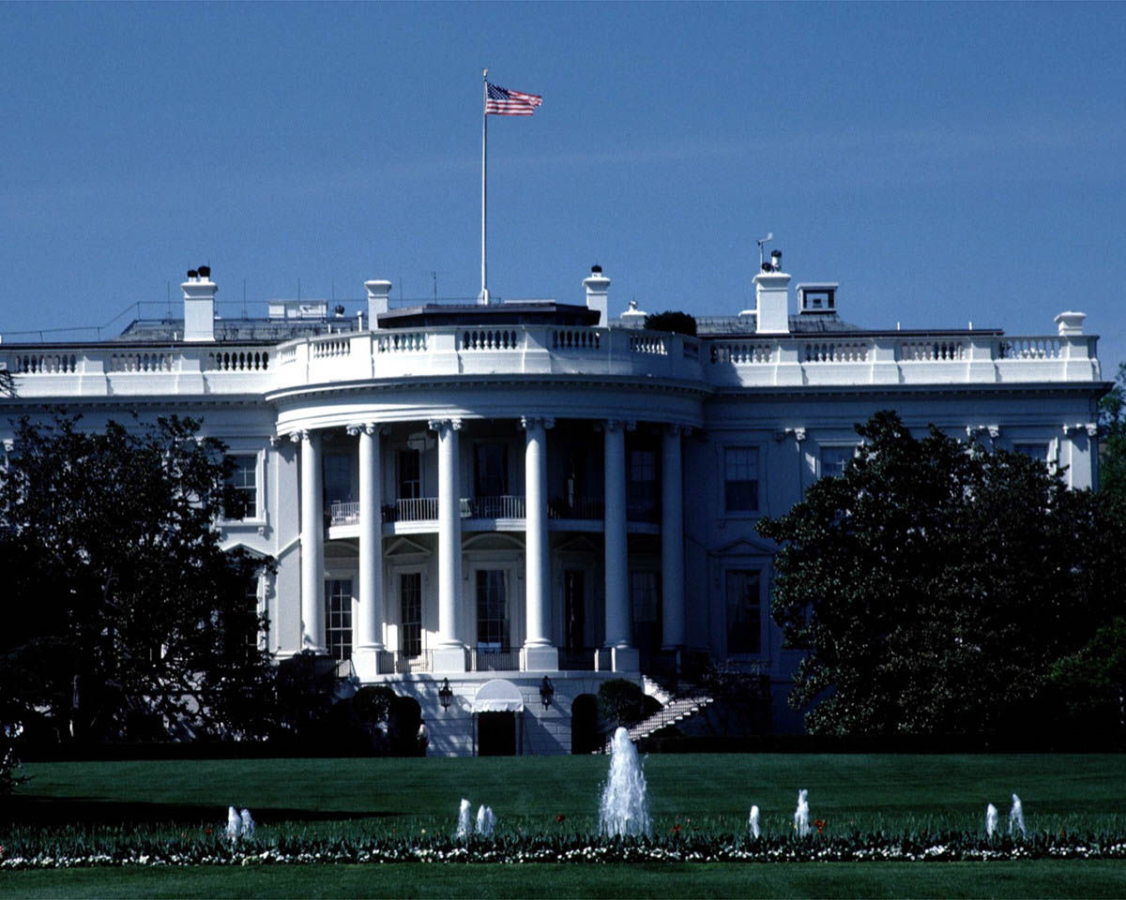
The White House in Washington, D.C.

Slide 15
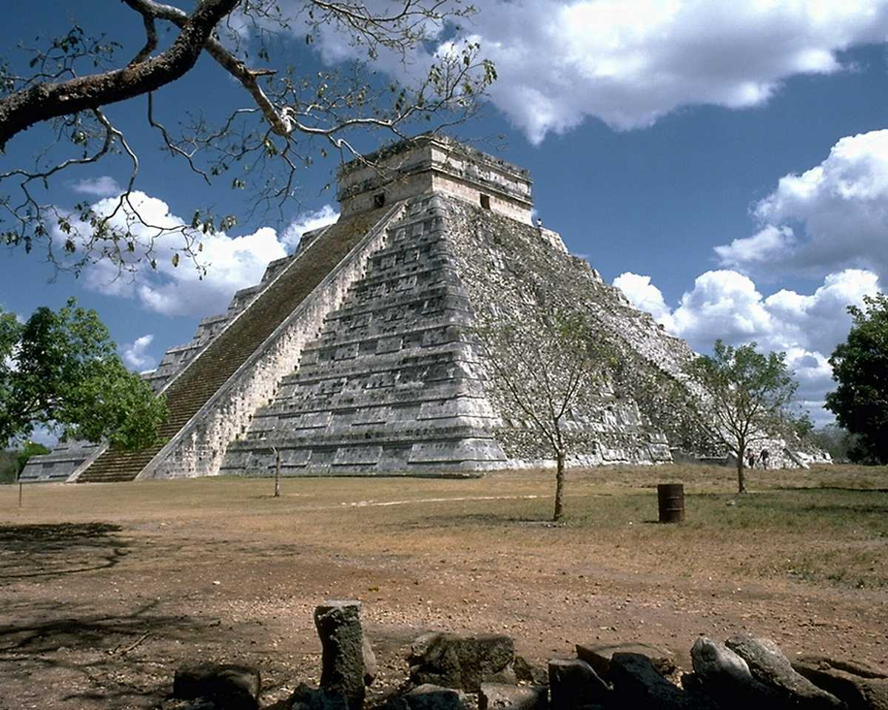
Chitzen Itza in Mexico

Slide 16
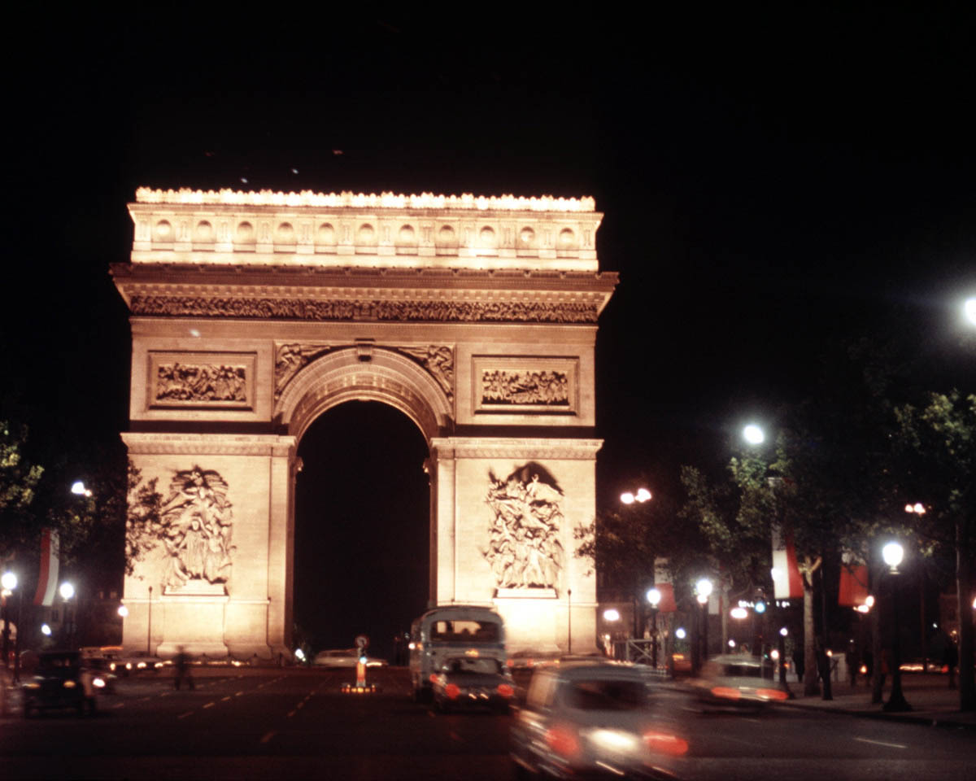
Arc de Triomphe in Paris, France

Slide 17
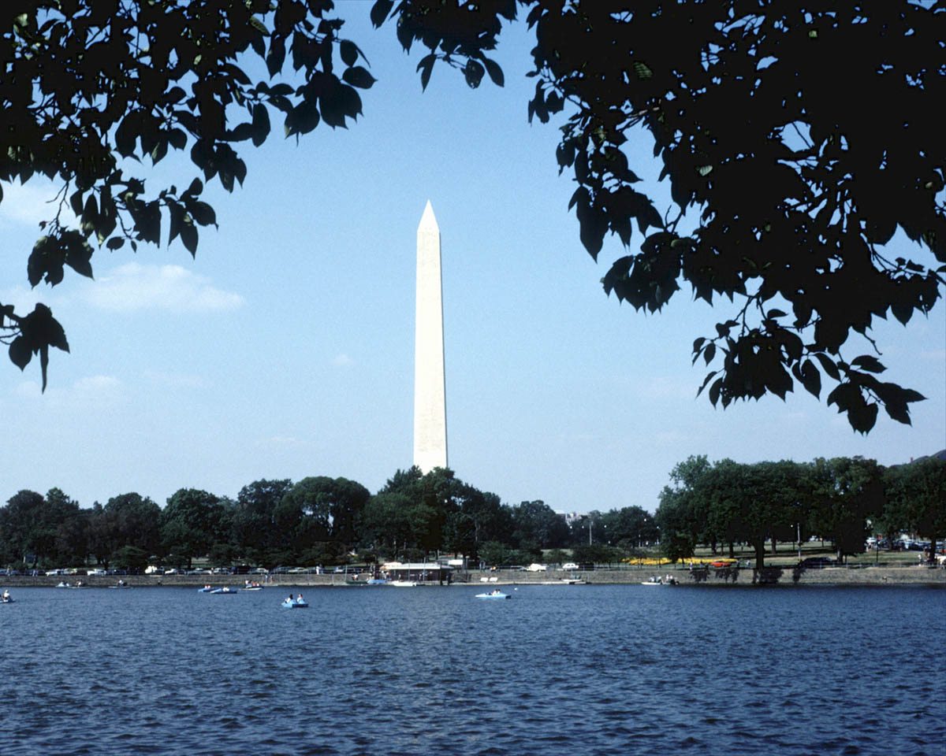
Washington Monument, Washington, D.C.

Slide 18
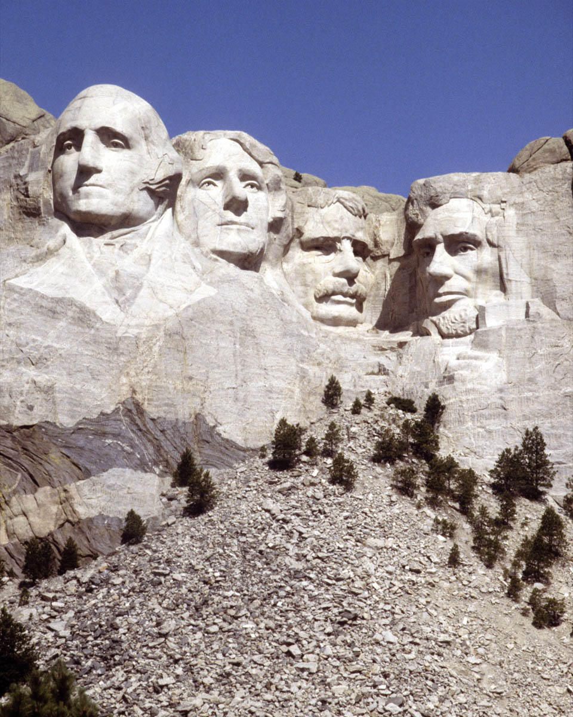
Mt. Rushmore, U.S.A.

Slide 19
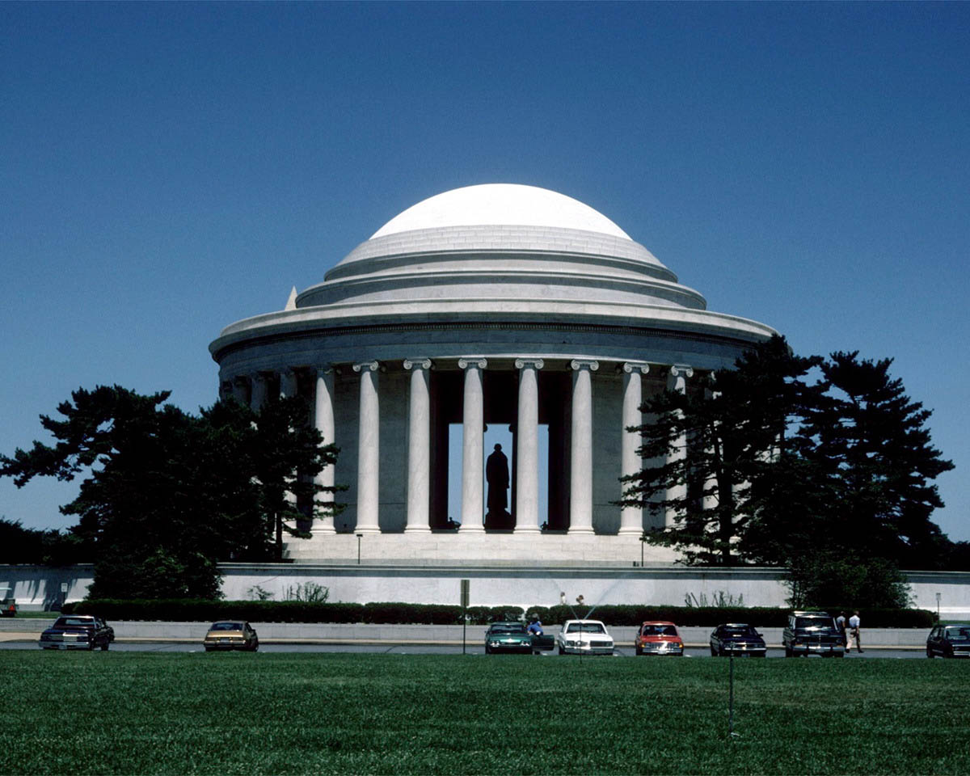
Jefferson Memorial, Washington, D.C.

Slide 20
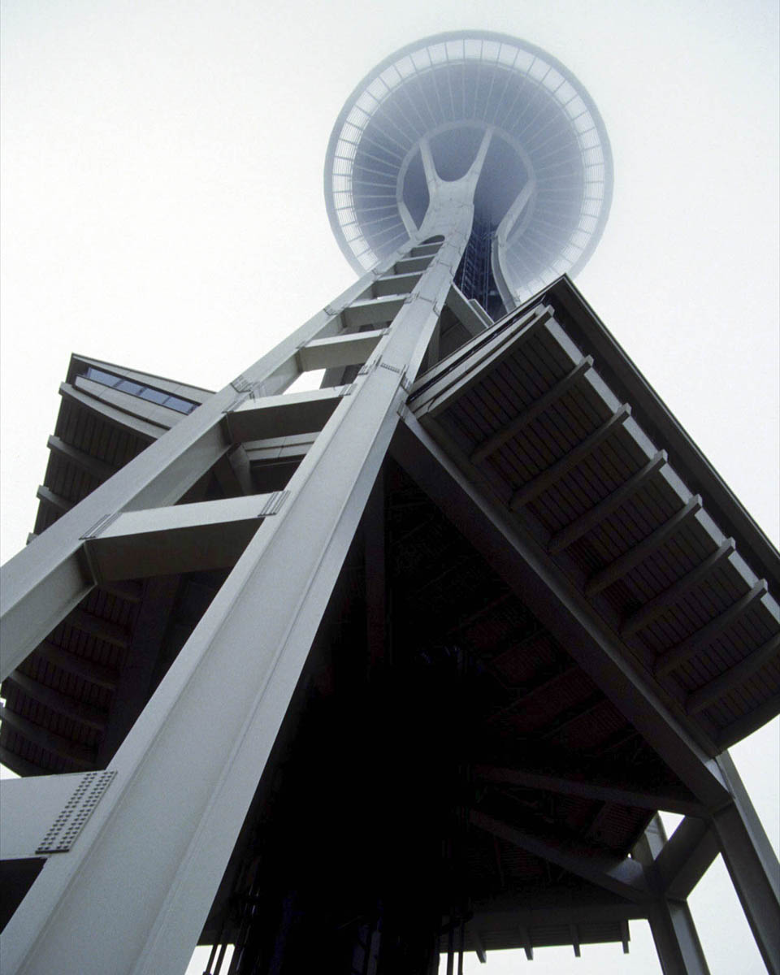
Space Needle in Seattle, Washington – U.S.A.

Slide 21
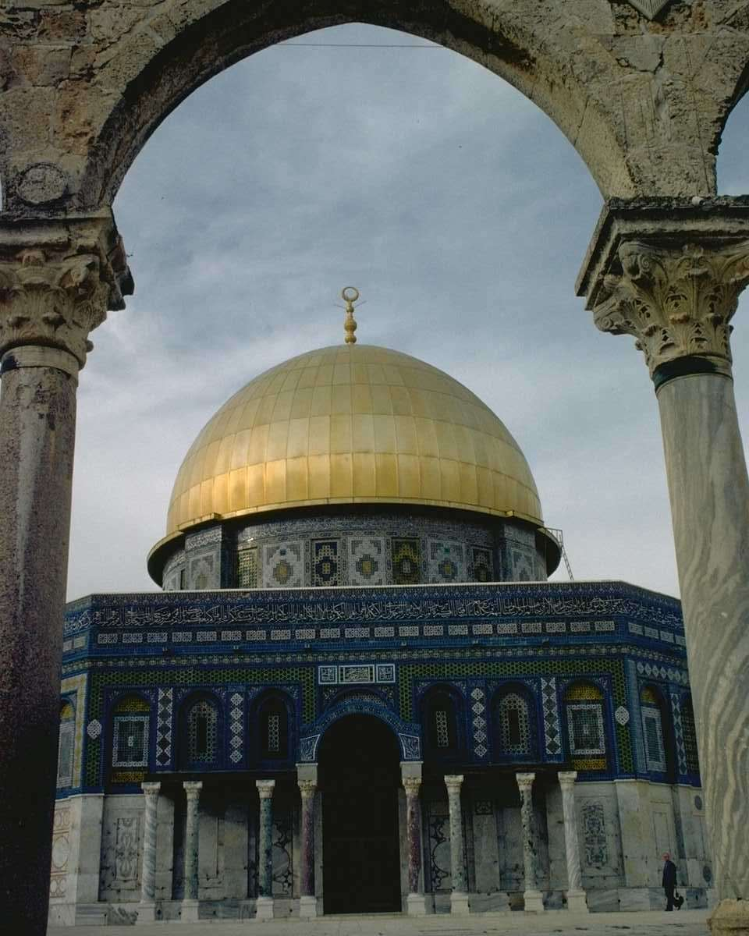
The Dome of the Rock in Jerusalem

Slide 22
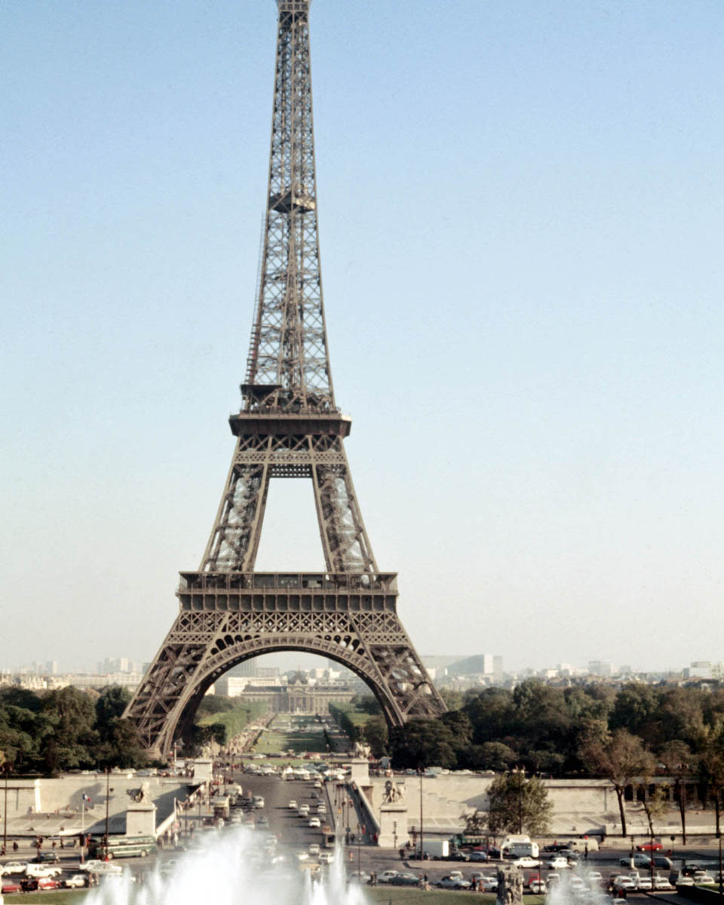
Eifel Tower in Paris, France

Slide 23
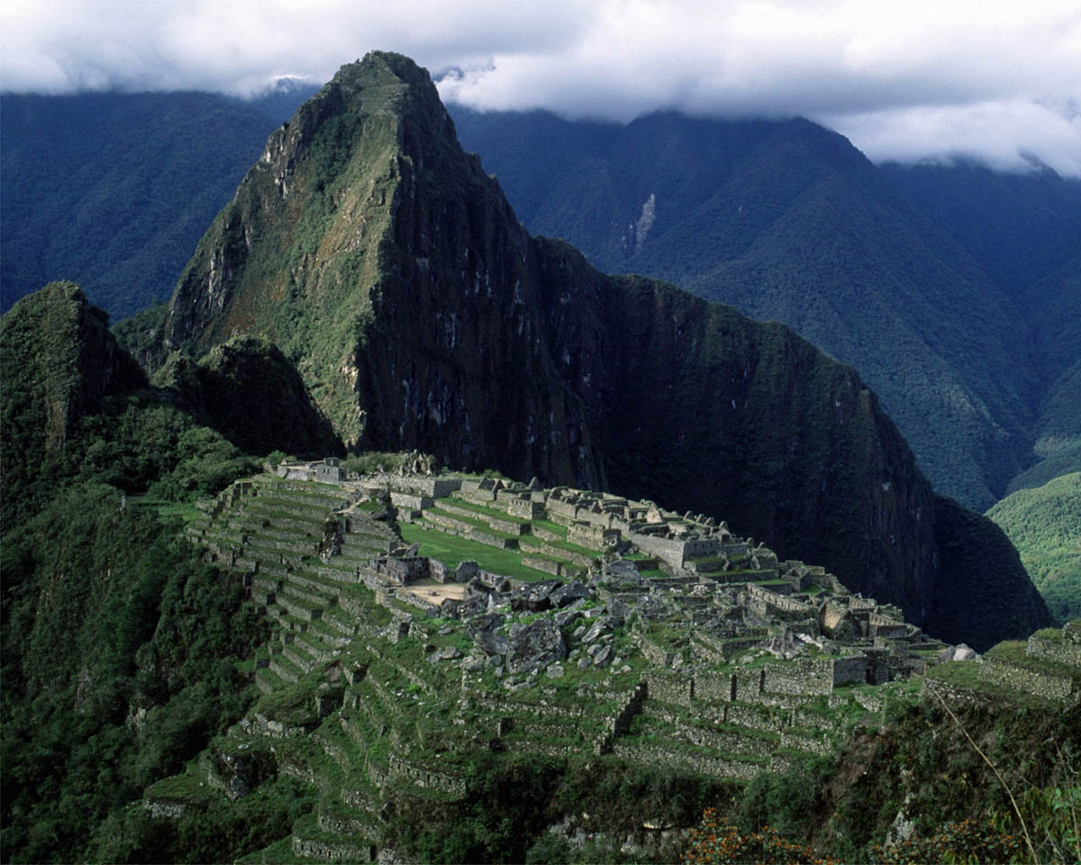
Machu Picchu, Peru

Slide 24
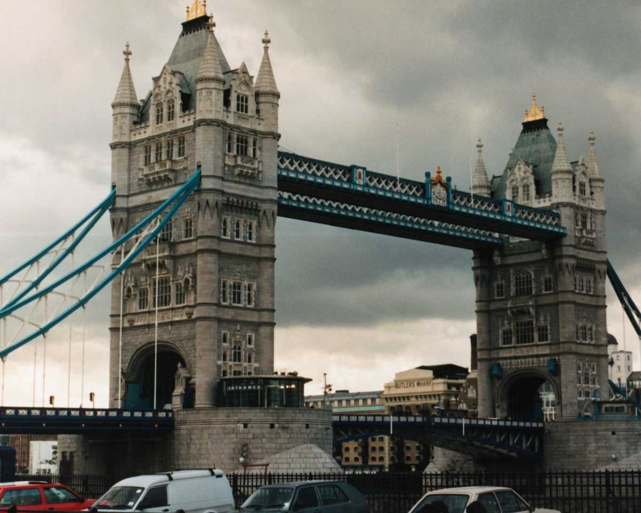
Tower Bridge, London, UK

Slide 25
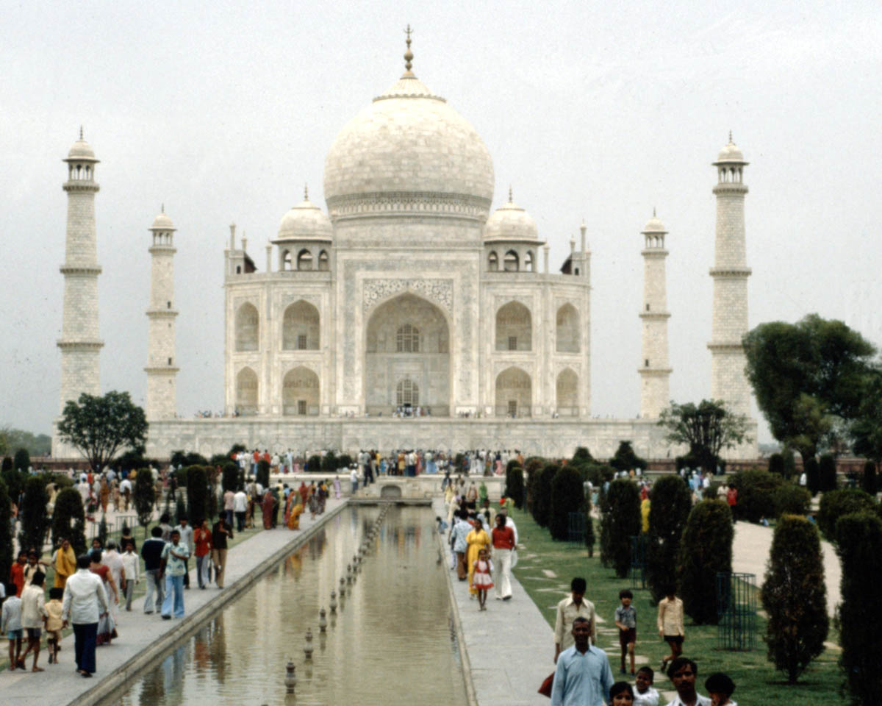
Taj Mahal, India

Slide 26
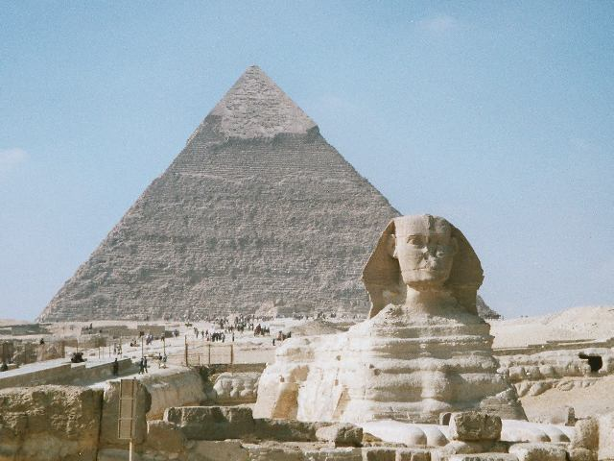
Sphinx and Pyramid, Egypt

Slide 27
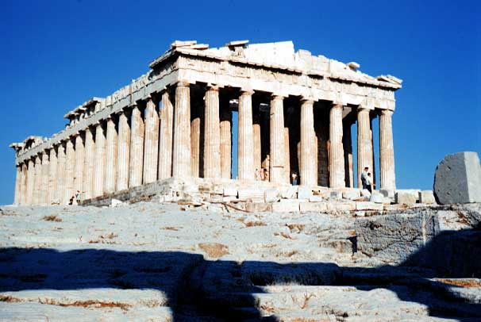
Parthenon in Athens, Greecde

Slide 28
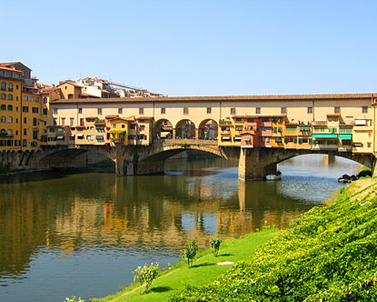
Ponte Vecchio in Florence, Italy

Slide 29
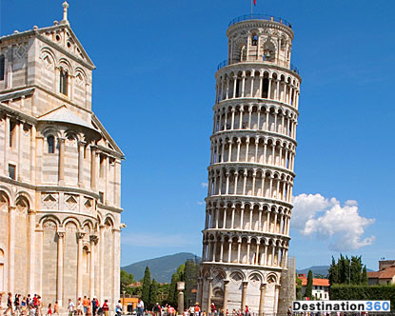
Leaning Tower of Pisa in Pisa, Italy

Slide 30
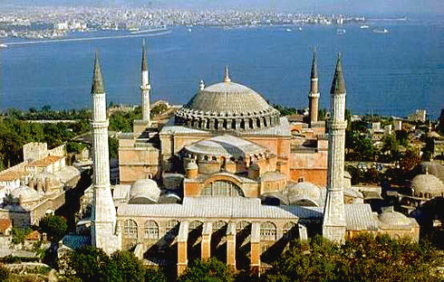
Hagia Sophia, Istanbul, Turkey

Slide 31
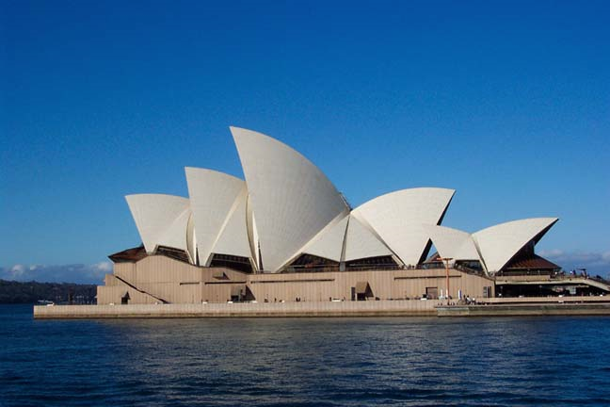
Sydney Opera House, Sydney, Australia

Slide 32
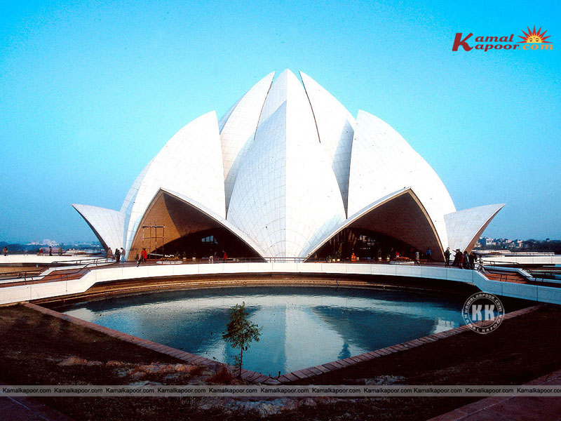
Lotus Temple, India

Slide 33
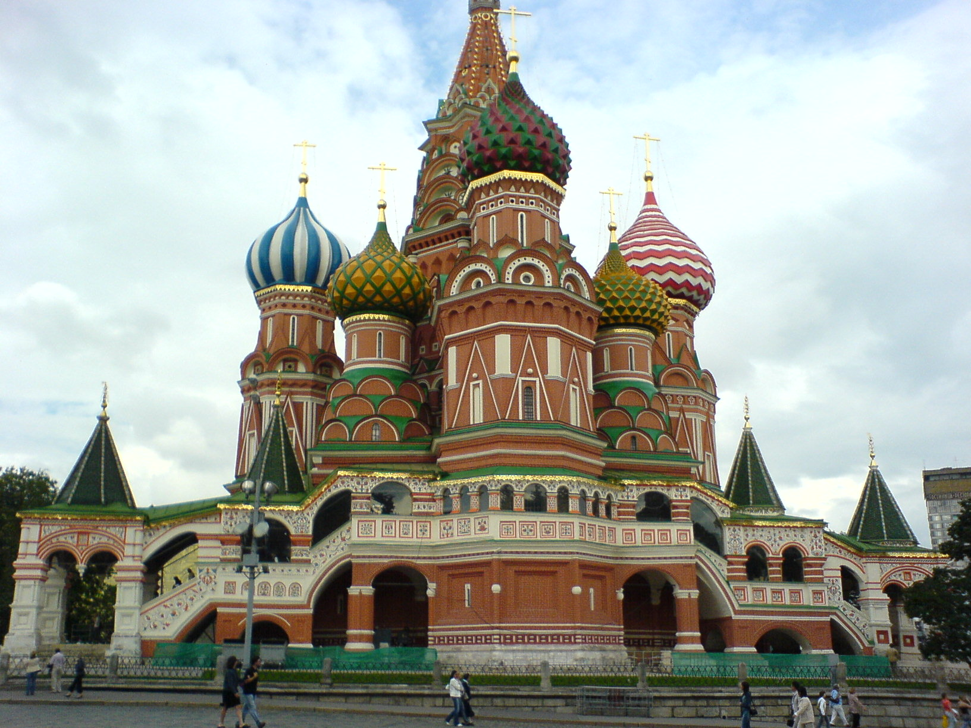
St Basil Cathedral. Moscow

Slide 34
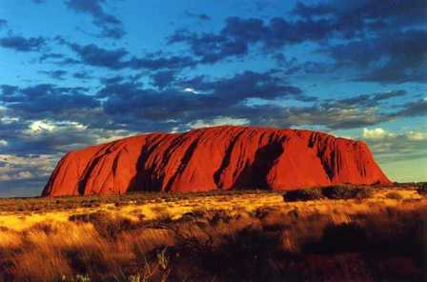
Ayers Rock in the Australian “Outback”

Slide 35
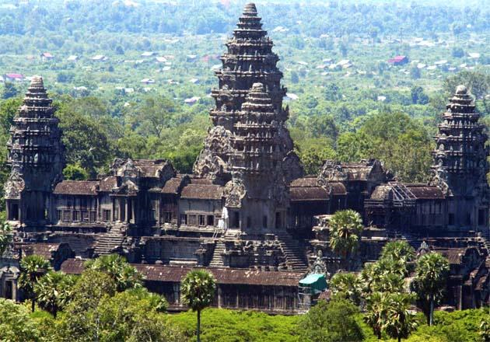
Angkor Wat in Cambodia

Slide 36
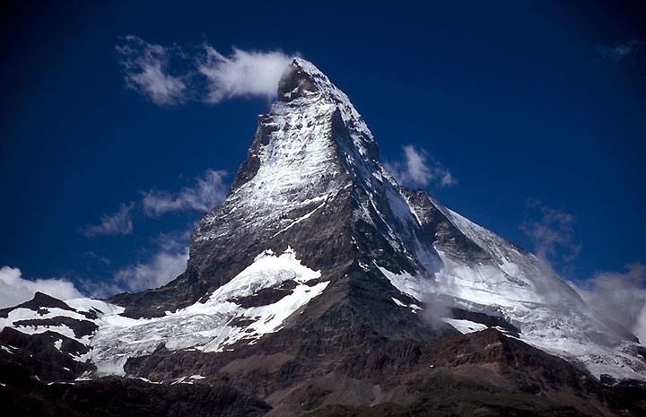
The Matterhorn in the Swiss Alps, Switzerland

Slide 37
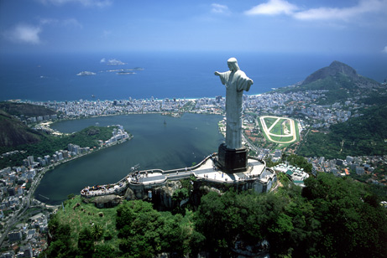
"Christ the Redeemer" statue in Rio de Janeiro, Brazil

Slide 38
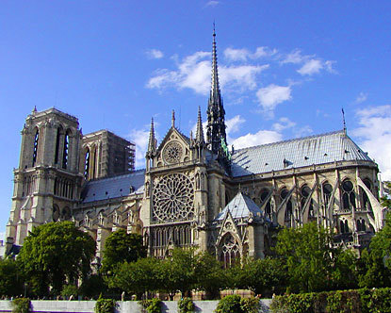
Notre Dame Cathedral in Paris, France

