Slide 1
The Future of Computing May Depend on YOU!
Vicki L. Sauter
Computer Science for High Schools
June 8, 2011

Slide 2
Agenda
My Background
The case for increased numbers of women and minorities in computing fields
The barriers to women and minorities in computing and how your classroom can help change the trends

Slide 3
Background
BSIE from Northwestern University
PhD in Systems Engineering from Northwestern University
Professor of Information Systems for 32 years

Slide 4
Research
Systems for Business Intelligence
Decision Support Systems for Business Intelligence, John Wiley, 2011
Improved Methodologies for System Development
Women in Information Technology Fields

Slide 5
Teaching
Systems for Business Intelligence
Systems Analysis
… the study of a current business system and its problems, the determination and definition of business needs and information requirements, and the evaluation of alternative solutions …

Slide 6
What Problem Are We Solving?
How can we get better software?

Slide 7
Computer Technology is Important
Computing is one of the fastest growing occupations: Employment projections claim there will be more than 800,000 new high-end computing jobs by 2016
Five of the top ten fastest growing jobs will be in computing-related fields
Contrary to what you might read, computer science, information systems, and computer engineering bachelor degrees are in high demand, and command two of the top three average salary offers from employers among all majors this year
Borrowed from: http://www.csedweek.org/key-facts

Slide 8
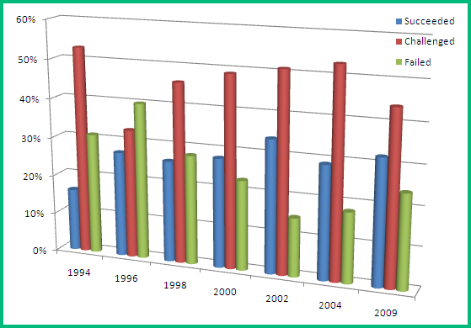
As a field, we are not good at creating software
Chaos Report from the Standish Group

Slide 9
More on Developing Software
Oxford University Study of IT
Successful Software: 16%
Challenged Software: 74%
Abandoned Software: 10%
National Institute of Standards and Technology (NIST)
Software defects cost nearly $60 Billion Annually
80% of development costs involve identifying and correcting defects
More data regarding success of IT projects can be found at http://www.galorath.com/wp/software-project-failure-costs-billions-better-estimation-planning-can-help.php

Slide 10
Why is Development Flawed?
Many hypotheses about the failure
Poor choice of Languages
Inappropriate or Missing Methodologies
Poor Requirements Definitions
Not including the User in the Process
Makeup of the Design and Coding Teams

Slide 11
Diversity provides teams the opportunity to tap into multiple, unique perspectives on the task

Slide 12
Software Development Success
Diversity in team make up is critical to success
Gender
Race
Background
Skills
Personality
Recent research: more women on a team lead to a better outcome!

Slide 13
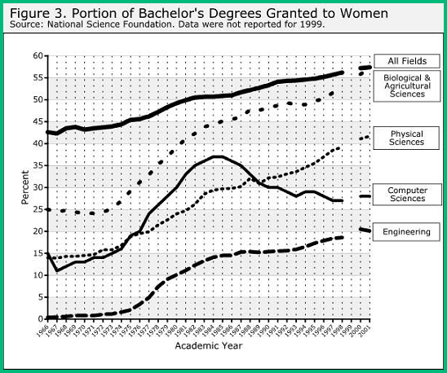
Gender Diversity is Challenging

Slide 14
Race Diversity is Harder

Slide 15
Trends with Women are Confusing
Ada, the Countess of Lovelace
(10 December 1815 – 27 November 1852)
Considered the first programmer
Worked with Charles Babbage on his Analytical Engine
Her notes contain what is considered the first computer program —an algorithm encoded for processing by a machine
She wrote about the ability of computers to go beyond mere calculating or number-crunching

Slide 16
Grace Murray Hopper
(December 9, 1906 – January 1, 1992)
One of the first programmers of the Mark I computer (Harvard)
Developed the first compiler of a programming language
Conceptualized the idea of machine-independent programming languages
Lead the team that developed the language COBOL, which is still the dominant language in use by businesses

Slide 17
The original programmers for the Eniac (first general purpose computer)
They programmed without programming manuals or courses, using only the logical diagrams
Jean Bartik was born in Gentry County Missouri (1924) and attended Northwest Missouri State Teachers College.

Slide 18
People of Color
Clarence (Skip) Ellis
(1943 -- )
First African American to receive a PhD in Computer Science in 1969 (University of Illinois)
One contribution of his research: idea of clicking on icons to launch programs
Worked to create national standards to make computers more friendly
Notes:
When he was 15 years old, Ellis got a part-time job at an insurance company to help support his family. He worked as a security guard on the night shift and his primary responsibility was guarding the company's new computer. In 1958 computers were rare and expensive. They were also quite large, since microcircuits had not yet been invented. Ellis' job was to protect the company's computer from theft and vandalism. Although he was not allowed to touch the new computer, he did have access to all of the computer's operating manuals. During his long hours guarding the computer, Ellis read all of these manuals.
Ellis' ambition was put to good use one day when there was a computing crisis at the insurance company. At that time data was entered into computers using punch cards. The computer technicians at the insurance company were in the middle of an important project when they ran out of punch cards. No one knew how to fix the problem, except for Ellis. One of the things he had learned from his late-night reading was how to reuse old punch cards

Slide 19
Data
Teenage girls are now using computers and the Internet at rates similar to their male peers, but are five times less likely to consider a technology-related career or plan on taking post-secondary technology classes than those boys
The proportion of girls who take the SAT and who state they intend to major in computing fields has decreased steadily (relative to the proportion of boys): 20% in 2001 and 12% in 2006
More boys than girls (59% vs. 41%) reported course work or experience with computer programming, even though more girls reported having some coursework or experience using computers
The percentage of degrees in Computer Science awarded to women has decreased from almost 40% in 1984 to about 26% in 1998

Slide 20
More Data
A 2006 study showed only 8% of bachelors degrees in computer science were granted to African Americans and Latinos
Only 17% of AP computer science test-takers in 2008 were women, although women represented 55% of all AP test-takers
Participation in computer science AP tests among underrepresented minorities has increased in the past 10 years but is only 11%, compared to 19% of all AP test-takers
Only 4% of AP Computer Science test takers in 2008 were African Americans, although African Americans represented 7% of all AP test takers. Only 784 African American students nationwide took the AP Computer Science exam

Slide 21
Why?
What can we do?

Slide 22
Remember
The problem we are solving is how to improve computer software
We believe that diversity on teams will lead to better software
Diversity on teams is threatened because of insufficient number of women and people of color

Slide 23
Conventional Wisdom
Women and people of color are not good in mathematics
Mathematics is crucial for any programming field

Slide 24
Reality
Differences in mathematical aptitude have been shown to be due to exposure to mathematics: the more mathematics classes a student takes, the better the student is at mathematics
Not all programming requires significant mathematical aptitude

Slide 25
So, what are the problems and what can we do?

Slide 26
Problem 1: Stereotyping
What we know
Boys tend to get called on in class more often than girls
Boys tend to take over computers more often in schools
Boys are more often encouraged to take advanced computing classes or to work with a computer

Slide 27
Stereotyping
What we can do
Ensure that all students are given equal access to computers
Make an effort to call on girls and people of color more in class
Recruit girls to the computing classes and encourage them to pursue after school programs
Mentors

Slide 28
Problem 2: Stereotype Threat
What we know
Stereotype threat is a person’s anxiety that he or she will confirm negative stereotypes about a social group (e.g., women, people of color)
Stereotype threat has been shown to reduce performance of people who belong to negatively stereotyped groups
Anxiety comes from the social situation, not the individual
Students experiencing stereotype threat are likely to disassociate themselves from the situation

Slide 29
“…the best women in a CS program are far more likely to drop out than the worst guys. When asked how they think they compare, these women consistently rank themselves far below their actual skill level. This means women aren’t good at judging their actual skill level or comparing themselves to others. They need mentors and a leg up, to help them do it. Women are also less likely to pester their boss until she finally relents to send them to a conference. Again, we need to actively invite talented women …”
-Maria Klawe
President, Harvey Mudd College
Director, Microsoft

Slide 30
Stereotype Threat
What we can do
Introduce computing as a gender-neutral and racial-neutral topic
Use examples of successful women and people of color in the discussion of the topic
Require students to find examples of successful women and people of color
Find mentors: older students, college students, people in practice
Encourage students to work together in gender-mixed and racially-mixed groups
Don’t generalize performance
Encourage each student’s effort

Slide 31
Problem 3: Women are too Social
What we know
People believe that computer careers are nothing more than “heads down” programming all day
Women worry that they will be isolated and not have enough social contact
Women want to have more impact on society

Slide 32
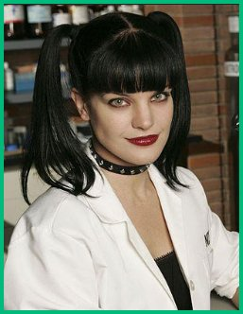
Women are too Social
The Reality
No one works on a project alone
There are many parts of a project team that require significant interaction with colleagues, users and others in an organization
Today everyone uses computers and so people can work for the kind of organization and kind of application that makes them happy

Slide 33
Women are too Social
What we can do
Recruit women students and students of color to the class
Involve students in project teams
Works well if you add some ambiguity to the project that needs to be discussed
Work on problems from a wide range of application areas
Use examples from sports and from the human genome or crime or social networks
Encourage students to think about a wide range of types of programs, even if they are not able to code them at this time
Speakers are often good to provide examples of the kind of systems they use

Slide 34
Problem 4: Stuck in the Shallow End: Education, Race, and Computing
Pioneering study by Jane Margolis and colleagues about how students of color receive little or no institutional encouragement and educational support to pursue computer science at the pre-college level

Slide 35
Results
Large disparity in learning opportunities along racial lines in the schools studied
None of the computing classes at minority schools went beyond cut-and-paste instructions
No classes that introduced the problem-solving and scientific reasoning of computer science were offered at minority schools
Teaching low-level computing skills rather than computational thinking was also the norm at the minority magnet school
The charter school provided a variety of computer courses, but few students of color were enrolled

Slide 36
Problem 5: The Code Cowboy
Cowboy coding is a form of software development method without an actual defined method – team members do whatever they feel is right.
Image borrowed from http://cowboyprogramming.com/2007/01/11/delving-into-cowboy-programming/

Slide 37
Cowboy Coding
Stays up all night recoding the entire code base, documents nothing, and forbids anyone to touch it because they aren’t good enough to understand his level of code.
Refuses meetings, chats, or any other form of communication.
Cares more about being perceived as the brilliant-uber-genius than he does about his team working well together.
Gets into silly pissing contests which boil down to “hehe, my brain is bigger than yours”.
Finds complex solutions to problems, thus proving his brilliance.
Makes a lot of mistakes due to lack of sleep, overcaffination, and ego — but thank god he is around to save the day when the bug is discovered
Is fairly certain clients, PMs, designers, and really anyone he has to deal with on a daily basis is at least three standard deviations below his IQ.
Jumps to say “me, me, me!” when credit or rewards for accomplishments are offered.
Jumps to say “me, me, me!” when opportunities to attend or speak at conferences arise. The good developer
Borrowed from: http://www.stubbornella.org/content/2010/07/26/woman-in-technology

Slide 38
Cowboy coding and cowboy coding environments tend to discourage anyone different from joining them. This includes women and people of color.

Slide 39
The Good Developer
Digs the fact that he is making products for people. Likes people and enjoys communicating with them and understanding how they think. Can put him or herself in other people’s shoes and reliably imagine how they might react to different parts of the user interface
An excellent problem solver who takes into account all aspects of a challenge when designing a solution – including human elements like maintainability and usability
Borrowed from: http://www.stubbornella.org/content/2010/07/26/woman-in-technology

Slide 40
What we can do
Discourage the vices of computing
Help students develop good coding practices

Slide 41
Four Vices of Computing
Vice 1: galloping off on one’s own without a prior plan
What we can do – encourage good practices
Require all students to outline their projects before they begin coding with flowcharts, pseudo code or pictures
Assign some complex projects (less toy-like)
Include some ambiguity in the problem definition so students experience unforeseen interactions in code
Limit the number of edit-compile-test runs
Use some (heterogeneous) group exercises

Slide 42
Four Vices of Computing
Vice 2: unnecessarily dense, unreadable code
What we can do – encourage good practices
Require documentation of all code
Meaningful field names
In-code documentation
Diagram of code
Appropriate indentation
Include documentation in the grading of code
Return code after a week or more delay and ask them to explain their approach to the class
Encourage “beautiful coding”

Slide 43
Four Vices of Computing
Vice 3: reinventing the wheel unnecessarily
What we can do – encourage good practices
Encourage students to develop code libraries
Encourage students to re-use code
Require students to use someone else’s code for part of the project

Slide 44
Four Vices of Computing
Vice 4: brute-force programming
What we can do – encourage good practices
Do not provide students with test data sets
Or provide them with only partial test sets
Limit the number of edit-compile-test runs
Students who have reached an impasse and with access to the test suite will often resort to a kind of evolutionary programming where they incrementally tweak parts of a program, test the code, and repeat

Slide 45
Majors Differ
Computer Science
A computer scientist focuses on the development of solutions to problems taking into account the limitations of the machine and its resources, as well as how to best utilize the resources.
Information Systems
IS professionals utilize their business-based backgrounds in working with managers and users to specify technology needs that benefits the organization. In addition, they write programs to codify that technology and later manage it.
http://mis.umsl.edu/misvscsc.html

Slide 46
Resources
Anita Borg Institute: http://anitaborg.org
Women in Technology: http://www.witi.com/
Addressing Core Equity Issues in K-12 Computer Science Education -- Identifying Barriers and Sharing Strategies: http://anitaborg.org/files/ABI-csta-full-report.pdf

Slide 47
More Resources
Women in Computer Science: http://legacy.sdsc.edu/CRAW/careers
Computer Scientists of the African Diaspora:
http://www.math.buffalo.edu/mad/computer-science/index.html
Coalition to Diversify Computing: http://www.ncsa.illinois.edu/Outreach/CDC/
Women and Minorities in Computer Science
http://www.cs.cmu.edu/~jmankoff/women.html

Slide 48
Shameless Plug
http://mis.umsl.edu/xtremeit.html

Slide 49
Contact Information
Email: Vicki.Sauter@umsl.edu
Website: http://www.umsl.edu/~sauterv
Facebook: Vicki TheGeek Sauter
LinkedIn: Vicki Sauter
Twitter: VLSauter (but I do not tweet very often)

Slide 50
Questions?

