Slide 1
SYSTEMS

Slide 2
What is a SYSTEM?
A system is composed of interacting parts that operate together to achieve some goal or purpose.
A system “absorbs” inputs, processes them in some way, and produces outputs that are defined by goals, objectives or common purposes.

Slide 3
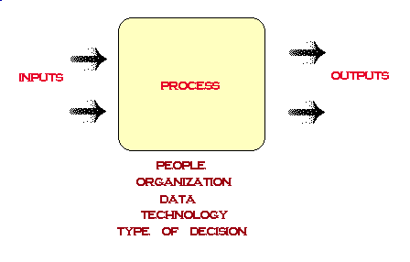
There are 5 components that need to be considered when defining the system: people, organization, data, technology and type of decision.

Slide 4
In order to understand the system, you need to understand the environment in which it exists.
The environment represents everything that is important to understanding the functioning of the system, but is not part of the system.
The environment it is that part of the world that can be ignored in the analysis except for its interaction with the system.
It includes: competition, people, technology, capital, raw materials, data, regulation and opportunities.
The boundary defines the difference between the environment and the system; the correct boundary is a function of the problem under consideration.

Slide 5
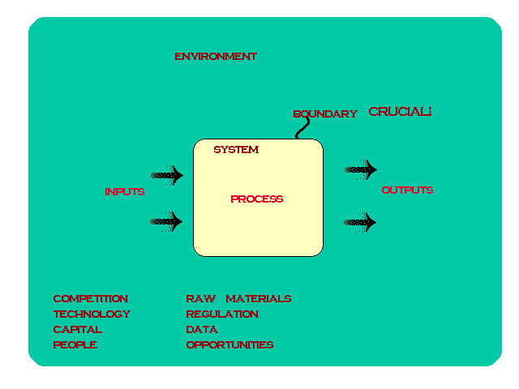

Slide 6
How do we define a system?

Slide 7
work backwards from the definition of outputs
What essential outputs must the system produce to satisfy users’ requirements?
What transformations are necessary to produce these outputs?
What inputs are necessary for Transforms to produce their outputs?
What types of information does the system need to remember?

Slide 8
Complete a stimulus-response Analysis
What are the stimuli and responses to each stimulus?
For each stimulus/response pair, what transformations are necessary?
What are the essential data that must be retained?

Slide 9
Essential transformations analysis
What are the essential transformations required to complete the systems fundamental information processing functions and fulfill users’ business policies?
What is required to maintain essential data?

Slide 10
Subsystems
What happens when you do not scope properly? Scope Creep! Scope Creep Blues

Slide 12
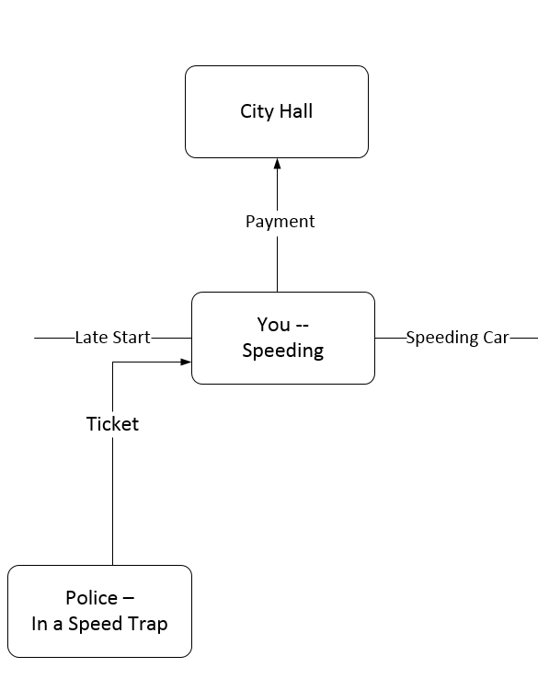
Systems and their environments interact

Slide 13
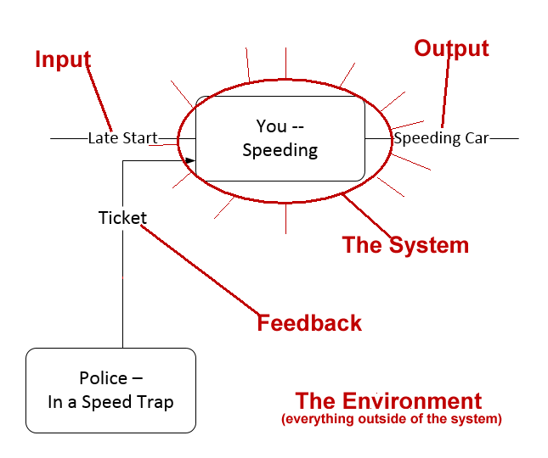

Slide 15
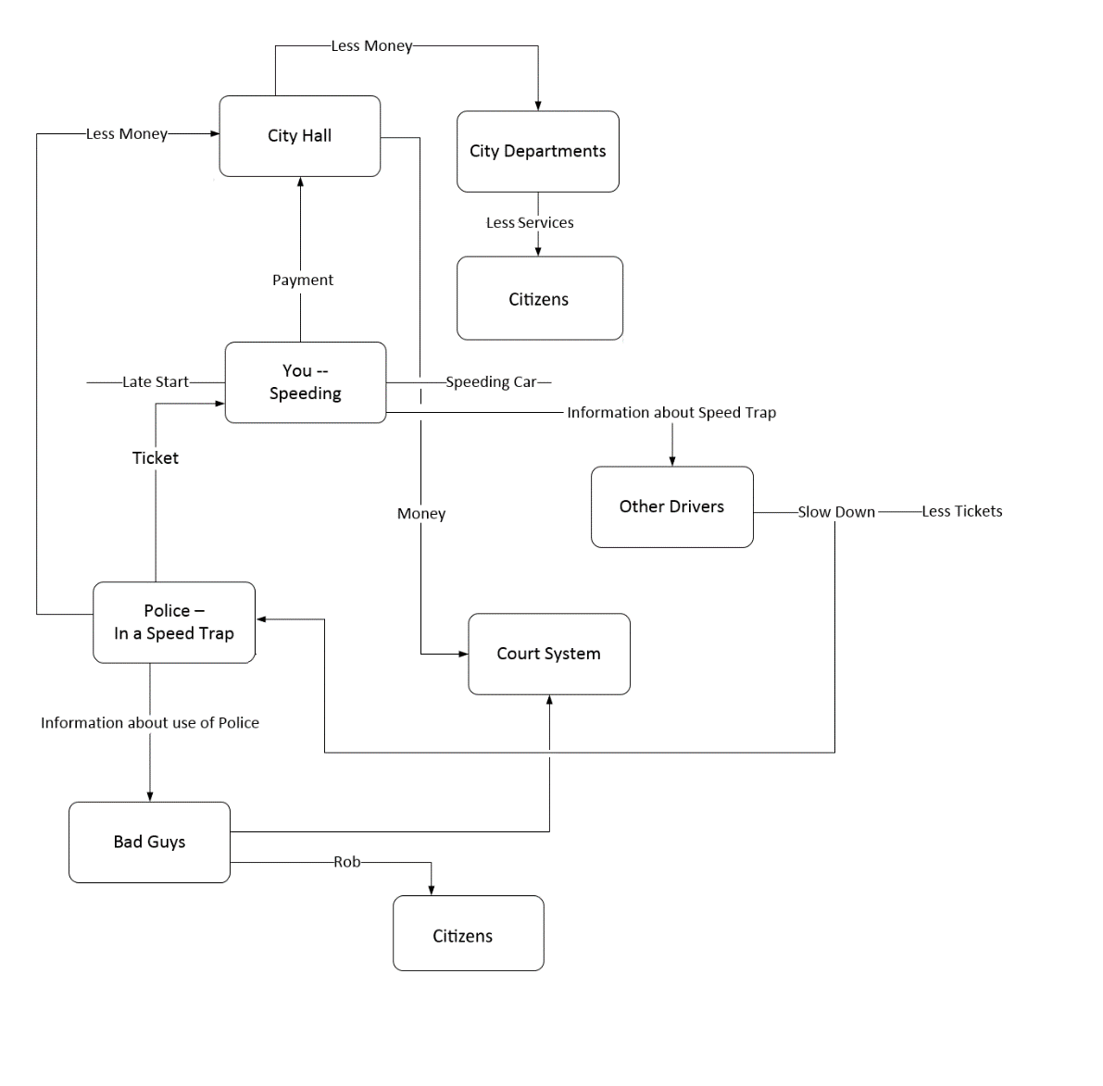

Slide 16


Slide 17
Dr. Russell Ackoff on systems
There are three parts to this discussion.

Slide 18
More from Dr. Ackoff

Slide 19
Animation explanation of Systems

Slide 20
What do we need to learn about systems?
Characteristics of Systems A system's parts must all be present for the system to carry out its purpose optimally.
A system's parts must be arranged in a specific way for the system to carry out its purpose.
Systems have specific purposes within larger systems.
Systems maintain their stability through fluctuations and adjustments. Systems have feedback.
The structure of systems is defined by the interrelationships of the parts (subsystems), not the parts themselves.

Slide 21
Principles of Systems Thinking

Slide 22
Other Factors
Think in the big picture
Balance short term and long term perspectives
Recognize the dynamic, complex and interdependent nature of systems
  Feedback
Video and explanation are from the Waters Foundation and WebEd.
The materials are copyright 2006 by the Waters Foundation.

Slide 23
Other Factors, Continued
Take into account both measurable and non-measurable factors
Be aware we are influenced by and influencing system
      Unintended Consequences
      Assumptions
      Values and beliefs

Slide 24
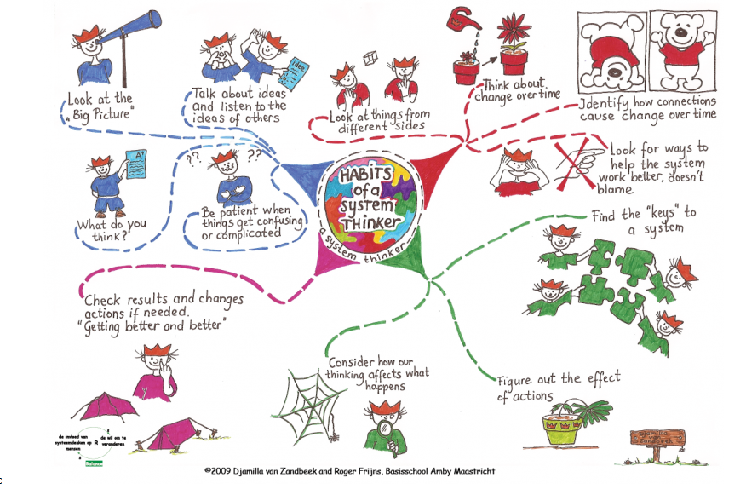
This image was created by and is the property of Djamilla von Zandbeek and Roger Frijns, Basicsschool Amby Maastricht. It has a copyright of 2009.

Slide 25
Graphic is the property of the Waters Foundation. The second edition was copyright 2014. There is more information at the site about systems, tools and strategies.

Slide 26
Define a System completely
Events: What happens
Patterns: trends or changes in events over time
    What happens over time
    Measure or track events
    Learn how to anticipate the events
Structure: what is causing the patterns
    Why did the events happen
    Look at the causality
    Creative problem solving
    How to shape the events in the future

Slide 27
Systems thinking strategies
Graphic is the property of the Waters Foundation. There is more information at the site about systems, tools and strategies.

Slide 28
stages
Define
  Decide what issue you are trying to resolve
  Agree on who the audience is
  Prioritize this project in terms of urgency
  Determine what will make this project successful
  Establish a glossary of terms
Research
  Review the history of the issue; identify any existing obstacles
  Collect examples of other attempts to solve the same issue
  Note the project supporters, investors, and critics
  Talk to your end-users, that brings you the most fruitful ideas for later design
  Take into account thought leaders' opinions

Slide 29
Stages, Continued
Ideation
  Identify the needs and motivations of your end-users.
  Generate as many ideas as possible to serve these identified needs.
  Log your brainstorming session.
  Do not judge or debate ideas.
  During brainstorming, have one conversation at a time.
Prototype
  Combine, expand, and refine ideas.
  Create multiple drafts.
  Seek feedback from a diverse group of people, include your end users.
  Present a selection of ideas to the client.
  Reserve judgement and maintain neutrality.
  Create and present actual working prototype(s)

Slide 30
Stages, continued
Choose
  Review the objective
  Set aside emotion and ownership of ideas
  Avoid consensus thinking
  Remember: the most practical solution isn't always the best
  Select the powerful ideas
Implement
  Make task descriptions
  Plan tasks
  Determine resources
  Assign tasks
  Execute
  Deliver to client

Slide 31
Stages, continued
Learn
  Gather feedback from the consumer
  Determine if the solution met its goals
  Discuss what could be improved
  Measure success; collect data
  Document

Slide 32
Stages, continued
Research
Review the history of the issue; remember any existing obstacles.
Collect examples of other attempts to solve the same issue.
Note the project supporters, investors, and critics.
Talk to your end-users, that brings you the most fruitful ideas for later design.
Take into account thought leaders' opinions.

Slide 33
Stakeholders
Identify your stakeholders
Your boss | Shareholders | Government
Senior executives | Alliance partners | Trades associations
Your co-workers | Suppliers | The press
Your team | Lenders | Interest groups
Customers | Analysts | The public
Prospective customers | Future recruits | The community
Your family | Key contributors | Key advisors
Material adapted from Mindtools: Management Training and Leadership Training Online. It is available online; last viewed August 1, 2018.

Slide 34
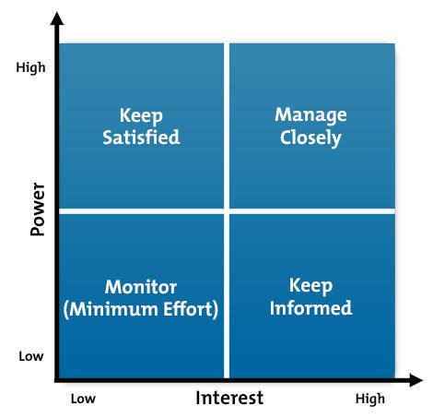
Stakeholders, continued
Prioritize Stakeholders
Material adapted from Mindtools: Management Training and Leadership Training Online. It is available online; last viewed August 1, 2018.
They in turn, adapted this image from Mendelow, A.L. (1981) Environmental scanning – the Impact of the Stakeholder Concept, ICIS 1981 Proceedings, p. 20.

Slide 35
stakeholders
Understand your Key Stakeholders
  What financial or emotional interest do they have in the outcome of your work? Is it positive or negative?
  What motivates them most of all?
  What information do they want from you, and what is the best way of communicating with them?
  What is their current opinion of your work? Is it based on good information?
  Who influences their opinions generally, and who influences their opinion of you?
  Do some of these influencers therefore become important stakeholders in their own right?
  If they aren’t likely to be positive, what will win them around to support your project?
  If you don't think that you’ll be able to win them around, how will you manage their opposition?
  Who else might be influenced by their opinions?
  Do these people become stakeholders in their own right?

Slide 36
Systems Example

Slide 37
Innovate

