Slide 1

Mathews-Dickey Boys’ & girls’ Club
Presented by Group D

Slide 2
Presentation Outline
Identified Problem
System Description
Survey Results
Prototype
Cost & Benefit Study
System Specification

Slide 3
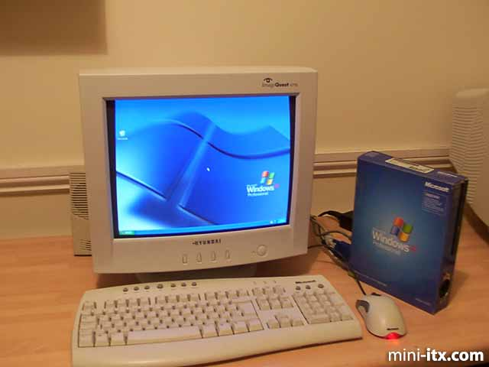

Identified problem
Outdated Operating Systems
Old software and hardware
Lack of a secure network

Slide 4
System description
Environment
Internet
your clients
the volunteers (coaches, instructors, umpires, etc.)
sensitive information about your clients and volunteers),,
Investors
KidTrax software
the Payment Card Industry Data Security Standard (PCI DSS)

Slide 5
Interfaces - interactions that relay personal information and/or schedule information
They include
1) with e-mails, face-to-face contact or phone calls.
2) Internet (i.e. e-mail)
3)entering of that information into Internet-linked KidTrax software

Slide 6
Inputs:
schedule information for volunteers and stakeholders
capital inputs from investors
payments for programs from the stakeholders.
Outputs:
schedule information for volunteers, employees, the kids, parents and sports field organizations
the teachers and coaches output educational information or athletic concepts to the stakeholders (the children)

Slide 7
General Internal Processes:
The activities department receives the payment information (amount and form of payment) from the stakeholders, then enters it into an excel database and KidTrax’s record for accounts receivables.
The CFO then processes this information using KidTrax's record and the excel database to incorporate paid receivables into the accounting records.
(Schedule information concerning volunteers, stakeholders participating in certain programs, and sports field availability are handled similarly)

Slide 8
Subsystems
the financial department
activities department
the program coordinating department
the different programs
the technology (the operating systems)

Slide 9


“What operating system are you currently using on your work PC?”
About 20 of the kids computers were not accounted for.

Slide 10
“How important Is it to keep personal information safe?”
100% - percent of responders marked very important

Slide 11
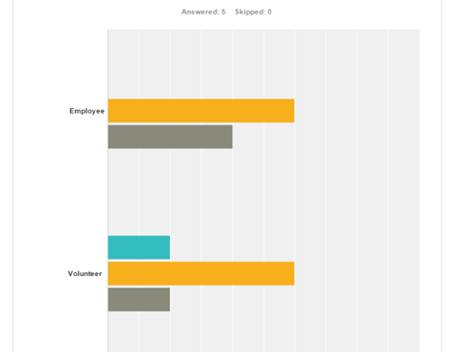
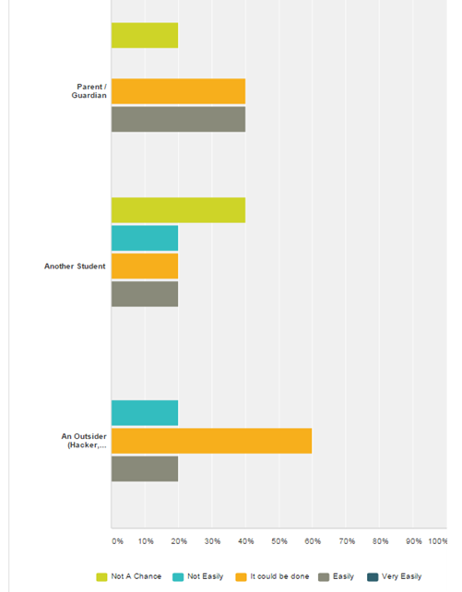
“how easily can someone get personal information about a student?”
Targeted at five groups of people:
Employees, Volunteer, Parent/Guardian, Another Student, Outsider (Hacker)
Ranted on a scale one through five
Results that stood out Employee, Volunteer, Outsider
60% of respondents believe “It could be done”
80% of respondents Outsider could get or easily get information

Slide 12
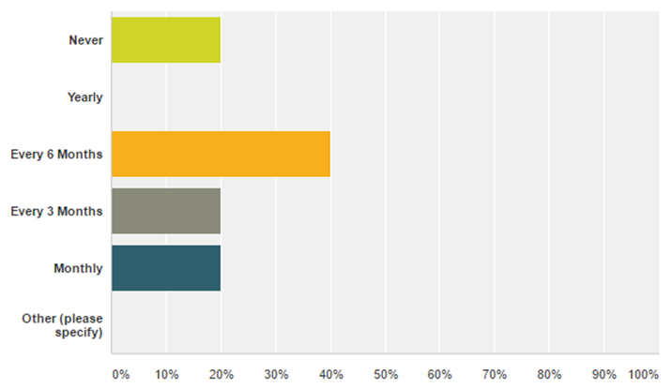
“How often do you change your password?”

Slide 13
Prototype solutions
Windows 10
Office 2016
Norton Security Suite
Internet Browser

Slide 14
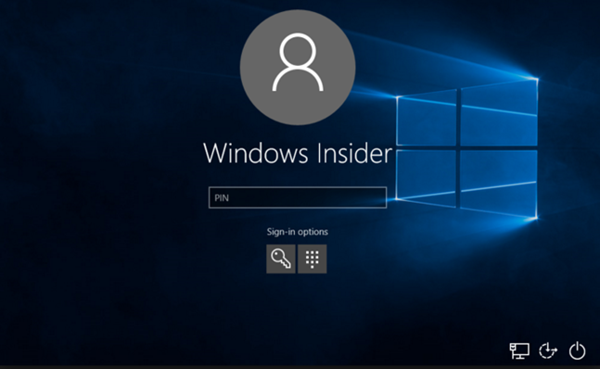
New Windows 10 logon screen

Slide 15
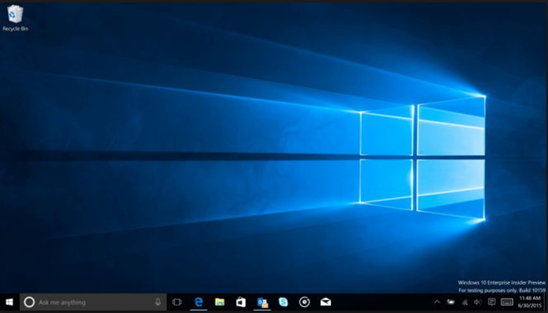
Windows 10 Desktop

Slide 16
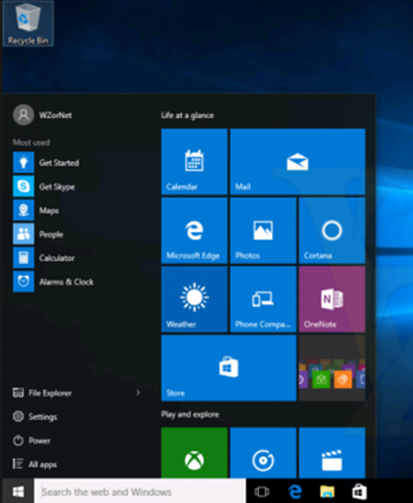
Windows 10 Start Menu

Slide 17
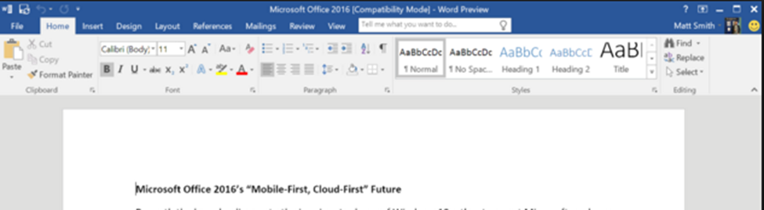
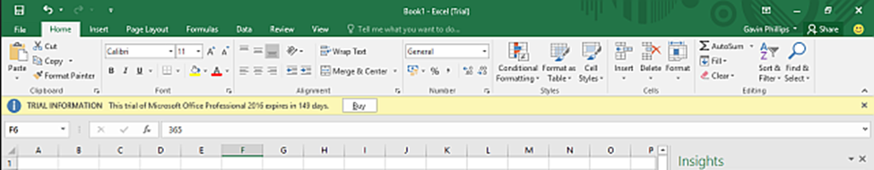
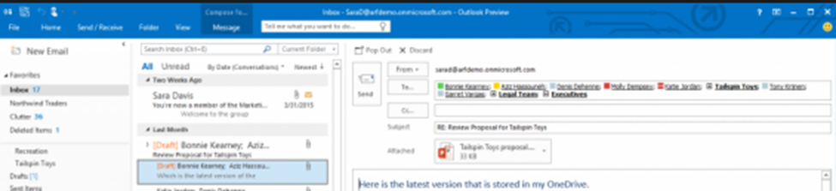
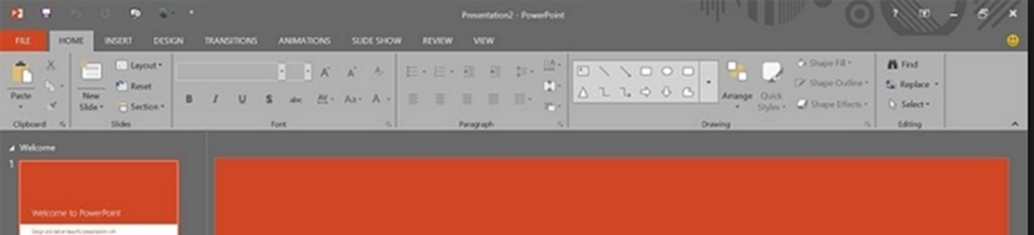

Slide 18
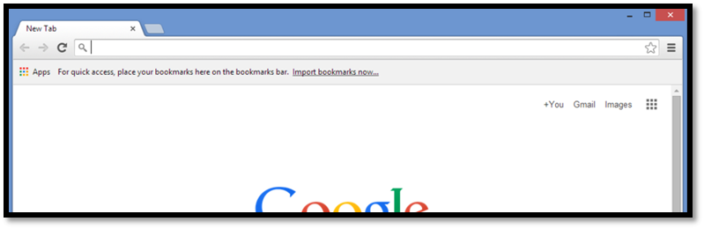
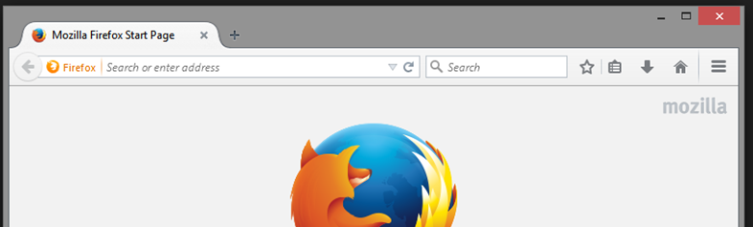
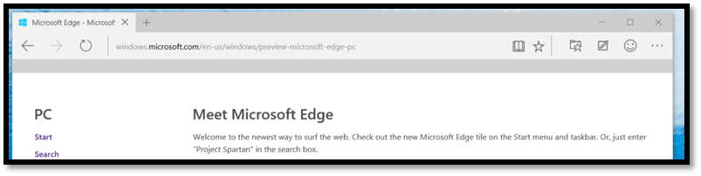
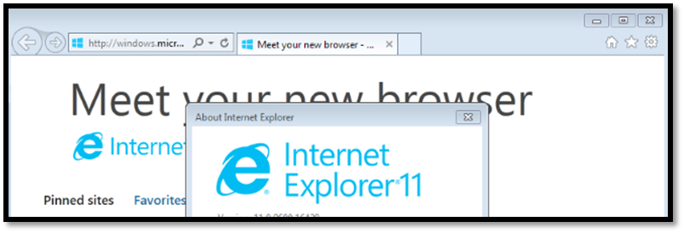

Slide 19
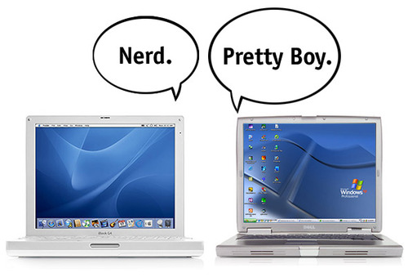



Cost/benefit
SolarWind
Windows vs Other OS
Comodo Internet Security
Microsoft Security Essentials

Slide 20
System specifications
Updating to Windows 10
Latest OS: Windows 7 Service Pack 1 OR Windows 8.1
Processor: 1 gigahertz or faster processor
RAM: 1 GB for 32-bit version of Windows 10 OR 2 GB for 64-bit version of Windows 10
Hard disk space: 16 GB for 32-bit Windows 10 OR 20 GB for 64-bit Windows 10
Graphics card: DirectX or later with WDDM 1.0 driver
Display: 800x600 resolution display

Slide 21
Proposed Schedule
Replacing Old PCs
Any machine that not meeting requirements
EPC Computers in St. Charles
Acquire Office 2016
Microsoft donation page
Install Norton Small Business Security Solution
Helps to ensure data is secure

Slide 22
Estimated Costs
30 refurbished machines for ~$2,500
One year of Norton Security ~$100
Total for the first year ~$3,000
Yearly maintenance and fees ~$500/year

Slide 23
Business need
Prevent costly data breaches
Helps prevent lawsuits
Too much personal information for these risks
Peace of mind
Helps improve student use of technology
Consistent setup through organization

Slide 24
Conclusion
Improvement of cybersecurity
Peace of mind
Improve children’s learning experience
Spark new interest in technology

