Slide 1
design thinking
And human centered design

Slide 2
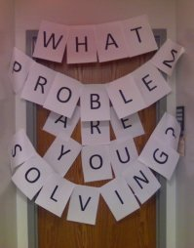

Slide 3
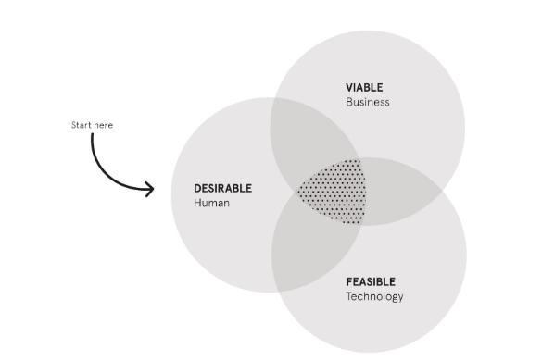
Goal
Graphic is the property of IDE-O and is available Online

Slide 4
What is Design thinking
It is sometimes called Human-Centered Design
Focus is on how you think

Slide 5
Practice Supportive Mindsets
Learn from failure
      Think of it as designing experiments through which you are going to learn
Make It
      Take the risk out of project by making something simple first
Creative Confidence
      Have big ideas and the ability to act on them
Have Empathy
      Helps us create new ideas
Embrace Ambiguity
      We must give ourselves permission to explore
Optimism
      This drives the group forward
Iterate, iterate, iterate
      This is what provides validation for the project

Slide 6
Stages of Design THinking
Inspiration
Ideation
Implementation

Slide 7
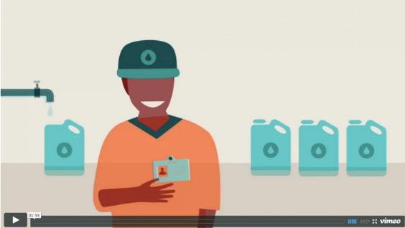
Video is the property of IDE-O and is available Online

Slide 8
Inspiration
    You learn as much as possible about the organization and its features
    Analysts learn from client and the users
    Analysts take photos
    Analysts immerse themselves in the life of the client
    Analysts do secondary research
    Analysts understand users’ needs and wants
    Specific methods include those from the IDE-O site but it can include other tools. See possible activities at the Design Kit Website
Library

Slide 9
The content is the property of IDE-O. It can be found in The Field Guide to Human Centered Design, or online.

Slide 10
The content is the property of IDE-O. It can be found in The Field Guide to Human Centered Design, or online.

Slide 11
The content is the property of IDE-O. It can be found in The Field Guide to Human Centered Design, or online.

Slide 12
IDEATION
Team Members share what they have learned
Ideas are evaluated
Identification of how the different parts of the organization call for different solutions.
Prototype
The content is the property of IDE-O. It can be found in The Field Guide to Human Centered Design, or online.

Slide 13
The content is the property of IDE-O. It can be found in The Field Guide to Human Centered Design, or online.

Slide 14
The content is the property of IDE-O. It can be found in The Field Guide to Human Centered Design, or online.

Slide 15
The content is the property of IDE-O. It can be found in The Field Guide to Human Centered Design, or online

Slide 16
The content is the property of IDE-O. It can be found in The Field Guide to Human Centered Design, or online.

Slide 17
Implementation
    The team delivers the project
    Maintenance and Enhancement
    Create a Pitch
    Define Success
    Build Partnerships
    Other activities normally associated with Design, not Analysis

Slide 18
The content is the property of IDE-O. It can be found in The Field Guide to Human Centered Design, or online

Slide 19
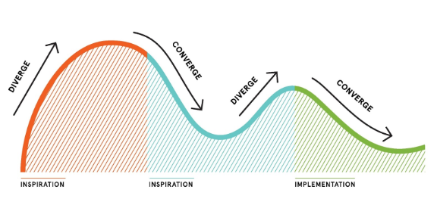
This is not a linear process
Graphic is the property of IDE-O and is available Online

