Slide 1
Weekends Only, Inc Mobile App Study
WEO Customer App

Slide 2
Background
Mission & Values
Business strategy
E-commerce model
Insider’s Club
Head office organizational structure
IT department
Systems architecture
Your Questions

Slide 3
Mission & Values
Save our customers money
Driving force: Practice how low we can go, not how much we can get
Guiding Values
Personal Responsibility | Teamwork
Honesty | Growth
High Performance | Commitment to Profitable Growth

Slide 4
Business Strategy
Ltd hours & Ltd Choice
Open 3 days/wk
Ever-changing selection & low price
Close-outs, overstocks, one of a kind
Lean fulfillment
No special orders, backorders or holds
Customer-centric experience
Employee engagement with customer
No frills or options
Low overhead
Lean supply chain
Customer-driven buying experience

Slide 5
E-commerce Model
ShopVisible e-commerce provider
Launch date 29 Oct 2013
Mobile version of site to launch 30 days later
Real time data processing
File transfers
Web services
Unified channel customer experience
Phase I scope:
Sell only from distribution center (DC)
Pick-up @ stores or home delivery within 100 miles

Slide 6
Insider’s Club
Sign-up online
E-mail notification of new products / events
No coupons or special discounts
Benefits:
First notification of great deals
Limited supply – first to show up wins

Slide 7
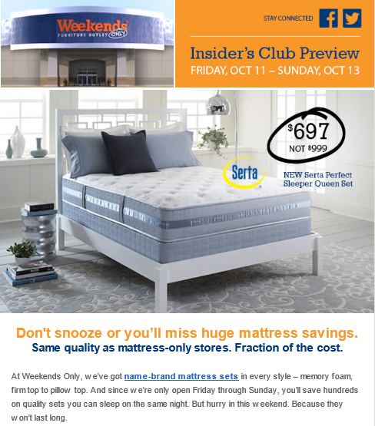

Slide 8
Head Office Organization
Tom Phillips, CEO
John Wennemann, HR Director
Dionne Dumitru, COO
Lane Hamm, CFO
Jane Roberts, VP-Merch
IT (Sean Copple)
Marketing (Monda Petrinelli)

Slide 9
IT Department
Sean Copple, Mgr
Todd Barnidge, Sr. Programmer
Jacob Kresse, Sr. Network Admin
Jared Freesh, Programmer
Chris Scofield, Business Analyst
Travis Esmon, Business Operations Analyst
Responsibilities
Maintain all company networks, servers and devices (350-400 employees)
7/24 help desk support for business system (Pronto ERP, unix-based)
Systems administration
Maintain business system software
Enhance business system software (software development)
Support Lean process improvement
Maintain all user documentation for business systems and SOPs
Administer all Microsoft software including Exchange and SharePoint
Provide operational training & analysis

Slide 10
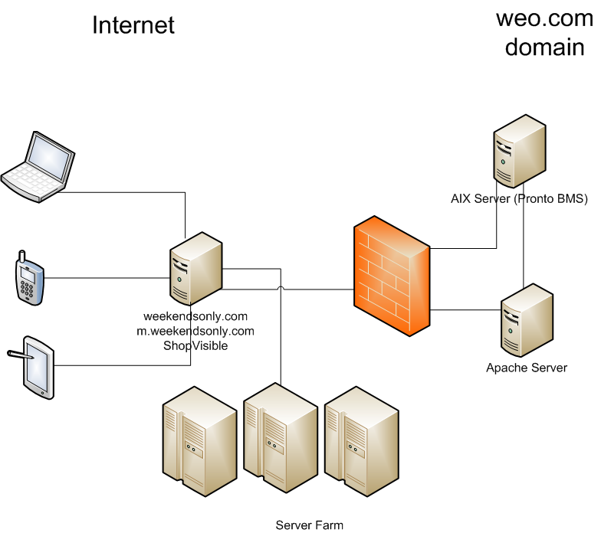
Systems Architecture

Slide 11
Your Questions: Strategy
What changes are necessary to achieve top 50?
Biggest internal/external obstacles?
Risk factors? Weaknesses? Threats?
How do we decide to grow?
How do we leverage analytics?
How do we measure success?
Strongest current competitor?
Differentiators?
How does WEO provide value to customers?
How does B2B model interact w/B2C?
Notes:
Top 50
E-commerce and new stores in outlying markets.
Biggest obstacle for e-commerce is setting up logistics for home delivery nationwide
Obstacle for store expansion is available real estate at prices to suit our model in markets we want
Risks – stores: entry of a category-killer competitor – such as Ikea or NFM
Weaknesses – Being a small privately held business means there’s not the capital to fund rapid expansion; - we don’t have Warren Buffett’s deep pockets -- being no-frills and operating at low margins means we bootstrap a lot. Good for innovation; it also stretches us.
Threats – new competitors we know and don’t know - have no idea how Internet sales are affecting us now, for instance
Growth strategy: We’ve defined the market that we can succeed in, because we can differentiate and we can bring value. It’s more than we can go into here
We use analytics internally to drive process improvement, and external analytics to drive marketing decisions
Measure success primarily in SPC – since this succinctly measures how well we met the needs of each customer who visited our store
Current competitors: Matt Firm, Ashley, Rothman, Macy’s
Differentiators: Strategic positions: WOW pricing – ltd hours and ltd choice – customer-centric experience – lean fulfilment. We offer brand name furniture items at a fraction of the cost, an ever changing selection, we own the furniture and you can have it today if you want to pick it up – no one else can touch us on these.
Value: we unbundle the costs – we don’t make every customer pay for financing or delivery or protection plans – you choose what you want to buy, that’s of value to you.
We’re b2c – we do have B2B trading partner relationships (EDI, web services with merchandise vendors and home delivery carrier) but not through e-commerce. We don’t sell furniture to other businesses to on-sell.

Slide 12
Your Questions: Buying
Criteria used for buying? Just opportunistic or is there a plan, and is it informed by marketing targets or customer feedback?
How do we train buyers?
Relationships with vendors: close-outs, costs, agreements? Percentage of liquidation market? How long to receive?
Supply chain overview ?
How do we set prices? Profit margin?
Notes:
We classify products by category (upholstery that doesn’t move, sectionals, dining sets) and by subcategory according to customer need. Within each subcategory we also create a pricing bell curve, so that we can offer customers the look they want at a price they can afford. Although we do have market research data, we haven’t yet incorporated it into our buying plans. However, sales associates are able to capture customer feedback very quickly and easily on the computer, and this feedback goes straight to the buyers through lost sale reporting. We’ve certainly purchased items based on customer feedback - e.g., we increased our selection of beds-only and this has worked well for us. Buyers take the lost sales reports to market with them.
Explain market and vendor reps
- Closeouts – not all items are close-outs; focus on finding close-out deals. Often opportunistic, but it has to be competitive. If we can’t be competitive we don’t pick it up. Good example: Sauder closeout – buyer checked big box stores (Menards, WalMart) pricing – if he couldn’t be $50 less than them he passed on it. He ended up cherry pickign the list, but knows that when it comes in it will blow out. It’s not just driven by category performance – this is about our brand – it’s how the customer knows us. We have to be credible across the store.
- We have buyers who came through planning (logistics and forecasting), showroom display, and store manager. We’ve also hired from other companies. We have onboarding plans for all positions in our company; most corporate positions require an extensive onboarding period due to complexity of the role.
Lead times on closeouts are generally tight due to urgency to offload the goods – sometimes they ship before we can enter the purchase orders. But we have lead times on overseas containers that can be up to 6 months. Everything is full load – no less than load. Most items are shipped centrally – and either cross-docked to ship to stores on our own trucks or put in storage racks in the DC. Filliing stores is fully automated – the computer generates the transfer orders and generates the order picking tasks.
Set prices to be as competitive as possible and pass along savings to the customer. We have a blended margin model – strive to achieve about 40% GM – which is 5-15 points lower than competitors.

Slide 13
Your Questions: E-commerce & Employment
Plans to sell online?
Will customer know whether item’s available?
How will it change company philosophy?
How do we keep employees when only open 3 days/week? What are incentives and how do they affect turnover rate?
Notes:
E-commerce:
Launching e-commerce this month
Only selling from DC stock available, therefore items could be displayed as “Shop at stores….” and optionally “Add to Cart” or just Add to Cart or just “Shop at stores…”
Website product availability is refreshed within every 15 minutes; as stores reserve DC stock for customers, or other web customers place items in carts, the availability is changed. Reservations last 3 hours in store and xxx online.
Will not change philosophy – the ‘limited hours’ doesn’t work online – there’s no value proposition since it doesn’t cut overhead to be dark on the web. This simply allows us to extend the total value proposition to more customers, and give customers more choice.
Employees: We’re open 7 days/week just not for business. For any retailer, turnover is a problem, so we make efforts to (1) be an employer of choice and (2) focus on engagement, because employees make up their minds on a daily basis whether they want to continue to work with you – pay and benefits only get you so far.

Slide 14
Project
Objective
Extend value to Insiders while increasing customer loyalty
Need to define
What value-add would delight customers?
What would differentiate WEO while remaining true to strategic position and brand?

Slide 15
Timing Considerations
Corporate contact availability M-F
One Business Analyst works Tues-Sat
Store General Managers Tues-Sat
Variable schedule (opening or closing store)
Stores open for business
Friday & Saturday 10am-9pm
Sunday 10am-8pm
Thanksgiving weekend (Black Friday)
High volume – plan on limited availability

Slide 16
Contacts
Project Oversight
Sean Copple, IT Manager, scopple@weekendsonly.com
IT
Chris Scofield, Business Analyst, cscofield@weekendsonly.com
Jared Freesh, Programmer, jfreesh@weekendsonly.com
Marketing
Monda Petrinelli, Sr. Marketing Mgr, mpetrinelli@weekendsonly.com
Store
Dan Ashurst, Bridgeton General Manager, dashurst@weekendsonly.com

