Slide 1
Homicide Predictions in St Louis
InfSys 3843
Group Members:
Ana L Bolanos
Dian Prasetyo
Edward Conrey
Jameka Johnson

Slide 2
The Problem
What is the predictive number and location of unlawful homicides in St. Louis City for 2012?

Slide 3
Objective
To predict where crime, specifically
homicides, are likely to occur
in the St Louis City using both
quantitative and qualitative data.

Slide 4
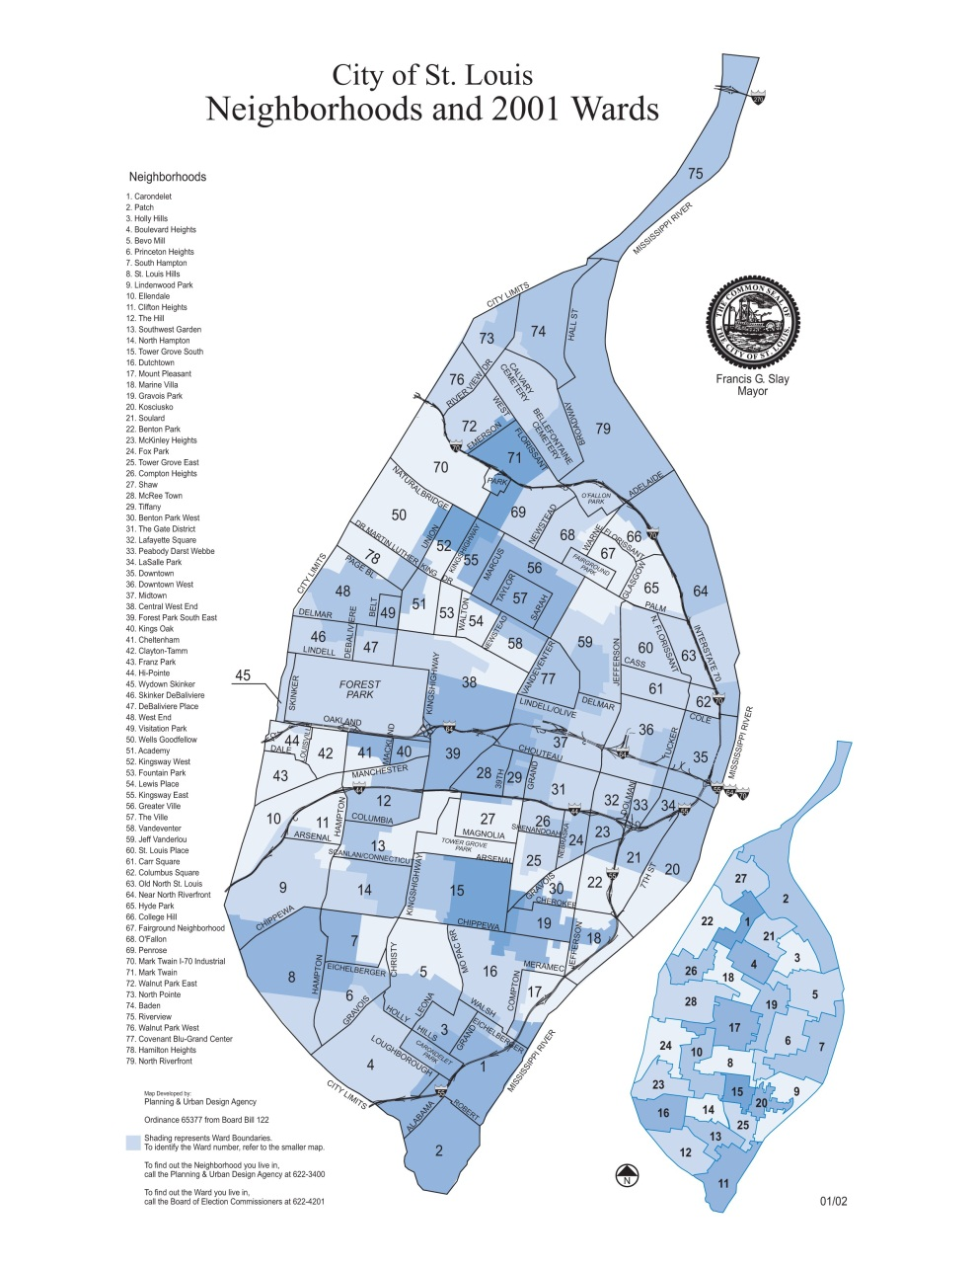
St Louis City Map

Slide 5
Overview
The city of St. Louis has its fair share of crime.
53rd largest city in the nation
11th in homicides
78 bordering neighborhoods

Slide 6
Homicide: Definition
Homicide is the killing of a human being by the act, procurement, or omission of another, death occurring at any time, and is either (1) murder, (2) homicide by abuse, (3) manslaughter, (4) excusable homicide, or (5) justifiable homicide.
- Washington State Legislature

Slide 7
The Approach
Quantitative Data:
We will be using graphs and charts that contain information about the number of homicides per neighborhood of the city of St Louis. This information will summarize the number of homicides of the past few years.
Qualitative Data
We will be supporting our predictions with economic factors also.
Notes:
We cannot predict the individual homicides, but their pattern is highly predictable.

Slide 8
Quantitative Data
 | National | St. Louis city
 | Homicides | Homicides | Population
2008 | 16,442 | 167 | 356,204
2009 | 15,241 | 143 | 355,208
2010 | 14,748 | 144 | 319,294
2011 | ? | 113 | ?
2012 | January | 11 | ?
2012 | February | 3 | ?
Although the root causes of homicides are education, unemployment and poverty, some of the decrease is simply a function of population decline. The drop in local crime also follows a drop in crime on the national level.

Slide 9
Qualitative Data
There is a national trend of decreasing homicides. St. Louis finished 2011 with 113 homicides, compared with 144 for 2010.
HMCA Homicide ministers
G.R.E.A.T Gang Resistance Education and Training.
Most homicides involve the use of firearms.
In May 2011 St. Louis Circuit Court took a new approach to gun crimes in St. Louis that sets high bail for young people accused of gun crimes. The city of St. Louis has seen a drop in the homicides cases in the city.
Saint Louis Police Department collaborated with state probation and parole officers in tracking down locations with high number of homicides.
Mayor Francis Slay brought IBM to help enhanced the communication between residents and the criminal justice system.

Slide 10
Qualitative Data – Cont.
Saint Louis city plan on rejuvenating neglected neighborhoods. For example: Lafayette Square and JeffVanderLou plans.
Saint Louis community efforts in revitalizing their neighborhood and preventing crimes. For example: Saint Louis Rehabbers club and St. Louis Public Safety Partnership.

Slide 11
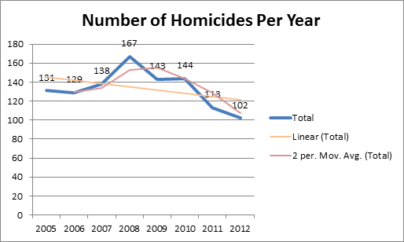
Results
14 homicides / 53 days = .26415 homicides per day * 366 days = 96.6792 homicides ≈ 97 homicides

Slide 12
Top Homicide Location in Saint Louis
Neighborhood | 2008 | 2009 | 2010 | 2011 | Distribution (Average) | 2011 Actual | 2012 Prediction
Baden | 3.59% | 4.90% | 4.86% | 8.85% | 5.55% | 10 | 6
College Hill | 2.40% | 4.20% | 1.39% | 3.54% | 2.88% | 4 | 3
Dutchtown | 3.59% | 2.10% | 3.47% | 2.65% | 2.95% | 3 | 3
Fairground | 2.99% | 0.00% | 6.25% | 1.77% | 2.75% | 2 | 3
Hamilton Heights | 3.59% | 2.80% | 2.08% | 4.42% | 3.22% | 5 | 3
Hyde Park | 2.40% | 4.20% | 3.47% | 0.88% | 2.74% | 1 | 3
JeffVanderLou | 7.78% | 6.99% | 4.86% | 7.96% | 6.90% | 9 | 7
Kingsway West | 2.99% | 4.20% | 4.17% | 0.88% | 3.06% | 1 | 3
Mark Twain | 6.59% | 3.50% | 4.17% | 2.65% | 4.23% | 3 | 4
O' Fallon | 5.39% | 2.10% | 4.17% | 0.88% | 3.13% | 1 | 3
Penrose | 2.99% | 4.20% | 3.47% | 2.65% | 3.30% | 3 | 3
The Great Ville | 2.99% | 3.50% | 3.47% | 4.42% | 3.60% | 5 | 4
Wells - Goodfellow | 5.99% | 7.69% | 4.17% | 4.42% | 5.57% | 5 | 6
West End | 2.99% | 3.50% | 2.78% | 1.77% | 2.76% | 2 | 3

Slide 13
Suggestions
Continue promoting innovative strategies and increase community involvement.
Increase public’s awareness on crime information tools that can be used easily. For example, website and smart phone app crime locator https://www.crimereports.com/

Slide 14
Data Sources
Metropolitan St Louis Department http://www.slmpd.org/crime_stats.html
City- Data http://www.city-data.com/crime/crime-St.-Louis-Missouri.html
Neighborhood Scout http://www.neighborhoodscout.com/mo/st-louis/crime/
STL Today http://www.stltoday.com/news/multimedia/html_b1ea1c08-2411-11e0-96a8-0017a4a78c22.html
City Rating http://www.cityrating.com/crime-statistics/missouri/
The Lectric Law Definition http://www.lectlaw.com/def/c330.htm
Washington State Legislature http://apps.leg.wa.gov/RCW/default.aspx?cite=9A.32.010
St. Louis (KMOV)
http://www.kmov.com/news/local/Homicides-down-by-30-percent-in-St-Louis-136243888.html

Slide 15
Data Sources - Cont.
nextSTL
http://www.nextstl.com/urban-living/is-the-city-of-st-louis-becoming-a-safer-place-the-answer-decidedly-is-yes
http://www.nextstl.com/urban-living/one-city-two-plans-compare-and-contrast-of-2001-lafayette-square-jeffvanderlou-plans
Missourian
http://www.columbiamissourian.com/stories/2009/01/02/2008-deadly-year-st-louis-kansas-city
IBM Smarter Cities Challenge. St. Louis Report.
http://www.scribd.com/doc/77264344/IBM-Smarter-Cities-Challenge-St-Louis-Report
St. Louis Rehabbers Club
http://rehabbersclub.org/
Missouri Criminal Lawyers Blog. “St. Louis City Judges Raise Bail in Gun Cases and St. Louis City Homicides Drop”.
http://www.missouricriminallawyersblog.com/2012/02/st-louis-city-judges-raise-bai.html

Slide 16
Questions!

