Slide 1
Human Computer Interaction (HCI)
Alexius Gandy & Anel Jugovic
IS6833

Slide 2
What are Human-Computer Interaction Systems?
Human-computer interaction is a multidisciplinary field of study focusing on the design of computer technology and, in particular, the interaction between humans and computers.
Incorporates computer science, human factors engineering, and cognitive science

Slide 3
Cont.
• Human-computer interaction plays a crucial role in the way technology is built.
• Google, Facebook, and Microsoft Word.
Notes:
and was directly responsible for the incredible growth of the World-Wide Web, turning it into what it is today.
Combining these methodologies within HCI has blessed the world with websites and programs including

Slide 4
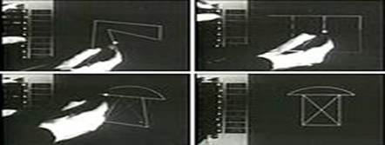
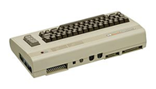
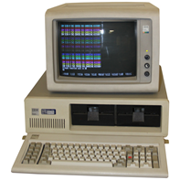
History - When?
In 1963, Ivan Sutherland demonstrated the first use of a direct manipulation interface using a system called Sketchpad.
William Newman created the Reaction Handler in 1966.
Gained large popularity in the 1980s due to the growing popularity of personal computing.
Included machines such as Apple Macintosh, IBM 5150, & Commodore 64
Notes:
Point 1: Sketchpad is a system, which supported the manipulation of objects using a light pen, included grabbing objects, moving them, changing the size, using constraints.
Point 2: This provided another form of direct manipulation of graphics and introduced “Light Handles,” which are a form of graphical potentiometer (4). It used interface techniques such as, icons, gesture recognition, and dynamic menus which when combined with a pointing device such as a mouse, it allowed easy selection and navigation.
Point 3 & 4: Popularity and reason for it.

Slide 5
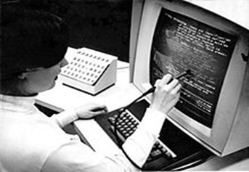
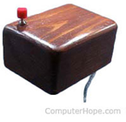
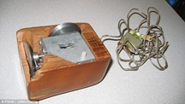
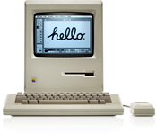
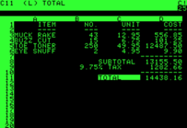
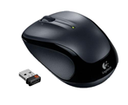
History - What?
A lot of innovation came from HCI
Machines – Macintosh first none tiled system. Graphical interfaces.
The mouse replaced the “Light-Pen” in 1964.
Applications – Sketchpad, Text Editor, Spreadsheets, Hypertext, Hyperlink
Notes:
Point 1: The vast amount of these innovations within technology and HCI came from the geniuses at MIT. Some of the first commercial uses of windows were on machines coming straight out of MIT lab projects.
Point 1.1: Machines, inspired Windows 95 design. Spread sheet, VisiCalc 1979 Apple 2
Point 2: Mouse was a cheap replacement for the light-pen. Took a ergonomic approach to the design of the mouse.
Point 3: Text editor - Stanford research lab was introduced in 1962 (6). It included features we take for granted now-a-days like automatic word wrap, search and replace, copy and delete characters and much more. This would also be what all modern text editors include today, even the most basic.
Point 4: Spreadsheets which were invented by Frankston and Bricklin in 1977 for the Apple 2 was the start of what we know as excel and other spreadsheet programs. Hypertext was an idea by Vannever Bush from 1945 and the term was coined by Ted Nelson in 1965
Point 5: Hypertext did not become what we know it as today until 1983. Ben Shneiderman’s Hyperties was the first system which allowed a highlighted item in text to be clicked and would go to another page

Slide 6
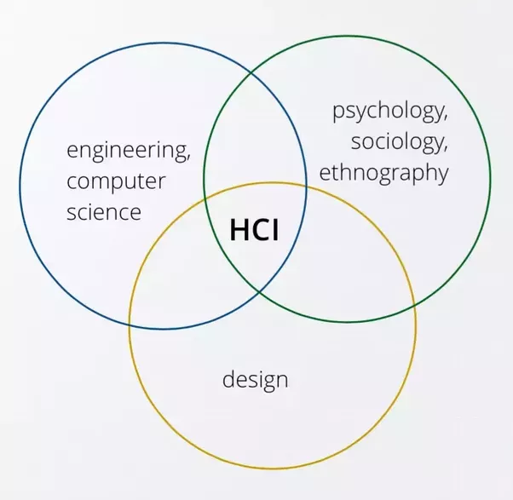
WHAT IS HUMAN-COMPUTER INTERACTION?
Communication between the human and the computer, synonymous with user interface and usability
Similar to person-to-person interaction, where the amount of incorrectly perceived information and effort expanded by the decision maker is minimized
Generally, the goal incorporates Computer Science, Psychology and System Design aimed at minimizing the barriers between the human’s cognitive model of what they want to accomplish and the computer’s understanding of the user’s task so that users can avail themselves of the full potential of the system (Sauter, 2011).
Notes:
Decision Support Systems is synonymous with “user interface” where the emphasis is on “the user”. The human is the decision maker and the common denominator of the cycle of inputs and outputs between the computer and the human

Slide 7
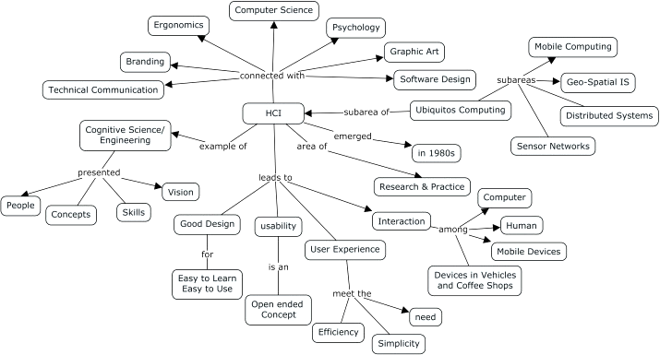
HUMAN-COMPUTER INTERACTION & DECISION SUPPORT SYSTEMS
Humans (or the user) is the Decision maker and the protagonist in the jungle of technological advancement
A system or technology can be expertly built and perform well, but ONLY to the extent that it serves the user
The decision maker must be able to access models, data, and peruse results, invoke assistance, share results or interact with the system or it cannot provide support. Designing the user interface aims

Slide 8
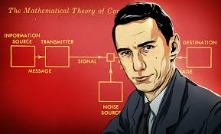
FATHER OF INFORMATION/COMMUNICATION THEORY
Wrote the landmark paper, The Mathematical Theory of Communication (1948), which was converged into a single fiber optic and wireless worldwide network for all types of communication
An additional Article by Warren Weaver is contained in the book as an overview of the theory for a general audience.
Lays out the basic elements of communication:
Notes:
An information source produces a message
A transmitter that operates on the message to create a signal

Slide 9
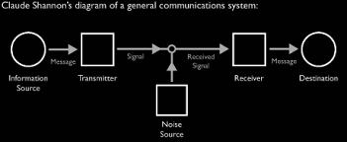
FATHER OF INFORMATION THEORY (cont.)
Notes:
Although this graph is deceptively simple, it is the basis of our current wireless world. His contribution to our existing technical landscape is most imp

Slide 10
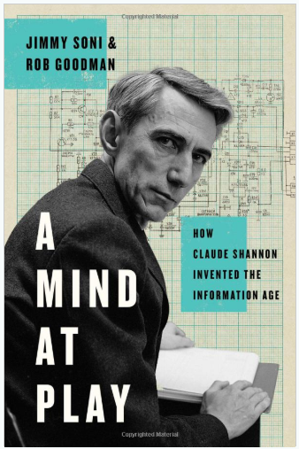
CLAUDE SHANNON (1916 - 2001)

Slide 11
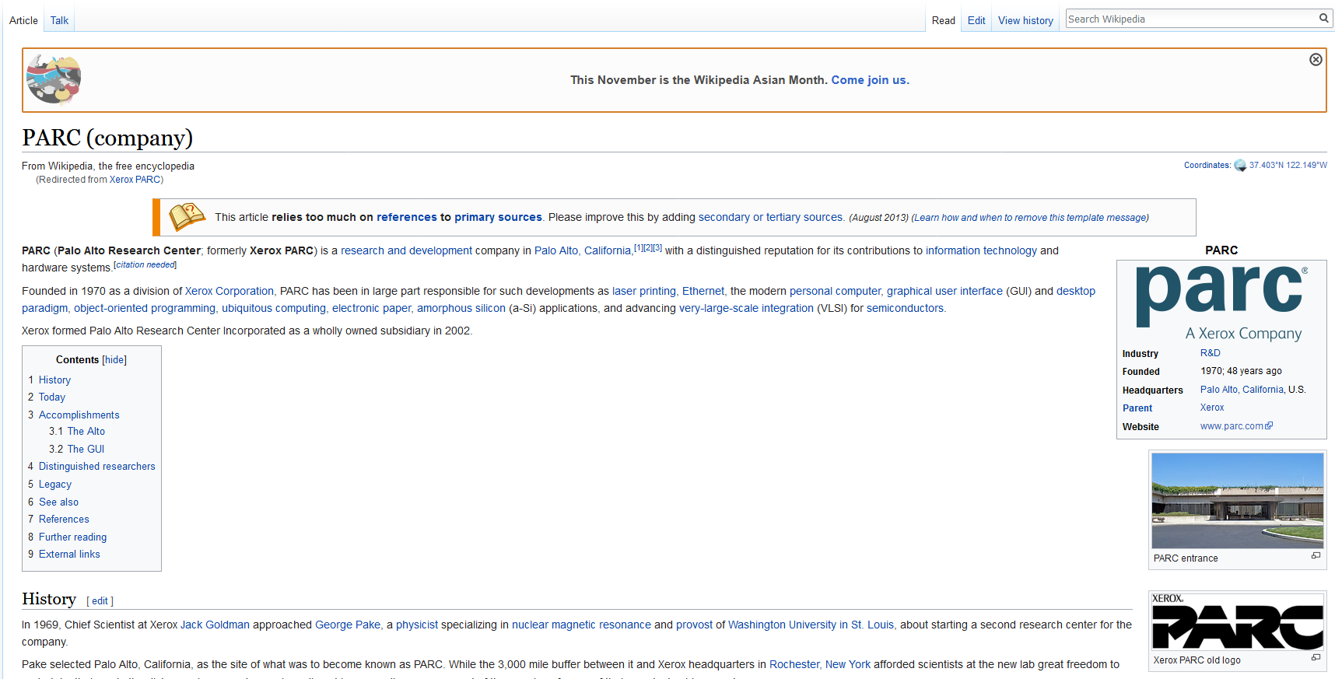
BUSINESS INTELLIGENCE SILO - PARC
Notes:
Premier center for commercial innovation. It is a Xerox company and responsible for some of the earliest technology breakthroughs. The company has forty years as the leading edge of innovation, merging inquiry and strategy to pioneer technical change. This company works and has worked closely with global enterprises, entrepreneurs, government agencies, and partners, and other clients to invent co-develop, and bring to market game-chinging innovations by combining imagination, investigation and return on investment for its clients.

Slide 12
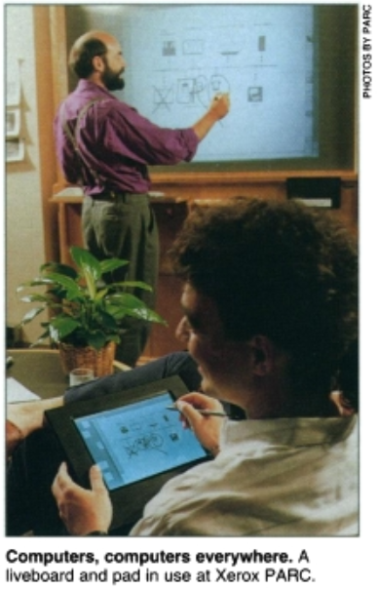
FATHER OF UBIQUITOUS COMPUTING
Coined by the head of Xerox Palo Alto Research Center (PARC) Computer Science group, Mark Weiser (1988 - 1993)
Weiser’s vision, although difficult to articulate, was to create many, many ways to access computational capabilities (Waldrop, 1993).
Weiser described a system in which all the devices would automatically stay in contact with the network all the time.
Notes:
Decision Support Systems is synonymous with “user interface” where the emphasis is on “the user”. The human is the decision maker and the common denominator of the cycle of inputs and outputs between the computer and the human

Slide 13
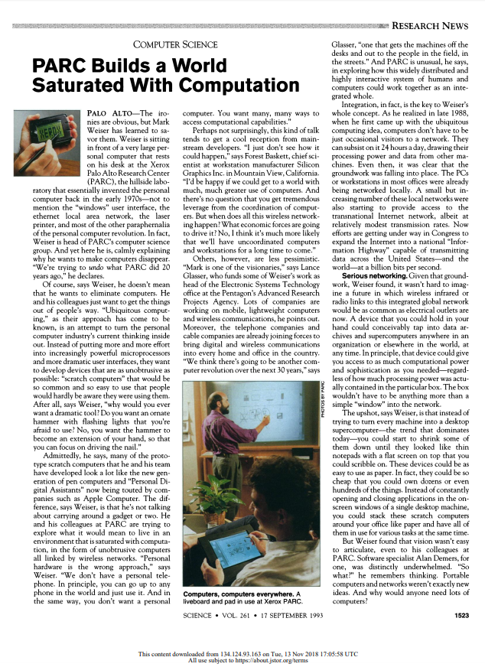
MARK WEISER (1952 - 1999)

Slide 14
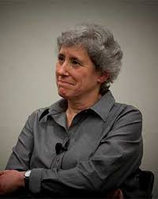
MOTHER OF HCI THEORY
Profoundly influential in helping form the nuances of ethnography in technology innovation, at PARC and across the entire field of Human-Computer interaction .
Groundbreaking “Man vs Machine” experiment as UC Berkeley Ph.D student catapulting her career in ethnographic technology innovation (1977)
Authored one of the first books on HCI called, “Plans and Situated Actions: The problem of human-machine communication” (1985)
An ethnographic anthropologist researcher for Xerox Palo Alto Research Center (PARC)

Slide 15
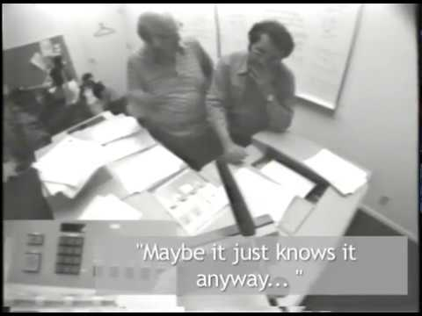
LUCY SUCHMAN
Notes:
The people shown in this clip are PARC researchers (users) Dr. Alan Newell and Dr. Ron Kaplan

Slide 16
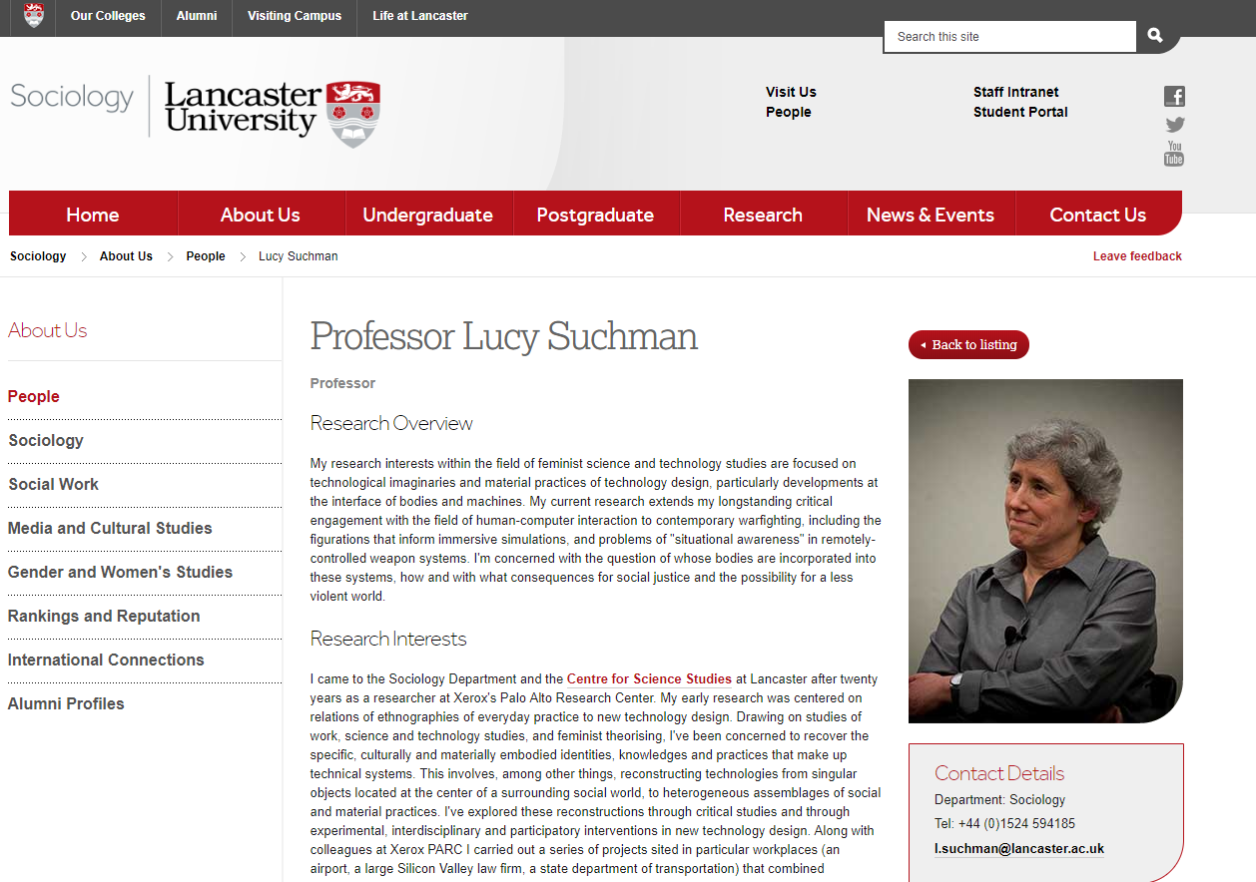
LUCY SUCHMAN

Slide 17
DESIGN PROCESS
Traditionally been about designing efficient and effective systems
Well-designed interfaces can elicit good feelings in users. Badly designed interfaces make people angry and frustrated
Emotional interaction is concerned with how we feel and react when interacting with technologies
Aesthetically pleasing and rewarding interfaces will increase positive affect.

Slide 18
DESIGN: PROVIDE FEEDBACK
INFORM THE USER ABOUT:
What it is doing
How it is interpreting the user’s input
User should always be aware of what is going on

Slide 19
DESIGN (cont.)
INFORM THE USER ABOUT:
User interface should be designed to match the skills, experience and expectations of its anticipated users
Users often judge a system by its interface rather than its functionality
Designers should be aware of people’s physical and mental limitations and should recognize user mistakes

Slide 20
REFERENCES (cont.)
Sauter, V. L. (2011). Decision support systems for business intelligence. Wiley-Blackwell (an imprint of John Wiley & Sons Ltd).
Darejeh, A., & Singh, D. (2014, 09). An investigation on Ribbon interface design guidelines for people with less computer literacy. Computer Standards & Interfaces, 36(5), 808-820. doi:10.1016/j.csi.2014.01.006
Xerox Digital Printing. “Top Takeaway from PRINT '17.” Xerox, Xerox, 21 Nov. 2017, www.xerox.com/en-lu/digital-printing/insights/printing-business-evolution
Weiser, M. (1991, 09). The Computer for the 21st Century. Scientific American, 265(3), 94-104. doi:10.1038/scientificamerican0991-94
Waldrop, M. M. (1993, 09). PARC Builds a World Saturated With Computation. Science, 261(5128), 1523-1524. doi:10.1126/science.261.5128.1523
Miller, G. A. (2003, 03). The cognitive revolution: A historical perspective. Trends in Cognitive Sciences, 7(3), 141-144. doi:10.1016/s1364-6613(03)00029-9

Slide 21
REFERENCES
Want, R., Pering, T., Borriello, G., & Farkas, K. (2002, 01). Disappearing hardware [ubiquitous computing]. IEEE Pervasive Computing, 1(1), 36-47. doi:10.1109/mprv.2002.993143
Weiser, M., Gold, R., & Brown, J. S. (1999). The origins of ubiquitous computing research at PARC in the late 1980s. IBM Systems Journal,38(4), 693-696. doi:10.1147/sj.384.0693
PARC (2011). Busting the Myth of the Giant Green Button. Retrieved from https://uxmag.com/articles/busting-the-myth-of-the-giant-green-button
“Ethnography and the PARC Copier.” YouTube, YouTube, 22 Dec. 2016, youtu.be/DUwXN01ARYg
Sutherland, I.E. “SketchPad: A Man-Machine Graphical Communication System,” in AFIPS Spring Joint Computer Conference. 1963. 23. pp. 329-346.Sutherland, I.E. “SketchPad: A Man-Machine Graphical Communication System,” in AFIPS Spring Joint Computer Conference. 1963. 23. pp. 329-346. (3)
Newman, W.M. “A System for Interactive Graphical Programming,” in AFIPS Spring Joint Computer Conference. 1968. 28. pp. 47-54.(4)

Slide 22
QUESTIONS?
For a Copy of this Presentation

