Slide 1
Where Will Fatal Crime Occur In St. Louis in 2014?
Presented by:
Andrew West
Eric Warrington
Justin Schickler

Slide 2
Objective and Background
Goal is to analyze crime data using a statistical approach to predict where fatal crimes will occur in the city of St Louis.
The city has recently undergone a redistricting, lowering it from 9 down to 6 police districts. As of now there is not enough data to show that this has or will changed the crime rate in any way.
Violent crime data from 2007 to 2013 of each neighborhood in St. Louis was used in our predictions.
Crime data is reported based on the city population only and does not include the county.

Slide 3
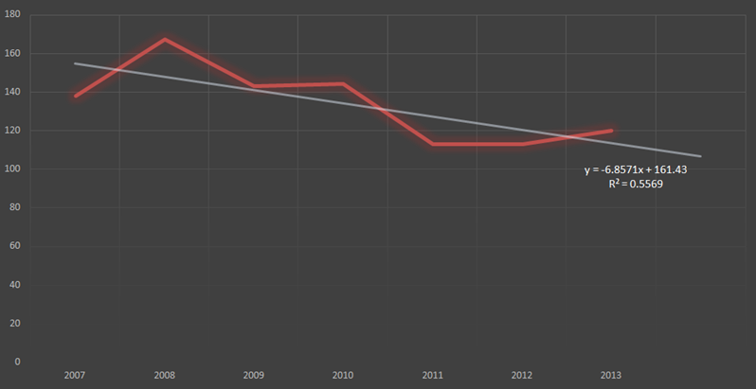
St. Louis Murder Trend
Murders have decreased over the past 7 years

Slide 4
Assumptions
Lower income neighborhoods have higher crime
Neighborhoods with high aggravated assault and armed robbery have high correlation to murders
Most homicides are committed using guns
A neighborhoods previous years murder rates are good predictors for future murders.
Possible Discrepancies
Note change in districts and how this could change predictions of crime in 2014

Slide 5
Method 1
Using the Trend function in Excel, we predicted the number of murders for each neighborhood in 2014
The Trend Function uses linear regression to predict the value of the next data item
Developed a separate regression equation for each neighborhood
This case is simple linear regression because there is only one independent variable (murders)

Slide 6
Predicted amounts of murders by Neighborhood
Academy | 1
Baden | 9
Benton Park | 0
Benton Park West | 1
Bevo Mill | 1
Botanical Heights | 0
Boulevard Heights | 1
Cal-Bell Cem | 0
Carondelet | 3
Carondelet Park | 0
Carr Square | 1
Central West End | 1
Cheltenham | 0
Clayton-Tamm | 0
Clifton Heights | 0
College Hill | 6
Columbus Square | 1
Compton Heights | 0
Covenant-Blu/Grand Ctr | 0
DeBaliviere Place | 0
Downtown | 3
Downtown West | 0
Dutchtown | 6
Ellendale | 0
Fairground | 5
Fairground Park | 0
Forest Park | 0
Forest Park SE | 0
Fountain Park | 1
Fox Park | 2
Franz Park | 0
Gravois Park | 5
Hamilton Heights | 2
Hi-Point | 0
Holly Hills | 0
Hyde Park | 3
Jeff Vanderlou | 4
Kings Oak | 0
Kingsway East | 2
Kingsway West | 3
Kosciusko | 0
La Salle | 0
Lafayette Square | 0
Lewis Place | 0
Lindenwood Park | 1
Marine Villa | 0
Mark Twain | 2
Mark Twain I-70 Ind. | 3
McKinley Heights | 1
Midtown | 1
Mount Pleasant | 2
Near N. Riverfront | 2
North Hampton | 0
North Point | 4
North Riverfront | 0
O'Fallon | 6
O'Fallon Park | 0
Old North St. Louis | 1
Patch | 1
Peabody-Darst-Webbe | 1
Penrose | 4
Penrose Park | 0
Princeton Heights | 0
Riverview | 0
Shaw | 0
Skinker-DeBaliviere | 0
Soulard | 1
South Hampton | 0
Southwest Garden | 0
St. Louis Hills | 0
St. Louis Place | 2
The Botanical Garden | 0
The Gate District | 0
The Greater Ville | 4
The Hill | 0
The Ville | 1
Tiffany | 0
Tower Grove East | 2
Tower Grove Park | 0
Tower Grove South | 1
Vandeventer | 1
Visitation Park | 0
Walnut Park East | 4
Walnut Park West | 3
Wells-Goodfellow | 4
West End | 2
Willmore Park | 0
Wydown-Skinker | 0
TOTAL | 115

Slide 7
Method 2
Test to see whether income and aggravated assaults had a significant impact on the number of murders
y= 0.3814 + 0.0607(Assault) – 5.991x10⁻⁶(Income)
Results showed that income did not have a significant impact on the number of murders
Adjusted R²= 0.48
 | Coefficients | Standard Error | t Stat | P-value
Intercept | 0.3814 | 0.805429 | 0.473481 | 0.637322
Agg. Assault | 0.0607 | 0.008090 | 7.507221 | 0.000000
Income | 0.0000 | 0.000026 | -0.227958 | 0.820334

Slide 8
Method 3
Test the significance of aggravated assaults and armed robbery on the number of murders
y= 0.0018 + 0.0343(Robbery) + 0.0538(Assault)
Results showed that both variables were significant
Adjusted R²= .99
 | Coefficients | Standard Error | t Stat | P-value
Intercept | 0.0018 | 0.1517 | 0.0118 | 0.9906
Robbery | 0.0343 | 0.0217 | 1.5807 | 0.1176
Assault | 0.0538 | 0.0126 | 4.2675 | 0.0001

Slide 9
Method 3 (cont.)
Use SLOPE and INTERCEPT functions on Excel to create a trend line for each variable
Neighbor-hood | Robbery Slope | Robbery Intercept | Forecast
Academy | -3.32 | 3.54 | 14
Baden | -7.18 | 51.38 | 24
Benton Park | -0.21 | 5.23 | 13
Benton Park W. | -4.93 | 7.77 | 10
Bevo Mill | -1.39 | 18.92 | 26

Slide 10
Method 3 (cont.)
Neighborhood | Assault Slope | Assault Intercept | Forecast
Academy | -7.61 | 64.43 | 4
Baden | -2.32 | 78.57 | 60
Benton Park | -0.18 | 7.57 | 6
Benton Park W. | -7.75 | 71.00 | 9
Bevo Mill | 0.54 | 18.15 | 22

Slide 11
Method 3 (cont.)
Plug in armed robbery and agg. assaults forecasts into regression equation
y= 0.0018 + 0.0343(Robbery) + 0.0538(Assault)
Academy | 1
Baden | 4
Benton Park | 1
Benton Park West | 1
Bevo Mill | 2
Botanical Heights | 0
Boulevard Heights | 1
Cal-Bell Cem | -1
Carondelet | 3
Carondelet Park | -1
Carr Square | 2
Central West End | 2
Cheltenham | 0
Clayton-Tamm | 0
Clifton Heights | -1
College Hill | 2
Columbus Square | 2
Compton Heights | 0
Covenant-Blu | 2
DeBaliviere Place | -1
Downtown | 4
Downtown West | 1
Dutchtown | 10
Ellendale | 0
Fairground | 3
Fairground Park | 0
Forest Park | 0
Forest Park SE | 1
Fountain Park | 1
Fox Park | 1
Franz Park | 0
Gravois Park | 3
Hamilton Heights | 1
Hi-Point | 0
Holly Hills | 0
Hyde Park | 2
Jeff Vanderlou | 4
Kings Oak | 0
Kingsway East | 3

Slide 12
Kingsway West | 1
Kosciusko | 0
La Salle | 1
Lafayette Square | 0
Lewis Place | 2
Lindenwood Park | 0
Mark Twain | 3
Mark Twain I-70 | 1
McKinley Heights | 1
Midtown | 1
Mount Pleasant | 2
Near N. Riverfront | 0
North Hampton | 0
North Point | 2
North Riverfront | 0
O'Fallon | 5
O'Fallon Park | -2
Old North St. Louis | 3
Patch | 1
Peabody-Darst-Webbe | 1
Penrose | 6
Penrose Park | -2
Princeton Heights | 1
Riverview | 0
Shaw | 1
Skinker-DeBaliviere | 1
South Hampton | 0
Southwest Garden | 0
St. Louis Hills | 0
St. Louis Place | 3
The Botanical Garden | 0
The Gate District | 1
The Greater Ville | 5
The Hill | 0
The Ville | 1
Tower Grove E. | 1
Tower Grove Park | 0
Tower Grove S. | 3
Vandeventer | 2
Visitation Park | 0
Walnut Park E. | 3
Walnut Park W. | 4
Wells-Goodfellow | 4
West End | 3
Willmore Park | 0
Wydown-Skinker | 0
Total | 114

Slide 13
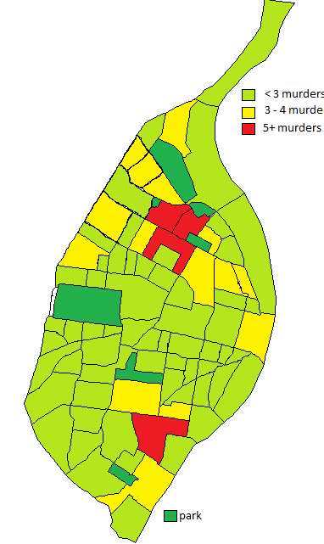
Method 1
Method 3

Slide 15
Sources
http://quickfacts.census.gov/qfd/states/29/2965000.html
http://stlcin.missouri.org/census/cen_city_comp.cfm
http://www.zillow.com/local-info/MO-Saint-Louis/
http://www.slmpd.org/crime_stats.shtml

