Slide 2
Where to Start?
Professor Richard Rosenfeld
Social sources or violent crime
Crime control policy
Crime trends

Slide 6
Steps Towards Prediction
1. Understand project purpose
2. Decide which data is important and collect data
3. "Clean" data
4. Choose right software and right model
5. Calculation & Understanding the result
6. Predict
Notes:
1, Use statistical technique to predict crime, specifically Homicide will occur in city. In particular, we must predict the number and location of homicide.
2, All data are useful but subject to our limited time, manpower, technology, we need to decide which data is more value to us and collect it.

Slide 7
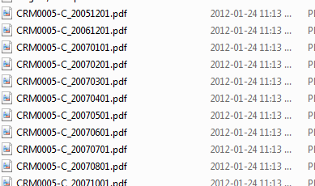
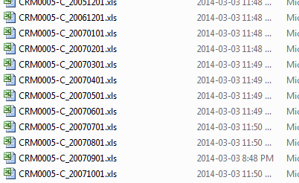
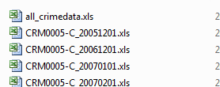
Notes:
3. Format data and make it readable by software.

Slide 8
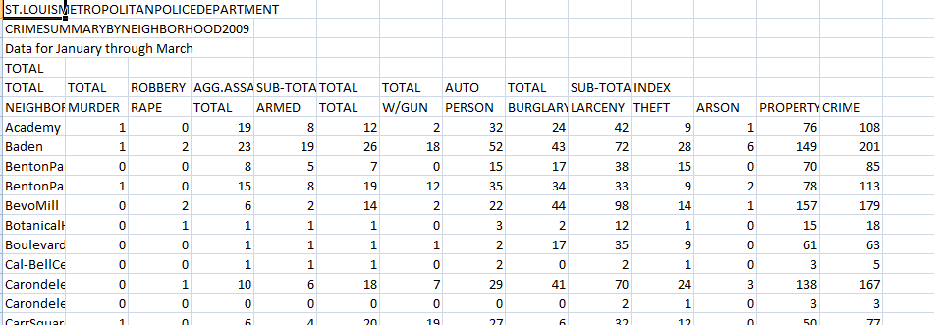
Notes:
1, Use statistical technique to predict crime, specifically Homicide will occur in city. In particular, we must predict the number and location of homicide.
2, All data are useful but subject to our limited time, manpower, technology, we need to decide which data is more value to us and collect it.
3. Format data and make it readable by software.

Slide 9
Choose right software and right model
Stata, SPSS and SAS
“Statistical” +“Data”=Stata
Notes:
4, There are numbers of software nowadays. Stata, SPSS and SAS are three major statistics softwares. Compared to SAS and SPSS, Stata is a relatively easy to learn and also offer user easy GUI interface and powerful programming experenice. Since Stata is very good with time-series data and we believe Professor already hint us to use STATA by using language such as “Statistical” “Data”, In her assignment requirement, We decide to use Stata, especially its liner regresstion fuction to solve our problem.

Slide 10
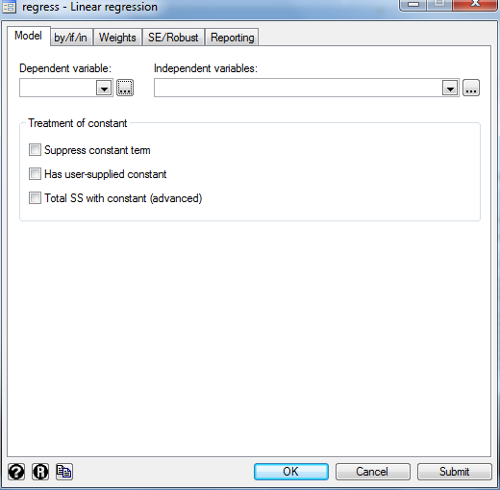

Slide 11
Stata Information

Slide 12
Data Mining
Stata values used to come to our end result
Years multiplied by -0.0091884
Months multiplied by 0.002323568
Location multiplied by 0.0034655
Constant = 18.46278
Homicide=Y* (-0.0091884)+M* 0.002323568+L* 0.0034655+ 18.46278

Slide 13
Prediction = ~112

Slide 14
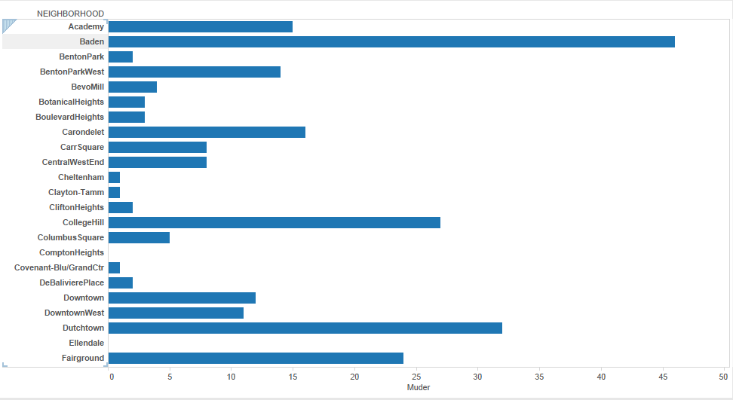
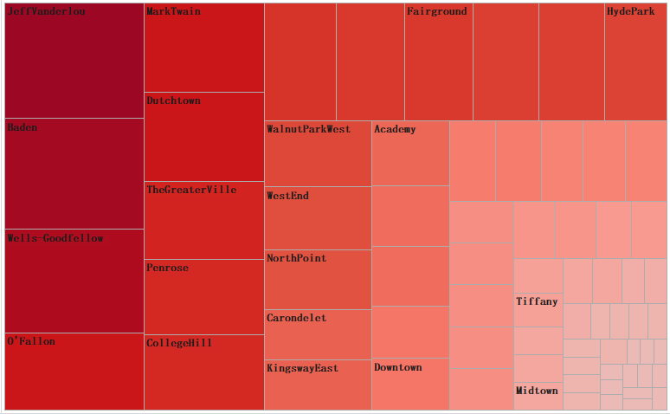
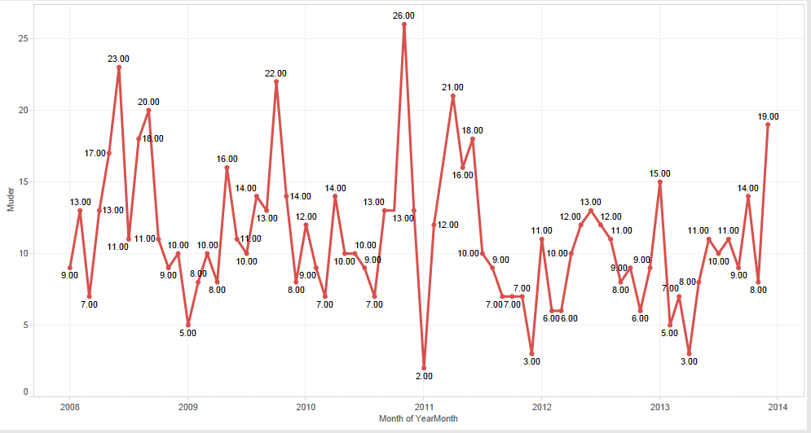
Tableau

Slide 15
Mean, Median, Mode and IQR
 | Median Household Income | 2008 Total | 2009 Total | 2010 Total | 2011 Total | 2012 Total | 2013 Total
Sample Size | 76 | 79 | 79 | 79 | 79 | 79 | 79
Sample Mean | $33,303.32 | 2.05 | 1.80 | 1.81 | 1.41 | 1.43 | 1.52
Sample Median | $33,324.50 | 1 | 1 | 1 | 1 | 1 | 1
IQR(Inter Quartile Range) | $42,815.50 | 3 | 3 | 3 | 2 | 2.5 | 2

Slide 16
Quote
“Crime was down in the city and across the country last year, according to preliminary numbers released by the FBI this morning. When the St. Louis Metropolitan Police Department first released the numbers in January, Chief Dan Isom said they showed the city is “headed in the right direction.”” McClatchy - Tribune Business News 05/23/2011

Slide 17
Five Neighborhoods with a Drop in Homicide
Neighborhoods | 2008 | 2009 | 2010 | 2011 | 2012 | 2013 | Total | Median Income
Fairgrounds | 5 | 0 | 9 | 2 | 2 | 6 | 24 | $23,761
Hyde Park | 4 | 6 | 5 | 1 | 4 | 2 | 22 | $27,870
O’Fallon | 9 | 3 | 6 | 1 | 5 | 8 | 32 | No Data
Mark Twain I-70 Ind. | 2 | 2 | 4 | 0 | 3 | 3 | 14 | No Data
Kingsway West | 5 | 6 | 6 | 1 | 4 | 3 | 25 | $32,112

Slide 18
Language is a tool to conceal the truth. –George Carlin

Slide 19
Questions

Slide 20
References
・SE, Heather Lane. Crime statistics McClatchy - Tribu
ne Business News, May 12, 2007 Income Statistics by Rorty, M. C
・Publications of the American Statistical Association, ISSN 1522-5437, 09/1917, Volume 15, Issue 119, pp. 794 – 800
・Despite economy, national and St. Louis crime down St. Louis Post-Dispatch (St. Louis, MO), 05/24/2011
・FBI stats show drop in crime in St. Louis, nationwide by Jennifer Mann
McClatchy - Tribune Business News, 05/23/2011
・Crime and Crime Control by Joo, Hee-Jong Social Indicators Research, ISSN 0303-8300, 04/2003, Volume 62, Issue 1, pp. 239 – 263
Other data source: http://www.areavibes.com/st.+louismo/neighborhoods/
http://www.neighborhoodscout.com/mo/st-louis/
https://stlouis-mo.gov/neighborhoods/

