Slide 1
The Fundamentals of Facebook, LinkedIn and Twitter
Vicki L. Sauter
August 4, 2011

Slide 2
A Shameless Plug

Slide 3
A Less Shameless Plug
Personal Branding and Professional Networking
Nicholas Gilham and Danyelle Little
JC Penny Conference Center at UMSL
August 20: 1-5 pm
http://abrandedyou.eventbrite.com/

Slide 4
What is a Social Networking Service?
an internet-based service that allows us to interact with others
build networks
connect across political, economic and geographic borders
share information within that network

Slide 5
What does it Involve?
Create profile
Post entries for others to read
Maybe post photos for sharing
Search for people or interests and create contact lists
Create groups for people of similar interests

Slide 6
Facebook

Slide 7
LinkedIn

Slide 8
Twitter

Slide 9
Why Use Social Networks
share ideas
share activities
share events
share interests
meet people
find people (who are lost to you)
blogging (and microblogging) your ideas
play games
participate in other activities
become known
stay informed
get a job

Slide 10
Why Businesses use Social Networks
Premises:
individual workers and groups of workers gain productivity by leveraging contacts in other units of the same organization or in other, separate organizations
there is value in knowing what your customers and competitors think
there may be value in having your customers know what you think

Slide 11
Why Businesses use Social Networks
may improve intra-organizational communication
but might contribute to the development of cliques and cause a rise in "political" behaviors
might improve the relationship between the organizations (for instance, helping coordinate a supply chain)
might foster cooperation on some issues
but also might lead to leakage of proprietary information

Slide 12
Why Businesses use Social Networks
might lead to performance disadvantages if unmanaged (those who have good networks being at an advantage)
might understand customers better
might be able to respond to customers faster
applications for doing business on Facebook

Slide 13
Examples of Use
Daughter of ousted GM CEO takes revenge online
Gangs using Facebook, Twitter more often
Facebook employed in search for missing Rockefeller
Auschwitz Museum embraces Facebook
Facebook and the 2008 Election
ABC News Joins Forces With Facebook
Debates
Phishing Scam Targeting Facebook Users
Facebook and the Revolution in Egypt
Power of Twitter, Facebook in Egypt crucial, says UN Rep
Egypt’s Facebook revolution faces identity crisis
Egypt's Facebook Revolution: Wael Ghonim Thanks The Social Network
Facebook and the Japanese Tsunami
Facebook Causes Rallies Help For Japan’s Tsunami
Japan hates Facebook

Slide 14
How to Use Social Networking
Step One:
Determine WHY you are using Social Networking
Share Information
Get Information
Be Sociable
What is your GOAL

Slide 15
Step Two:
Determine with WHOM you communicating
Friends
Family
Colleagues
Potential Employers

Slide 16
Step Three:
Think about potential risks of communication BEFORE you start
What if someone who is not intended gets the information?
What image are you setting?
What are the chances of viruses, trojans, stolen data, etc.

Slide 17
Criticisms of Facebook: Wikipedia

Slide 18
Keep a Positive Image
DO clean up digital dirt BEFORE you begin your job search
Remove any photos, content and links that can work against you in an employer's eyes
DO consider creating your own professional group on sites like LinkedIn or Facebook to establish relationships with thought leaders, recruiters and potential referrals
DO keep gripes offline … keep the content focused on the positive, whether that relates to professional or personal information
Make sure to highlight specific accomplishments inside and outside of work
DON'T forget others can see your friends, so be selective about who you accept as friends. Monitor comments made by others. Consider using the "block comments" feature or setting your profile to "private" so only designated friends can view it
DON'T mention your job search if you're still employed

Slide 19
Facebook
largest usage worldwide
general connections with friends and relatives
more than 600 million users
official statistics

Slide 20
Advice on the Use of Facebook
12 Ways to Use Facebook Professionally
32 Ways to Use Facebook for Business
How to Create a Business-Friendly Facebook Profile

Slide 21
News Feed, Home or the Wall

Slide 22
Profile -- Wall

Slide 23
Profile --Information

Slide 24
My Profile, Continued

Slide 25
My Profile, Continued

Slide 26
Profile -- Photos

Slide 27
Tagging Photos

Slide 29
Profile -- Friends

Slide 30
Adding Friends

Slide 31
Finding Friends

Slide 32
Other Ways to Find Friends

Slide 33
Controlling what you Read

Slide 34
Applications

Slide 35
Games

Slide 36
Groups

Slide 39
Fan Pages

Slide 41
Security and Privacy

Slide 43
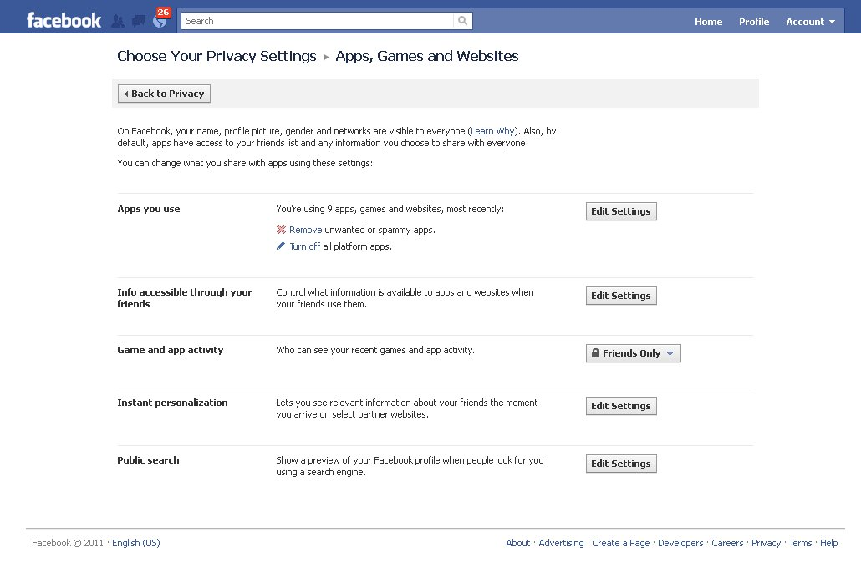

Slide 44
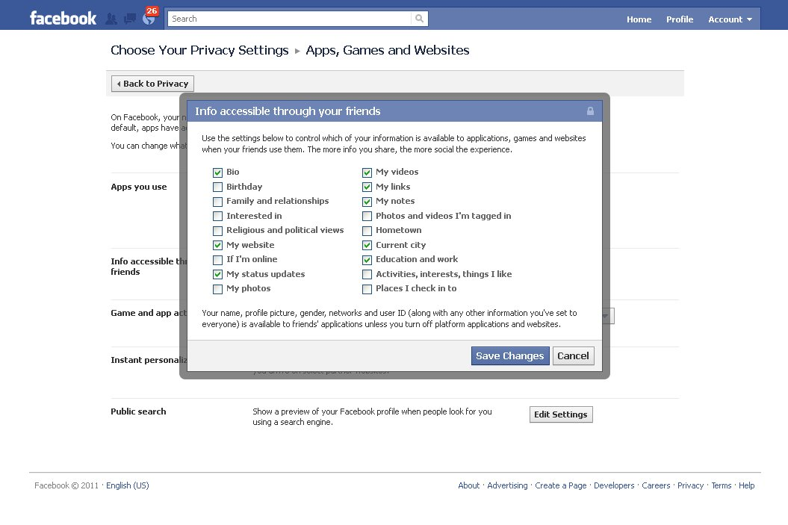

Slide 45
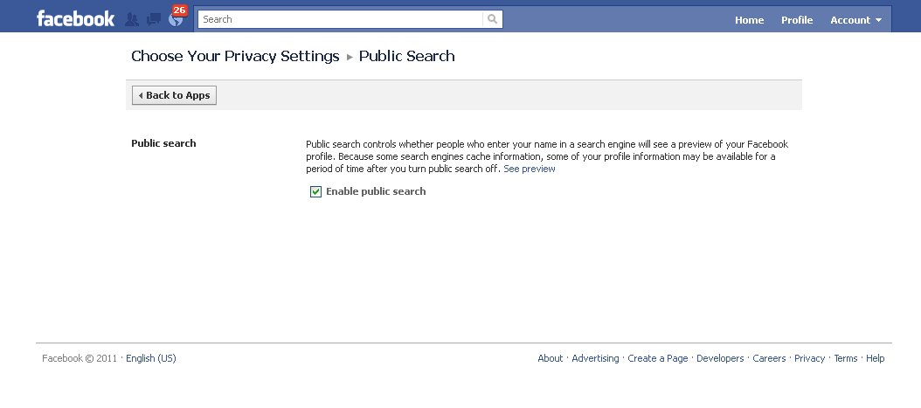

Slide 46
LinkedIn
largest usage in North America
past its 100 millionth member last spring
primarily business connections
advice on using LinkedIn: Dwayne Miller

Slide 47
Benefits of LinkedIn
Ability to be known: If you use the tools, follow good netiquette and provide intelligent and useful information you can make yourself known and promote yourself
Ability to be found: Recruiters can find you -- Recruiters spend a lot of time on LinkedIn
Ability to find others: Find people who are at companies or who have specific skills
Opportunity to learn and share: LinkedIn Answers allows you to get expert advice fast
Ability to connect with group members: In this way you may connect with other group members whom you might not otherwise "meet”
Opportunity to show you are plugged into the current technology

Slide 48
Limitations of LinkedIn
It is not a full social environment
LinkedIn has limited features for communication and sharing
But, the ones it has are professional!
It does not give you complete control of your relationship
Both people need to agree to be connected and either may leave the "connection" at any time
It does not allow you to store relationship information about your contacts
It doesn't provide much privacy
It has a closed communication system

Slide 49
Home

Slide 50
Profile

Slide 51
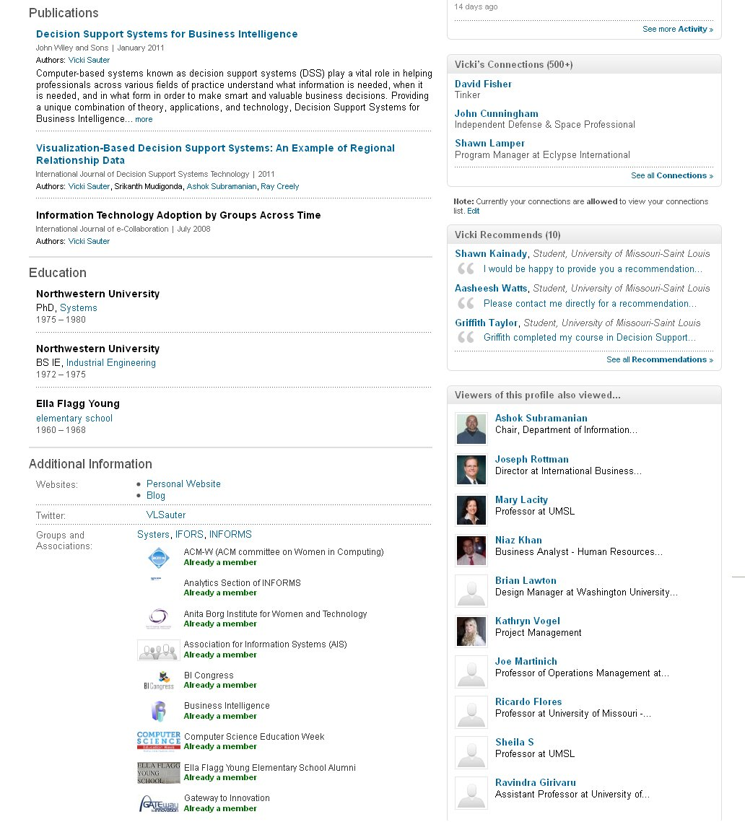
My Profile, Continued

Slide 52
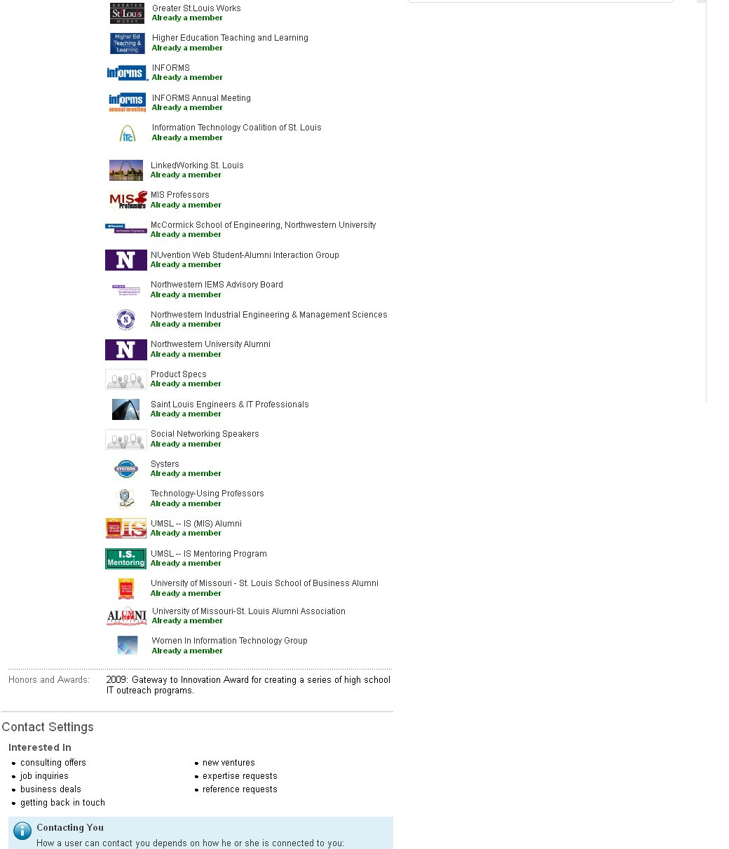
My Profile, Continued

Slide 53
BRAND Yourself

Slide 56
Contacts

Slide 57
Contacts – By Company

Slide 58
Contacts – By Industry

Slide 59
Import Contacts

Slide 60
Understanding Your Contacts

Slide 61
More about Your Contacts

Slide 62
Searching for Contacts

Slide 63
Contacts at a Specific Company

Slide 64
Learning more about Contacts

Slide 65
Learning More about Companies

Slide 66
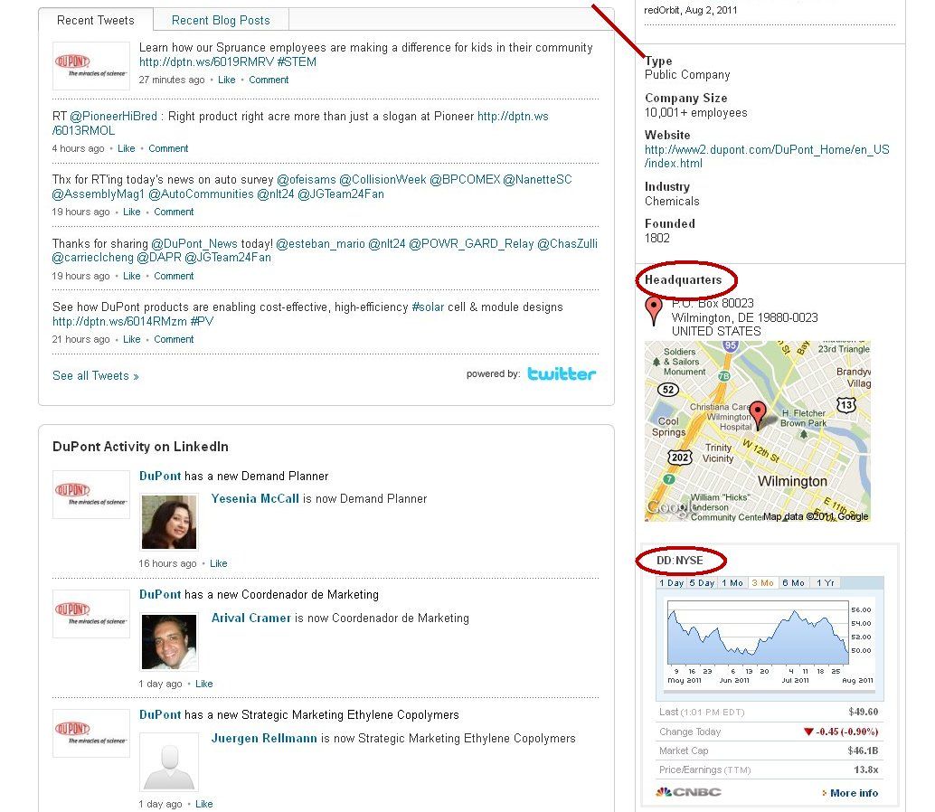
More about the company

Slide 67
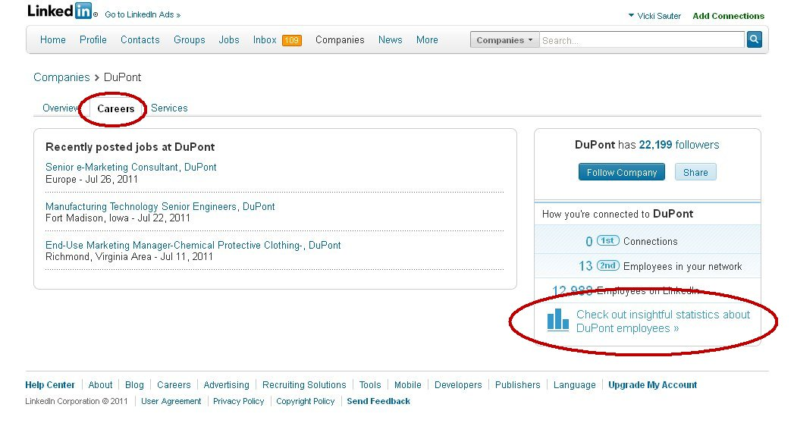
More about the company

Slide 68
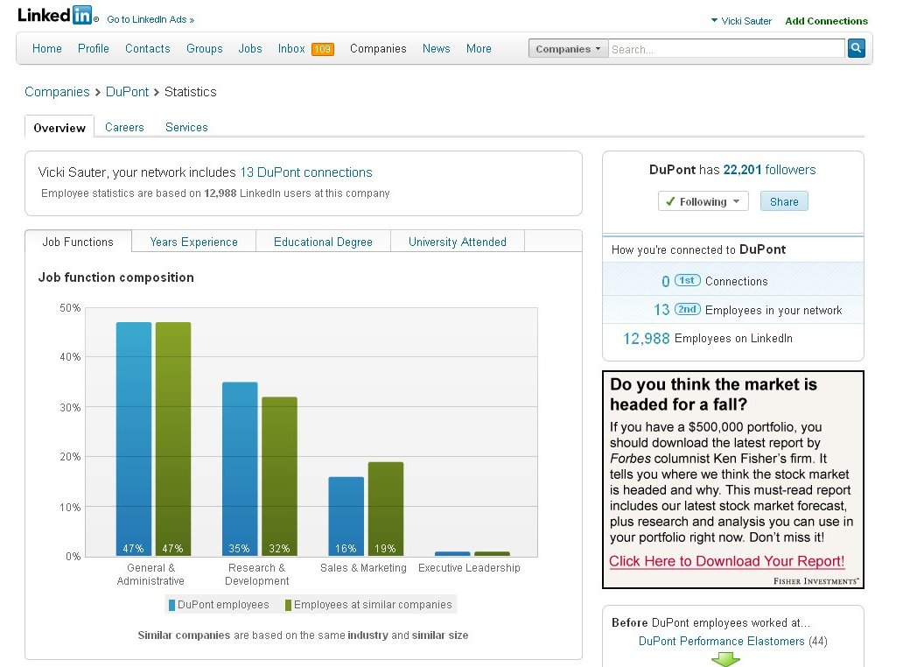

Slide 69
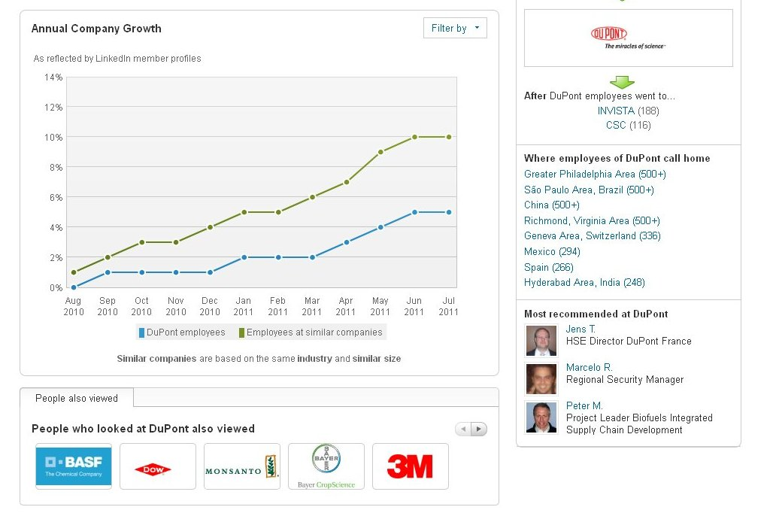

Slide 70
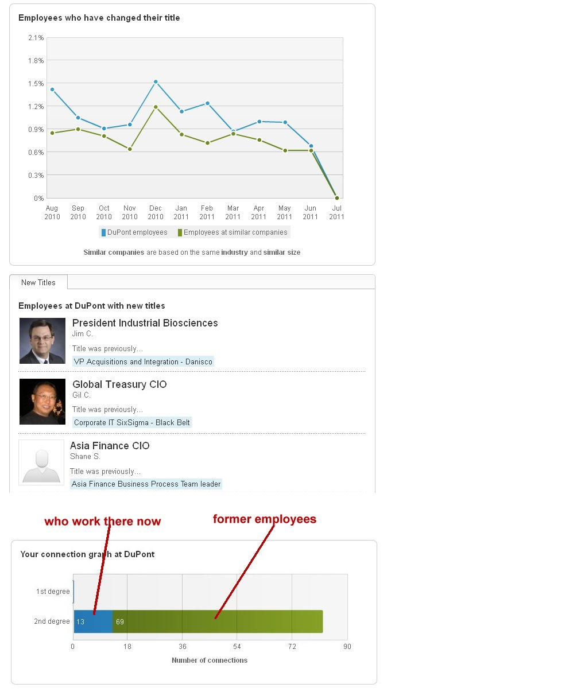

Slide 71
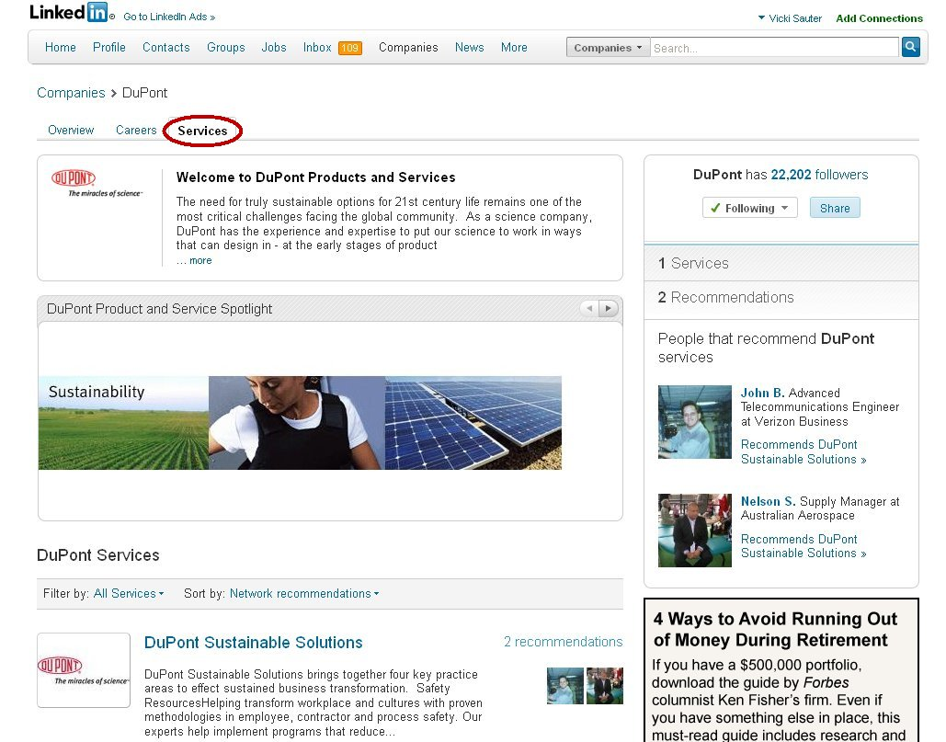

Slide 72
See How Others See YOU

Slide 75
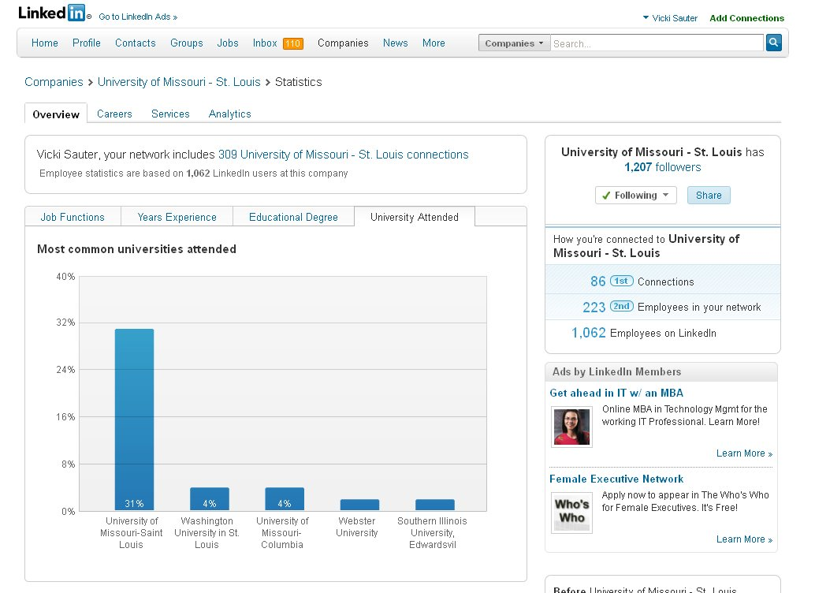

Slide 76
Careers at Your Company

Slide 77
Services at Your Company

Slide 78
Analytics

Slide 79
More Analytics

Slide 80
Individual Communications

Slide 81
Invitations to Connect

Slide 82
Helping the Job Search

Slide 83
Communities of Interest

Slide 84
Following Discussions

Slide 85
Finding New Communities

Slide 86
Example Community -- Discussions

Slide 87
Example Community -- Members

Slide 88
Example Community -- Announcements (Promotions)

Slide 89
Example Community – Targeting Job Ads

Slide 90
Adding Connections

Slide 91
Focused Search -- Colleagues

Slide 92
Focused Search -- Universities

Slide 93
Learn about your Classmates

Slide 94
Twitter
microblogging site: limited to 140 characters
190 million users
65 million tweets/day
800,000 search queries each day

Slide 95
Why Tweet
drive people to your blog or webpage by providing context for it
publish a short story, article or a book by posting one line each day
@Genny_Spencer: diary of an Illinois farm girl
fundraising campaigns for not for profit organizations (e.g., Haiti)
boost your professional reputation
this means you must post interesting material that is well written and must post regularly on a specific topic

Slide 96
Notable Examples
2007 California fires: those using Twitter kept their followers (who were often friends and neighbors) informed of their whereabouts and of the location of various fires minute by minute
2008 Mumbai attacks: eyewitness accounts; list of dead and injured; vital information such as emergency phone numbers and the location of hospitals needing blood donations
February 2009 Victoria bushfires in Australia: used to send out alerts
2009 health departments: H1N1 alerts
2009 Iranian Elections: rallying tool and way of communicating with outside world
2009 Brazilian Supreme Federal Court: posts daily planner of the ministers and important decisions
2010 Resignation by Sun's CEO: Financial crisis/Stalled too many customers/CEO no more
2011 Anthony Weiner scandal

Slide 97
Twitter Terms
Tweet: to send a message
Retweet: reposting a tweet while giving credit to the original tweeter
Follow: receive a message each time the person updates
You can control if and how you receive messages from everyone or from specific people
You can set to mobile phone if you wish

Slide 98
Hashtags
Hashtag (#): designate related messages
example #breakfastandbusiness
events, groups of people
it is a way to create groupings
Be sure it is unique
search for popular hashtags and uses
http://thebounder.co.uk/tagref/
http://tagal.us
http://whatthetrend.com

Slide 99
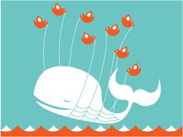
More Terms
Fail Whale: Twitter experiences an outage
Tweetup: create an event
http://twtvite.com

Slide 100
Home

Slide 101
Profile

Slide 102
A Person I Follow

Slide 103
Suggestions to Follow

Slide 104
Finding Folks to Follow
http://mrtweet.net recommendations based on your specific activity
http://whoshouldifollow.com recommendations based on your specific activity
http://wefollow.com
http://twellow.com
http://trackingtwitter.com -- listing of the top media, entertainment, and consumer product feeds
http://twibs.com -- businesses on twitter
http://exectweets.com -- business executives who tweet
http://yammer.com -- people in your organization
http://presentlyapp.com -- enterprise collaboration

Slide 105
Settings

Slide 106
Mobile Settings

Slide 107
Notifications

Slide 108
Customization

Slide 109
LIMITED to 140 characters
use characters instead of words
"+" instead of "and"
"2" instead of two, too
avoid punctuation
use abbreviations
helpful suggestion sites
shorten links
bit.ly -- shortens links and user can track views
is.gd -- shortens links to share; no tracking
twi.bz -- shortens links to share; allows some domain information in new URL

Slide 110
To Send a Tweet

Slide 111
Insert your Location

Slide 112
How to Find Me
Facebook: Vicki TheGeek Sauter
LinkedIn: Vicki Sauter
Twitter: @VLSauter
Google Plus: vicki.sauter@gmail.com
Email: vicki.sauter@umsl.edu
My Home Page: http://www.umsl.edu/~sauterv

Slide 113
Questions

