Slide 1
Internet Tools and Business
Mateusz Czernikiewicz
Adam Whitaker
Natallia Dziatsel
Susan Krause
Matt Baker

Slide 2
Home Depot Website
Ease of use
Problems with the site

Slide 3
Other Home Depot Websites
Corporate Sponsored
Homedepotrents.com
Homedepotfoundation.com
Homedepotimproverclub.com
Homedepotmoving.com
Homedepotgardenclub.com
Non-corporate Sponsored
Sprawl-busters.com/hometown
Homedepotsucks.com

Slide 4
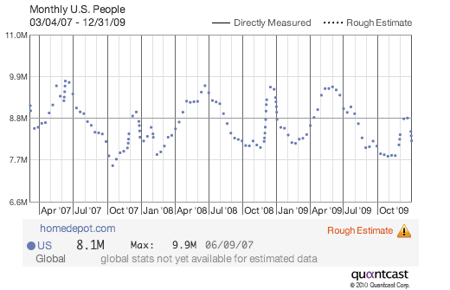
Home Depot Website
Launched on August 4, 1992
Ranking
Audience
Websites linking to Home Depot

Slide 5
HD Blog & Social Networks
Orangeblooded.net
Social Networks
Facebook
Twitter
Youtube Channel

Slide 6
Target

Slide 7
Website
4th largest retailer in US
Website started in 1999
Shopping abilities
Wedding registry
Pharmacy center
Photo center

Slide 8
Website continued
Pleasing to the eye
Can view current ad or download coupons
Daily website only deals
“Where to follow us” section for Facebook, Twitter, YouTube, and Target Mobile

Slide 9
Blogging
Two independent blogging sites
Slave to Target
3 million followers
Also titled “red cart romance”
Target Addict
Newsworthy events & consumer alerts
Fashion & beauty tips

Slide 10
Social Networking
Variety of Facebook pages
Company sponsored page has 800,000 fans
Similar features to website
Solid community service involvement
Valentine’s Day contest for $1 million donation

Slide 11
Twitter & Linkedin
9000 twits
Updates on trends, contests, and recent charitable contributions
Linkedin
Career opportunities
Key stats, such as employee data and company financials
Culture & goals as a retailer

Slide 12
YouTube & Target Mobile
Good buzz advertising
Promotes ad campaigns, fashion tips, and new and upcoming products
Target Mobile sends coupon and current promotion texts

Slide 13
Best Buy

Slide 14
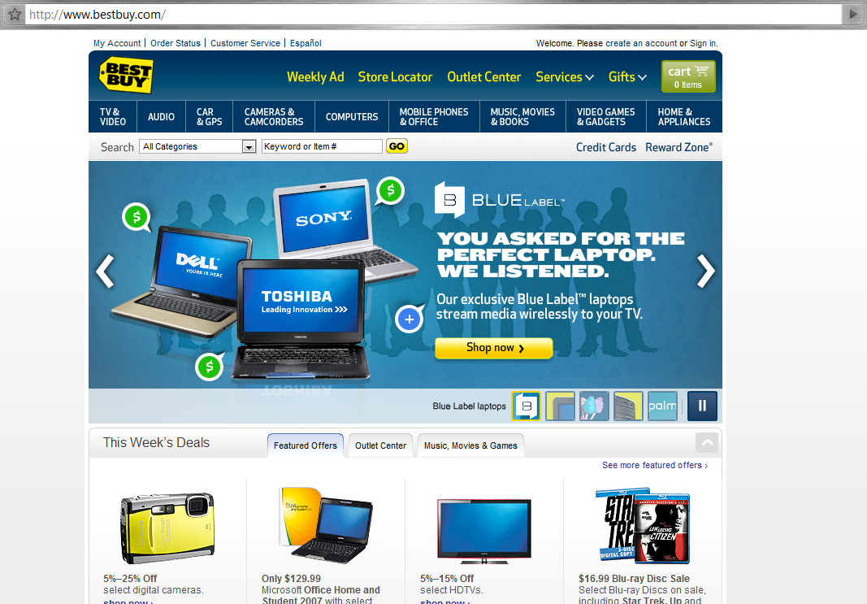
BestBuy.com
Virtual storefront
Central resource
Easy to use
Information:
Price (sales, deals)
Specs
Shipping
Reviews
Functions:
Order and pay
Comparison shop
Manage RewardZone
Apply for a job
Store locator
Online community forum
Notes:
Speed of access – a bit slow sometimes due to high graphics content
Forums.bestbuy.com

Slide 15
Best Buy and Blogs
No sponsored blogs
Aggressive in protecting its image
ImprovEverywhere.com and LaughingSquid.com
Mainly single posts here and there
"Best Buy" vs. Consumer Protection Blog
http://bestbuybadbuyboycott.blogspot.com/
Anti-Best Buy Blog
Created after Best Buy lost a woman’s laptop
Public relations nightmare
Notes:
Will live on in search results

Slide 16
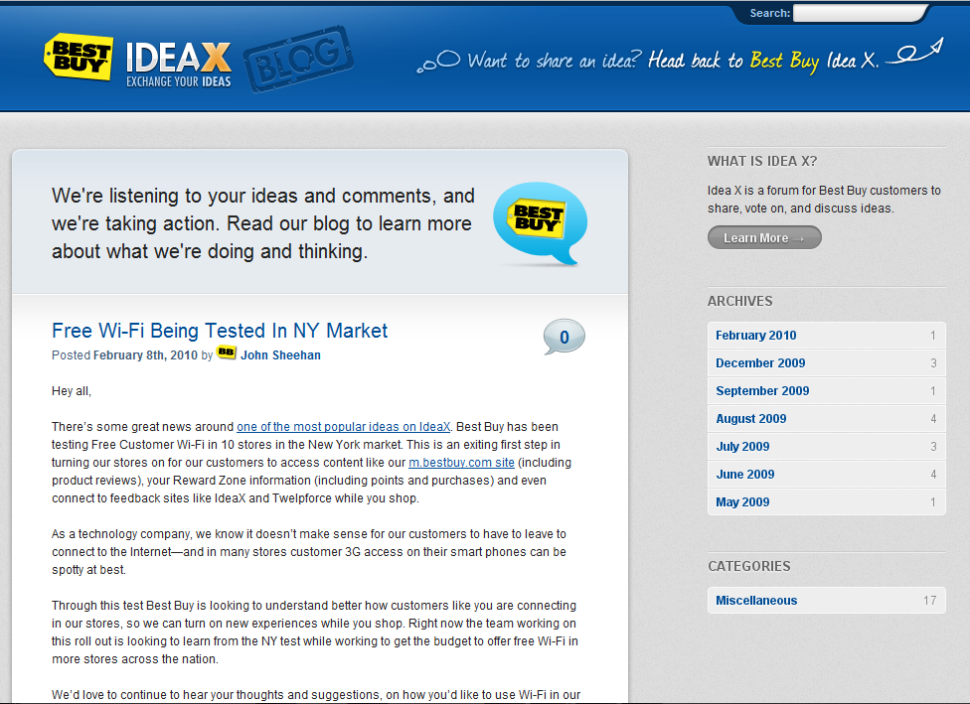
Best Buy Idea Blog ( http://blog.bestbuyideax.com/)
Idea X
Addresses customer ideas
Services and products
Family-friendly
Easy to use
Notes:
May 2009...?
Idea X is a forum for Best Buy customers to share, vote on, and discuss ideas.

Slide 17
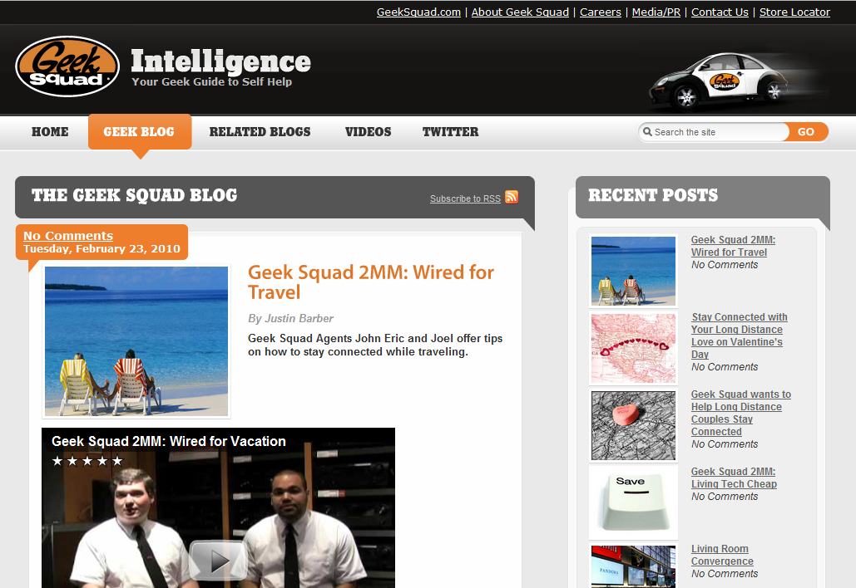
Geek Squad Intelligence
Tech services side
Technology issues
Geek Squad Updates
Family-friendly

Slide 18
Best Buy and Social Networking
Best Buy is deeply involved in social networking
Facebook
Twitter (“Twelp”-force)
YouTube
Community forums (http://forums.bestbuy.com)
Internal social network

Slide 19
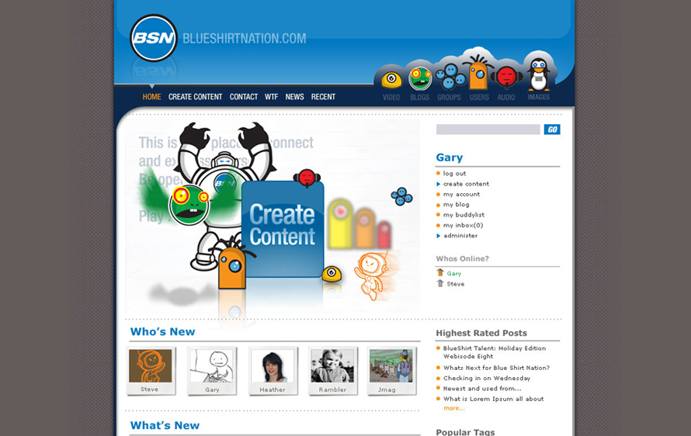
Blue Shirt Nation
Internal social network
Communication tool
Employee feedback
Ideas
Lower boundaries

Slide 20
Best Buy Conclusion
Best Buy is well established on the internet
Makes good use of various social technologies to promote itself
Knows how to use these platforms to get feedback to help service the customers better.

Slide 21
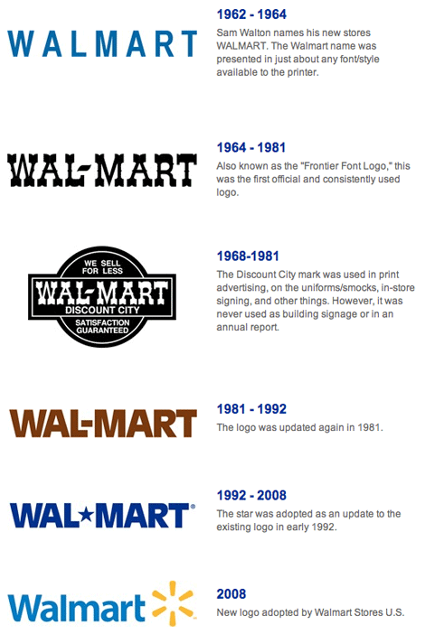
Walmart
Walmart

Slide 22
Website
Company founded in 1962
Largest public corporation by revenue
Largest private employer and grocer in US
Walmart.com launched in 1996 with no online purchase capability
Relaunched in 2000 as a joint venture
Fully acquired by Walmart in 2003
Leading online shopping destinations

Slide 23
Vision of walmart.com
To be the most visited and valued online retail site by making it easier for customers to shop Walmart, both online and in stores

Slide 24
Average Walmart.com customer
Female
Over 43 years old
Have children
Some college education
Browse site from home

Slide 25
Walmart.com customer benefits
Best Value
Large Assortment
Fast Delivery
Easy Experience
Compelling Content

Slide 27
Blogging
The “Checkout” Blog
Walmart Giving Blog

Slide 28
Blogging Continued

Slide 29
Social Network Use
Facebook
Twitter
LinkedIn
Mobile Application
RSS Feeds

Slide 30
Twitter
13 Twitter Accounts
Total number of followers less than 50,000

Slide 31
Facebook
Walmart-666,139 fans
Walmart Beauty-919 fans
Walmart Soundcheck-1,465 fans

Slide 32
LinkedIn
Walmart Group
Walmart Supplier Network members

Slide 33
Mobile Application
Search for all Walmart products
Test different size TVs for your room using your camera
Bookmark your favorite products
Share products using Facebook & email
Quickly find a local Walmart store
Navigate to the Walmart.com full site to buy products

Slide 34
RSS Feeds
Really Simple Syndication
Allows us to publish new information and updates that will be picked up by customers who subscribe to our RSS feeds

Slide 35
Summary
Our retailers have made extensive use of internet business tools
There is room for expansion and improvement
Internet is now and will continue to be a major tool to promote business and communicate with customers

Slide 36
Conclusion
Internet tools will play a crucial part in the futures of nearly every company in existence today
Key component of sales, customer communication, and public relations
Will only continue to grow and become a larger part of the business landscape

