Slide 1
Internet Tools and business in Automotive
Group Members:
1) Jill Lehmen
2) Tracy Clegg
3) Nattapon Nattigon
4) Clayton Nichols
5) Robert Loggins

Slide 2
BMW Motor CO.

Slide 3
Background
Founded in 1916, is a German automaker based in Munich, Germany and is known for its performance & luxury vehicles.
With the tagline of the “Ultimate Driving Machine”, BMW positions itself as a brand of elegance, performance, superior quality of service
The mission statement of BMW simply states:
- The BMW Group is the world’s leading provider of premium product and premium services for individual mobility.

Slide 4
Website
Purpose:
- To market products & services in accordance with the mission statement of BMW.
Intended Audience:
- Current & prospective customers
www.bmw.com

Slide 5
Information and Tools Provided
Traditional information such as where to find a local dealer, model specifications and pricing information, interactive tours & financing options.
Build & price their own BMW, schedule a test drive, request brochures, drive & apply for financing directly through the website.
Download screensavers & wallpapers; sign up for mobile text alerts.

Slide 6
Information and Tools Provided
BMW’s customer care programs, links to product reviews such as www.edmunds.com .
BMW USA offers 2 unique services: European Delivery and the Performance Driving School.
Links to official BMW car clubs and recommended enthusiast websites & forums.

Slide 7
Strengths of Website
Sleek, sophisticated look.
Efficient use of dropdown menus and links for ease of navigation.
Provides necessary product information, promotes its brand and services all the while portraying the BMW as “The Ultimate Driving Machine”

Slide 8
Social Networking and Blogging
BMW’s official presence on blogs and social networking sites is limited.
No official BMW presence on LinkedIn, Twitter or Myspace.
Unofficial LinkedIn company page
http://www.linkedin.com/companies/2387
Facebook is the notable exception.

Slide 9
BMW on Facebook
Links National BMW Pages on Facebook
http://www.facebook.com/BMW?v=wall&ref=search#!/BMW?ref=mf

Slide 10
BMW’s blog
Created by Horatiu Boeriu out of his passion for BMWs.
Find resources on all BMW series, BMW news & rumors, videos, spy photos of 2011 and 2012 models, links to auto shows, events, tips for the BMW owner, as well as connect with other BMW owners.
www.bmwblog.com
www.twitter.com/bmwblog
www.feedburner.com/bmwblog.com

Slide 11
Strengths
www.bmw.com
Facebook Presence
Weakness & Suggestions
No official blogs or social network presence
Use their own Facebook page or bmw’s blog to expand official BMW presence.

Slide 12
ForD MOTOR CO.

Slide 13
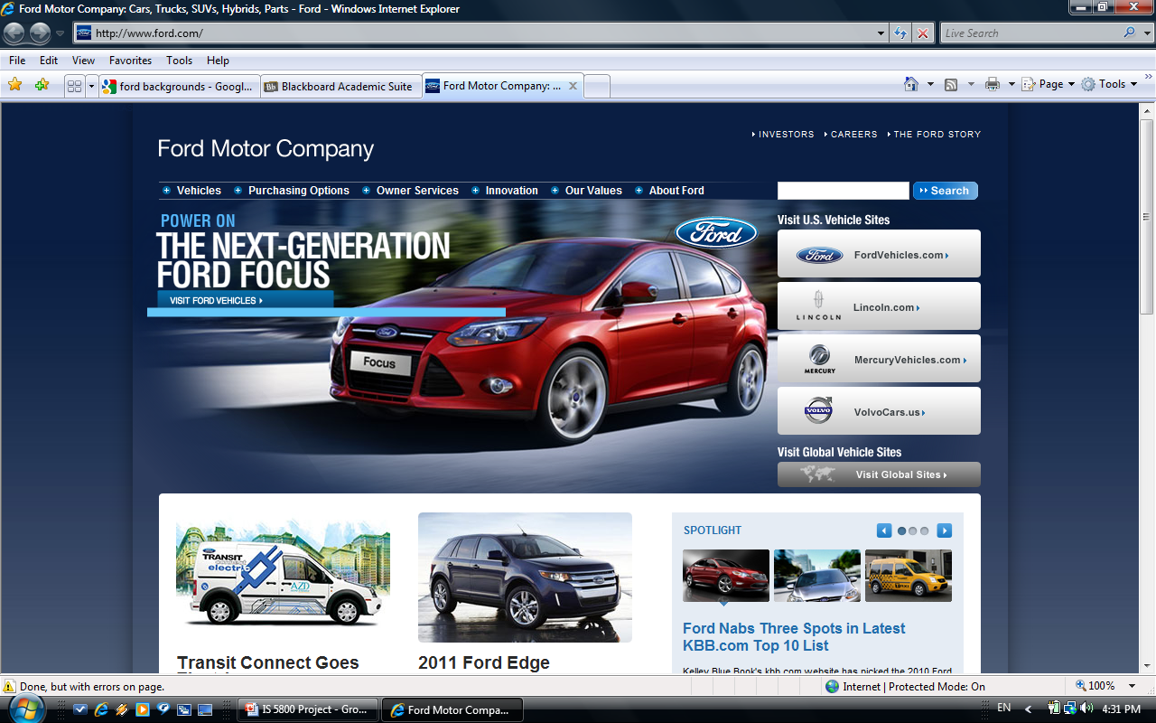
Ford’s Website
www.ford.com

Slide 14
Website
Purpose:
- To provide Ford products & services along with investment & media updates
Intended Audience:
- People who are looking for a car or Ford products

Slide 15
Website
INFORMATION PROVIDED:
Career opportunities
Information about the company
Announcements
Company’s values
Safety
Quality
Financing

Slide 16
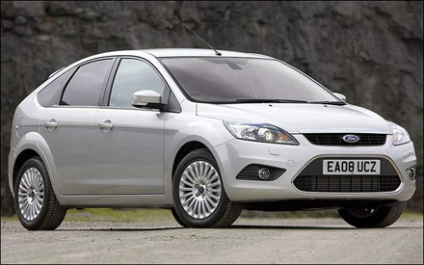
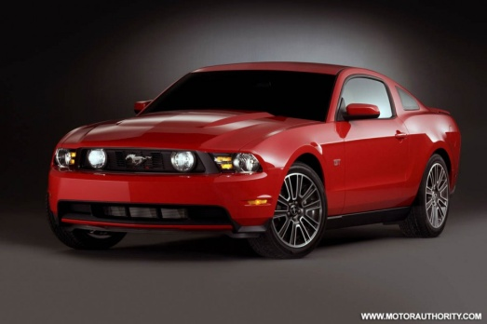
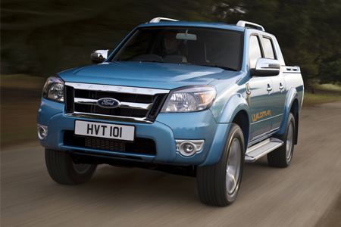
Website
Website in terms of clarity, use, & speed
Several goods found on website but not purchased directly
Overall opinion of website

Slide 17
BLOGGING
Company sponsored sites
www.ford.com
www.fordvehicles.com
www.media.ford.com
Policies:
- They respect your privacy and don’t collect personal information unless provided voluntarily
Information found:
- Announcements, information about the company

Slide 18
BLOGGING
Non-sponsored Ford blogging sites:
www.automotive.com
www.mustangblog.com
www.blueovalnews.com
Ranges and background of people

Slide 19
BLOGGING
Comparison of websites
General guideline

Slide 20
SOCIAL NETWORKING
Facebook
Twitter
Youtube
Screenscape
Delicious
Flickr
Scribd

Slide 21
SOCIAL NETWORKING
Information found:
Information about the company
News and announcements
Pictures
Videos

Slide 22
SOCIAL NETWORKING
Ranges of people and background
Comparison of websites
General guideline

Slide 23
Toyota Motor Corp.

Slide 24
Toyota’s Company Website
Purpose: To inform customers
Current
Prospective
Message is positive
Make current customers feel good about purchase
Lure prospective customers
Message is informative
Everything about the vehicle
Interactive applications

Slide 25
Toyota’s Company Website
Functions:
Narrow searches of vehicles
Up-to-date starting prices
High-quality photos with zooming and rotating features
List of specs
List of additional options available
Vehicle comparison tools
Build your own Toyota

Slide 26
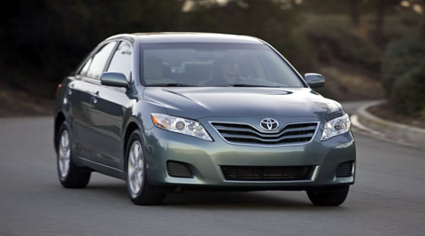
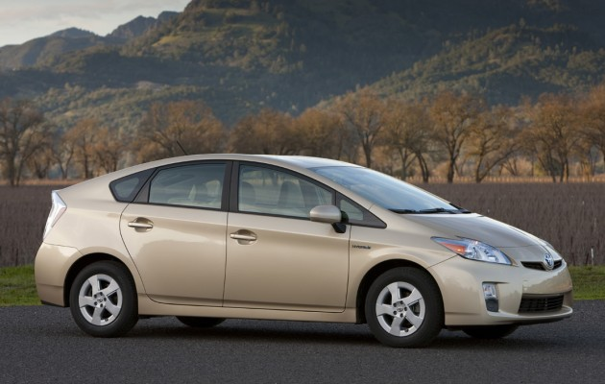
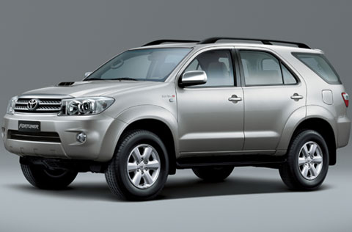
Toyota’s Company Website
Opinion of the website:
Well-designed
Ease of use
Speed of access
Aesthetics

Slide 27
Blogging
Company-sponsored blogging:
http://www.pressroom.toyota.com
http://pressroom.toyota.com/pr/tms/our-point-of-view.aspx
Maintained by company associates
Not objective.
Everyone is encouraged to share their ideas/viewpoints.
Not updated since December 2009.

Slide 28
Blogging (Con.)
Non-company sponsored blogs:
Well-known third-parties
Consumer Reports
Motor Trend
Many more mentions in other blogs due to recent troubles
Recent popularity of mentioning Toyota has led to a very wide range of opinions.

Slide 29
Social Networking
Company-sponsored uses all the well-known sites including:
Facebook
Twitter
LinkedIn
YouTube
Non-company-sponsored
Over-whelming positive message
Recent news has created some negative postings

Slide 30
Honda Motor Co., Inc.

Slide 31
Background
Registered in Japan in 1953
Trademark in the U.S. after a decade
American Honda Motor Co. is based in Torrance, California

Slide 32
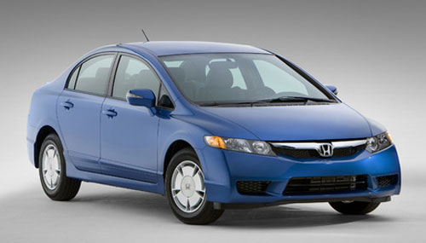
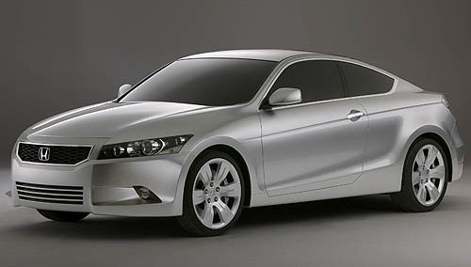
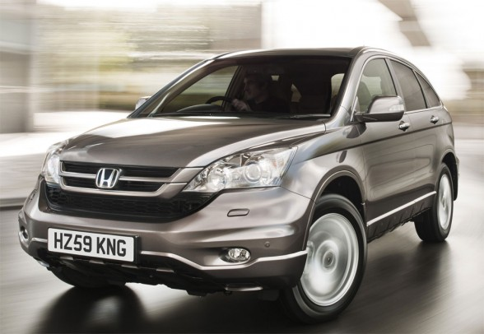
Possible performance in 2010
Market share & Sales volume
Toyota’s cars recalled situation
8 million cars worldwide

Slide 33
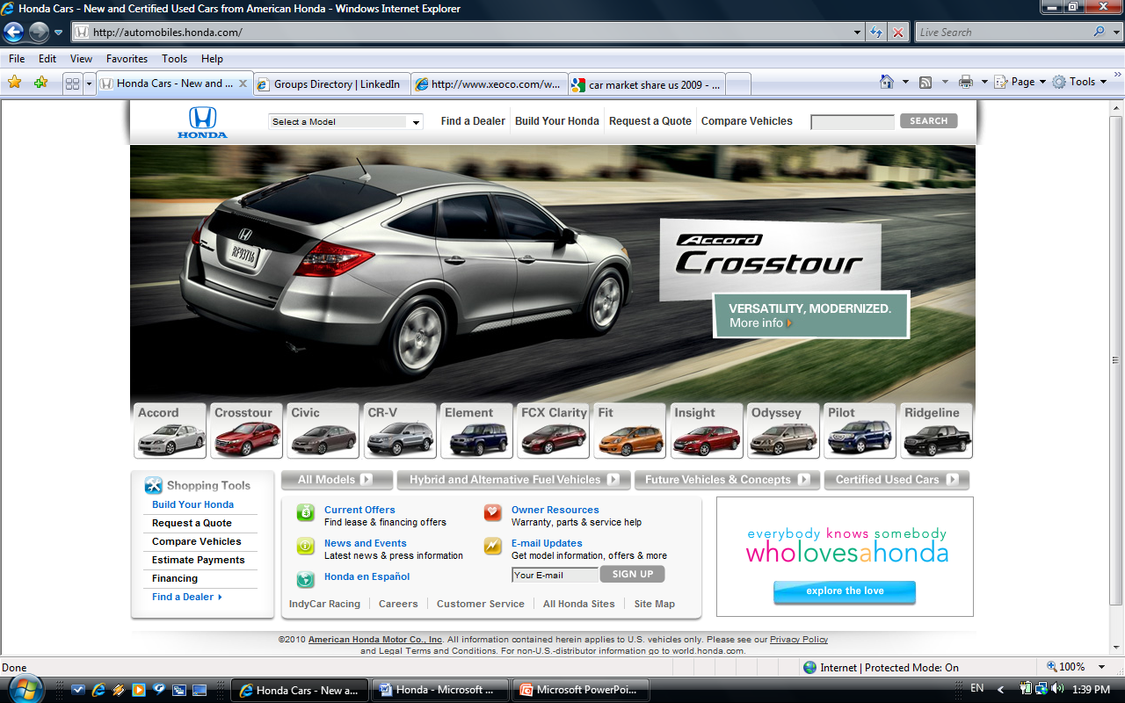
Website
Website: http://automobiles.honda.com

Slide 34
Purpose in developing the site
To provide coverage information to customers who are interesting in purchasing cars
Eg. price, color, design, interior & exterior, and so on.
Intended audience
The customers who are interesting in buying cars & need to search for the cars’ information and compare among each models and other brands.

Slide 35
Information content
Vehicle type (Coupe, Sedan, SUV,…..)
Model
Color (Silver, black, white,…..)
Accessories
Price
Financing inf.& estimate monthly payment.
Cannot purchase car from Honda’s site

Slide 36
Conclusion about Honda’s site
Coverage each car model’s information
Very convenience to use Good sections arrangement
Processing very fast.
Aesthetic Fascinated cars’ pictures

Slide 37
Blogging
Honda sponsor blogging site
http://automobiles.honda.com/insight-hybrid/insight-blog.aspx
Many articles are posted by Honda’s employees.
Provides cars’ inf. & events inf. (Eg. music festival)
Some tips to consider before buying a car.
Policies on site: Intellectual Property, Privacy & Security,
Information use, and so on.

Slide 38
Non-Honda-sponsored blogging sites
Numerous non-Honda-sponsored blogging sites and they
Can be found easily by using search engine (Eg. Google/ Yahoo)
http://blogs.automotive.com/1/honda/index.html
http://blogs.motortrend.com/2/83/honda/index.html
Comparison between non-Honda to Honda-sponsored blogging sites
Inf. for each car model in non-Honda-sponsored blogging sites is not detail like Honda official site does.
Honda-sponsored blogging site has more fascinating pictures.

Slide 39
The ranges of people who blog about Honda cars
For Honda’s blogging site
- Employees in Honda will be the person who posts articles.
Eg. Senior Product Planner or Manager - Product Planning in Honda Car-Line.
For non-Honda-sponsored blogging sites
Difficult to identify bec. every people can post anything on the blogs.
People who post should have experience with Honda or own Honda car.
Randomly reviews: Honda’s cars got many complements from customer.

Slide 40
Honda’s Social Networking sites
Many groups to join.
Policy: Privacy, Sharing your content and information, Safety, Protecting Other People Rights, and so on.
http://twitter.com/Honda
Policy: basic terms, privacy, passwords, content on the services, your rights, Twitter rights, Restrictions on Content and Use of the Services and so on
Many groups to join.
Policy: Your Obligations, Your Rights, Our Rights and Obligations, LinkedIn User DOs & DON’Ts, General Terms, and else.

Slide 41
Information on Honda’s social networking sites
Information about cars & the experience customers have from using Honda car.
Many conversations between each group member
Eg. Questions about car or some members might post something that is not related to Honda cars
Non-Honda-sponsored social networking sites
Easily to find by typing the word “Honda” in any social networking sites
Not much different between Honda-sponsored & Non-Honda-sponsored social networking site.

Slide 42
The What, How, Who and Why
What are the plans for internet presence?
How does an Internet presence help companies achieve
their goals?
Who is using the various networking outlets?
Why are companies blogging and using social networking?

Slide 43
Internet Use and Effectiveness
The comprehensive approach to include blogging and many social networking cites.
Standard approach to include some blogging and few social networking cites.
Standard approach to include some blogging and few social networking cites.
Limited approach to include one social networking cite.

Slide 44
Strategy Evaluation
→ High internet saturation
- Mainstream/Progressive
& → Medium
- Mainstream/Moderate
→ Low internet saturation
- Luxury/Conservative

Slide 45
Guidelines for Internet Strategy
Company website is the cornerstone.
Website must facilitate the customer shopping process.
Use blogging to give customers more personal feel for company.
Social networking should be fortify branding and marketing strategies.

Slide 46
Questions?

