Slide 1
meta-methodogies

Slide 2
What are they?
These are tools and concepts that an analysis should use regardless of the methodology followed
The tools give more information about how to accomplish tasks
They are Systems Theory and Human Centered Design (or Design Thinking) with a few addititons
Help with solving problems
Help with complexity

Slide 3
First, what problem are we solving?

Slide 4
What can go wrong?
More information about these problems can be found at the Modern Analyst website.

Slide 5
Top 10 reasons for success
Executive Management Support
User Involvement
Clear Business Objectives
Emotional Maturity
Optimization
Agile Process
Project Management Expertise
Skilled Resources
Execution
Tools and Infrastructure
Property of the Standish Group. The entire report is available online, and provides more detail.

Slide 6
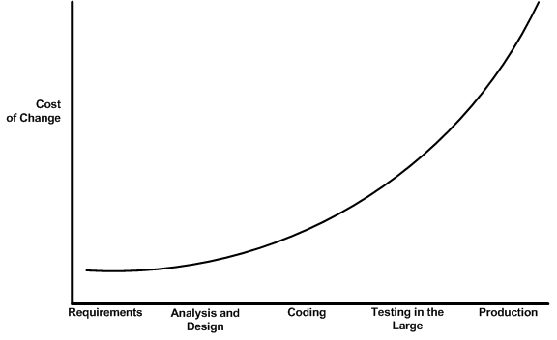
Cost of problems vary by stage

Slide 7
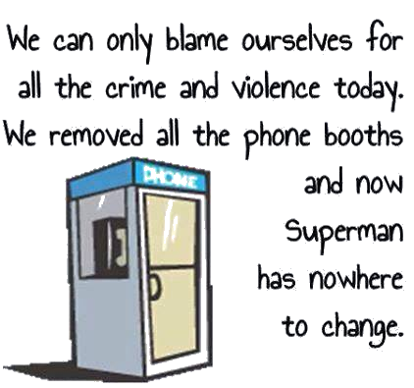
Unintended Consequences
Another example of unintended consequences is available at ORMS Today.

Slide 8
Deal with Complexity
SECOND,

Slide 9
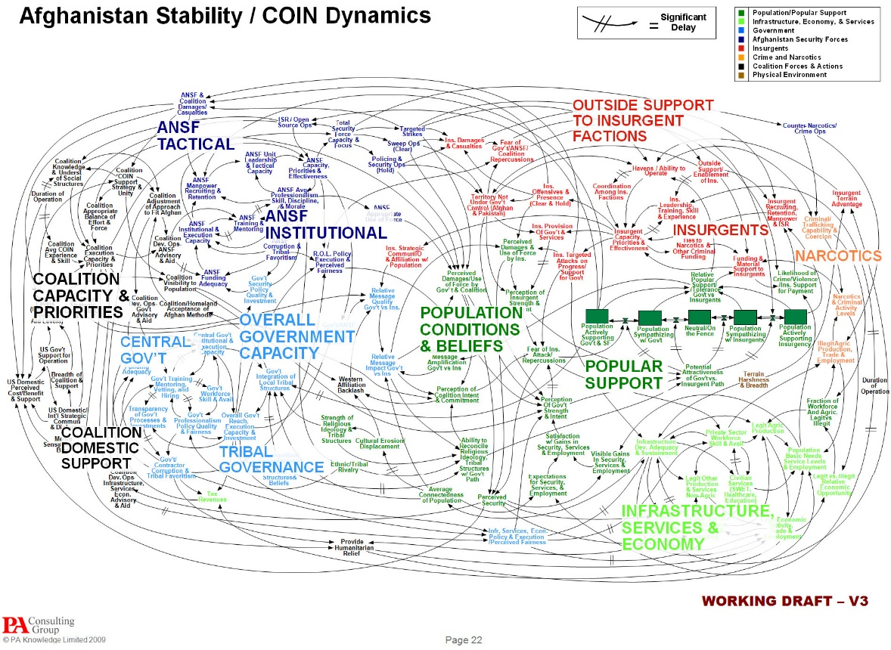
Courtesy of the Pentagon. This is the actual image used by Gen. Stanley A. McChrystal, the leader of American and NATO forces in Afghanistan, to portray the complexity of American military strategy.

Slide 10
More about complexity

Slide 11
Hit the mark: Make Complex Ideas Understandable
Diagram
Deconstruct
Compare
Picture
Map
Do it

Slide 13
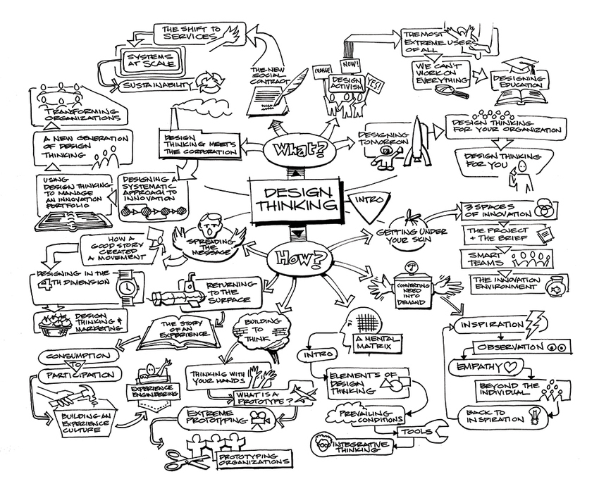

Slide 14
Standish has their own meta-methodology rules
Standish provides 100 best practices, available in groups of 10. The list below identifies the topics covered.:
Correctly identify user
Have a clear vision
There must be agreement on the project, the outcome, measures and value
Minimize the scope
Use an iterative development style
Projects must follow project management fundamentals
Create and maintain accurate estimates and develop a more systematic approach toward project estimating and costing.
Examine the matter of competency and what you need to consider in evaluating the competency of your staff and the team.
A formal methodology must have a problem statement to ensure that everyone is solving the same business problem.
The remainder of the lessons can be found online.

