Slide 1
Chapter 11 GROUP DECISION SUPPORT SYSTEMS
Decision Support Systems
For Business Intelligence

Slide 2
Table 11.1: Functionality of Groupware Products
Enterprise needs
•Cross-vendor support
•Local and remote servers
•Integrated networks
•Executive information systems standards
•Network operating systems
•Database
•Document and image repository
•Object repository and knowledge ware
Group needs
•GDSS
•Desktop video and audio conferencing
•Group application development environment
•Group editing
•Workflow management
Tools
•Email and messaging
•Calendar management and scheduling
•Personal productivity applications
•Models and model management

Slide 3
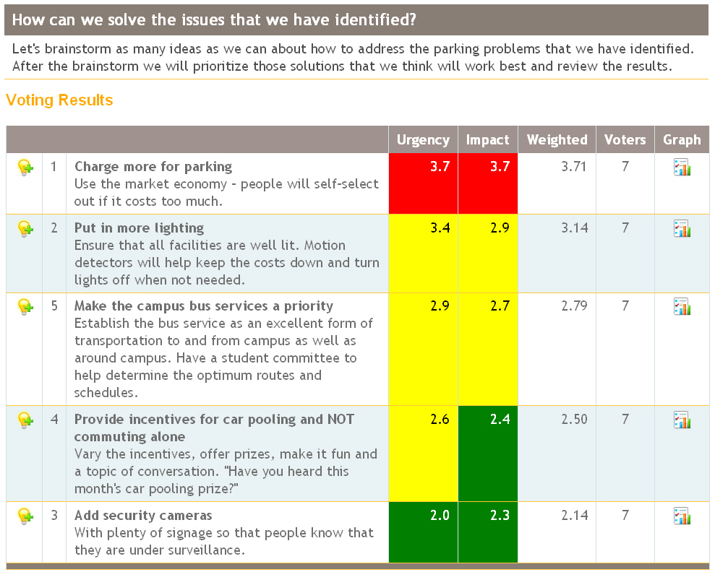
Figure 11.1: Voting Tools Available with Groupware

Slide 4
Table 11.2: Possible Standards for Groupware Products
• the multi-vendor scheduling standard should support transparent scheduling for all store-and-forward messaging transports, as well as via real-time network protocols
• the standard should include hooks into shared X.500 directory services, as well as proprietary e-mail, groupware and network operating system directories
• the standard should support the calendar synchronization policies maintained by various scheduling tools
• the standard should support interfaces to multi-vendor network-enabled project planning and management tools
• the standard should allow users to control who may access their personal calendars, what fields may be viewed and modified, and what types of events may be scheduled without the owner’s prior consent
• the standard should mediate between the various techniques used by scheduling tools to request meetings, negotiate meeting times and places, and reconcile conflicting schedules.

Slide 5
Figure 11.2: Typical Decision Conferencing Configuration

Slide 6
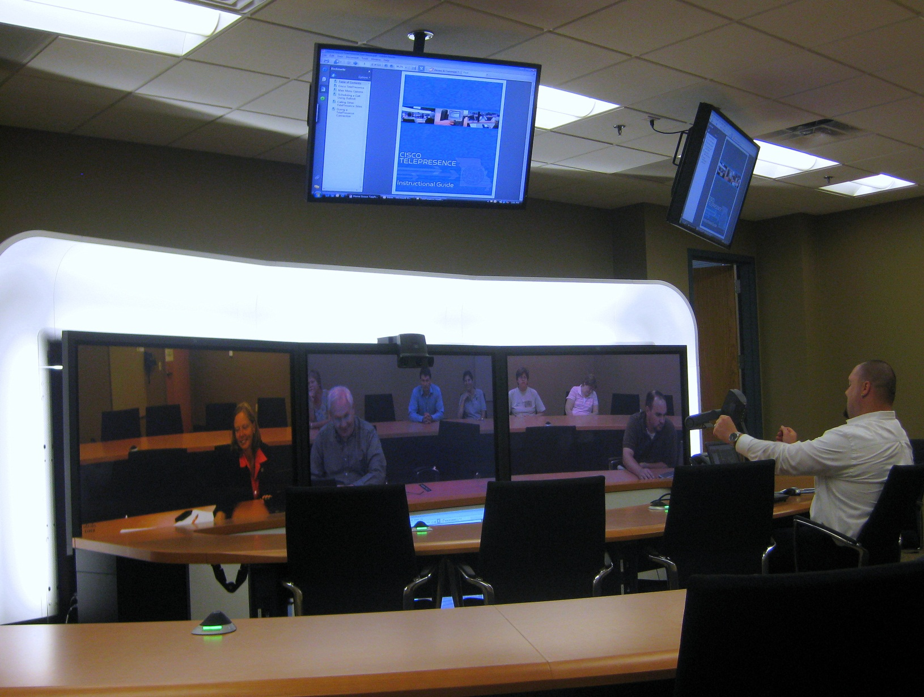
Figure 11.3: GDSS and Videoconferencing Room at University of Missouri

Slide 7
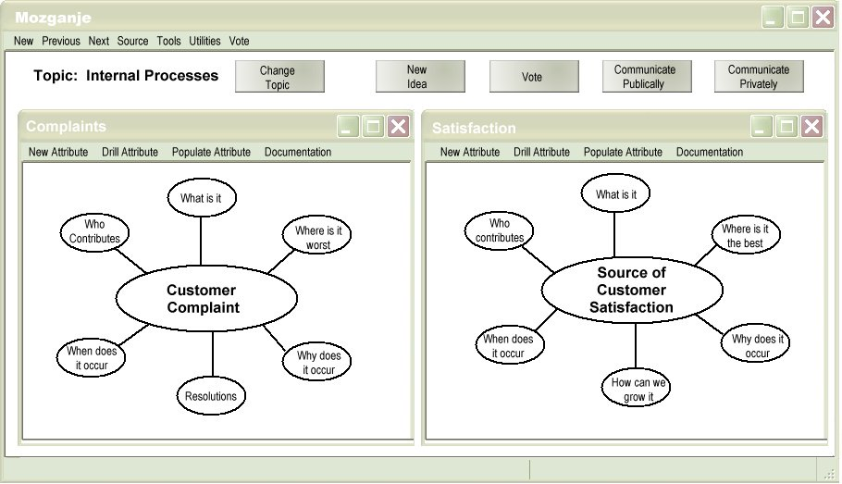
Figure 11.4: Facilitating Problem Definition

Slide 8
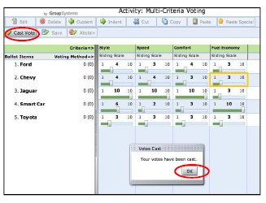
Figure 11.5: Definition of Multiple Criteria and Weights in Decision Making

Slide 9
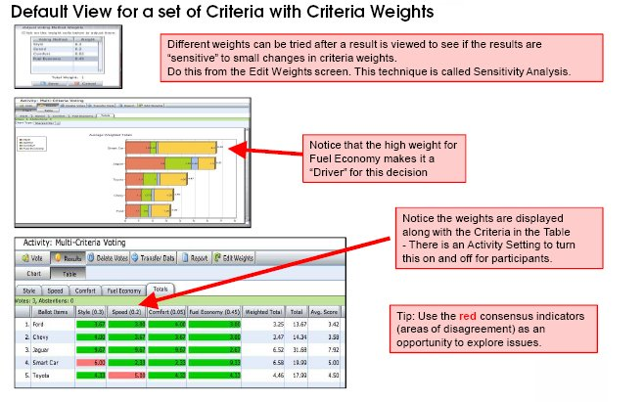
Figure 11.6: Helping Users Understand Sensitivity of Decision to Criteria and Weights

