Slide 1
Chapter 10 EXECUTIVE INFORMATION AND DASHBOARDS
Decision Support Systems
For Business Intelligence

Slide 2
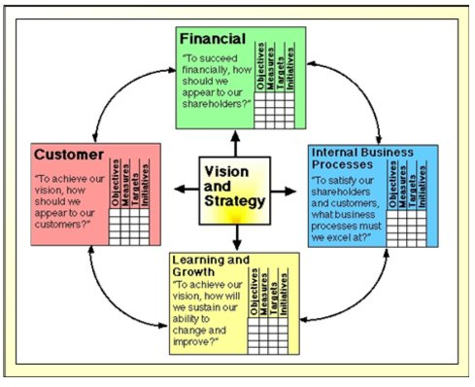
Figure 10.1: Building a Balanced Scorecard

Slide 3
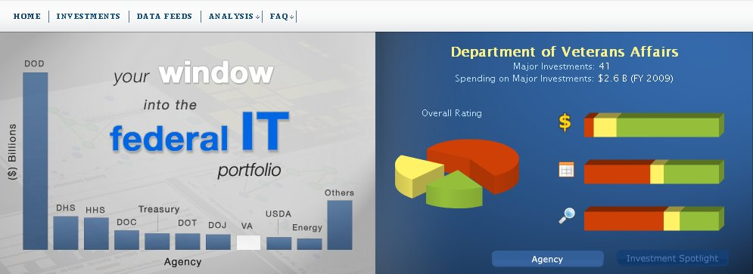
Figure 10.2: The Federal IT Dashboard

Slide 4
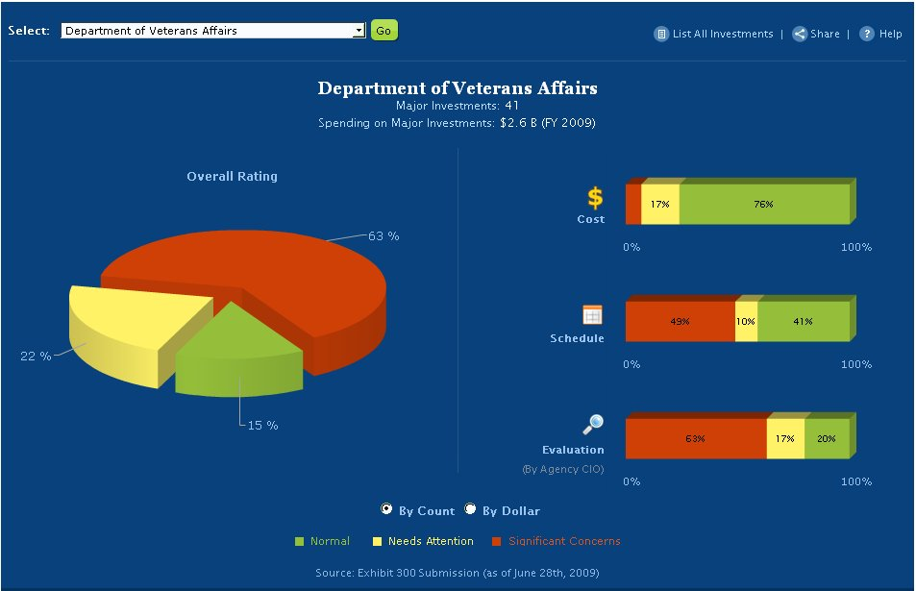
Figure 10.3: First Drill-Down

Slide 5
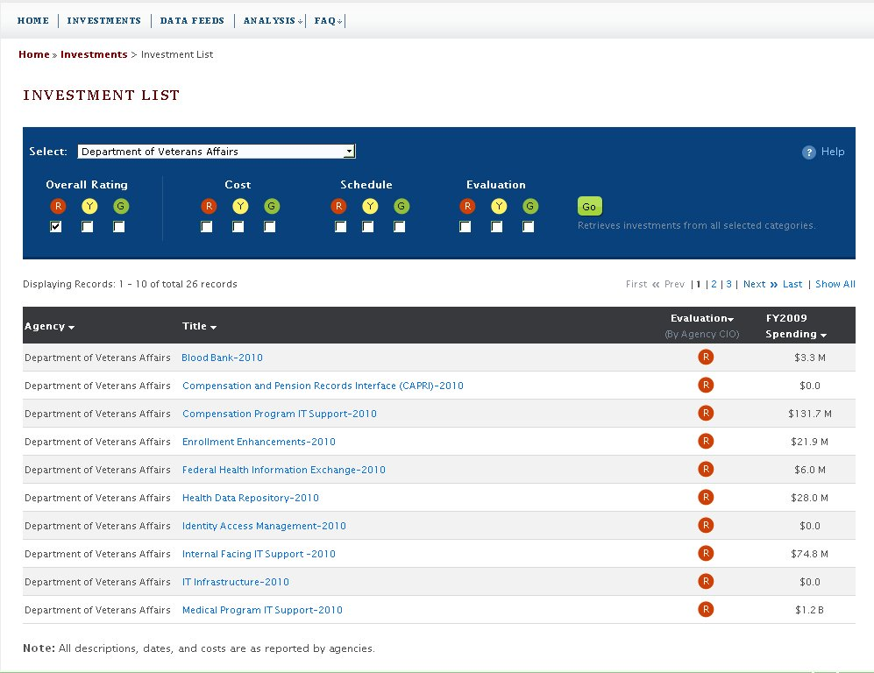
Figure 10.4: Second Drill-Down

Slide 6
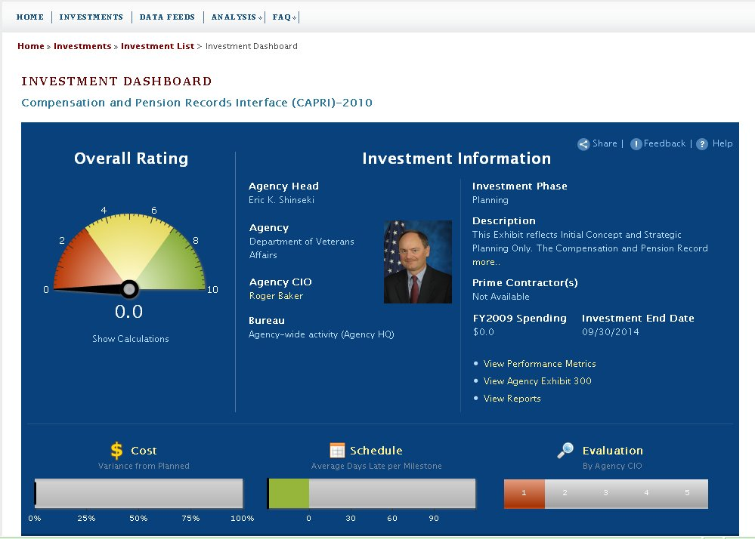
Figure 10.5: Third Drill-Down

Slide 7
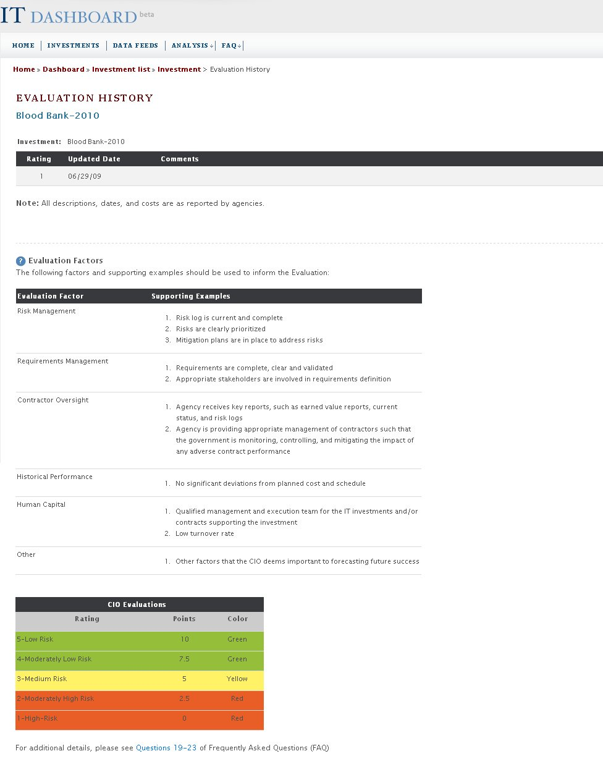
Figure 10.6: Fourth Drill-Down

Slide 8
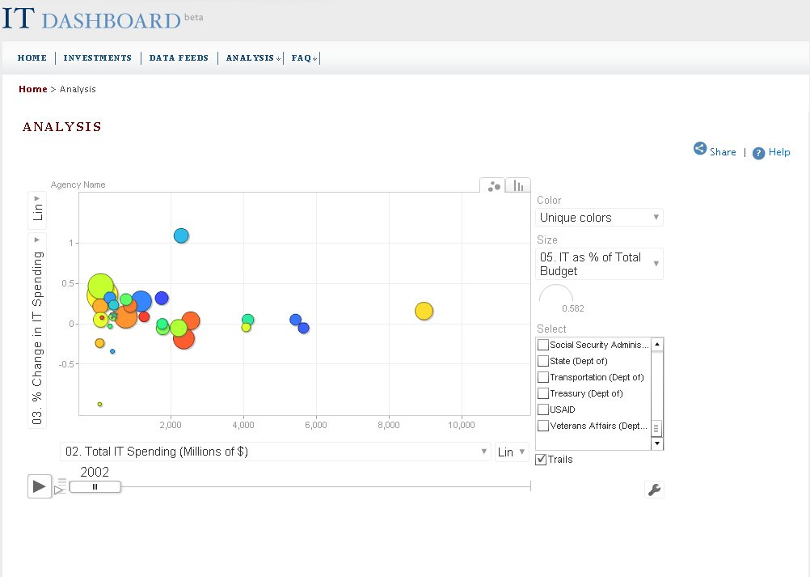
Figure 10.7: Analysis in a Dashboard

Slide 9
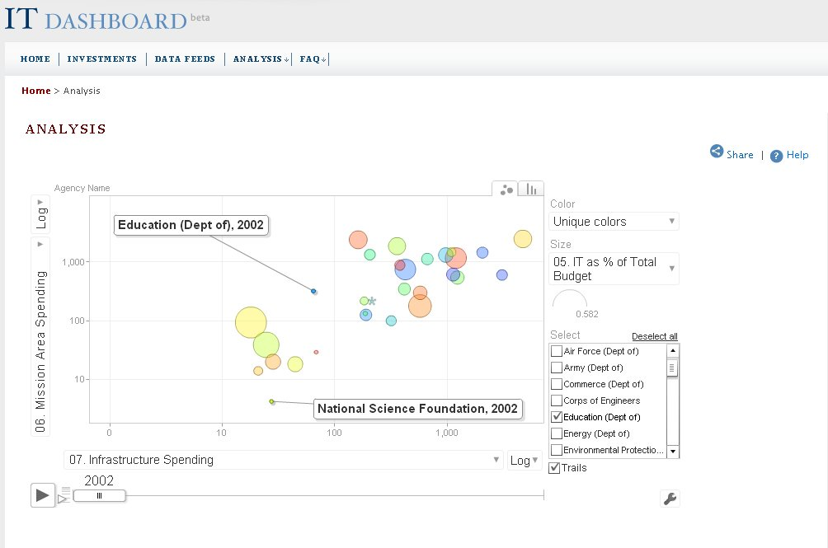
Figure 10.8: Additional Analysis

Slide 10
Table 10.1: Information Needs to Be Met by a Dashboard
• Timely: information needs to be available as soon as possible
response time should be very short
• Sufficiency: information needs to be complete
users need extensive external data
users need historical data as well as most current data
• Aggregation level: users need access to global information of the organization and its competitors
information should be provided in an hierarchical fashion information needs to be provided at various levels of detail, with “drill down” capability users need “exception” reports or problem “flags”
• Redundancy should be minimized
• Understandability: system should save users time
problem indicators should be highlighted
written explanations should be available
should support open-ended problem explanation
• Freedom from Bias: information must be correct and complete
• Reliability: information must be validated
access must be controlled but reliable for those approved to use the system
• Decision Relevance: system must meet the needs of executives
• Comparability: users need trends, ratios and deviations to interpret
• Appropriateness of Format: flexibility is crucial
format should reflect user preferences
integrates text and graphics appropriately

Slide 11
Table 10.2: Modeling Needs to Be Met by a Dashboard/EIS
• extensive use of click through and drill down abilities
• easy to use ad hoc analysis
• extensive use of exception reports and facility for tracing the reason for the exceptions
• models are provided appropriate to address critical success factors
• forecasting models are integrated into all components
• user has easy access to filters for data analysis
• extensive use of “what if” facility
• extensive use of planning models

Slide 12
Table 10.3: User Interface Needs to Be Met by a Dashboard
• interface must be user-friendly
• interface must incorporate sophisticated use of graphic user interface
• interface should incorporate alternative input/output devices such as mouse, touch pads, touch screens, etc.
• system must be accessible from a variety of machines in a variety of locations
• interface should be intuitive
• interface should be tailored to management style of individual executives
• interface should contain help menus for functions of the system
• interface should contain content-sensitive help menus

Slide 13
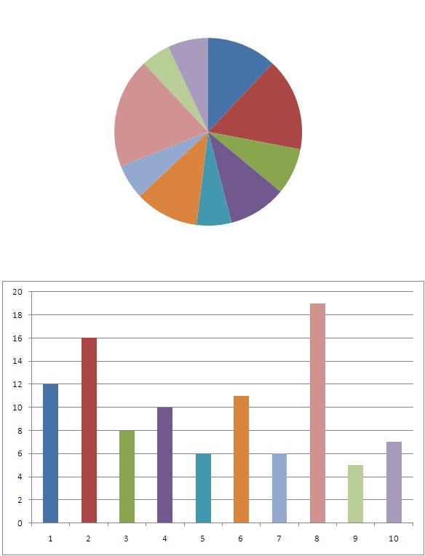
Figure 10.9: Comparison of Pie Chart and Bar Chart

Slide 14
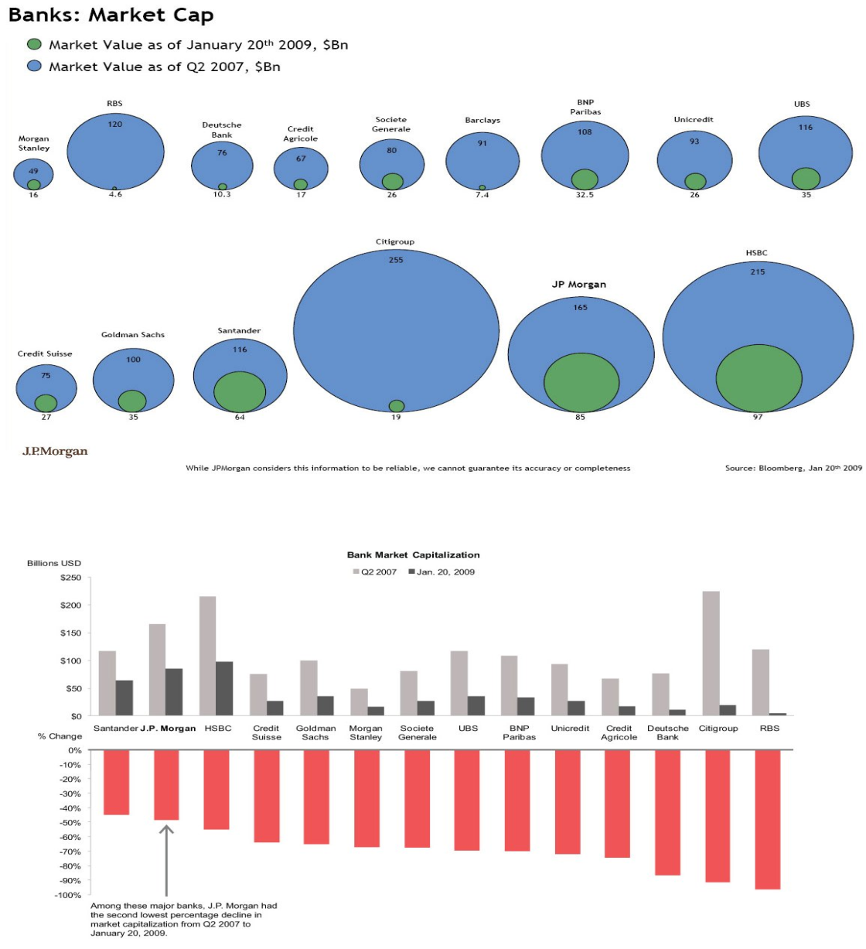
Figure 10.10: Comparison of Bubble and Bar Charts

Slide 15
Figure 10.11: An Overpopulated Dashboard

Slide 16
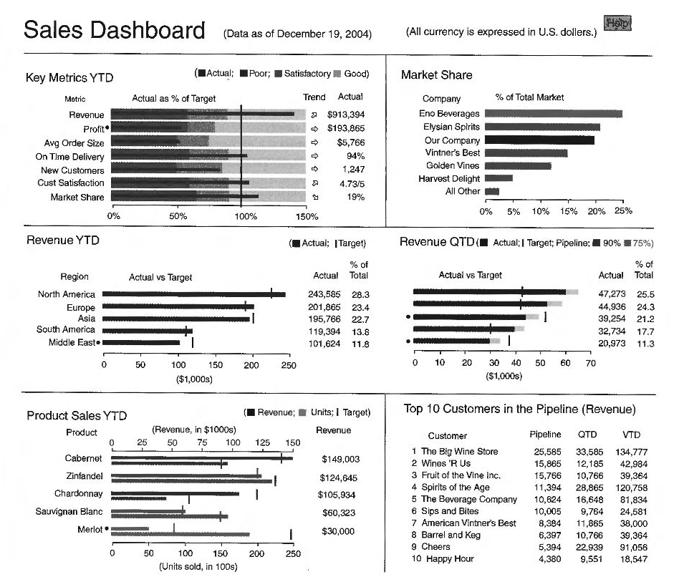
Figure 10.12: A Good Dashboard

Slide 17
Table 10.4: Design Mistakes
• Exceeding the boundaries of a single screen
• Supplying inadequate context for the data
• Displaying excessive detail or precision
• Choosing a deficient measure
• Choosing inappropriate display media
• Introducing meaningless variety
• Using poorly designed media
• Encoding quantitative data inaccurately
• Arranging the data poorly
• Highlighting important data ineffectively or not at all
• Cluttering the display with useless decoration
• Misusing or overusing color
• Designing an unattractive visual display

Slide 18
Table 10.5: Sample EIS Adoption Criteria
1.0 Ease of use
Development
Applications to be easy and quick to develop
New users to be easy and quick to add to the system
Suitability for quick prototyping
Display alternative output formats quickly
Learning
Learning time for developers
Learning time for users
Availability of appropriate documentation and tutorials
End user
Menu system
Customized menus for each user
Ability to bypass menus not required
Various modes of use (mouse, touchscreen)
Minimal number of keystrokes
Consistent use of functions
Maintenance
Easy to add and modify data
Ability to maintain integrity and timeliness of data (handling of frequent updates)
Easy to add and modify screens, reports, and graphs
Availability of standard templates
Ability to copy existing screens, graphs, and so on
Ability to monitor system usage
Easy to add additional users
Ability to incorporate changes to corporate structure
continued

Slide 19
Table 10.5: Sample EIS Adoption Criteria Continued
2.0 Reporting capability
Reports to be presented as both graphs and tables
Ability to display graphs, tables, and text on a single screen
Ability to switch between tabular and graphic output
Ability to color code exceptions on the current screen
Ability to present a summary screen listing all exceptions throughout the system
Support analysis of budgeted actual and forecast figures
Effective presentation of time series data
Ability to highlight variations
Support interactive user-defined variance criteria
Retrieval of historical data as required
Maintain historical data and discard after a user-defined period
Analysis of historical data and identification of trends
Built-in restrictions to protect historical data
Facility for personalized queries (i.e., ability for users to scan the database according to interactively defined criteria)
Explanatory notes to be attached to reports
continued

Slide 20
Table 10.5: Sample EIS Adoption Criteria Continued
3.0 Graphic presentation
Quality of graphics
Speed of presentation
Effective use of default color coding
Ability to highlight areas of concern
Availability of individual color schemes
Ability to include explanatory notes for each graph
Ability to produce a variety of graphs (pie, 3D bar, line)
Automatic generation of simple, default formats which can be customized
Easy to produce executive defined graphs
Automatic scaling
Graph limitations
Automatic legends
4.0 General functionality
Drill-down cability
Built-in statistical capabilities
Lookaside capability for interrupting a process to use another facility
Screen scrolling (horizontal and vertical)
Multiple tasks to be operating and displayed concurrently (e.g., windows, split screens)
Access to notepad facility
Integration with DSS
Import data from spreadsheets/word processing
Minimal screen repainting
Ability to display other languages
continued

Slide 21
Table 10.5: Sample EIS Adoption Criteria Continued
5.0 Data handling
Version checking to ensure all users are accessing the same version of software, applications, and data
Interfaces with external databases and internal WMC systems
Efficient storage of time series data
Stored aggregates for rapid access
Built-in periodicity conversions
Efficient indexing and retrieval mechanism
Instantaneous distribution of new data among users
Ability to consolidate various sources and formats of data into an EIS database via manual input or electronic data transfer from other systems
Ability to sort screen data according to user-defined criteria
6.0 Output options
Laser printer, plotter, color printer, transparencies
Large-screen presentations for meetings
7.0 Performance
Response times
PC-mainframe communications uploading and downloading data
Efficient resource usage
Capacity issues (i.e., number of users, volume of data)
Reliability of software
Recovery facility
8.0 Electronic mail
Ability to run corporate mail
Ability to incorporate EIS reports and graphs into mail facility
continued

Slide 22
Table 10.5: Sample EIS Adoption Criteria Continued
9.0 Security
Restricted system access
Restricted function access
Add/edit/delete restrictions for applications and data
10.0 Environments and hardware
Local access
Across networks
Multiuser access to the same data (only 3 users tested)
Portability
PC-mainframe links
11.0 Documentation
Reference manual, introductory guide, tutorials
Overall style of documentation
Online, context-sensitive help screens
Meaningful error messages
Appropriate cross-referencing and indexing
Stand-alone chapters
12.0 Vendor support
Training courses for developers
Technical support
Local support
Timeliness and smoothness of initial installation
Availability of off-the-shelf applications
Availability of source code
Hot-line support

