Slide 1
Phishing
Susan Krause
Adam Whitaker
Natallia Dziatsel
Mateusz Czernikiewicz
Matt Baker

Slide 2
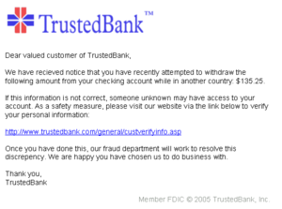
Definition
The use of electronic communication, mainly email, to trick someone into providing sensitive passwords that will allow access to bank accounts, credit card information, and related data

Slide 3
History
Term first used in 1996 on then widely used AOL
Efforts to stop the creation of accounts with false credit card numbers led to the practice of phishing
Phishers began targeting financial institutions at the beginning of the century

Slide 4
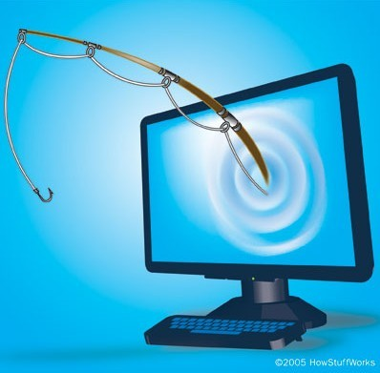
History
Phishers began using fake websites to trick consumers into providing valuable information
Paypal was hit in 2006

Slide 5
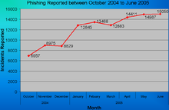
Dramatic Increase
Creativity by phishers and a lack of consumer common sense has caused phishing to increase dramatically

Slide 6
TYPES OF PHISHING
Deceptive Phishing
Uses deceptive emails to get vital information
Malware Based Phishing
Runs malicious software on a user’s PC
Keyloggers or Screenloggers
Type of Malware that tracks keyboard input and sends information to the hacker over the internet

Slide 7
TYPES OF PHISHING CONT.
Session Hijacking
Monitors a users actions until they sign into a targeted account then malicious software will undertake unauthorized actions.
Web Trojans
Invisible pop ups that collect credentials locally and sends them to the phisher.
Host File Poisoning
Poisons host files to take users to a “look alike” website where information can be stolen.

Slide 8
TYPES OF PHISHING CONT.
System Reconfiguration Attacks
Modifies settings on a users PC for malicious purposes.
Data Theft
Stealing confidential information from a secured server and selling it to those that will damage that person or business.
DNS-Based Phishing (Pharming)
Hacker’s tamper with a companies host files or domain name system to direct communications to a fake site.

Slide 9
TYPES OF PHISHING CONT.
Content-Injection Phishing
Hackers replace false content on a legitimate website to mislead the user into giving up confidential information.
Man-in-the-Middle Phishing
Hackers place themselves in between the user and a website and record information that the user enters on the website
Search Engine Phishing
Phishers create websites with “to good to be true” deals and legitimately index them with search engines.

Slide 10
Laws
State/Local
To date, there are no specific laws regarding phishing in Missouri
Only 22 states have enacted laws specifically targeting phishing
Federal
There are currently no federal laws that deal specifically with phishing
Many pieces of legislation have been presented to Congress but none have been passed
Cases may be tried as a criminal statute under Title 18 U.S.C., which deals with fraud related offenses
Notes:
Although there are currently no laws that deal with phishing per se, a person may be tried under one or more of the various criminal statutes found under the U.S codes

Slide 11
Laws U.S. Code Title 18: Crimes & Criminal Procedure
Ch. 47 U.S.C. 1030: Computer Fraud & Abuse
Accessing a computer without authorization & retrieving confidential information (computer hacking)
Max. 1-5 years in prison & a fine
Ch. 47 U.S.C. 1028: Identity Theft
Knowingly using or transferring another’s “means of identity”
3-15 years imprisonment; max $250,000 fine
Notes:
Means of identity includes D.O.B, SSN, acct. #’s, etc.

Slide 12
Laws U.S. Code Title 18: Crimes & Criminal Procedure
Ch. 63 U.S.C. 1344: Bank Fraud
Obtaining money from a financial institution by means of false representation
Max. 30 years in prison; $250,000 fine
Ch. 63 U.S.C. 1343: Wire Fraud
A scheme to defraud, by means of false pretenses, for the purpose of retrieving money or property
20-30 years in prison; $250,000 fine
Notes:
An example of each of these crimes would be a person sending out emails to prospective victims in order to obtain money from them.

Slide 13
Recent Cases United States v. Forcellina (District Court of Connecticut, sentenced April 30 and June 18, 2004)
Mr. Forcellina gathered usernames of chat room participants
Next he sent emails that appeared to be from the user’s ISP, requesting correct billing information, including current credit card numbers
He then used the credit card numbers and other personal data he had obtained to arrange for wire transfers of funds via Western Union
He had other conspirators pick up the funds for him
Mr. Forcellina and his wife pleaded guilty to conspiracy to commit access device fraud
He was sentenced to 18 months imprisonment
Mrs. Forcellina was sentenced to 6 months home confinement

Slide 14
United States v. Hill (Southern District Court of Texas, sentenced May 2004) FTC v. Hill (Southern District Court of Texas, preliminary injunction December 2003)
Hill operated a phishing scheme that used AOL and PayPal to fraudulently obtain credit card numbers, which he then used to buy $47000 worth of goods and services
Hill pleaded guilty in February 2004 to possession and use of access devices
Sentenced to 46 months imprisonment

Slide 15
United States v. Carr (Eastern District Court of Virginia 2003)
Helen Carr sent fake e-mail messages to AOL customers in the United States and several foreign countries, advising them that they must update their credit card and personal information on file with AOL to maintain their accounts
Pleaded guilty in October 2003 to conspiracy to possess unauthorized access devices
Sentenced in January 2004 to 46 months imprisonment
George Patterson, a co-conspirator, previously pleaded guilty to the same charge and was sentenced in July 2003 to 37 months imprisonment

Slide 16
United States v. Guevara (Western District Court of Washington, 2003)
Matthew Guevara created false e-mail accounts with Hotmail and an unauthorized website with the address www.msnbilling.com through Yahoo!
He then sent MSN customers e-mail messages that directed customers to his www.msnbilling.com website and asked them to verify their accounts by providing name, MSN account, and credit card data
The website was designed to automatically forward each customer’s data to one of Guevara's false Hotmail accounts
Guevara used stolen credit card information himself and provided it to another person as well
Pled guilty in September 2003 to wire fraud
Sentenced January 2004 to 5 years probation, 6 months home confinement

Slide 17
United States v. Gebrezihir (Southern District Court of New York, 2003)
Isaac Gebrezihir allegedly involved with a scheme to send fraudulent letters on bank letterhead, along with altered or counterfeit IRS forms, to victims requesting personal information concerning victim and victim’s bank account
Forms look almost exactly like the forms IRS would send
Fraudulent bank letter instructs victim to fill out fraudulent IRS form and then fax completed form, apparently to the IRS or to the bank
In reality, the fax numbers provided are Internet-based fax numbers that convert all incoming faxes to e-mail attachments and then forward attachments to free e-mail accounts
Wire transfer instructions are then sent to banks and large amounts of money are transferred from the victims’ accounts, usually to overseas accounts
Overall investigation has identified more than $700,000 in losses
Indicted Nov. 2003

Slide 18
United States v. Kalin (District Court of New Jersey, Nov. 2003)
Shawn Kalin allegedly registered four websites with domain names deceptively similar to website operated by DealerTrack, Inc.
DealerTrack provides services via the Internet to auto dealerships located throughout the United States, including credit reports on prospective automobile buyers
Because Kalin’s websites designed to be almost identical to main page of the www.dealertrack.com website, a number of dealership employees mistakenly entered usernames and passwords at his sites
He could then use this information to obtain unauthorized access to DealerTrack for personal data
Kalin was charged in a criminal complaint Nov. 2003

Slide 19
Summary: Statistics
Phishing has been growing rapidly, approximately 8 million daily phishing attempts worldwide.
The Anti-Phishing Working Group (APWG) reported that unique phishing attacks rose 13% during the second quarter of 2008 to more than 28,000.
Number of malware-spreading URLs infecting PCs with password-stealing code rose to more than 9,500 sites - a 258% increase compared with the same quarter in 2007.
Damage caused by cyber crime is estimated at $100 billion annually according to the Organization for Security and Cooperation in Europe.

Slide 20
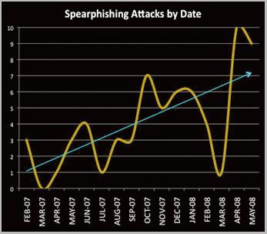
Summary: Spear Phishing
The graph below shows one area of phishing - spear phishing - and its growth over a 16-month period.

Slide 21
Summary: Industries Effected
While the financial industry continues to be a primary target for phishers, it’s certainly not the only sector vulnerable to attack. Auction sites, payment services, retail, and social networking sites are also frequent targets.
The APWG also reports a massive increase in attacks aimed at cell phone providers and manufacturers. In short, no business or brand is inherently safe

Slide 22
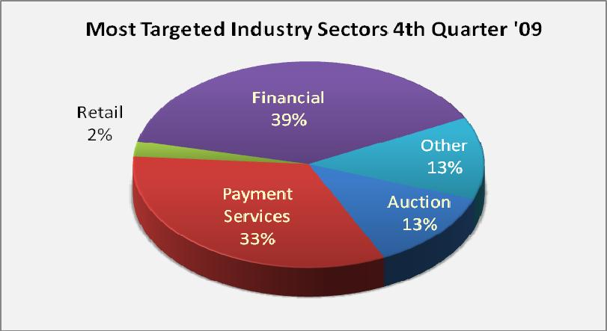
Summary: Industries Effected

Slide 23
Summary: Effects on Business
Phishing attacks:
Diminish the company’s online brand
Deter customers from using the actual Web site out of fear of becoming a fraud victim.
Huge costs of fraud losses
Businesses whose customers fall victim to a phishing scam also risk:
A drop in online revenues and/or usage due to decreased customer trust
Potential non-compliance fines if customer data is compromised
Even phishing scams aimed at other brands can impact a business. The resulting fear caused by phishing can cause consumers to stop transacting with anyone they can’t trust.

Slide 24
Summary: Protection Tools
SSL, the world standard for Web security, is the technology used to encrypt and protect information transmitted over the Web with the HTTPS protocol. SSL protects data in motion which can be intercepted and tampered with if sent unencrypted.
Extended Validation (EV) SSL Certificates offer the highest level of authentication available with an SSL Certificate and providing tangible proof to online users that the site is indeed a legitimate business.
Notes:
There are technologies that can help protect a business and its customers. Technology such as Secure Sockets Layer (SSL) and Extended Validation (EV) SSL are critical in fighting phishing and other forms of cyber crime by encrypting sensitive information and helping customers authenticate company’s site.
Support for SSL is built into all major operating systems, Web browsers, Internet applications, and server hardware. To help prevent phishing attacks from being successful and to build customer trust, companies also need a way to show customers that they are a legitimate business.
EV SSL gives Web site visitors an easy and reliable way to establish trust online by triggering high security Web browsers to display a green address bar with the name of the organization that owns the SSL Certificate and the name of the Certificate Authority that issued it. The green bar shows site visitors that the transaction is encrypted and the organization has been authenticated according to the most rigorous industry standard. Phishers can then no longer capitalize on visitors not noticing they are not on a true SSL session. While cyber criminals are becoming experts at mimicking legitimate Web sites, without the company’s EV SSL Certificate there is no way they can display its name on the address bar because the information shown there is outside of their control. And they cannot obtain the legitimate company’s EV SSL Certificates because of the stringent authentication process.

Slide 25
Summary: Consumer and Employee Education
It is important to educate employees and customers how to recognize the signs of a phishing attempt such as: misspellings, generic greetings instead of being personalized, urgent calls-to-action, account status threats, requests for personal information, and fake domain names/links.
Also it is important to educate customers and employees on how to recognize a valid, secure Web site before they provide any personal or sensitive information by:
Looking for the green bar
Making sure the URL is HTTPS
Clicking on the padlock to match the certificate information with the Web site they intended to go to.

Slide 26
Summary: Consumer and Employee Education
Update your operating system with the latest patches as soon as they appear.
Alternate Internet Explorer with other browsers.
Use antivirus and firewall solutions and keep them permanently up-to-date.
Always type the URL yourself instead of following a link. Don't use the links in an email, instant message, or chat to get to any web page if you suspect the message might not be authentic or you don't know the sender or user's handle
Regularly check your accounts and statements and immediately report any abuse.
Report suspicious emails to security companies and authorities.

Slide 27
Summary: Consumer and Employee Education
Avoid filling out forms in email messages that ask for personal financial information
Always ensure that you're using a secure website when submitting credit card or other sensitive information via your Web browser
Remember not all scam sites will try to show the "https://" and/or the security lock. Get in the habit of looking at the address line, too. Were you directed to PayPal? Does the address line display something different like http://www.gotyouscammed.com/paypal/login.htm?" Be aware of where you are going.
Consider installing a Web browser tool bar to help protect you from known fraudulent websites. These toolbars match where you are going with lists of known phisher Web sites and will alert you.

Slide 28
Conclusion
Phishing will continue to evolve into new forms, while attempting to take advantage of human behaviors such as compassion, trust, or curiosity. Protecting a brand and a business from phishing requires constant diligence, but pays rewards beyond reduced fraud losses.
By educating and protecting the customers with the highest levels of protection provided by EV SSL Certificates, a business can ensure customers have greater confidence in online services. By demonstrating leadership in online security, a business can broaden its market appeal and in doing so, generate new revenue streams.
Notes:
The outcomes of phishing attacks are dramatically increasing every day. Attacks on financial services companies have been doubling each year compared to previous years. It is very important for companies to come up with new ways to solve phishing problems because it can become a major loss to well-known companies. Also, it can cause consumers to lose confidence in doing business online, which can affect many companies with an online presence. Not any type of technology can stop phishing attacks, but there are many ways to enable phishers from accomplishing their goals. Consumer education can increase the awareness of the phishing threat and other online vulnerabilities. Lastly, biometrics should become one of the major aspects and play an important role to combat phishing because it provides different steps to authenticate users.

