Slide 1

The Chinese Software Development Industry
Outlook and Forecast
Presented to Professor Sauter’s
IS5800 Class
3/3/2010
Dr. Joseph Rottman
Associate Professor of Information Systems
University of Missouri - St. Louis USA

Slide 2
Agenda
Overall research project summary
Global markets and China outlook
China research base
China / India comparison
Impact on project managers
Conclusion and Discussion

Slide 3









Global Network of Researchers

Slide 4

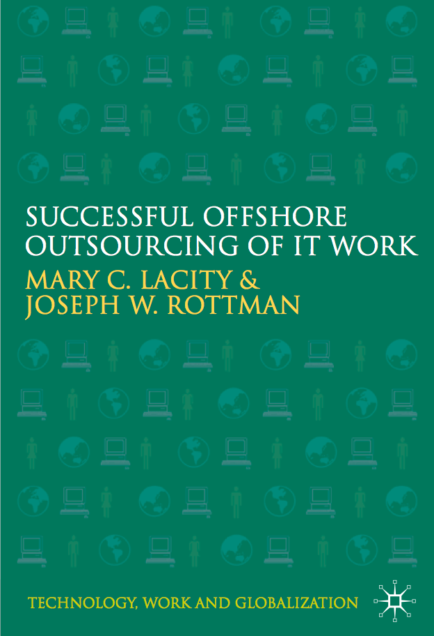




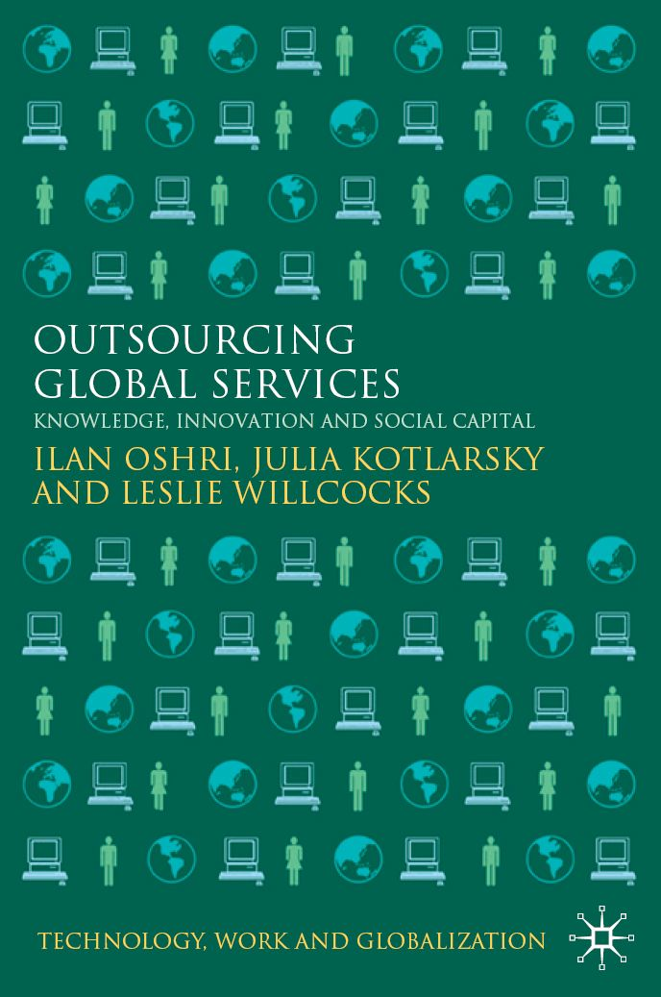
Global Network of Researchers
PALGRAVE BOOK
SERIES ON TECHNOLOGY, WORK, AND GLOBALIZATION

Slide 5
Table of Contents
Chapter 1: Offshore Outsourcing of IT Work
Chapter 2: A Client’s Experiences with its Initial Offshore Outsourcing Program
Chapter 3: A Client’s Offshore Outsourcing Program Becomes Institutionalized
Chapter 4: A Client’s Offshore Outsourcing Program Becomes Strategic by Investing in Social Capital
Chapter 5: A Client’s Award-winning Global Shared Services
Chapter 6: Can China Compete with India in the Global ITO/BPO market?
Chapter 7: Understanding Turnover Among Indian I.S. Professionals
Chapter 8: Emerging Trends

Slide 6
Research Base
Stakeholders | Number of Firms | Number of Interviews
US / UK Clients | 25 | 96
Indian Suppliers | 10 | 43
Chinese Suppliers | 9 | 42
North American / European Suppliers and Joint Ventures | 17 | 50
Offshore Advisors | 11 | 12
Chinese Economic and Development Zone Officials | n/a | 16
Total | 72 | 259

Slide 7
Stakeholders
Stakeholder Category | Stakeholder Group | Number of Research Participants
Client | Senior management (CEO, CFO, COO, VP) | 6
 | IT management (CIO, PMO, Directors) | 35
 | IT staff | 67
 | Users/Business unit managers | 3
 | Specialists | 2
Supplier | Senior management | 31
 | Sales and marketing | 13
 | Account/Engagement managers | 11
 | Delivery team | 64
Advisors | Lawyers | 6
 | Consultants | 5
Officials | Economic and software park officials | 16
Total number of participants |  | 259

Slide 8
We have found mixed results
The same organization typically had several successes, failures, and mediocre projects
Many organizations had to “re-launch” after learning from early mistakes
Time/Value
Phase 4:
Institutionalized/
Commercialized
Focus on Value-added
Phase 3:
Relationships mature
May renegotiate, switch suppliers
Richer practices emerge
Focus on Costs, Quality, Flexibility, etc.
Client Learning
Phase 2:
Pilots, first relationships
Best and worst practices emerge
Focus primarily on Costs
Phase 1:
Hype and fear

Slide 9
Agenda
Overall research project summary
Global markets and China outlook
China research base
China / India comparison
Conclusion and Discussion

Slide 10
China Buzz
China’s software export soared 39% in 2008 (MIIT 2/11/09).
China’s global market share reached 8.74% in 2007 (China Tech News).
In 2008, China’s 18,000 software companies registered 50,000 software products (China Tech News).
China’s software industry realized a year on year increase of 30.4% in first six months of 2008 (China Tech News).

Slide 11
Indian and Chinese Firms¹
Top 10 Indian Outsourcing Firms |  |  | Top 10 Software Development and Outsourcing Chinese Firms
Name | Total Revenue in billions | Headcount | Name | Revenue from Outsourcing in millions | Headcount
Infosys | $4.3 | 103,000 | NeuSoft | $156/$182 | 15,000
Wipro | $3.5 | 71,000 | VanceInfo | $97 | 4975
TCS | $4.3 | 89,000 | DHC | $95 | 2600
Satyam | $1.87 | 55,000 | Sinocom | $93 | 3500
HCL | $.673 | 50,000 | Inspur | $73 | Unknown
Tech Mahindra | $.902 | 21,000 | ICSS | $47 | 4363
Patni | $.718 | 14,000 | HiSoft | $45 | 3100
L&T | $.652 | 7,000 | Beyondsoft | $4 | 1600
I-flex | Unable to determine | Unable to determine | Insigma | $3.8 | 4000+
Perot Systems TSI | ~$.300 | 12,000 | NEC Avanced | $3.2 | 807
 | $16.92 | 408,000 |  | $617.00 | 30,775
Notes:
Note: ICSS = ChinaSoft International Information Technology Ltd

Slide 12
Agenda
Overall research project summary
Global markets and China outlook
China research base
China / India comparison
Impact on project managers

Slide 13
Chinese Software Industry Research Base
40 days in Dalian / Shanghai / Beijing
58+ interviews
  Captive Centers
  Development Firms
  Government Officials
6 IT conferences
Tours of Special Economic Zones and Software Parks

Slide 14
Neusoft Participants
Firm Name | Titles of Participants Interviewed | N | Headcount | Total Revenue 2008
Neusoft | Vice President and CTO Vice President and GM of International Software & Services Division Deputy General Manager CTO President, Institute of Information Vice – President Institute of Information Director, International Office Project Director Member, International Office Director, Propaganda Department Associate Marketing Specialist | 11 | 15,000 | $492 Million
Notes:
27 years at IBM

Slide 15
Dalian Captive Centers
Firm Name | Titles of participants interviewed in China | Number of participants | Headcount in Dalian
Oracle | Senior Vice President General Manager | 2 | 150
Financial Services 1 | Branch Manager Administrative Manager | 2 | 400
Staff Augmentation Firm | General Manager Relationship Manager | 2 | 100

Slide 16
Dalian Participants
Firm Name | Participant Titles | Number | Headcount | 2006 Revenue
Dalian Hi-Think Computer Technology Co | CTO | 1 | 2800 | $70 Million
NewLand | CEO | 1 | 40 | $800,000
Crystal | CEO CTO Project Manager Developer Specialist Graphics Designer (3) | 8 | 100 | n/a
Netai Techno | CEO | 1 | 40 | n/a
Digital China (Shanghai) | GE Practice Director GDC Delivery Manager | 2 | 160 | n/a

Slide 17
2008 CCID Outsourcing Market Revenue / Share
Rank | Firm name | 2008 Revenue from Outsourcing in millions USD | Market Share
1 | Neusoft | 156/180 | 6.05%
2 | VanceInfo | 97 | 3.76%
3 | DHC | 95 | 3.68%
4 | Sinocom | 93 | 3.60%
5 | Inspur | 73 | 2.83%
6 | ICSS | 47 | 1.82%
7 | Hisoft | 45 | 1.74%
8 | Beyondsoft | 4 | 1.55%
9 | Insigma | 3.8 | 1.47%
10 | NEC Advanced Software | 3.2 | 1.24%
11 | Others | 1,864 | 72.26%
 | Total | $2,580 | 100%
Notes:
http://www.chinasofti.com/cms/cms/website/CSI/csi/index.jsp?siteId=1

Slide 18
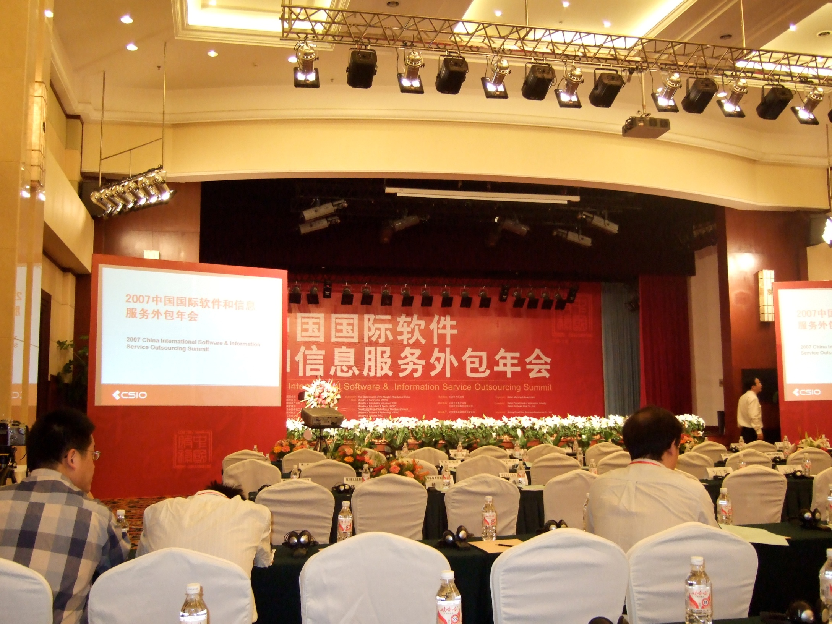
Slideshow
Notes:
International Finance Conference Center Dalian China
It is within the Dalian Special Economic Zone that Intel has chosen to invest $2.5 billion in a new nano chip manufacturing plant. This represents the largest investment to date in Dalian and will house 2,000 people of which 1,500 will be from Dalian.

Slide 19
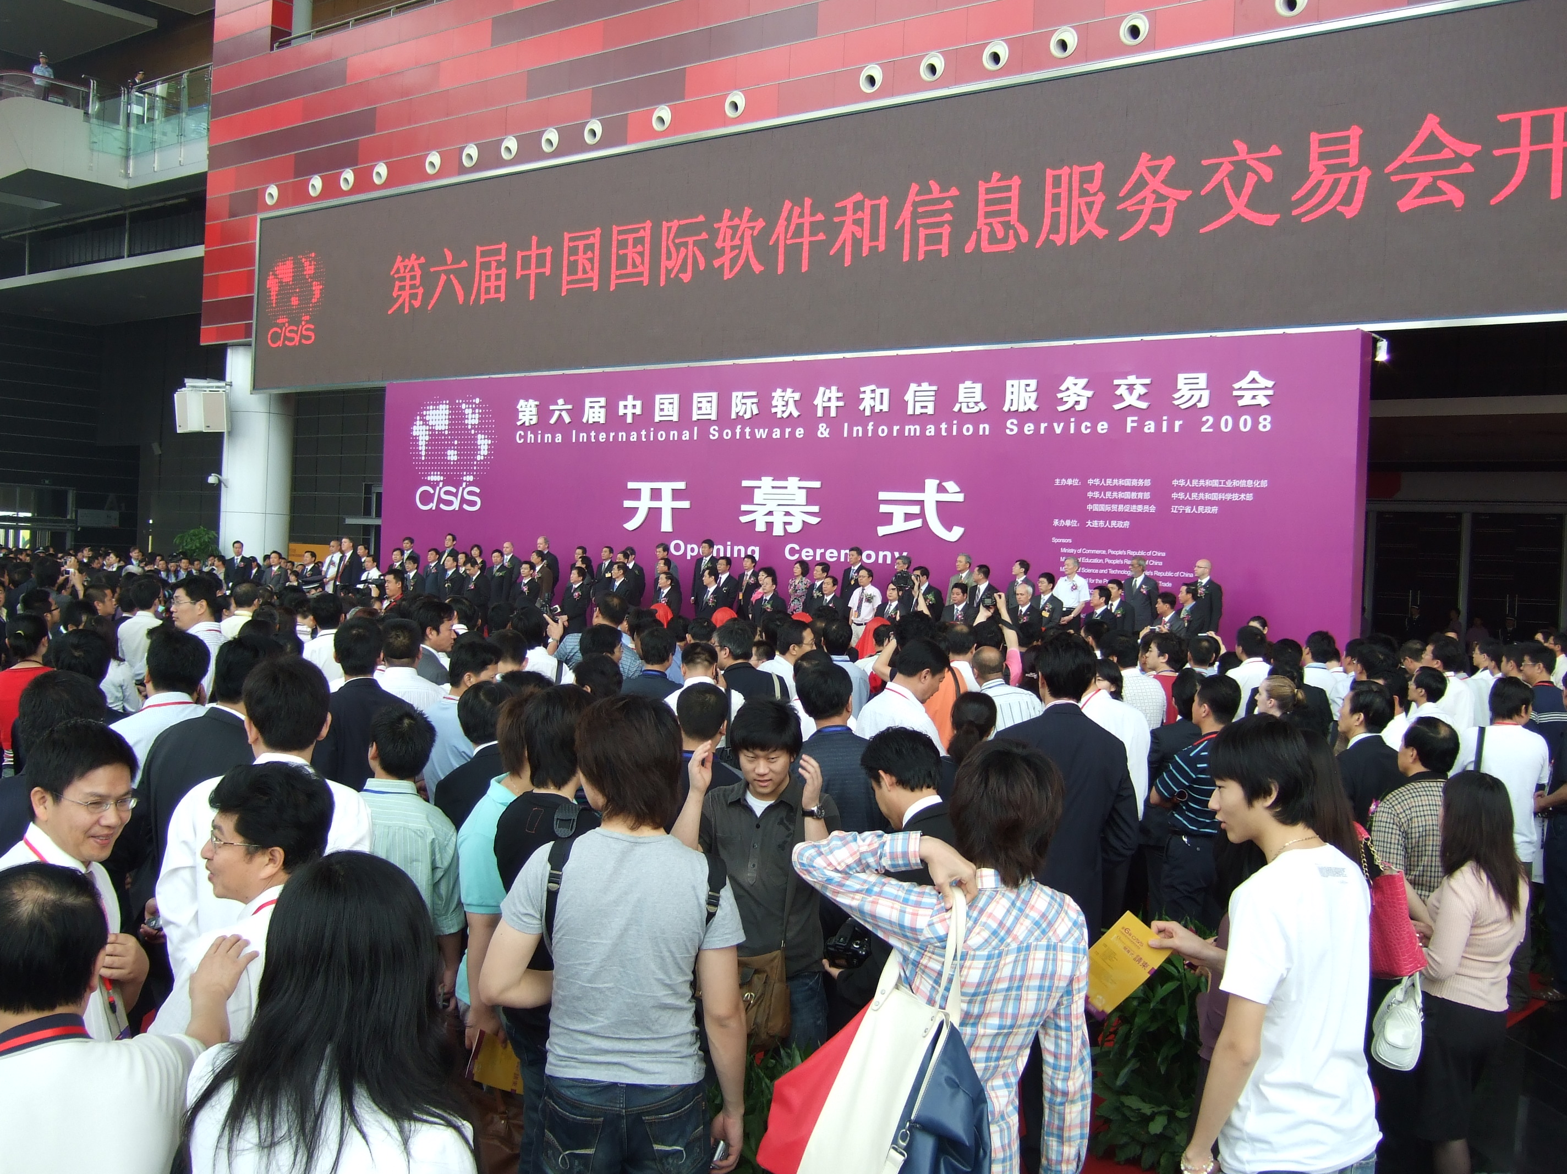

Slide 20
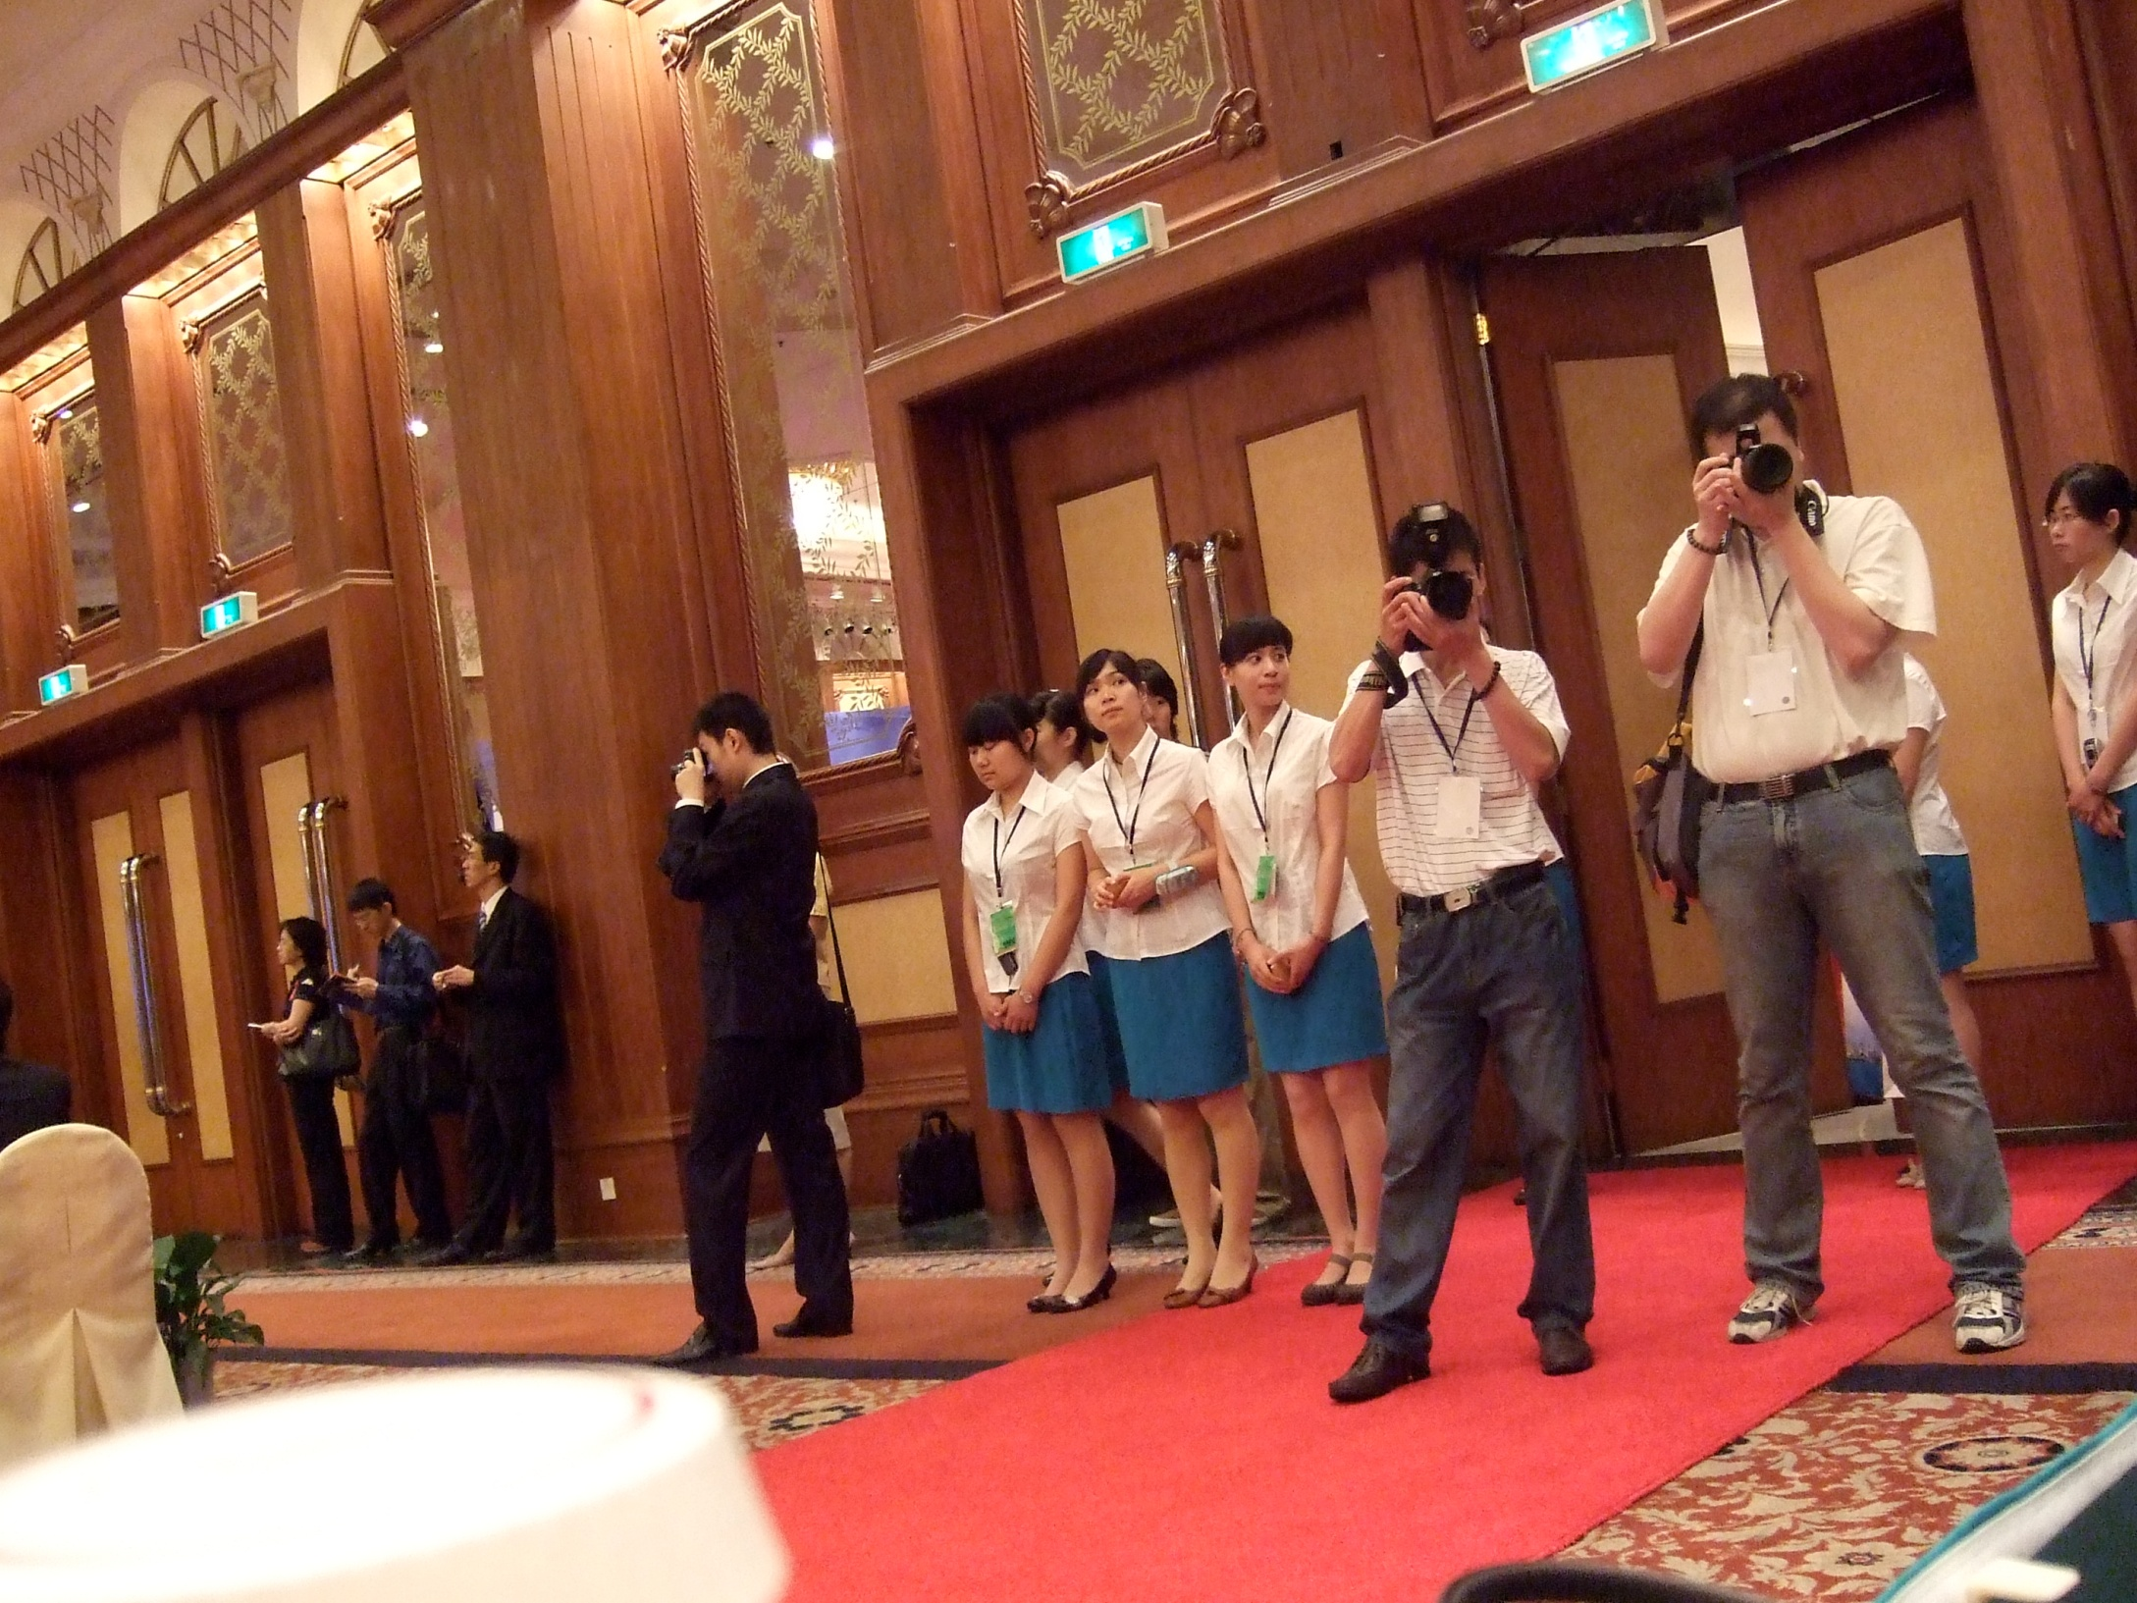

Slide 21
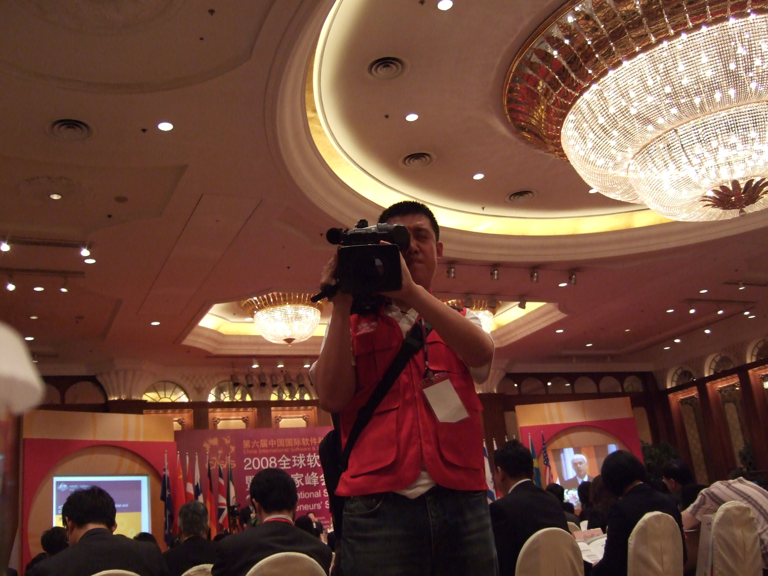

Slide 22
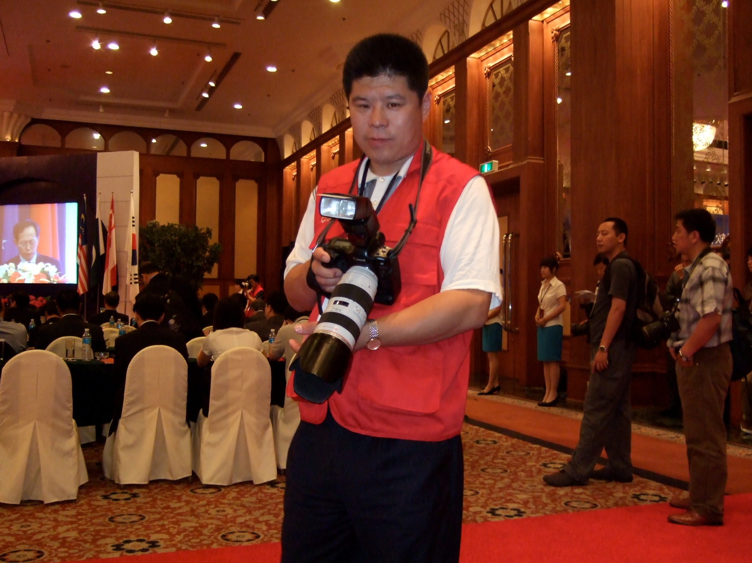

Slide 23
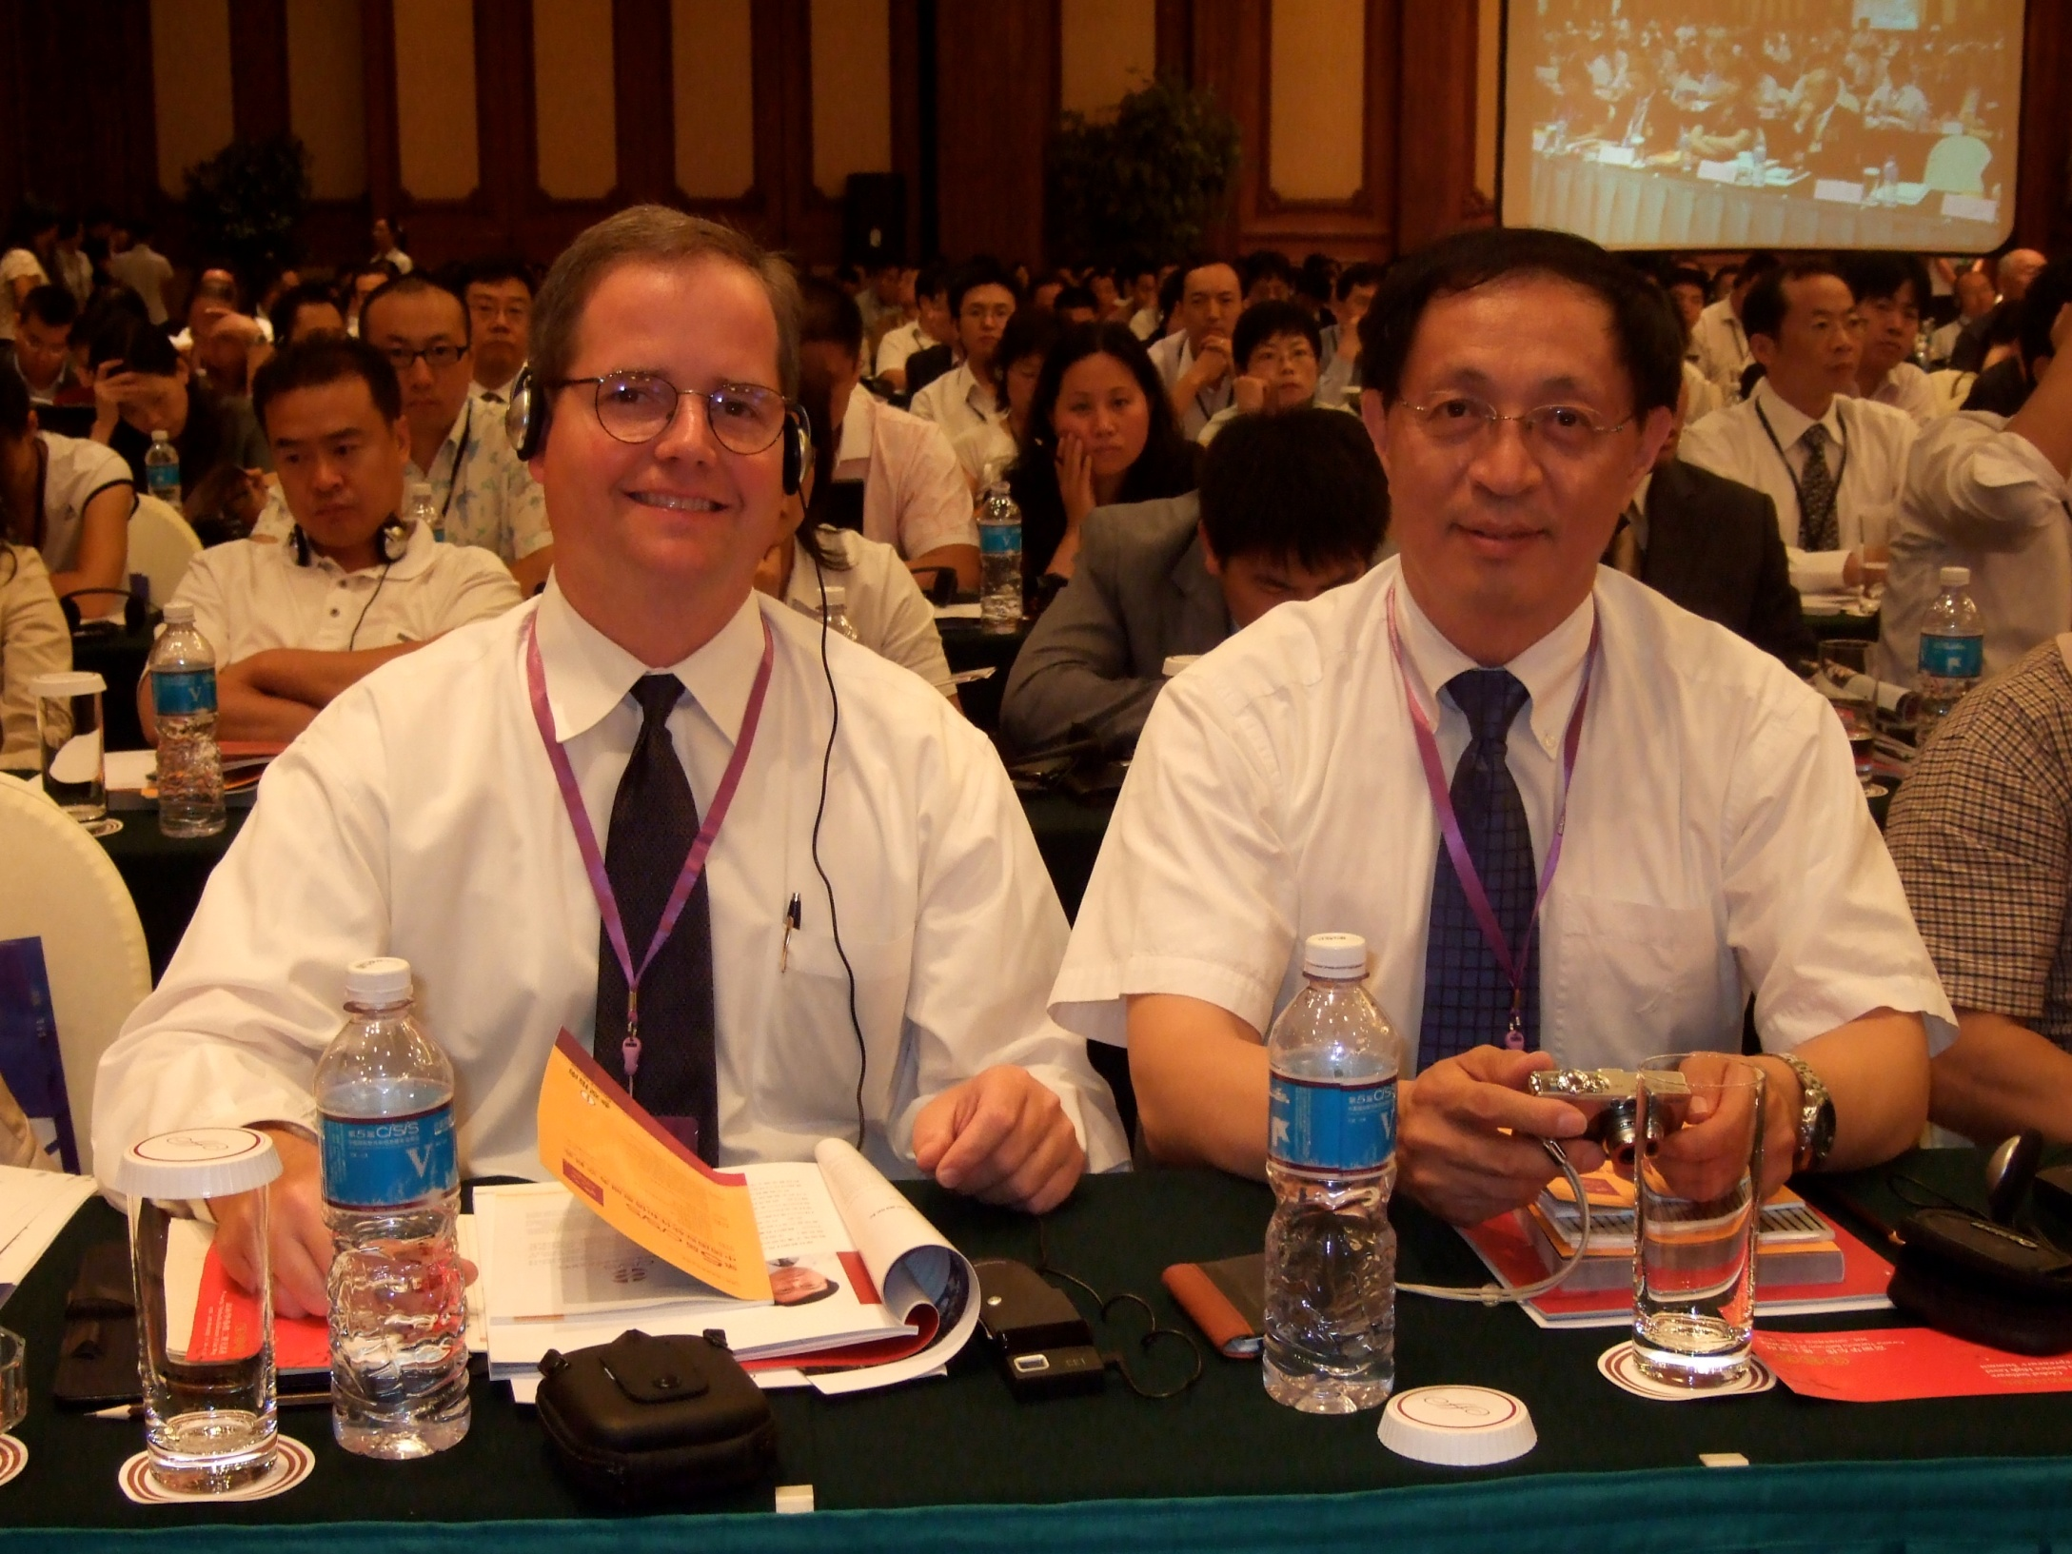

Slide 24
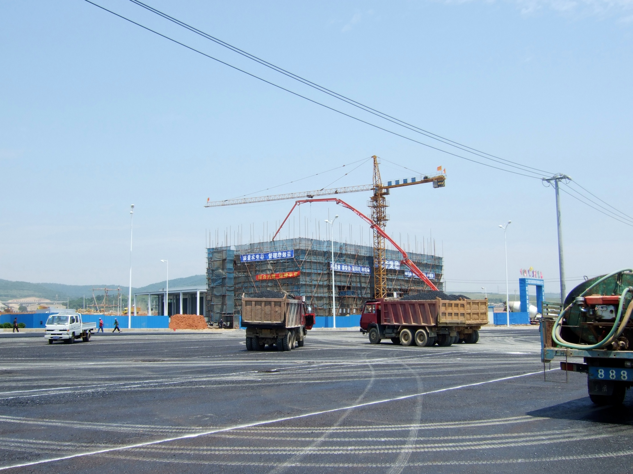

Slide 25
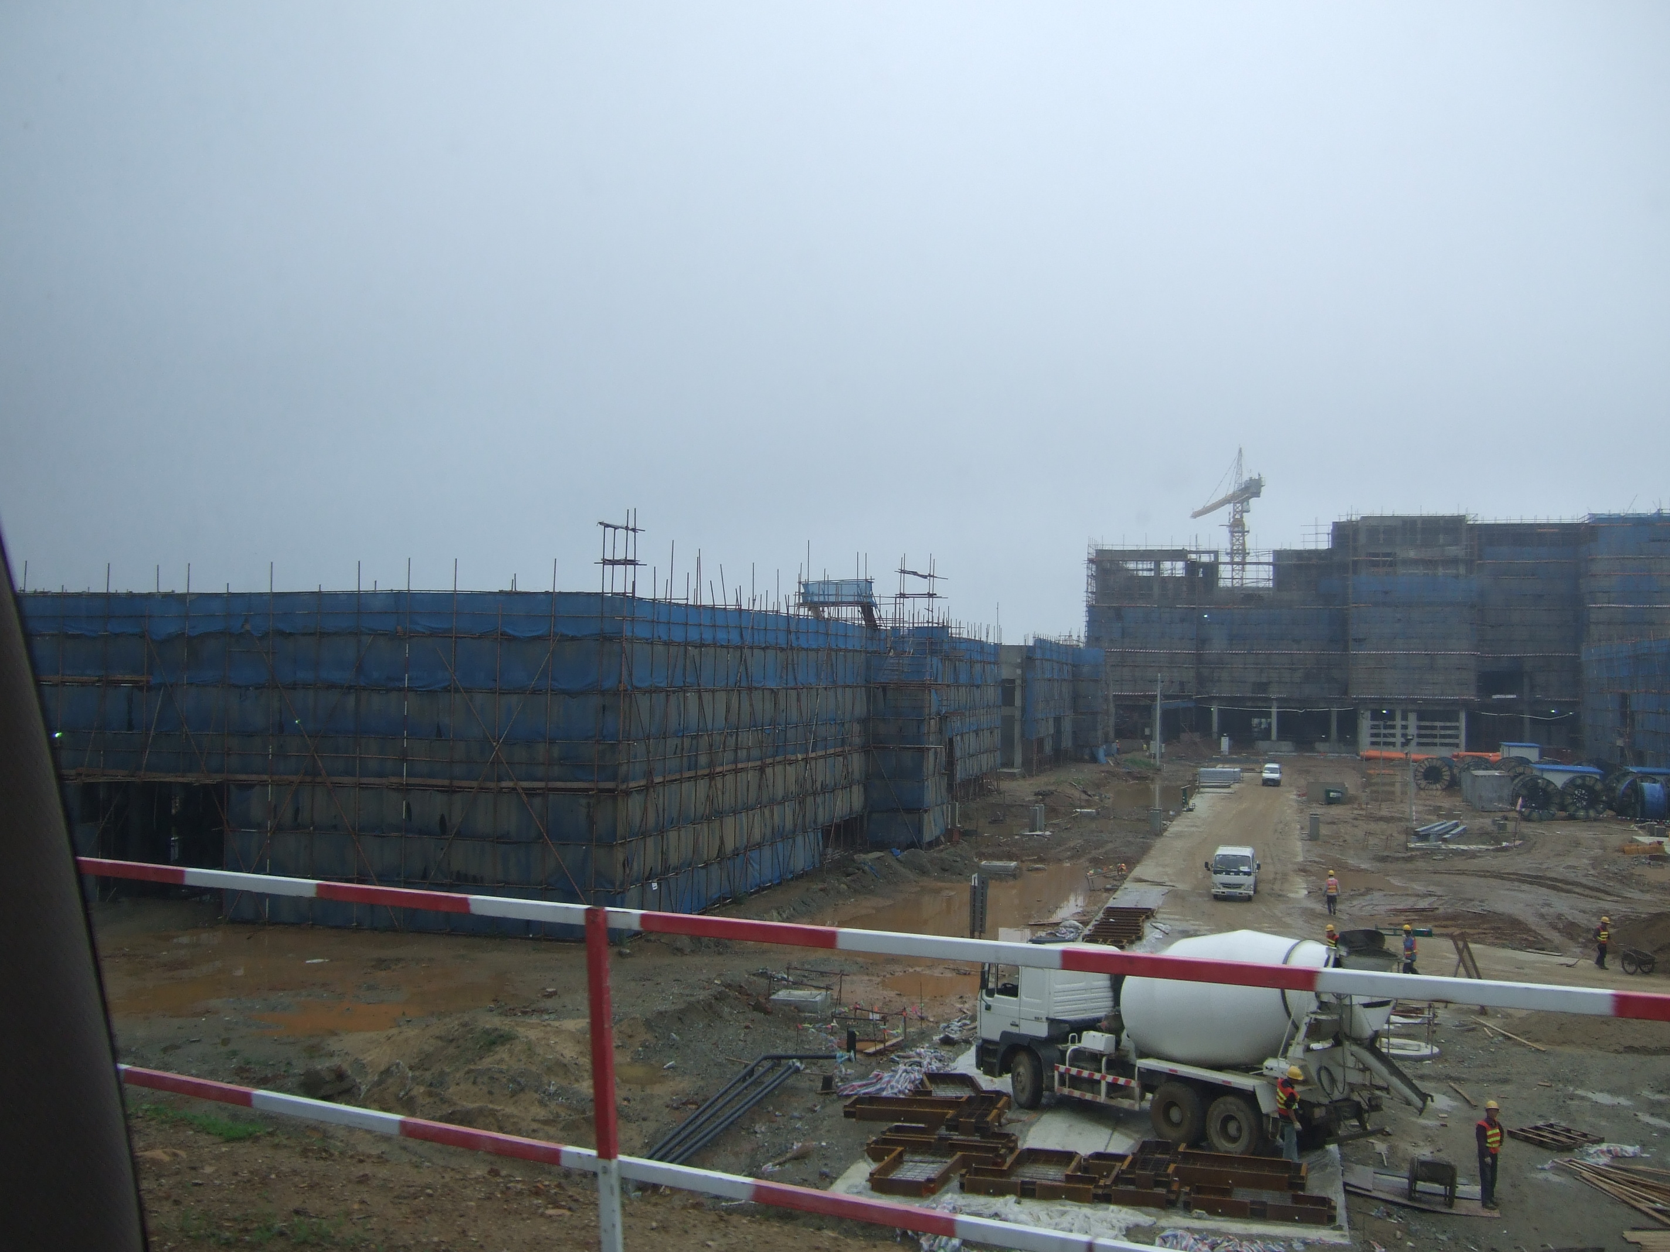

Slide 26
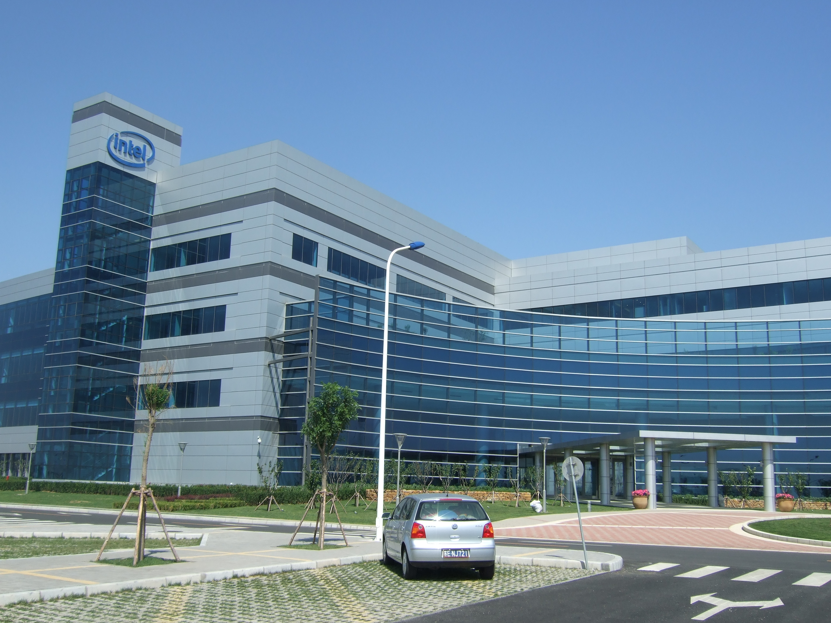

Slide 27


Slide 28
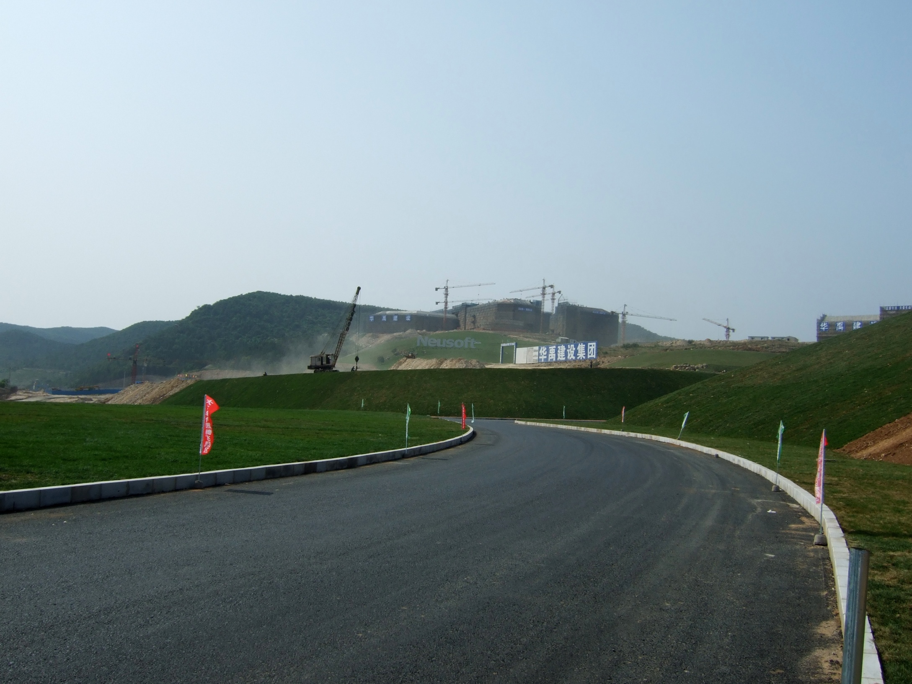

Slide 29
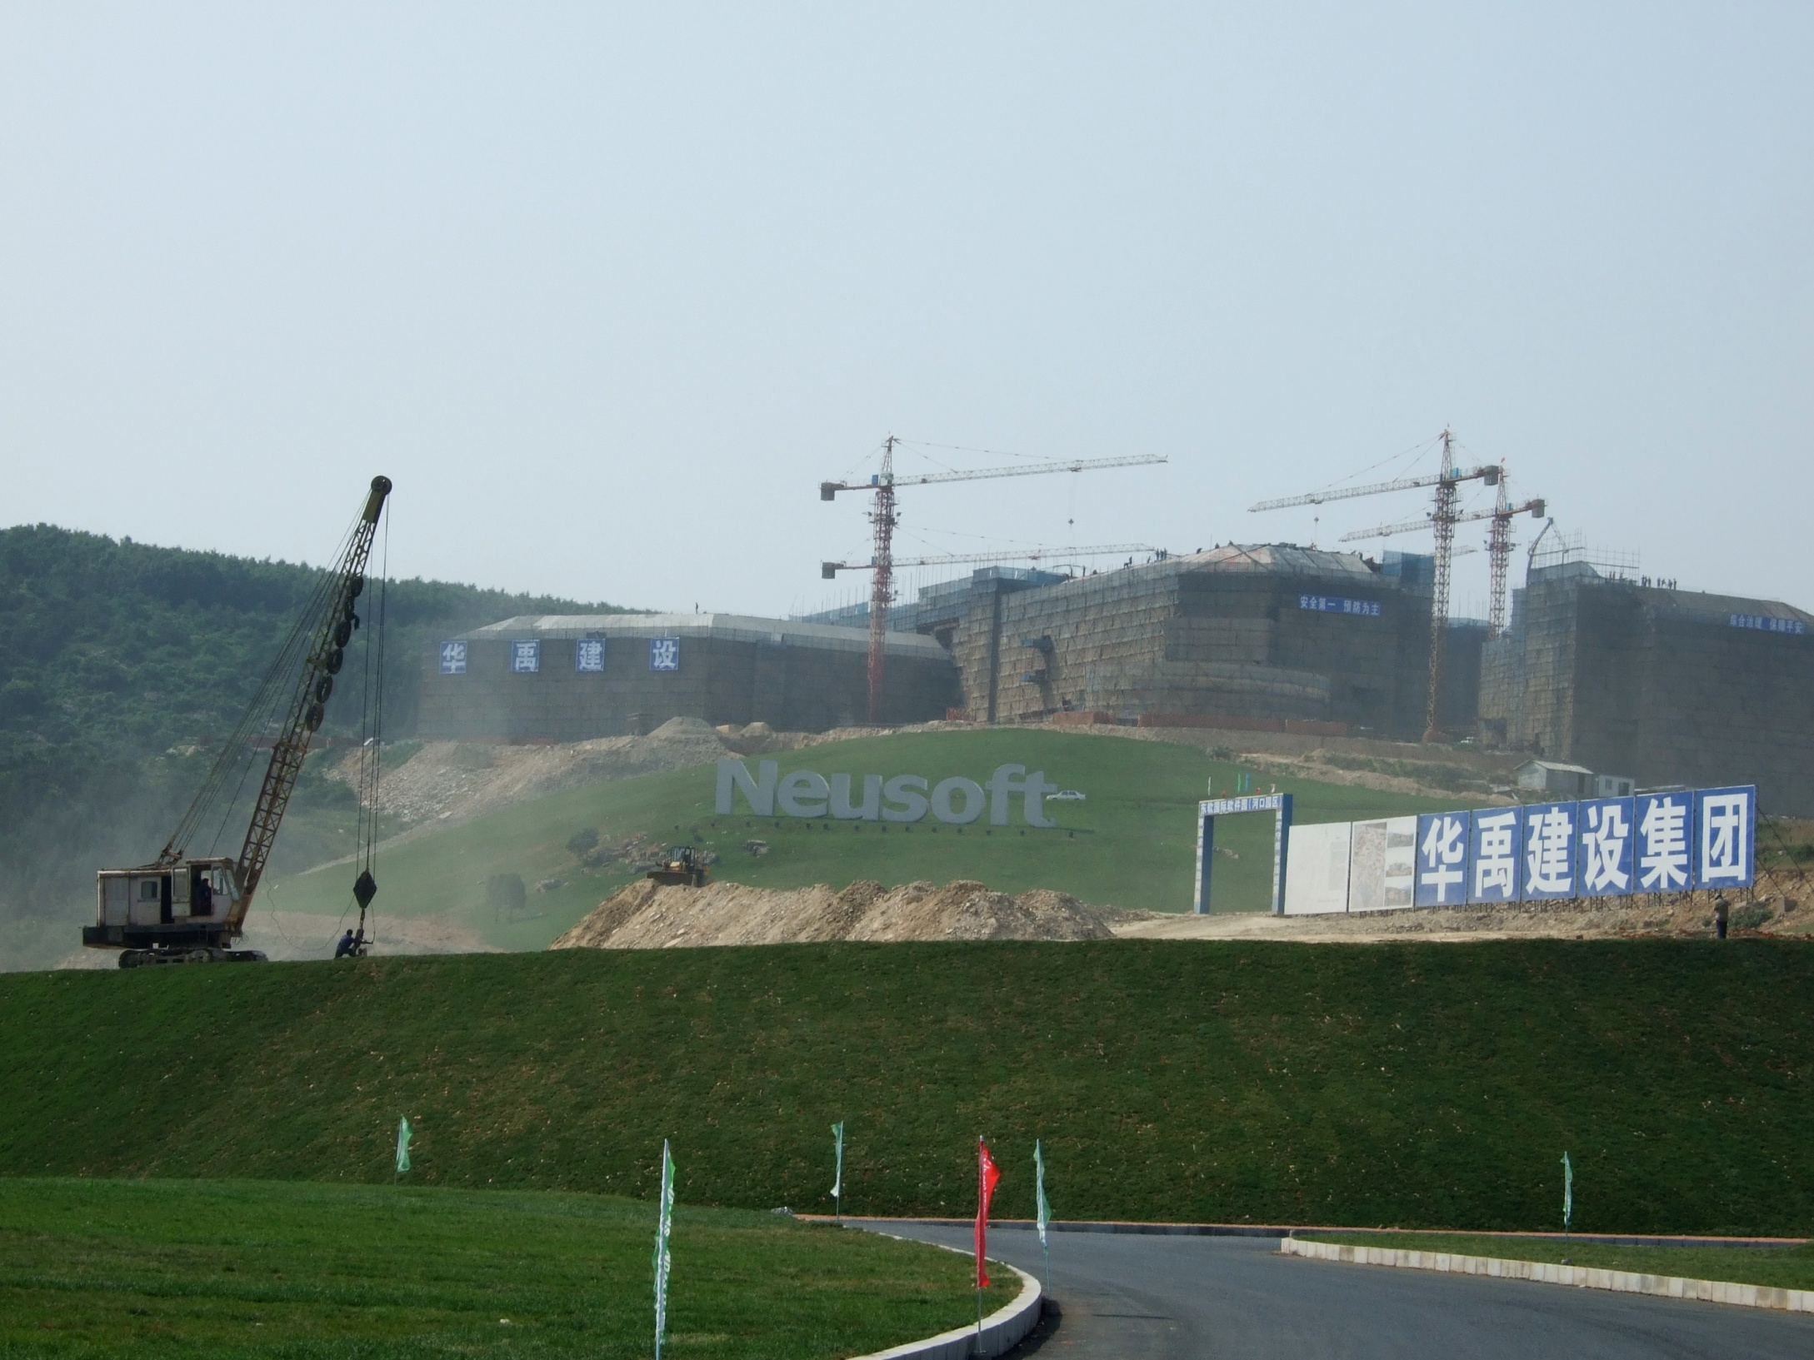

Slide 30


Slide 31
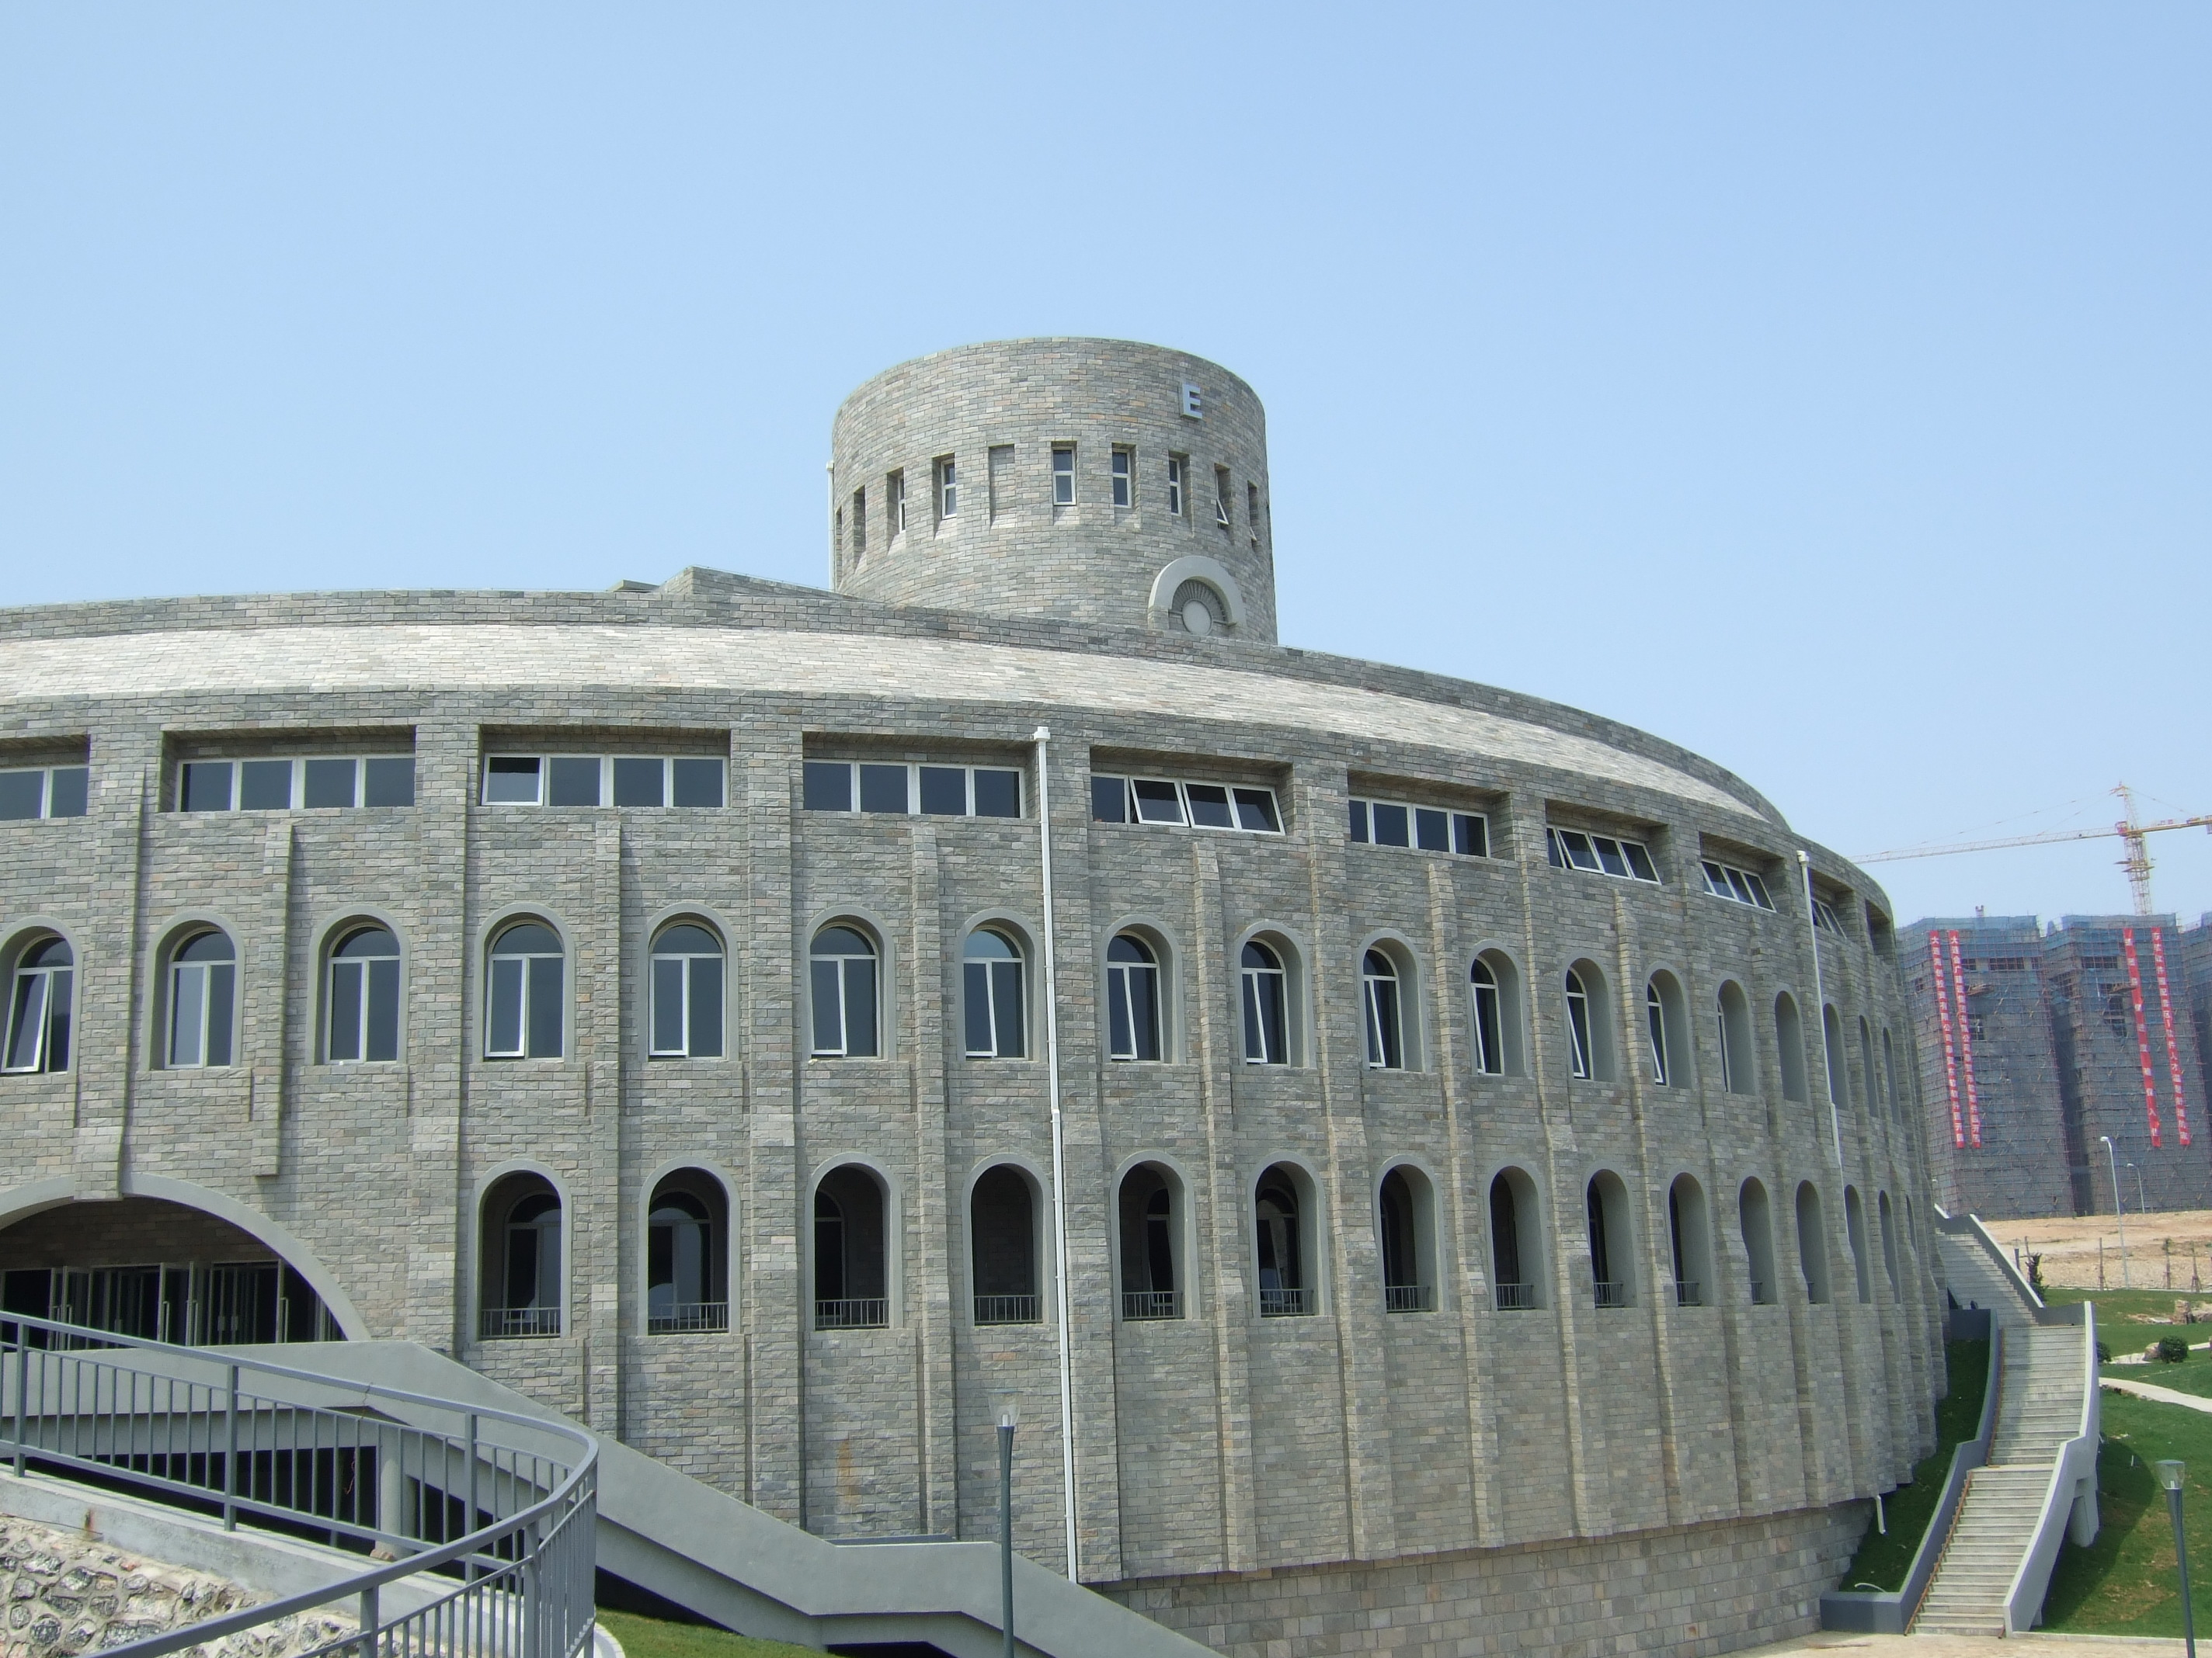

Slide 32
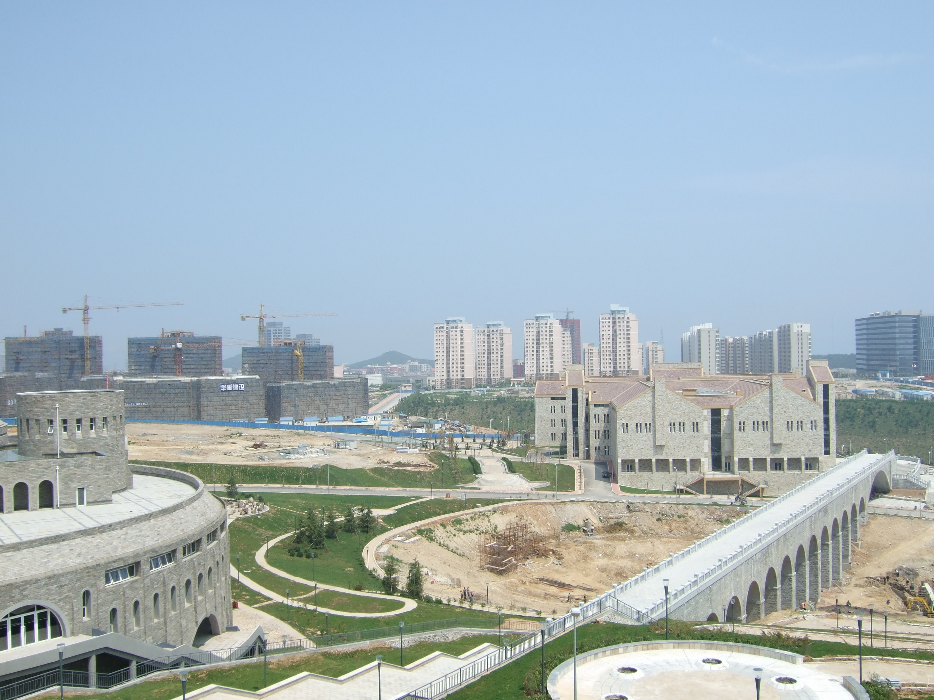

Slide 33
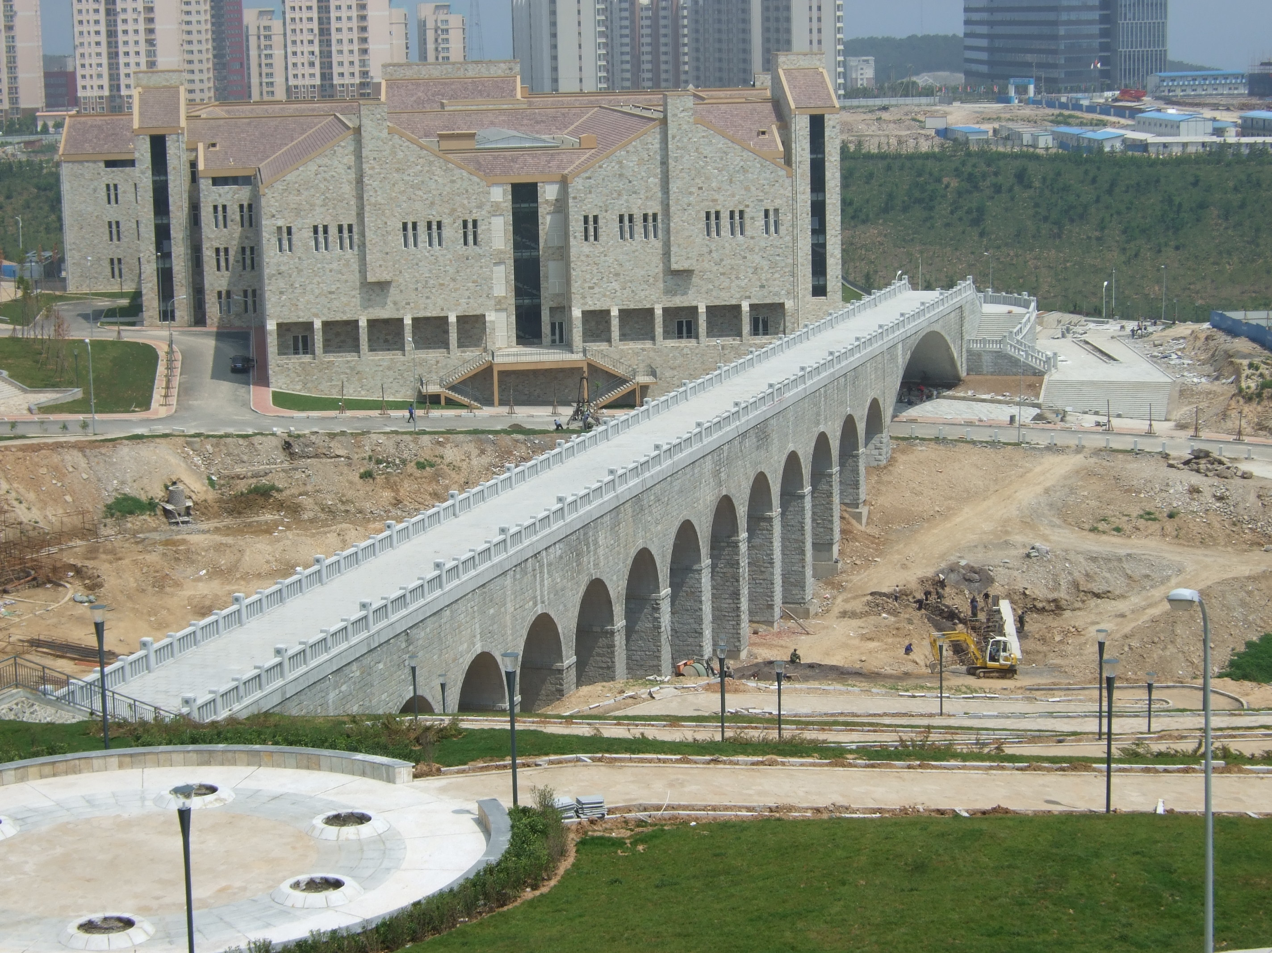

Slide 34
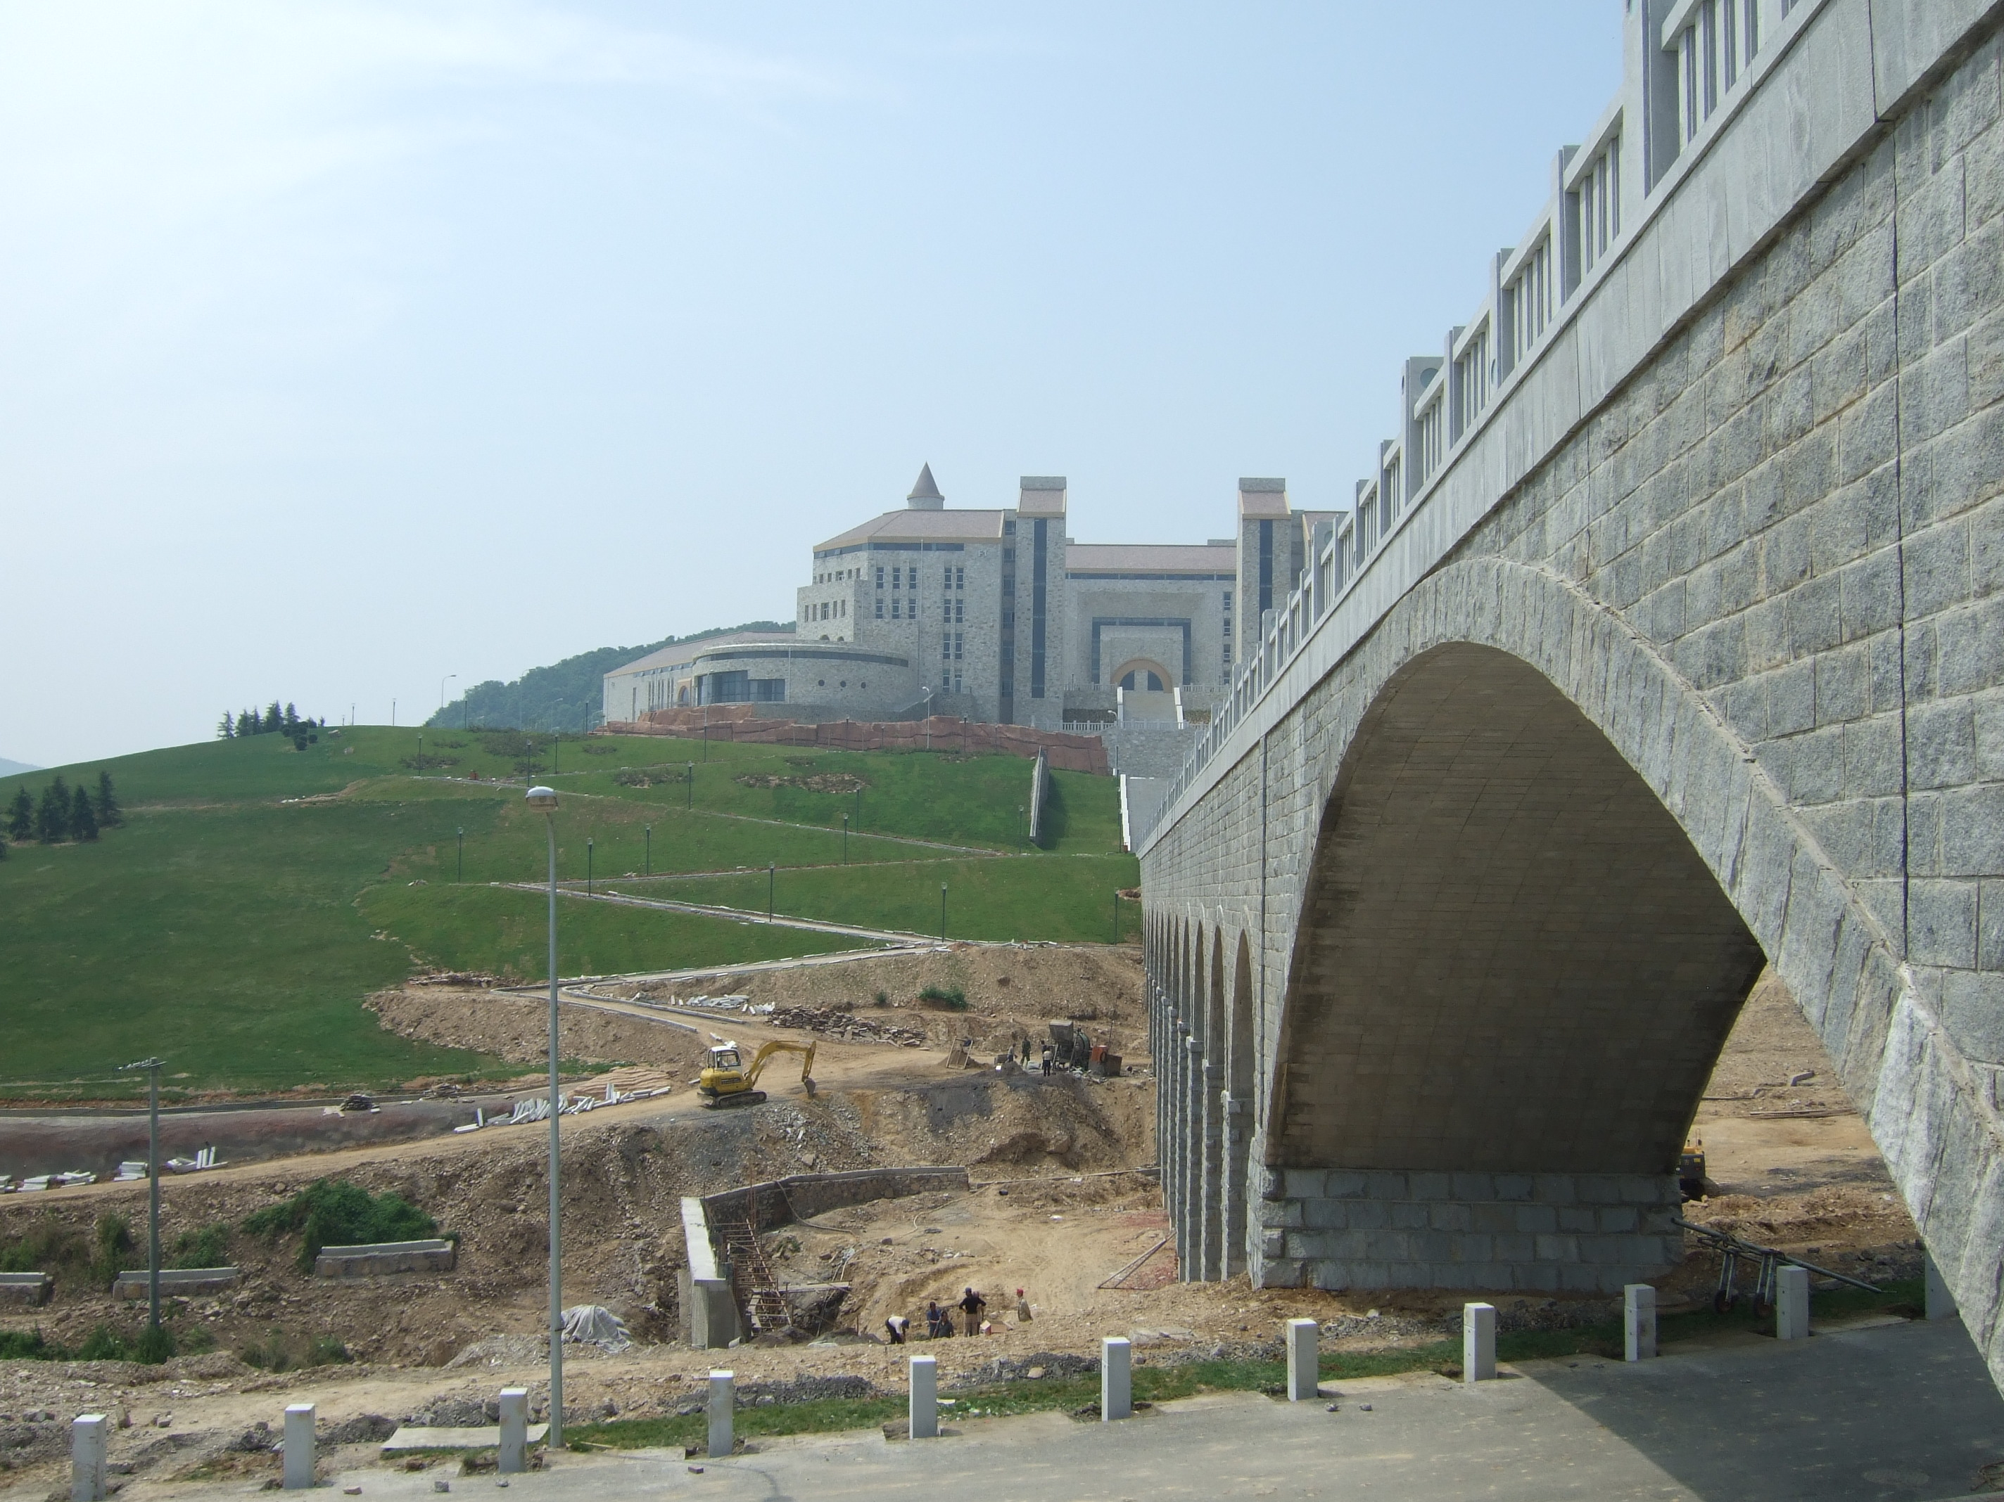

Slide 35
Agenda
Overall research project summary
Global markets and China outlook
China research base
China / India comparison

Slide 36
Strengths: India vs.China
India | China
Maturity of market and firms | Infrastructure
English proficiency | Excellent base for Asian operations
Reputation and history | Growing economy
Size of market and firms | Cultural compatibility with Asia
Nasscom | National movement: From “Made in China to China Service”
Mature project management practices | Diversification of Geo-political risks
 | Augmentation to an India-centric sourcing strategy
 | Vast domestic IT market
Notes:
National Association of Software and Service Companies

Slide 37
Challenges: India vs.China
India | China
Decreasing labor arbitrage | Decreasing labor arbitrage
Infrastructure | Lack of English proficiency
Cultural disconnect with North American and European customers | Cultural disconnect with North American and European customers
Increased global competition for clients and talent | Lack of industry history
 | Lack of “Chinese NASSCOM”
 | Intellectual property concerns
 | Immature and fragmented market
Notes:
Note: China Software Industry Association might be the one! http://en.wikipedia.org/wiki/China_Software_Industry_Association

Slide 38
Global Readiness
Dalian
Infrastructure
  Highway systems
  Power grid
  Utilities
Scale of software parks and firms
Capacity for sustained growth
City planning

Slide 39
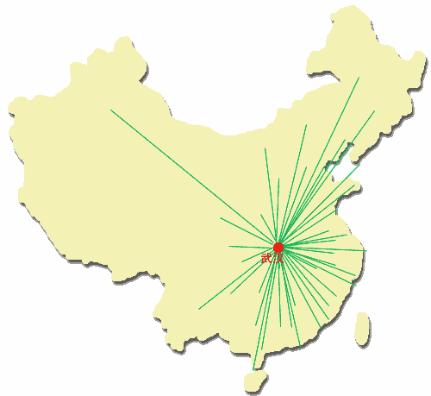
China’s Strengths
1000, 100 and 10 Project
  11th Five Year Plan
Tianjin
Dalian
Beijing
Jinan
Nanjing
Xian
Shanghai
Wuhan
Hangzhou
Chengdu
Shenzhen
Notes:
During the Eleven Five-Year Plan period, efforts shall be made to develop 10 base cities of service outsourcing with international competitiveness, promote 100 well-known transnational corporations to transfer their service outsourcing businesses to China and cultivate 1000 large and medium-sized service outsourcing enterprises with international qualification. Favorable conditions will be created to accept international offshore service outsourcing businesses in an all-round way, increase the value of service and quadruple the export volume of service outsourcing of the year 2005 by 2010. http://www.chnsourcing.com/article/thousand/policies/143820070627094628.html

Slide 40
China’s Strengths
Unified focus
  From “Made in China” to “China Service”
  Strong history in manufacturing
Extensive and mature domestic industry
Expanding economy
Excellent base for Asian operations
Strong labor pool
China offers mitigation of geopolitical risks
China can augment an Indian-centric sourcing strategy

Slide 41
China’s Challenges
Intellectual property concerns
  Security
  Piracy
Cultural and distance barriers
English proficiency (+/-)
Immature markets and firms
Increased competition for skilled workers - wage inflation
Lack of central, organized marketing leadership i.e. NASSCOM

Slide 42
Learning from Indian Software Firms
Importance of social capital
Importance of knowledge transfer
Value of long term goals and relationships
Moving up the supplier value chain

Slide 43
Agenda
Overall research project summary
Global markets and China outlook
China research base
China / India comparison
Impact on project managers

Slide 44
Organizational Support
Project managers had to fill many of the roles of the PMO
Project managers needed specialized training
Project managers felt offshore outsourcing helped their career
Project managers felt offshore outsourcing hurt their career

Slide 45
Project Planning
Projects could be staffed more quickly
PM’s had access to scarce IT skills
PM’s had to thoroughly verify suppliers work estimates
PM’s experienced higher transaction costs
PM’s experienced more project delays
PM’s experienced faster delivery when time zones were coordinated
PM’s experienced project delays when time zones were not coordinated

Slide 46
Knowledge Transfer
PM’s had to do more knowledge transfer up front
PM’s had to shortcut KT because of deadlines set by upper management
PM’s had to test suppliers to verify KT
PM’s had to ensure knowledge renewal
PM’s had to ensure knowledge was transferred back from the supplier
PM’s had to use external information to validate bids

Slide 47
CMM/CMMi
PM’s had to provide greater detail in requirement definitions
PM’s had to ensure the suppliers were fully trained as promised by the supplier
PM’s said supplier CMM capabilities improved their internal processes

Slide 48
Conclusion and Discussion
China is in a prime position to gain both market share and mindshare in global software development industry.
Strong government support and acknowledgement of challenges is promising.
China may offer US / European customers an option to India.
Successful outsourcing requires specialized skills for project managers.

Slide 49
References and Notes
“Managing Offshore, Strategies and Tactics for Global Sourcing”, Volume 2.01, January, 2005, available http://www.managingoffshore.com; “Top 10s in Outsourcing” by India Reports, published by Chillibreeze, October 2006, available http://www.indiareports.com; “Annual Research Report of Chinese Software Outsourcing Market 2005-2006”, by CCID Consulting Company, Ltd.; websites of top 10 global, Indian and Chinese outsourcing companies.
“Annual Research Report of Chinese Software Outsourcing Market 2005-2006”, by CCID Consulting Company, Ltd.
The data is from a report given by the CTO of Neusoft. It was also confirmed through various sources including: Li, Z., “China’s Informatization Strategy and its Impact on Trade in ICT Goods and ICT Services”, EU China Trade Project, available http://www.unctad.org/templates/Download. asp?docid=7910&lang=1&intItemID=4024 -; Foster, P. L., Wolcott, P., and McHenry, W., “The Internet in India and China”, available http://www.firstmonday.org/issues/issue7_10/press/#p2; Kshetri, N., “What determines Internet diffusion loci in developing countries: Evidence from China and India”, available ritim.cba.uri.edu/wp2002/pdf_format/ Essay-Contest-2001-Kshetri-v3%5B1%5D.pdf; Kshetri, N., and Dholakia, N., “Drivers of the broadband industry in China and India: What can we learn?”, available, www.ptc07.org/program/presentation/M21_NirKshetri.pdf.

