Slide 1
Photos Show the Reality of a Warming Planet

Slide 2
In the lead up to COP21, the Paris climate talk, the United Nations Conference on Climate Change has put together 10 images that show a changing world. From the impacts of melting glaciers to species extinction to communities facing sea level rise, these images reflect the reality of climate change.

Slide 4
Melting ice is destroying many species’ habitats: Destroying habitats and ecosystems leads to many species becoming extinct. Currently, 20-30 percent of animal and plant species are under threat of extinction.

Slide 5
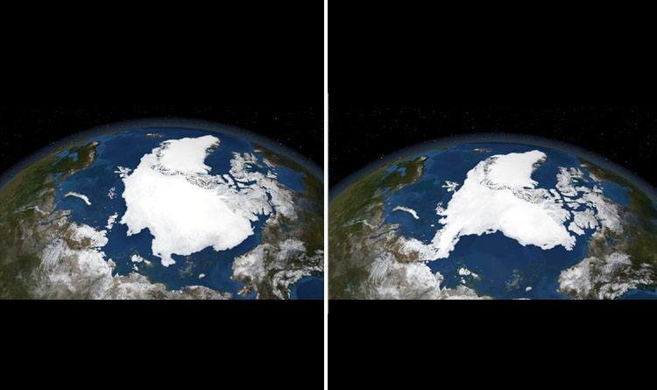
Satellite images from the Arctic ice pack in September 2005 and again in September 2007: The Arctic ice pack is most extensive in the month of September. Yet NASA, which has been mapping it annually since 1979, has measured a 13 percent drop in its surface area per year.

Slide 6
Iceberg drifting off the village of Kulusuk in Greenland: Global warming has hit Greenland hard, with the ice melting increasingly quickly. In barely ten years, temperature variations of several dozen degrees in the same period have been recorded.

Slide 7
The Robeson Islands in the San Blas archipelago (Panama) are under threat from rising water levels: Experts from the IPCC have predicted that average sea and ocean levels could rise from 26cm to 82cm by 2100. This would pose a threat to all islands, deltas and coastal areas.

Slide 8
Flooding in Pakistan: The recent deadly floods which hit Pakistan are largely due to the melting Himalayan glaciers, which in turn is caused by global warming.

Slide 9
The Maldives under threat from rising water levels: The rising water levels are threatening more and more islands and coastal cities. Scientists have calculated that sea levels rose by 18cm between 1870 and 2000, and at a faster rate in recent years (+6cm in 20 years).

Slide 10
Drought, one of the consequences of climate change: Climate change increases the risk of more violent and more frequent extreme climate events such as droughts, torrential rain and storms.

Slide 11
Pollution from factories contributes to global warming: In 2012, the primary production of renewable energies rose to 22.4 million tonnes of oil equivalent (Mtoe). The main sectors are wood fuel (44.8 percent), hydropower (22.4 percent), biofuels (10.7 percent) and heat pumps (6.2 percent).

Slide 12
Large-scale deforestation: Four centuries ago, 66 percent of the earth was covered in forests—today, this figure has been halved. And this deforestation is intensifying, with 23 million hectares of forest destroyed between 2000 and 2012.

Slide 13
I don’t believe in global warming: A meta-study published in 2013 in “Environmental Research Letters” compiled almost 12,000 research abstracts published by over 29,000 researchers between 1991 and 2011. Among them, 3,896 articles stated a position on the causes of global warming over the past 50 years: 97.1 percent of them endorsed the consensus that it is human-caused.

Slide 15
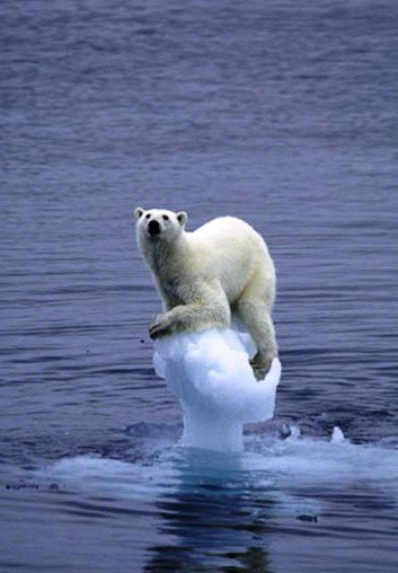
More pictures

Slide 17
Higher storm surges due to climate change are worsening damage from hurricanes and other tropical storms.

Slide 18
These images of Alaska link to a set of climate change scenarios for created specifically for Alaska.

Slide 21
USDA Hardiness Zone Maps for 1990 and 2012

Slide 26
Air pollution in Delhi, India

Slide 29
The bottom picture is the recent one

Slide 32
1941 and 2004

Slide 34
1928 and 2000

Slide 35
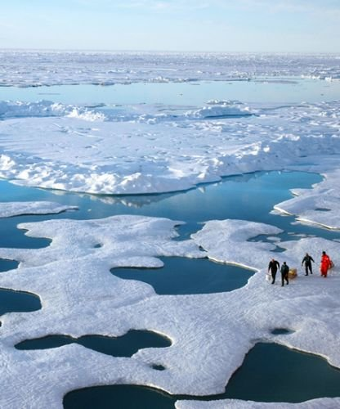
Photos To Show Anyone Who Doesn't Think Climate Change Is Real

Slide 36
Aral Sea – shrinking water bodies

Slide 39
Coral bleaching (dead now)

Slide 49
With its northern glaciers melting and its population surging, Pakistan's climate change time bomb is already ticking. (AFP Photo/Aamir Qureshi )

Slide 50
Increase in forest fires during summer months

Slide 53
Heat, drought and ISIS: Climate change as a ‘threat multiplier’

Slide 54
A new study by NASA scientists has revealed that climate change is increasing the temperature levels in lakes across the world. Nathan Frandino reports.

Slide 55
Humans adding massive amounts of carbon dioxide into the atmosphere

Slide 56
Super hurricanes as in the Philippines

Slide 57
Filipino activists hold placards as they take part in a protest about climate change in Manila December 13, 2015

Slide 58
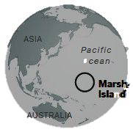
Marshall Islands and others
They can actually see the rising ocean making their islands smaller.
Climate change isn’t a theory to them, it is reality to them.
Where will they go as their islands disappear? The U.S.A. is a real possibility.

Slide 60
A small part of the Marshall Islands – it won’t take much of a rise to submerge them.

Slide 61
Trying to prevent high tide waters from entering their homes

Slide 63
Children playing in a tree on Ebeye. In the background, on nearby Kwajalein, is the Ronald Reagan Ballistic Missile Defense Test Site. We’ve used them for our purposes, so we may owe them a new home as theirs disappears.

