Slide 1
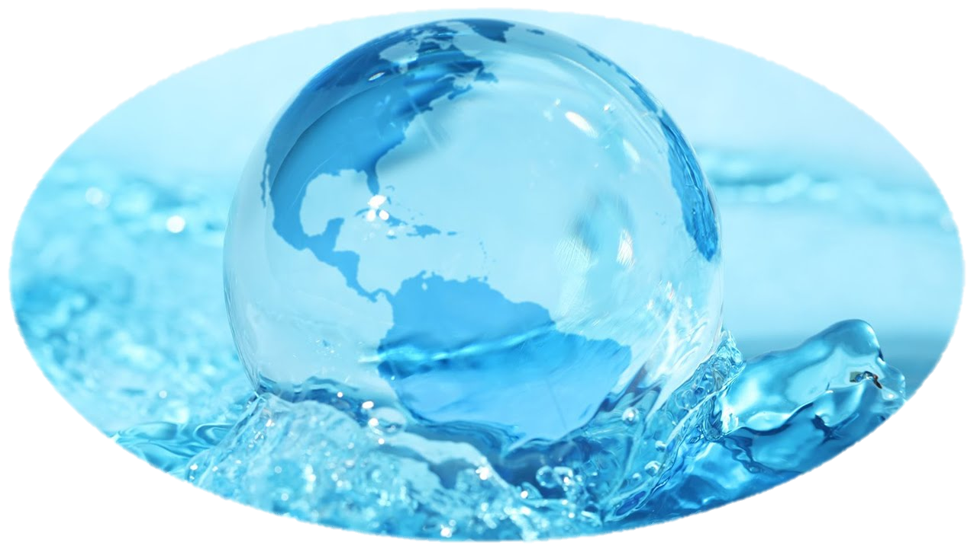
River Systems
Physical Geography

Slide 2
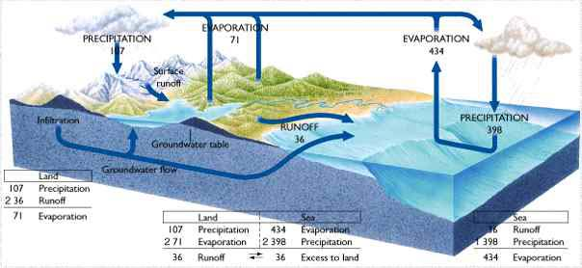
The Hydrologic Cycle
Infiltration = Groundwater System
Runoff = Surface Water System
  Runoff = Precipitation - Evapotranspiration
This is a solar powered system which will continue to recycle water molecules as long as the Sun shines on the Earth. Since (1) everything is connected on this Earth and (2) everything goes somewhere (3) nature knows best, and (4) there are consequences for any alteration of the conditions of the system. Human actions have consequences.
Humans can choose to work with nature with minimal disturbance of the natural systems or humans can try to alter conditions and disrupt the natural systems. Human decisions should be carefully thought out before action is taken. Try to anticipate consequences before taking action.

Slide 3
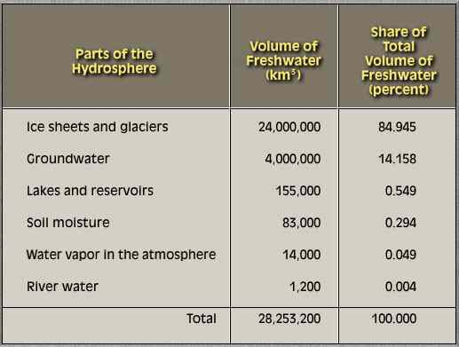
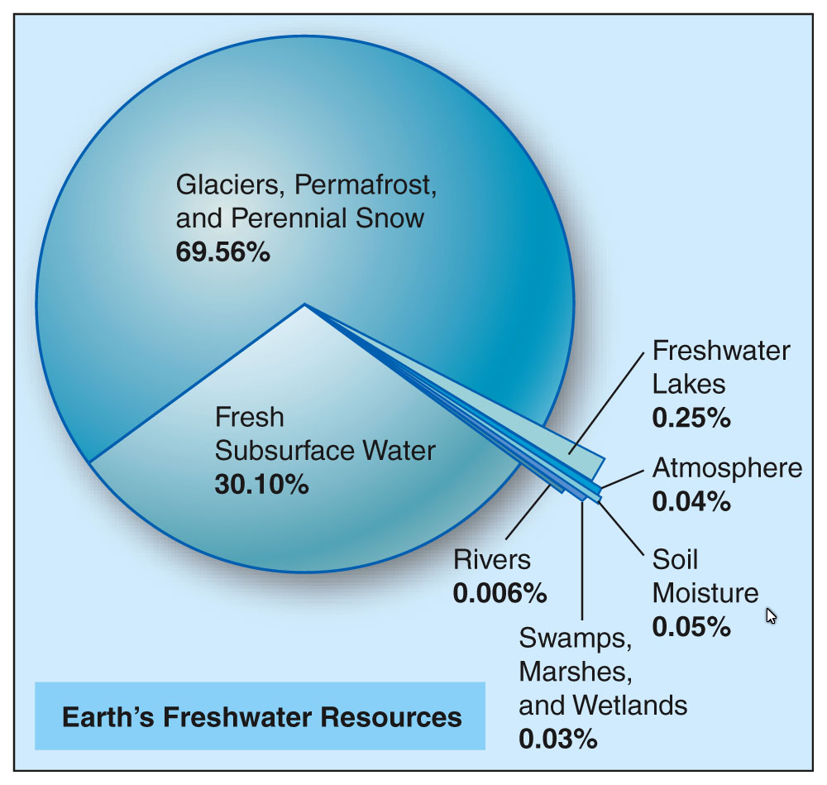
Where is the Water ?

Slide 4
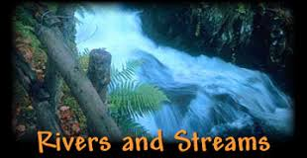

Slide 5
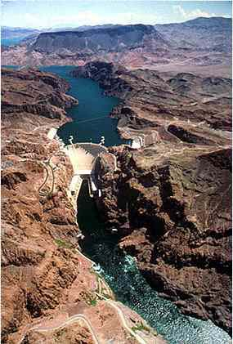
RIVERS & STREAMS
Water Reservoirs
The Hydrologic Cycle
Surface Water Systems
Meandering
Deltas/Alluvial Fans
Floods and flooding
If you haven’t been to the Hoover Dam on the Colorado River, you should do that – it is spectacular – breathtaking.

Slide 6
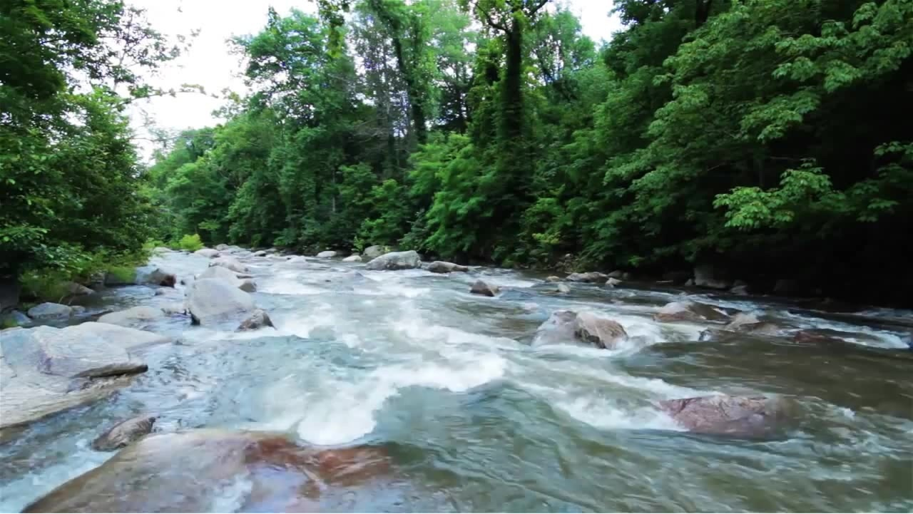
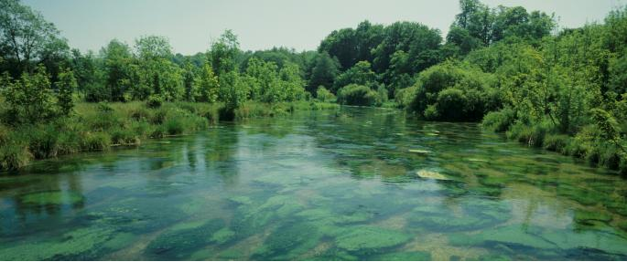
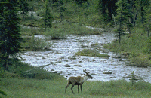
Importance of rivers
Rivers:
  Provide water and nutrients for agriculture
  Provide habitat to diverse flora and fauna
  Provide routes for commerce
  Provide recreation
  Provide electricity
Notes:
Rivers are of immense importance geologically, biologically, historically and culturally. Although they contain only about 0.0001% of the total amount of water in the world at any given time, rivers are vital carriers of water and nutrients to areas all around the earth. They are critical components of the hydrological cycle, acting as drainage channels for surface water - the world's rivers drain nearly 75% of the earth's land surface. They provide habitat, nourishment and means of transport to countless organisms; their powerful forces create majestic scenery; they provide travel routes for exploration, commerce and recreation; they leave valuable deposits of sediments, such as sand and gravel; they form vast floodplains where many of our cities are built; and their power provides much of the electrical energy we use in our everyday lives. Rivers are central to many of the environmental issues that concern society, and they are studied by a wide range of specialists including hydrologists, engineers, ecologists and geomorphologists.

Slide 7
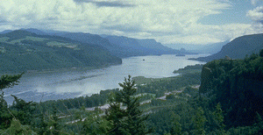
Natural Watercourses: Measurements
Discharge- volume of water
  #1 is the Amazon River
Velocity- rate of water movement
Gradient- slope of inclined surface
  The steeper the slope, the greater the velocity
    More down cutting than side cutting
  The more gradual the slope, the slower the velocity.
    More side cutting and less down cutting.
Notes:
Rivers are natural watercourses, flowing over the surface in extended hollow formations (i.e., channels), which drain discrete areas of mainland with a natural gradient. In basic terms the existence of a river depends on three things: the availability of surface water, a channel in the ground, and an inclined surface. In this sense the term river includes all kinds of watercourses, from the tiniest of brooks to the largest of rivers (the term stream is used interchangeably with river when describing characteristics of the watercourse). Essentially, a river represents the excess of precipitation over evaporation for a certain land area (see the general section on the hydrological cycle).
www.aquatic.uoguelph.ca/rivers/chintro.htm

Slide 8
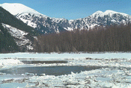
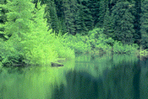
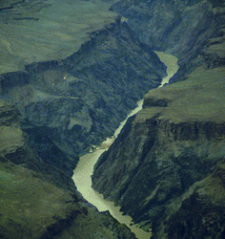
Variation in time and space
The shape, size and content of a river are constantly changing, forming a close and mutual interdependence between the river and the land it traverses.
Notes:
Rivers are very dynamic and show tremendous variation through time and space. The shape, size and content of a river are constantly changing, forming a close and mutual interdependence between the river and the land it traverses. Imagine following one river from a small trickle in the mountains, over raging rapids and waterfalls, through areas of peaceful, nearly motionless water, all the way to its meshing with the mighty waves of the sea. On its way, a river may carve through majestic mountain ranges, create deep gorges and canyons, gentle valleys, lush meadows, and mighty plains, all the while providing the setting for a diversity of biological communities. Over time it may change drastically from a roaring, overflowing force in the spring, to a still, icy-cold mass in the winter.

Slide 9
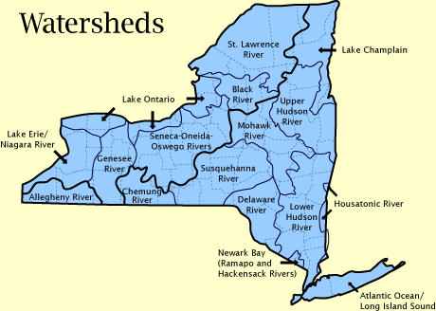
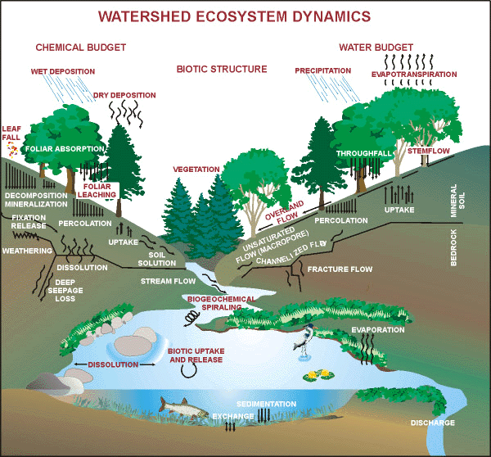
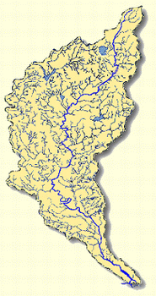
What is a Watershed?
www.dec.state.ny.us/website/2000/watersheds.gif
A drainage basin is any area of land where precipitation collects and drains off into a common outlet, such as into a river, bay, or other body of water.
www.aquatic.uoguelph.ca/rivers/chwater.htm
www.epa.gov/watertrain/ecology/ecology21.html

Slide 10
The Worlds Largest Rivers
Nile
Amazon
Mississippi-Missouri
Yangtze
Ob

Slide 12
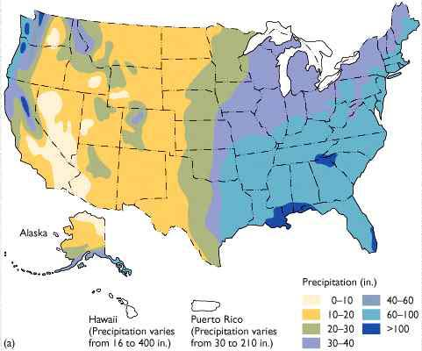
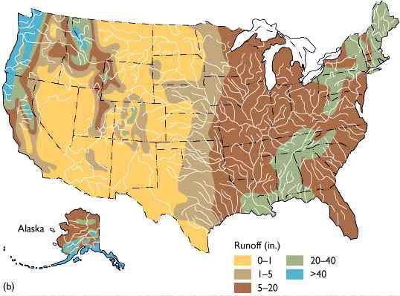
U.S. Precipitation Map
Notice the effect of the Rocky Mountains
U.S. Runoff Map

Slide 13
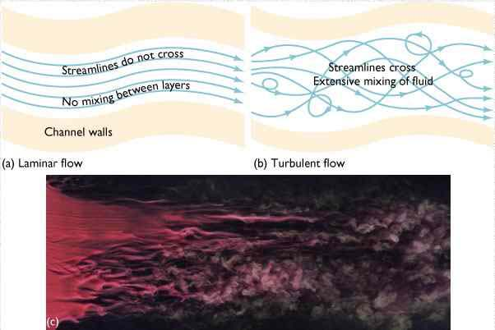
Laminar vs. Turbulent Flow

Slide 14
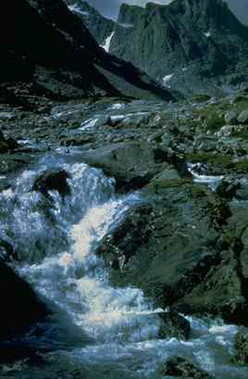
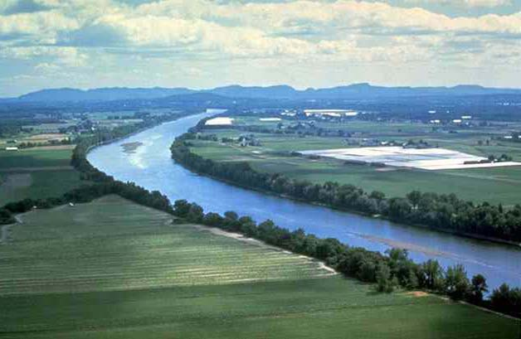
Near-Laminar flow in the center of a river channel
Turbulent flow in the headwaters of a rushing mountain stream

Slide 15
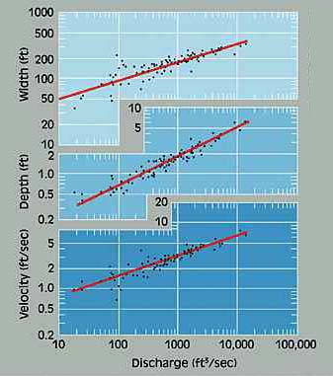
So Where Does The Stream Move Fastest?
Headwaters move slowest
Mouth of stream moves fastest
Laminar flow is more efficient than turbulent flow.
Deeper stream move faster than shallow streams

Slide 16
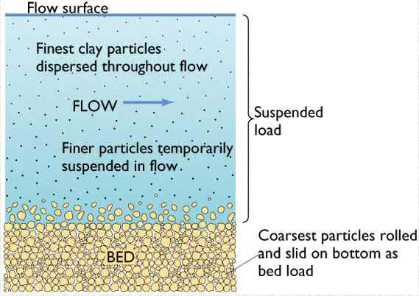
Sediment Load: all streams carry (transport) some sediment.
Force of gravity tends to work to produce inert particles.
The volume and velocity of the stream overcomes inertia most easily with the smallest particles. The heavier the particles, the more the effect of gravity causes them to move toward being inert
As the velocity of a stream begins to slow down, sedimentation of the stream bed increases

Slide 17
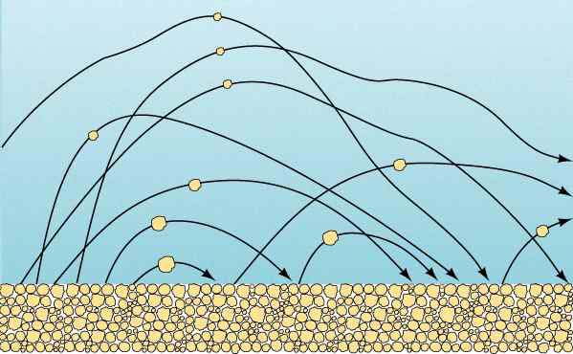
Movement of Bedload by Saltation

Slide 18
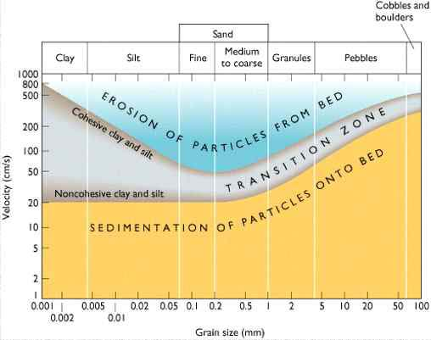
Sedimentation

Slide 19
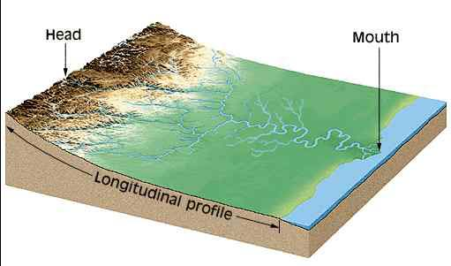
Longitudinal Stream Profile
Can be divided into 3 main parts
Drainage (Tributary) System
Distributary System
Transport System

Slide 20
Drainage System
Stream energy is spent eroding downward into the basement rock and...
Moving sediment
Creates “V” shaped canyon and valleys
When streams emerge from the mountain front, they often deposit some of this sediment forming alluvial fans.
  A move from greater slope to lesser slope
  A shift from higher velocity to lower velocity
    The effect of gravity on the stream load (of sediment) increases

Slide 21
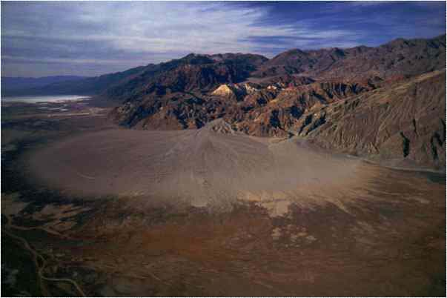
Alluvial Fans
A shift from erosion and transportation to deposition
Common feature where mountains descend to arid plains

Slide 22
Aging Rivers: How Old Is It?
Young- rapid bed erosion, waterfalls, rapids, v-shaped valleys, few tributaries, low volume
Mature- well established tributaries, larger volume of water, erode banks and not the bed (bottom), meanders, oxbow lakes

Slide 23
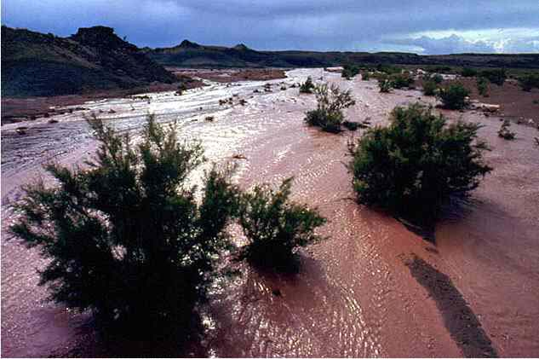
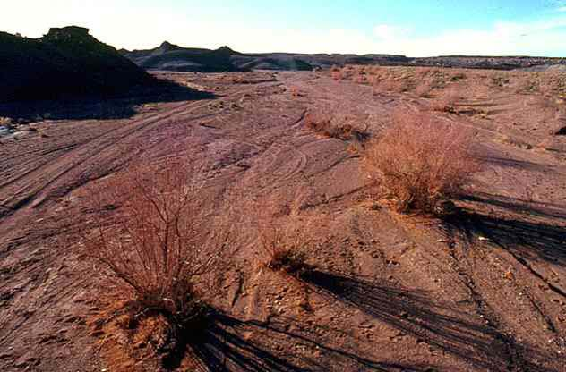
Flash Flooding & Sheetwash

Slide 24
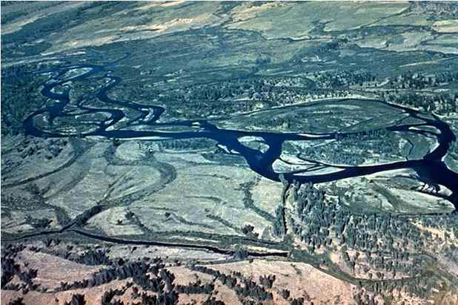
Braided Pattern = moderate slope + high stream power + coarse bed materials

Slide 25
Braided Streams & Rivers
High sediment load
Constantly changing course
Floodplain is completely occupied by channels
Many small islands called mid-channel bars
Usually coarse sand and gravel deposits.

Slide 26
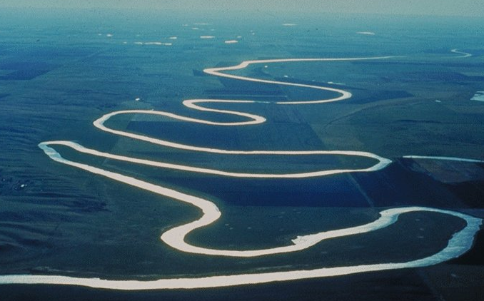
Meandering Rivers

Slide 27
Meandering Rivers
Constantly erode material - Cut bank
Constantly deposit material - Point bar
Change their channel course gradually
Create floodplains wider than the channel
  Very Fertile soil
  Subjected to seasonal flooding

Slide 28
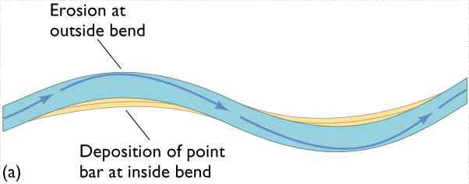
Formation of Meanders

Slide 29
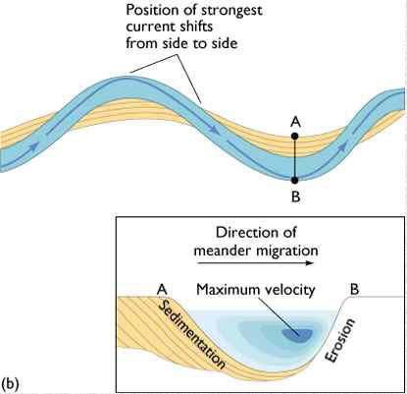
Point bar deposits

Slide 30
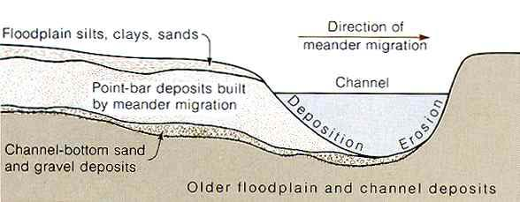
Point Bar Deposits
Point bar deposits grows laterally through time

Slide 31
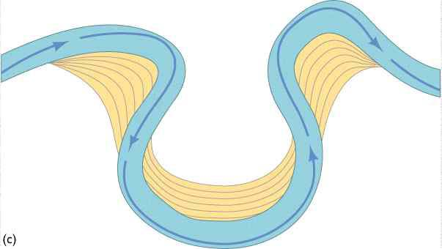
Cut bank erosion
Point bar deposits
}
Meander loop

Slide 32
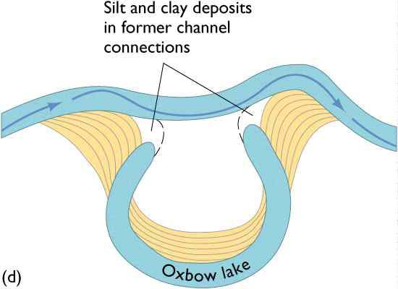
Formation of an Oxbow

Slide 33
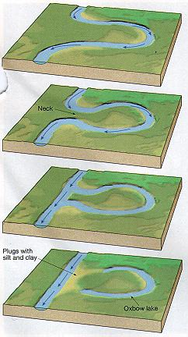
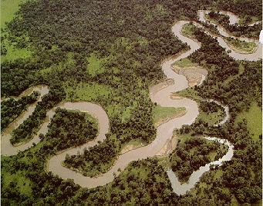
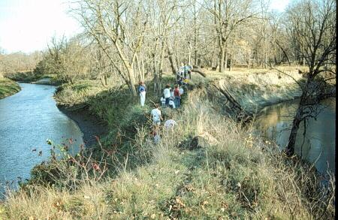

Slide 34
Meandering stream
flowing from
top of screen
to bottom

Slide 35
Maximum
deposition
Maximum
erosion

Slide 45
Meander scars
Oxbow Lake
Oxbow
cuttoff

Slide 46
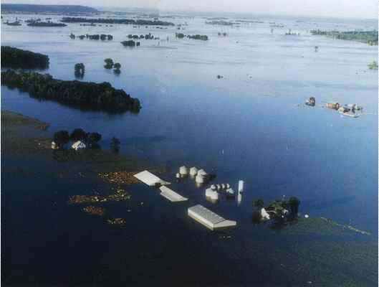
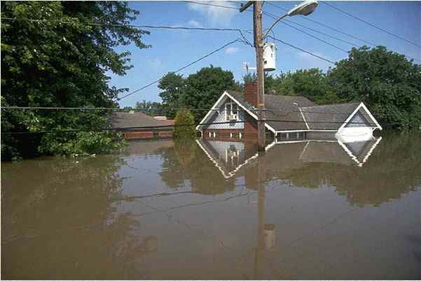
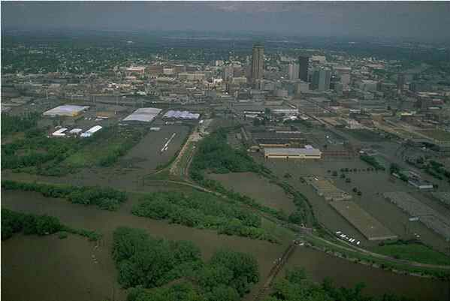
1993 Mississippi Flood

Slide 47
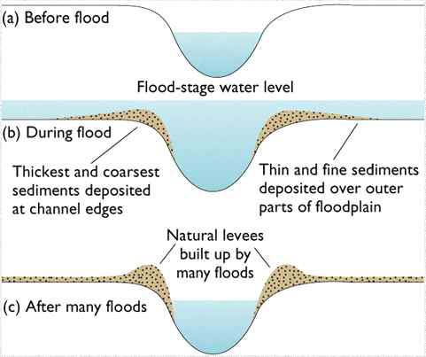
Flooding & Sedimentation

Slide 48
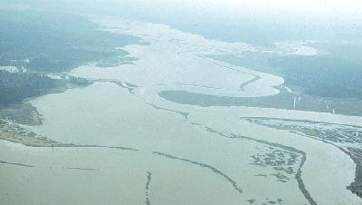
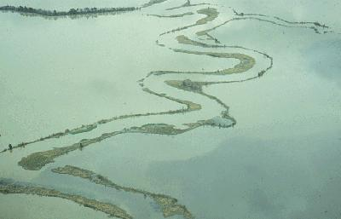

Slide 49
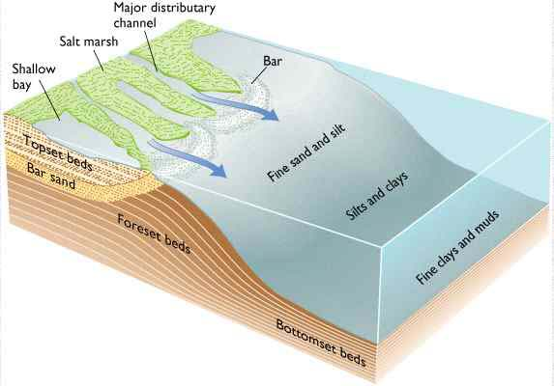
Deltas - Distribution Systems
Tributaries: smaller streams that feed into larger streams. Example: The Illinois River is a tributary of the Mississippi River.
Distributaries: a stream that branches off and flows away from a main stream channel. They are a common feature of river deltas. The phenomenon is known as river bifurcation (dividing up). The opposite of a distributary is a tributary.

Slide 50
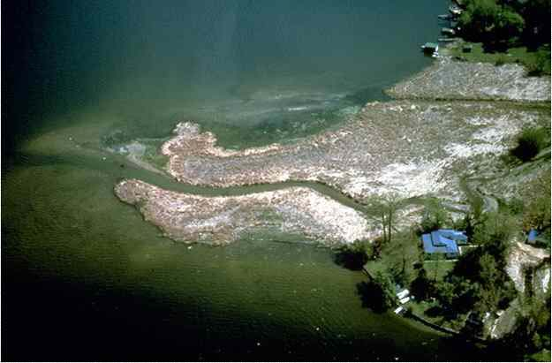

Slide 51
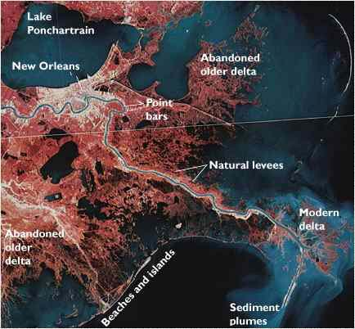
If the Mississippi changes course again, what will happen to the City of New Orleans?

Slide 52
What could the 1993 flood teach us?
The Earth City levies held and protected the development there.
Because flood water couldn’t spill into that area, more water was pushed across the river and parts of St. Charles county were flooded which might not have been flooded if the Earth City levies hadn’t been built.
Levies don’t always hold, but when they do, they just create worse conditions for other areas and the people who live and work there.
Floodplains should not be intensively developed-they’re called floodplains for a reason! The best uses are farming and wildlife reserves and simple parks with a minimum of buildings. The flood damage costs would be very low and the land could be back in shape shortly.

Slide 53
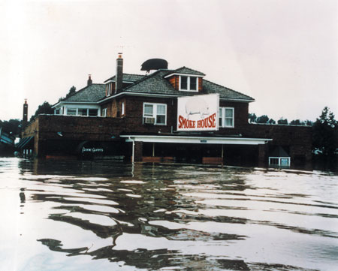
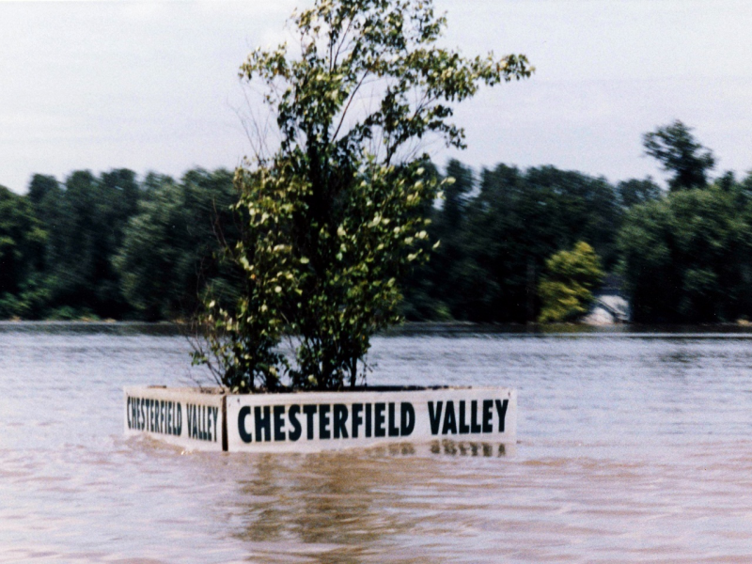
Man-made levies
Man-made levies may temporarily protect a portion of the flood plain; however, they just push more water to the other side of the river and the flood extends further there than it would have, or they cause floodwater downstream to be higher (creating problems for the people there)
Remember Chesterfield Valley in 1993? Their levy failed and the whole developed floodplain was flooded. Then businesses foolishly rebuilt in the valley after the levy was sufficiently repaired (they hope).

Slide 54
Things to Remember
Ground water isn’t stationary and lakes and streams are where ground water levels are higher than that area of land.
Rivers are part of a larger hydrologic system
The have three main components:
  Drainage (Tributary) systems - collect water
  Transport Systems - move water along
    Alluvial fans, braided streams, meandering streams
  Distributary systems - return water to the sea
    Deltas.
Rivers exceed their capacity during floods
Floodplains should not be intensively developed.

