Slide 1
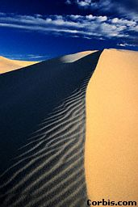
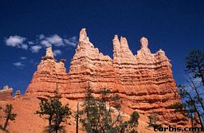
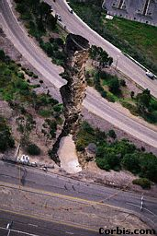
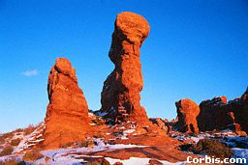
Weathering, Mass Wasting, and Erosion
You have studied the internal processes that create relief. Now, we will examine the external forces at work on the landscape. These forces, though often miniscule, act over time to inexorably wear away at the landscape, transforming it, shaping it, while carrying material down towards the sea. In reality trying to level everything out

Slide 2
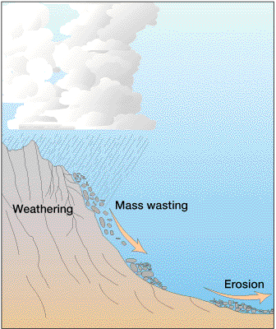
Weathering > Preparing solid matter to be dislocated
Mass Wasting > the force of gravity overcomes inertia and weathered material is dislocated
Erosion > If the force is great enough, moving air, water, or ice ae able to move weathered materials away from the place where inertia kept them located.
Transport > The process of moving air, water or ice moving loose materials to a new location
Deposition > As the moving force (air, water, or ice) weakens, gravity attracts the heavier particles and they settle down on the surface, returning to a state of inertia. And as the moving force continues to weaken, lighter and lighter particles settle down.

Slide 3
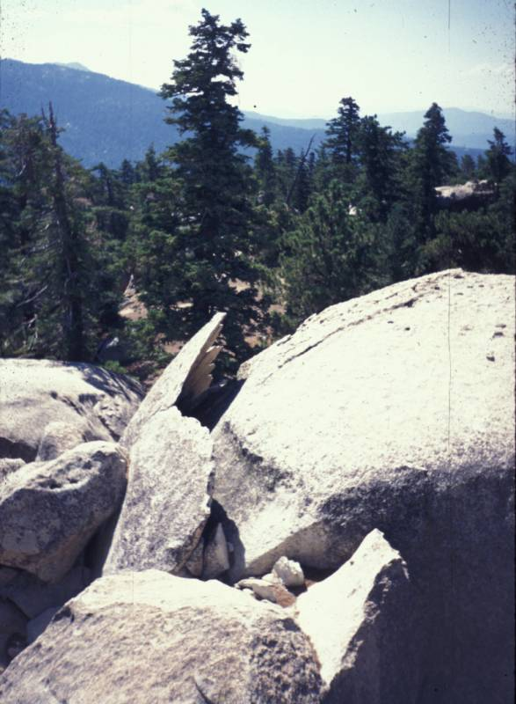
Weathering
The mechanical disintegration and/or chemical decomposition that fragments rock masses into smaller components.
The processes begin in:
Microscopic spaces
Joints
Faults
Lava Vesicles

Slide 4
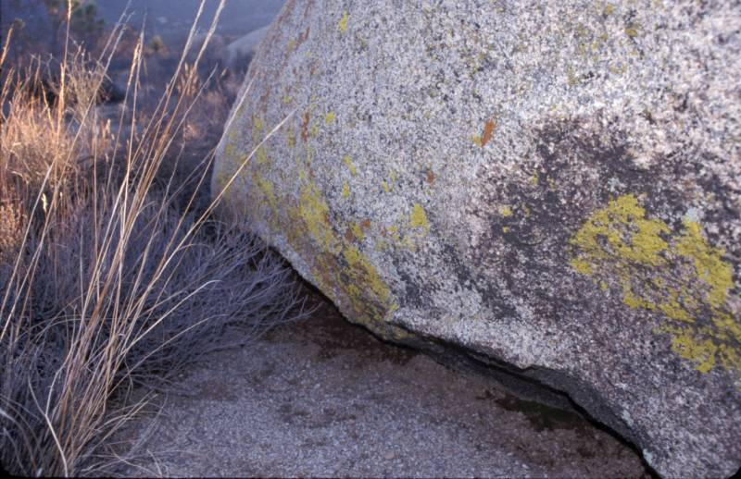
The growth of the lichen on the rock surface makes chemical changes in the surface of the rock.

Slide 5
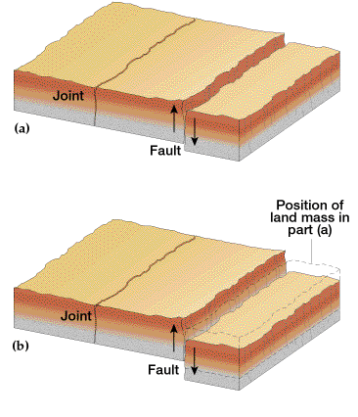
Difference between a joint and fault:
Faults show relative displacement.
Joints are more common.
Both provide more areas where weathering can occur. A system of horizontal and vertical can eventually end up as a system of caverns.

Slide 6
Types of Weathering
Mechanical (Physical) - no change in chemical composition.
Frost wedging
Salt wedging
Chemical - decomposition of rock through a chemical change in its minerals.
Oxidation - important in iron-rich rocks
Hydrolysis - igneous rocks have much silica which readily combines with water
Carbonation - carbon dioxide dissolved in water (carbonic acid) reacts with carbonate rocks to create a soluble product (calcium bicarbonate)

Slide 7
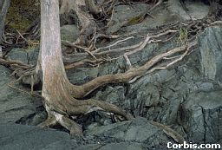
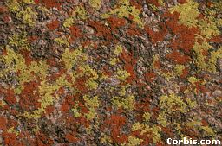
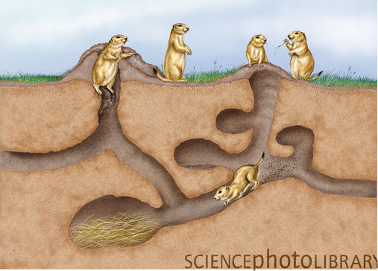
Types of Weathering
Biological - plants and animals contribute to weathering.
Roots physically break or wedge rock
Lichens (algae and fungi living as single unit), remove minerals and weaken rock by releasing acids
Burrowing animals can increase weathering.
Lichens

Slide 8
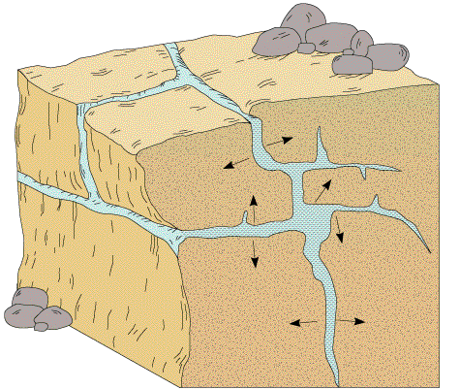
Frost Wedging in joints
When water freezes, it increases in volume (about 9% for fresh water). The effect of expansion during freezing can be dramatic, and ice expansion is a basic cause of freeze-thaw weathering of rock in nature and damage to building foundations and roadways from frost heaving

Slide 9
Frost Wedging and Sheeting
Frost weathering, also called ice wedging or cryofracturing, is the collective name ... Exfoliation due to pressure release is also known as "sheeting".
San Jacinto Mts.

Slide 10
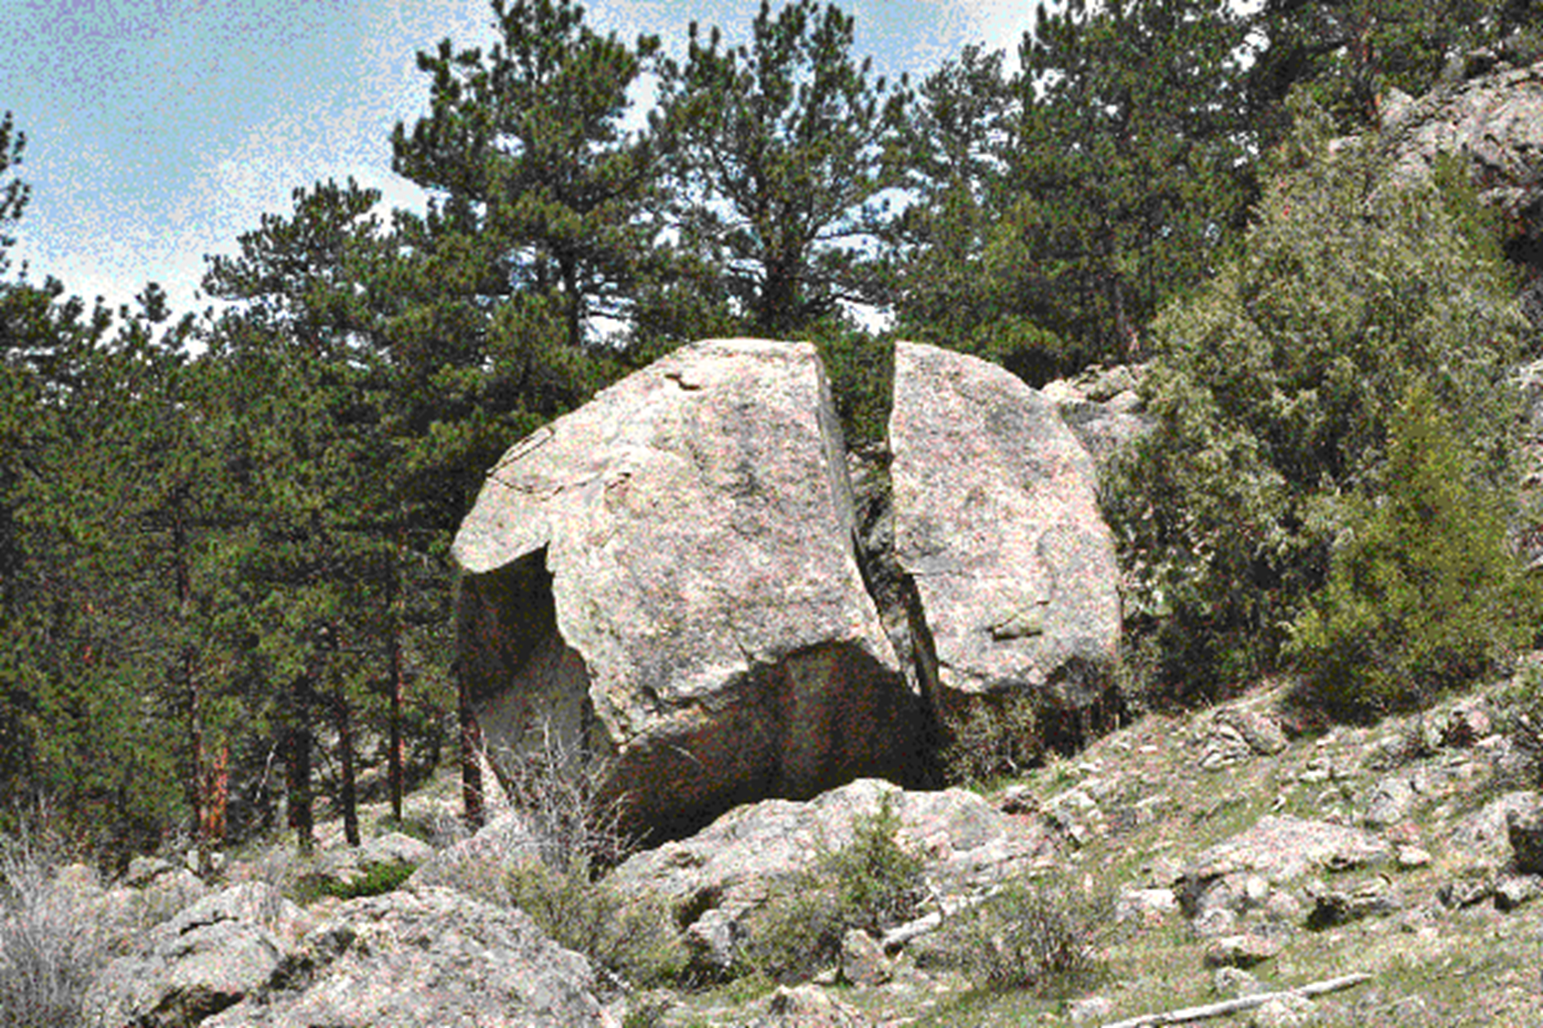
Frost Wedging

Slide 11
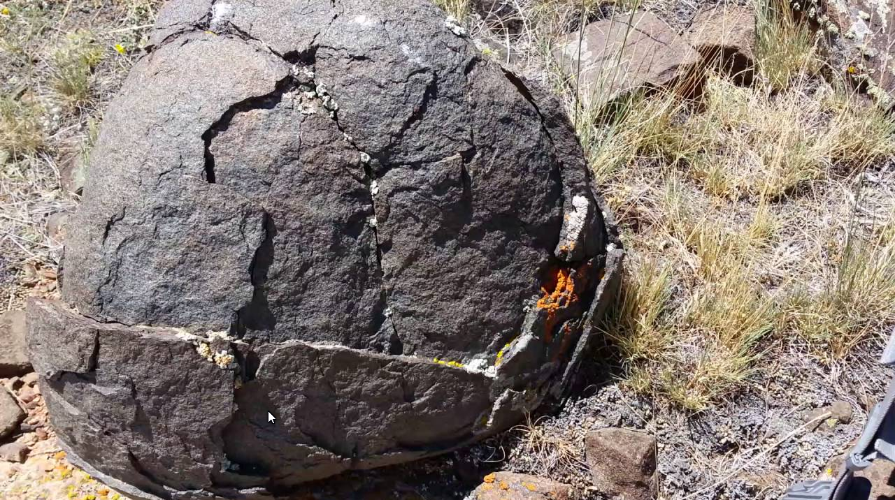
Exfoliation

Slide 12
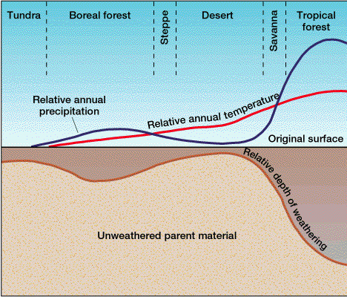
Relationships between climate and weathering

Slide 13
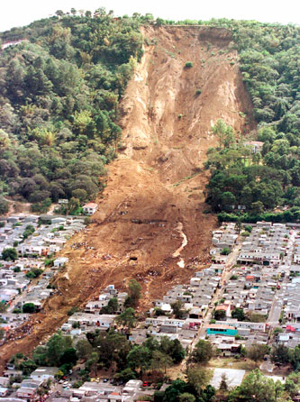
Mass Wasting
Process whereby weathered material is moved downslope under the immediate influence of gravity.
Angle of Repose - the steepest angle that can be assumed by loose fragments on a slope without downslope movement.
Talus or scree slope - pieces of rock at bottom of a rock fall.

Slide 14
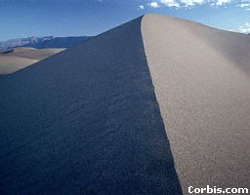
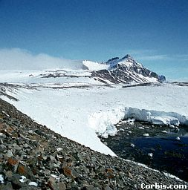
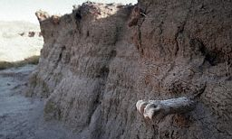
Angle of Repose
Dependent upon the internal coherence of the material. Softer, looser material has lower angle of repose. Rock and compressed sediments can have very high angles of respose.

Slide 15
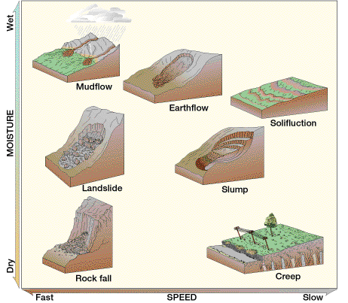

Slide 16
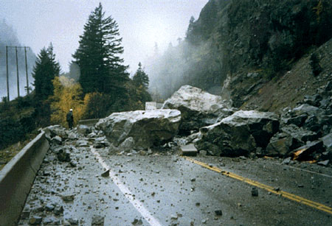
Rockfall

Slide 17
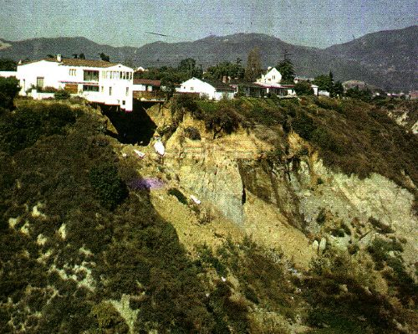
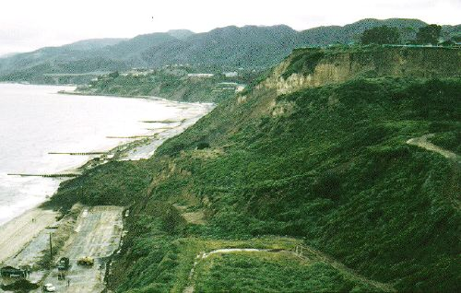
Pacific Palisades, November 1956

Slide 18
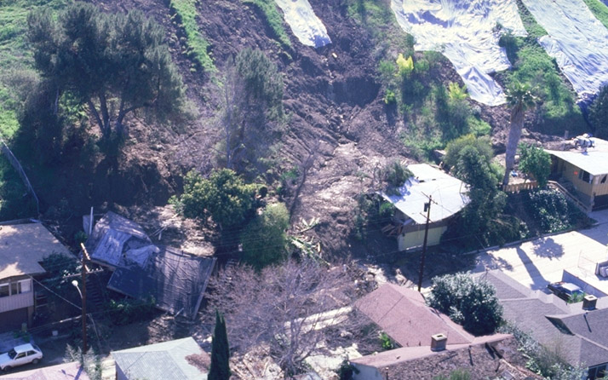
Monterey Park Debris Flow, 1980

Slide 19
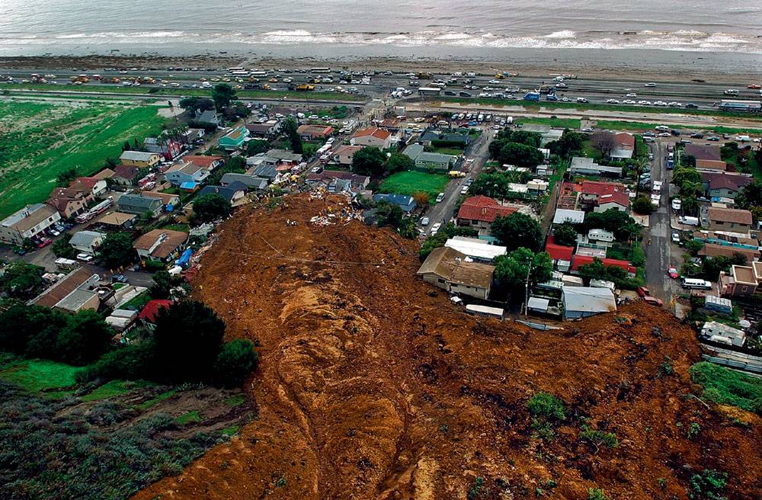
La Conchita Landslide, January 10, 1995

Slide 20
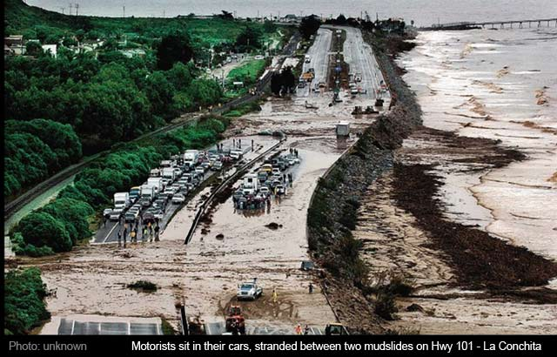
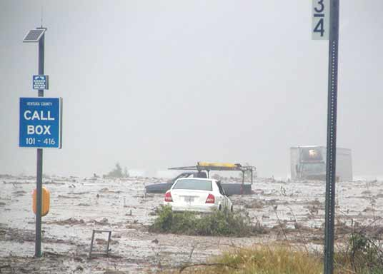
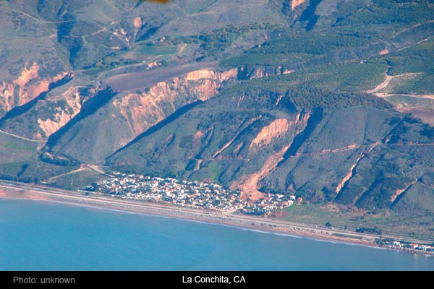
Triggered by powerful winter storms.
Killed 10 people; destroyed 18 homes.
Previous landslide in 1995 destroyed 9 homes but killed no one.

Slide 21
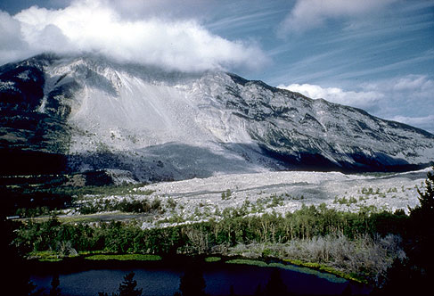
The rock slide at Frank, Alberta, Canada (1903) moved 33 million cubic meters of rock from Turtle Mountain over the town of Frank in less than two minutes killing 70 people.

Slide 22
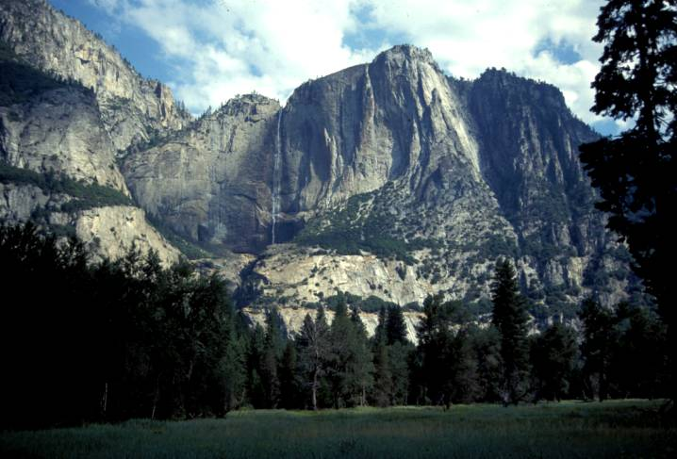
Talus slope

Slide 23
Erosional Agents and Deposition
Running Water
Stream Landscapes
Glaciers
Waves and Currents
Wind
Erosion
Deposition
What gets picked up in one place is eventually left somewhere else (it doesn’t disappear)

Slide 24
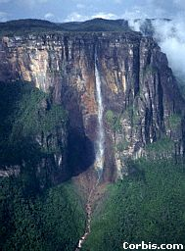
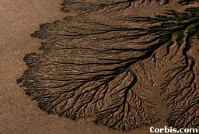
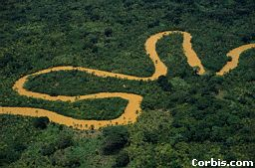
The Fluvial Processes – the effects of moving water

Slide 25
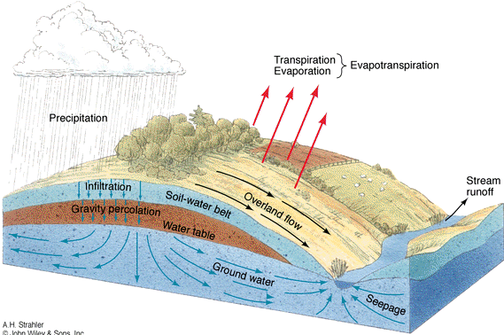
Hydrologic cycle (solar powered)

Slide 26
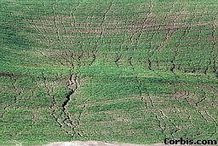
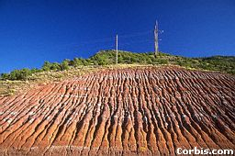
Stream Flow
Sheet flow - on smooth, non-permeable surfaces: roads, concrete, bedrock. This is rare.
Stream flow - as water finds path of least resistance stream flow begins.
Gully erosion on dirt road in mountains. How to preserve the road? Crown the road or let water flow underneath where it wants to go.

Slide 27
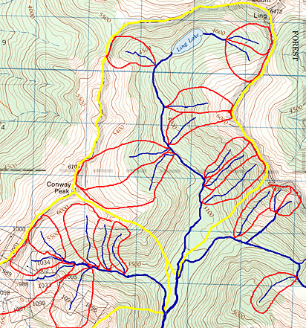
Drainage Basins (Watersheds) – the area which drains into a stream They form nested hierarchies. Divides – The ridge which separates drainage basins

Slide 28
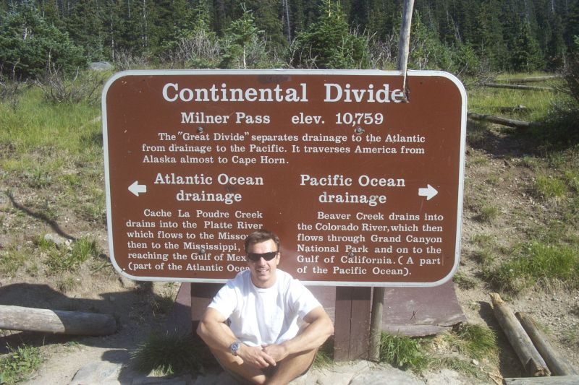

Slide 29
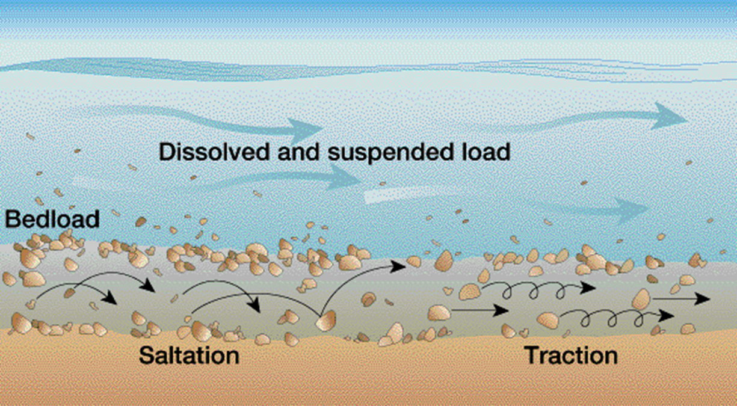
Stream Load
1 Whenever water is in motion, it carries some load.
2 The amount of load carried by a stream is positively related to its volume and velocity.
3 The maximum size of stream load is dependent upon velocity and volume of stream flow.
4 Thus, when a stream slows, it deposits load and when it increases its speed it erodes material to add to its load.
Bedload: Saltation - series of small jumps Traction - dragging along the bottom.

Slide 30
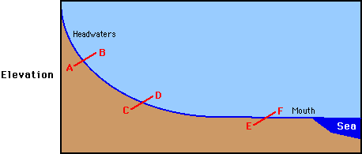
Stream Profile

Slide 31
Stream Grading
Degrading - material is eroded from the landscape by fast moving water. Stream incises the landscape.
Aggrading - material is deposited by slow moving water. Depositional features predominate.
Graded - neither process dominates. Streams tend towards this equilibrium over time.

Slide 32
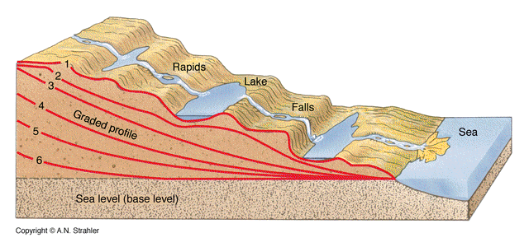
Stream Grading Progression

Slide 33
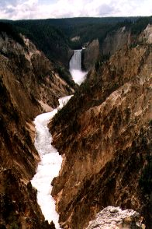
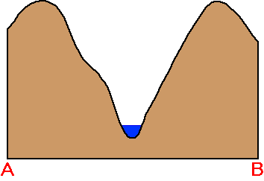
Young stream
Headwaters
Higher Elevation
Steeper Gradients
V-Shaped Degrading (Erosive) Valleys

Slide 34
Old Stream
Graded or Aggrading
Small or no gradient
Meanders
Wide Valleys
Floodplains

Slide 35
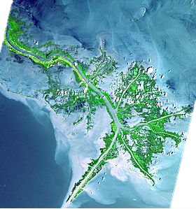
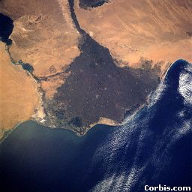
Deltas
broad triangular shape, such as Nile River (Greek letter)
outlets become clogged and new channel created
maze of outlets (distributaries)
richest habitat
severely threatened by diversions and pollution
Sac. / San Joaquin delta
Colorado River delta
Mississippi R. Delta
Nile River Delta, Egypt

Slide 36
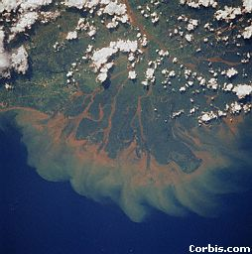
Mahakam River Delta and Silt Plumes,
Borneo, Indonesia

Slide 37
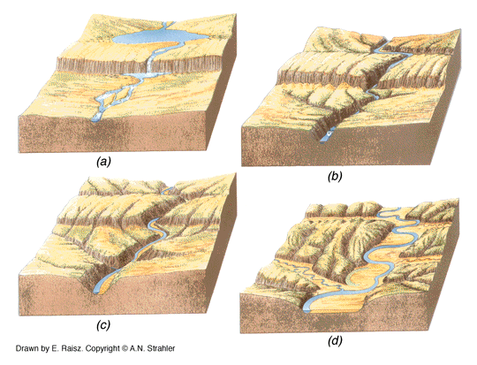
Progression of Gradation

Slide 38
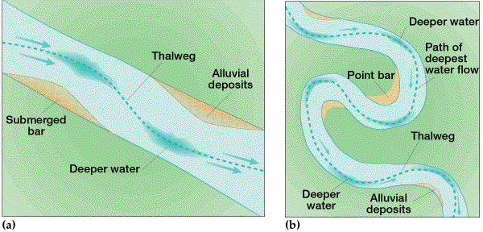
Stream Meanders
Develop on very level floodplains.
In geography and fluvial geomorphology, a thalweg or talweg is the line of lowest elevation within a valley or watercourse. Under international law, a thalweg is the middle of the primary navigable channel of a waterway that defines the boundary line between states.

Slide 39
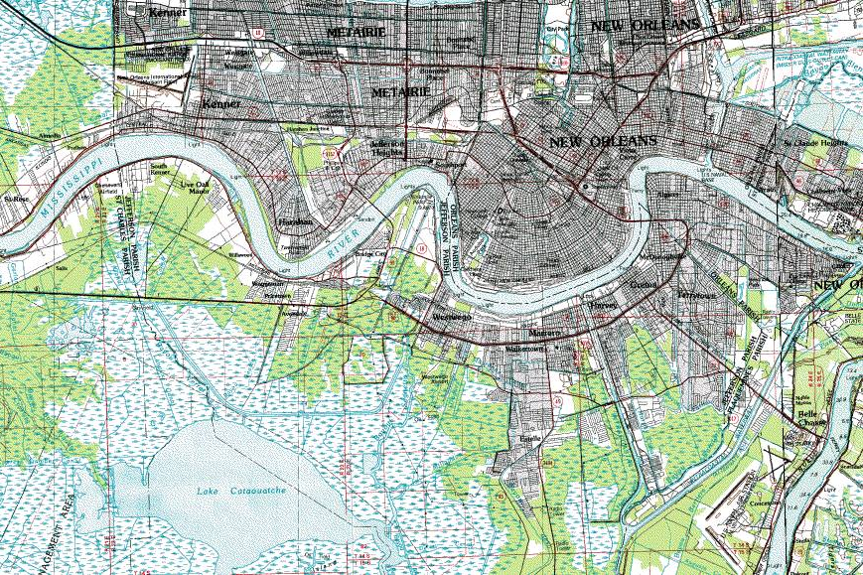

Slide 40
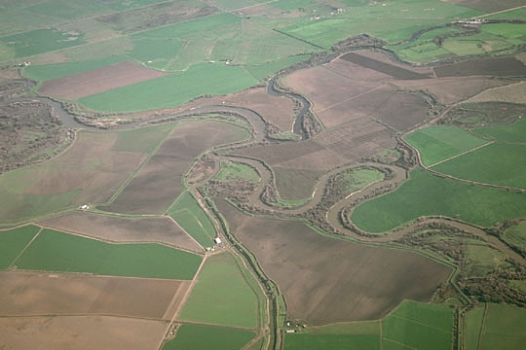
San Joaquin River

Slide 41
Meander Bends: Erosion and Deposition
Outside of Bend Is undergoing erosion
Inside of Bend Has Deposition (Point Bar)
Bedrock
Alluvium

Slide 42
Oxbow Lake
A former meander of the nearby river that was cur off (probably during a flood) when the river changed its course.

Slide 44
Formation of Natural Levees
A long, broad low ridge or embankment of sand and coarse silt, built by a stream on its flood plain and along both sides of its channel, especially in time of flood ... A river spreading over its banks slows and releases some of its burden of sediment. Flooding repeatedly, the river will coat its banks with sediment ...
New Orleans

Slide 45
Headward Erosion
Headward erosion is erosion at the origin of a stream channel, which causes the origin to move back away from the direction of the stream flow, and so causes the stream channel to lengthen.

Slide 46
Headward Erosion / Waterfalls
The stream is trying to get rid of the waterfall and get everything leveled out.

Slide 47
Niagra Falls, Canada
Efforts were made to stabilize the American Niagara Falls; however, it really just slowed down the natural process. In the long run, nature will continue this process.
Angel Falls, Venezuela, 3212 ft.

Slide 48
Drainage Patterns
Dendritic - most common, all meet at < 90º
Rectangular – form in highly jointed bedrock
Trellised – form where there are alternating strata of differing density
Parallel – form in unconsolidated material

Slide 49
Entrenched Meanders
Meanders generally suggest flat floodplains. However, in a number of places in the world they have been incised deeply into the landscape.
How might this have happened?

Slide 50
Is this river aggrading or degrading? Is it near the headwaters or the delta?
Aggrading, at the delta

