Slide 1
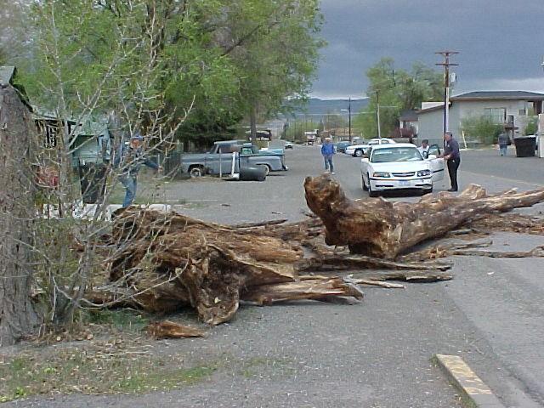
Wind
John Harris - Head of Geography - Radley College - UK
mjh@radley.org.uk
http://atschool.eduweb.co.uk/radgeog/

Slide 2
Quick review…
When comparing warm air and cold air, which:
  Is more dense?
  Rises?
  Is more humid?
  Creates a low pressure air mass?

Slide 3
Quick review…
When comparing warm air and cold air, which:
  Is more dense? Cold air!
  Rises? Warm air! (Because it is less dense!)
  Is more humid? Warm air!
  Creates a low pressure air mass? Warm air! (Because it is less dense so it rises)

Slide 4
Check it out!
What makes this happen!?
http://www.youtube.com/watch?v=Kk7sXkzmtp0
The water spins 1 direction north of the equator, the OPPOSITE direction south of the equator, and NO direction on the equator…what gives!?!?

Slide 5
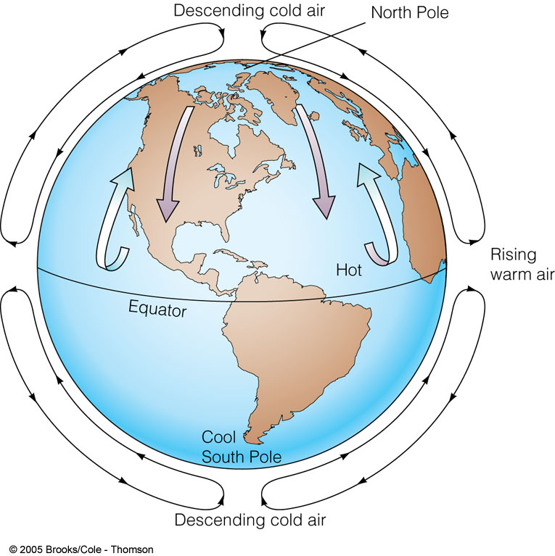
How Wind Develops
Caused by a difference in air pressure due to unequal heating of the atmosphere resulting from the unequal heating of the land and water bodies

Slide 6
Air rises over warm areas and sinks over cold areas (convection currents)
Air rises in warm regions where pressure is low (i.e. the tropics)
Air sinks in cold areas where pressure is high (i.e. the poles)
Cool air rushes in to replace warm air, going from high pressure to low pressure, forming winds
Poles: cold, high pressure – air sinks
Equator: warm, low pressure – air rises

Slide 7
Why don’t winds only travel north and south?
If all that causes wind is uneven heating of the earth’s surface, shouldn’t wind always blow toward the equator?

Slide 8
Winds deflect!
Winds do not blow directly from high to low pressure …. they get deflected by the Coriolis Effect

Slide 9
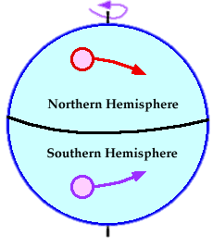
The WHAT!?!?
Coriolis Effect – the rotation of the Earth causes moving air and water to change directions
Northern Hemisphere winds curve to the right
Southern Hemisphere winds curve to the left

Slide 10
The Wind is actually moving in a relatively straight line; however . . .
The earth is rotating beneath the wind
Since we do not actually feel the rotation of th earth, we feel as if we are in a stationary position and it appears to us that the wind is moving in a curving direction.
It’s similar to how we think the Sun rises in the morning and sets in the evening. The sun hasn’t moved; the planet Earth has rotated but we can’t tell that it was actually the earth that moved.
Notation from J. Naumann

Slide 11
The Coriolis Effect
http://www.youtube.com/watch?v=_36MiCUS1ro
http://www.youtube.com/watch?v=mcPs_OdQOYU

Slide 12
Two types of winds
1. Local Winds
2. Global Winds

Slide 13
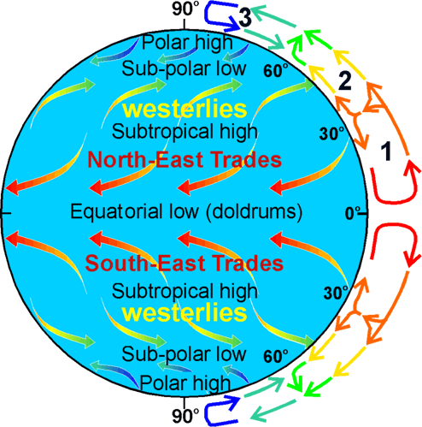
Global Winds
Don’t travel North and South because of the Earth rotating on its axis
4 types of Global winds:
  Doldrums
  Trade winds
  Prevailing westerly winds
  Polar Easterlies

Slide 14
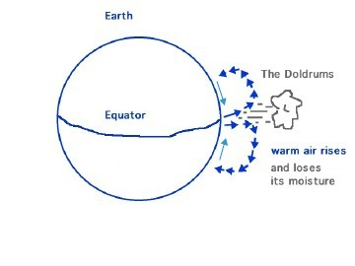
Doldrums
At the equator, surface winds are calm and weak
  Why would these winds be calm and weak?
  When would this cause a problem? (Think historically)

Slide 15
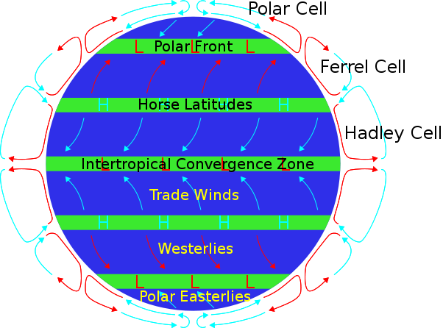
Trade Winds
30 degrees north and south of Equator
Calm winds, few clouds, little rain fall
Blow from East to West
Also known as Horse Latitudes

Slide 16
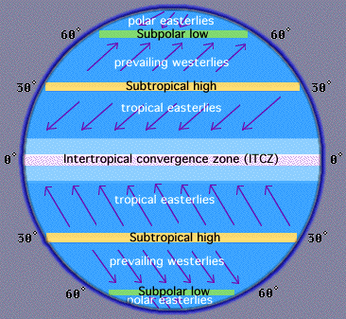
Prevailing Westerlies
Strong Winds
Located in the belt from 30 to 60 degrees latitude in both hemispheres
Has an impact on US
weather
Blow from West to East

Slide 17
Polar Easterlies
Cold but weak winds
Near the north and south poles
US weather influenced by these
Blow from East to West

Slide 18
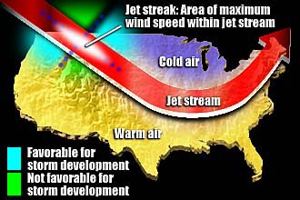
Jet Stream
Discovered in the 1940s
Can be found in the upper troposphere
Strong high speed and high pressure
Moves west to east across the US, moving storms

Slide 19
Connection to Human Activities
How would the existence of global winds impacted trade and exploration, historically?

Slide 20
Local Winds
Cover short distances
Blow any direction
2 types
  Land & Water
    Sea Breezes – from sea to land
    Land Breezes – from land to sea
  Mountain & Valley
    Valley Breeze – from the valley up the mountain
    Mountain Breeze – from the mountain down to the valley

Slide 21
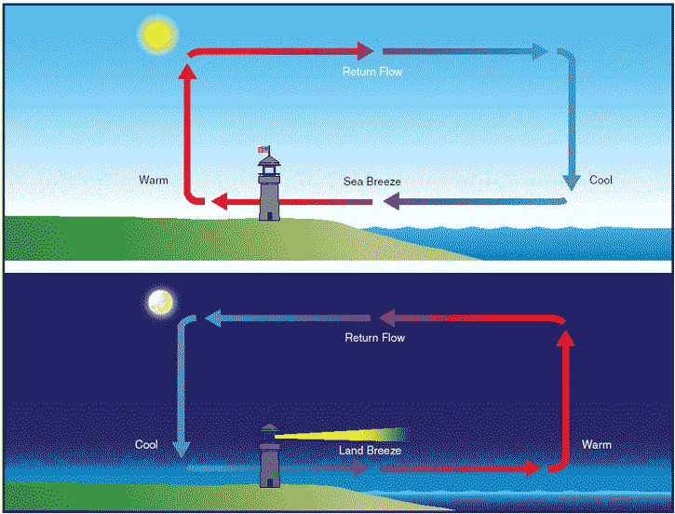
Caused by Specific Heat Capacity!

Slide 22
