Slide 1
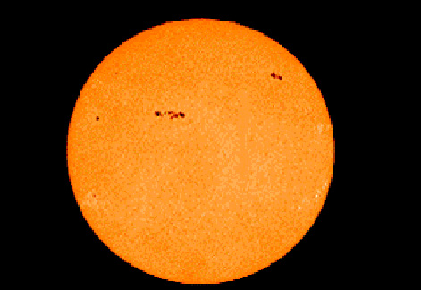
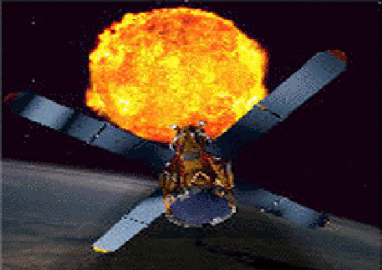
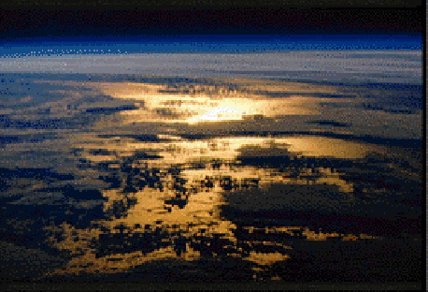
Introduction
Sun-Earth Connection:
Our Solar Powered World
A New Perspective

Slide 2
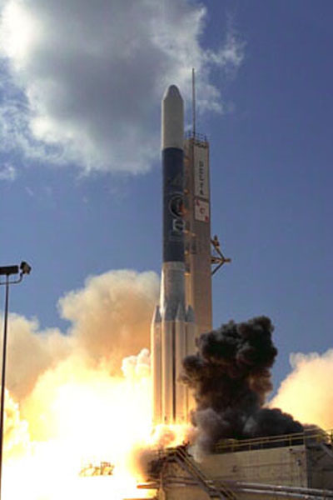
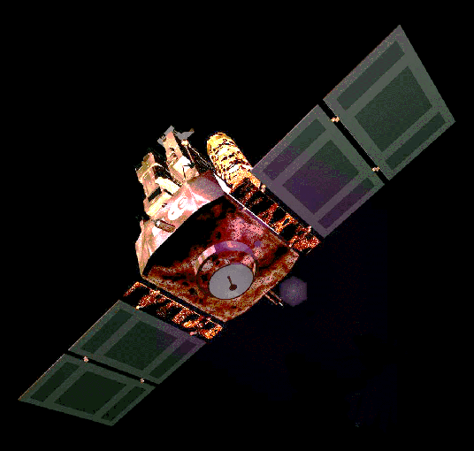
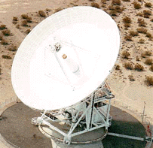
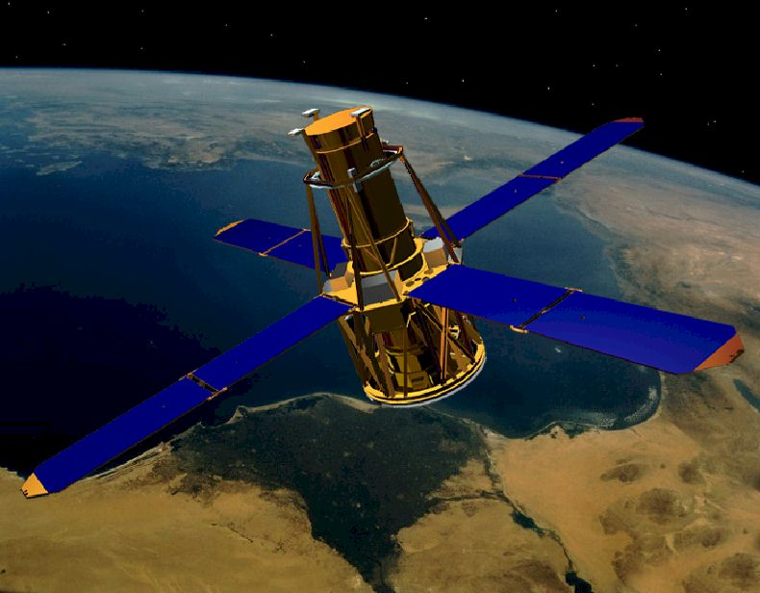
Importance of Space Technology
Better Observation Of The Sun And Earth

Slide 3
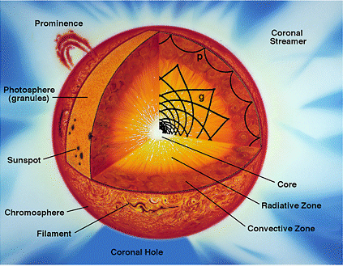
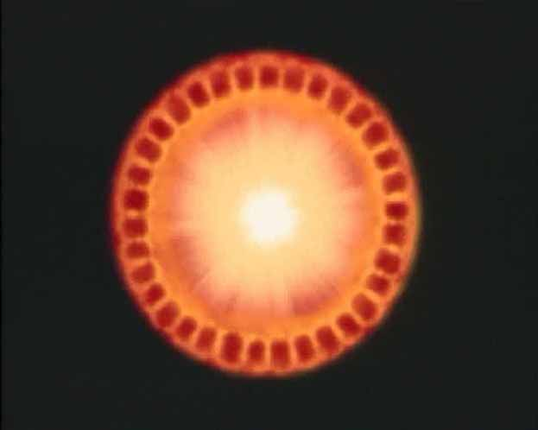
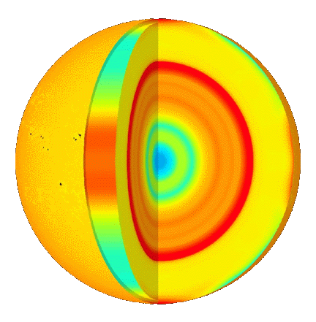
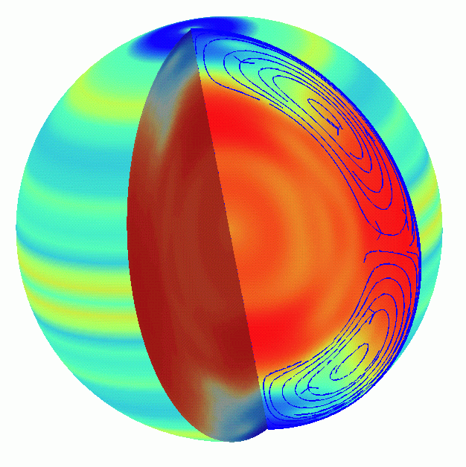
Sun’s Internal Structure – A Huge Nuclear “Furnace”
The globes to the left and right represent variations in temperature and rotation of the Sun based on MDI data.
Michelson Doppler Imager

Slide 4
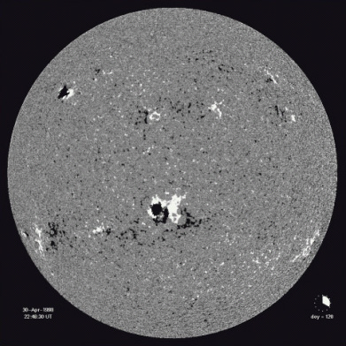
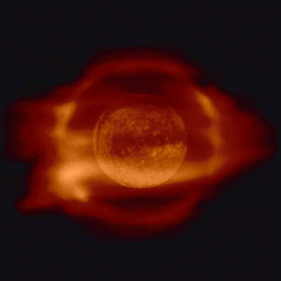
Surface And Atmosphere Of The Sun Are Subject To Changes - Cycles

Slide 5
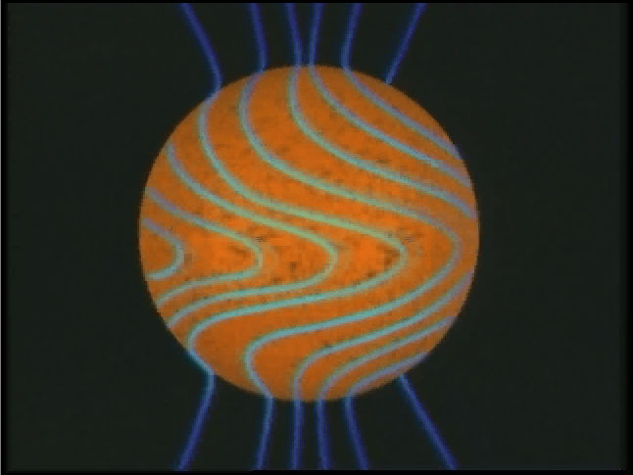
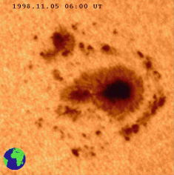
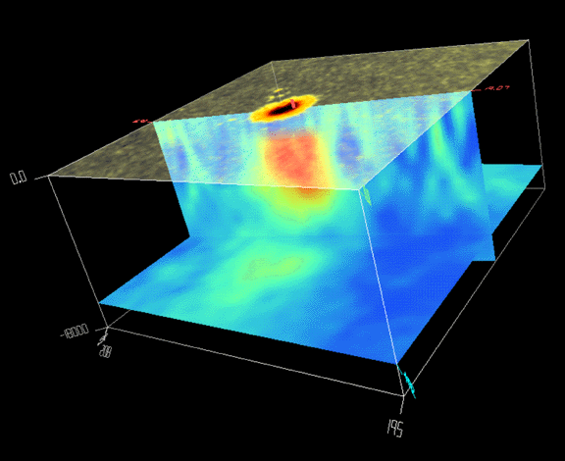
Sunspots
Sun’s Magnetic Field
Sunspots
Sunspot Structure
Solar Cycle
1850 1860 1870 1880 1890 1900 1910 1920 1930 1940 1950 1960 1970 1980 1990 2000

Slide 6
Sunspots
Due to its link to other kinds of solar activity, sunspot occurrence can be used to help predict space weather, the state of the ionosphere, and hence the conditions of short-wave radio propagation or satellite communications. Solar activity (and the solar cycle) have been implicated in global warming,

Slide 7
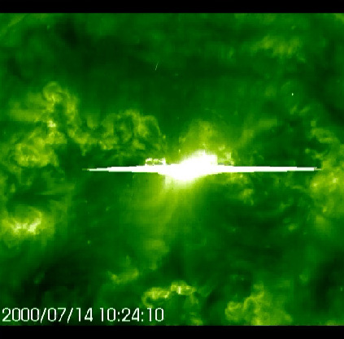
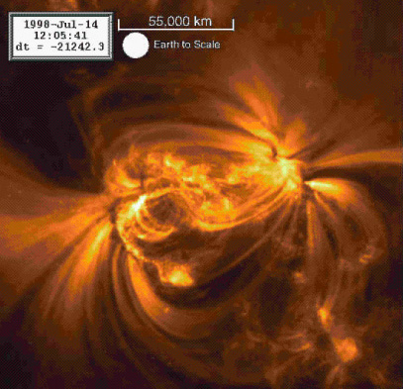
Solar Flares
The solar wind is a stream of charged particles released from the upper atmosphere of the Sun, called the corona. This plasma consists of mostly electrons,

Slide 8
A solar flare is a sudden flash of increased Sun's brightness, usually observed near its surface. Flares are often, but not always, accompanied by a coronal mass ejection. The flare ejects clouds of electrons, ions, and atoms along with the electromagnetic waves through the Sun's corona into outer space. The phenomenon therefore provides an early example of multi-messenger astronomy. If ejection is in the direction of the Earth the particles hitting the upper atmosphere can cause bright auroras, and may even disrupt long range radio communication. It usually takes a day or two for these clouds to reach Earth.

Slide 9
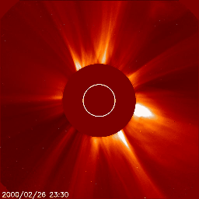
Coronal Mass Ejections
A coronal mass ejection (or CME) is a giant cloud of solar plasma drenched with magnetic field lines that is blown away from the Sun often during strong, long-duration solar flares and filament eruptions. When the Sun isn't very active during solar minimum, coronal mass ejections are rare. There might only be one coronal mass ejection every week. When the Sun's activity increases towards solar maximum, coronal mass ejections become more common and we can see multiple coronal mass ejections every day.

Slide 10
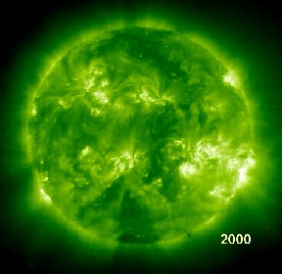
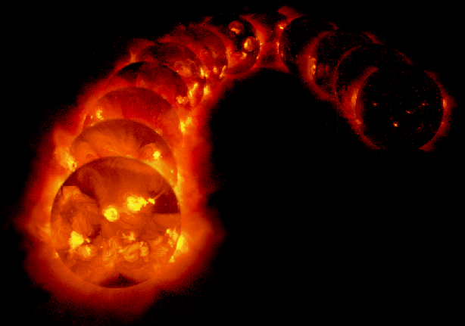
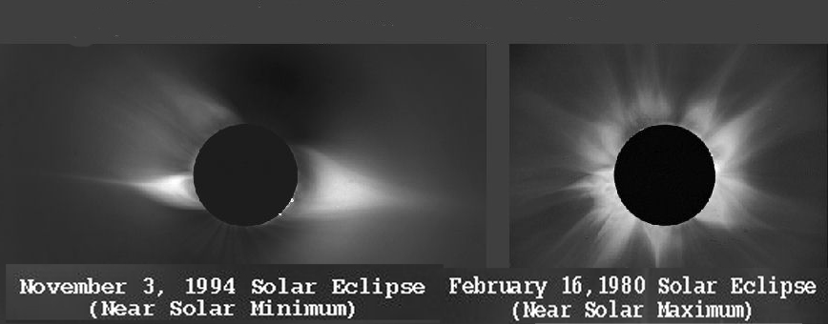
Solar Cycles
1992
1996
Minimum 6 Maximum 6

Slide 11
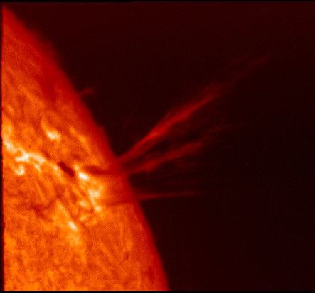
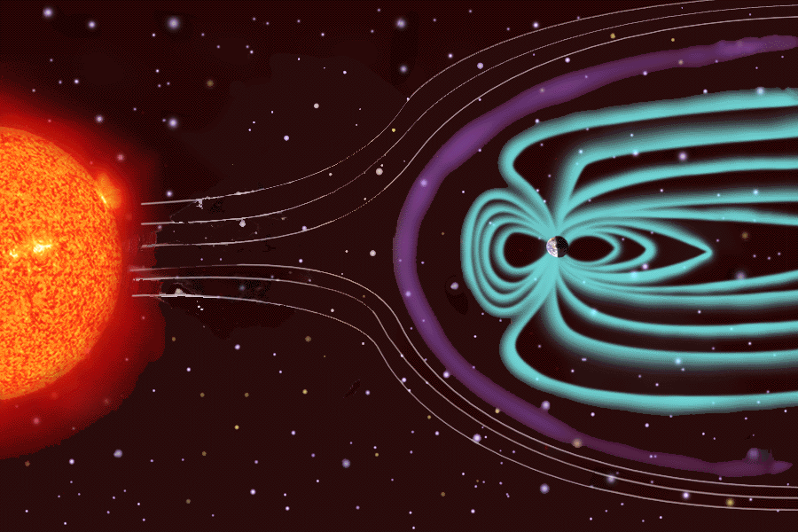
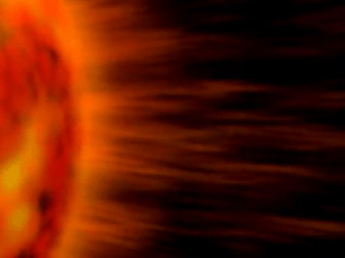
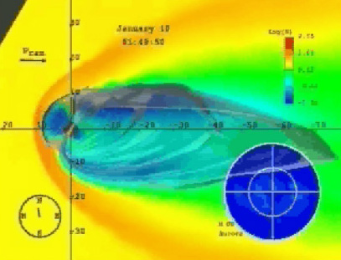
Solar Wind
The solar wind consists of plasma that is continually being released from the Sun.

Slide 12
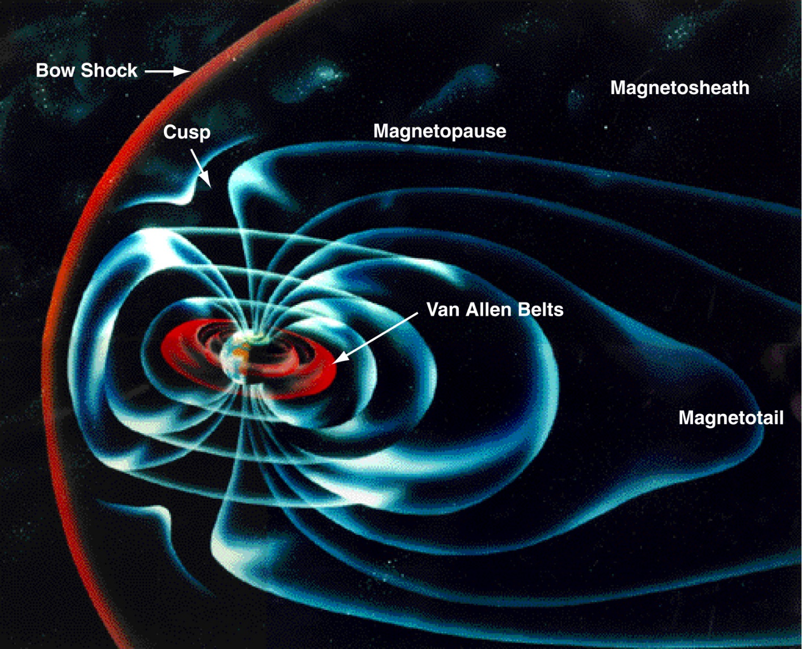
Earth’s Magnetosphere

Slide 13
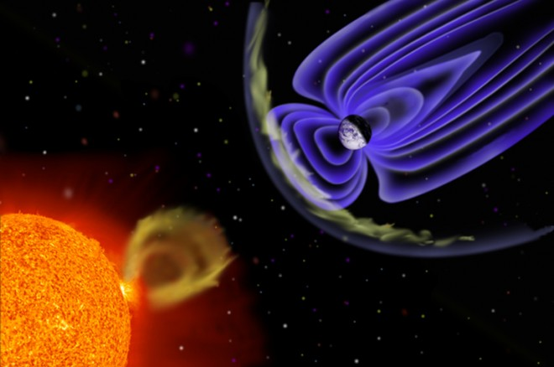
The magnetic field protects the earth from some of the solar wind

Slide 14
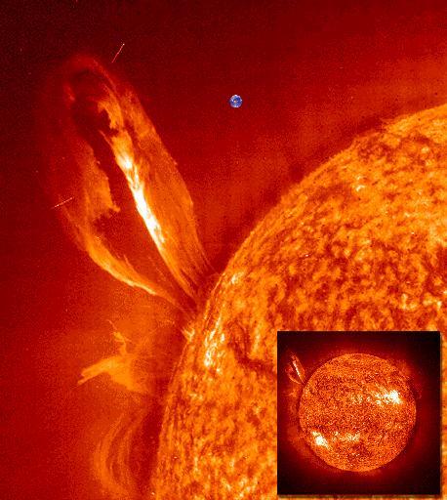
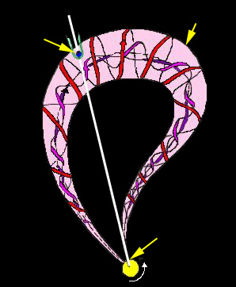
Coronal Mass Ejections: Crossing the Earth’s Path
Earth Is Shown For Size Comparison
Magnetic Cloud
Earth
Coronal
Mass
Ejection
SUN

Slide 15
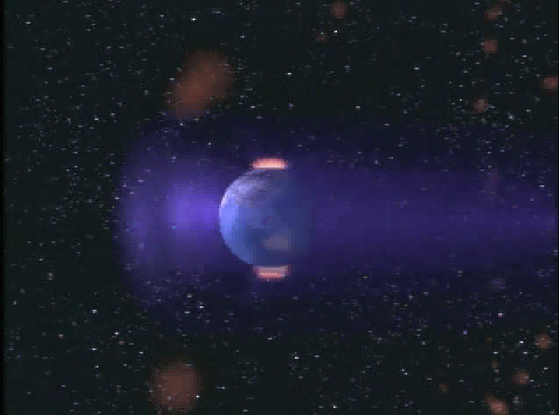
Coronal Mass Ejections: Impact On Earth

Slide 16
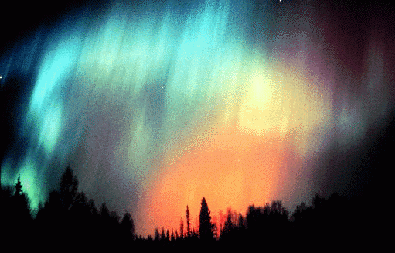
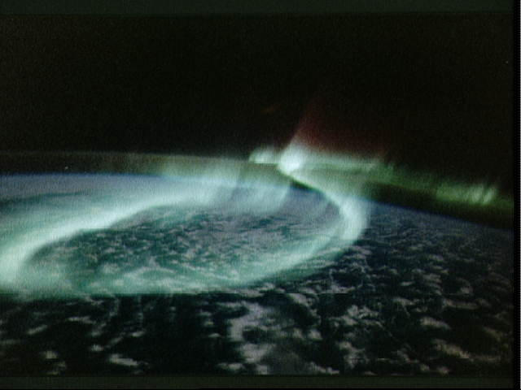
Aurora: Points of View
View From Earth
View From Space

Slide 17
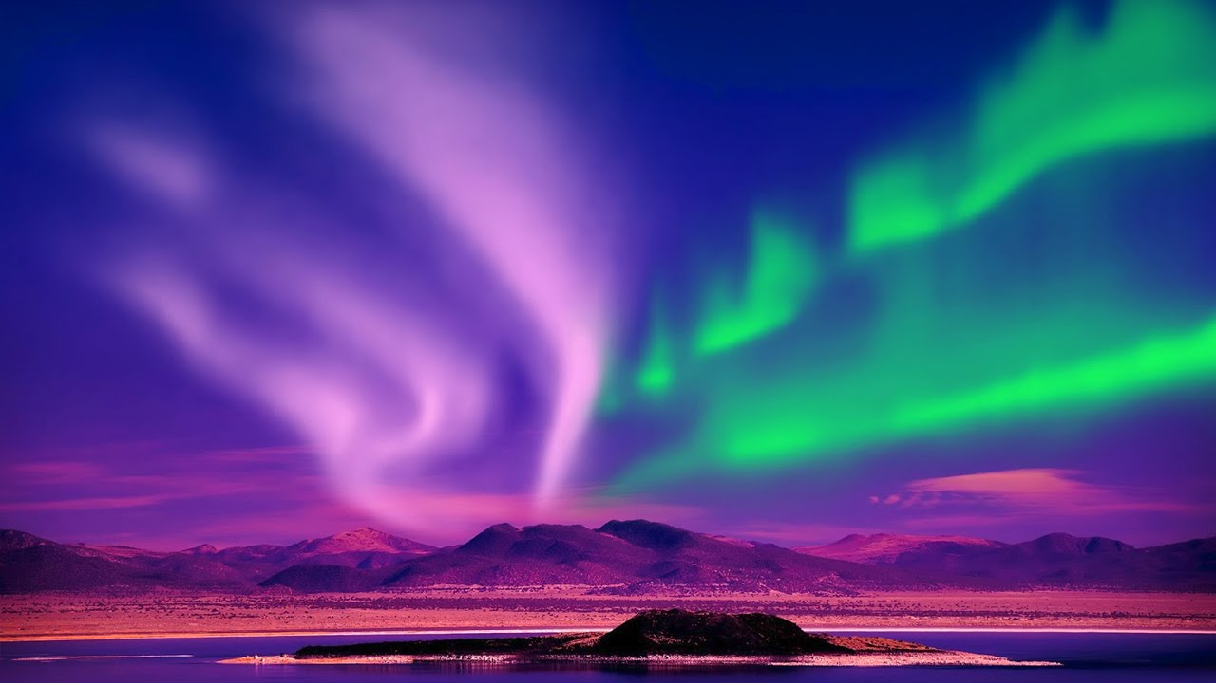
One of the most beautiful

Slide 18
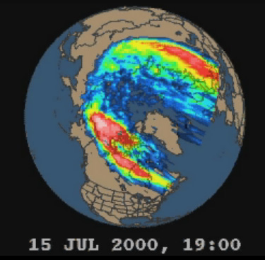
Aurora: Lights in Motion

Slide 19
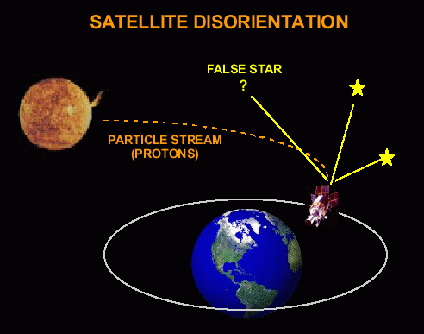
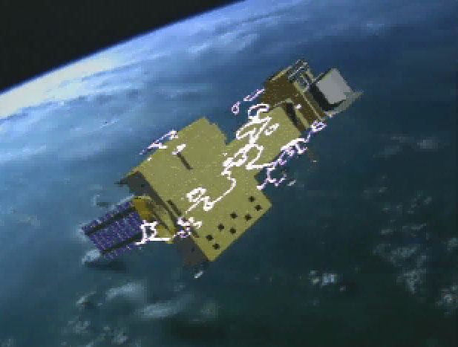
Space Weather : Effects On Orbiting Spacecraft

Slide 20
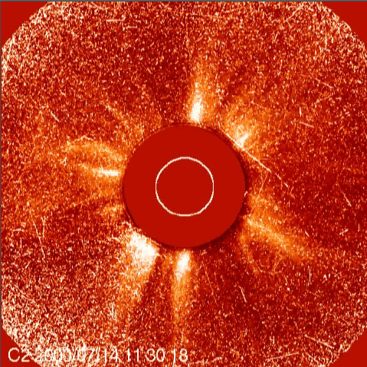
Space Weather : Effects On Satellite Sensors

Slide 21
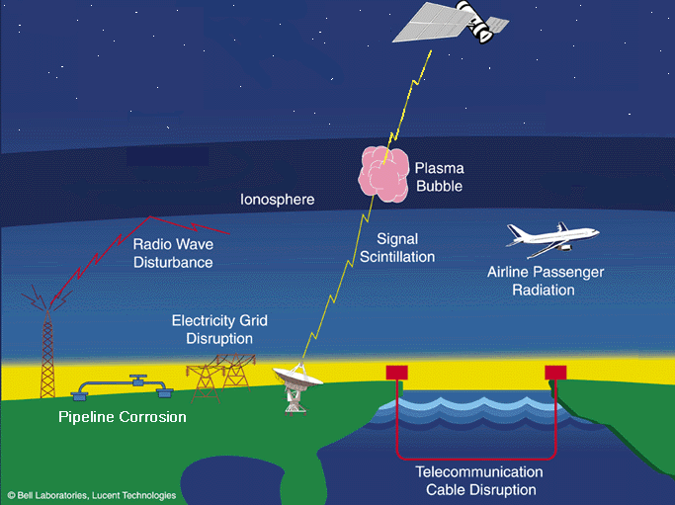
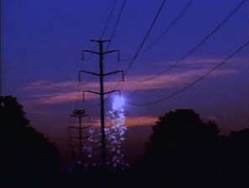
Solar Storms: Effects On Societal Systems

Slide 22
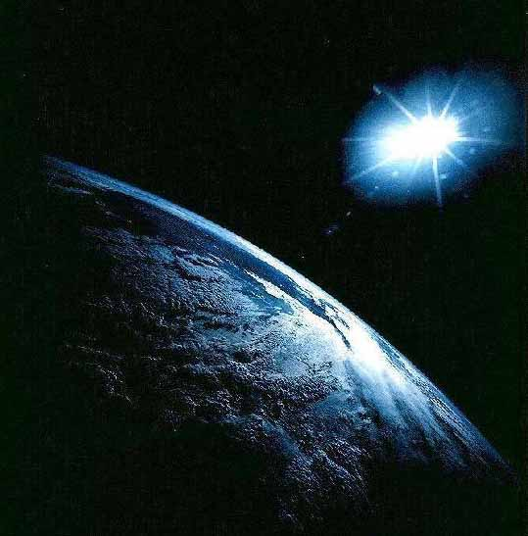
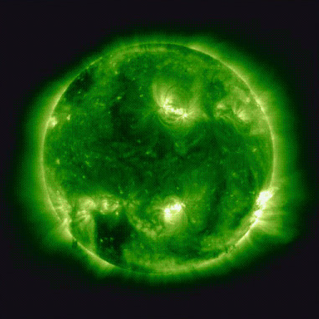
Sun-Earth Connection

Slide 23
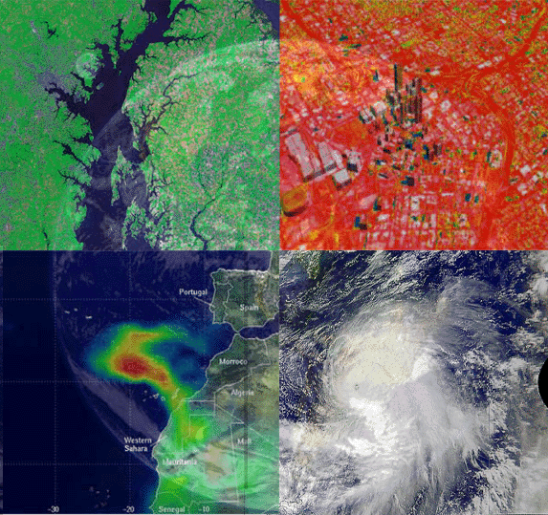
The Sun’s Energy: Driver of Earth Weather
Water Level In
The Chesapeake Bay
Infrared Image Of
Atlanta, Georgia
Sahara Dust Plume
Off The African Coast
Hurricane In
The Atlantic Ocean

Slide 24
THE TILT OF THE AXIS CAUSES THE SEASONS

Slide 25
Tilt
In December, the earth is closer to the sun than in June.
Due to the tilt of the axis, the most intense insolation is striking the earth south of the equator.
So in June, the earth is farther from the sun than it was in December, however due to the tilt of the axis of the earth the most intense insolation is striking north of the equator causing it to be warm in spite of the greater distance.

Slide 26
Key Points in the Earth’s Revolution Around the Sun
NAME | DATE* | N. HEMISPHERE | S. HEMISPHERE
March Equinox | 21st | EQUAL DAY AND NIGHT | EQUAL DAY AND NIGHT
June Solstice | 21st | LONGEST DAY OF THE YEAR | SHORTEST DAY OF THE YEAR
September Equinox | 21st | EQUAL DAY AND NIGHT | EQUAL DAY AND NIGHT
December Solstice | 21st | SHORTEST DAY OF THE YEAR | LONGEST DAY OF THE YEAR
Everywhere on Earth
DATE: May vary by a day from year to year – like falling on the 22nd some years

Slide 27
Climatic Effect of the Axis Tilt
1. Differential heating cooling of the earth surface causes the wind belts
2. Wind belts cause the ocean currents
3 Every day the direct (most intense) rays strike the earth at a slightly different latitude
SO
Energy gets distributed to more of the earth’s surface

Slide 28
Intensity Differences
North of the Tropic of Cancer and South of the Tropic of Capricorn
Between the Tropics

Slide 29
Insolation

Slide 30
Remember
This is a solar powered world directly or indirectly
Provide energy for all plants and animals
Allow water to exist in all three forms – gas, liquid, and solid
Causes the wind belts to form, which gives the ocean currents their motion and direction

Slide 35
Flood of 1993

Slide 39
3. Provide data for decision-making and planning

Slide 40
Cycles as Systems
Everything on the earth gets recycled And the main driver for most is the sun.

Slide 41
1# law of Ecology – Everything is connected

Slide 50
Important role of decomposers
Decomposers: bacteria, fungi, other microorganisms, digestive systems of worms, bugs, etc.
Functions of Decomposers: deconstruct complex organic molecules into simpler molecules and chemical elements so that they can be absorbed and used by plants to keep the cycle of life going.

Slide 52
It’s all about recycling

Slide 53
Remember!
The Sun, directly or indirectly, is the ultimate source of energy that “drives” most of the systems of the earth. It is a solar powered world.
The earth is composed of a finite quantity of material; therefore, the cycles and systems have recycling at their core.

