Slide 1
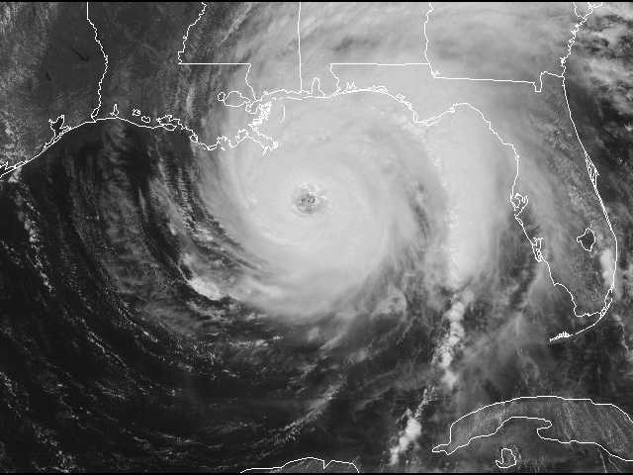
Climate, Weather, and Biota

Slide 2
Most of what we will be discussing occurs within the Troposphere

Slide 3
Climate
Climate is the statistics (AVERAGES) of weather over long periods of time. It is measured by assessing the patterns of variation in temperature, humidity, atmospheric pressure, wind, precipitation, atmospheric particle count and other meteorological variables in a given region over long periods of time. Descriptions of averages do not mention the extremes.
St. Louis Temperature Averages
January High 40⁰ Low 23⁰ July High 90⁰ Low 71⁰
St. Louis Extremes
Low -23⁰ in 1873 High 115⁰ in 1954
St. Louis average annual precipitation 38.75 inches
Wettest year 54.97" (1982)
Driest year 20.69” (1953)
St. Louis deepest snow 63.6” 1912 Least snow 1.5” 1954
There are also years that may not have an annual record temperature or precipitation, but may have an extreme season ie. The hottest or wettest Spring.

Slide 4
A climograph is a graphical representation of basic climatic parameters, that is monthly average temperature and precipitation, at a certain location. It is used for a quick-view of the climate of a location.

Slide 5
Air pressure and winds
Result from differential heating and cooling of land and water bodies, creating high pressure areas in the atmosphere and low pressure areas in others. High pressure areas where cool air is descending and low pressure where temperatures are relatively warmer and are rising.

Slide 6
Distribution of land and water bodies – distance from large bodies of water
Land heats and cools faster and to a greater extent than water bodies because with land it is essentially the surface that is heating or cooling.
Water bodies heat and cool more slowly and to a lesser degree than land because it is the whole volume of water that is being heated or cooled.
The centers of large land masses like North America and Eurasia are too far from water bodies to be influenced by them, so they experience temperature extremes. Cities like St. Louis, Chicago, Minneapolis, etc. experience these temperature extremes.
Coastal areas like where Seattle and Portland are located on the West Coast, have temperatures moderated by the ocean. They are farther north than St. Louis but have warmer winters that we do. The combination of prevailing winds, warm ocean currents moderate conditions in the Pacific Northwest so the temperatures are not as cold as one would expect for their latitude.

Slide 8
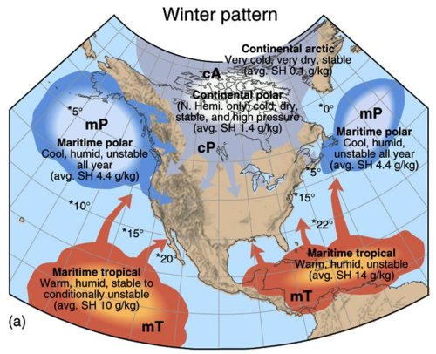
The influencing air masses shift north and south seasonally as the intense solar insolation moves from the Tropic of Cancer to the Tropic of Capricorn

Slide 9
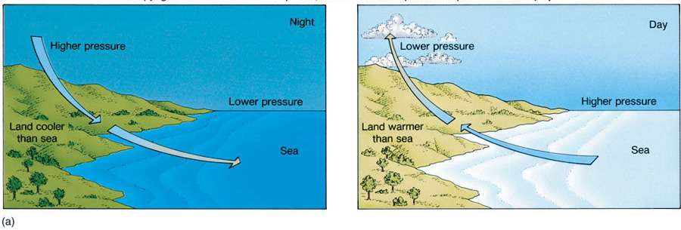
Air pressure and winds
Air is a mixture of gasses that have fluidity
Warmer air is less dense and rises and visa versa.
Air moves from dense (high pressure) to less dense (low pressure) conditions
Wind = horizontal movement of air from a high pressure area to a low pressure area.
Ex.: Land-sea breezes

Slide 10
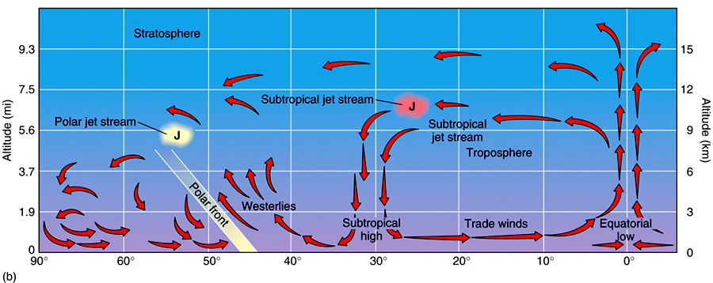
Global air circulation
Beit between Tropic of Cancer and Tropic of Capricorn receives most insolation
Hot air rises, heads towards poles
Air cools & becomes heavy and sinks approximately at 30°N and 30°S latitude
Plus the Coriolis effect (winds appear to curve)

Slide 11
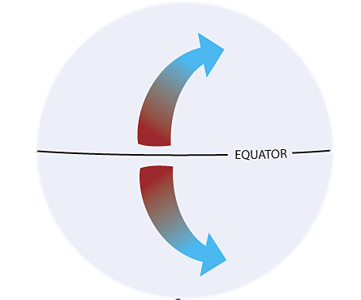
Coriolis Force
Coriolis Force: an artifact of the earth's rotation. Once air has been set in motion by the pressure gradient force, it undergoes an apparent deflection from its path, as seen by an observer on the earth which is rotating. This apparent deflection is called the "Coriolis force" and is a result of the earth's rotation.
Northern Hemisphere: rotation is clockwise and deflection appears to go to the right.
Southern Hemisphere: rotation is counterclockwise and deflection appears to go to the left.

Slide 12
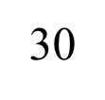
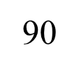
90
Where we live, St. Louis, Missouri, we are affected by the Prevailing Westerlies of the Northern Hemisphere most of the time. In the winter, the Polar Easterlies extend further south and in the summer, the Southeast Trade Winds extend further north. This accounts for the wide variety of weather we receive.
60
30
0
60

Slide 13
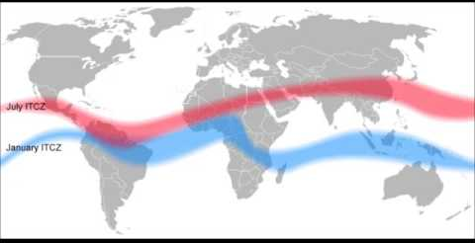
Driving Force of the Wind Belts
Intertropical Convergence Zone (Equatorial Low) = this is the “engine” that drives the whole wind belt system. Another example of our solar powered earth.
Due to the tilt of the earth’s axis, relative to the earth, the ITCZ seems to shift back and forth between the Tropic of Cancer and the Tropic of Capricorn, causing the seasons.

Slide 14
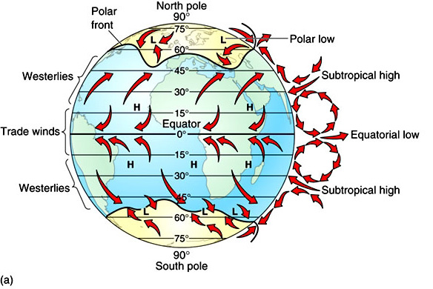
Warmer air “holds” more water & visa versa
Low pressure=warm air=high potential precipitation
High pressure=cold air=dry air absorbing what moisture is available.
WIND = The horizontal movement of air from a high pressure center to a low pressure center.

Slide 15
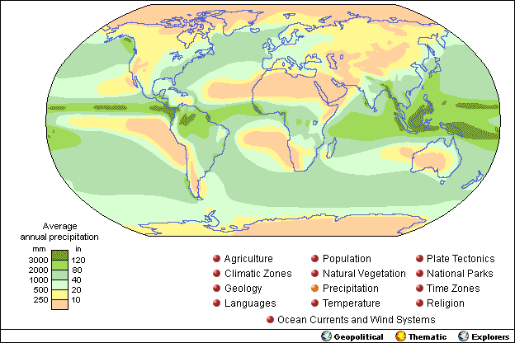
Climate change will probably create changes in how much precipitation falls and where it does and doesn’t fall.

Slide 16
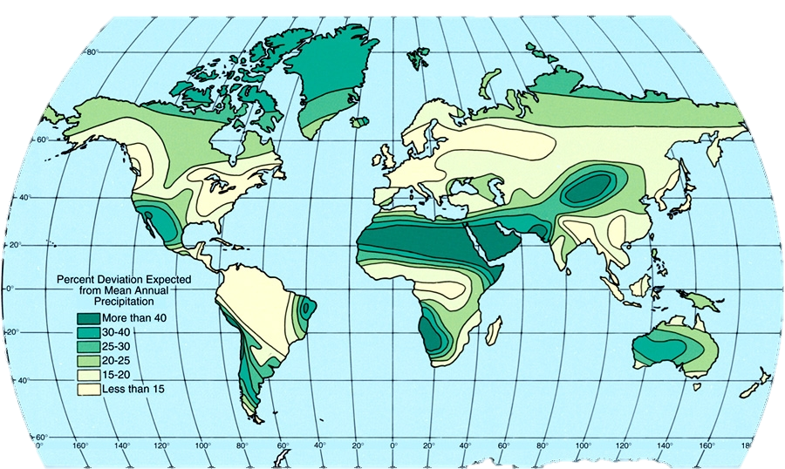

Slide 17
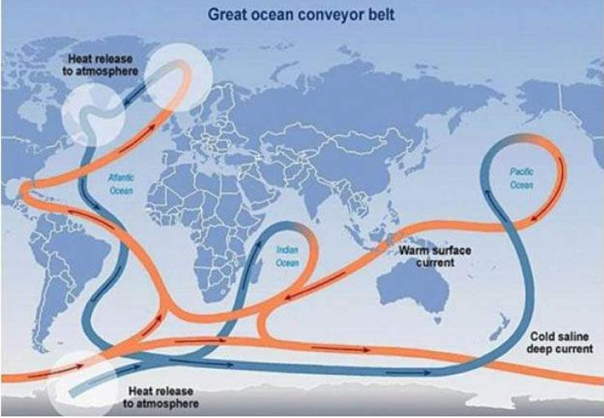
Ocean currents
Follow same circular pattern (driven by wind)
Warm currents flow away from equator, pile up on eastern shores
Gulf Stream, Brazil
Cold currents flow towards equator, cause upwelling
Humboldt/Peru, California

Slide 18
Factors that influence climate – various combinations cause the different types of climate
Add the size and shape of land masses

Slide 19
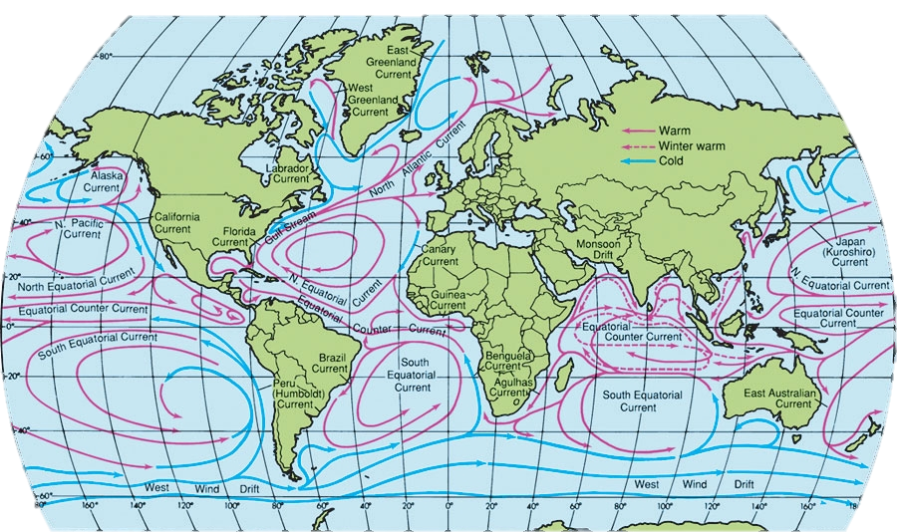

Slide 20
Altitudinal Zonation – influence of altitude & topography

Slide 21
Influence of topography and prevailing winds

Slide 23
H – Undifferentiated highlands (mountain areas that are too complex to classify)

Slide 25
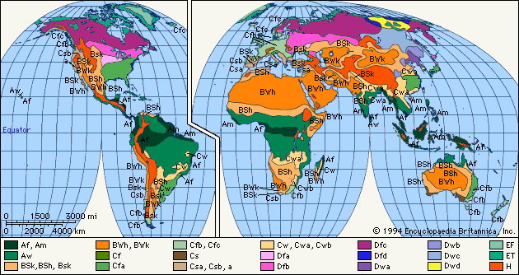
Climate classification
Temperature and precipitation
Köppen classification system
Five types, plus highlands
A Tropical
B Dry
C Humid
Mild winter
D Humid
Cold winter
E Polar
H Highlands

Slide 27
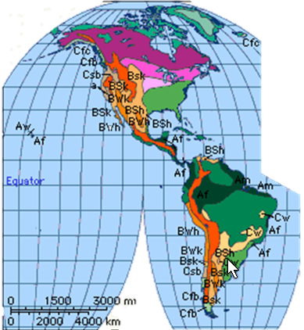

Slide 28
It is natural for there to be similarities between a map of climates and a map of natural vegetation and a map of soil types.

Slide 30
#1 Law of Ecology: Everything is Connected
Highly interconnected systems create a variety of ecosystems or biomes
Climate
Soil
Parent mineral matter (highly weathered bedrock, fluvial deposits, glacial till [glaciofluvial deposits], or other erosional deposits)
In Southern Missouri, it is bedrock, but in northern Missouri it is glacial till
Topography – slope, shape, elevation etc.
Vegetation
Today, we must also add human actions to the mixture.

Slide 31
Each of these biomes can be divided into subcategories, such as the Oak-Hickory forest of Missouri is one subcategory of the Deciduous Forest biome.

Slide 32
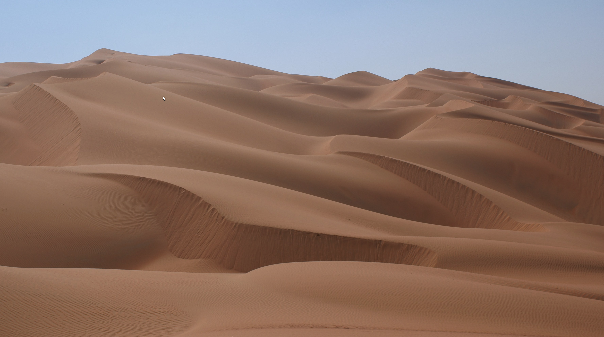
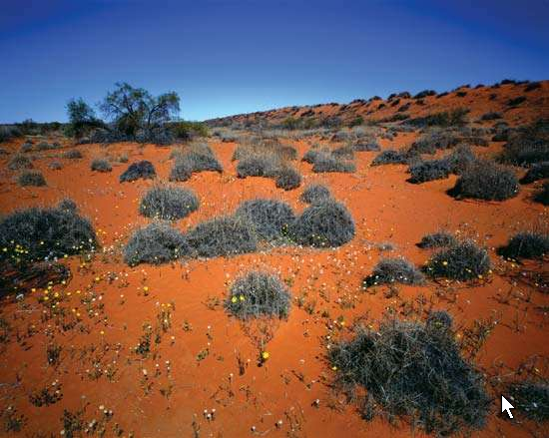
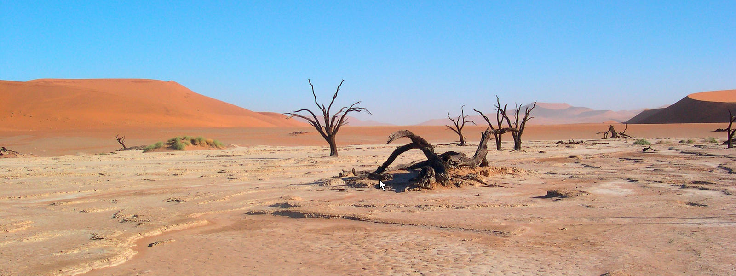
Desert
A desert is a barren area of landscape where little precipitation occurs and consequently living conditions are hostile for plant and animal life. The lack of vegetation exposes the unprotected surface of the ground to the processes of denudation.

Slide 33
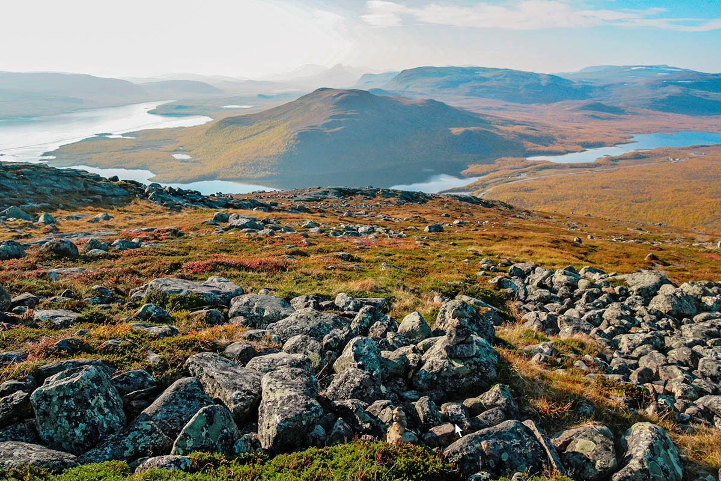
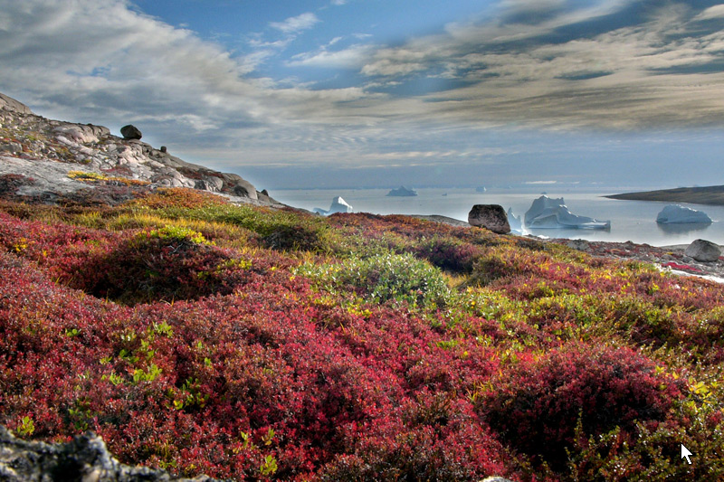
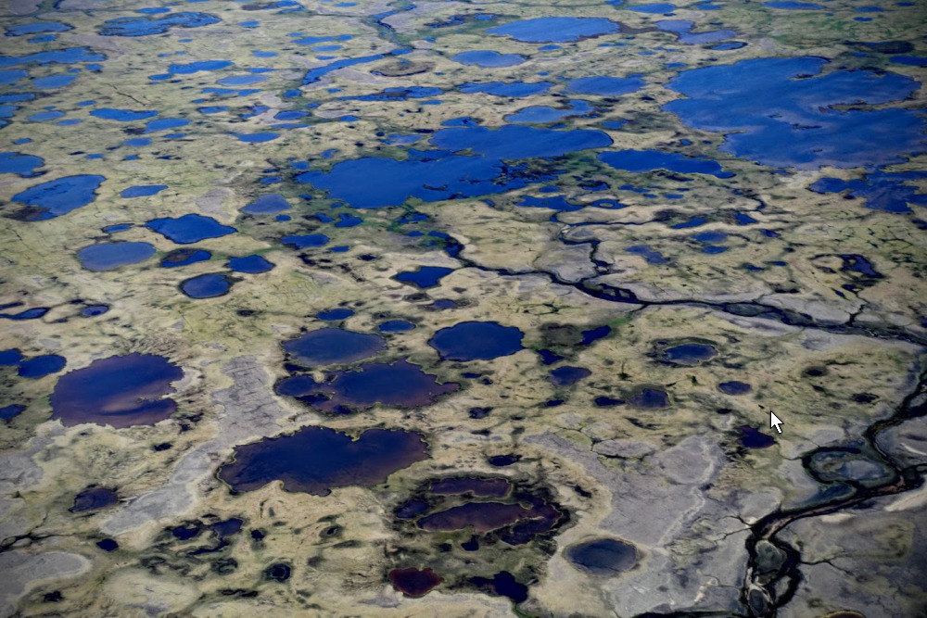
Tundra
In physical geography, tundra is a type of biome where the tree growth is hindered by low temperatures and short growing seasons

Slide 34
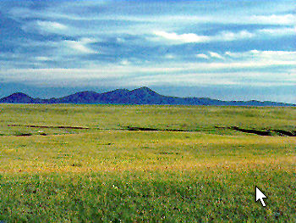
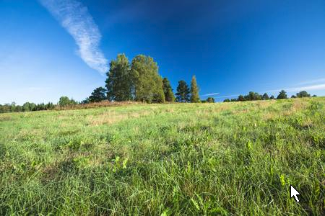
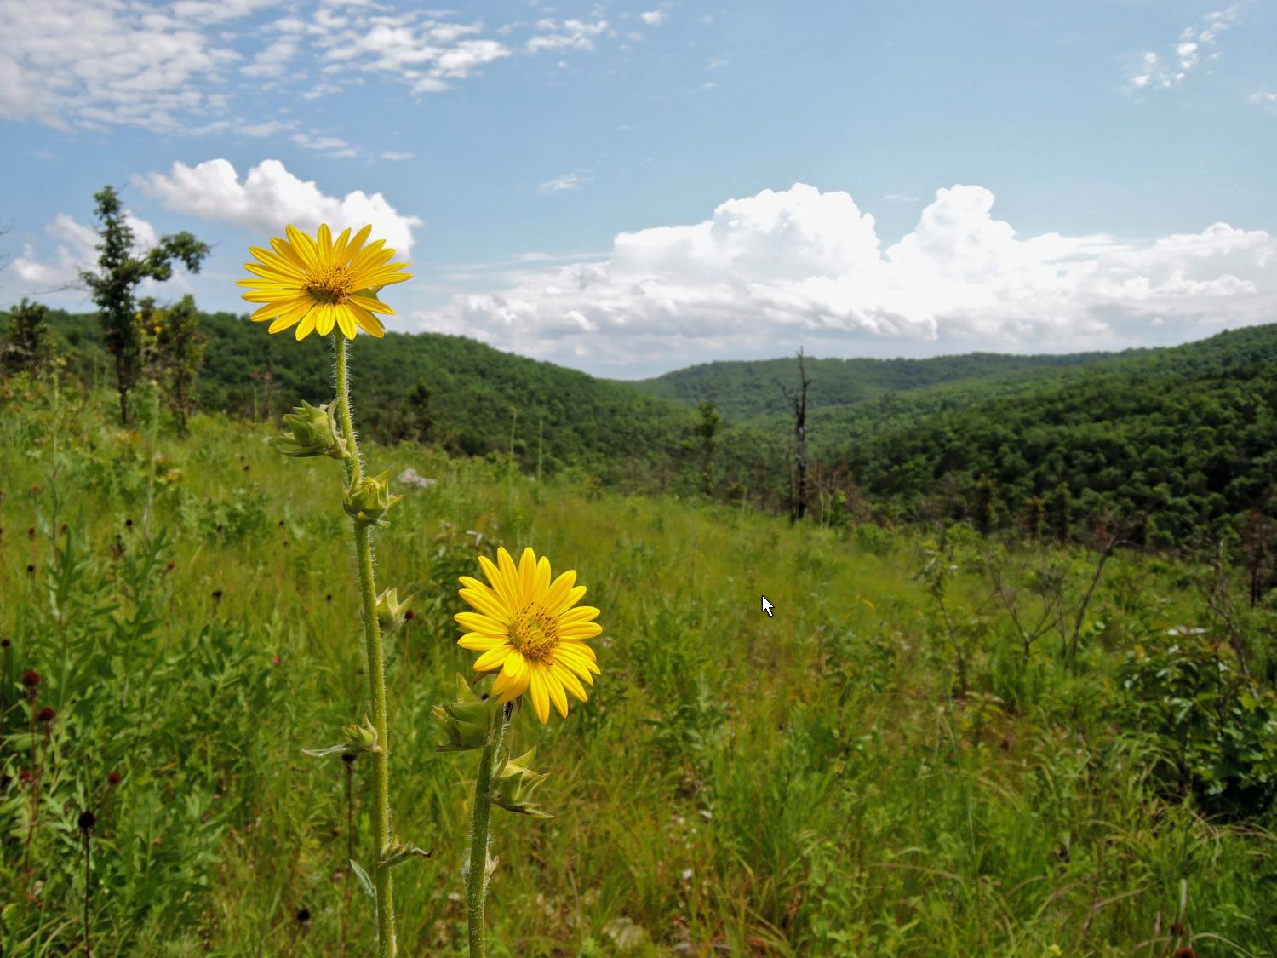
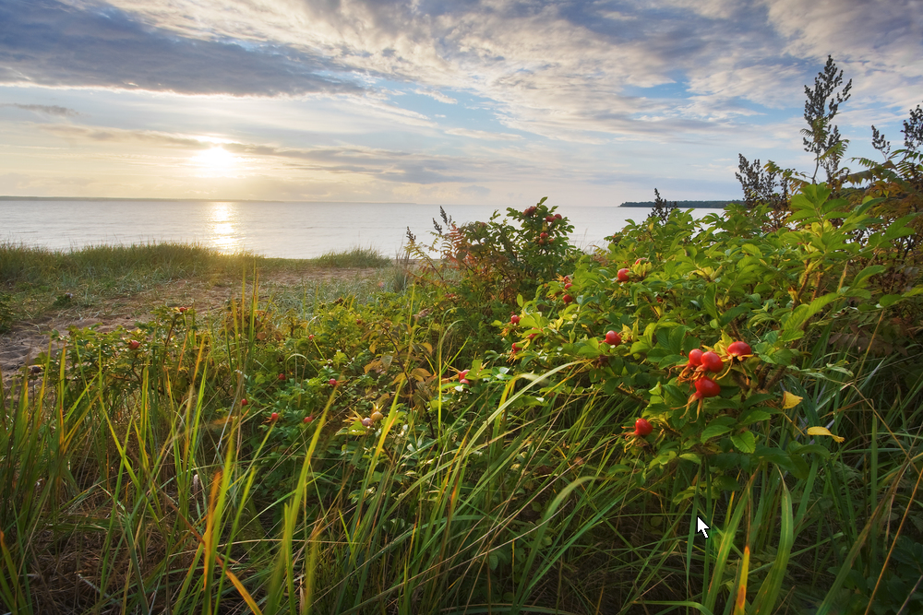
Grasslands
Grasslands are areas where the vegetation is dominated by grasses; however, sedge and rush families can also be found along with variable proportions of legumes, like clover, and other herbs

Slide 35
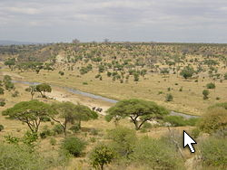
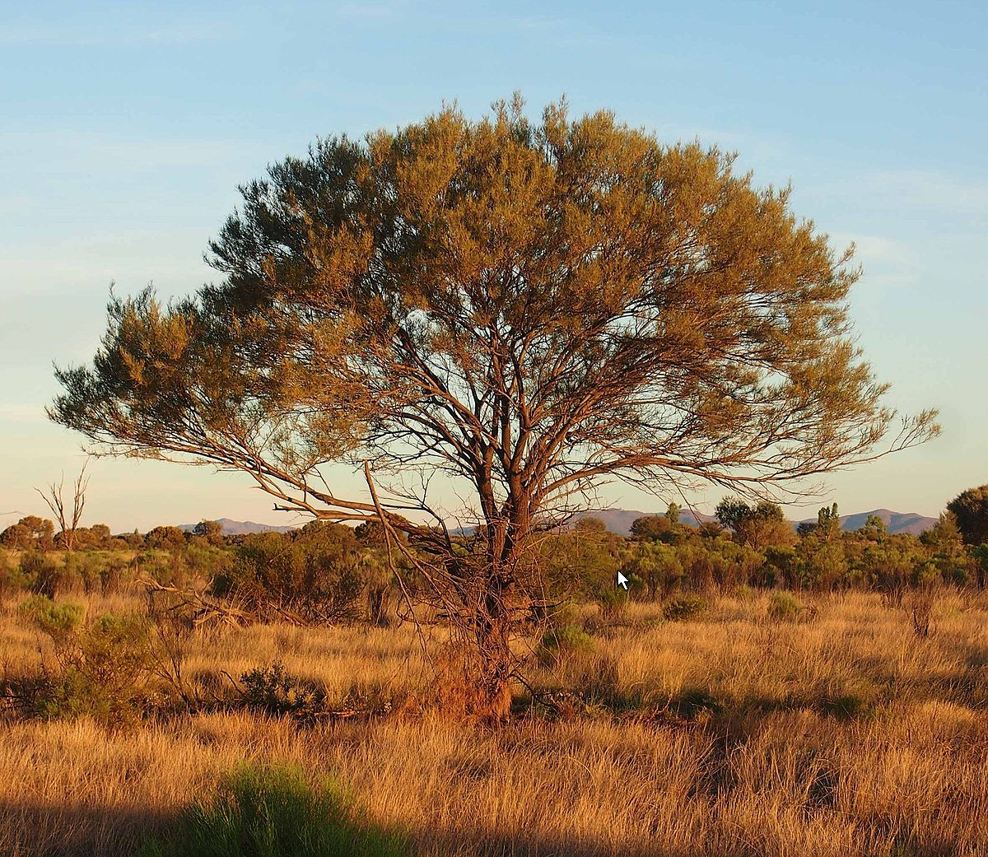
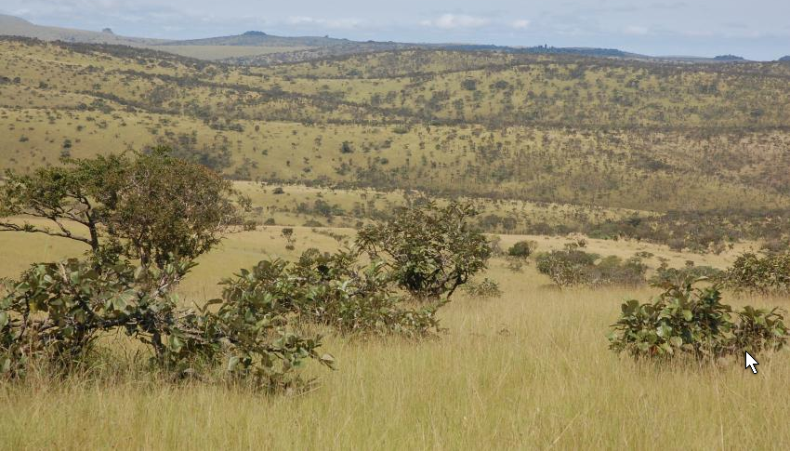
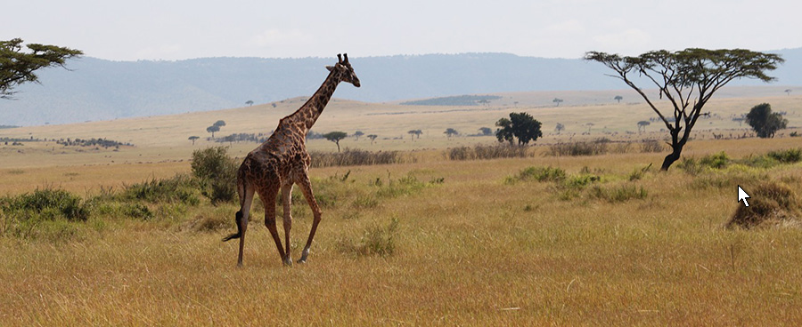
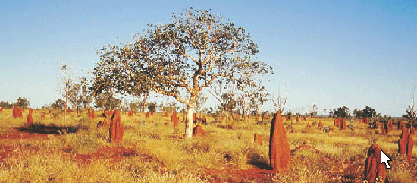
Savanna
A savanna or savannah is a mixed woodland grassland ecosystem characterised by the trees being sufficiently widely spaced so that the canopy does not close.

Slide 36
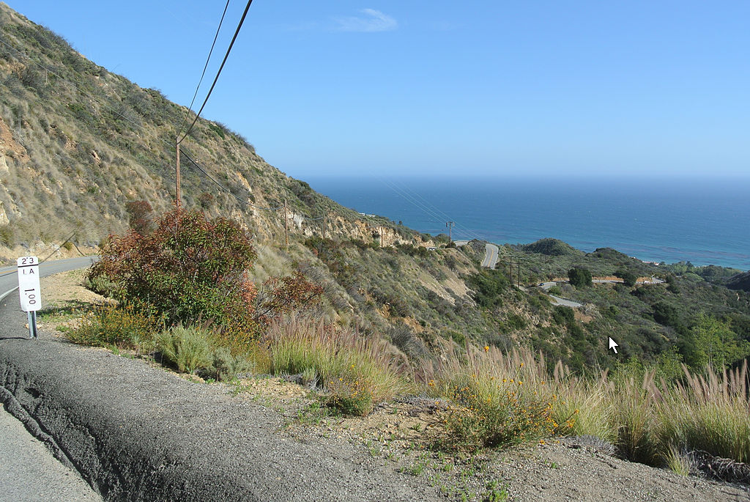
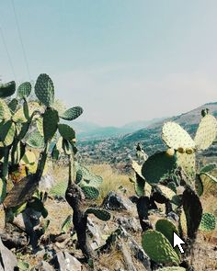
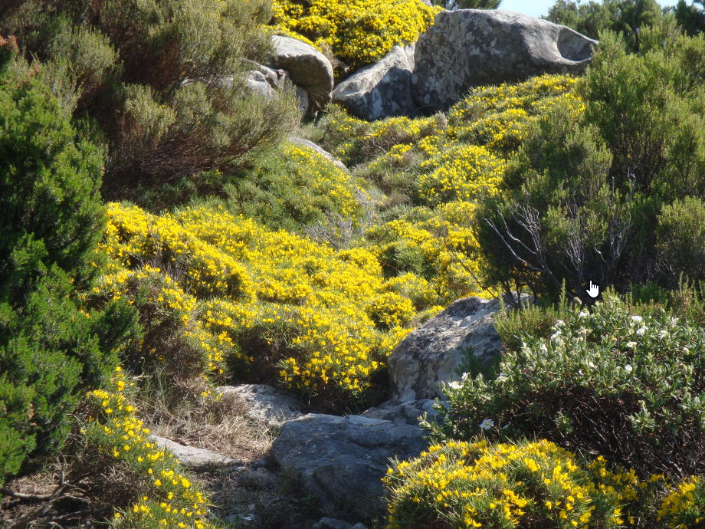
Maquis or Chaparral
Maquis or Chaparral is a shrubland or heathland plant community found primarily in the US state of California and in the northern portion of the Baja California Peninsula, Mexico. Much of the woody vegetation in Mediterranean-climate regions is sclerophyll, which means 'hard-leaved' in Greek. Sclerophyll vegetation generally has small, dark leaves covered with a waxy outer layer to retain moisture in the dry summer months.

Slide 37
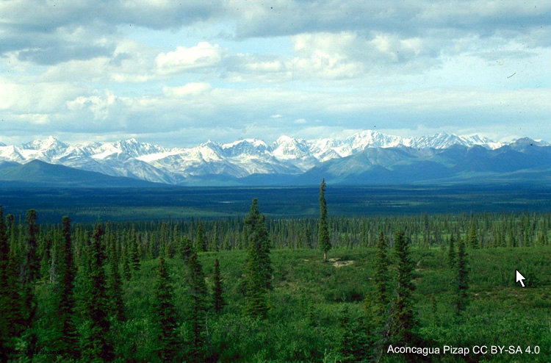
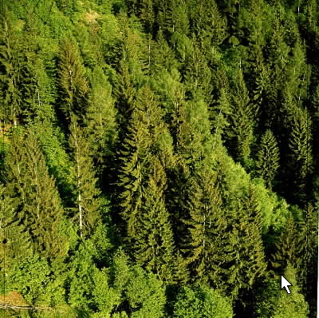
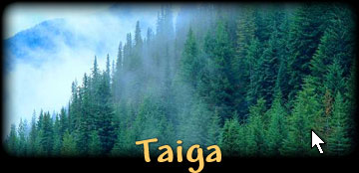
Taiga
Taiga, also known as boreal forest or snow forest, is a biome characterized by coniferous forests consisting mostly of pines, spruces and larches. The taiga is the world's largest biome apart from the oceans.

Slide 38
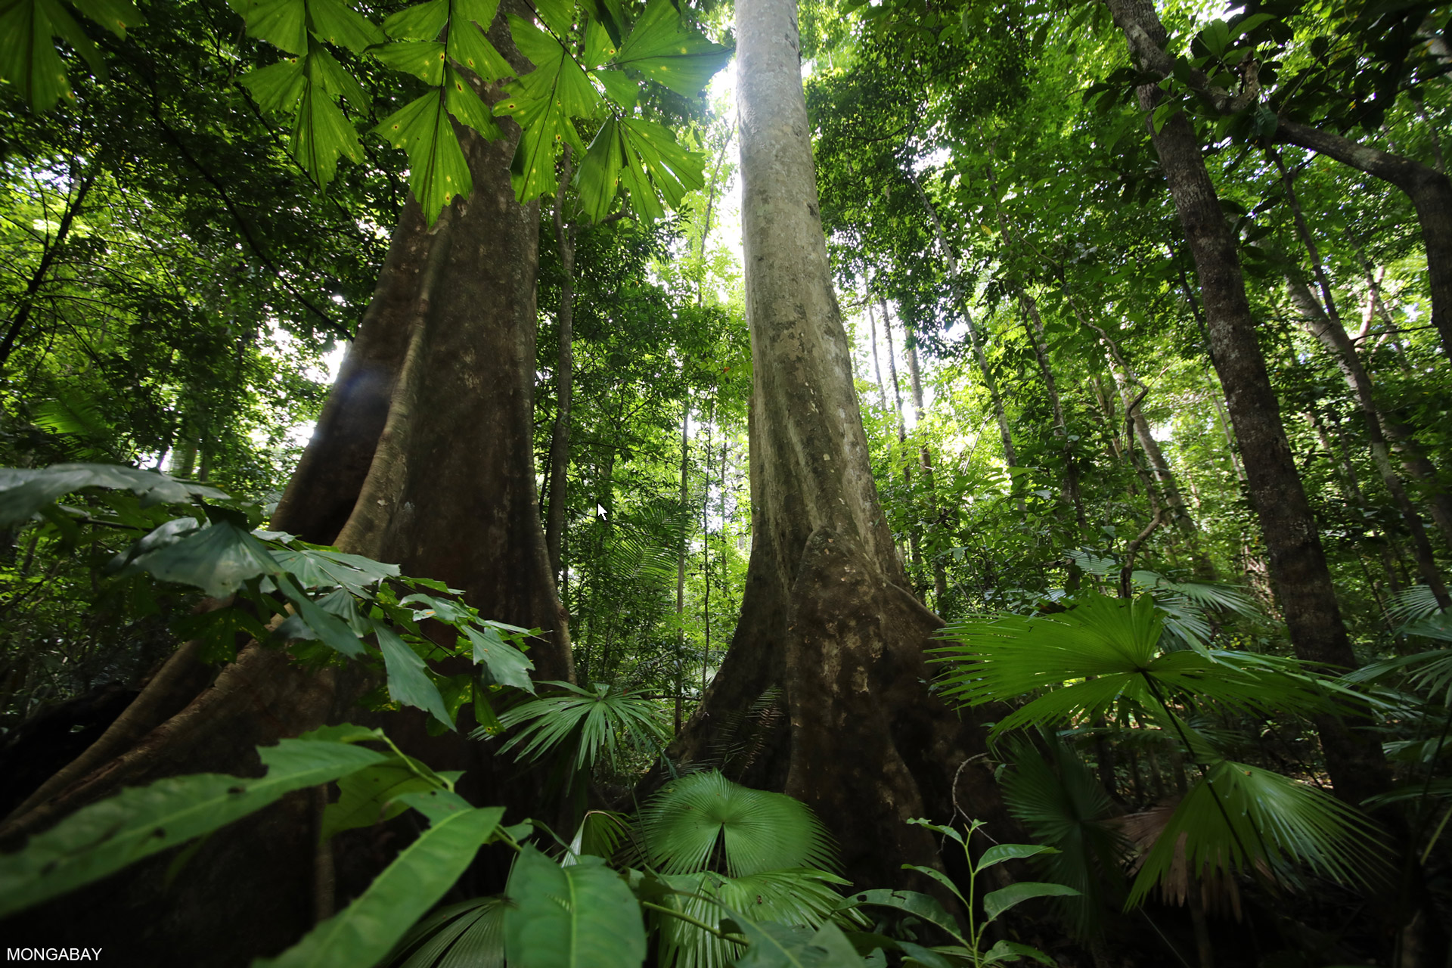
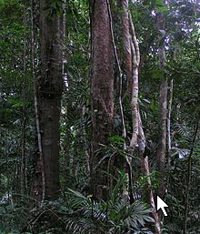
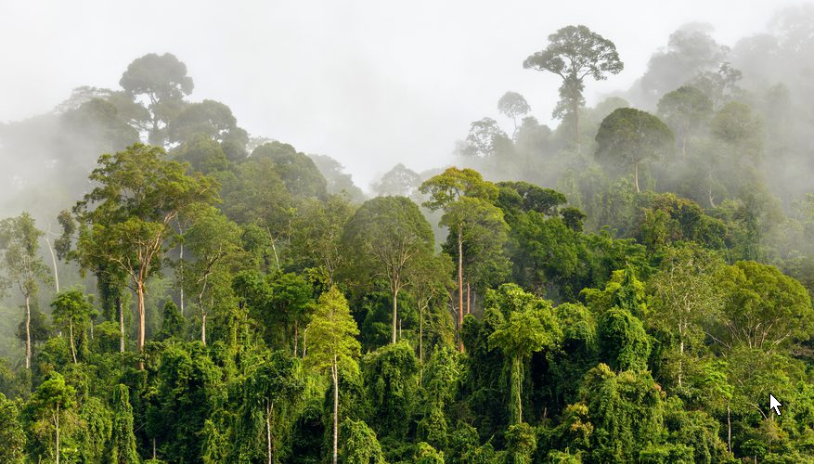
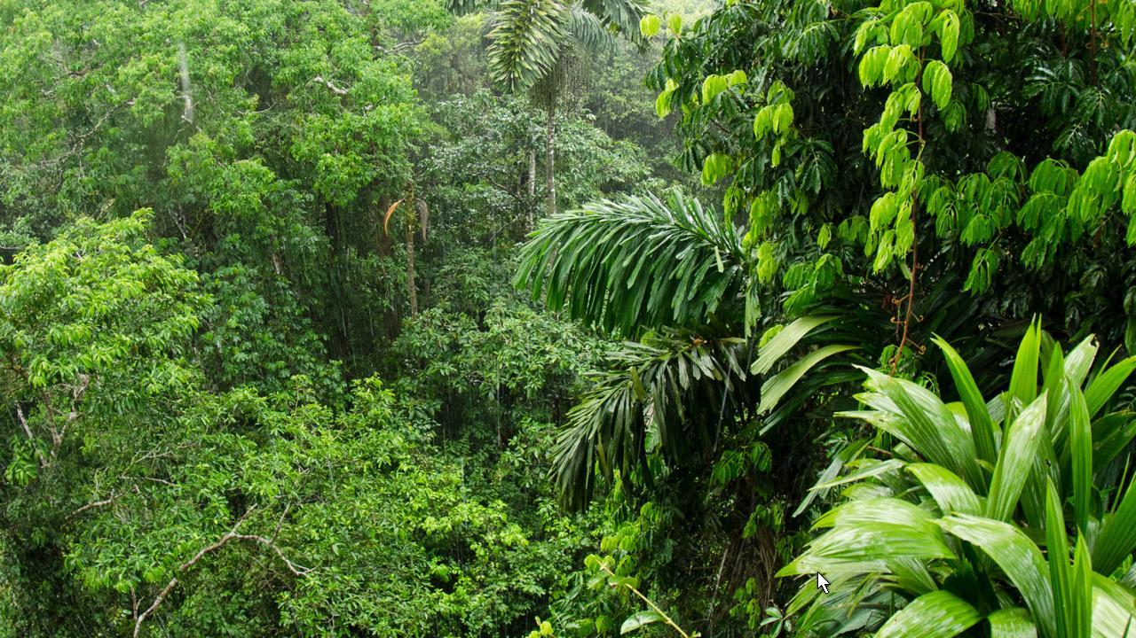
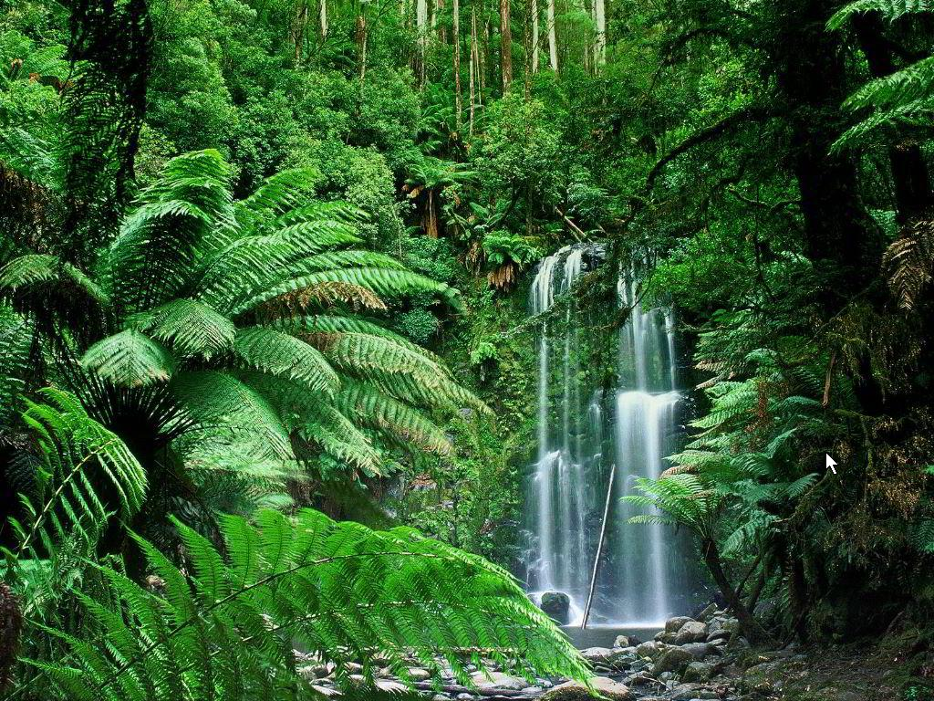
Rainforests
Rainforests are forests characterized by high rainfall, with annual rainfall in the case of tropical rainforests between 250 and 450 centimetres, and definitions varying by region for temperate rainforests.

Slide 39
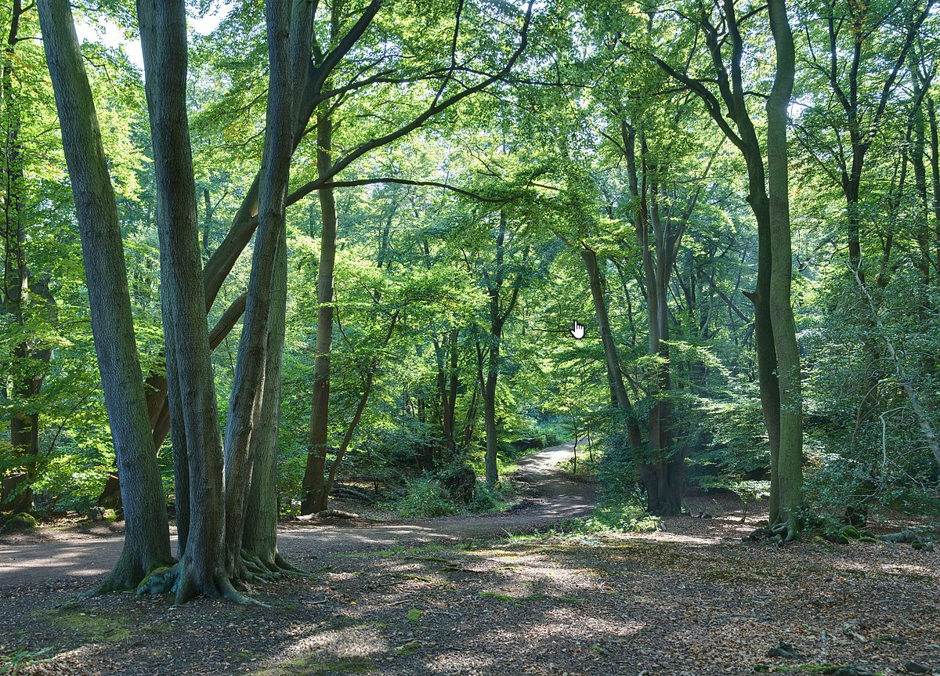
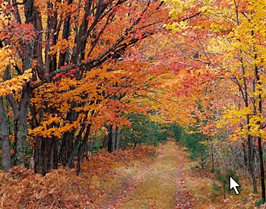
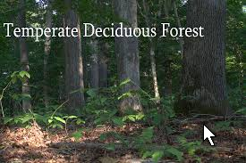
Temperate deciduous forest
Temperate deciduous or temperate broad-leaf forests are dominated by trees that lose their leaves each year. They are found in areas with warm moist summers and cool winters.

Slide 40
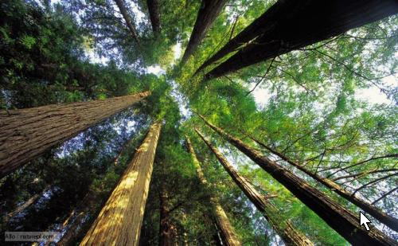
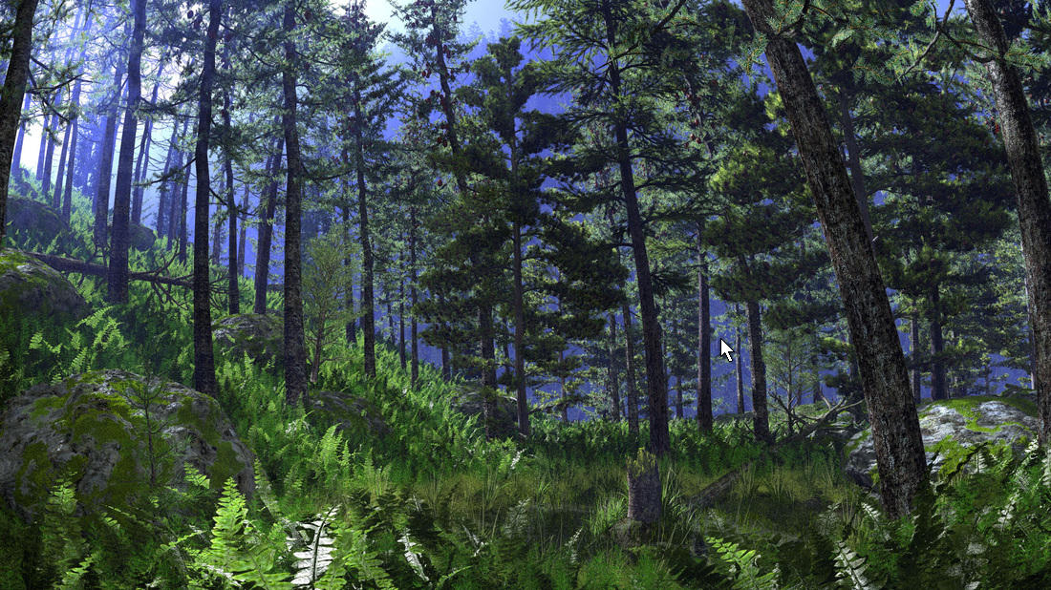
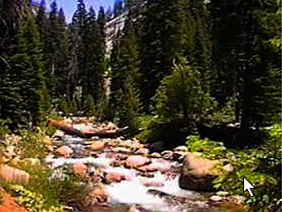
Temperate coniferous forest
Temperate coniferous forest is a terrestrial biome found in temperate regions of the world with warm summers and cool winters and adequate rainfall to sustain a forest.

Slide 41
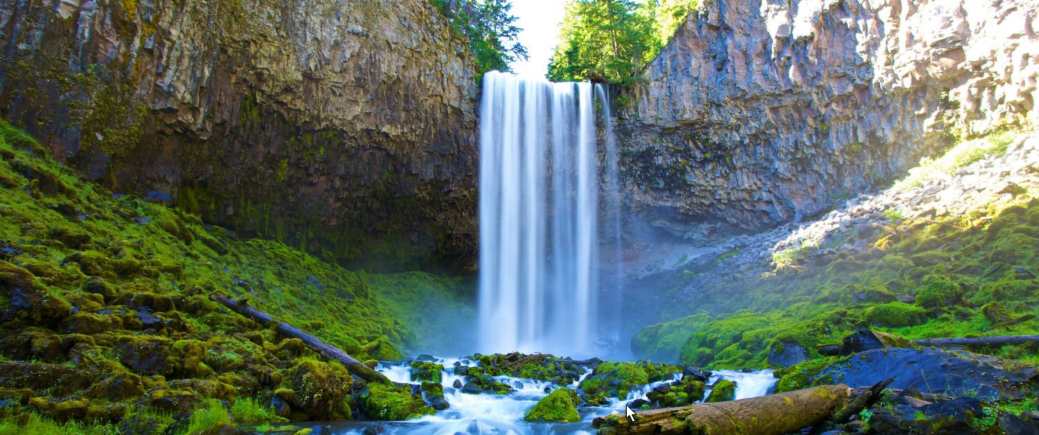
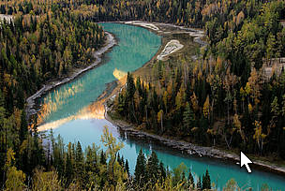
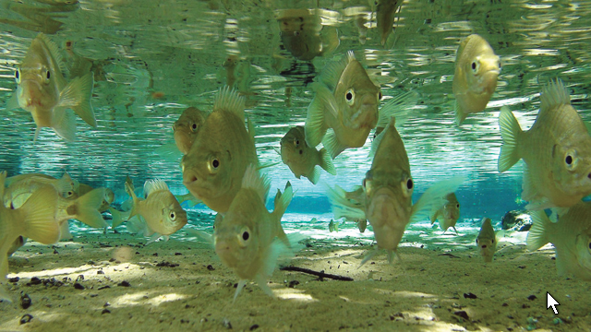
Fresh water
Fresh water is any naturally occurring water except seawater and brackish water. Fresh water includes water in ice sheets, ice caps, glaciers, icebergs, bogs, ponds, lakes, rivers, streams, and even underground water called groundwater.

Slide 42
WEATHER OR NOT!

Slide 43
Weather
the temporary state of the atmosphere with respect to wind, temperature, cloudiness, moisture, pressure, etc.
Simply put . . .
Weather is what hits you in the face when you walk out the door.
Weather is influenced by the same factors that influence – climate is, after all, the average pattern of weather experienced in a particular locality
Weather persons on the news talk about temperatures, humidity, high and low pressures, wind speed and direction.
Some weather can be extremely dangerous
Y
state of the atmosphere with respect to wind, temperature, cloudiness, moisture, pressure, etc.

Slide 45
Weather: hurricanes
Start at low pressure centers
Warm air rises – passing over warm water tends to “feed” a tropical storm until it is large enough and winds are fast enough to call it a hurricane. Passing over land tends to sap the hurricane of its energy until it eventually breaks up.
Water evaporates with energy from sun
With condensation, energy is released
August 2018, Hurricane Lane headed for Hawaii. It’s only been in the last few years that I’ve heard of Hawaii being in the path of hurricanes. We usually hear about them in the Gulf of Mexico or on the southeastern coast of the U.S. – evidence of climate change?

Slide 50
Power
1 x 4 board driven through the trunk of a palm tree.

Slide 51
This is the usual area we hear about in the news when there is talk of hurricanes.

Slide 52
World Hurricane Paths Pattern
Typhoon is just an Asian word that means hurricane

Slide 53
Precipitation

Slide 55
Kinds of precipitation - Convectional
Land heats up quickly forming powerful low pressure cell – expanding air absorbs moisture (warm air holds more)
The air rises and cools and compresses, squeezing out some of the water vapor (condensation)
When water drips get heavy enough to overcome the updraft of air, they fall as precipitation – rain, sleet, hail, snow.
This is what St. Louis gets in the Summer months.
Thunder Storm
Cooling
Sometimes may spawn a Tornado
Low Pressure

Slide 57
Tornados

Slide 60
Cyclonic or Frontal Precipitation
What St. Louis gets in the winter

Slide 61
Cold Front
Length of precipitation (rain, snow, etc.) in hours – narrow band of clouds moves through.

Slide 62
Warm Front – the angle of the front is much less steep than when it is a cold front
Length of precipitation (rain, snow, etc.) possibly a day or more – wide band of clouds moves through.

Slide 63
Orographic Precipitation
A landform interrupts the flow of prevailing winds, forcing the air to move up and over the landform (Mountain). St. Louis does not get this kind because there are no mountains near by.
Windward side - wet
Leeward side – dry

Slide 65
Monsoons
It doesn’t mean rainy. The word comes from the Arabic language and refers to a seasonal shifting of the prevailing winds, so there is a rainy season (Wet Monsoon) and a dry season (Dry Monsoon).

Slide 66
Dry Monsoon
Wet Monsoon

Slide 68
CLOUDS

Slide 69
Clouds are large groups of tiny water droplets (vapor) or ice crystals that cling to pieces of dust in the atmosphere. If or when the droplets become big and heavy enough to overcome uplifting air currents, they fall (pulled by gravity) as some form of precipitation.

Slide 70
How Clouds Form
As air rises it cools and decreases pressure, spreading out. Clouds form when the air cools below the dewpoint, and the air can not hold as much water vapor.
If a mass of air at ground level is said to have 50% humidity, it has half the amount of water vapor it could hold at that temperature.
The dewpoint is the temperature to which that mass of air would have to cool in order for the mass to have achieved a small enough volume so that with the same amount of water vapor it would now be 100% full.

