Slide 1
Global Wind Belts
By
Diana L. Duckworth
Rustburg High School
Campbell County, VA

Slide 2
Begin with Single Convection Cell
Northern Hemisphere
Southern Hemisphere
H
L
H
L
H
L
Direct
tropical
cell
Direct
tropical
cell
L
H
L
H
L
H
90°N
60°N
30°N
0°
30°S
60°S
90°S
cold
cool
warm
hot
warm
cool
cold
Begin with convection cell as before
Air cools enough to sink by 30° N & S
At surface it diverges to N and to S and begins to warm up from contact with Earth

Slide 3
Add an Indirect Cell
Northern Hemisphere
Southern Hemisphere
L
H
L
H
L
H
L
Indirect
cell
Direct
tropical
cell
Direct
tropical
cell
Indirect
cell
H
L
H
L
H
L
H
90°N
60°N
30°N
0°
30°S
60°S
90°S
cold
cool
warm
hot
warm
cool
cold
By the time the air at the surface reaches 60° N & S it has warmed enough to rise
At the top of the troposphere it diverges to the north and to the south

Slide 4
Three Convection Cells
Northern Hemisphere
Southern Hemisphere
L
H
L
H
L
H
L
Direct
polar
cell
Indirect
cell
Direct
tropical
cell
Direct
tropical
cell
Indirect
cell
Direct
polar
cell
H
L
H
L
H
L
H
90°N
60°N
30°N
0°
30°S
60°S
90°S
cold
cool
warm
hot
warm
cool
cold
By the time the air in the upper troposphere reaches the poles it has cooled enough to sink
At the surface it diverges toward the Equator
This creates a second direct convection cell

Slide 5
Three Convection Cells
Northern Hemisphere
Southern Hemisphere
L
H
L
H
L
H
L
Direct
polar
cell
Indirect
cell
Direct
tropical
cell
Direct
tropical
cell
Indirect
cell
Direct
polar
cell
H
L
H
L
H
L
H
90°N
60°N
30°N
0°
30°S
60°S
90°S
cold
cool
warm
hot
warm
cool
cold
Direct cells include tropical & polar cells
Driven directly by insolation
Indirect cell (mid latitudes) exists only for air flow between the direct cells

Slide 6
Key Features of Model
Northern Hemisphere
Southern Hemisphere
L
H
L
Direct
polar
cell
Indirect
cell
Direct
tropical
cell
Direct
tropical
cell
Indirect
cell
Direct
polar
cell
H
L
H
L
H
L
H
90°N
60°N
30°N
0°
30°S
60°S
90°S
cold
cool
warm
hot
warm
cool
cold
These are the jet streams
Narrow bands of west winds with speeds of 100 mph or more
Two polar jets and two subtropical jets
Polar & subtropical jet sometimes merge

Slide 7
Polar Jet stream marks Polar Front
Jet stream does not flow in a straight line
Produces waves & troughs
Sometimes splits around parts of the indirect cell into a subtropical and polar jet
Dynamic – the waves and troughs move around the earth, bringing warm conditions in a ridge and cold conditions in a trough.
Storms follow jet & intensify in troughs.

Slide 8
Polar Air
ridge
trough
trough
ridge

Slide 9
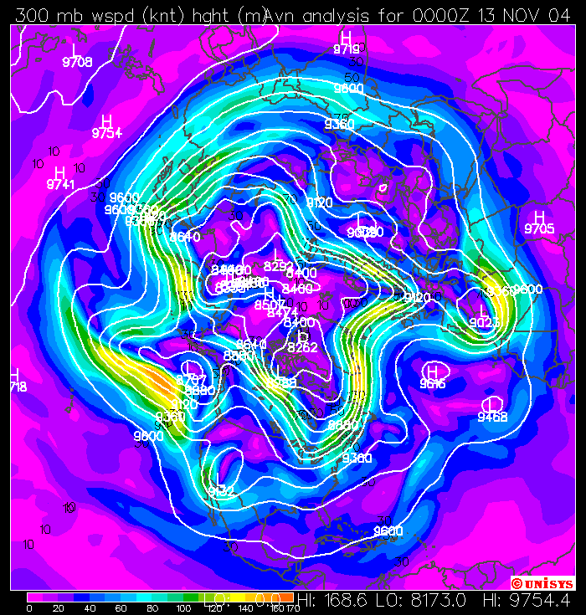
Indirect
Cell
Polar Cell
Indirect
Cell
Base figure from unisys.com

Slide 10
Some more key features shown for one hemisphere
POLAR
FRONT
HORSE
LATITUDES
ITCZ
90°N
60°N
30°N
0°
ITCZ stands for intertropical convergence zone
ITCZ moves with vertical rays of sun
Area around equator also called DOLDRUMS
an area of very light winds, as is horse latitudes
Polar Front is region where storms are formed

Slide 11
In the Summer - Northern Hemisphere
Tropical cell
expands &
moves north
90°N
60°N
30°N
0°
Direct tropical cell expands & moves north
Equatorial Low is in Northern Hemisphere
Indirect cell shrinks to insignificance
Polar cell also retreats to the North

Slide 12
In the Winter - Northern Hemisphere
Tropical cell
moves south
over Equator
Polar Cell expands and moves
to the south.
90°N
60°N
30°N
0°
Direct polar cell expands & moves south
Equatorial Low is in Southern Hemisphere
Indirect cell shrinks to insignificance
Tropical cell also retreats to the south

Slide 13
H
HIGH
60°N
L
LOW
30°N
Horse latitudes
H
HIGH
Equator
ITCZ
LOW
doldrums
L
30°S
HIGH
H
Horse latitudes
60°S
LOW
L
HIGH
H

Slide 14
Surface Winds
Polar Northeasterlies
H
60°N
L
Prevailing
Southwesterlies
30°N
H
NE Tradewinds
Equator
L
SE Tradewinds
30°S
H
Prevailing
Northwesterlies
60°S
L
Polar Southeasterlies
H

