Slide 1
5 Foolproof Ways to Stop Procrastinating with Adult ADD
Simple strategies to help adults start — and finish — projects at home and the job.

Slide 2
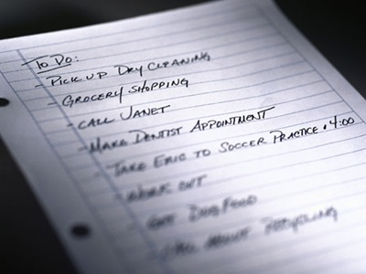
If you have adult ADD/ADHD, you’ve
probably noticed that you
procrastinate more than others. Such behavior can cause problems in
personal relationships and those at
the workplace. When we fail to
complete tasks on time, others see it
as a sign of disrespect, incompetence, or laziness.
Because procrastination is essentially a mind-set, cognitive-behavior
techniques can help even chronic
procrastinators break the habit. If
you’ve been putting something off for days (or months), try the following
ADHD time-management tips.

Slide 3
Do Something Fun First
Many people with ADHD find it
helpful to do something they love
first as a way to get in the mood
to do less enjoyable tasks.
Any stimulating activity you enjoy will do the trick. Some ADDers
play basketball or computer games. Others dance or take a bubble bath. Set a timer for 20 minutes to make sure you don’t get so absorbed in
the fun activity that you forget to
do the necessary one

Slide 4
Create the Right Work Environment
People who have ADHD often are most
productive in unconventional surroundings.
Instead of wearing earplugs to ensure silence, you may find that you get more done when listening to loud music.
If you work best under pressure, but still turn in projects late or exhaust yourself by pulling all-nighters, set your own deadline for completing portions of the project. This way, you can still work under pressure to finish each portion “on time.”
Do it: If you're taking ADHD medication, it’s generally best to schedule difficult tasks for times when your symptoms are fully covered.

Slide 5
Don't Beat Yourself Up
What we silently say to ourselves about
doing the task at hand has a strong impact
on how (or whether) we do it. Avoid
negative self-talk, and send yourself positive, realistic messages.
Instead of saying, “This will take forever, and it’s so late already…” substitute “I might not
be able to finish this today, but I can do the first two steps within the next 30 minutes.”
The messages you send yourself when you
complete a task can be powerful deterrents
to future procrastination. They can also
diminish the guilt that procrastinators often
feel about having missed appointments in
the past or having turned in work that
doesn’t measure up to their ability.

Slide 6
Just Do It
Just starting a task — even if it’s begun
poorly — makes it easier to follow
. Next time you find yourself avoiding something, take a “first sloppy step.”
If you need to write something, for
example, start by typing random letters
on the page. It is gibberish, but at least
you will no longer be looking at a blank page. ”

Slide 7
Take One Step at a Time
Break large tasks into pieces. The smaller steps
aren’t as intimidating and facilitate getting
started. If a project can’t be completed
piecemeal over several days, keep up your
momentum by focusing only on the next doable step. Write this step on a sticky note and post it within your line of sight.
Put on your blinders and focus on this one step rather than on the task as a whole. When that’s done, move on to the next step in the same
manner. Before you know it, you’ll be done.
Try it: If you need external pressure to stick to a task, enlist a body double — someone who will sit with you quietly while you’re working on a
boring chore.

