Slide 1
the World's Many Sacred Places

Slide 2
Lake Atitlán in Guatemala

Slide 3
The Church of the Nativity in Bethlehem

Slide 4
The Church of the Nativity in Bethlehem, West Bank, is built over the cave, or grotto, in which Jesus is believed by many to have been born during the reign of Caesar Augustus.
The first basilica of the Church of the Nativity in Bethlehem was built in the 4th century by the Roman Emperor Constantine and has been a sacred place for Christians and Muslims for centuries, surviving a wide variety of political and religious conflicts.

Slide 7
Mount Sinai in Egypt

Slide 8
Mount Sinai in Egypt is where Moses is said to have received the 10 Commandments.
A Greek Orthdox chapel is one of many religious structures that stand on Mount Sinai.

Slide 10
Uluru-Kata Tjuta National Park in Australia

Slide 11
Uluru-Kata Tjuta National Park in Australia is a sacred site to the Anangu people of the Pitjantjatjara Aboriginal tribe.
Uluru-Kata Tjuta National Park is the site of an ancient Aboriginal creation story and is said to be inhabited by ancestor spirits.

Slide 13
Cenote Sagrado in Mexico

Slide 14
Cenote Sagrado in Mexico was the site of ancient Mayan ceremonies and occasional human sacrifice.
Cenote Sagrado was created from a natural limestone cave.

Slide 16
Mahabodhi Tree in Bodh Gaya, India

Slide 17
The ascetic Prince Siddhartha took rest under a native bodhi tree like the Mahabodhi Tree in Bodh Gaya, India, and awoke with the enlightenment that is a central tenet of the Buddhist tradition.
A temple stands near the site of the Mahabodhi Tree.

Slide 19
Mount Kailas in Tibet

Slide 20
Mount Kailas in Tibet is a sacred place to Buddhists, Hindus, and Jains alike.
Tantric Buddhists say Mount Kailas is home to Buddha Demchog, who represents supreme bliss.

Slide 22
The ruins of St. Michael’s Tower at the top of Glastonbury Tor in England

Slide 23
Ancient Celts believed that Glastonbury Tor was the home of the King of the Underworld.

Slide 24
Crater Lake

Slide 25
The Klamath tribe of Oregon maintains that Crater Lake was the site of a battle between the Chief of the Above World and the Chief of the Below World.
Historians believe that the Klamath people of Oregon may have witnessed the implosion that formed Crater Lake nearly 8,000 years ago.

Slide 27
Mount Parnassus, greece

Slide 28
Mount Parnassus is the setting of many ancient Greek myths and legends, including the Oracle of Delphi. When Zeus released two eagles from the two ends of the earth, they met over Delphi, the Navel or Omphalos of the World. Watching clouds roll in far below from the Argolic Gulf, while the sun turns Parnassos to gold, one can easily see why there have been sacred temples to Apollo on this spot for thousands of years. An ancient Greek amphitheatre stands at the Sanctuary of Apollo on Mount Parnassus.

Slide 30
Lake Atitlán in Guatemala

Slide 31
Lake Atitlán in Guatemala is ringed by Mayan villages and its shores are strewn with archeological sites and ruins, some said to be the mythological “underwater city” of Chiutinamit.

Slide 32
Shwedagon Pagoda, Myanmar

Slide 33
Rising 100 yards above the city of Rangoon, Myanmar's Shwedagon Pagoda is, according to many travelers, one of the world's great wonders. The pagoda is famed for holding the relics of four Buddhas and savvy visitors should visit at night to enjoy the chants of the faithful, the wafting incense, and the great golden stupas shining in the spotlights.

Slide 35
Lotus Temple, India

Slide 36
The city of New Delhi isn't exactly known for peace and quiet, but the stunning Lotus Temple, home of the Baha'i faith, is a true oasis of tranquility. Built in 1980, the flower-shaped temple is surrounded by peaceful gardens and a large interior space is reserved for people of all faiths to come and meditate.

Slide 38
Hagia Sophia, Turkey

Slide 39
What can we say about the Hagia Sophia? It's one of the oldest and most architecturally influential places of worship in the world. While it's famous for its awe-inspiring domes and Byzantine mosaics, the fact that travelers from all cultures and religions flock to behold her glories is what truly makes the Hagia Sophia special.

Slide 41
Abu Simbel Temples, Egypt

Slide 42
Though built by the famous Pharaoh Ramesses II over 3,000 years ago, the Abu Simbel Temples and their stunning colossi are more famous than ever. The two temples of Ramses II and Nefertari were carved directly into the rock and their interiors feature gargantuan columns lined with hieroglyphics.

Slide 43
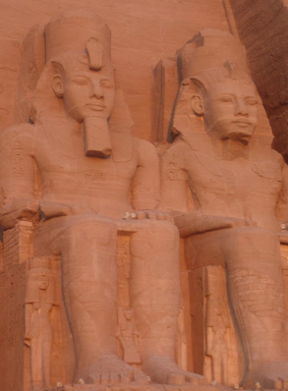

Slide 44
Ghats of Varanasi, India

Slide 45
Varanasi is the holiest of India's sacred cities and famous for its ghats, terraced areas on the river banks where the faithful come for ritual baths, washing, meditate, and even cremations. Described by travelers as powerful, visceral, and overwhelming, a boat ride along the ghats at dawn is something that no traveler ever forgets

Slide 47
Batu Caves, Malaysia

Slide 48
Located just north of Kuala Lumpur, the Batu Caves are one of the most amazing sight in all of Asia. The complex consists of massive limestone caves filled with intricate shrines, a 140ft. tall statue of the Hindu deity Murugah, and lots and lots of mischievous macaque monkeys ready to snatch a snack from unsuspecting tourists.

Slide 50
Basilica of San Vitale, Italy

Slide 51
The Basilica of San Vitale in Ravenna, Italy is one of the most important churches in early Christianity, a UNESCO World Heritage Site, and an amazing experience for lovers of art and architecture. The hypnotically colorful mosaics are some of only a few in the world that remain from the time of Emperor Justinian I.

Slide 52
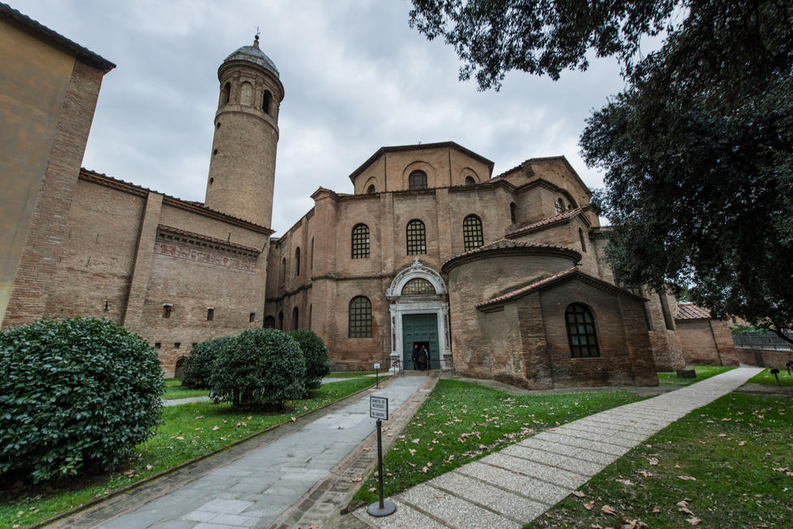

Slide 53
Spanish Synagogue, Czech Republic

Slide 54
Widely regarded as Europe's most beautiful synagogue, the Spanish Synagogue in Prague is one of those places where you could literally spend hours admiring the Moorish-style geometric carvings and paintings covering literally every square inch of the interior. Don't forget to check out the statue of famous Czech author Franz Kafka near the entrance.

Slide 56
The Temple mount, Jerusalem

Slide 57
The site of Herod’s temple which was leveled by the Romans in 70 C.E., it is sacred to Jews, Christians, and Muslims. Control of and access to this sacred space remains an area of disagreement among these religions that ironically preach peace and love.

Slide 59
Kaabah, Mecca

Slide 60
The Kaaba or Ka'aba is a building at the center of Islam's most sacred mosque, Al-Masjid al-Haram, in Mecca, al-Hejaz, Saudi Arabia. It is the most sacred Muslim site in the world. It is considered the "House of God" and has a similar role as the Tabernacle and Holy of Holies in Judaism. Wherever they are in the world, Muslims are expected to face the Kaaba when performing salat (prayer). From any point in the world, the direction facing the Kaaba is called the qibla. The sanctuary around the Kaaba is called Al-Masjid al-Haram (Sacred Mosque).

Slide 62
Lake Titicaca, Bolivia and Peru

Slide 63
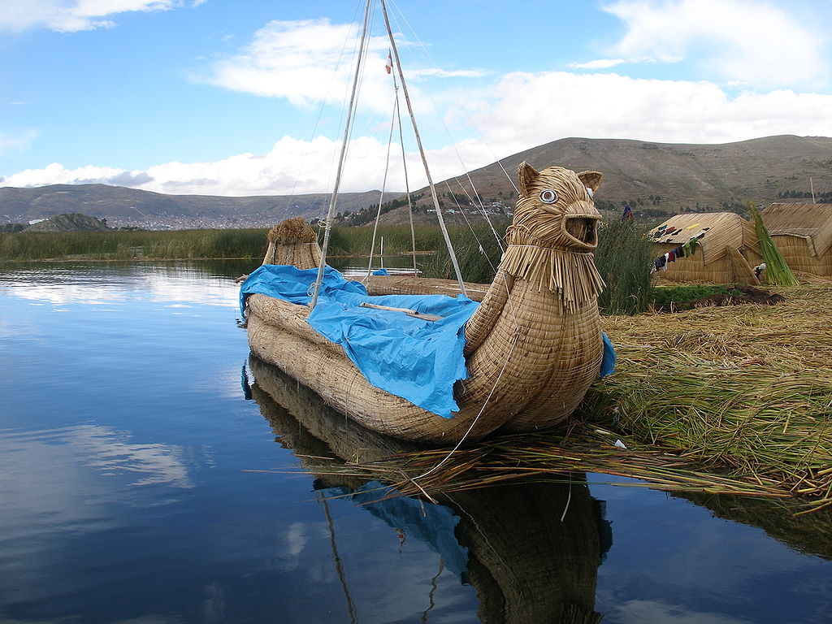
Lake Titicaca has been sacred since the time of the Incas and possibly earlier.

Slide 64
Mt. Fuji, Japan

Slide 65
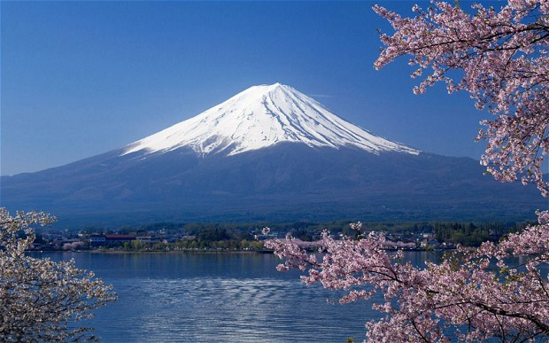
Mt. Fuji, Japan has been viewed as sacred in the Shinto tradition, Mt. Fuji has long been celebrated in Japanese art.

Slide 66
La Nariz de Maya

Slide 67
The mountain is called La Nariz de Maya or nose of the Maya. The local Tzutujil Maya honor it as a sacred site. Shaman regularly perform ritual offerings there

Slide 68
Angkor Wat, Cambodia

Slide 69
The mighty Angkor Wat complex in Cambodia is another site which is tough to describe in words. To visit Angkor Wat is to immerse yourself in countless 900-year old temples, massive stone faces, sprawling jungles, and groups of young, saffron-robed monks. If it's not on your bucket list, it should be

Slide 71
Unless humans remain vigilant and maintain their creations, both sacred and secular, nature will take back what it relinquished, temporarily, and assert its preeminent place in the grand scheme of things, as the previous slide illustrates.

