Slide 1
Wonderful Hindu Temples abroad

Slide 2
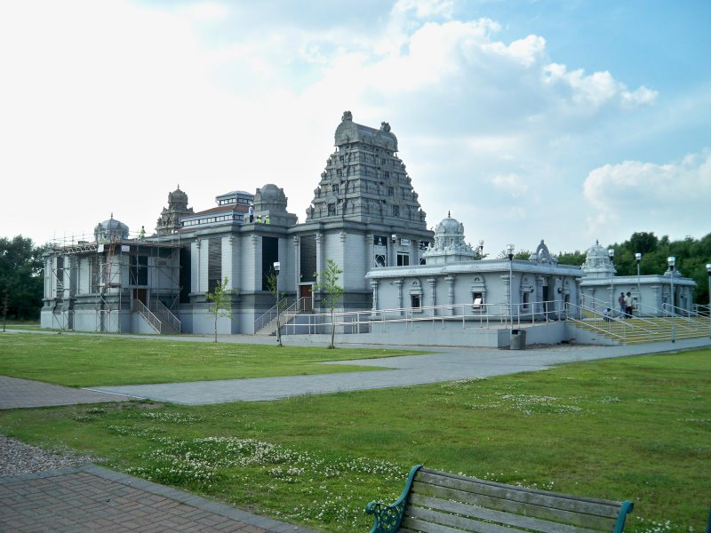
Lord Venkateshwara Temple, Birmingham, United Kingdom

Slide 3
Malibu Hindu Temple, Malibu, California, US

Slide 4
Shiva-Vishnu Temple, Livermore, California, US

Slide 5
Lord Vishnu Temple, Angkor, Cambodia
The largest temple of the world, raised during the reign of Suryavarman-II in 12th century, is, in fact, located in Angkor, a major archaeological site of Cambodia. It is dedicated to Lord Vishnu. It is also one of the two temples intact in Angkor, Cambodia. The other is a Buddhist Temple. The largest temple of Lord Vishnu in Angkor is built according to Khmer architecture, original to Cambodia.
Picture on next slide

Slide 7
Prambanan Shiva Temple, Central Java, Indonesia

Slide 8
Sri Venkateswara Swami Temple of Greater Chicago - Aurora, Illinois, United States

Slide 9
BAPS Shri Swaminarayan Mandir - Toronto, Canada

Slide 10
Sri Siva Vishnu Temple, Washington DC, United States

Slide 11
BAPS Shri Swaminarayan Mandir, London (Neasden Temple), United States

Slide 12
Sri Murugan Temple “Batu Caves”, Penang, Malaysia

Slide 13
Sri Venkateswara Temple, Bridgewater, NJ, US

Slide 14
Mother Temple of Besakih, Bali, Indonesia

Slide 15
Murugan Temple, Sydney, Australia

Slide 16
Venkateswara Swami temple, Riverdale near Atlanta, Georgia, US

Slide 17
Sri Venkateswara Swami Temple, Helensburgh, Sydney, Australia

Slide 18
Velmurugan Gnana Muneeswarar Temple, Rivervale Crescent Sengkang, Singapore

Slide 19
Sri Meenakshi Devasthanam - Pearland, Texas, US

Slide 20
Ekta Mandir, Irving, Texas, US

Slide 21
Sri Venkateshwara Temple - New Jersey, US

Slide 22
Sri Lakshmi Temple - Ashland, MA, US

Slide 23
Sri Venkateswara Swami Temple, Pittsburgh, US

Slide 24
Shiva Vishnu Temple of South Florida Inc, FL, US

Slide 25
Shiva - Vishnu Temple of Melbourne, Melbourne, Australia

Slide 26
Sri Murugan Temple, London, UK

Slide 27
Quad City Hindu Temple , Rock Island, IL, US

Slide 28
Sri Prasanna Venkateswara Swami Temple, Memphis, Tennessee, US

Slide 29
Sri Srinivasa Perumal Temple or Sri Perumal Temple, Little India, Serangoon Road, Singapore

Slide 30
Arulmigu Sri Raja Kaliamman Temple, Johor Baru, Malaysia - The only Hindu Glass Temple abroad

