Slide 1
U.S.A. in the early 20th Century

Slide 2
These photos of life in the US at the beginning of the 20th century are truly a walk back in time. The first photo below looks the same today and many of you have entered it on the way to NY. The third photo shows how trolley cars were air conditioned in the summer.

Slide 3
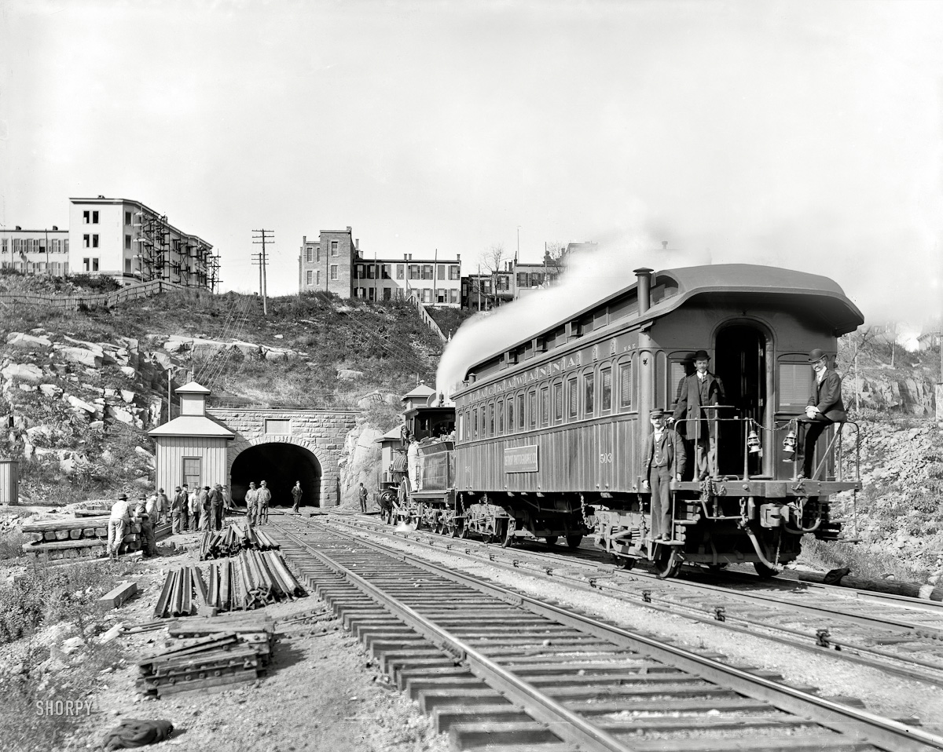
1900| New Jersey circa. " Bergen Tunnel, east end"

Slide 4
1900| Chicago . "A walk in Lincoln Park "

Slide 5
1900| Buffalo , New York. " Labor Day parade, Main Street "

Slide 6
1900| "U.S.S. Oregon quarterdeck”

Slide 7
1900| "U.S.S. Chicago.One of the crew"

Slide 8
1901| Buffalo , New York. "Unloading ore from whaleback carrier"

Slide 9
1901| "Hanging rock on the Susquehanna near Danville , Pennsylvania "

Slide 10
1901| Petoskey , Michigan. "Grand Rapids & Indiana R.R. Station"

Slide 11
1901| Detroit . "Excursion steamers Tashmooand Idlewild at wharves"

Slide 12
1901 | Colorado . "Station and hotel, summit of Pike's Peak "

Slide 13
1902 | "A happy family?"

Slide 14
1902| Iowa . " Chicago & North WesternRailway — steel viaduct over Des Moines River" | William Henry Jackson

Slide 15
1903| New York . " Brooklyn Terminal at Brooklyn Bridge "

Slide 16
1903| "S.S. Proteus.High water at New Orleans levee"

Slide 17
1903| "Unloading bananas at New Orleans, Louisiana "

Slide 18
1904| The Jersey Shore. " Steeplechase Pier and bathers, Atlantic City "

Slide 19
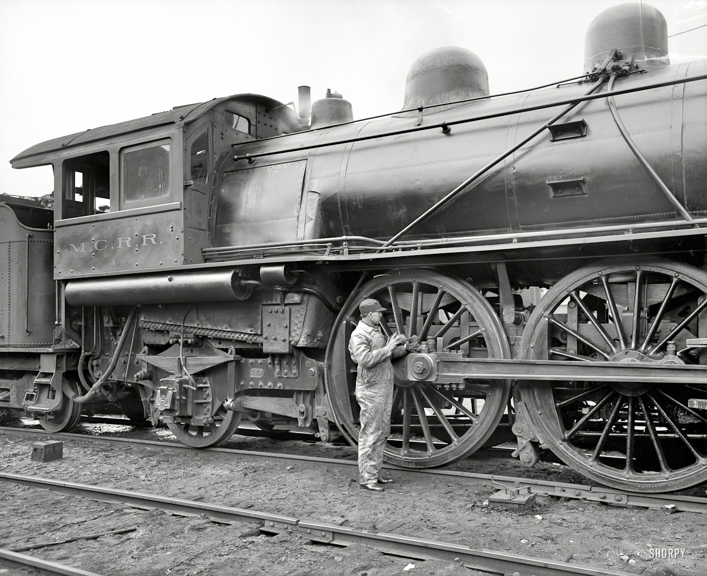
1904 | " Michigan Central Railroad. Oiling up before the start"

Slide 20
904| New York . "The Poies, Coney Island "

Slide 21
1905| St. Clair , Michigan. "Launch of steamer Frank J. Hecker"

Slide 22
1905| St. Augustine , Florida. "They were on their honeymoon"

Slide 23
1905| Coney Island , New York. "Surf bathing"

Slide 24
1905 | The New Jersey shore. " Boardwalk and beach, Asbury Park "

Slide 25
1905| Cleveland , Ohio. " Cuyahoga River from theViaduct"

Slide 26
1905 | Buffalo , New York. "Jack-Knife Bridge, City Ship Canal , foot of Michigan Street"

Slide 27
1905| The Detroit River. "Transfer steamer Detroit in the ice"

Slide 28
1905| Houghton , Michigan. "Loading copper on steamer Juniata"

Slide 29
1905 | Buffalo, New York. "Looking up Main Street. Steamer NorthLand at Long Wharf"

Slide 30
1905 | "A winter morning"

Slide 31
1905| Knoxville , Tennessee. " Gay Street looking north from Clinch Avenue"

Slide 32
1905 | Hot Springs, Arkansas. "Roadway through the pines"

Slide 33
1905| Chicago . "The bridge, Lincoln Park "

Slide 34
1906| " Mississippi River Landing"

Slide 35
1906| Birmingham, Alabama. " Second Avenue looking east"

Slide 36
1906| Gulfport, Mississippi. "Steamer loading resin"

Slide 37
906| Wequetonsing, Michigan. "The birches and the bay"

Slide 38
1906| Circa. "Banana docks, New York"

Slide 39
1906| "Railroad station, Magnolia, Massachusetts"

Slide 40
1907| Detroit . "Band concert on Grand Canal, Belle Isle Park "

Slide 41
1907| "The Brooklyn Bridge Promenade and ManhattanTerminal"

Slide 42
1907| Chicago, Illinois. Jackknife Bridge, Chicago River"

Slide 43
1907| Chicago, Illinois. " Jackknife Bridge , Chicago River"

Slide 44
1907| Savannah, Georgia. "The whole black family at the Hermitage"

Slide 45
1908| New York . " Times Square " The old New York Times building, now encased in billboards, Hotel Astor and various theaters seen from Broadway

Slide 46
1908| Detroit . "Waders at Belle Isle Park "

Slide 47
1908| Pittsburgh, Pennsylvania. " Nixon Theatre, Sixth Avenue & Cherry Alley"

Slide 48
1908| "Suburban Station, Petoskey , Michigan"

Slide 49
1908| New York . " Pompeiian Room — HotelSeneca"

Slide 50
1908| St. Louis Avenue, St. Louis, MO

Slide 51
the way things use to be, and what they are now makes you wonder
BUT
I love my Air and dishwasher and washing machine I remember the old wringer that I helped Mom wash and pull clothes thru yep something are better and this nice to look back on, wonder what the next generation will think of us ???

