Slide 1
Surprising Facts About The Early Humans and Evolution
By Anna Burke | June 16, 2016

Slide 2
Millions of years have passed since our ancestors roamed this earth, and we've learned much about them from archeological and anthropological discoveries and scientific conclusions. We know we have less hair, walk straighter and have better developed facial features than our Neanderthal, homo erectus and homo sapiens heritage - but what other factors have affected our evolution and adaptation? Here are some surprising insights and facts into the lives of the early humans.

Slide 3
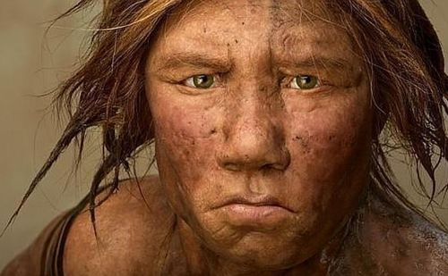
Early Humans Left Africa Over 1 Million Years Ago
Homo Sapiens, the ancestors of modern man, originated in the African continent. The “Out of Africa” theory suggests that our ancestors left the continent, migrated to Europe and Asia - and in so doing began replacing earlier examples of the human species - the Homo Erectus.
This migration took place approximately 80,000 years ago. What is interesting to note is that the Homo Erectus (upright human) had actually followed the exact same route (from Africa to Eurasia) - over 1 million years ago. Looks like Homo Sapiens weren't the first to get this idea.

Slide 4
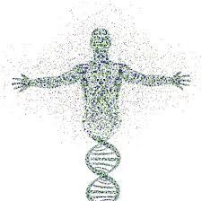
Early Humans Had Surprisingly Low Genetic Diversity
Despite having found a large variety of different human species, the discoveries don’t differ too much in terms of their genetic make-up. The scientific reasoning lies in the fact that we (and all of our ancestors) come from the same location in East Africa, where it is assumed all of our human-ape ancestors lived.
In order to determine genetic diversity, scientists need to know the effective population size of a specific group.. This size helps to understand how many organisms you need to create the genetic diversity of the full population. For our species, this number is 15,000 individuals to recreate a society of over 7 billion people.

Slide 5
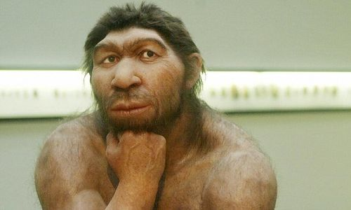
We May Have Neanderthal Genes
Neanderthals are our closest extinct human relatives. Our well-known, but often misunderstood ancestors lived between Europe and Asia up to 200,000 to 30,000 years ago. While the Neanderthals’ appearance was slightly
similar to ours, they were shorter and stockier with angled cheekbones, prominent brow ridges, and wide noses. These qualities were important for survival in Europe’s cold climate and in order to hunt big animals for food. Though sometimes thought of as barbarians, scientists have discovered that Neanderthals in fact used tools, buried their dead and had control over fire.

Slide 6
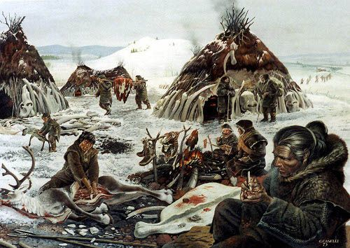
The Human Population Decreased 80,000 Years Ago
About 80,000 years ago there was a drastic reduction in the size of the human population. Archeologists are still not 100% sure what caused the decline, but it definitely wasn't pretty. Some say there may have been a massive volcanic eruption that filled the sky with ,millions of particles, blocking the sun’s heat for many years and in so doing created freezing temperatures that would have severely affected life and population growth on earth at the time.

Slide 7
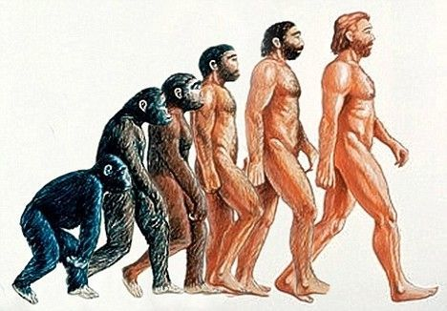
Homo Sapiens Always Evolve
Human evolution is the extended process of change that suggests humans originated from apelike ancestors. Scientific evidence shows that the physical and behavioral traits shared by all people stemmed from these ancestors and evolved over an extended period of time. Our species, as suggested by many, will continue to evolve as a response to our living conditions - different food, geographical and environmental changes, the advent of modern technology and of course the amalgamation of our different races.

Slide 8

Humans Navigated The Indian Ocean In Boats 50,000 Years Ago
It appears as though travel and navigation were pretty commonplace for our ancestors, but this discovery was a pretty incredible feat.There is no evidence that Homo sapiens travelled to Australia 50,000 years ago and they did so without maps, travel navigation - or any sea travel experience for that matter!

Slide 9
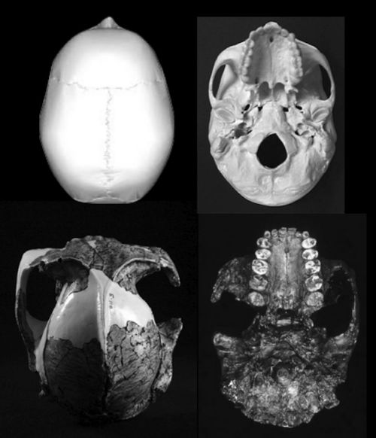
Our Tooth Size Decreased While Brain Size Increased
One of the most noticeable change in our own evolution and adaptation was the increase in the size of the human brain with the simultaneous decrease in the size of our teeth. This evolutionary trait came as a surprise to scientists who noticed the opposite trend in other animals whose brains and teeth grew in conjunction with each other. One speculation regarding the decrease in tooth size might be that humans had started to cook food over a fire which made chewing and digestion easier, and subsequently saving time and energy - that our ancestors would have spent on digestion, therefore large teeth wouldn't have been needed for the acquisition of additional nutrient for brain growth.

Slide 10

Human Longevity May Be Caused By A Slow Metabolism
In today's diet and health obsessed world, we are often told to eat many small meals a day in order to increase our metabolism in order to lose weight. The scientific truth is that a slow metabolism very well be the key to our living longer than other animals. The faster your metabolism, the more energy you need. The more energy you use the faster your body will wear out. If we were to compare humans rate of metabolism with that of other mammals, we would find that our metabolic rate is substantially lower, sometimes up to 50%.

Slide 11
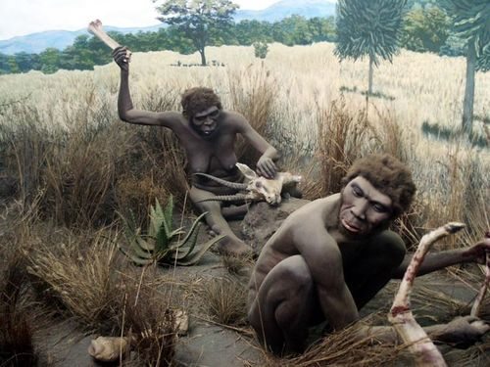
Different Types Of Food Allowed Us To Evolve
One of the primary factors in the role of evolution, is the food we consume. In the past, after travelling far distances and adapting to new locations, our ancestor’s diet changed according to what food was available to them. Their diet initially consisted of nuts, seeds, fish, insects and small animals - providing the foundation that helped evolve our brain, and develop our intelligence. This resulted in early human’s creating advanced tools and using fire, which helped the evolution train keep on chugging.

Slide 12

The Human Face Evolved To Withstand A Punch
However million years ago, battles and fist fights were commonplace, and research suggests the battles between humans could end up being pretty brutal. It makes sense therefore that our faces would have evolved in order to take a punch to the face.

Slide 13

Our Fists Have Constantly Evolved To Give A Punch
Considering our faces have evolved in order punches - it makes sense that the part of our body used for delivering the punch would have had to evolve as well. The notion that evolution shaped our hands, not for dexterity, but to form fists, recently emerged from a study of anatomical changes in humans. The study suggests that at about the same time we started walking upright, our hands became short and square with opposable thumbs. This change has always been recognised as a means for tool manipulation, but recent studies suggest the ability to form a fist with in order to deliver a punch when fighting.

Slide 14
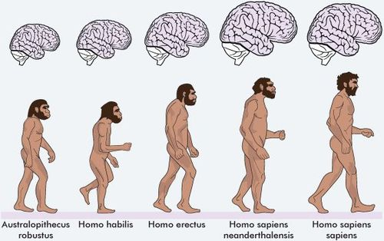
An Important Evolutionary Protein
DUF 1220 is a protein that may be essential in the development and evolution of the human brain evolution. This notion comes from the understanding that human beings have in excess 270 copies of DUF1220 in their brains, whereas our primate cousins, like chimpanzees and gorillas have slightly less copies of the protein in their brains. With further research we have no doubt scientists will link human intelligence to the protein itself, accounting for the disparity between us and animals.

Slide 15

Our Throwing Skills Evolved From Our Extinct Ancestors
Research shows that the human shoulder acts like a slingshot by storing and releasing energy during the throw. The human torso, shoulder, and arm evolved specifically to help us store this energy and allowed our ancestors to hunt, feed and defend themselves from dangerous predators.

Slide 16

Population Growth
It took 100,000 years for the world population to reach 1 billion. This may seem like a lot, but when we look at the other facts we will see that , it only took 133 years for that number to double to 2 billion and 44 years to reach 4 billion. One of the primary factors in evolution is the constantly changing landscape of our home, earth.

Slide 17

Why Do We Have Goose Bumps?
While trying to determine our own adaptations and evolution from our apelike ancestors, people have discovered that many human traits, including organs and behaviours have lost most of their original function due to evolutions. These include organs like the appendix, wisdom teeth and tail bone and also behavioural reflexes, such as the formation of goose bumps under the skin. While the exact reason for the raised bumps on our skin is not known for sure, research and scientists have suggested that a possible function would have been to raise the body's hair, making our ancestors appear larger and in so doing, scaring off predators. Raising the hair may also have been used to trap an extra layer of air, keeping an animal warm.

Slide 18

Why Humans Became Bipedal
Walking on two legs is what set us apart from the other apes, but there still isn’t quantifying research that suggests why this development actually occurred. Bipedalism - the fancy name for “walking on two legs” , along with slightly bigger brains - suggesting greater intelligence are unique traits of our ancestors the Neanderthals and Homow Erectus. One of the suggestions as to why we started walking upright was to allow us more chest room to breathe when we run.

Slide 19
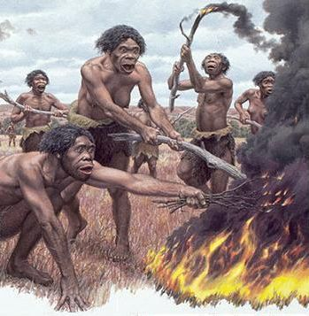
Fire
As we know, there are a few things that set us apart from our animal counterparts - these include walking on two legs, creating and using stone tools and being able to manage and use the natural element of fire. Evidence of fire used as tools came from archaeologists’ discovery of Stone Age flint tools, which were also used for scraping and cutting meat.

Slide 20
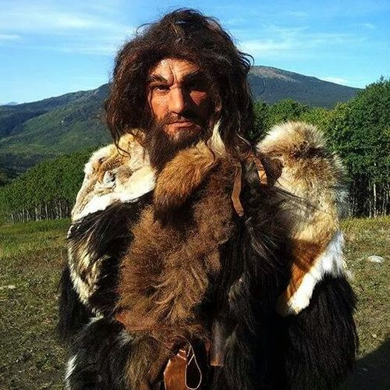
Clothes
While exact dates are always difficult to come by, studies have found that our human like ancestors began using the skin of animals to keep them warm. The need to do so may have arisen some time after losing a large portion of body hair. Scientists estimate the time at which human began wearing “clothes” at around 1 million years ago. This time frame was decided by examining factors such genetic skin-colouration of our ancestors at around this time.

Slide 21
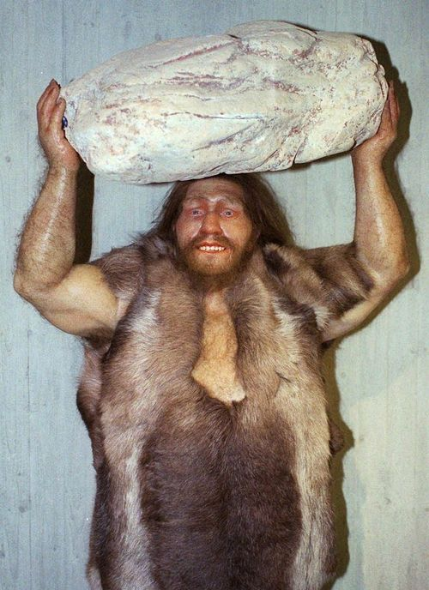
Stone Tools
The creation and use of stone tool by our ancestors is estimated at about 2.6 million years ago. In Dikkaa, Ethiopia, researchers have found fossil animal bones with possible butchery marks being used up to 3.4 million years ago. This discovery could show that early humans used naturally sharp rocks on the bones of antelope-sized animals as a means of killing and cutting their food.

Slide 22
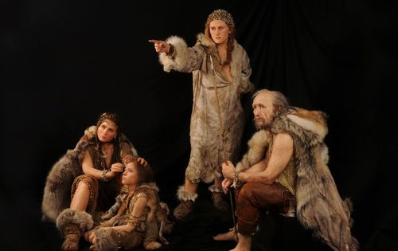
Language Skills
There are some scientists that believe that communication traits and the use of language arose from a common dialect spoken by our ancestors when they were all still in Africa. This language may have been made up of sounds and grunts as opposed to formal words, but were certainly used as a means for instruction and expression. With over 5000 different languages spoken in the world today, this concept is highly likely. Linguists and anthropologists suggest that human language probably started to develop around 100,000 years ago.

Slide 23
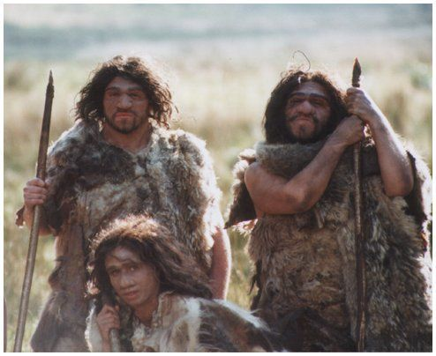
Anthropologist Pushes Back Date of First Humans Hunting For Meat To Two Million Years Ago
Evidence from an ancient butchery site in Tanzania shows early man was capable of ambushing herds of animals up to 1.6 million years earlier than previously thought. Ancient humans used complex hunting techniques to ambush and kill antelopes, gazelles, wildebeest and other large animals at least two million years ago.

Slide 24
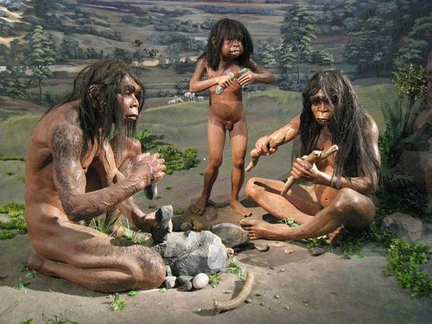
Our Ancestors Were More Developed Than You Expect
During this time our ancestors were small-brained apemen that many assumed survived off what the land produced or off the meat that came from animals that had already died from natural causes or had been left behind by other larger predators. But the discovery of hunting and eating tools suggest our ancestors maybe have been more intellectually developed than originally thought.

Slide 25
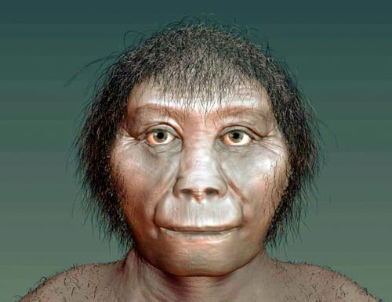
We Used to be Hobbits (Sort of)
A hobbit-like species of humans lived approximately 18,000 years ago, according to Australian and Indonesian researchers. The species lived among pygmy elephants, 10-foot lizards, and were no taller than the average 3-year-old.

Slide 26
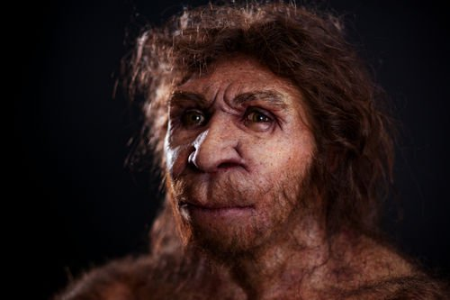
Our Brains are Shrinking
While may be getting smarter, our brains are getting more compact, explains University of Wisconsin researcher John Hawkes. Really, the reduction in size probably correlates with our decreased physical size. Less mass means less brain needed to control it.

Slide 27

Goosebumps are a New Addition
We used to have thick hair, which stood on head not so unlike the hair on the back of your neck does now. Only, we lost that thick hair over time. But the physiologic response stayed.

Slide 28
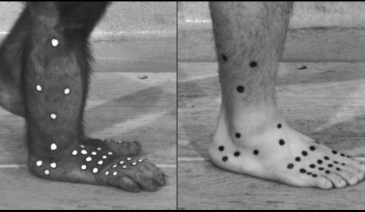
Some Feet Are More Evolved Than Others
Some nine percent of people are missing the muscle in their foot that allows them to grip objects like our primitive ancestors. (Might as well bend down, anyway, right?)

Slide 29
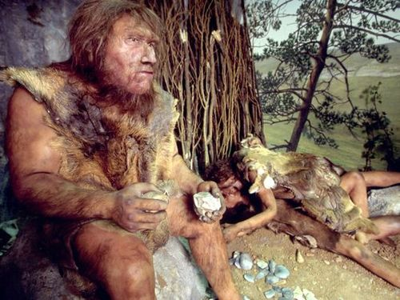
Lefties Compete, Righties Cooperate
Right-handed people outnumber lefties nine to one. But in competitive sports left-handed people are far more represented, leading many theorists to conclude that early cultures developed “handedness” as a form of cooperation.

Slide 30

A Population Explosion is Upon Us
It took 100,000 years for the population to reach one billion people. It took only 133 years for it to reach its second billion, and 44 after that to double again. Ecologists predict the world population will hit eight billion people by 2025.

Slide 31
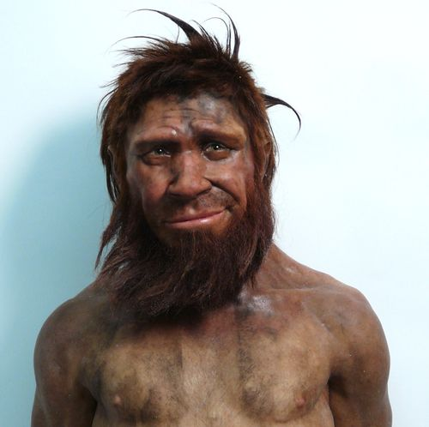
The Original Paternity Test
Blue eyes don’t just look good on Frank Sinatra; scientists believe they played a vital role in paternity testing babies. Two blue-eyed people can’t produce a brown-eyed baby.

Slide 32
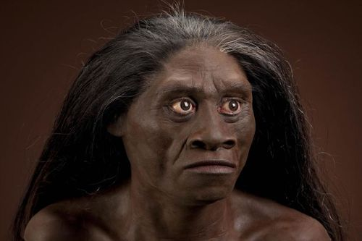
We May Have Been Endangered
A mysterious illness (probably tuberculosis) is thought to have wiped out all but 2,000 of our early ancestors around 70,000 BC — putting us shoulder-to-shoulder with black rhinos and giant pandas on the endangered species list.

Slide 33
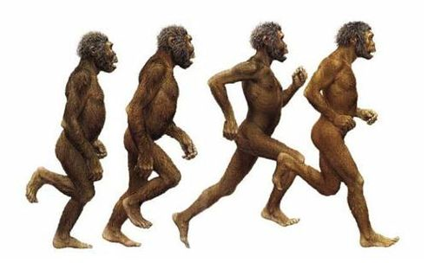
From Four Legs to Two
Why we became bipedal is still a mystery — perhaps to allow our chest room to breathe when we run, some say — but the move from four legs to two marked the hominid’s first break from our ape ancestors.

Slide 34
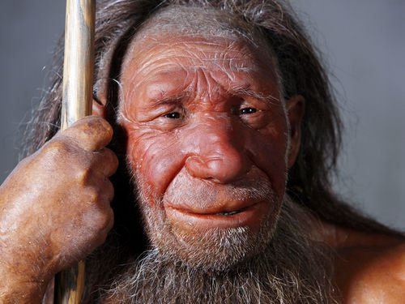
Aliens Among Us
Long-skulled geniuses may have walked the earth before us. In 1913, scientists uncovered strange-looking skull fragments that were later determined to sit behind childlike faces. This combination naturally led to conversations about aliens, but keep in mind: We survived, and they didn’t. So how smart could they be?

