Slide 1
Male ideal body in different cultures

Slide 2
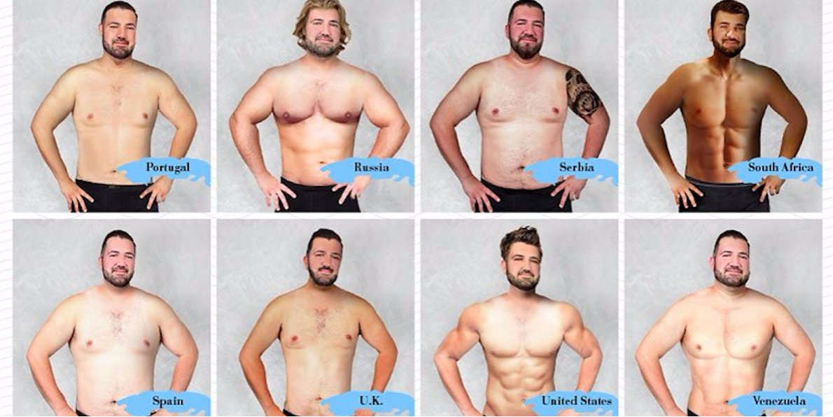

Slide 3
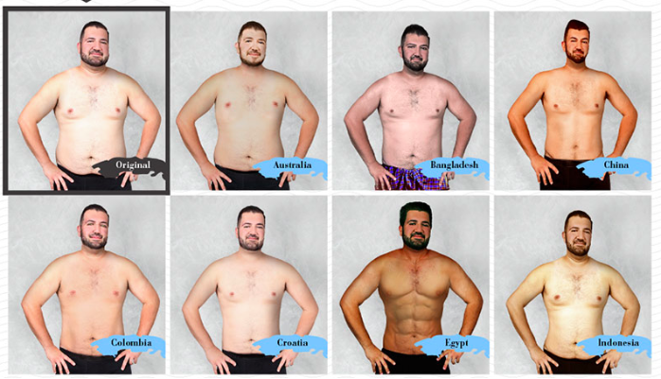

Slide 4
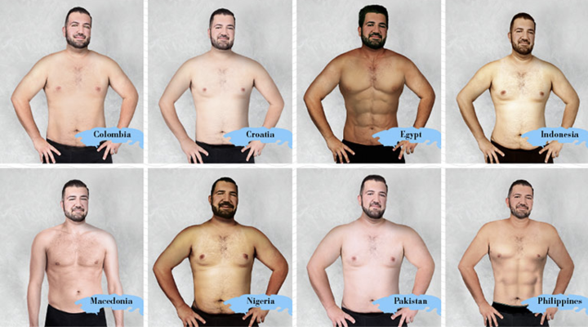

Slide 5
How the 'perfect' male body has changed over 150 years - from wide waists in the 1870s to the muscular man of today

Slide 6
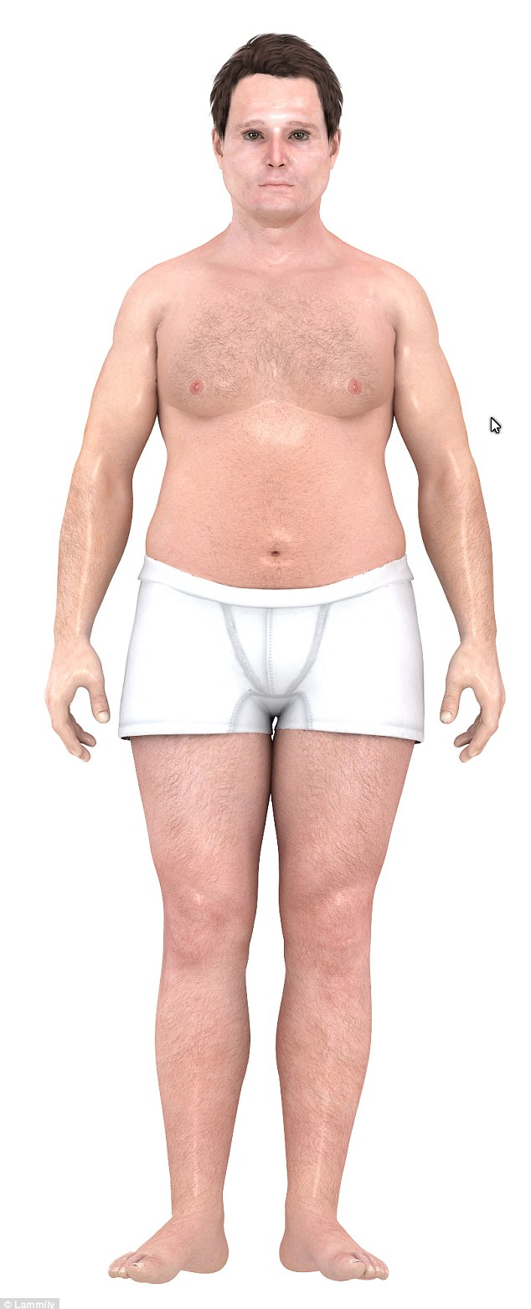
In the 1870s, having a wide waist was a sign of wealth and suggested having money to pay for plenty of food

Slide 7
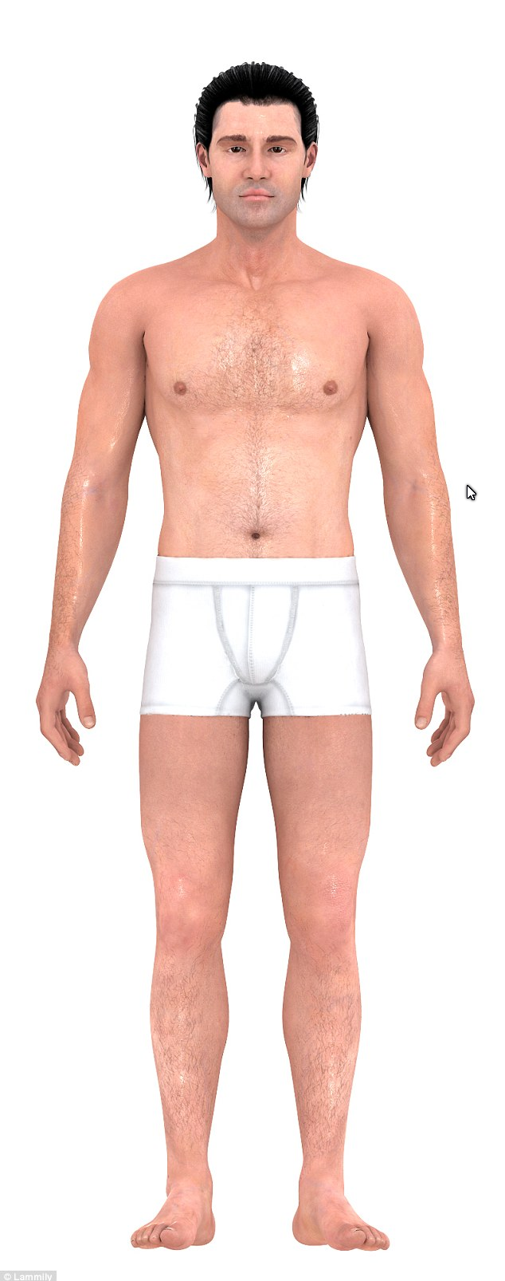
The slim ideal came 60 years later when food became easier to access for everyone

Slide 8
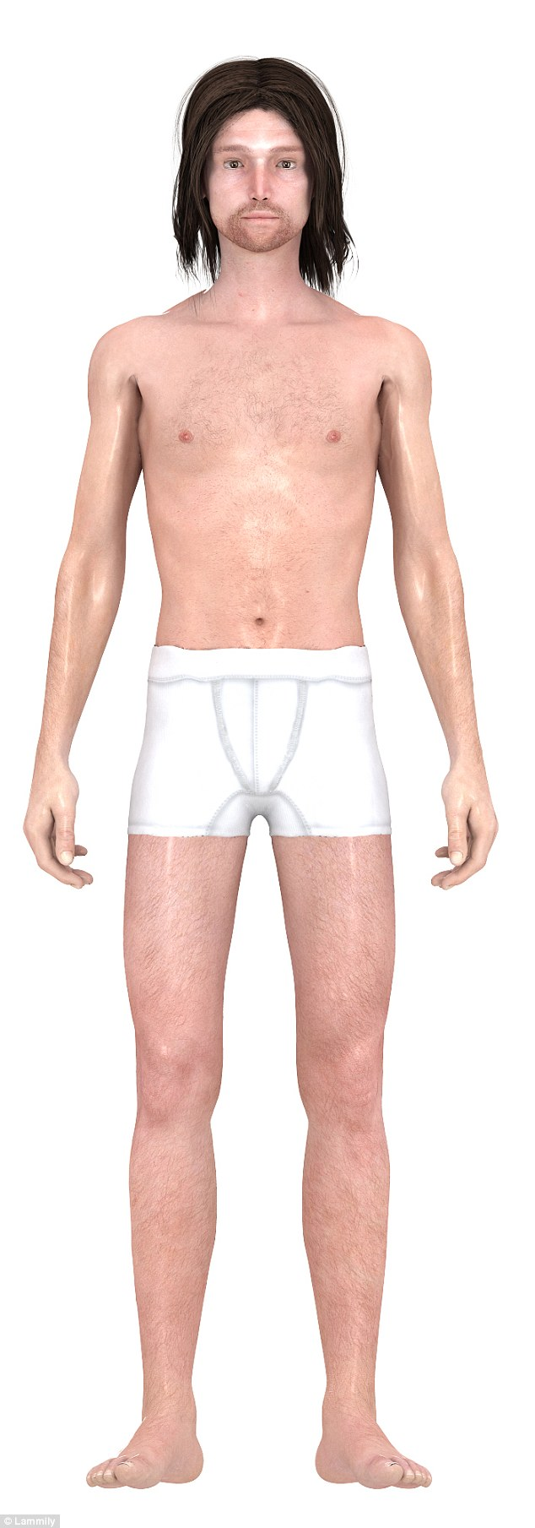
In the 1960s, men began rebelling, growing their hair, and some even experimented with drugs

Slide 9
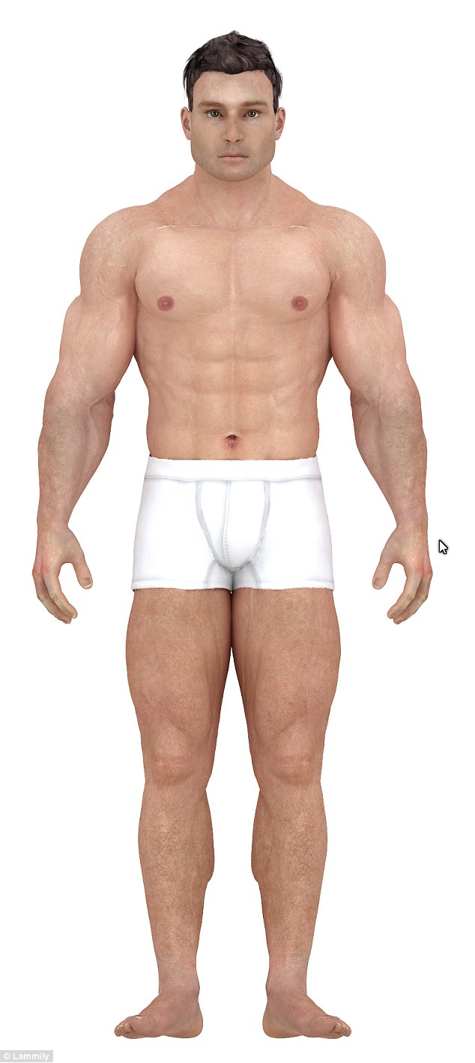
Men in the 1980s were far cry from the skinny frames sported in the 1960s, after bodybuilding became a mainstream activity

Slide 10
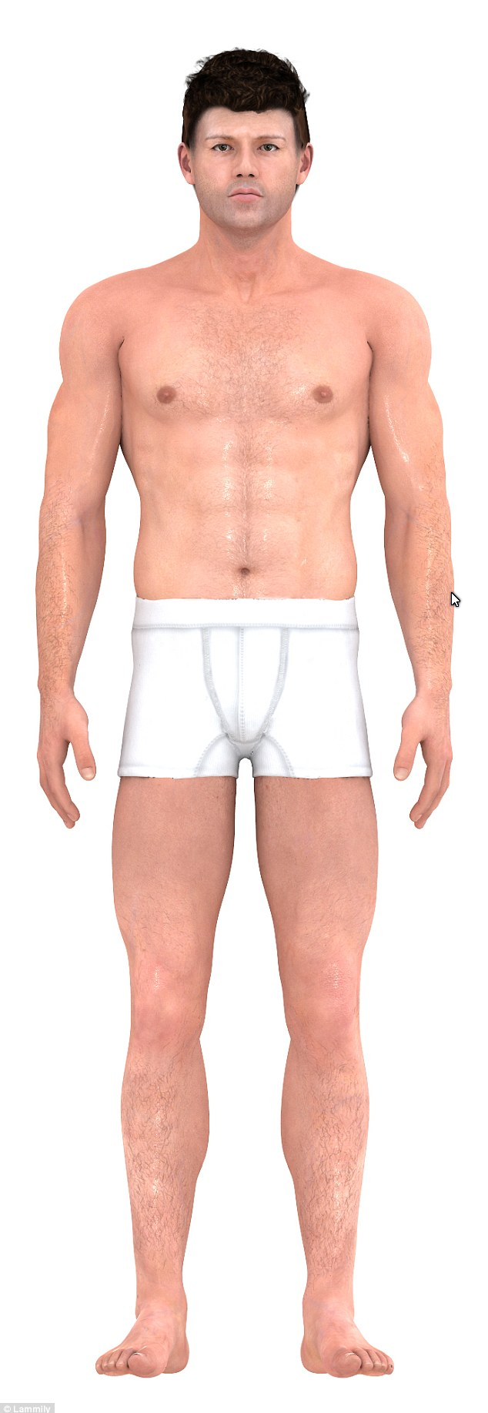
The 'lean and muscular' body that became the perfect shape in the 1990s is still seen as the 'ideal' frame

Slide 11
