Slide 1
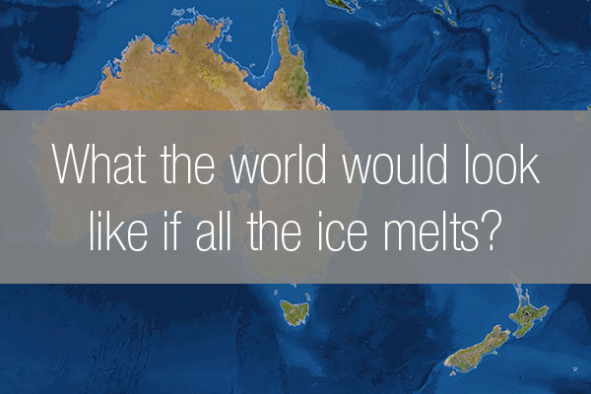
What if all the Ice Melts?

Slide 2
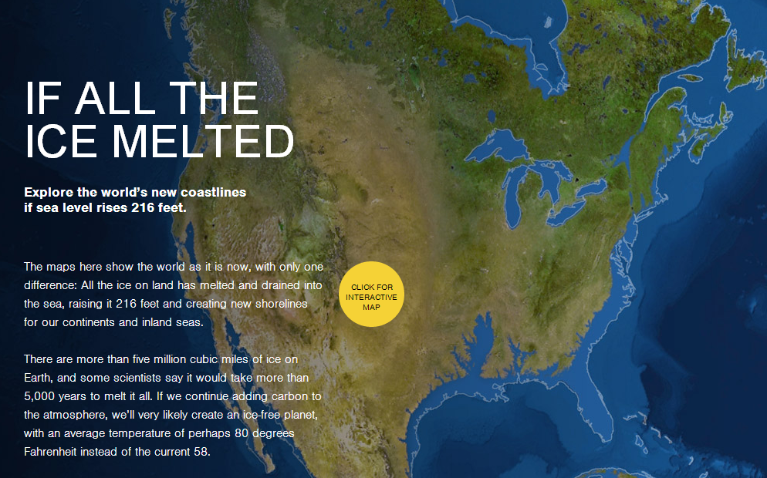

Slide 3
Many scientists believe that ocean levels are on the rise due to ice melt across the globe caused climate change. Currently 5 million cubic miles of ice exist on Earth; if global warming rates continue at their current pace, this volume is estimated to melt in 5,000 years. When this massive melt occurs, what will happen to world as we know it? National Geographic has released an interactive map that shows what the Earth would look like if all its ice melted and sea levels were to rise some 216 feet. It's no surprise to discover that current coastlines as we know them would be obliterated, and shorelines would appear much further inland.

Slide 4
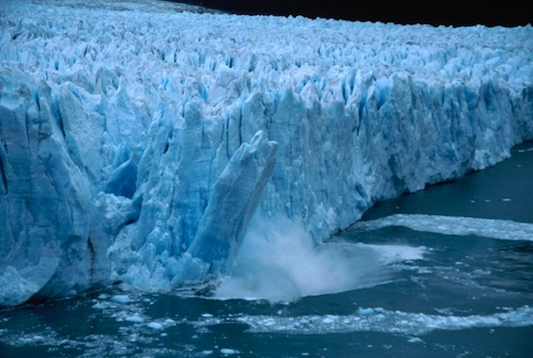

Slide 6
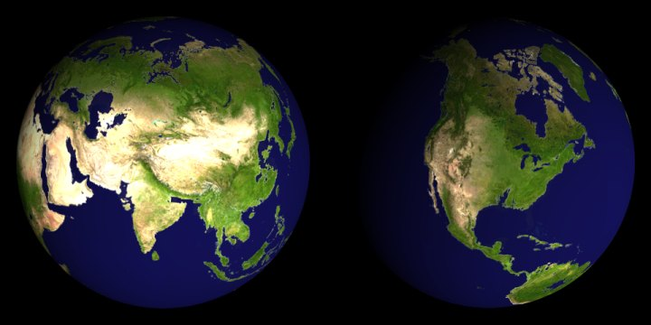

Slide 7
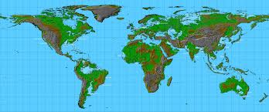

Slide 8
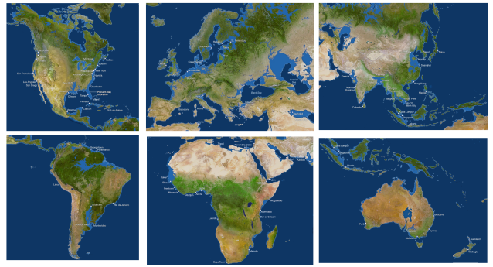

Slide 9
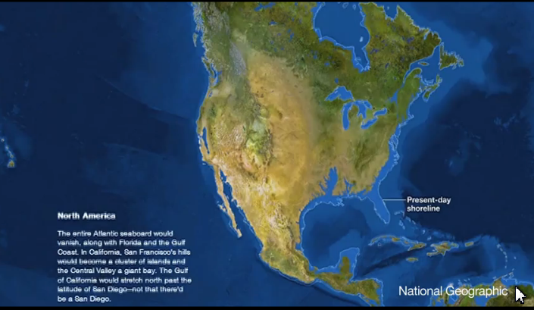

Slide 10
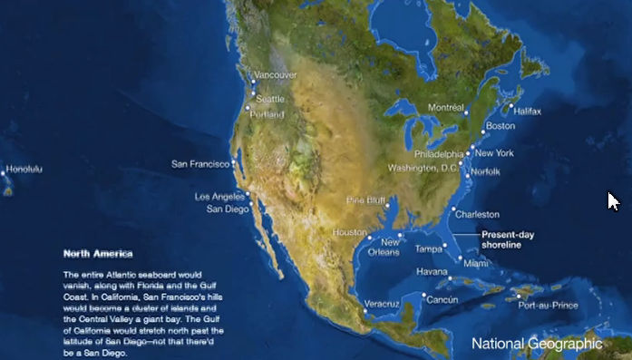

Slide 11
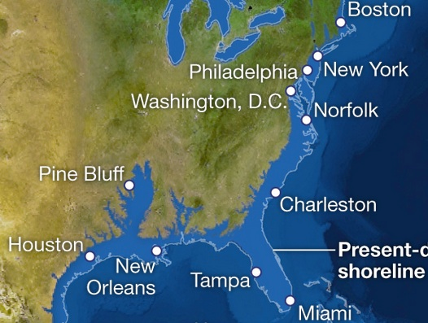

Slide 12
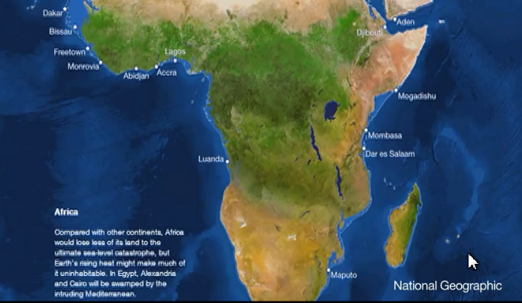

Slide 13
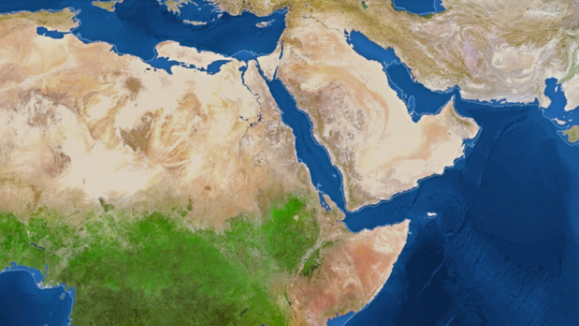

Slide 14
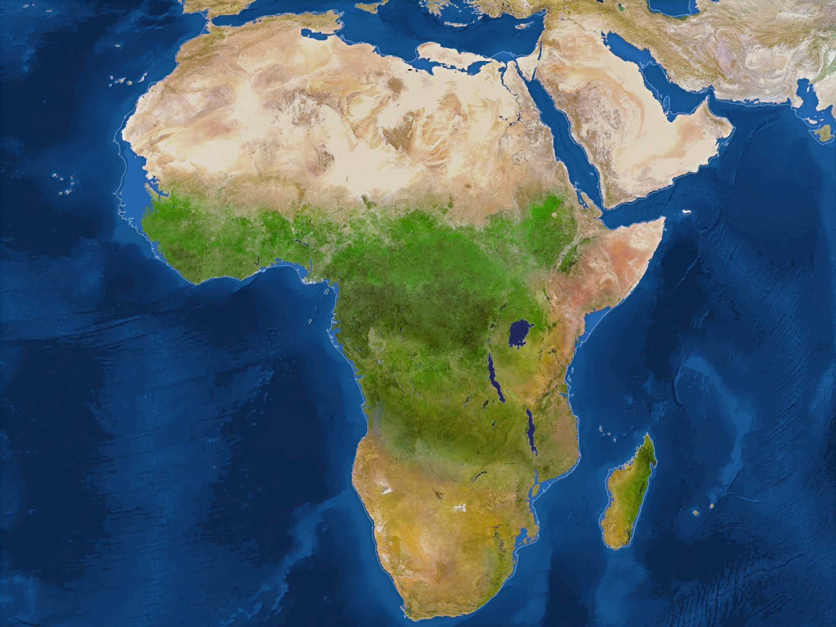

Slide 15
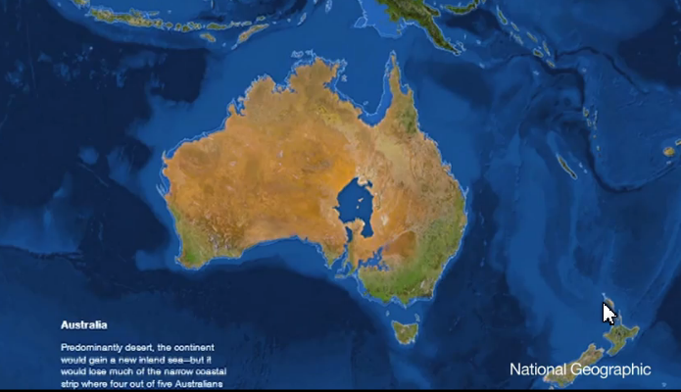

Slide 16
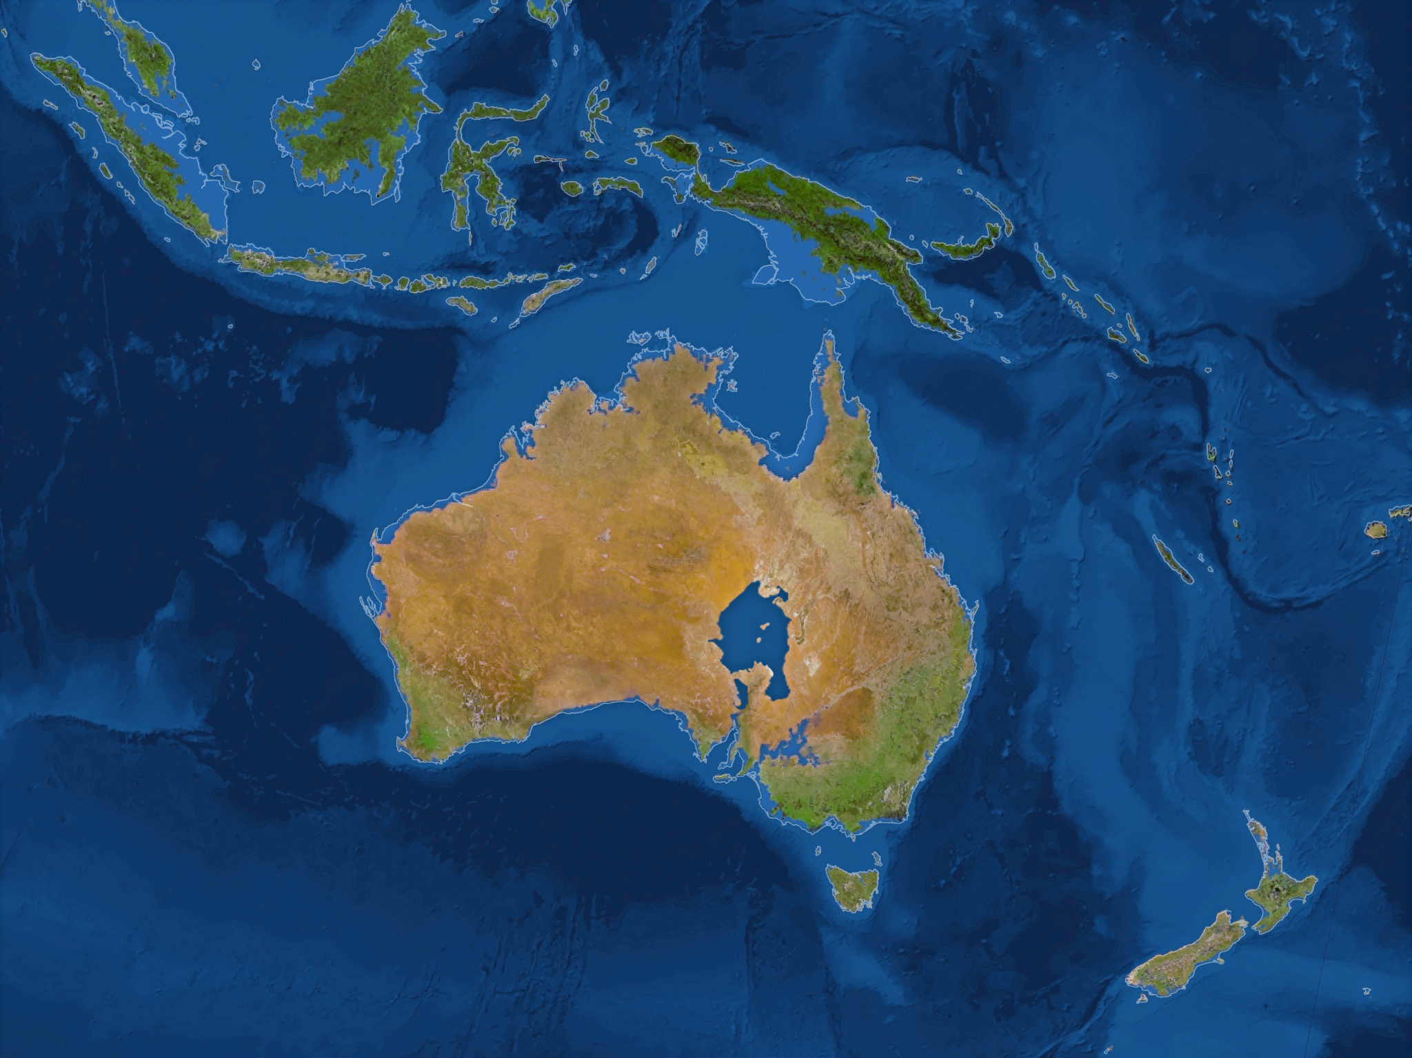

Slide 17
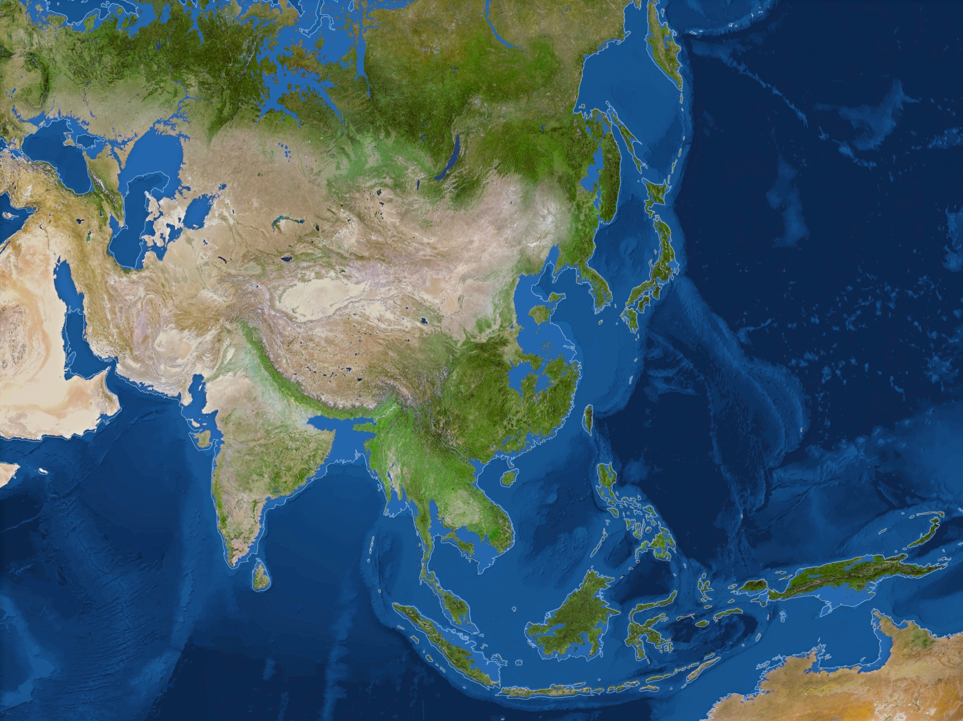

Slide 18
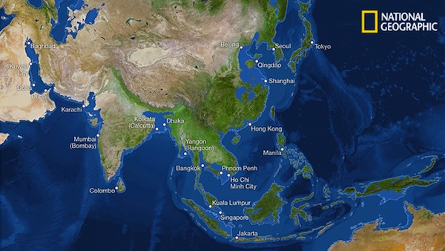

Slide 19
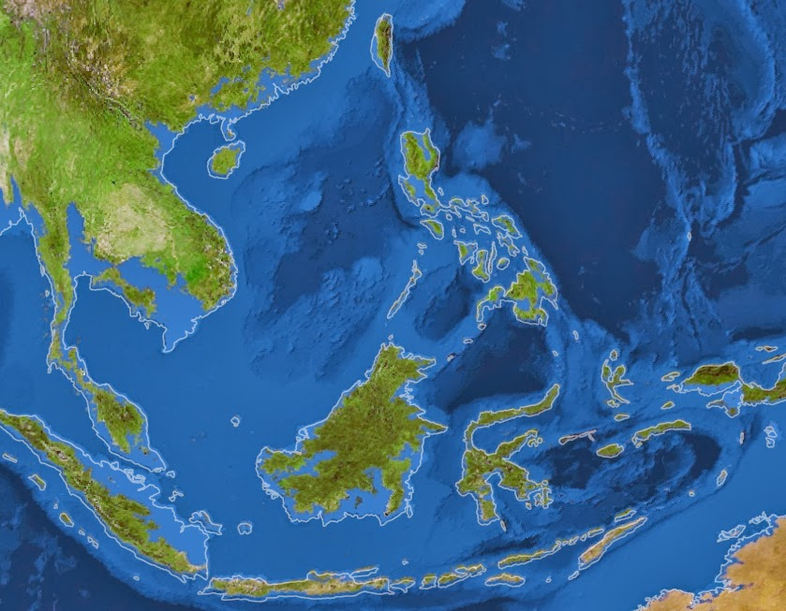

Slide 20
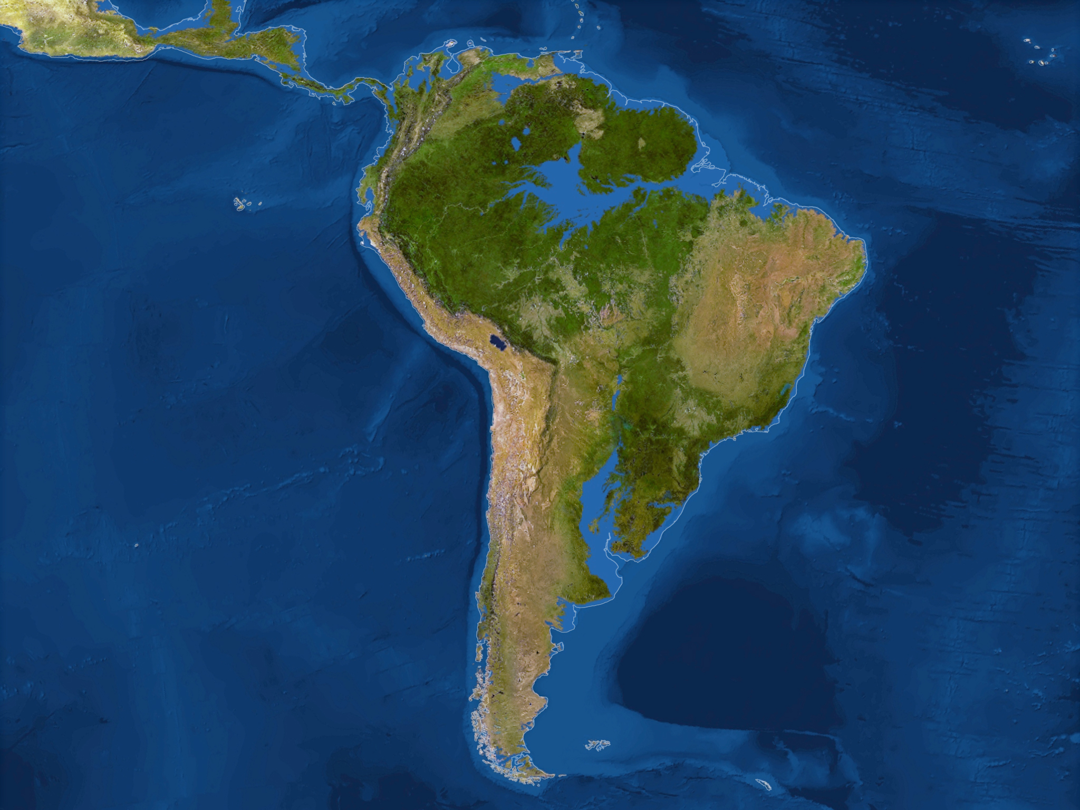

Slide 21
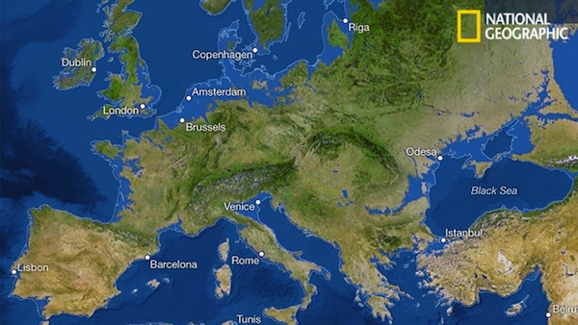

Slide 22
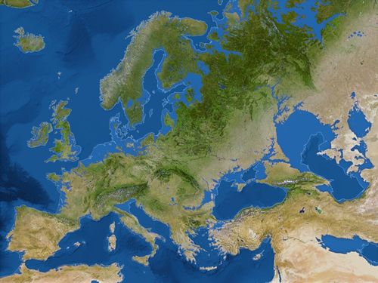

Slide 23
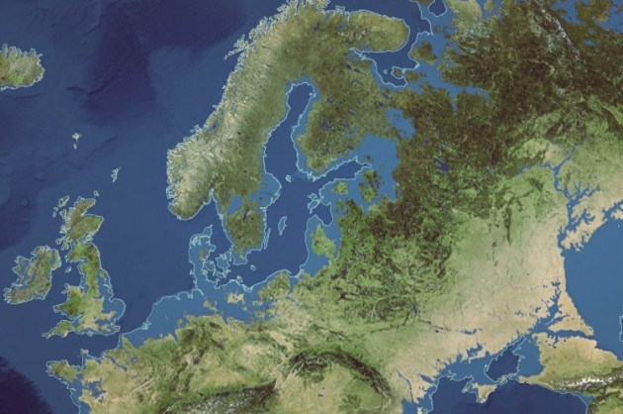

Slide 24
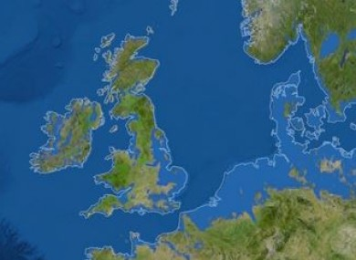

Slide 25
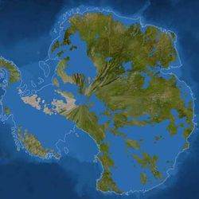

Slide 26
