Slide 1
If the World Were a Village
Based on the Book, © 2002 – updated 2008

Slide 2
The Problem
Demographics uses many large numbers from which forming a “mental picture” is quite difficult.
  World Population (2008) was 6,660,000,000
  Thirty countries have more than 40,000,000 people.
  Eleven countries have more than 100,000,000 people.
  Two countries have more than 1 billion people:
    China has 1,300,000,000
    India has 1,100,000,000

Slide 3
The Solution:
Change the proportions from a world of 6.66 billion people to a village of 100 people.
  Present valid information from which “mental pictures” can be formed.
Recommendation: Purchase this great book (it’s not just for kids)
  If the World Were a Village: A Book about the World’s People
    Written by David J. Smith
    Illustrated by Shelagh Armstrong
    Kids Can Press
    © 2002 – Updated in 2008

Slide 4
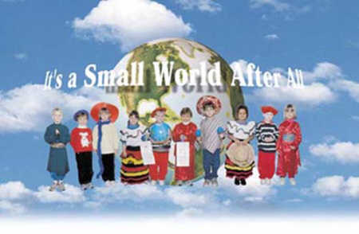

Slide 5
Nationalities – From where did these people come?
61 are from Asia
14 are from Africa
11 are from Europe
8 are from South America, Middle America, & the Caribbean
5 are from the US & Canada
1 is from the rest of the world
More than ½ of the Global Village come from the 6 most populated countries:
  20 are from China
  17 are from India
  5 are from the USA
  4 are from Indonesia
  3 are from Brazil
  3 are from Pakistan

Slide 6


Slide 7
Languages
In the real world, there are more than 6,000 languages spoken
In our global village, half of the people speak just 8 of these languages:
21 speak a Chinese dialect (16 speak Mandarin Chinese)
9 speak English
9 speak Hindi
7 speak Spanish
4 speak Arabic
4 speak Bengali
3 speak Portuguese
3 speak Russian

Slide 8
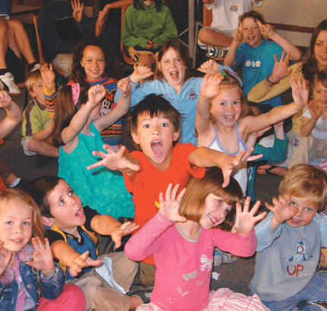

Slide 9
Ages
One-fifth of the village is 9 years old or younger.
On average, one person dies and two babies are born each year.
A baby born today can expect to live to age 60.
The age structure:
  9 are under the age of 5
  10 are between 5 & 9
  18 are between 10 & 19
  17 are between 20 & 29
  15 are between 30 & 39
  12 are between 40 & 49
  9 are between 50 & 59
  6 are between 60 & 69
  3 are between 70 & 79
  1 is over 79

Slide 10


Slide 11
Religions
In this world village, what religions do the people follow?
  33 are some type of Christian
  24 are Muslims
  13 are Hindus
  9 practice shamanism, animism, or other folk religions
  6 are Buddhists
  2 belong to other world religions: Baha’i, Confucianism, Shintoism, Sikhism, Jainism, or Taoism
  1 is Jewish
  15 are non-religious

Slide 12
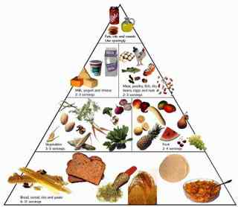

Slide 13
Food
The village has many animals that either help produce food or are a source of food. These are:
  31 sheep or goats
  23 cows, bulls, & oxen
  15 pigs
  3 camels
  2 horses
  250 chickens – they produce food and are food and they outnumber the people in the village by more than 2 to one.

Slide 14
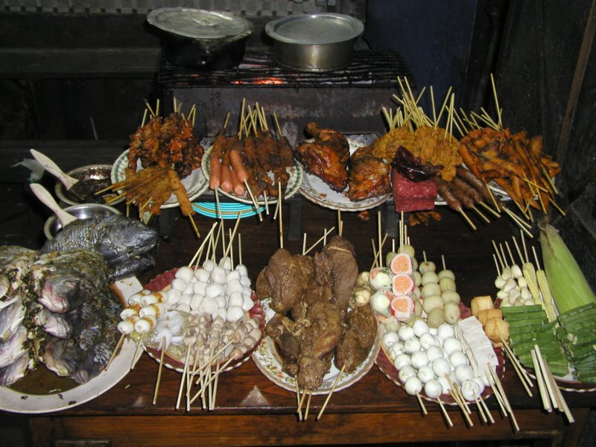
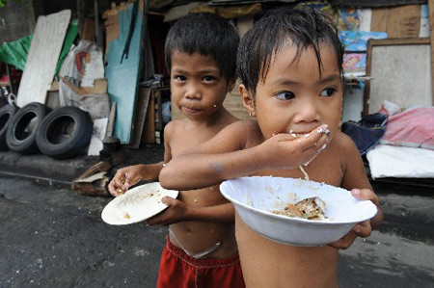

Slide 15
Food Distribution
There is enough food for everyone if it were divided equally among them; however, it is not equally divided. So everyone is not well fed.
50 people do not have a reliable food supply and are hungry some or all of the time
16 other people are seriously undernourished
Only 34 people always have enough to eat.

Slide 16
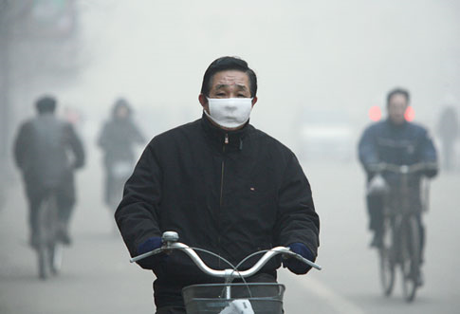

Slide 17
Air
Many breathe fresh air; however, not everyone is so lucky. These people have polluted air to breathe which threatens their health.
68 breathe clean air, while 32 breathe polluted air that threatens their health.

Slide 18
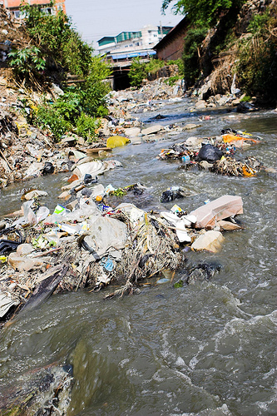
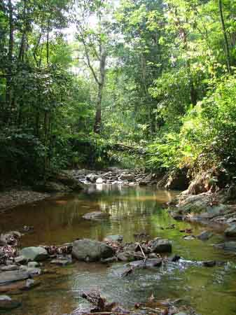
Polluted Clear

Slide 19
Water and Sanitation
As with air, many have access to clean water and adequate sanitation facilities; however, some are not so fortunate.
  64 have access to adequate sanitation – they have public or household sewage disposal – while 36 do not.
  83 have access to a safe source of water in their houses or within a short distance. The other 17 do not and spend a large part of each day simply getting safe water. Most of the hard work is done by women and girls.

Slide 20
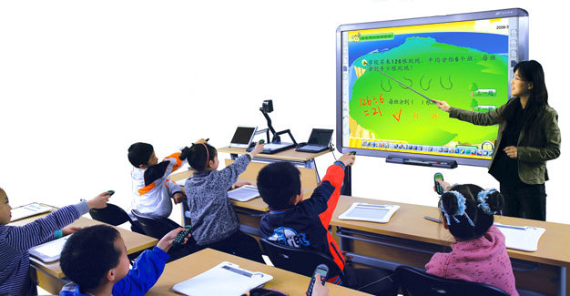
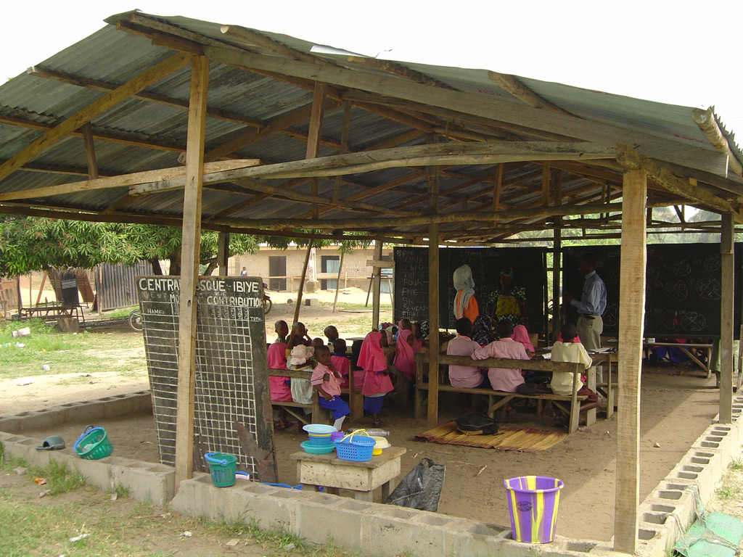

Slide 21
Schooling and Literacy
The school bell may ring, but only some of the children can go to school.
There are 36 school-age persons in the village, but only 30 go to school.
There is one teacher at the school.
Not everyone is encouraged to learn to read. Of the 72 people over the age of 15, 59 can read at least a little, but 13 cannot read at all.
More males are taught to read – 2/3 of the illiterates are women.

Slide 22
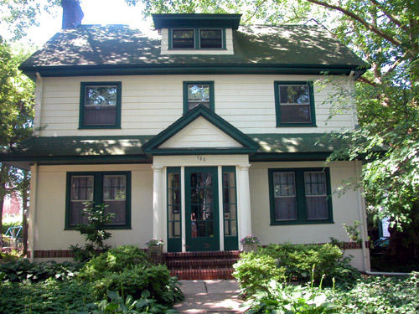
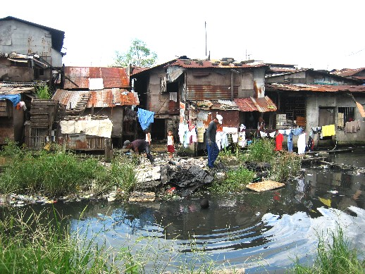
There’s quite a gap!

Slide 23
Money and Possessions
How much money do people in the global village have?
  If all the money in the village were divided equally, each person would have about $9350 (US $) per year, but it isn’t divided equally.
  The poorest 10 people have about 1$ per day.
  The richest 10 people have more than half of the money More than $25,000 per year.
  The other 80 people have something in between – 75 average about $4 a day.
  The average cost of food and shelter and other necessities is about $5000 per year. Many people cannot pay for these needs.

Slide 24
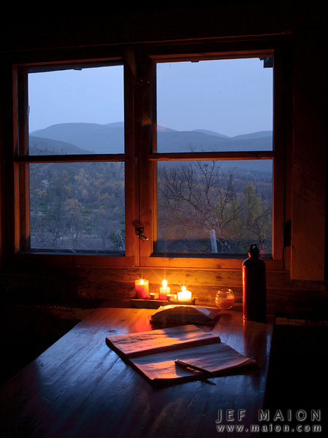
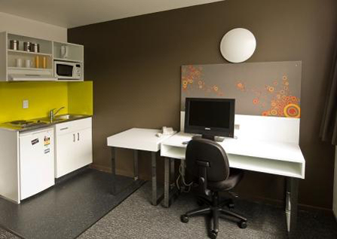

Slide 25
Electricity
When dusk arrives, bright electric lights go on in some homes, in others dimmer light is provided by candles and oil lamps and lanterns.
How many have electricity?
  76 have electricity
  24 do not have electricity.
For most who have electricity, it is only to provide light. Some villagers, however, have luxuries that require electricity. In the village there are:
  42 radios
  28 televisions (7 with cable)
  61 telephones (40 are cell phones)
  15 computers

Slide 26
The Village in the Past
Over a period of 3000 years, the village’s population doubled 5 times.
  Around 1000 BCE, only 1 person lived in the village.
  In 500 BCE, 2 people lived there.
  In 1 CE, 3 people lived there.
  In 1000 CE, 5 people
  In 1500 CE, 8 people lived there
  In 1650 CE, 10 people
  In 1800 CE, 17 people
  In 1900 C E 32 people
  In 2008, 100 people lived in the village.

Slide 27
The village in the future?
Today, the village is growing at 1.2% per year.
  In 2009 there will be 101 people
  In 2100 there will be 200
  In 2150 there will be 250
Experts think the maximum number of people the village can support is 250.
With 250 people, there will be severe shortages of food, shelter, and other resources.
The U.N., some governments and private agencies are working to improve the future outlook for the global village. Will they, or can they, do enough?

Slide 28
Every Teacher Should Have This Book!
What the book does:
  It presents a lot of information in an easy to understand format.
  It promotes critical thinking.
What the book doesn’t do:
  It doesn’t present information about medical care & disease.
  It doesn’t present information about careers and occupations.
  HOWEVER, the book is still a great resource.

