Slide 1
China: Yunnan Province
A variety of scenes

Slide 2
YUNNAN
Yunnan is a province of the People's Republic of China, located in the far southwest of the country spanning approximately 394,000 square kilometers (152,000 square miles).
The capital of the province is Kunming.
The province borders Myanmar (Burma), Laos, and Vietnam.

Slide 3
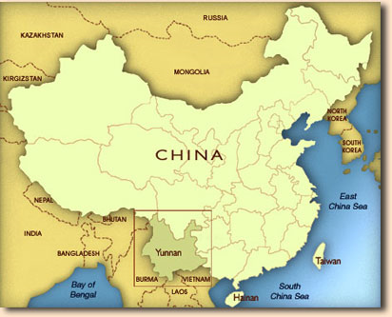

Slide 4
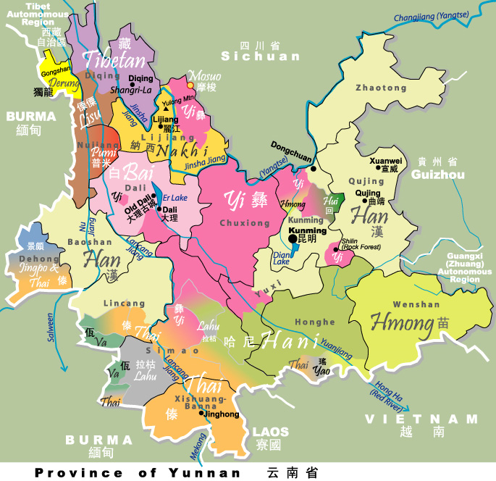
Ethnic Groups in Yunnan

Slide 5
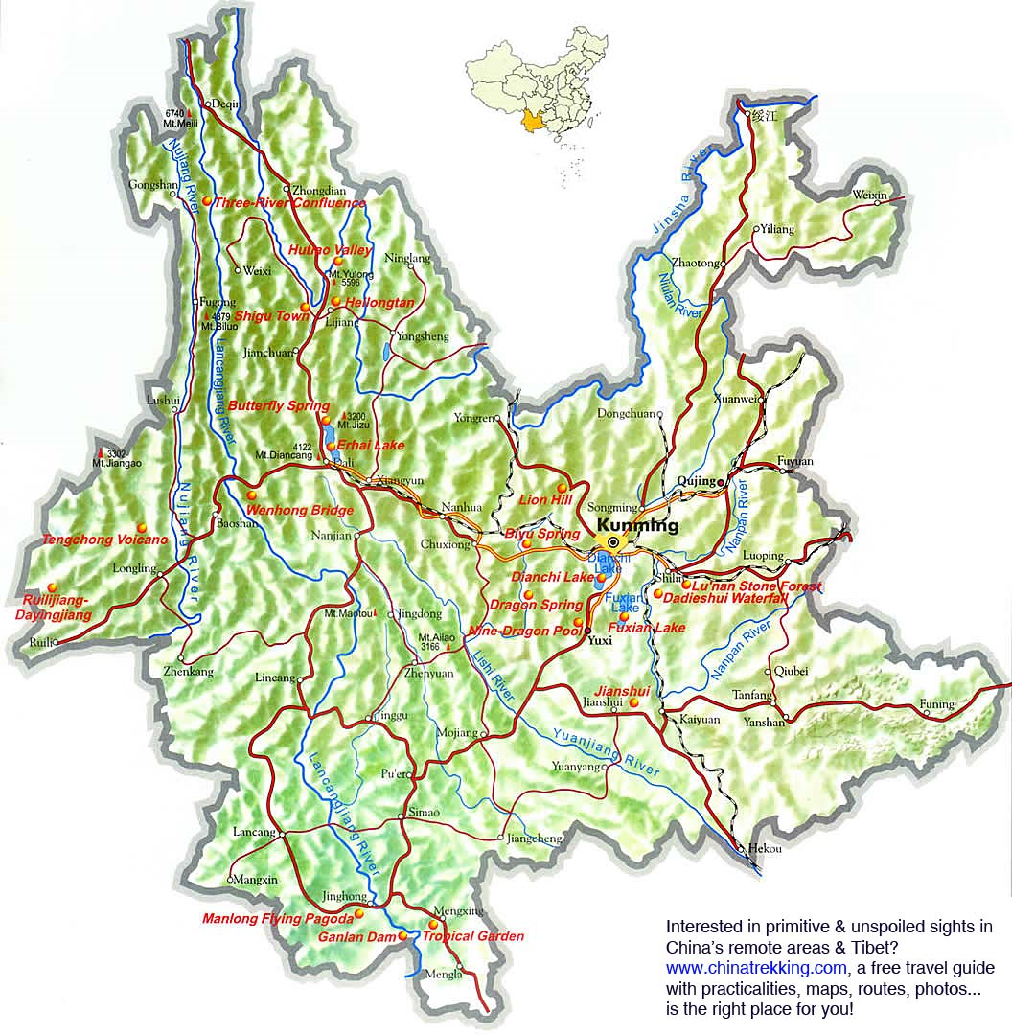

Slide 6
Physical place

Slide 7
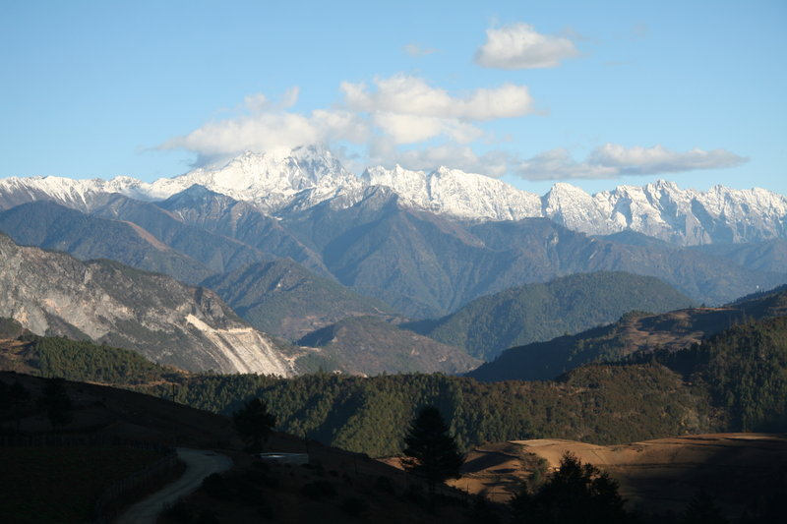
Yunnan is in a mountainous region of China

Slide 8
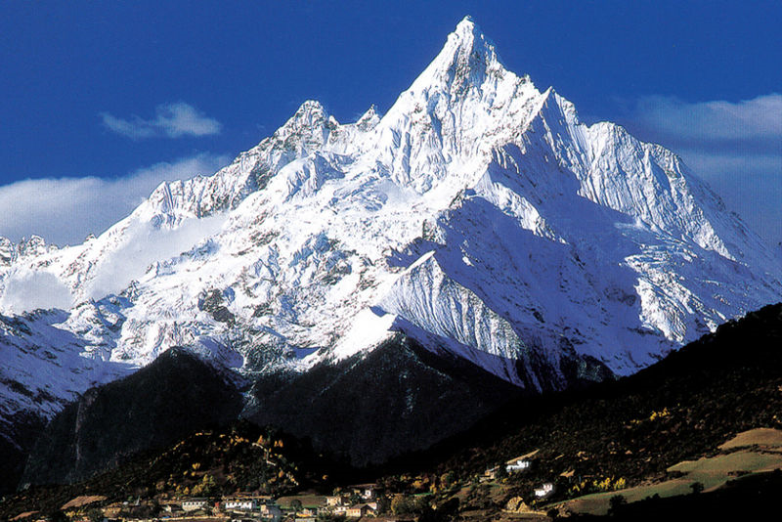
Kawagebo: Highest mountain in Yunnan

Slide 9
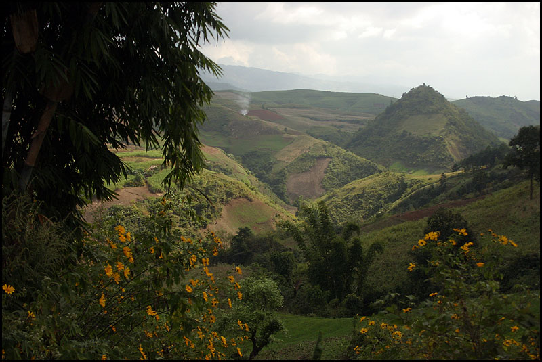
Lincang Mountains: cultivated slopes

Slide 10
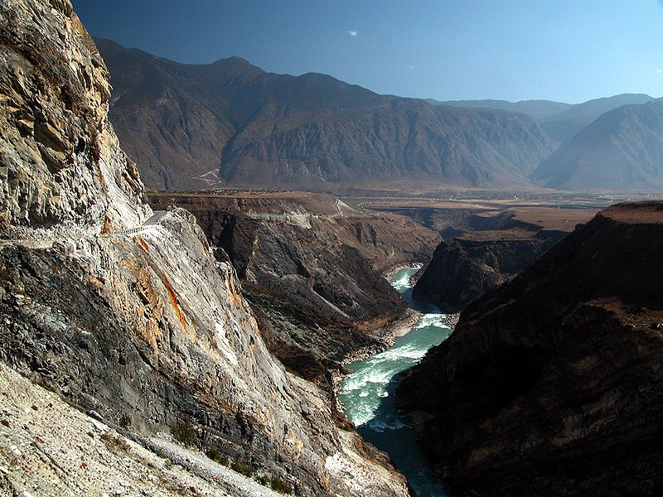
The Yangzi river near the Tiger Leaping gorge

Slide 11
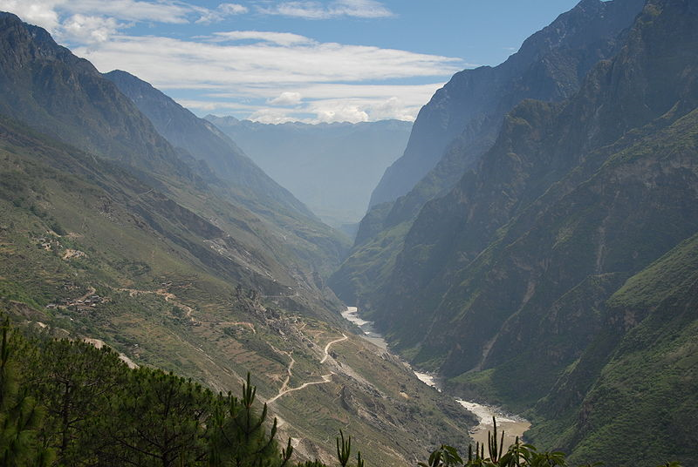
Tiger Leaping Gorge

Slide 12
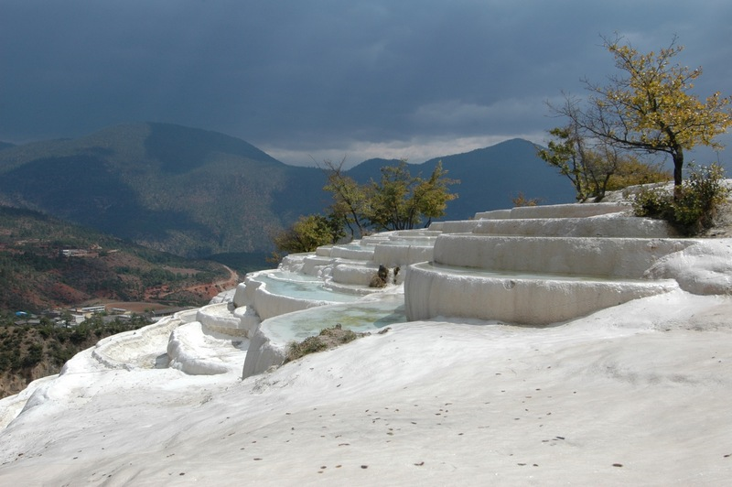
Baishuitai, Yunnan: Limestone terraces north of Lijiang

Slide 13
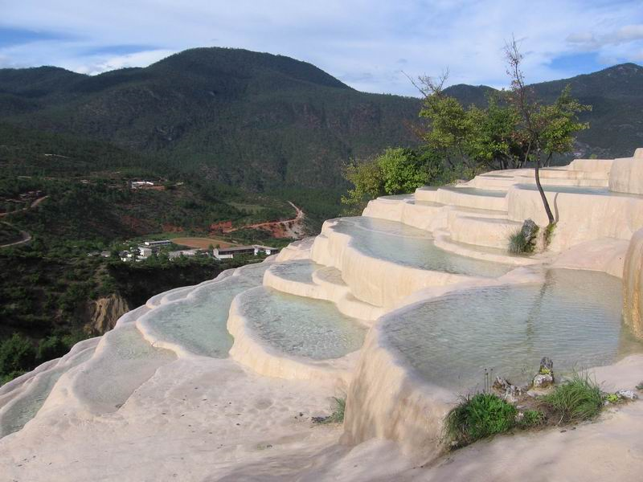

Slide 14
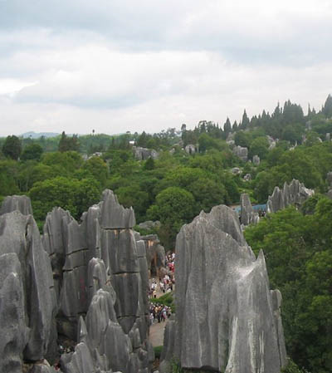
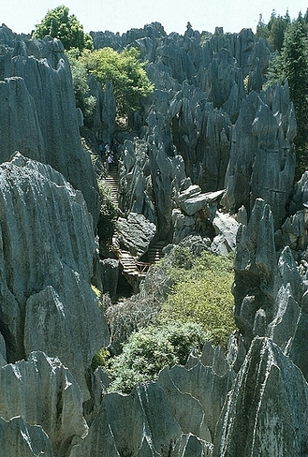
The Stone Forest

Slide 15
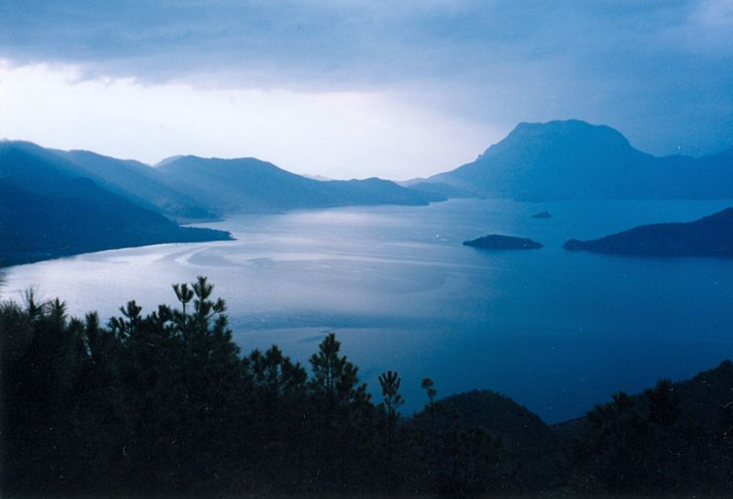
Lugu Lake, Yunnan, China. In the background on top of the right hand side of the lake you can see the holy mountain Ganmu.

Slide 16
Mineral Resources
Zinc, Germanium, Coal, Arsenic

Slide 17
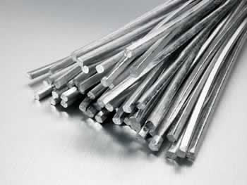
Yunnan tin

Slide 18
Agriculture

Slide 19
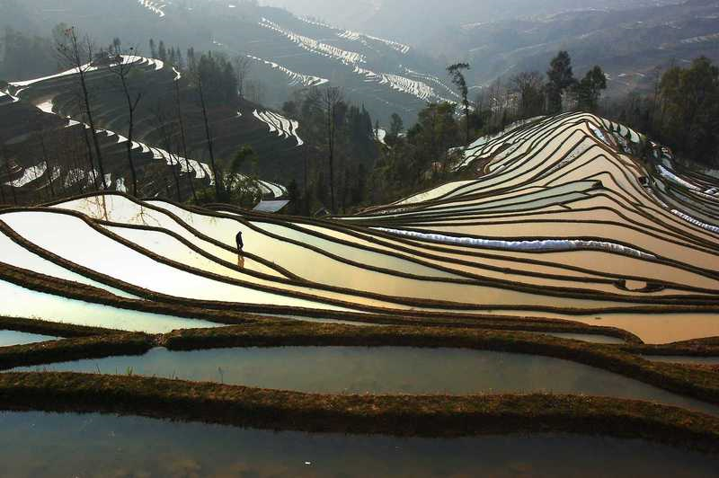
Rice Paddies

Slide 20
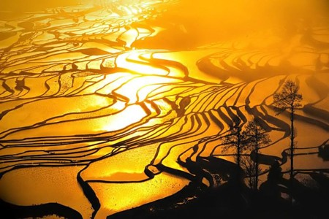

Slide 21
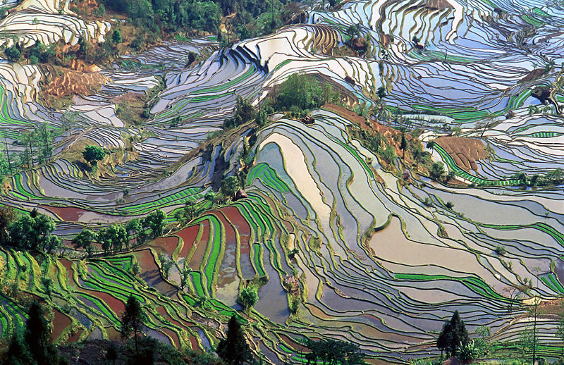

Slide 22
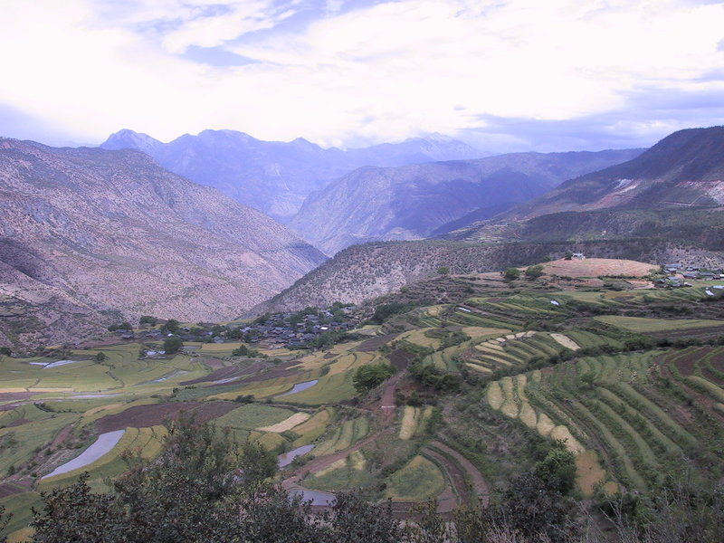
Agriculture

Slide 23
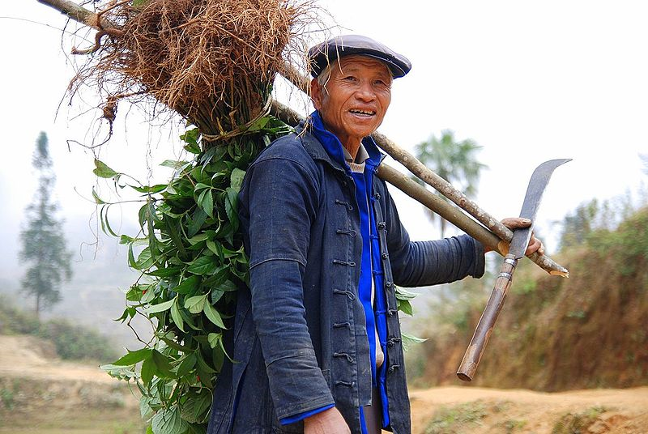
Yuanyang Hani farmer

Slide 24
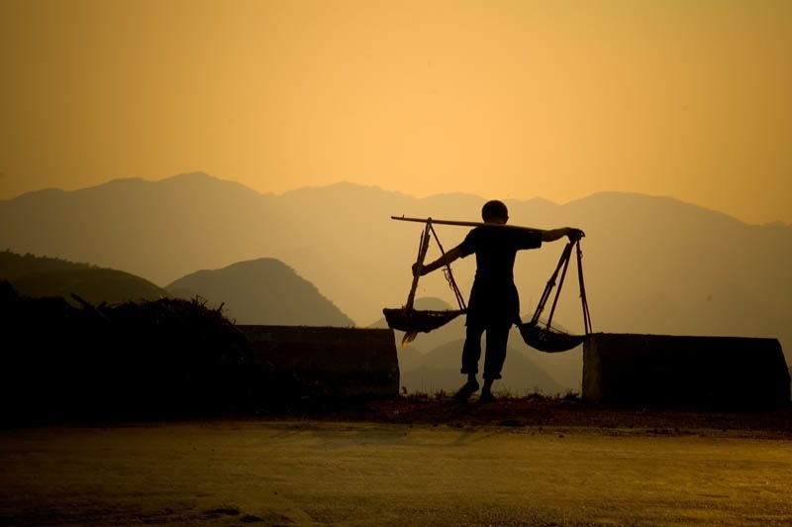

Slide 25
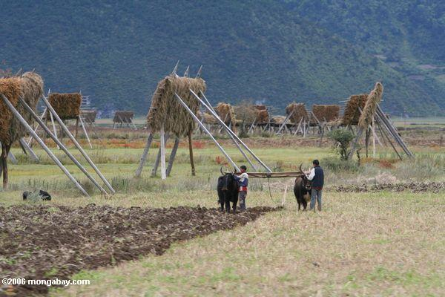
Tibetans plowing a field in NW Yunnan

Slide 26
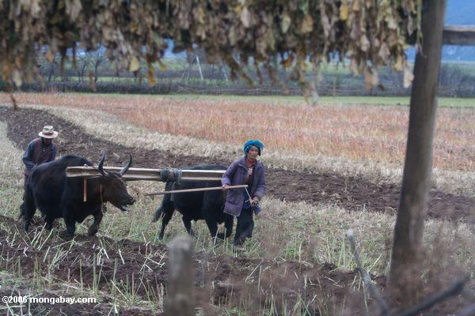

Slide 27
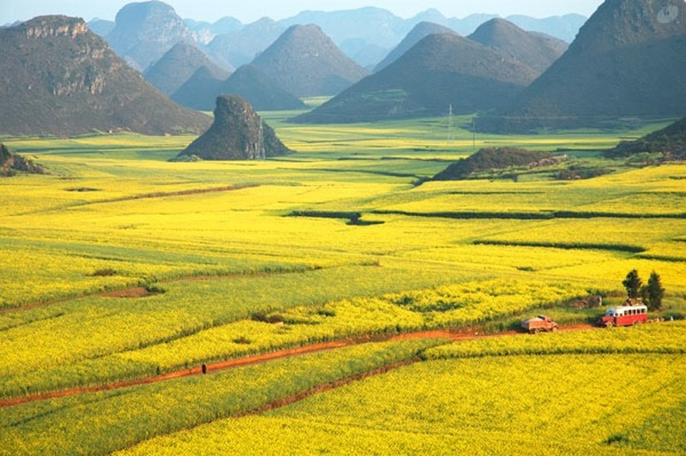

Slide 28
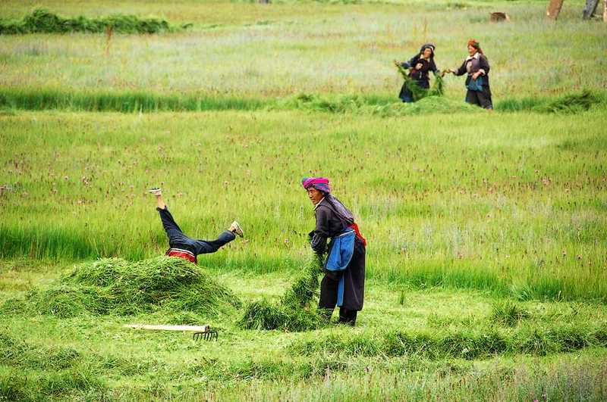

Slide 29
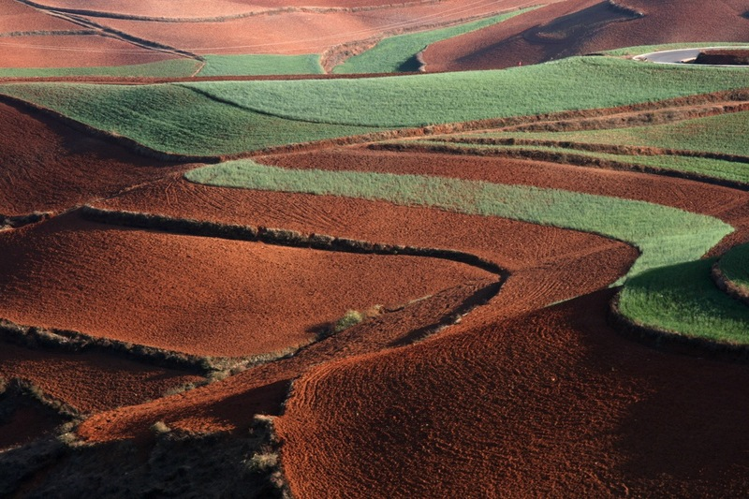

Slide 30
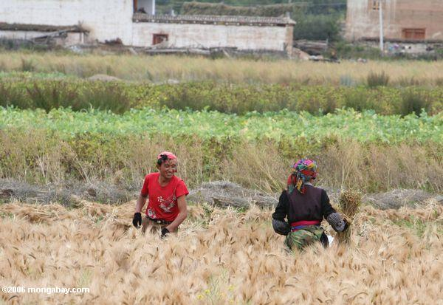
Tibetans harvesting grain in field near Shangri-la

Slide 31
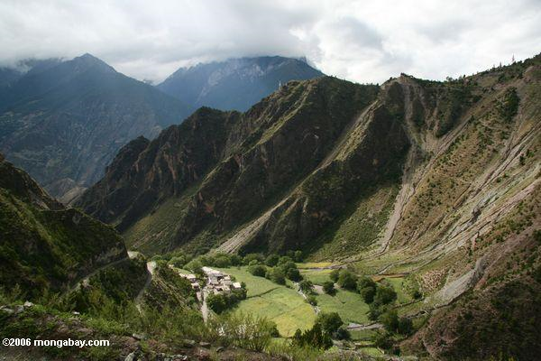
Rice fields in Tibetan Yunnan

Slide 32
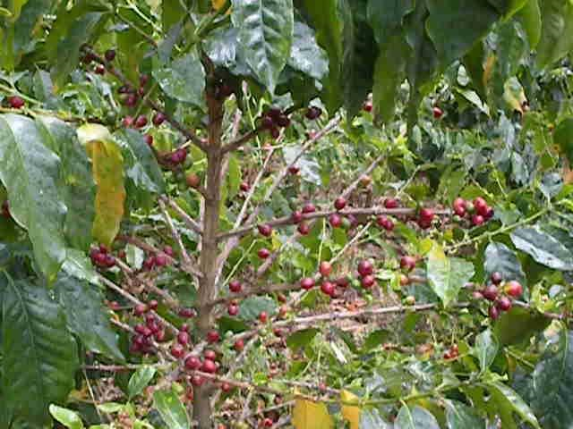
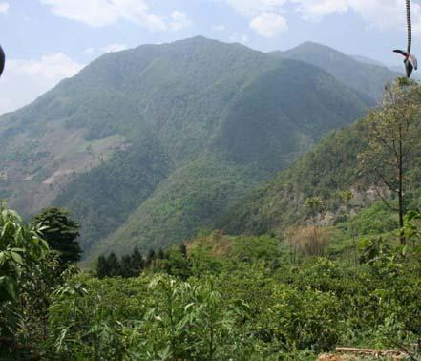
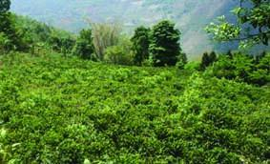
Yunnan coffee

Slide 33
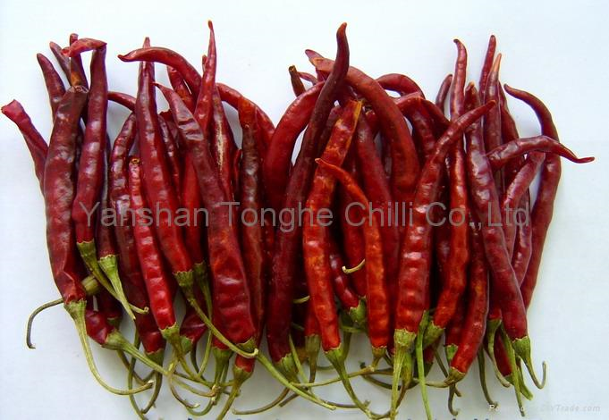
Yunnan Chillis

Slide 34
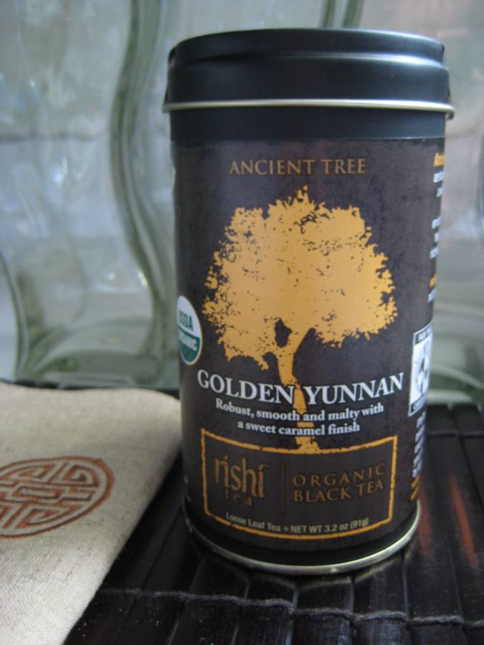
Yunnan Gold Tea

Slide 35
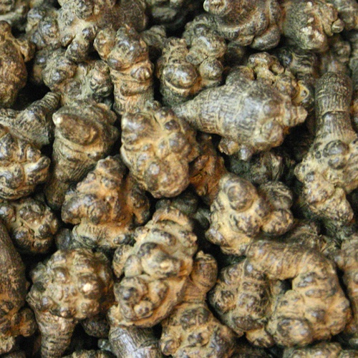
Ginsing

Slide 36
Religion

Slide 37
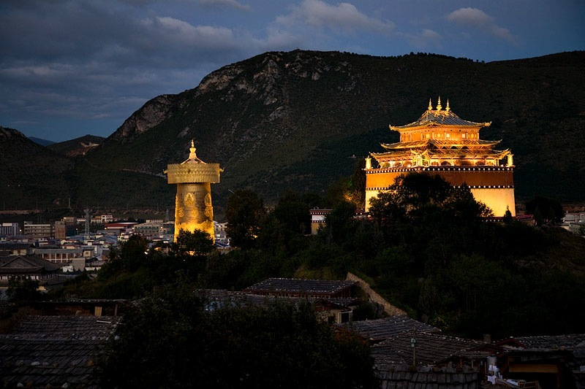
Buddhist temple

Slide 38
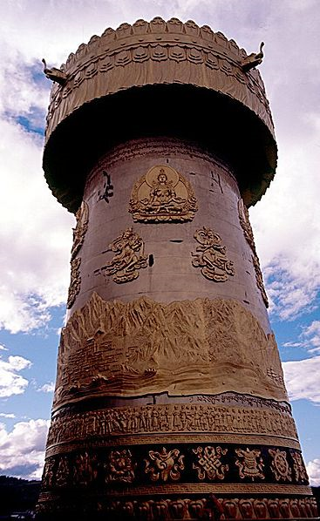
Zhongdian Prayer Wheel up close

Slide 39
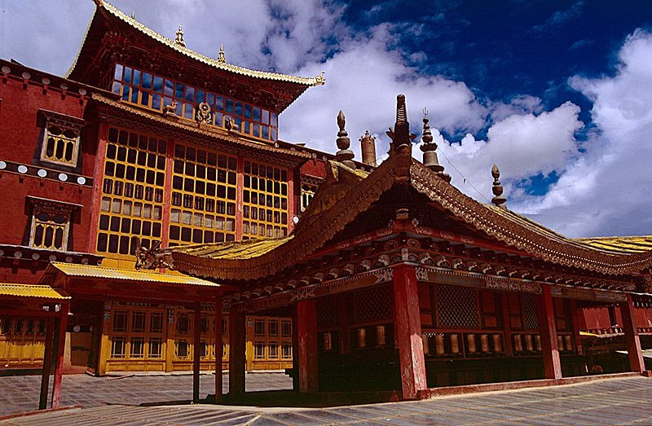
Zhongdian: Monastery

Slide 40
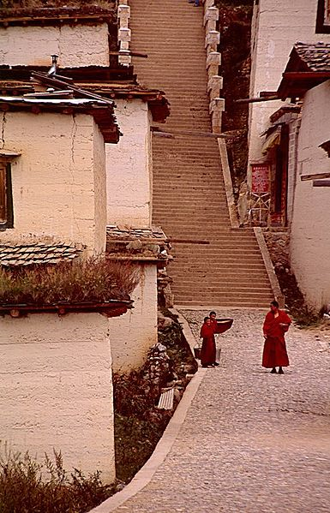
Inside the Monastery Complex

Slide 41
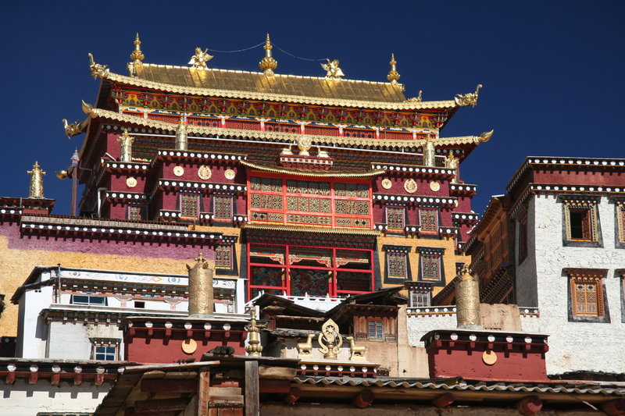
Buddhist Monastery

Slide 42
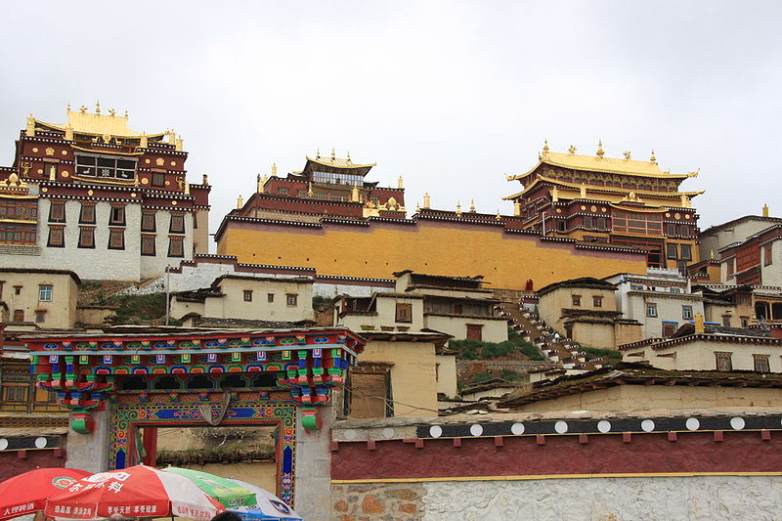
Gandan Sumtseling Monastery in Zhongdian

Slide 43
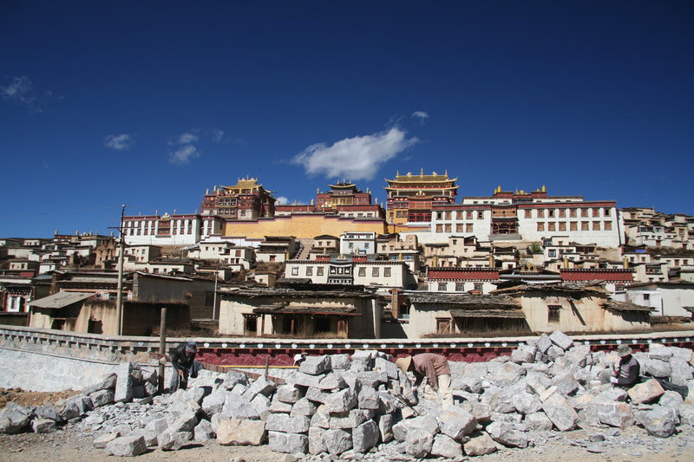

Slide 44
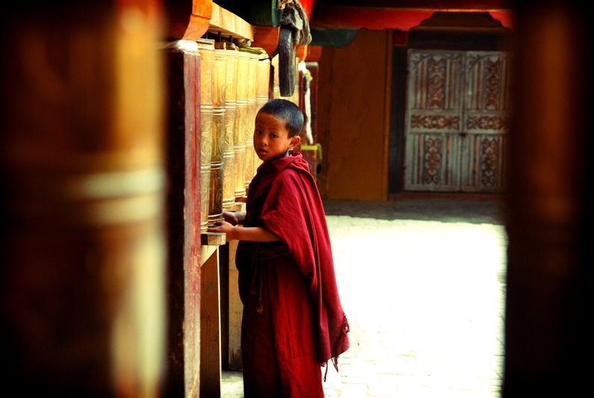
Young monk and Buddhist prayer wheels

Slide 45
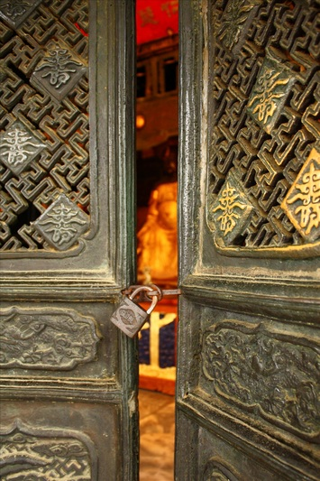
This Monastery Entrance is Locked.

Slide 46
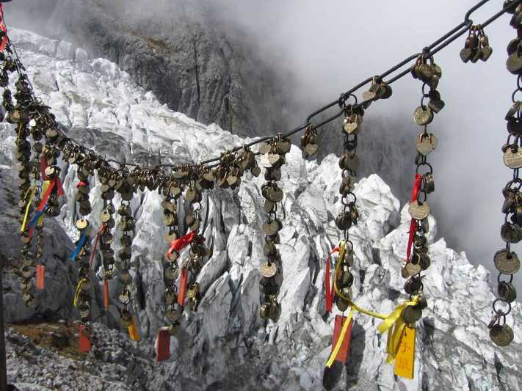
Buddhist prayers

Slide 47
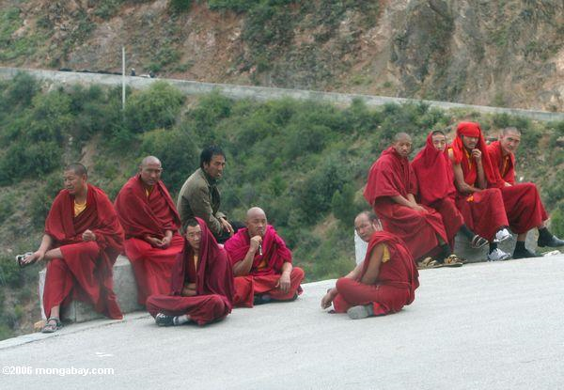
Monks waiting for a bus

Slide 48
Towns and settlements

Slide 49
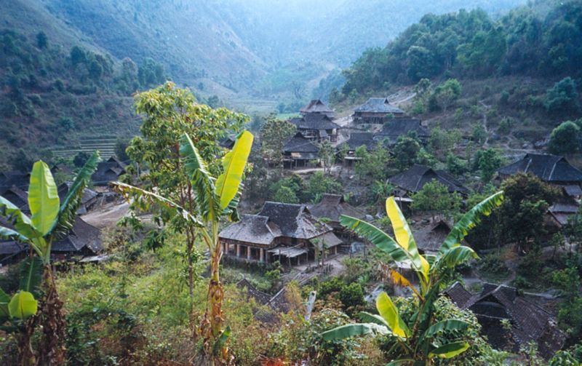
Manpo Village

Slide 50
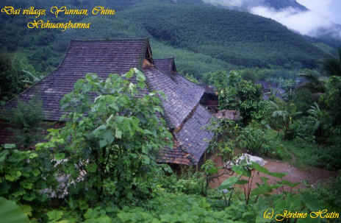
Dai Village

Slide 51
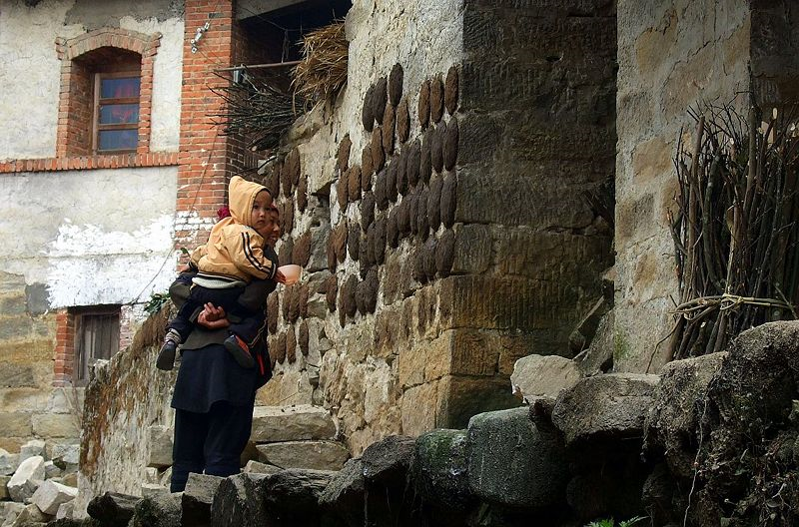
Yuanyang: water buffalo dung patties drying on side of house used for fuel

Slide 52
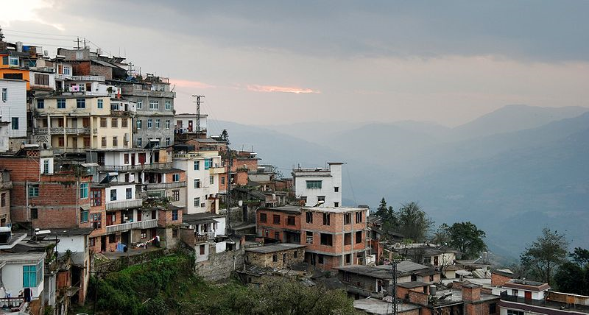
Old Yuanyang

Slide 53
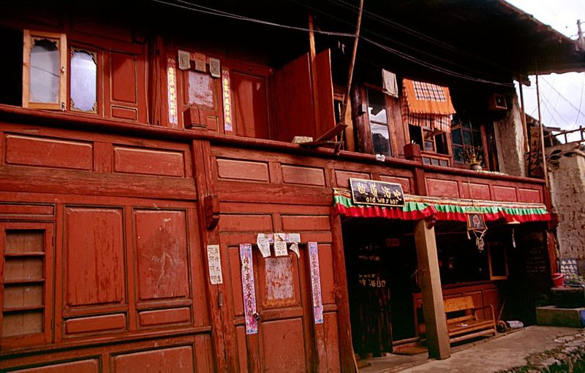
Zhongdian: Tibetan-style wooden house

Slide 54
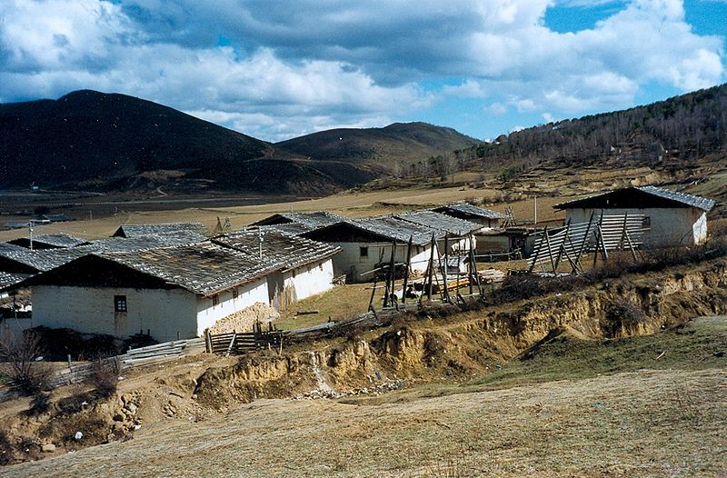
Outskirts of Zhongdian: Tibetan-style Houses

Slide 55
Zhongdian

Slide 56
Kunming – canal in the city

Slide 58
Kunming Skyline

Slide 59
Temple in Kunming

Slide 60
Dali vista

Slide 61
Dali and the Three Pagodas

Slide 64
Dali: temple – Zhonghe Shan

Slide 65
Dali: South Gate

Slide 66
Old City Gate

Slide 67
Front gate at old city Dali

Slide 68
Streets of Dali

Slide 69
Pagoda in Dali

Slide 70
Dali

Slide 71
Temple Chong Sheng of Dali

Slide 72
Dali at night

Slide 73
Chinese Lanterns Light the Way in Lijiang

Slide 77
Lijiang

Slide 78
Lijiang, Yunnan, China

Slide 79
Lijiang

Slide 80
Dongba aspiration windbells in Yuhe Square in Lijiang

Slide 81
Kegong Square canal

Slide 82
Li Jiang Guest House

Slide 83
Big house in Lijiang

Slide 84
Ethnic dance in Lijiang

Slide 85
Old Town: UNESCO heritage site – Decorated city wall

Slide 86
Old Town, Lijiang

Slide 87
Old Town cobblestone street

Slide 88
Old Lijiang

Slide 89
Commercial Ventures

Slide 90
Yunnan Coal & Chemical Co.

Slide 91
A Dongba paper mill in Lijiang

Slide 92
Dried Meat Yak store,

Slide 93
Butchers among pig heads

Slide 94
Meat (poultry) seller in Deqin

Slide 95
Poultry section of the Dechen meat market

Slide 96
Vegetables at the market in Deqin

Slide 97
Sellers at the meat market in Dechen

Slide 98
Dinner at a Tibetan restaurant

Slide 99
Ethnic Dress

Slide 105
Tibetan cowboy

Slide 109
Soup for lunch

Slide 111
Environmental Problems

Slide 112
Deforestation

