Slide 1
Great Destinations
Consider traveling!
Consider St. Louis, Missouri!

Slide 2
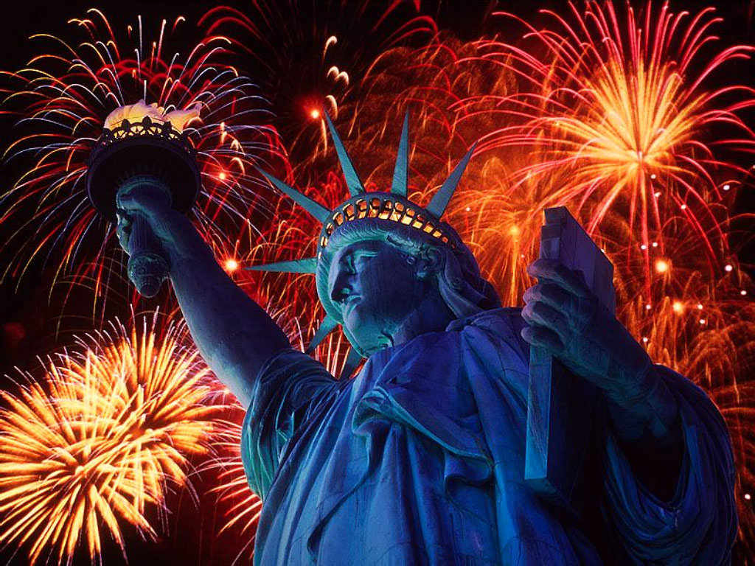
America The Beautiful, Statue Of Liberty, New York Harbor

Slide 3
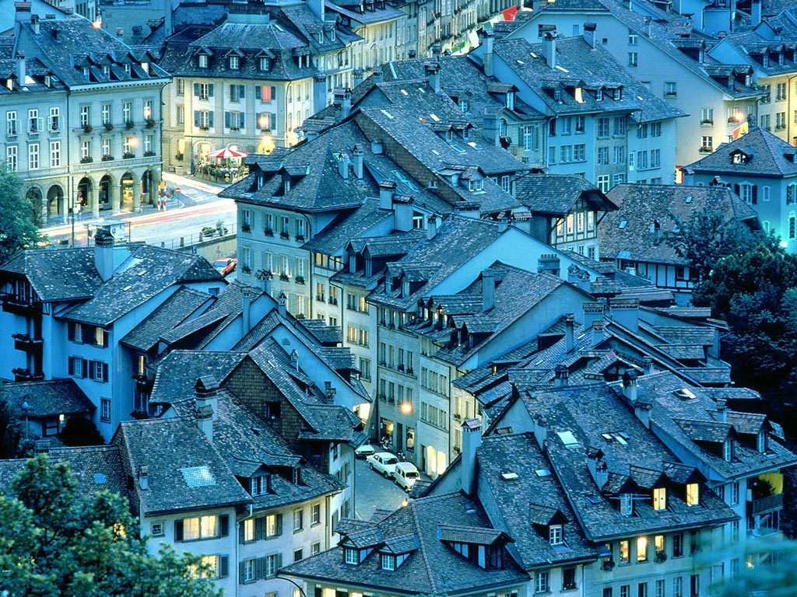
Bern, Switzerland

Slide 4
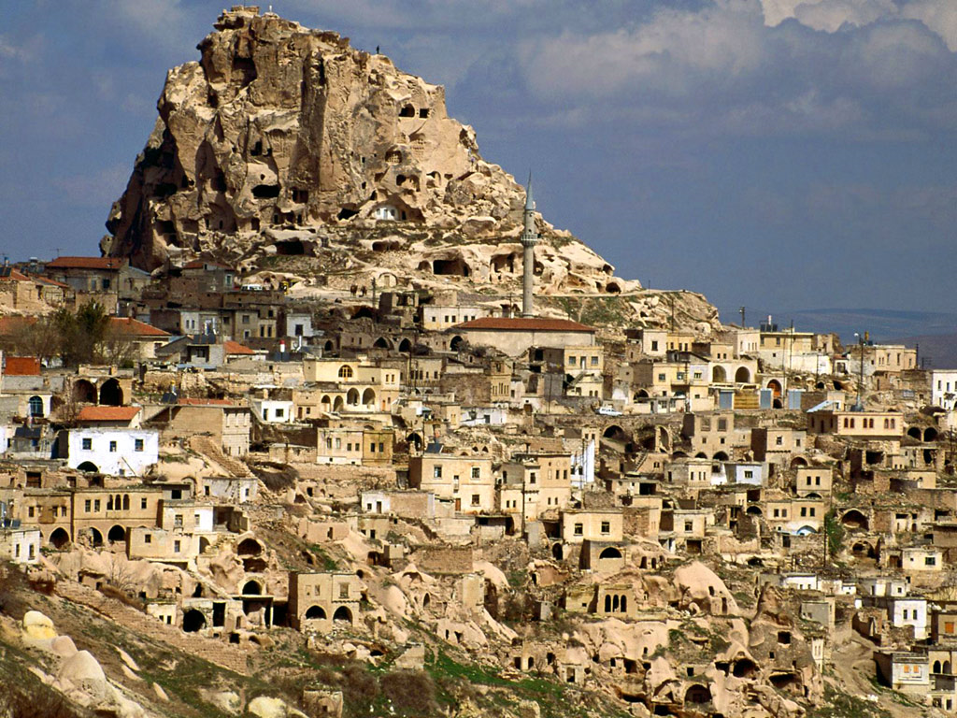
Cave Dwellings of Cappadocia, Turkey

Slide 5
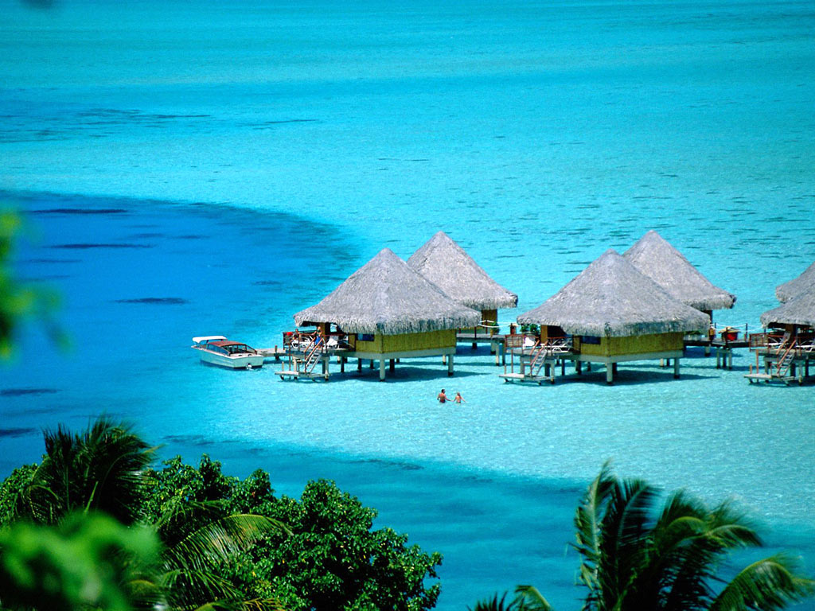
Bora-Bora Island, Tahiti, French Polynesia

Slide 6
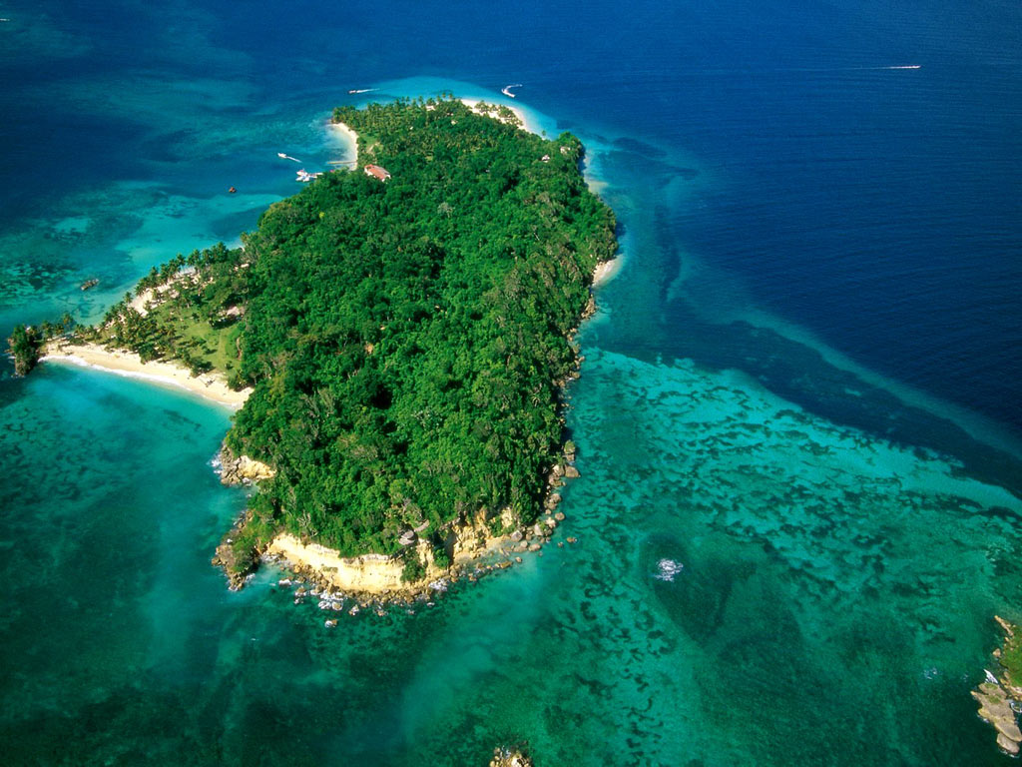
Cayo Levantado, Samana Peninsula, Dominican Republic

Slide 7
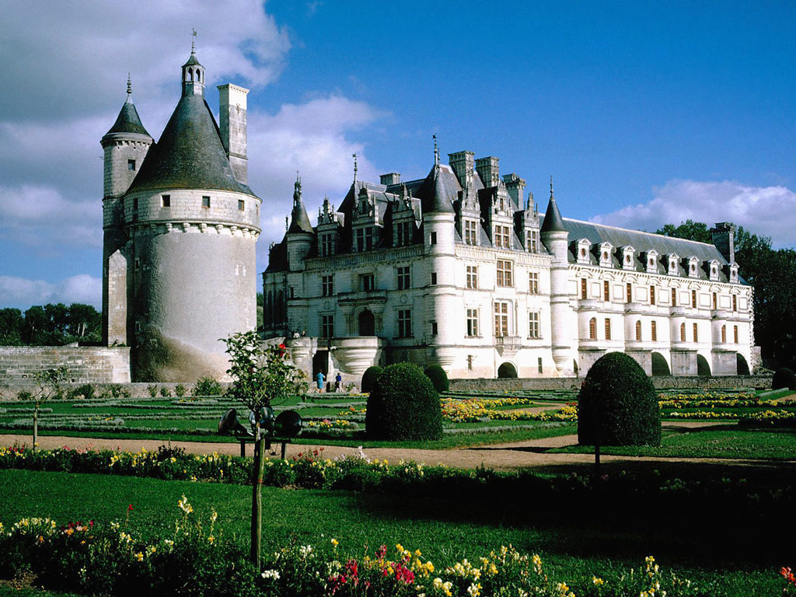
Chateau de Chenonceaux Castle, Chenonceaux, France

Slide 8
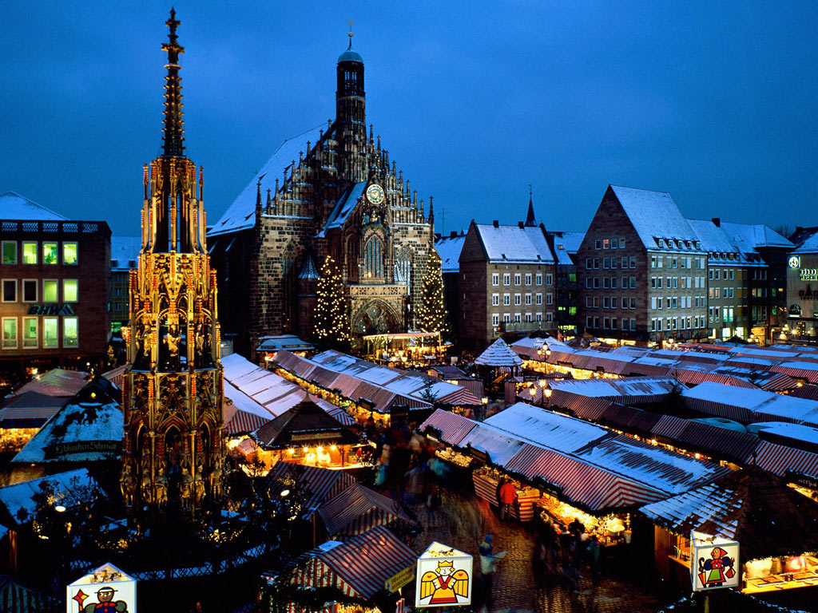
Christkindl Market, Nuremberg, Bavaria, Germany

Slide 9
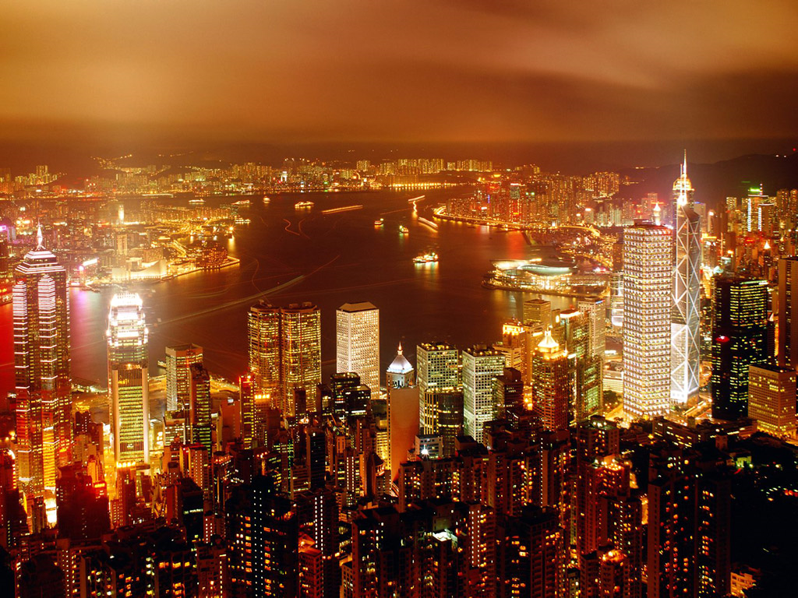
City Of Life, Hong Kong, China

Slide 10
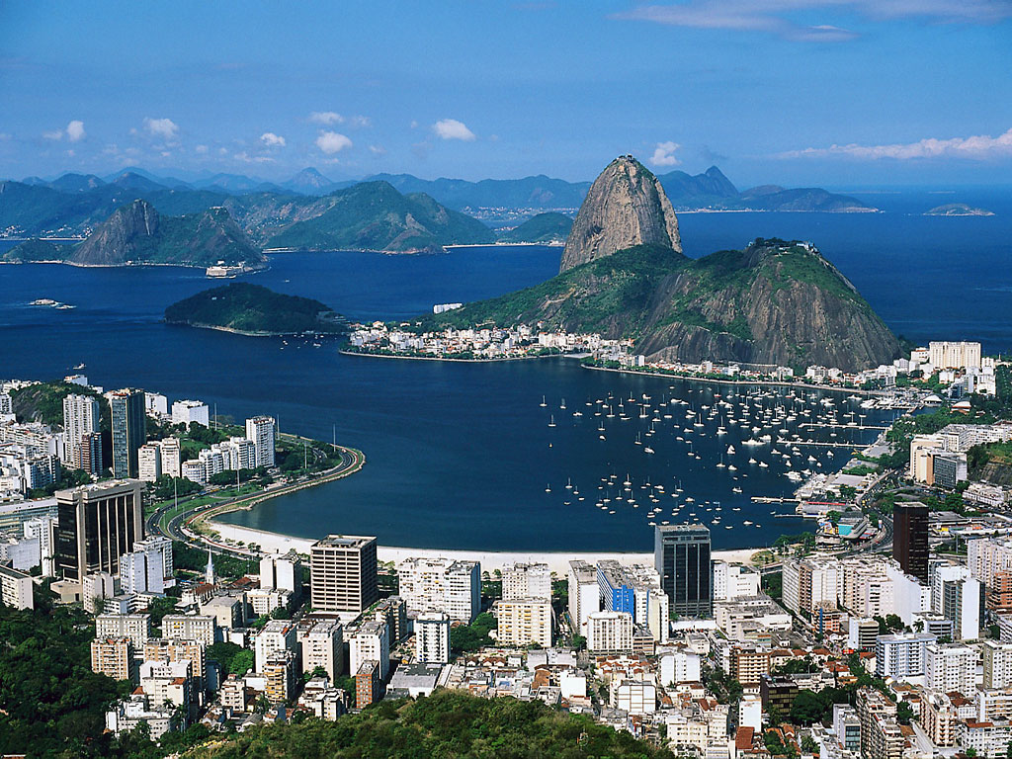
Corcovado Overlooking Rio de Janeiro, Brazil

Slide 11
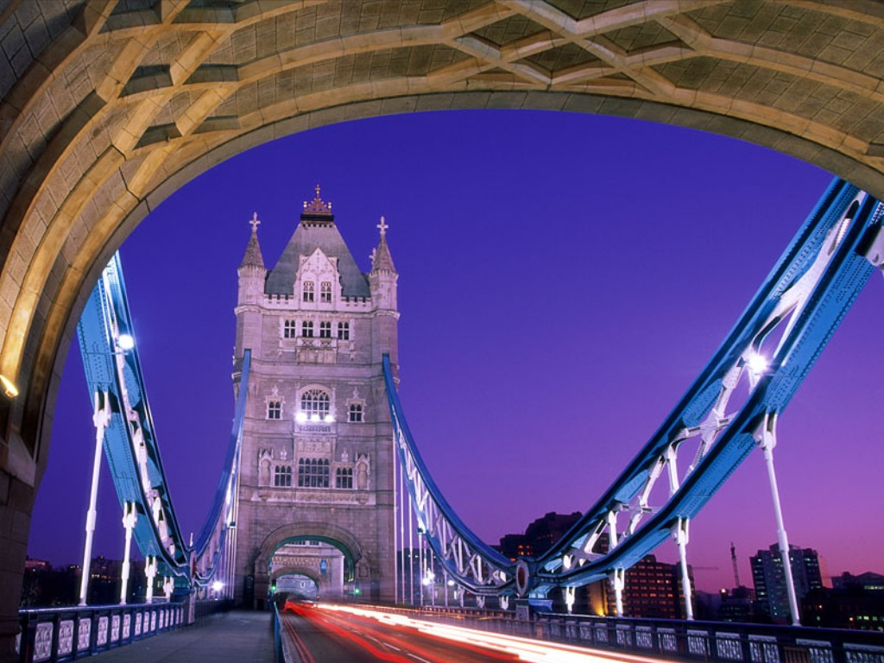
Crossing Over, Tower Bridge, London, England

Slide 12
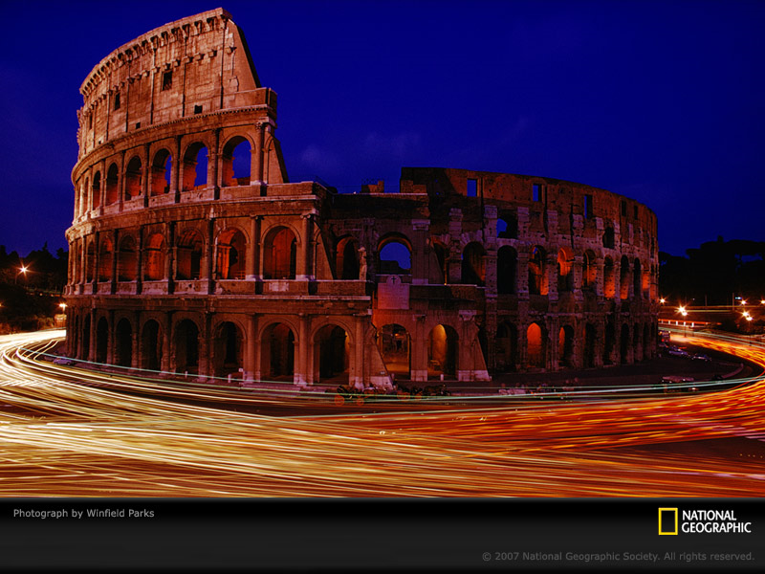
The Eternal City, Rome, Italy

Slide 13
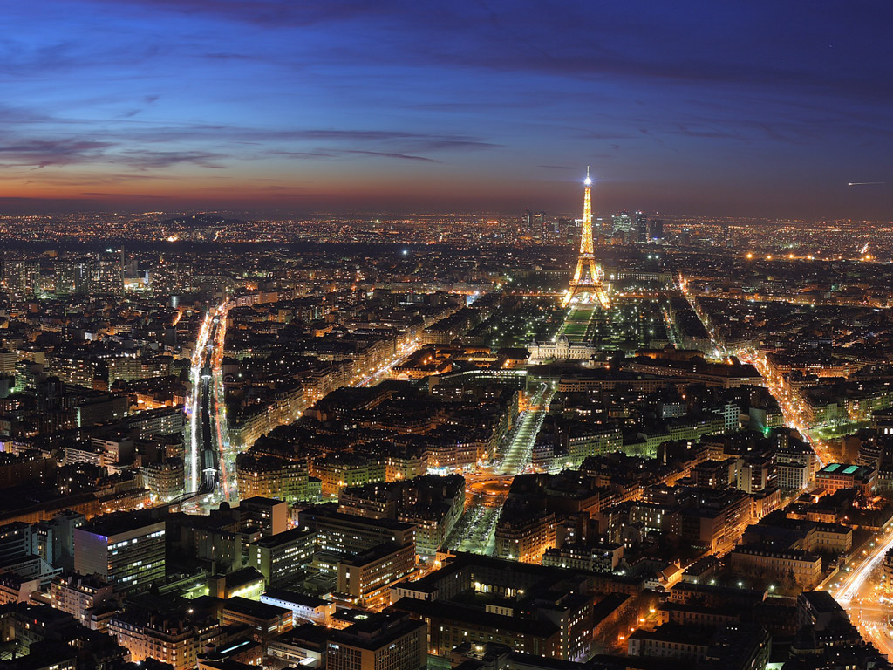
Romantic Paris, France

Slide 14
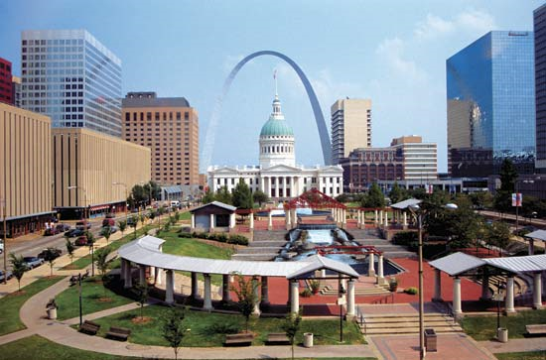
St. Louis, Gateway to a Great Time

Slide 15
More free admissions than most cities.
St. Louis Zoo
St. Louis Art Museum
Cahokia Mounds Museum
Missouri History Museum
Museum of Westward Expansion
St. Louis Science Center
Grant’s Farm
Municipal Opera (free seat section)
Missouri Botanical Garden (free Saturday mornings)
Jewel Box (Forest Park)

Slide 16
Outstanding in St. Louis
The Missouri Botanical Garden is among the top three botanical gardens in the world.
The largest collection of mosaic art in the world graces the walls and ceilings at the Cathedral Basilica of Saint Louis.
St. Louis is home to the oldest institution of higher learning west of the Mississippi River - Saint Louis University .
The oldest church between the Mississippi and the Rockies is St. Ferdinand Shrine.

Slide 17
More Outstanding
The world's first skyscraper - Louis Sullivan's Wainwright Building - was built in 1897 in St. Louis
Edward "Ted" and Pat Jones-Confluence Point State Park – confluence of the Mississippi and Missouri Rivers.
Forest Park, one of the largest urban parks in the U.S. (larger than Central Park in New York City)
The Gateway Arch - at 630 feet - is the nation's tallest man-made monument.

Slide 18
Universities
Large Universities
Washington University (11,400 full-time)
St. Louis University (12,700)
Missouri University St. Louis (16,000)
Innovative Smaller Universities
Maryville University
Webster University
Lindenwood University
Fontbonne University
Missouri Baptist University

Slide 19
Sports
Major League Professional
St. Louis Cardinals (Baseball)
St. Louis Rams (Football)
St. Louis Blues (Hockey)
Less expensive & a lot of fun
River City Rascals (minor league baseball – O’Fallon, MO)
Gateway Grizzlies (minor League baseball – Sauget, IL)

Slide 20
Cultural Venues
St. Louis Symphony (World class orchestra) at Powell Symphony Hall
St. Louis Opera Theater (at Webster U.)
Union Avenue Opera
Grandel Theater (Traveling shows & home to the Black Repertory Company)
Fox Theater (travelling Broadway shows & headline acts)
Touhill Center at UMSL – (operas, plays, & headline acts)
St. Louis Philharmonic Orchestra (performs at Webster U.)

Slide 21
Entertaining Places/Neighborhoods
Loft District – Washington & Market Street (includes the St. Louis City Museum)
Central West End (dining, shops, movies) Euclid Ave. north & south of Lindell Blvd.
University City Loop [dining, shops, & performances – Blueberry Hill, Tivoli (movie) Theater, Pagent Theater (live performances)] Delmar Blvd. east & west of Skinker Blvd.
Magic House & Museum of Transport in Kirkwood

