Slide 1
Mt. Etna Keeps Erupting 2011
Light show at the cathedral: Luminous lava lights up Sicilian town as Etna keeps on erupting.

Slide 2
Menacing and beautiful in equal measure, Mount Etna illuminates the cathedral of Zafferana Etnea with its latest violent eruptions.
In these stunning pictures, Europe's most active volcano appears to be spewing lava right onto the 19th century church.
The Sicilian municipality was in no immediate danger because the lava flowed into a valley, but flights had to be cancelled overnight because of the resulting ash.

Slide 3
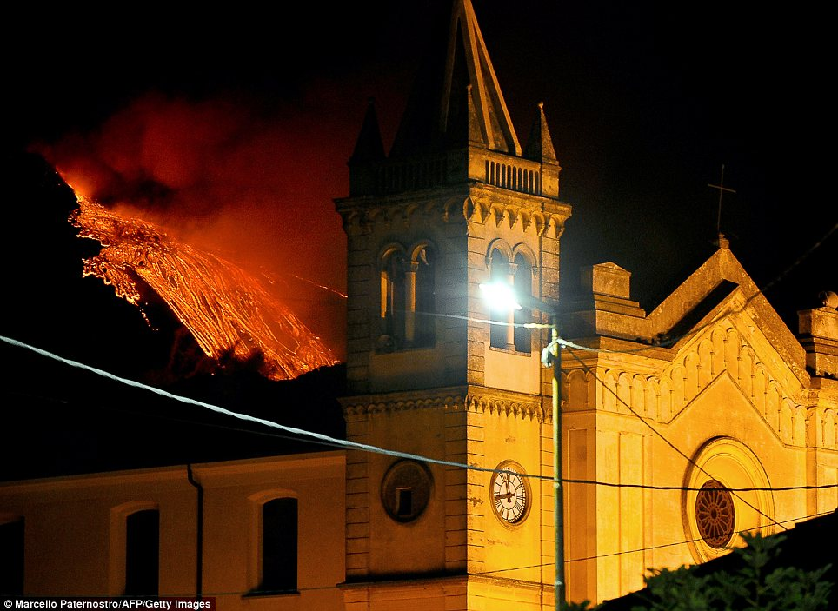

Slide 4
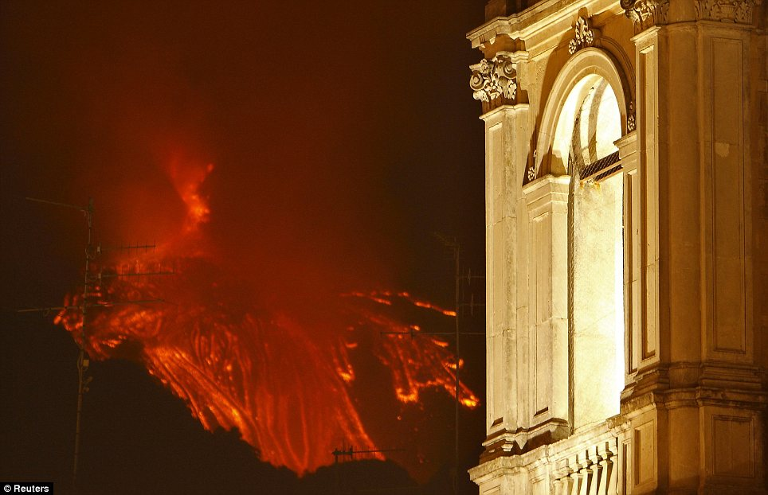
Golden glow: The eruption appears to be running right towards the cathedral in this image, but the lava has so far been flowing safely into a valley

Slide 5
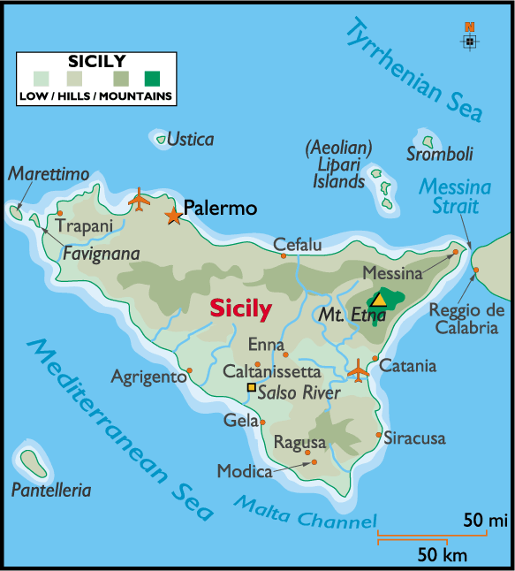
Catania's Fontanarossa airport was shut from midnight to 7am this morning.
The Crisis Unit met at 1am to monitor the situation until the activity subdued and the flight schedule was back to normal after the first flight came in from Naples at 7.53am.

Slide 6
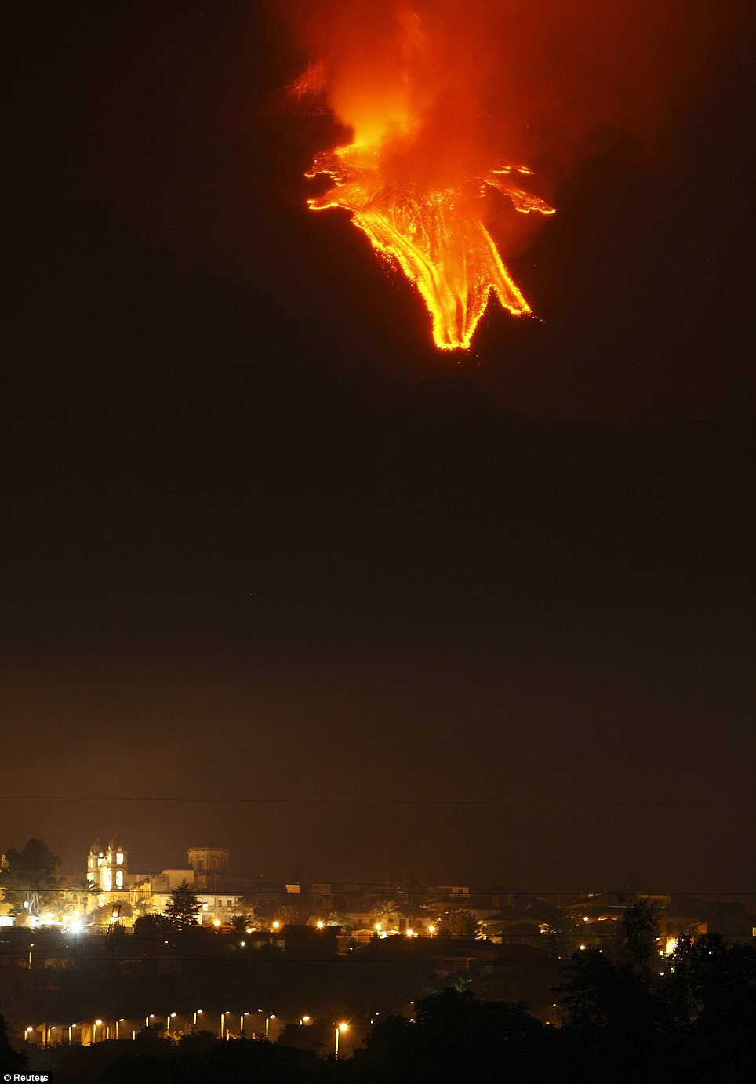
At the mercy of nature's power: Etna towers over the municipality of Zafferana Etnea

Slide 7
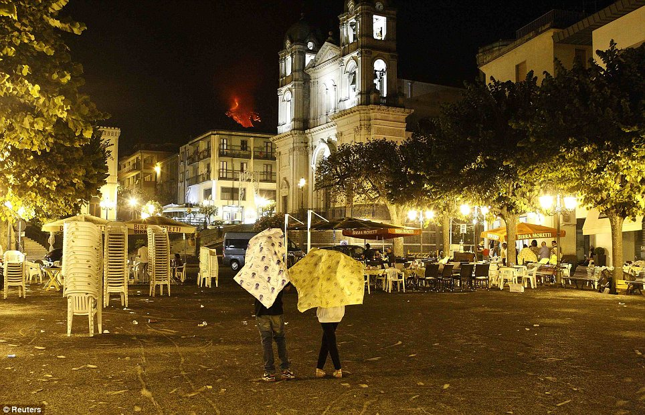
Taking cover: Residents shelter from the volcanic ash blown across the town. The ash has also caused severe disruptions to flights in the area.

Slide 8
There have already been eight eruptions so far this year.
A blast in May, the fifth of 2011, caused major disruption when lava spewed onto its south-eastern slopes and winds swept ash further afield, stopping flights at Catania's airport.
Etna is the highest active volcano in Europe at 3,295 metres (10,810 feet).

Slide 9
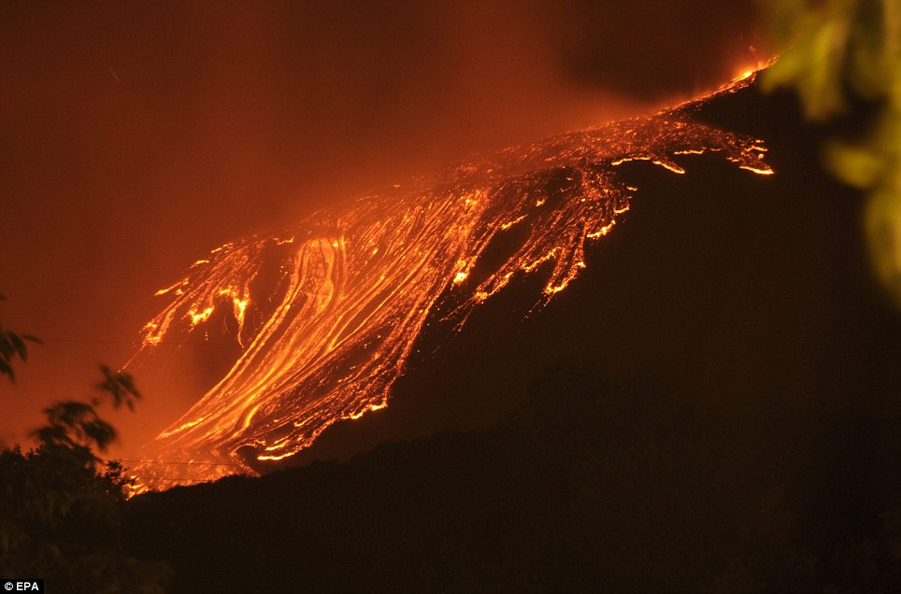
Creeping danger: A view of Etna erupting near Catania, where the airport was closed for seven hours due to volcanic ash

Slide 10
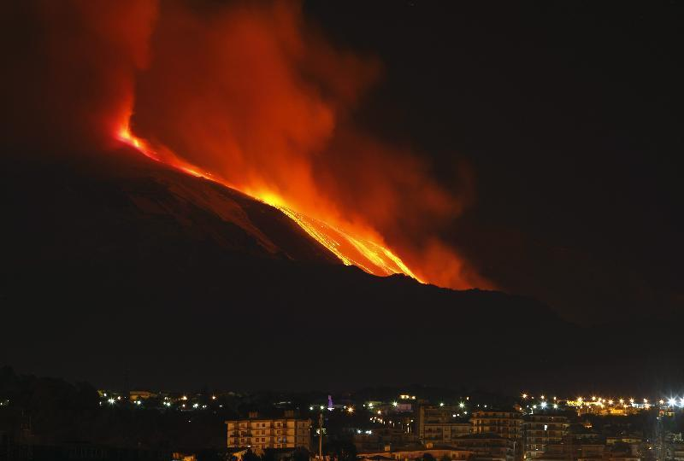
January 2011

Slide 11
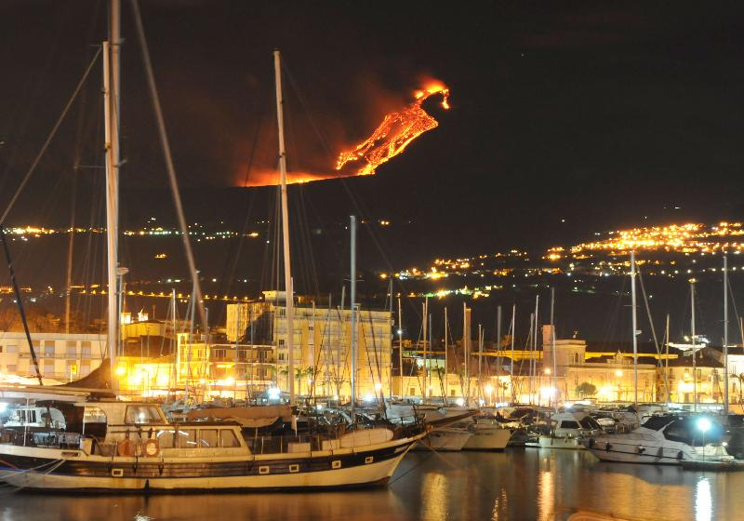
The glow from lava on Mount Etna hovered over Catania, Sicily.

Slide 12
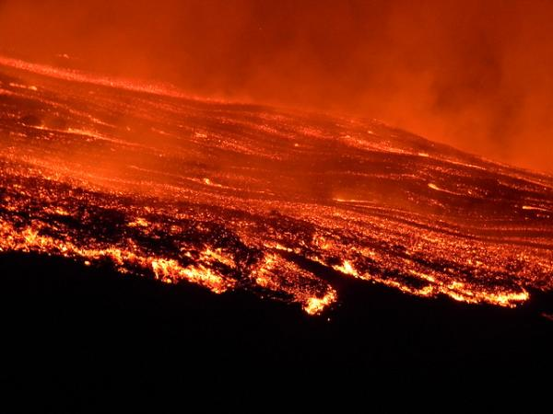
Lava pouring down the side of Mount Etna during the July 30 eruption. Credit: Boris Behncke.

