Slide 1
Italy – Jewel of the Mediterranean Part 5

Slide 2
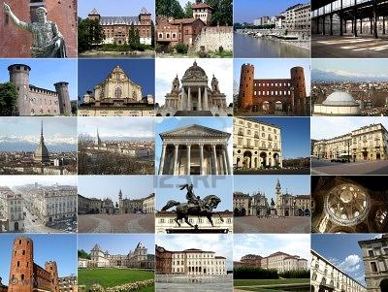
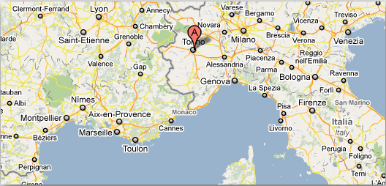
Turin (Torino), Piedmont, and Northern Lake Region

Slide 3
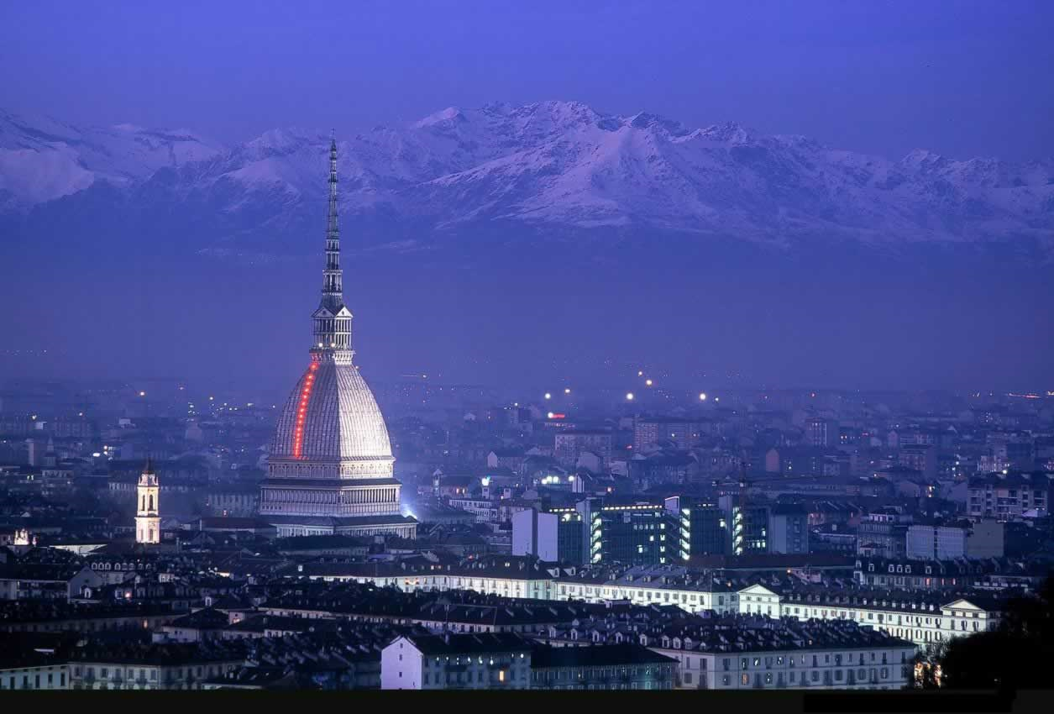
Turin with the Alps in the background

Slide 4
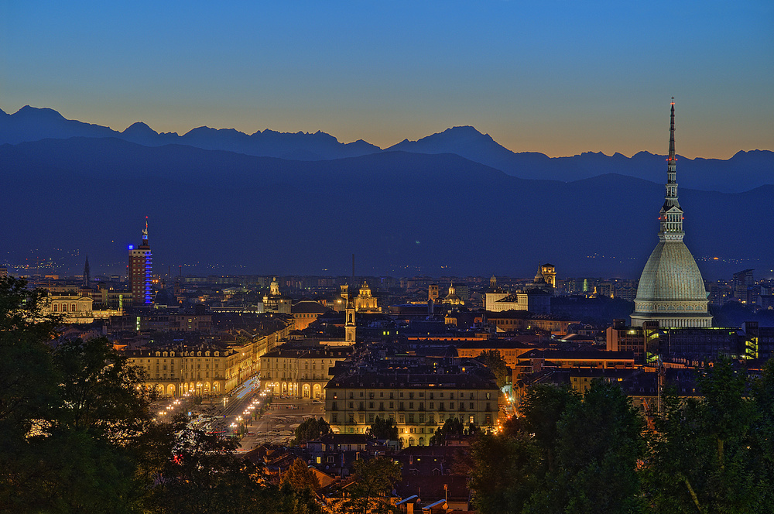

Slide 5
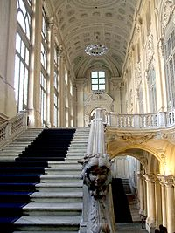
Wedding Hall at the Turin City Hall.

Slide 6
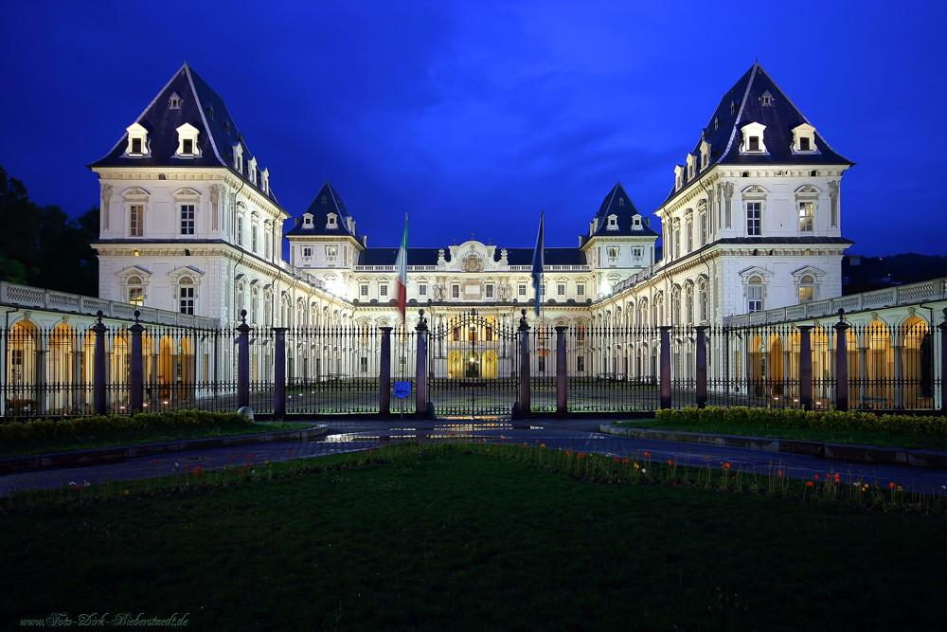
Valentino Castle

Slide 7
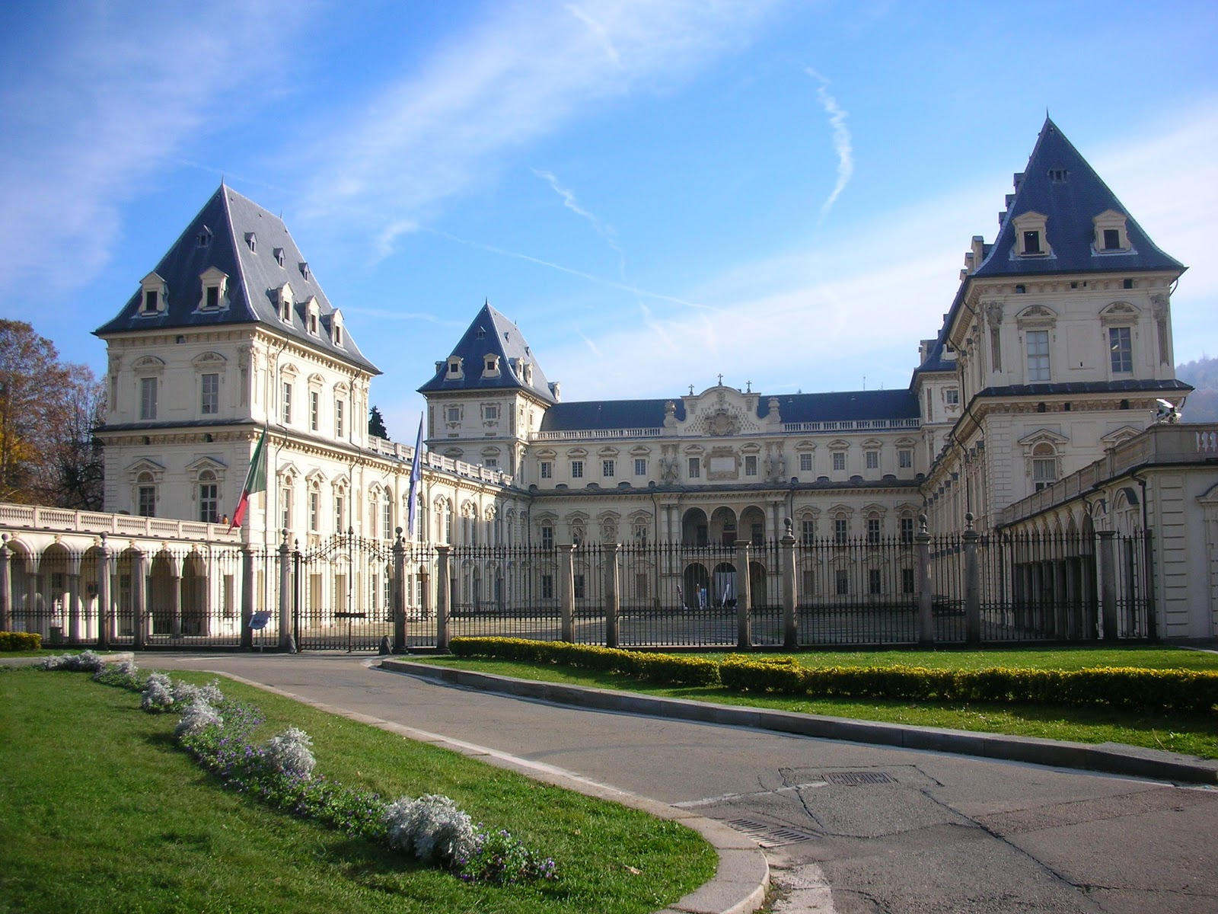

Slide 8
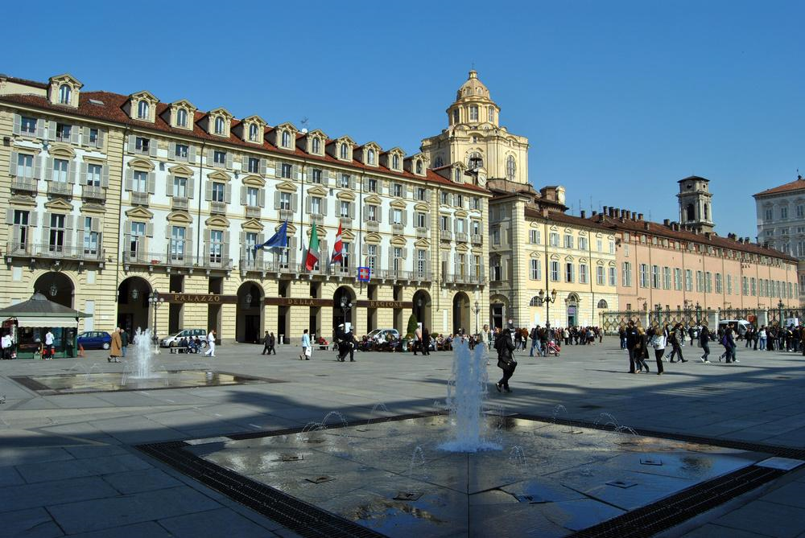
Castello square

Slide 9
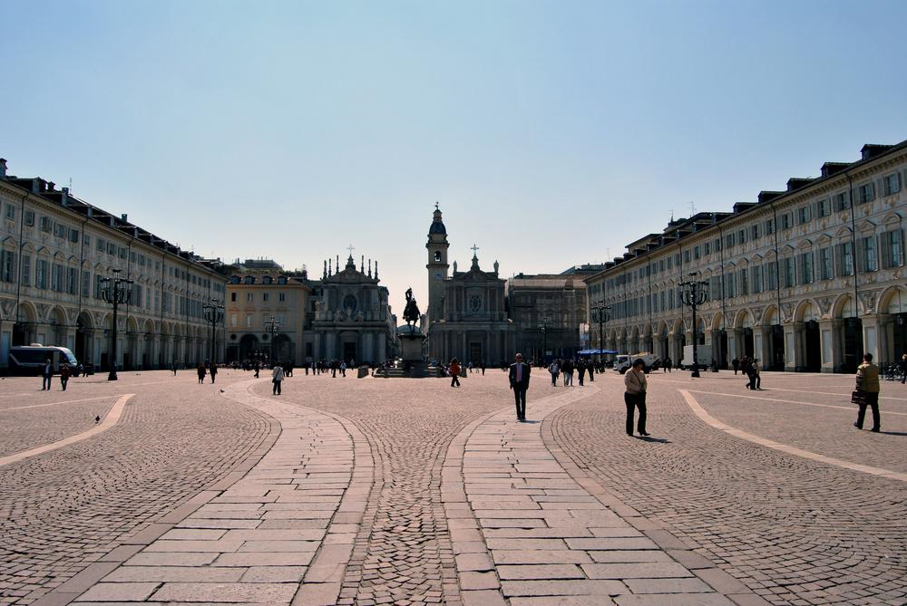
S.Carlo square

Slide 10
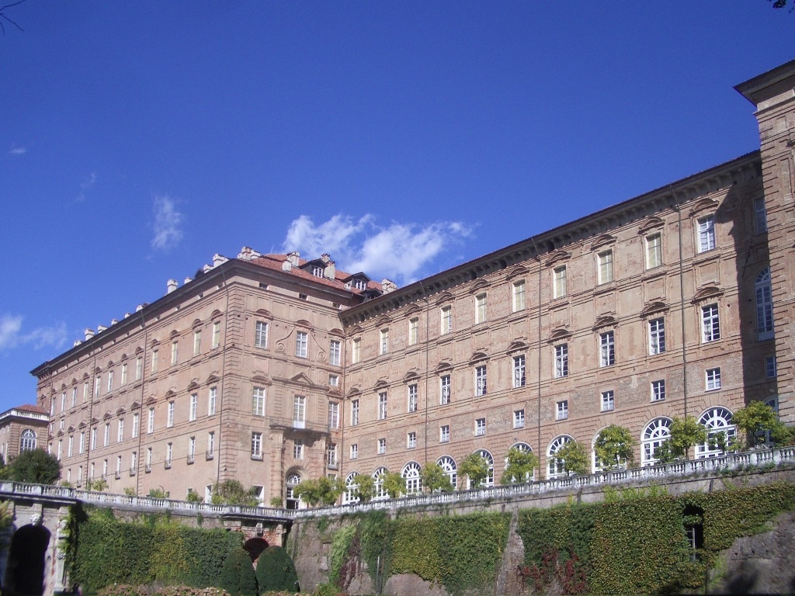
Castle of Agliè

Slide 11
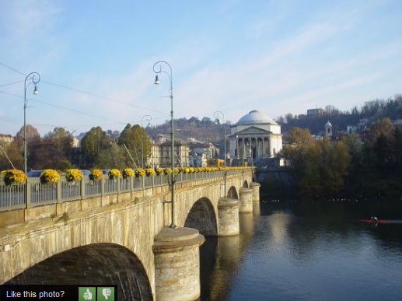
Ponte sul fiume Po

Slide 12
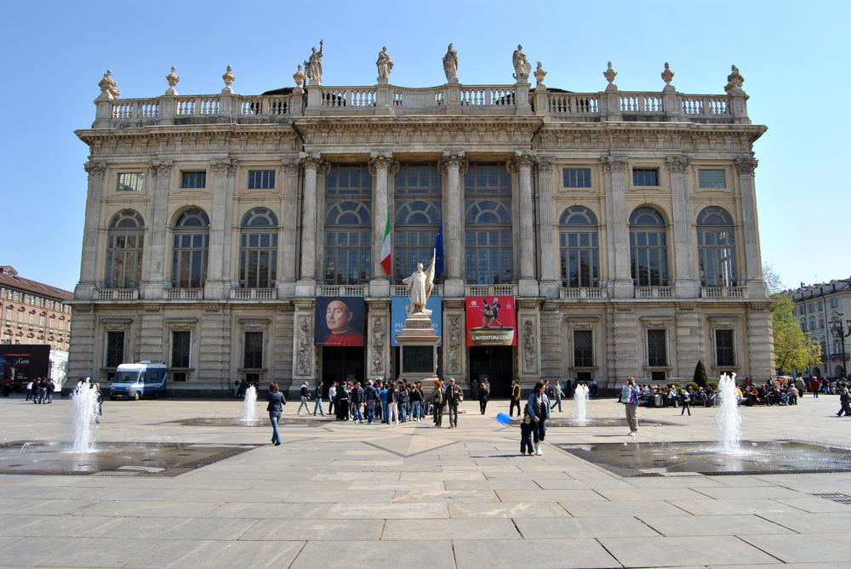
Palace Madama

Slide 13
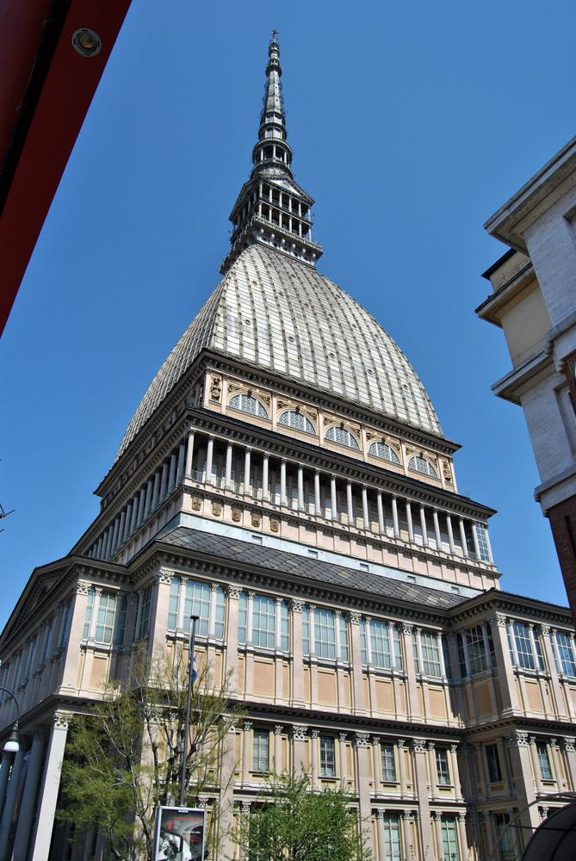
La Mole Antonelliana

Slide 14
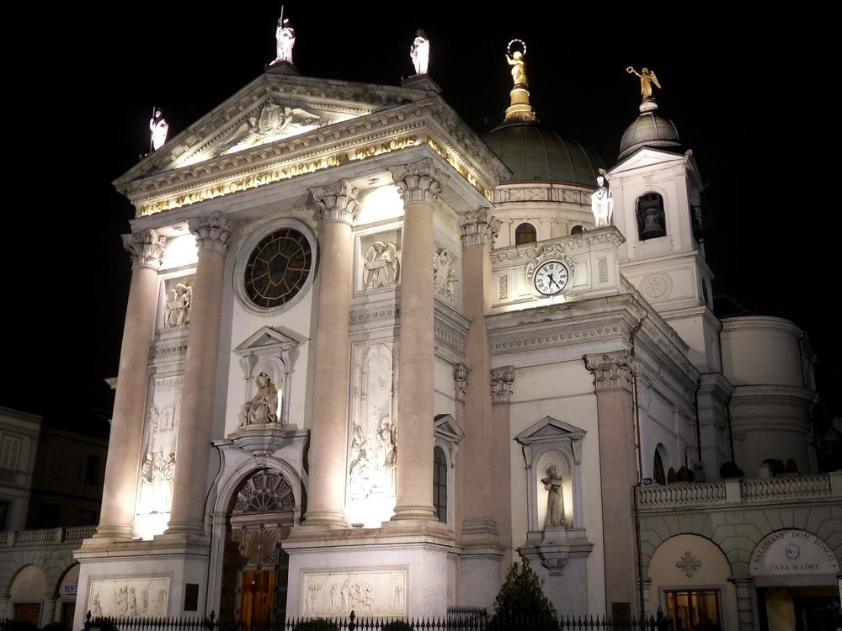
Basilica of Mary Help of Christians

Slide 15
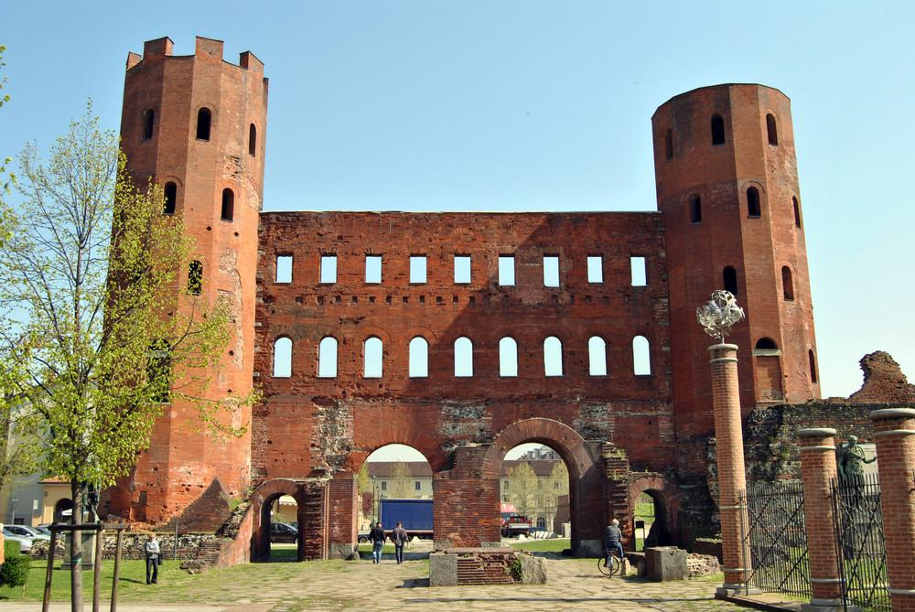
Porta Palatina

Slide 16
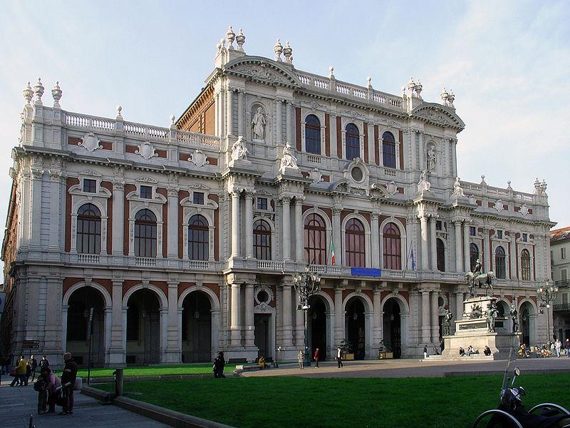
Palace Carignano

Slide 17
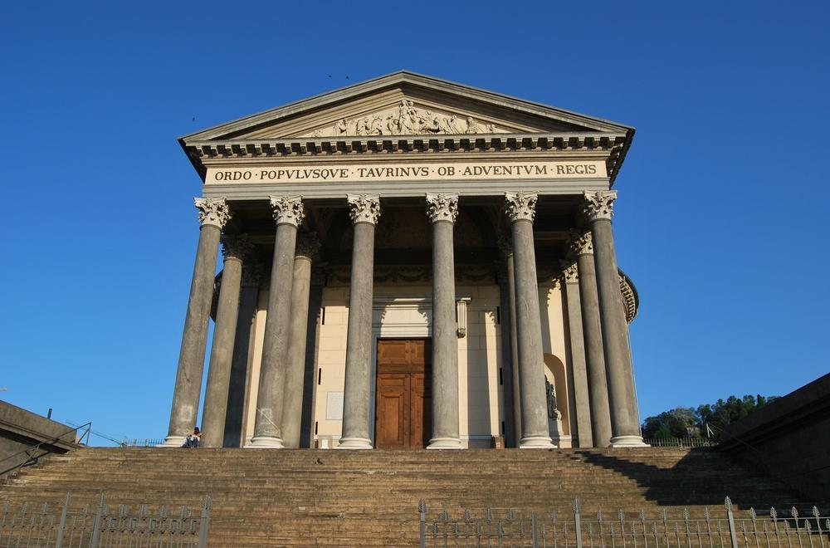
Chiesa della Gran Madre

Slide 18
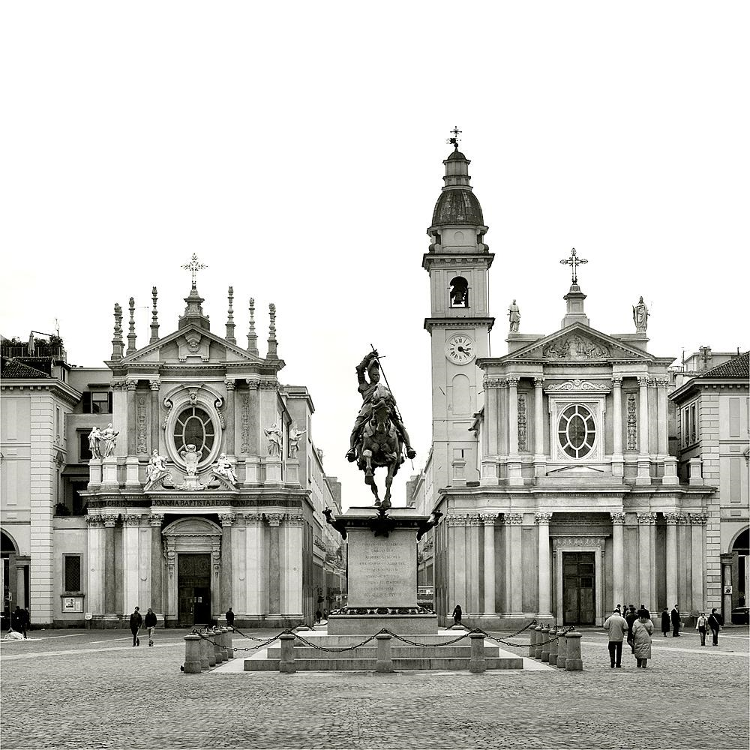

Slide 19
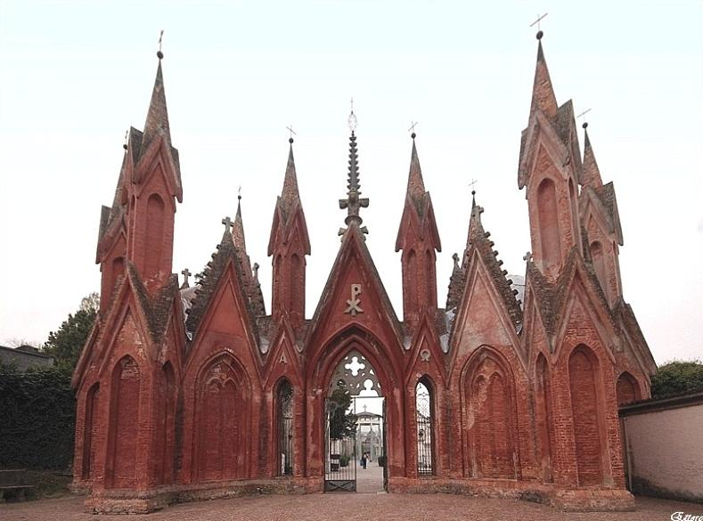
Neo-Gothic pinnacles

Slide 20
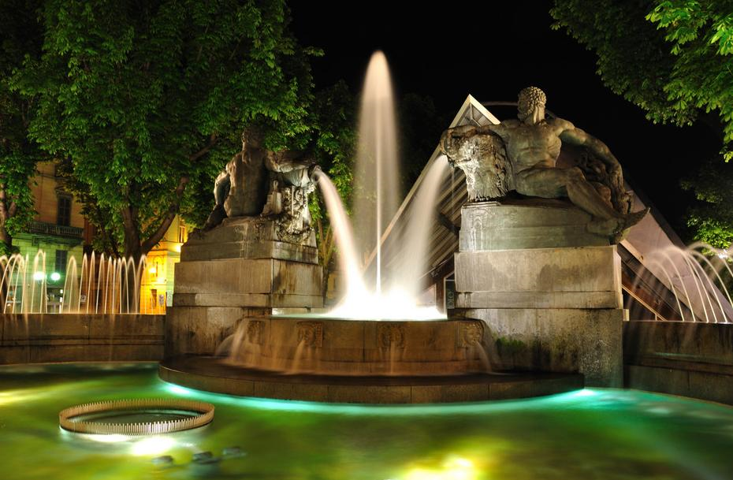
Fountain Angelica

Slide 21
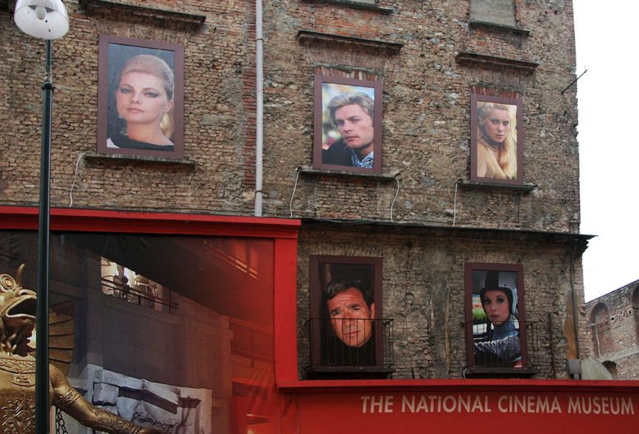

Slide 22
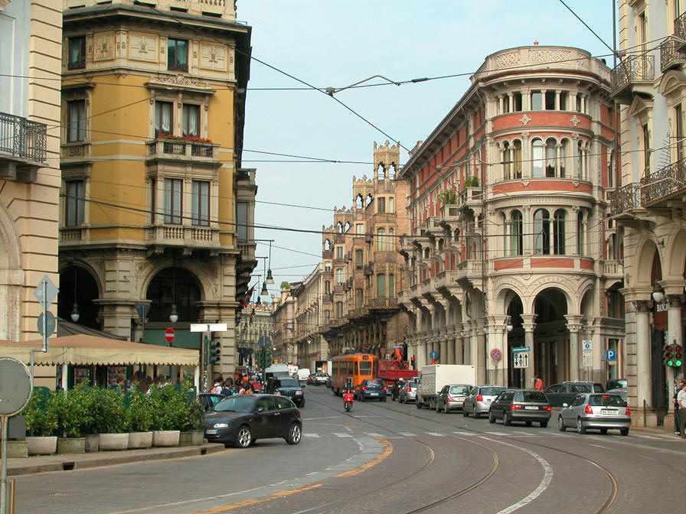
Street Scene

Slide 23
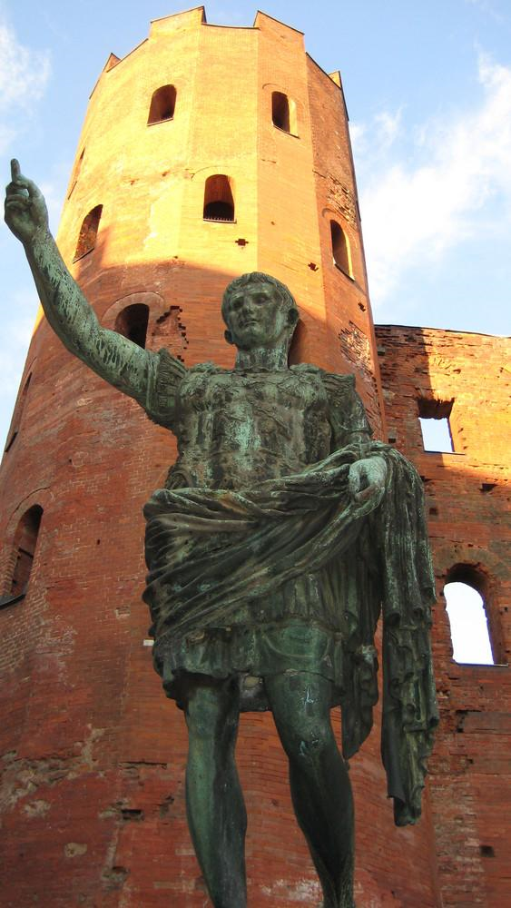
Caesar Roman ruins

Slide 24
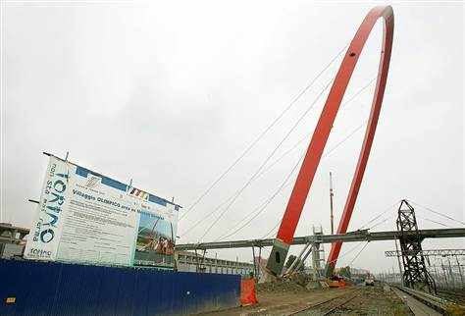
Turin Olympic Bridge

Slide 25
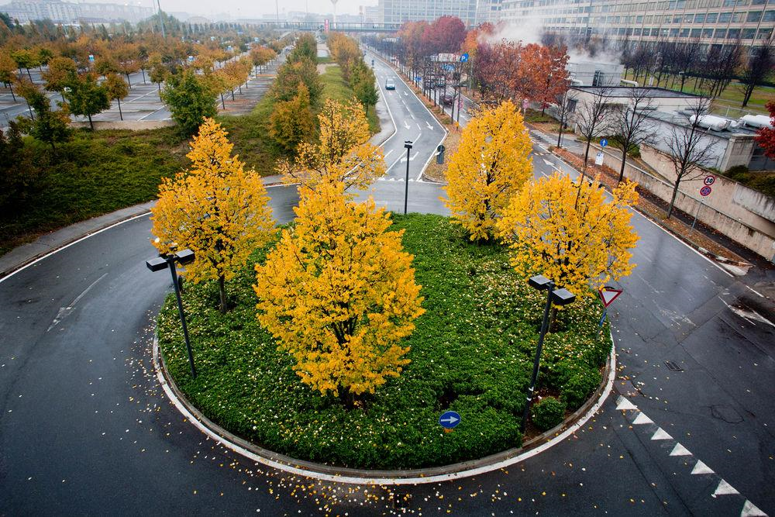
Lingotto - Torino

Slide 26
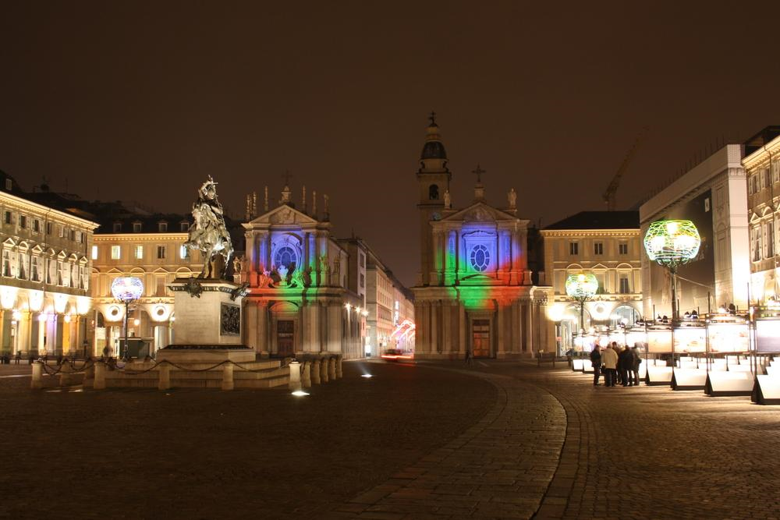
Luci D'artista Torino

Slide 27
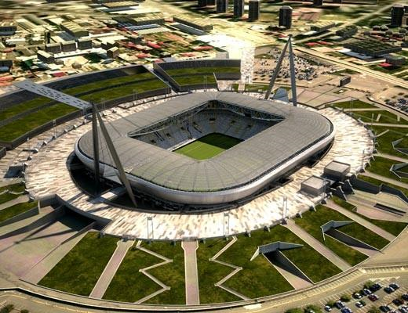
New stadium of Juventus

Slide 28
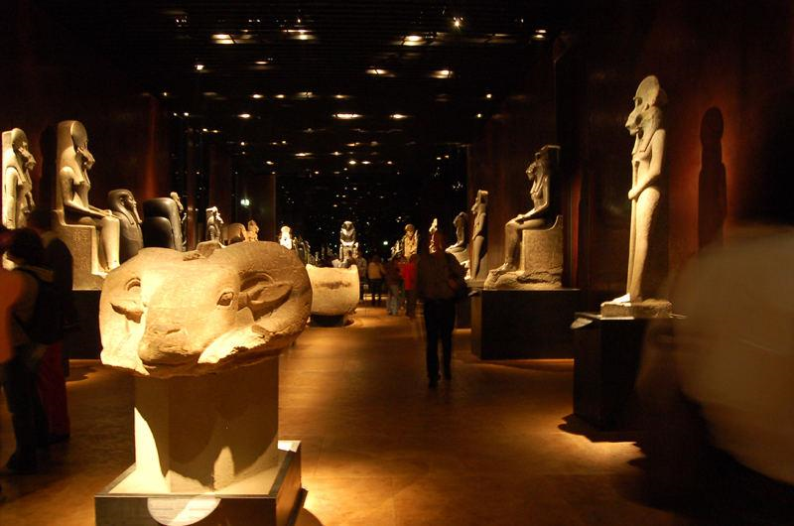
Egyptian Museum

Slide 29
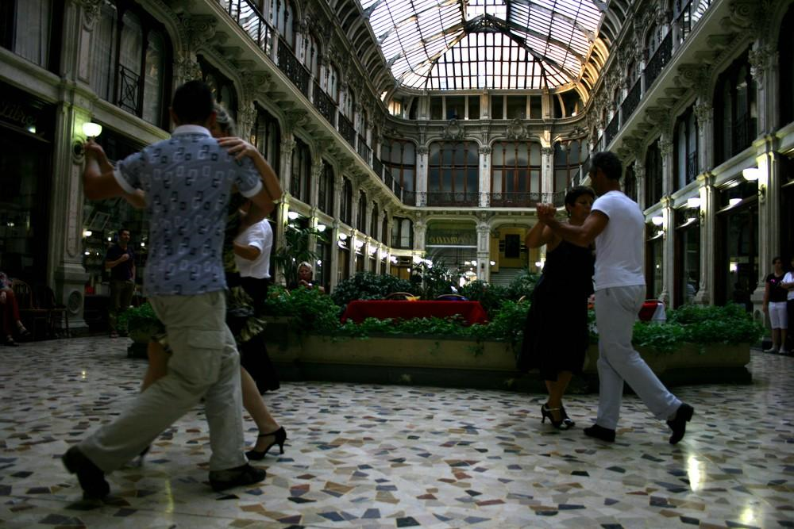
tango in Galleria Subalpina (Torino)

Slide 30
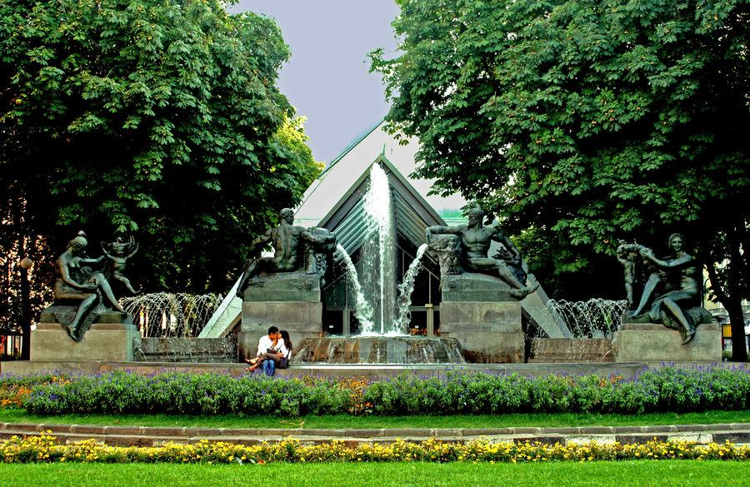
Park in Torino

Slide 31
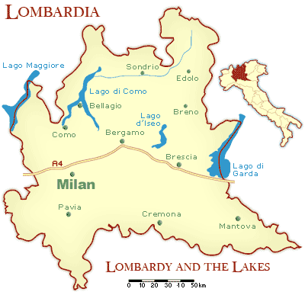
Piedmont & Lake Country

Slide 32
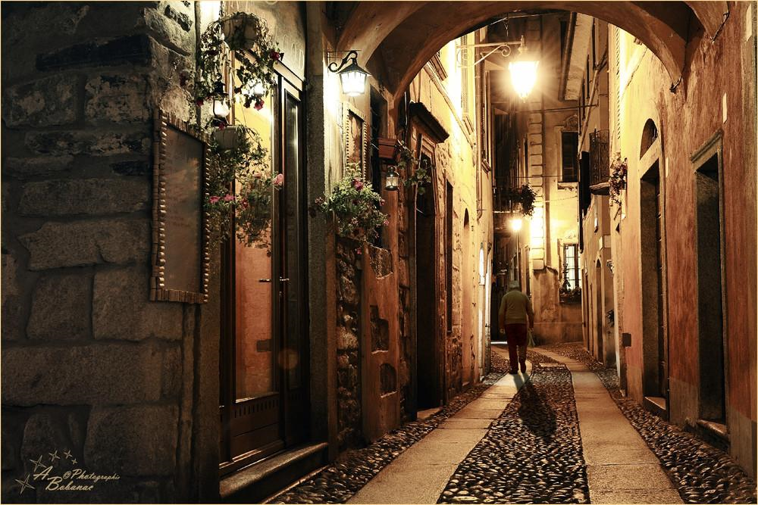
Orta Streets

Slide 33
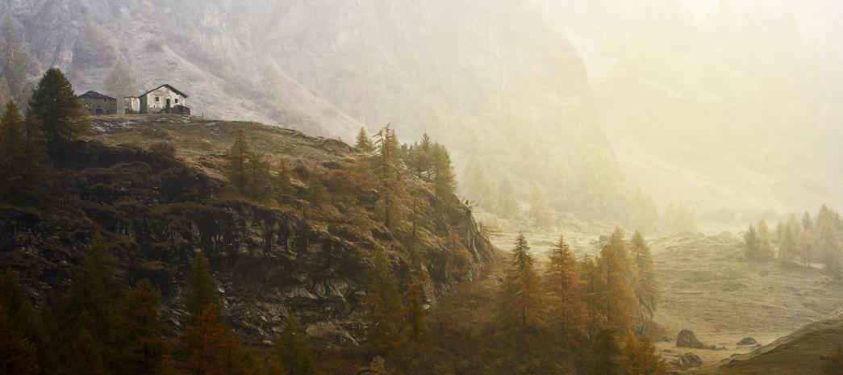
Aosta Valley

Slide 34
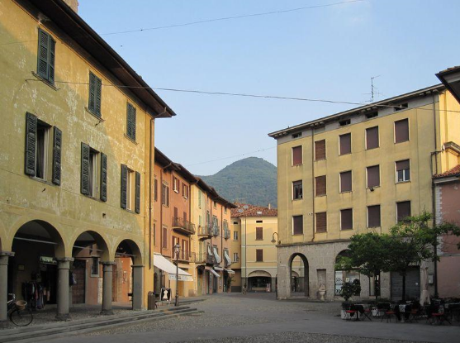
A square in Iseo on Iseo Lake, Italy

Slide 35
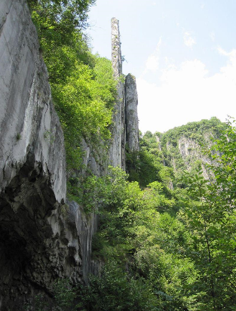
Cliffs near Castro on Iseo Lake, Italy

Slide 36
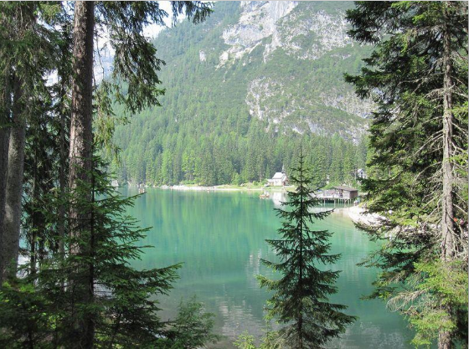
Braies Lake, South Tyrol, Italy

Slide 37
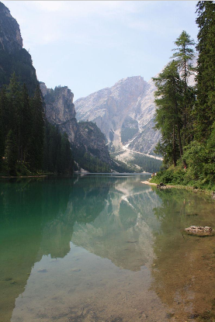
Lago di Braies (Italia)

Slide 38
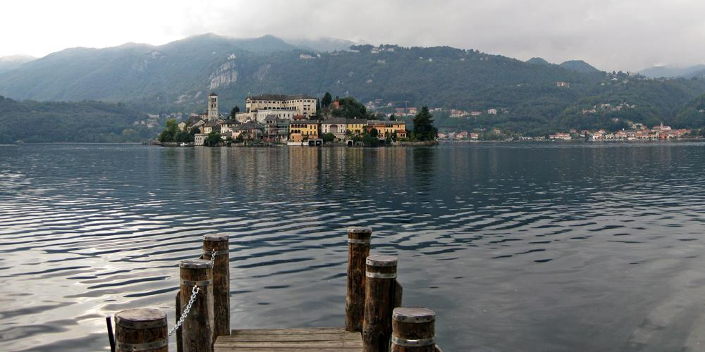
Island of San Giulio on Lake Orta

Slide 39
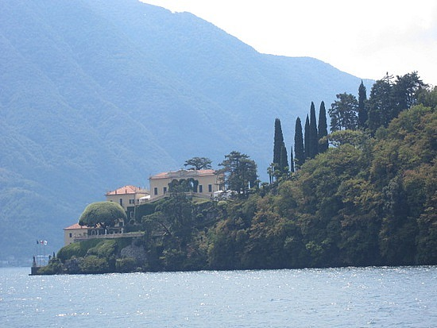

Slide 40
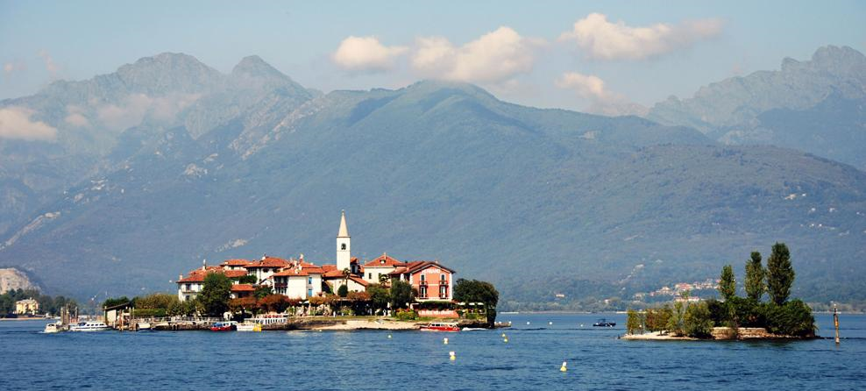
Isola dei Pescatori - Fishermen's Island

Slide 41
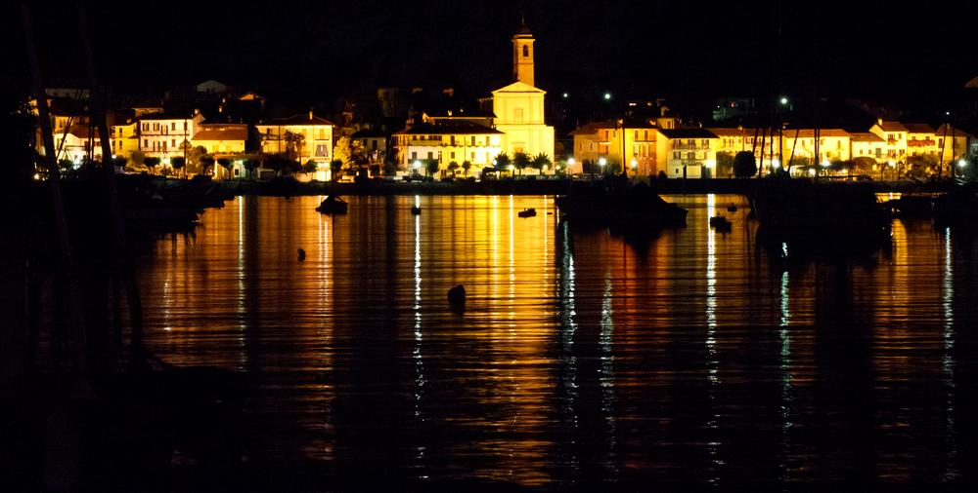
Lake Maggiore

Slide 42
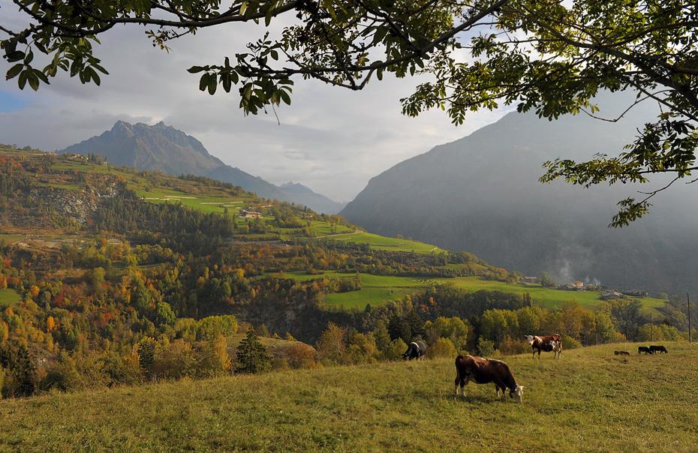

Slide 43
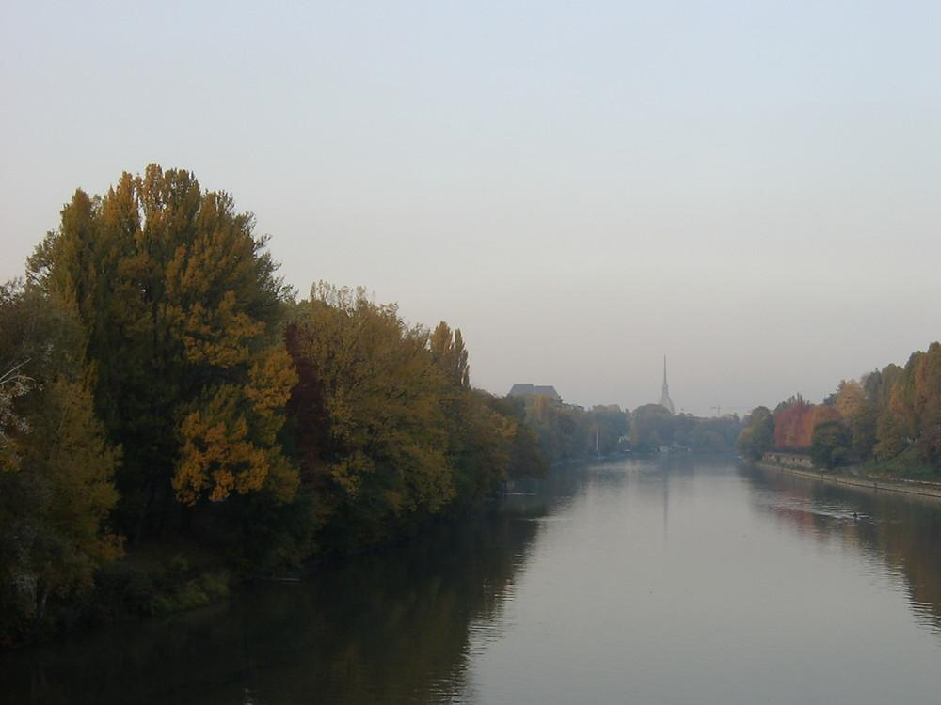
Po River

Slide 44
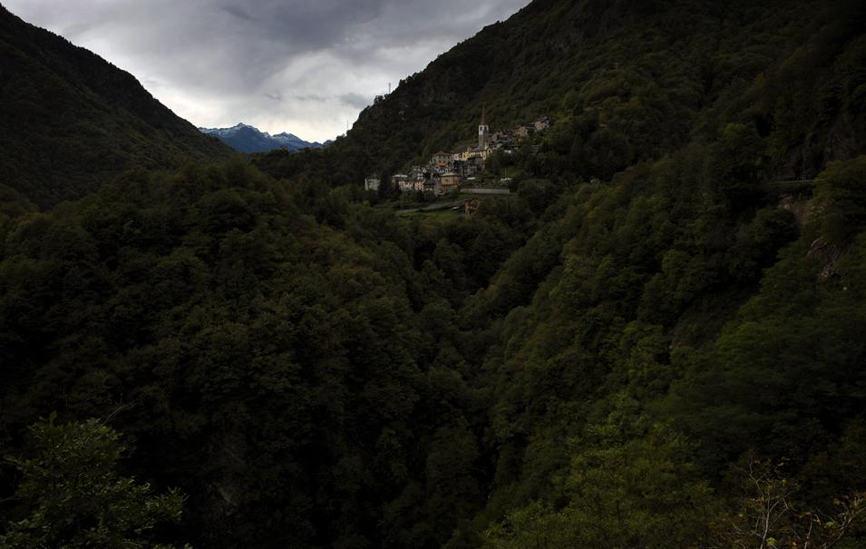
Simplon

Slide 45
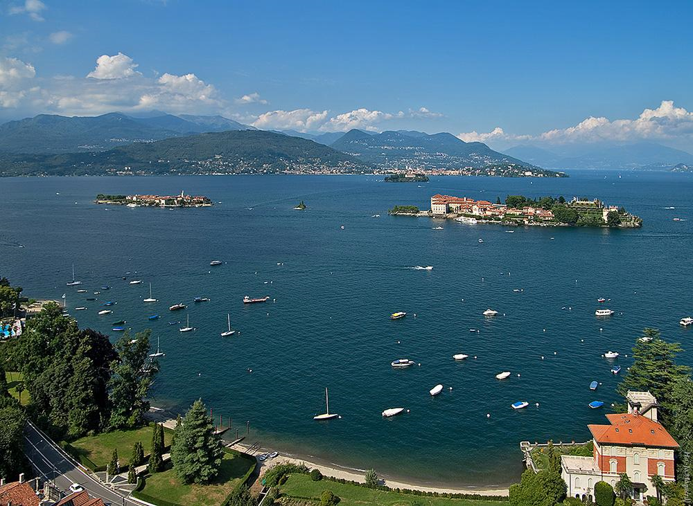
Lake Maggiore

Slide 46
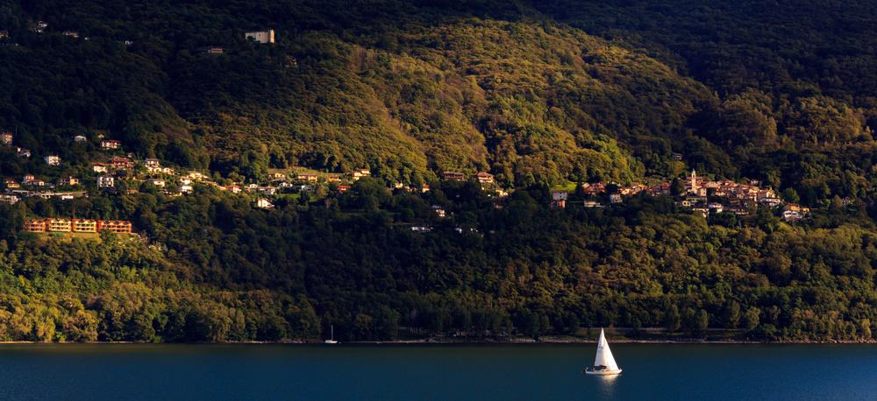
Lake Maggiore

