Slide 1
BRAZIL: The lost tribe staring extinction in the face
Extraordinary new pictures of life in the depths of the Amazon jungle
By Oliver Pickup

Slide 2
These incredibly detailed photographs offer a unique insight into the lives of one of the world's last uncontacted tribes.
Spears aloft, faces daubed with vivid red paint these bewildered villagers stare up at the helicopter high above them.
For them, as for those who saw them, it was a remarkable moment as the group live in total isolation in the dense Amazon rainforest along the Brazilian-Peruvian border.

Slide 3
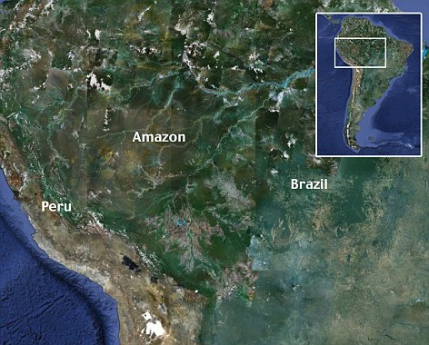

Slide 4
Fears are growing that an influx of illegal loggers from Peru could threaten their survival, by pushing back other tribes in the River Envira area and creating bloody conflict over raw materials and land.
But while the Brazilian government has marked out three continuous areas of territory on their side of the border, where four or more tribes live in peace, their Peruvian neighbors continue to adopt a more uncaring attitude.
The community, which is estimated to contain about 150 people, also has metal goods such as a machete knife and a pan - believed to have been acquired through inter-tribal trading.
Fiona Watson of Survival International and a researcher working in the area fear that if the Peruvian government persists with its current attitude and does nothing to halt the impact of the loggers the future of the tribe is in doubt.

Slide 5
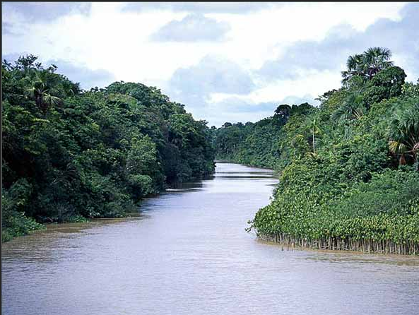

Slide 6
Mere Contact Poses Dangers
Back in 1987 the Brazilian government realized the disastrous impact it was having on the tribes by continually trying to make contact. Statistics showed that 50 per cent of those it had met died within a year due to their lack of immunity to diseases which they were unfamiliar with.
Mrs. Watson, who has worked for Survival for 20 years, is fearful that if pressure is not put on the Peruvian government to expel the loggers, then this small cluster of tribes - and their fascinating way of life - will be lost for ever.

Slide 7
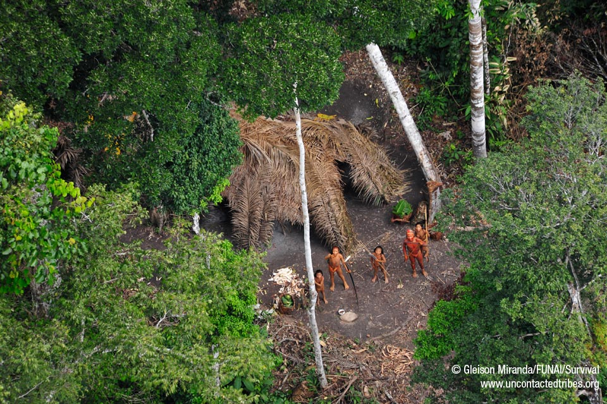

Slide 8
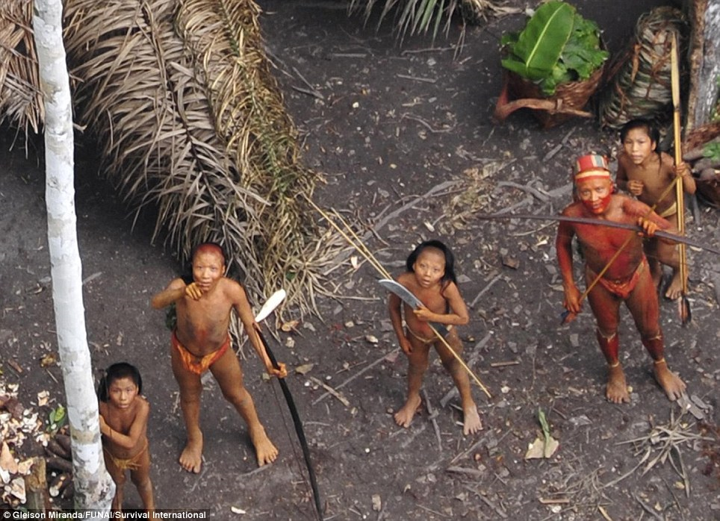

Slide 9
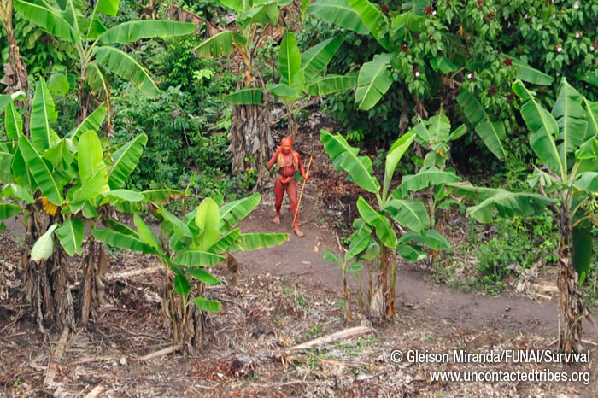

Slide 10
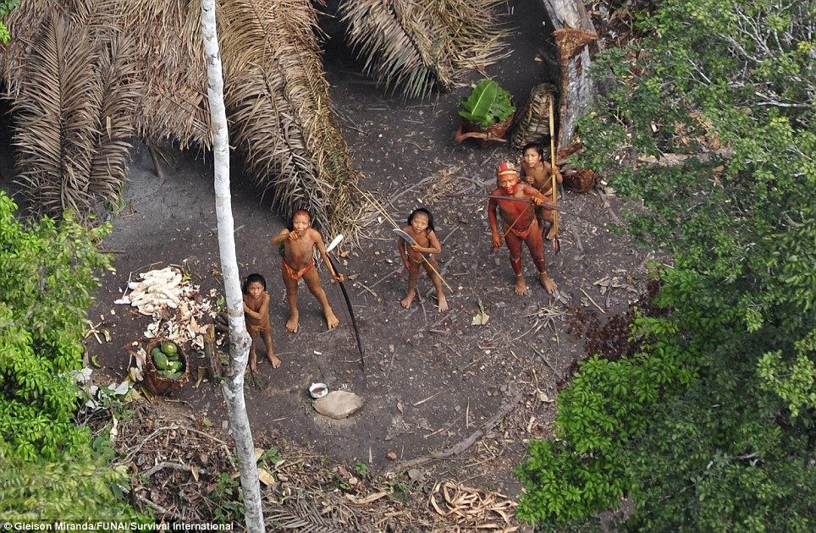

Slide 11
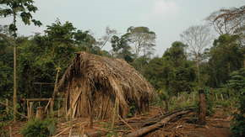

Slide 12
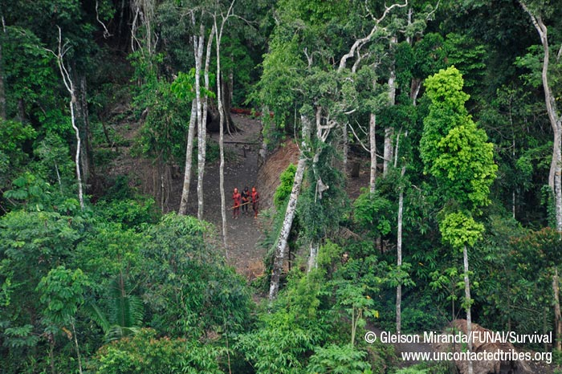

Slide 13
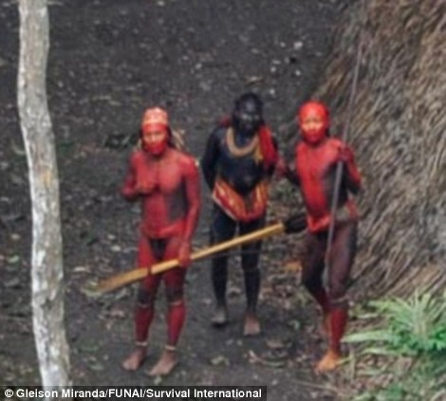

Slide 14
For more on the subject of endangered peoples . . .
http://www.survivalinternational.org/

