Slide 1
California Wildfires July 2016

Slide 2
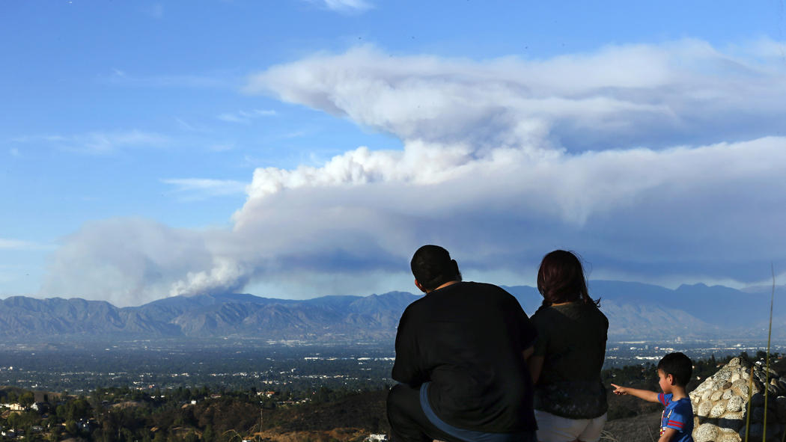
The Santa Clarita wildfire is visible from the Top of Topanga Overlook.

Slide 3
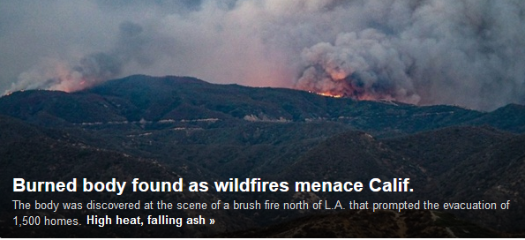

Slide 4
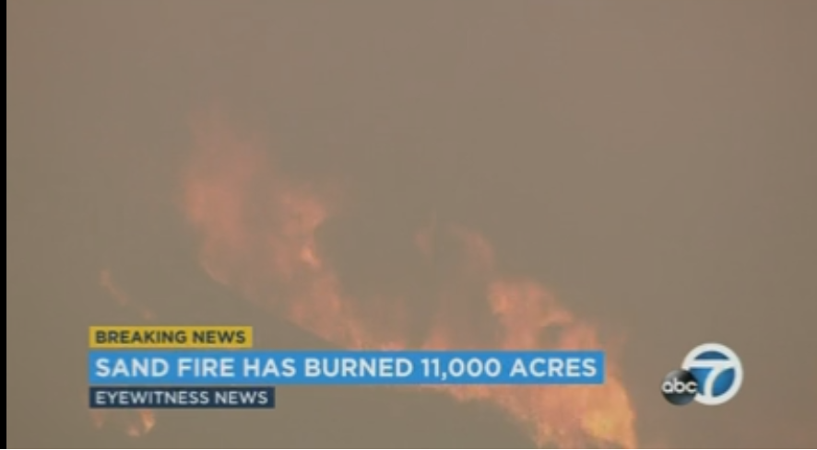

Slide 5
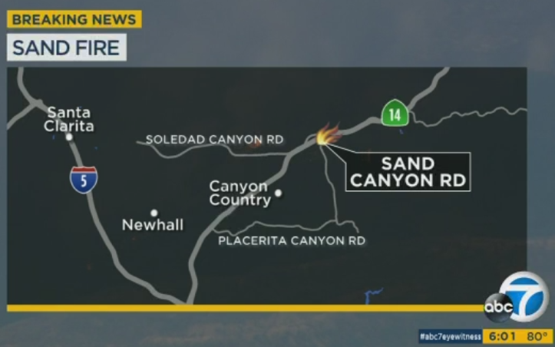

Slide 6
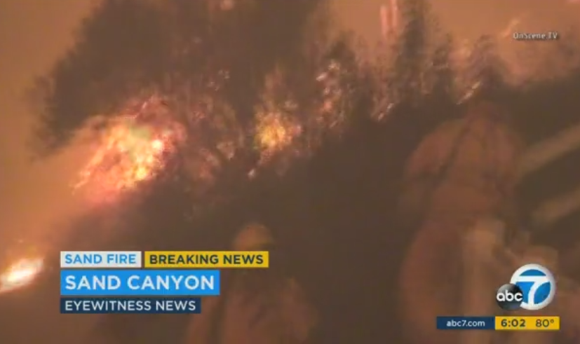

Slide 7
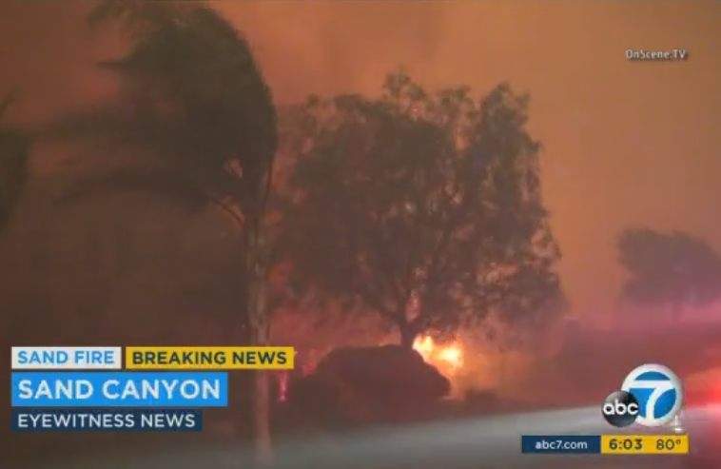

Slide 8
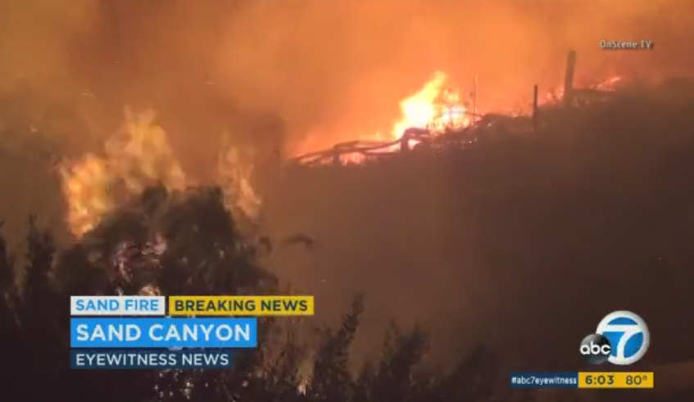

Slide 9
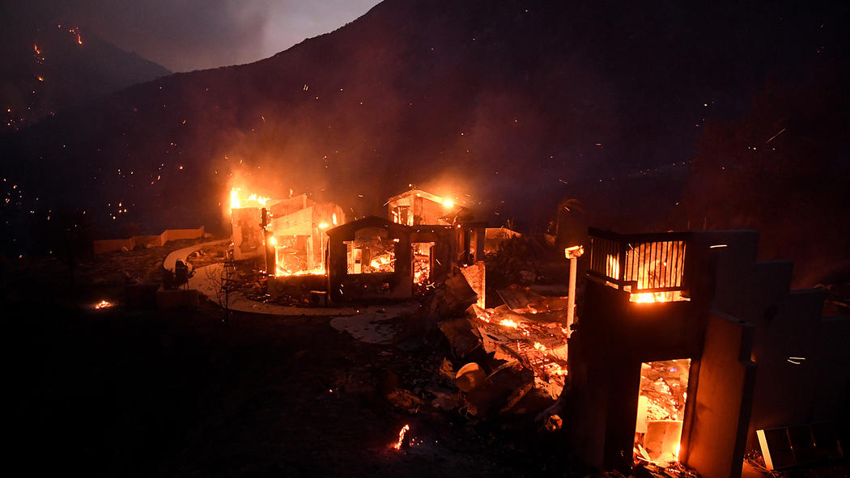
A house burns along Little Tujunga Canyon Road as the Sand Fire rages near Santa Clarita.

Slide 10
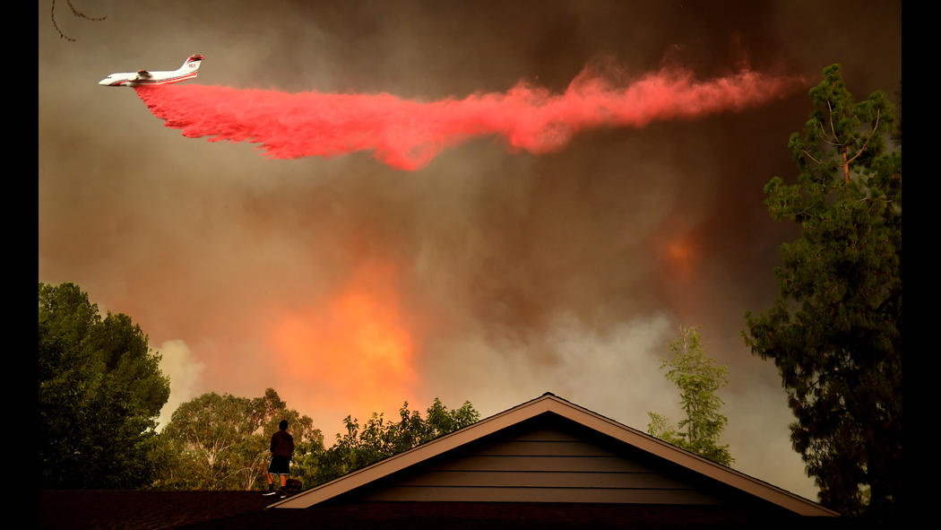
AJ Moberg, 15, waters down the roof of his family's house Saturday.

Slide 11
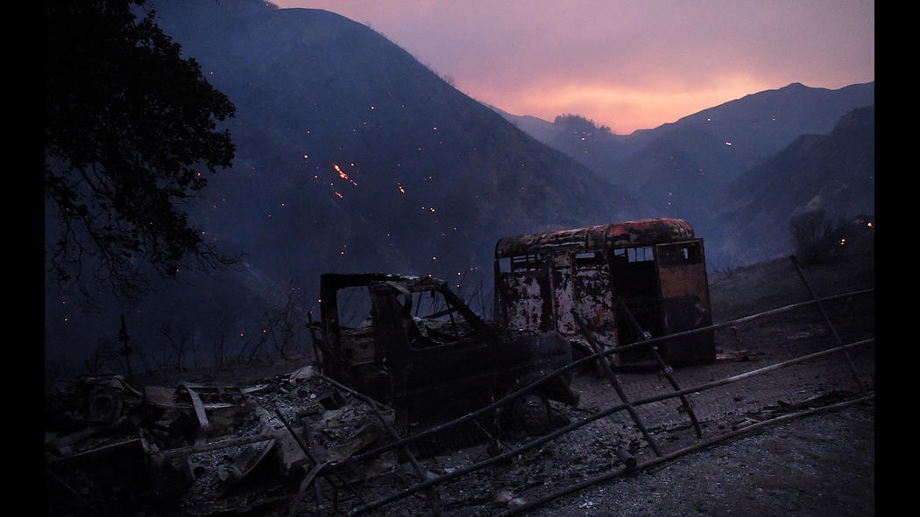
A burned van and trailer sit along Little Tujunga Canyon Road.

Slide 12
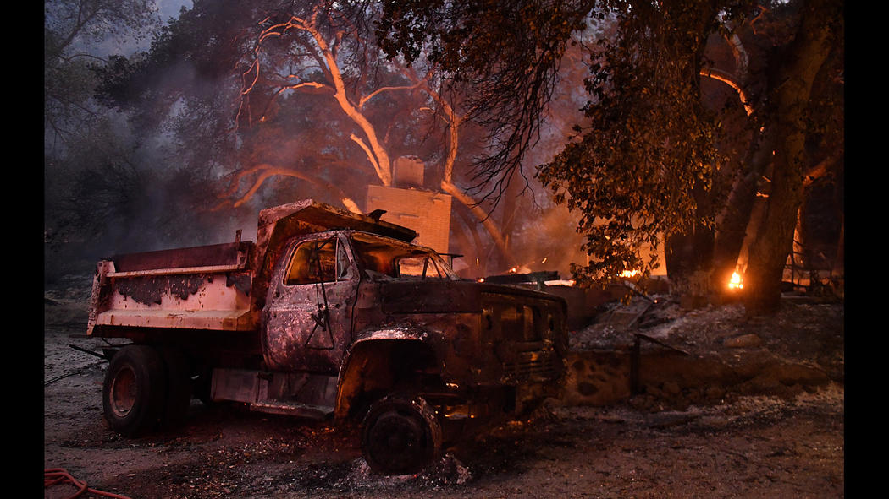
A truck and a house burn along Little Tujunga Canyon Road.

Slide 13
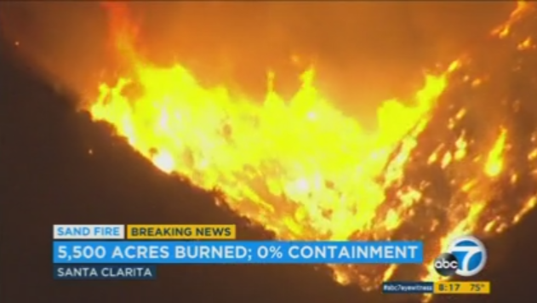

Slide 14
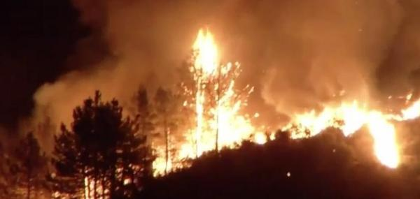

Slide 15
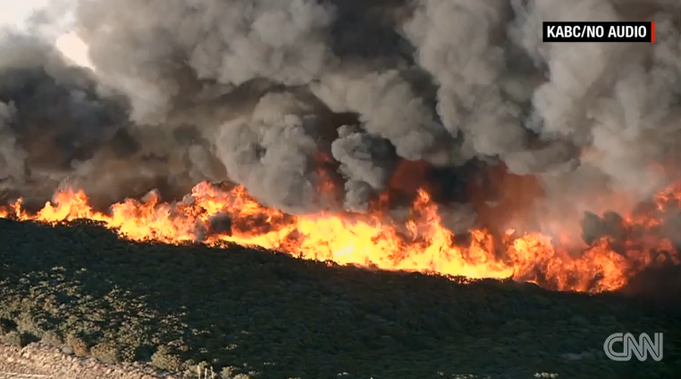

Slide 16
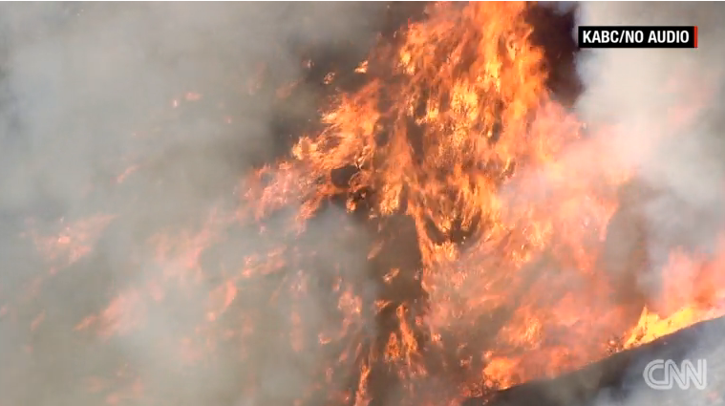

Slide 17
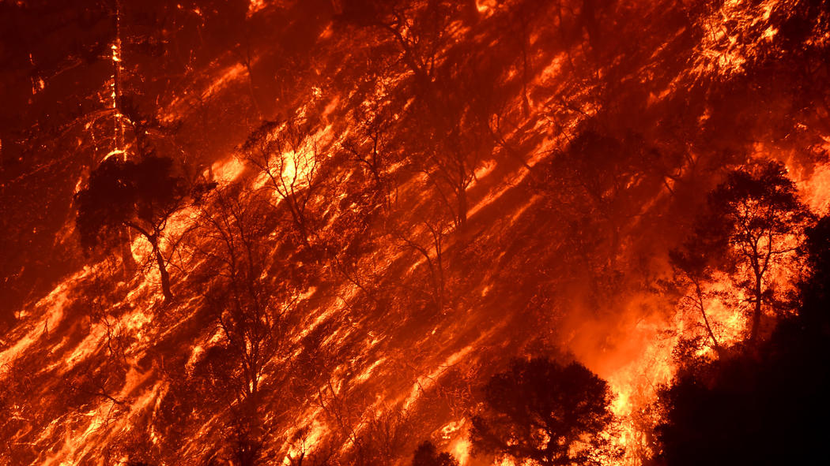
Flames from the Sand fire burn a hill near Little Tijunga on Saturday.

Slide 18
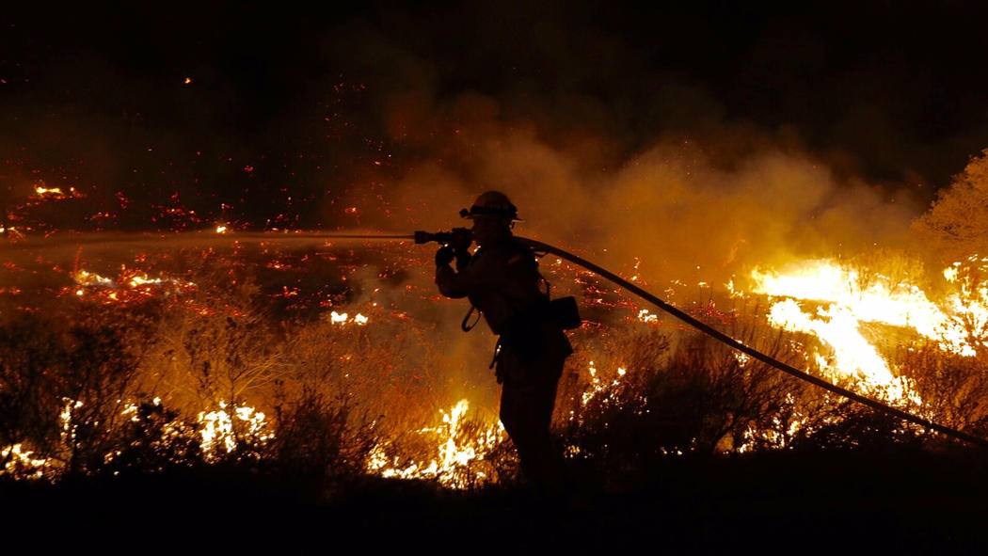
Joshua Miramontes with L.A. County Engine 82 works the fast-growing brush fire east of Santa Clarita.

Slide 19
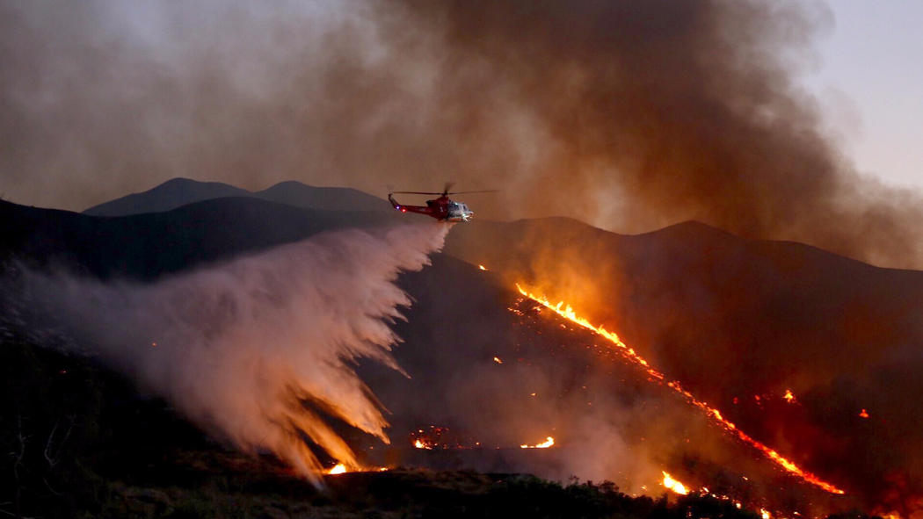
A helicopter drops water on the fast-growing brush fire east of Santa Clarita.

Slide 20
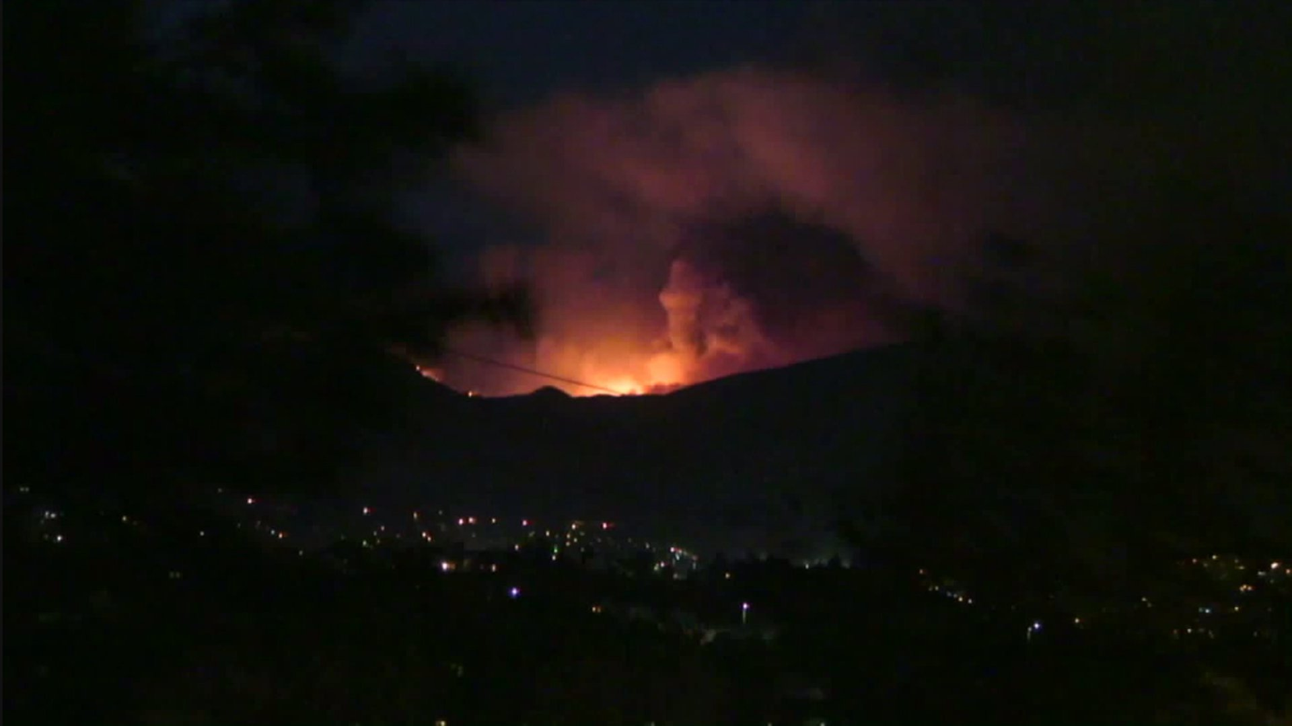
Flames from the Sand Fire burning in Santa Clarita light up the night sky in this image from the the Odyssey Restaurant

Slide 21
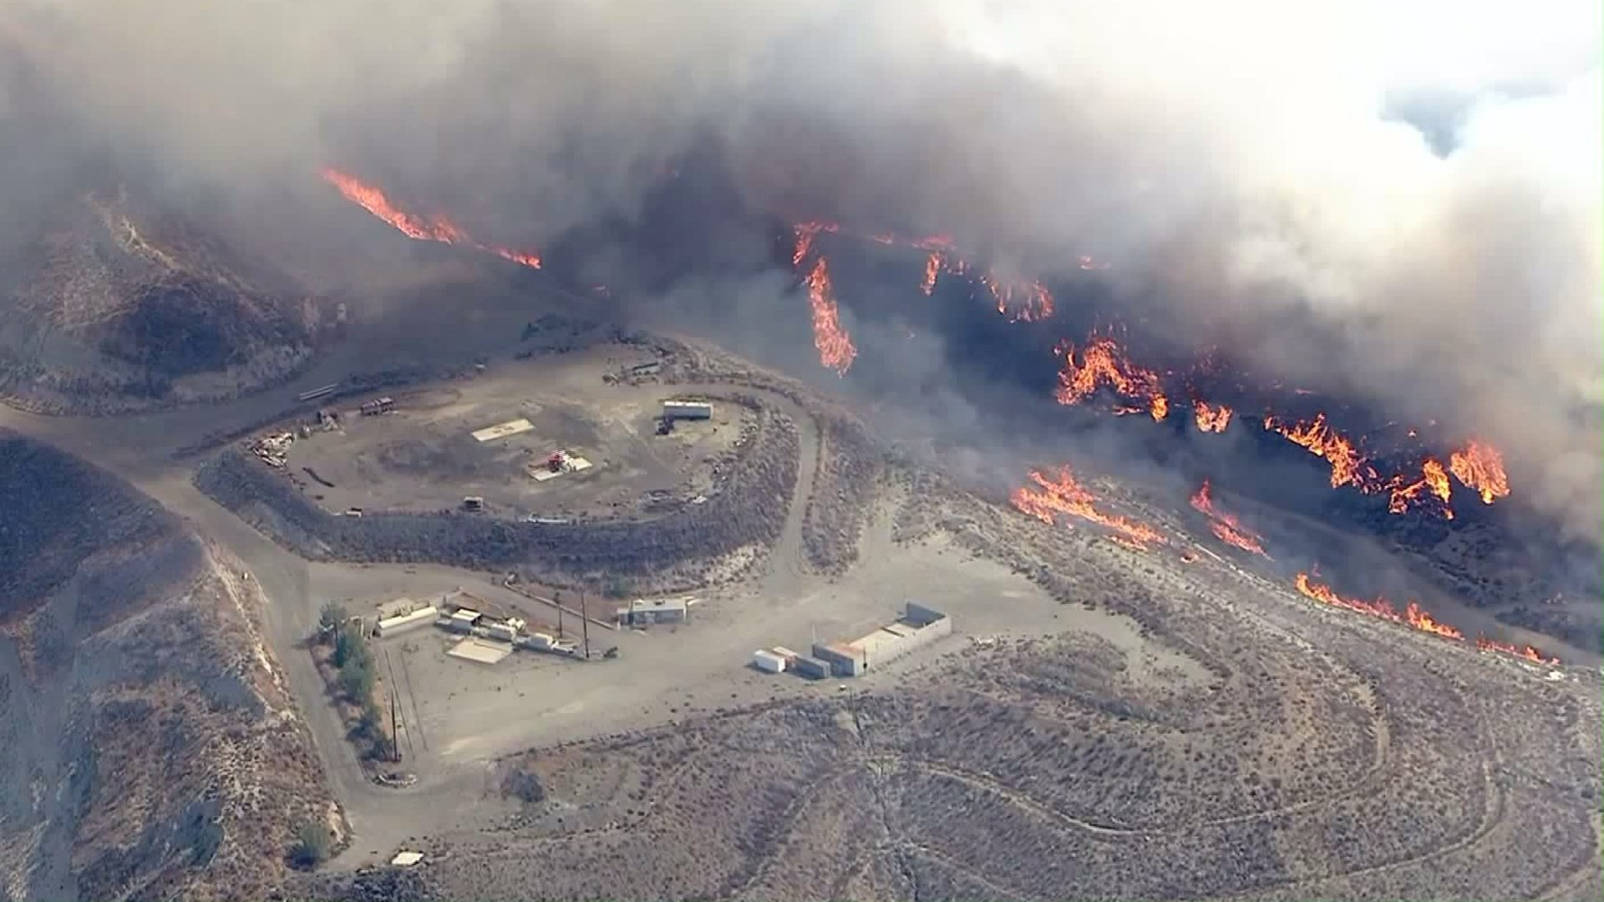
Smoke and flames rise from the Sand Fire on July 22, 2016. (Credit: KTLA)

Slide 22
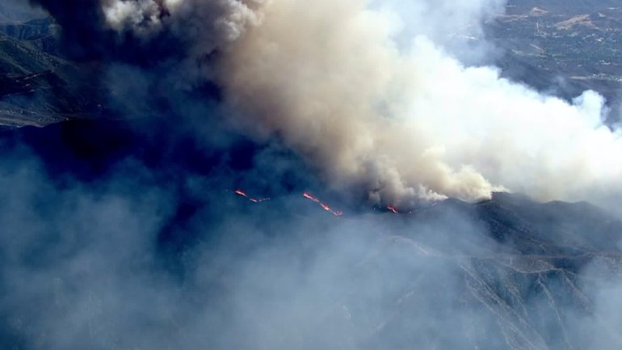
Smoke billows above the Sand Fire on July 22, 2016. (Credit: KTLA)

Slide 23
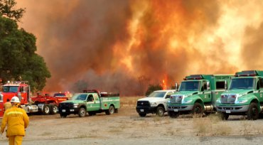

Slide 24
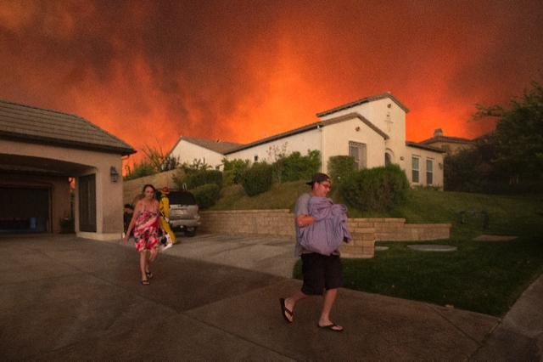
Evacuating

Slide 25
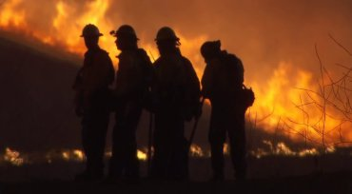

Slide 26
Other California Fires

Slide 27
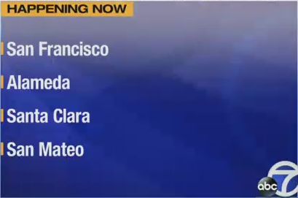

Slide 28
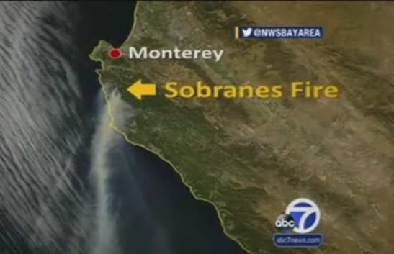

Slide 29
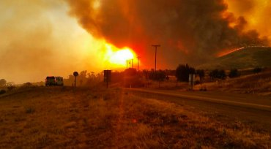
7,893 Acre Wildfire 62 Percent Contained in Santa Barbara County; Evacuation Areas Reduced

Slide 30
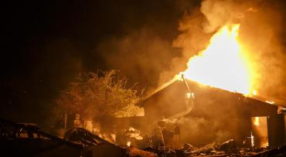
2 Dead, About 30,000 Acres Burned in Erskine Fire in Lake Isabella; Gov. Brown Issues State of Emergency

Slide 31
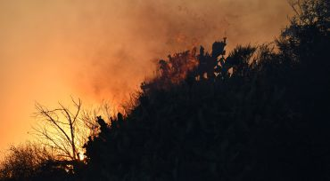
San Gabriel Complex Fires Burning Above Duarte, Azusa Char 4,900 Acres

Slide 32
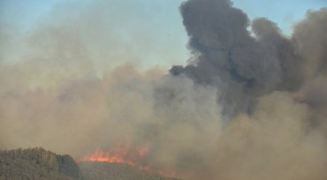
Fast-Moving ‘Sherpa Fire’ Forces Mandatory Evacuations in Santa Barbara County

