Slide 1
Tampere, Finland

Slide 2
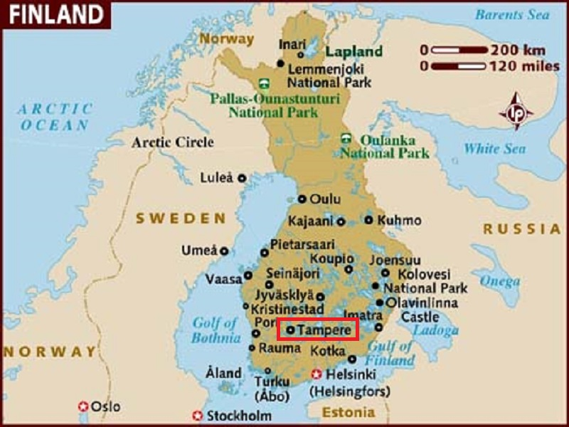
Tampere is a city in Pirkanmaa, southern Finland. It is the most populous inland city in any of the Nordic countries.

Slide 3
The city has a population of 223,292[7] growing to 313,058 people in the urban area, and 364,000 in the metropolitan area (Tampere sub-region) on an area of 4,977 km2 as of 2011. Tampere is the second-largest urban area and third most-populous individual municipality in the country, after Helsinki and Espoo municipalities (2014 data). It's also the most populous Finnish city outside the Greater Helsinki area and inner Finland's major urban, economic and cultural hub.
Tampere is between two lakes, Näsijärvi and Pyhäjärvi. Since the two lakes differ in level by 18 metres (59 ft), the rapids linking them, Tammerkoski, have been an important power source throughout history, most recently for generating electricity. Tampere is dubbed the "Manchester of Finland" for its industrial past as the former center of Finnish industry, and this has given rise to its Finnish nickname "Manse" and terms such as "Manserock".

Slide 4
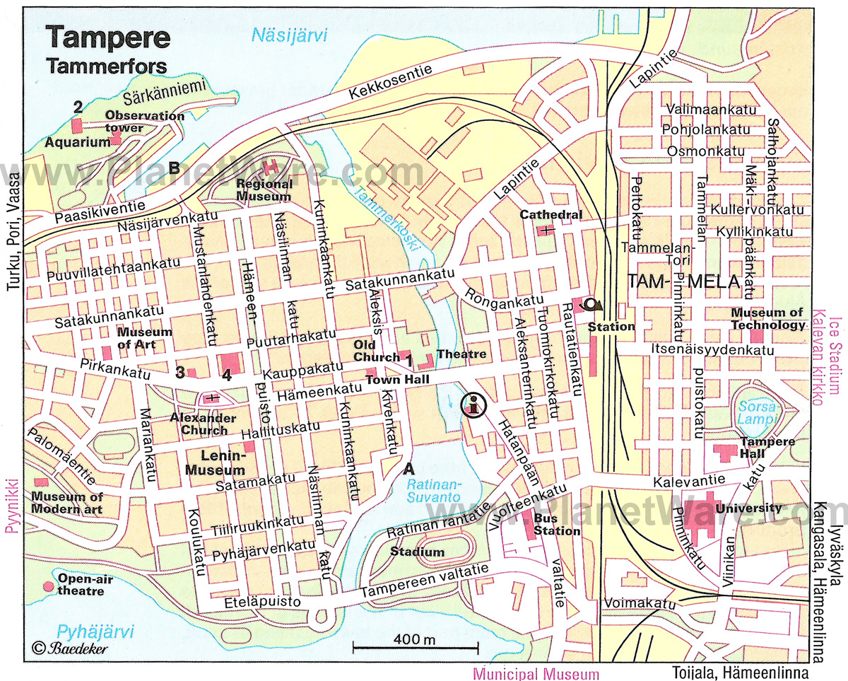

Slide 5
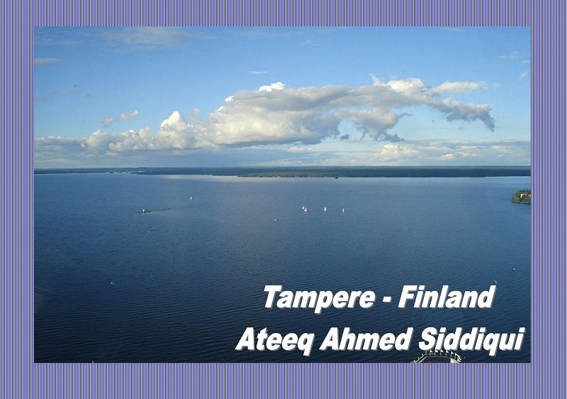

Slide 6
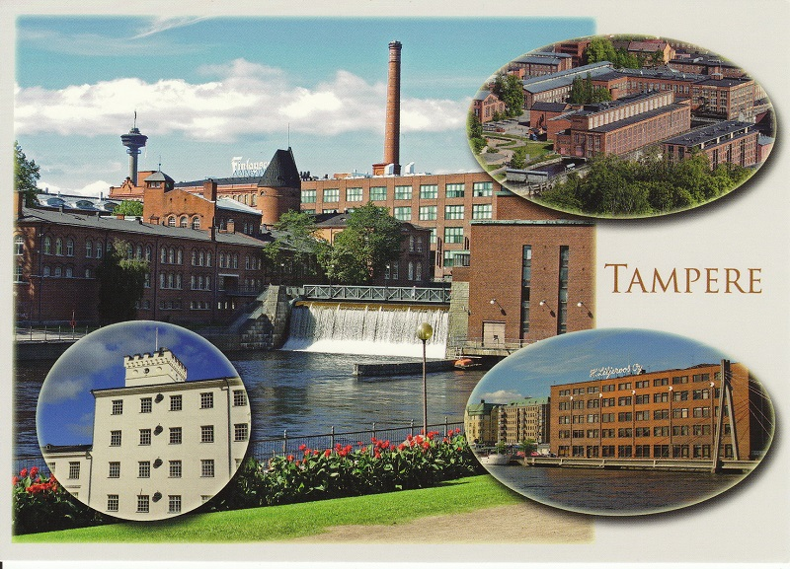

Slide 7
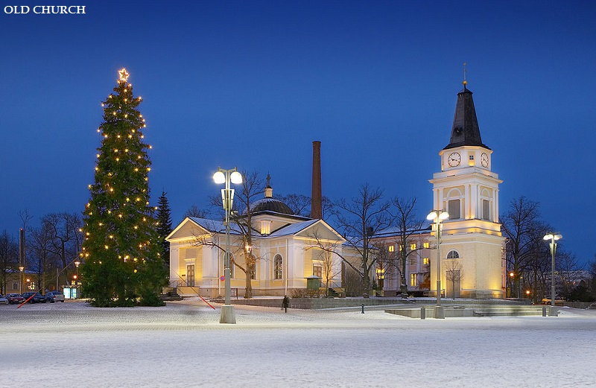

Slide 8
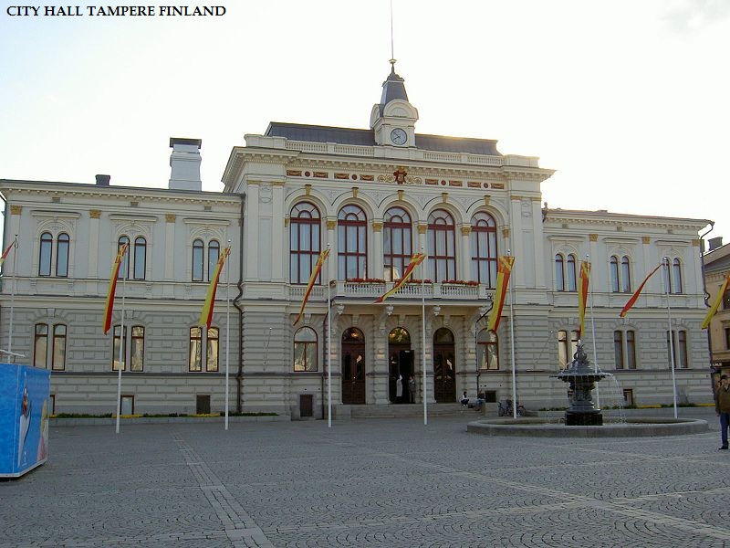

Slide 9
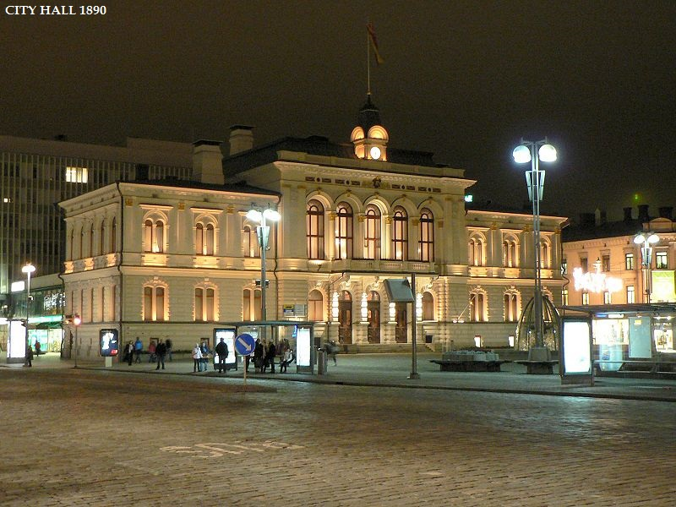

Slide 10
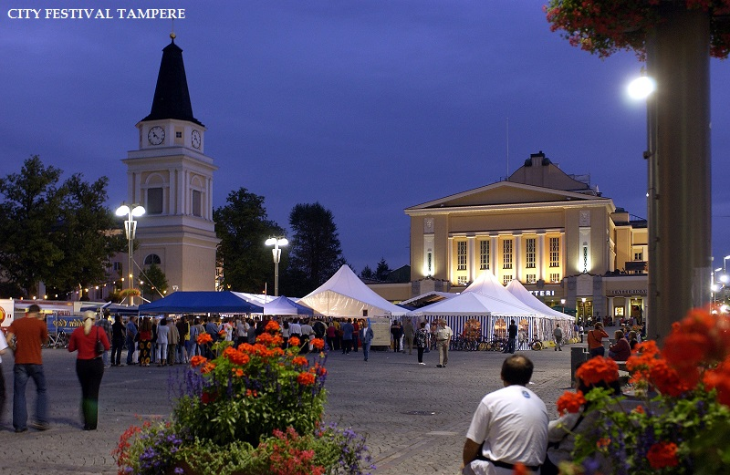

Slide 11
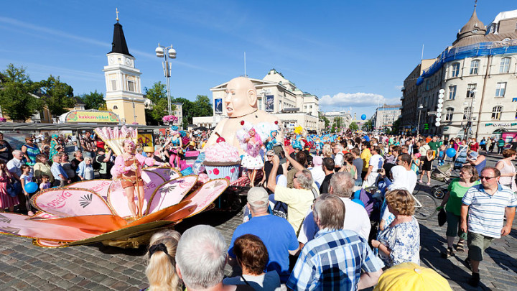

Slide 12
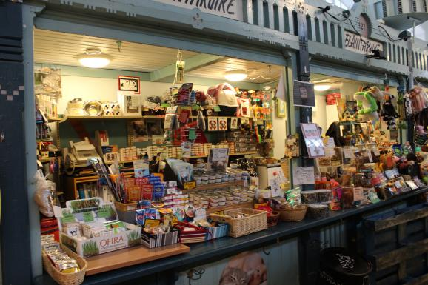
Tampereen Kauppahalli (central market)

Slide 13
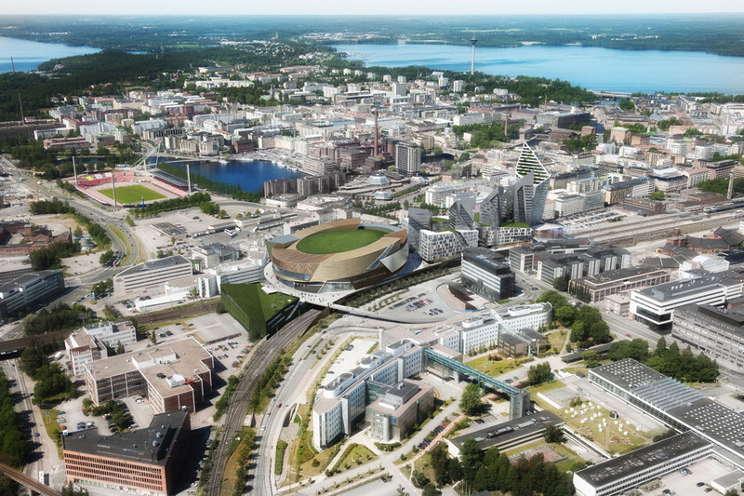

Slide 14
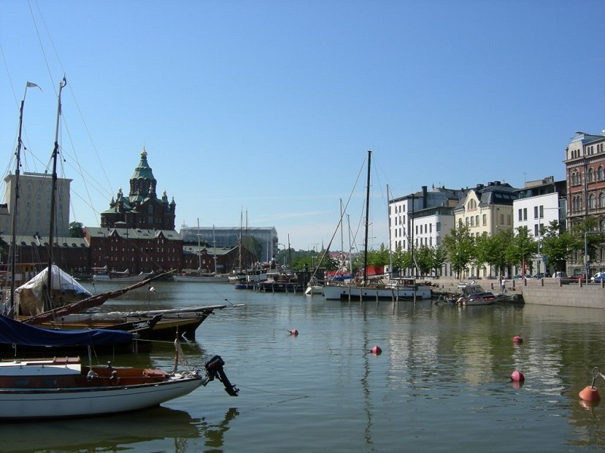

Slide 15
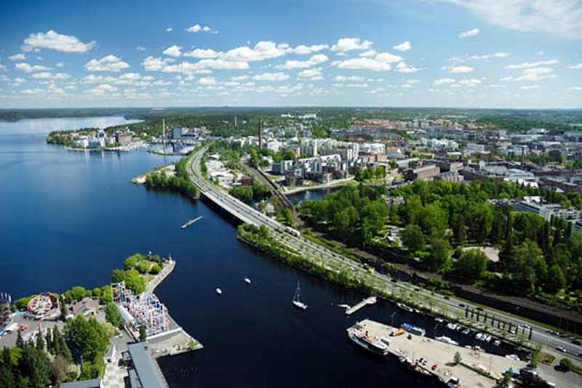

Slide 16
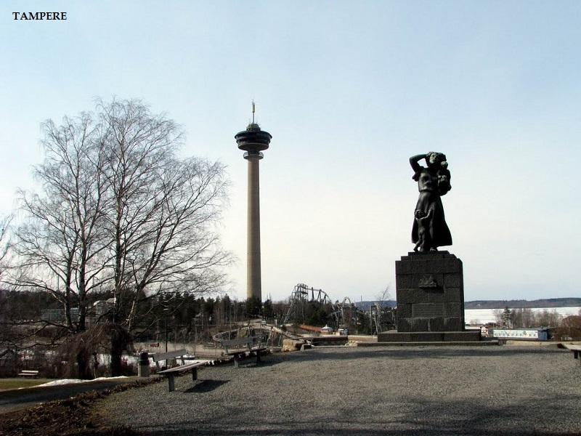

Slide 17
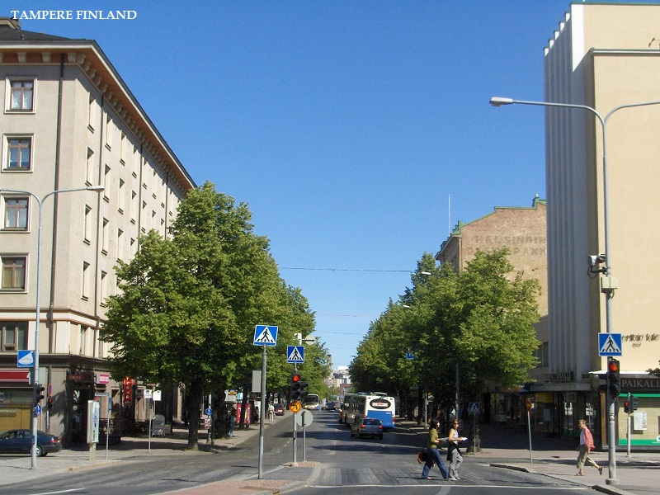

Slide 18
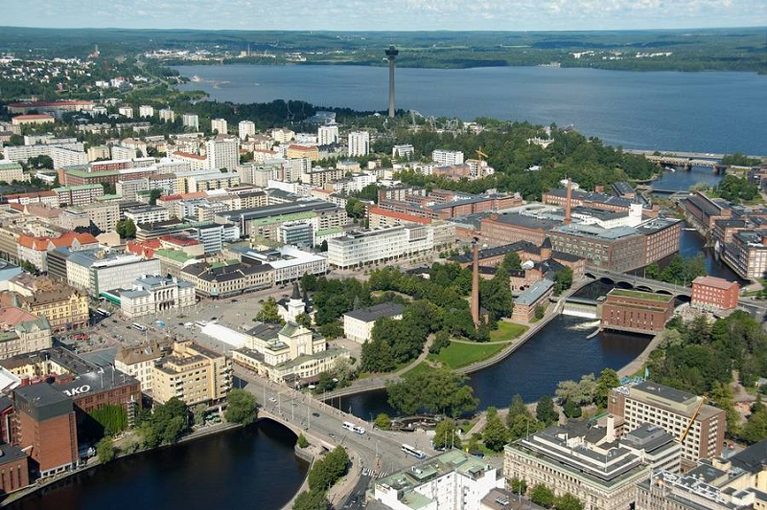

Slide 19
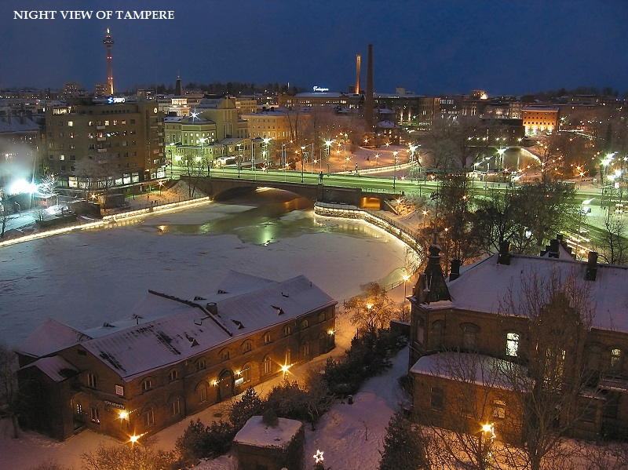

Slide 20
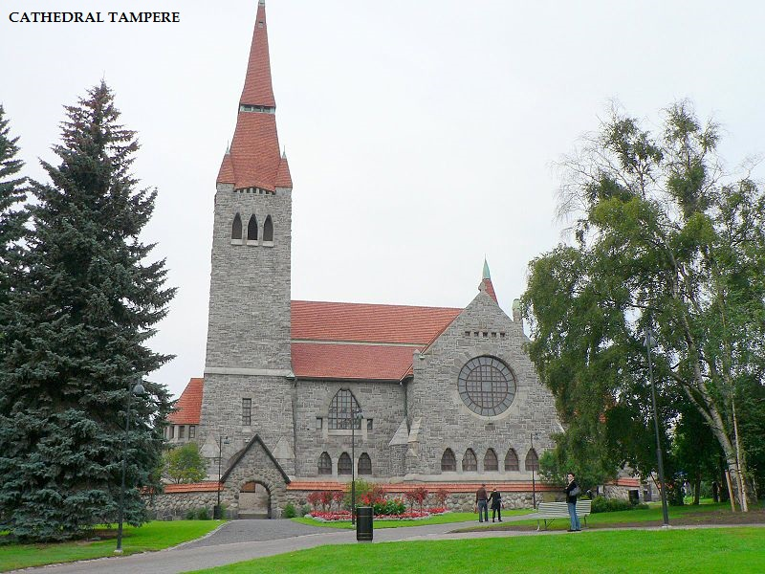

Slide 21
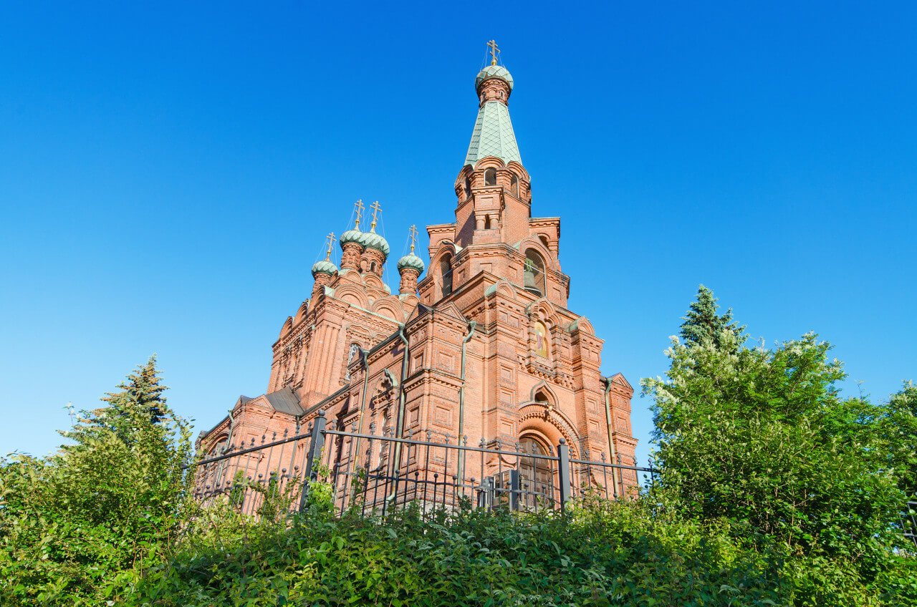

Slide 22
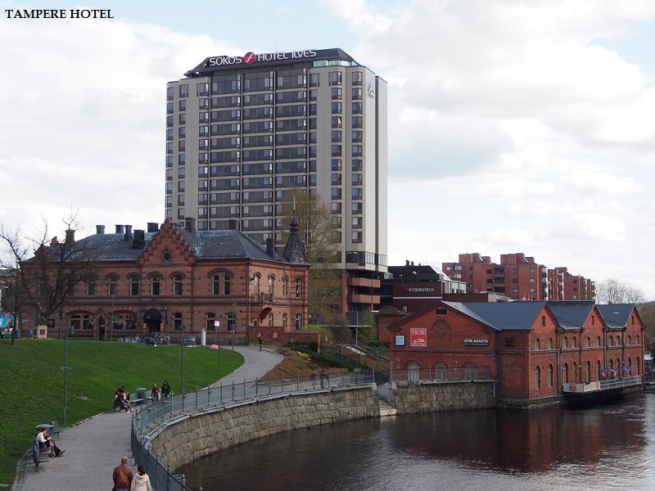

Slide 23
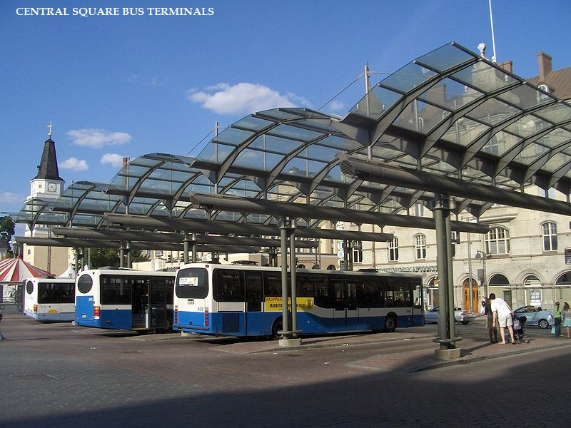

Slide 24
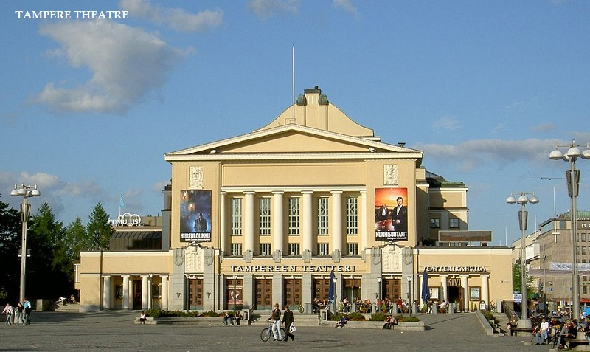

Slide 25
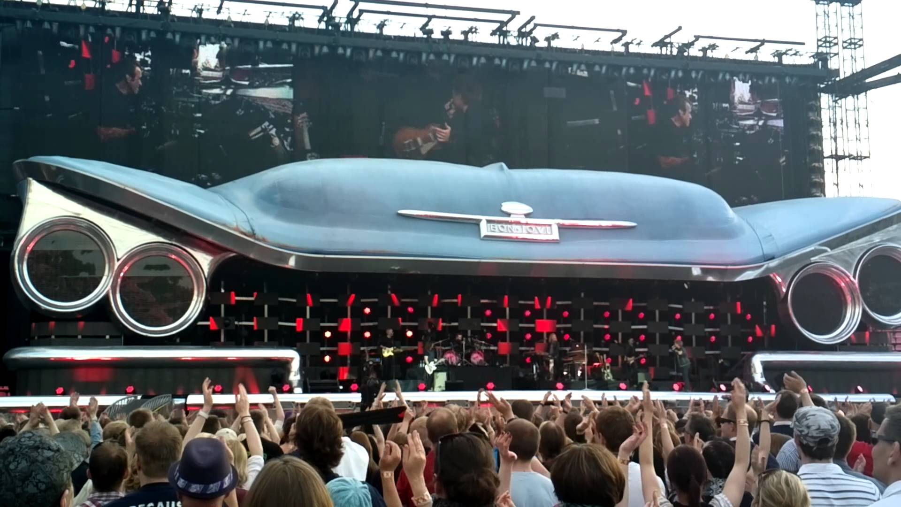
Bon Jovi Concert

Slide 26
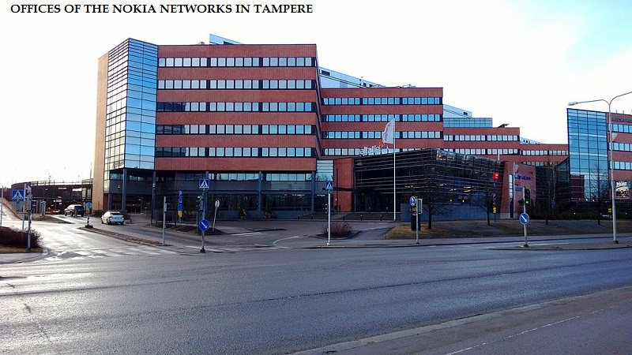

Slide 27
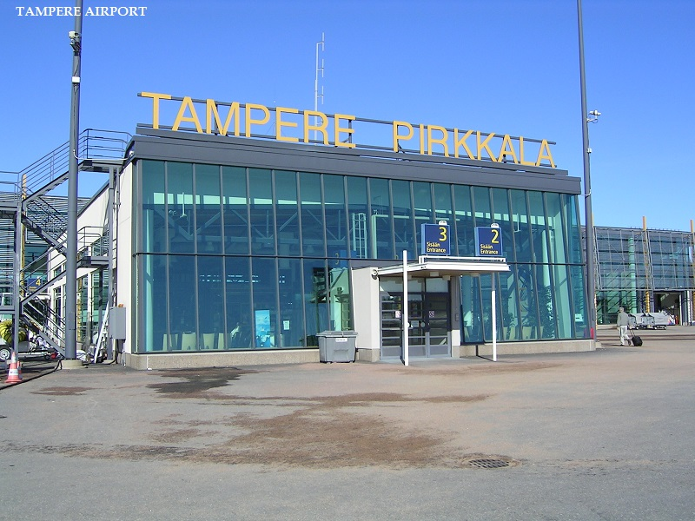

Slide 28
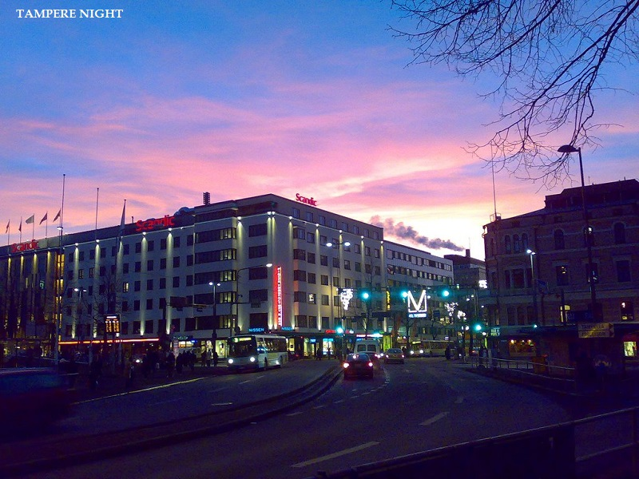

Slide 29
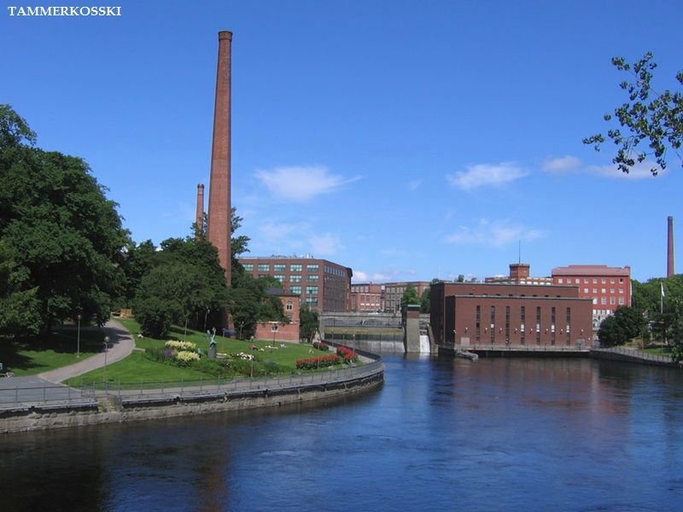

Slide 30
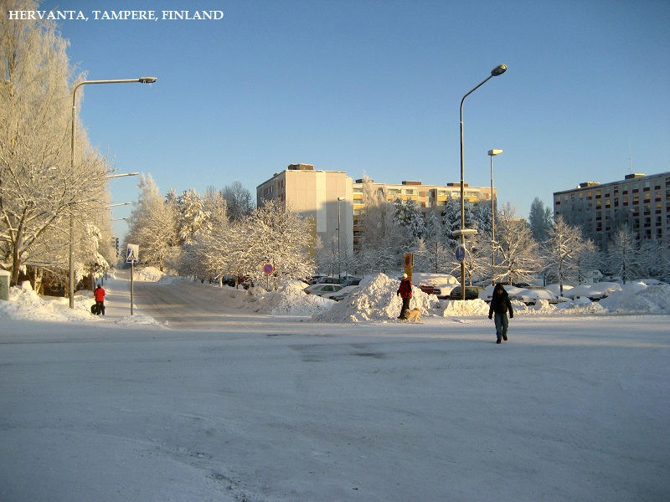

Slide 31
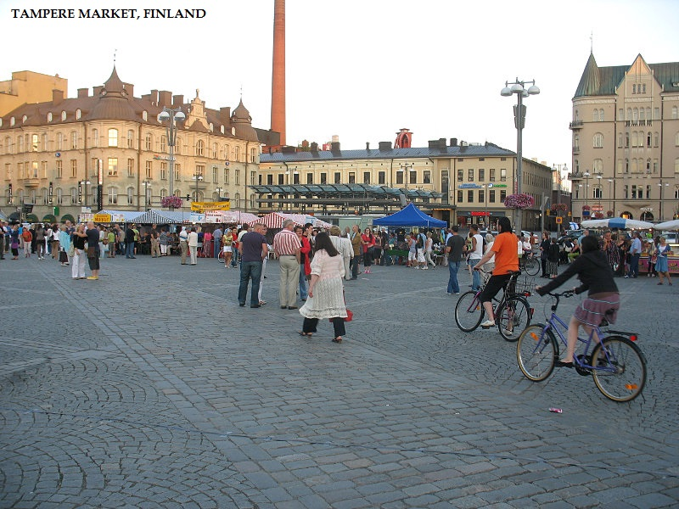

Slide 32
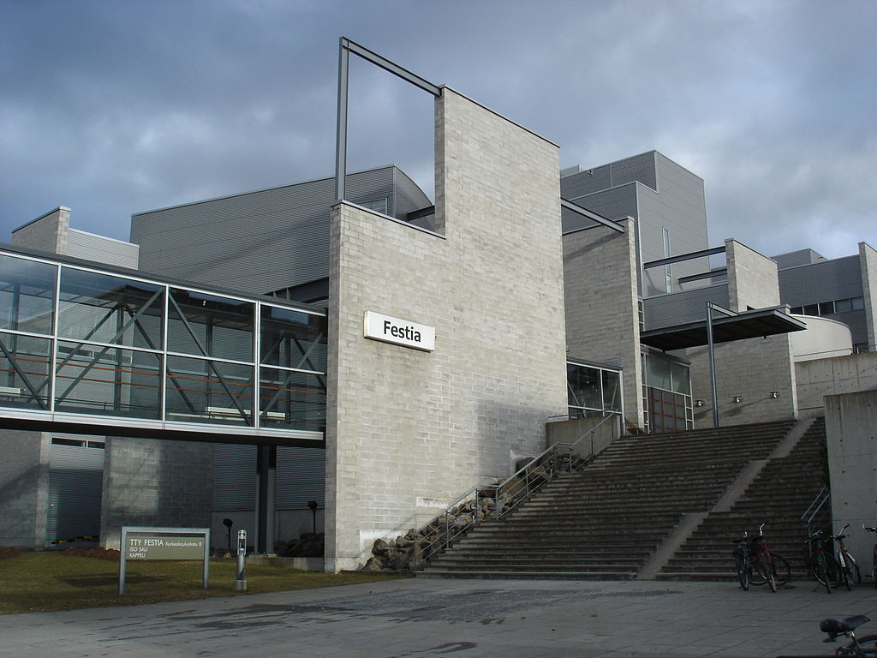
Tampere University of Technology, Festia building

Slide 33
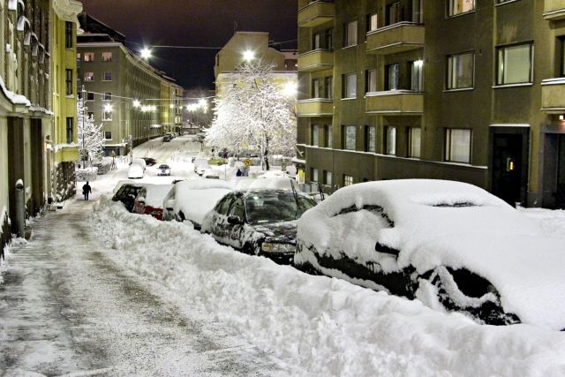
Winter

