Slide 1
China: Dragon Boat Festival
The boat racing component has become an international water competiton sport.

Slide 2
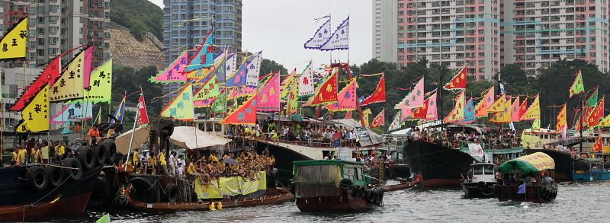
Background
The festival probably began with some religious meaning since dragons were considered gods of water bodies.
By the 21st century, it has transitioned into a largely secular sports competition held in many parts of the world.

Slide 3
The Legend
Contemporary folk tradition commonly attributes dragon boating racing's origins to the saving of a drowning folk hero in the 4th century BCE, Qu Yuan (formerly spelt Ch'u Yuan). But dragon boats are raced in some parts of China where this legendary figure is not venerated and revered, and the competitions predate the Qu Yuan legend itself,

Slide 4
The Dragon
The dragon plays the most venerated role within the Chinese mythological tradition. For example, of the 12 animals of the Chinese Zodiac the only mythical creature is the dragon. The rest are not mythical (e.g. dog, rat, tiger, horse, snake, rabbit, rooster, monkey, sheep, ox, pig - all of which are familiar to agrarian peasants.) Dragons are traditionally believed to be the rulers of rivers and seas and dominate the clouds and the rains of heaven. There are earth dragons, mountain dragons and sky or celestial dragons (Tian Long) in Chinese tradition.

Slide 5
Sacrifice
It is believed sacrifices were involved in the earliest boat racing rituals. During these ancient times, violent clashes between the crew members of the competing boats involved throwing stones and striking each other with bamboo stalks. Originally, paddlers or even an entire team falling into the water could receive no assistance from the onlookers as their misfortune was considered to be the will of the Dragon Deity which could not be interfered with. Those boaters who drowned were thought to have been sacrificed. That Qu Yuan sacrificed himself in protest through drowning speaks to this early notion.

Slide 6
Dragon boat racing traditionally coincides with the 5th day of the 5th Chinese lunar month (varying from late May to June on the modern Gregorian Calendar). This season is also associated with pestilence and disease, so is considered as a period of evil due to the high summer temperatures which can lead to rot and putrification in primitive societies lacking modern refrigeration and sanitation facilities. One custom involves cutting shapes of the five poisonous or venomous animals out of red paper, so as to ward off these evils. The paper snakes, centipedes, scorpions, lizards and toads - those that supposedly lured "evil spirits" - where sometimes placed in the mouths of the carved wooden dragons. Venerating the Dragon deity was meant to avert misfortune and calamity and encourage rainfall which is needed for the fertility of the crops and thus for the prosperity of an agrarian way of life.

Slide 16
The international aspect

Slide 17
Wellington, New Zealand 2005

Slide 18
Penang International Dragon Boat Festival, Malaysia

Slide 19
Lethbridge, Alberta, Canada

Slide 20
Colorado Dragon Boat Festival,

Slide 21
Taiwan

Slide 22
Boston

Slide 23
Singapore

Slide 24
Sudbury, Ontario

Slide 25
Chaohu City, China

Slide 26
Midwest Dragon Boat Festival, USA

Slide 27
Texas

Slide 28
Hong Kong

