Slide 1
Systems Analysis & Design Methods
“SADM”
IS 5800: Project Team
Dayanand Thakur & Teresa Zuro
November 6, 2007

Slide 2
Overall Objective
What is Systems Development Methodology?
Why is it important?
What are the roles & responsibilities?
What is the System Development Lifecycle
What are its common components?
Do companies really use development methodology?
Best Practices & Lessons Learned

Slide 3
What is Systems Analysis & Design Methodology?
Systems Analysis & Design Methodology (SADM) – A recommended collection of phases; procedures; rules; techniques; tools; documentation; management, and training to improve the quality of a software development effort. ¹
Various methodologies have emerged overtime ²
Transforming an ART into a SCIENCE through structured methodologies
Interchangeable Terms
  Systems Analysis & Design Methodology
  Systems Development Methodology
  Software Development Methodology

Slide 4
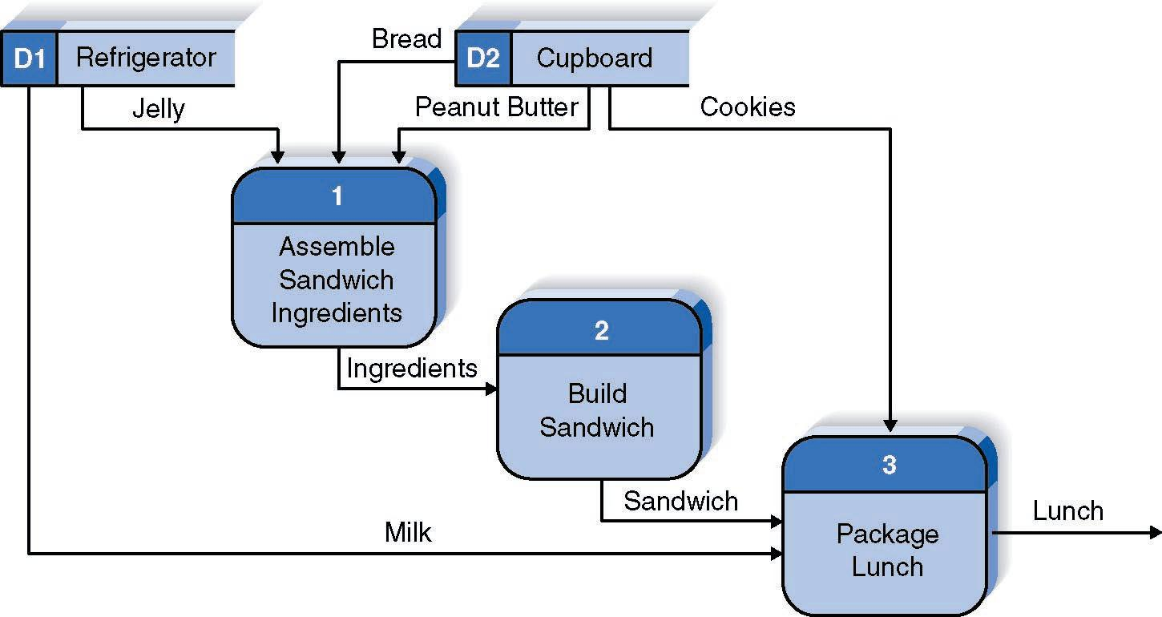
A Simple System “Making Lunch”
“Understanding the IT way of Thinking”
System – “Is composed of interacting parts that operate together to achieve some objective or purpose. A system is intended to absorb inputs, process them in some way and produce outputs. Outputs are defined by goals, objectives, or common purposes.” http://www.umsl.edu/~sauterv/analysis/intro/system.htm, reviewed 9/6/2007

Slide 5
Overall Message
What is systems development methodology?
Why is it important?
What are the roles & responsibilities?
What is the System Development Lifecycle
What are its common components?
Do companies really use development methodology?
Best Practices & Lessons Learned

Slide 6
SADM is Important to MBA Students!
  Preparation for future role as a business manager
  Bridging the gap between IT & Business through education
“Once general managers understand IT through experience and education, they are more likely to be involved in IT, and more likely to lead their organizations in achieving business success through IT.” - Lacity, M. Why General Managers Need to Understand Information Technology
http://mygateway.umsl.edu/webapps/portal/frameset.jsp?tab_id=_2_1&url=%2Fwebapps%2Fblackboard%2Fexecute%2Flauncher%3Ftype%3DCourse%26id%3D_16570_1%26url%3D

Slide 7
Why is SADM Important?
Software Evolution
  The expanding role of software in the information world forced attentions to software & development needs:
  Acceptable speed & cost for development
  Traceable time schedule for development process
  Software products need to be developed with assurances:
  High Quality
  Longevity—used/maintained over a long period of time
  Accommodate the changing requirements of the user
  Compliance

Slide 8




Why is SADM Important?
Managing Business Expectations & IT Capabilities
Systems Analysis & Design Methods:
  The methodology used will dictate how systems development gets done…
  That is, the strategy, steps, directions, or actions taken.
Common SAD Methods:
  Structured Systems Analysis & Design Methods (SSADM)
  Rapid Application Development Methods (RAD)
  Computer Assisted Software Engineering Tools (CASE)
Methodologies can be:
  Purchased
  Created in house
  Combination of both

Slide 9
Early Systems Development
“Too Much Ambiguity”
Unstructured Methods
Inadequate tools & techniques for analysis and design.
Business Requirements Not Satisfied
Extensive maintenance after implementation
Lack of business ownership
Requirements were misunderstood
Important data ignored or poorly analyzed
Over budget & not delivered on schedule
Poor project progress tracking
Limited user involvement
Poor resource planning

Slide 10
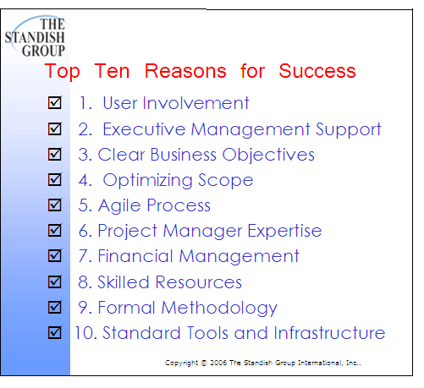
Formal Methodology
“Aim to better satisfy business objectives.”
Methodical Processes
Extensive user involvement
Time management
Aim to Satisfy Business Needs
Improved product quality
Formalized requirements analysis
Best practices techniques for analysis, design, and testing
Cost management
Resource management
Less ambiguity
Improved productivity
Reduced development lifecycle time
Business requirements satisfied
Reduction in post development costs
Fewer misunderstandings

Slide 11
Overall Message
What is systems development methodology?
Why is it important?
What are the roles & responsibilities?
What is the Systems Development Lifecycle
What are its common components?
Do companies really use development methodology?
Best Practices & Lessons Learned

Slide 12
Systems Development
Major Roles & Responsibilities
Project Sponsor
Project Manager
IT Project Team
End User

Slide 13

Project Sponsor
“Owner”
Most corporate leaders agree that this person should be the executive receiving a majority of the project’s benefits.
An effective business sponsor provides the leverage needed to promote, defend, and enhance the success of the business initiative.
Ultimately responsible for keeping the project on schedule, on budget, and achieving its planned benefits.
Develop a convincing business case.
Get approval to proceed & secure project funding
Monitor project progress
Chair the project steering committee
Sponsor a risk assessment
Be a project cheerleader
Remove project roadblocks
Assess project deliverables
Capture the benefits

Slide 14
Project Manager
“The Bus Driver”
Role of the Project Manager…
  Keep project on course
  Alert project owner of major roadblocks
  Navigate detours
  Keep everyone on board
  Maintain order
  Goal is to arrive at final destination on time & on budget
According to Peter Schulte, author of, Complex IT Project Management 16 Steps to Success, there are thirteen key questions that must be asked.
The purpose of the “Big Thirteen” is to:
  Uncover hard facts
  Assess the maturity of the project
  Get a feel for the positions and agendas of stakeholders
What is to be done?
What are the benefits?
Who benefits?
Who is the customer?
Who is the sponsor?
How will the deliverables fit the legacy system?
How much will the project cost?
What is the project timeline?
What are key dependencies?
What is the risk?
What are the success metrics?
How will we support this?
What is the shelf life?

Slide 15
IT Project Team
“The Mechanics”
The IT project team is the project’s “mechanic”.
Analyze business case
Feasibility study
Make recommendations
Design a system
Build the system
Test the system
Implement the system
Support the system

Slide 16
End User Community
“The Passengers”
The end user is the “passenger” on the project journey. Some have a more detailed role but all should benefit from the ride.
“We provide input to the needs and requirements analysis. We also participate in systems design and testing.”

Slide 17
Overall Message
What is systems development methodology?
Why is it important?
What are the roles & responsibilities?
What is the Systems Development Lifecycle
What are its common components?
Do companies really use development methodology?
Best Practices & Lessons Learned

Slide 18

System Development Lifecycle
“Systems development is the process of developing information systems through successive phases in an orderly way.” http://whatis.techtarget.com/definition/0,,sid9_gci936454,00.html, reviewed 9/14/2007

Slide 19
System Development Lifecycle Phases
PROJECT MANAGEMENT PHASES
Planning
Requirements
Analysis
Design
Development
Testing
Implementation
Planning
Analysis
Design
Implementation

Slide 20
Systems Development Lifecycle
Questions Answered
Planning
Why build the system?
Analysis
Who uses the system?
What will it do?
When & where will it be used?
Design
How will the system work?
Implementation
System delivery
Post-implementation support
How do we structure the project?

Slide 21
Systems Development Lifecycle
Participants
Planning
Project Sponsor
Analysis
Project Manager *
Design
Project Manager *
Implementation
Project Manager *
Business Managers *
Business Systems Analyst*
Business Systems Analyst*
Business Managers *
Technical Expert
Project Manager *
Business Systems Analyst*
End Users *
End Users *
End Users *
Business Managers*
Technical Developers
Business Managers *
Business Systems Analyst*
Technical Developers
End Users *
Vendor Consultant
Vendor Consultant

Slide 22

Systems Development Lifecycle
Definitions
PROJECT CHARTER – “is a statement of the scope, objectives and participants in a project… It serves as a reference of authority for the future of the project.”
REQUIREMENTS/NEEDS ANALYSIS – “encompasses those tasks that go into determining the needs or conditions to meet for a new or altered device, taking account of the possibly conflicting requirements of the various stakeholders.”
  Functional Requirements—specific functions that the software performs.
  Non-functional Requirements—such as performance, operational environment, standards conformance, reliability, robustness, accuracy of data, correctness.
SPECIFICATIONS ANALYSIS – “A project's specifications consist of the body of information that should guide the project developers, engineers, and designers through the work of creating the software.”

Slide 23
Project Requirements Vs. Specifications
Project Scope | Requirement | Specification
Family Vacation
LOCATION
Florida
U.S.
Gulf Coast
TRANSPORTATION
Condo
Sleeps 6
Within 1 block
of beach
Swimming Pool on Site
ACCOMMODATIONS
Driving
Family Car
DATE
Month of July

Slide 24
Systems Development Lifecycle
Definitions
TECHNICAL FEASIBILITY STUDY – “Involves questions such as whether the technology needed for the system exists, how difficult it will be to build, and whether the firm has enough experience using that technology. The assessment is based on an outline design of system requirements in terms of Input; Output; Fields; Programs, and Procedures.”
CONCEPTUAL SYSTEM DESIGN - “A conceptual system is simply a model. There is no limitations on this kind of model whatsoever except those of human imagination. “
SYSTEMS INTEGRATION TESTING – “is testing conducted on a complete, integrated system to evaluate the system's compliance with its specified requirements.”

Slide 25
Systems Development Lifecycle
Deliverables
PLANNING
Project Charter & Business Case
ANALYSIS
DESIGN
Physical design “Prototypes”
IMPLEMENTATION
Project Managers “Big 13”
Feasibility Study
Specifications analysis
Conceptual design
User acceptance testing
Construction –Develop and/or Purchase
Post-implementation audit, maintenance & support
Form CORE project team
System testing
Needs /Requirements analysis
System integration & testing

Slide 26
Overall Message
What is systems development methodology?
Why is it important?
What are the roles & responsibilities?
What is the Systems Development Lifecycle
What are its common components?
Do companies really use development methodology?
Best Practices & Lessons Learned

Slide 27
System Development Methodology
Two Common Approaches
Methodology
Rapid Application Development (RAD)
Joint Application Development
Structured Systems Analysis & Design (SSADM)
Spiral
Waterfall
Iterative

Slide 28
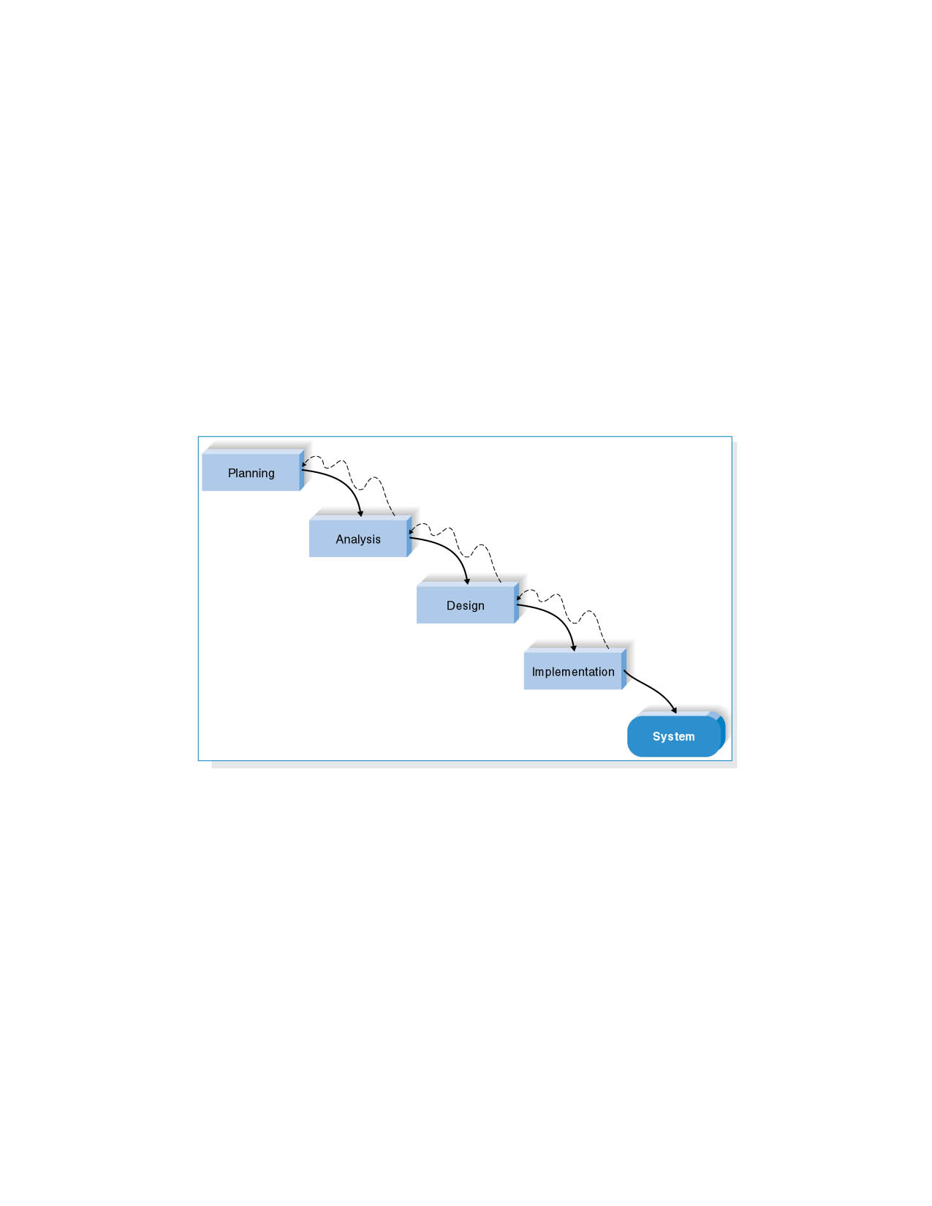
The Waterfall Model-Basic Concepts
Project is divided into sequential phases ,with some overlap acceptable between phases.
Emphasis is on planning, time schedules, target dates, budgets and implementation of entire system at one time.
Tight control is maintained over the life of project through the extensive use of documentation as well as through formal reviews and approvals by user and IT management occurring at the end of most of the phase before beginning of the next phase.
Paul Fisher,James Mc Daniel and Peter Hughes," System Development lifecycle Models and Methodologies", Canadian Society for International Health certificate course in Health Information systems,Module-3,Part-3:Lifecycle Models and Methodologies.
Alan Dennis, Barbara Haley Wixom, and Roberta Roth, “System Analysis and Design” 3rd Edition, John Wiley and Sons Inc.

Slide 29
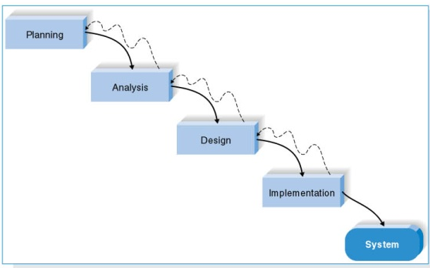
Waterfall Model
Strengths
Ideal for supporting less experienced project teams.
Orderly sequence of steps and strict control ensures Quality, Reliability and Maintainability of developed system.
Progress is measurable.
Weaknesses
Inflexible, slow, Costly and Cumbersome.
Problems not identified until testing.
Difficult to respond to changes.
Depends on early identification and specification of requirements, yet users may not be able to clearly define them.
Daryl Green and Ann DiCaterino, “A survey of system development process models”, CTS Albany,Feb.1998.

Slide 30
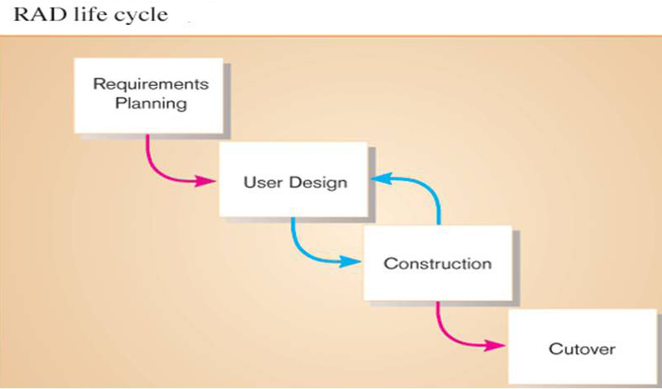
RAD – Phased Development Methodology
User design: users and IS professionals participate in JAD sessions
This methodology breaks the overall system into a series of versions that are developed sequentially.
The team categorizes the requirements into a series of versions, then the most important and fundamental requirements are bundled into the first version of the system.
The analysis phase then leads into design and implementation; however, only with the set of requirements identified for version 1.
As each version is completed, the team begins work on a new version.
Cutover is delivery of new system to end users

Slide 31

RAD Methodology
Strengths
Weaknesses
Early visibility
Greatly reduced manual coding
Increased user involvement
Possibly fewer defects
Possibly reduced cost
Shorter development cycles
Standardized look and feel
Buying corporate software components could be costly
Application is less efficient and less precise
May accidentally empower a return to the uncontrolled practices of the early days of software development
Reduced features
Reliance on third-party components may
  sacrifice needed functionality
  add unneeded functionality
  create legal problems
Software Engineering – Sommerville; seventh edition; Pearson Education. – Chapters 4,7

Slide 32
System Development Life Cycle
Tools & Techniques
Techniques and Tools Representing
System Flow
Data Flow Diagrams
Data
ER Diagrams
Process Logic
Communication with Users
Data Dictionary
Data Structure Diagrams
Interviews
User Reviews
JAD Sessions
Decision Tree /Table
Structured Charts
Business Area Analysis
Process Model
Business Area Analysis
Brain Storming
Business Systems Design

Slide 33
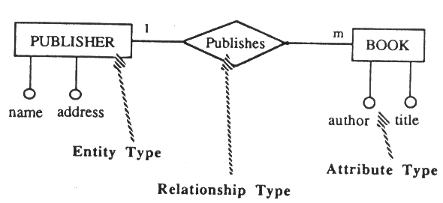
Entity-Relationship Diagrams
A graphical representation of the data layout of a system at a high level of abstraction.
Defines data elements and their inter-relationships in the system
The ERD is an implementation-independent representation of a problem domain and it facilitates communication between the end-user and the analyst.
The basic components of the ERD are entities, properties of entities called attributes, and relationships between entities.

Slide 34
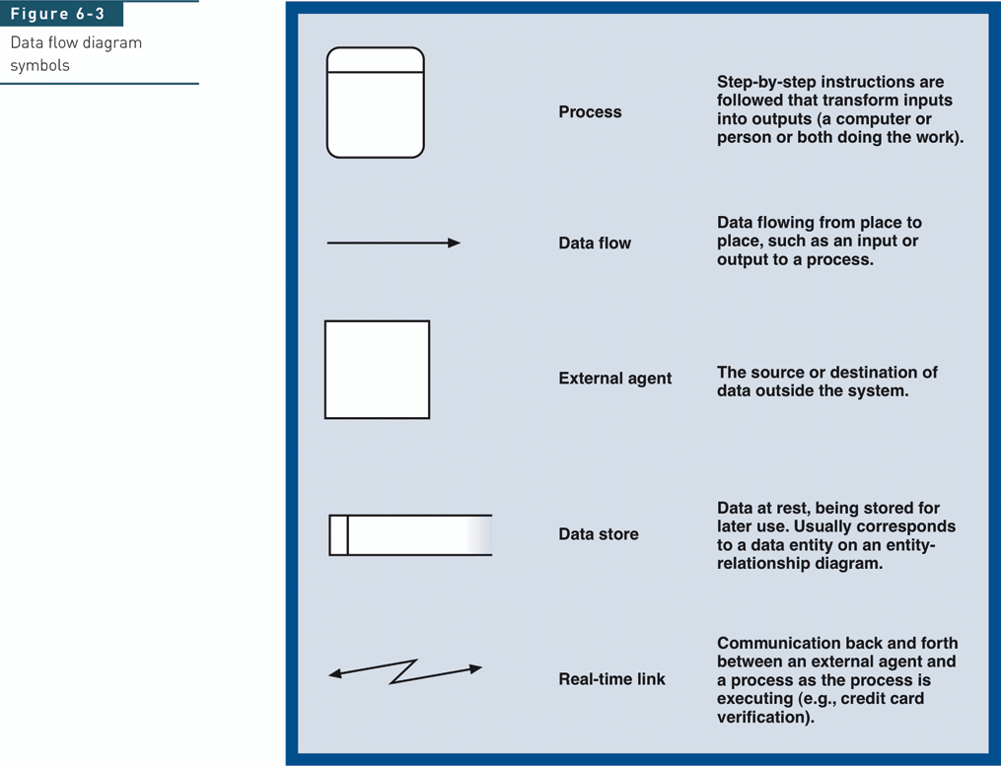
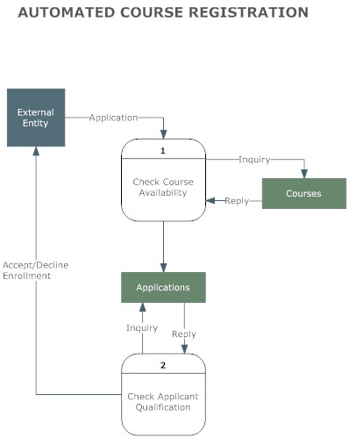
Data Flow Diagrams

Slide 35
Data Dictionary
➜ Data dictionary
  Defines each data element and data group
  Use of BNF to define structure of data groups
Example Data Dictionary
Mailing Label = customer_name +customer address
customer_name =customer_last_name +customer_first_name +customer_middle_initial
customer_address =local_address +community_address + zip_code
local_address =house_number + street_name +(apt_number)
community address =city_name + [state_name |province_name]

Slide 36
CASE Tools
Computer-Aided Software Engineering
Diagramming tools
Screen and report generators
Analysis tools
Repository
Documentation generators
Code generators
  support contemporary systems development
  automate step-by-step development methods
  reduce the amount of repetitive work
  allow developers to free their “mind cycles” for more creative problem-solving tasks

Slide 37
CASE Tools
Ab
Integrated CASE tools
  support the entire SDLC
Upper CASE
  Used to automate the first three phases of SDLC
Lower CASE
  Used to automate the last two phases of SDLC
A
b

Slide 38
Factors Affecting Use of
SAD Methods
Waterfall vs. Prototyping
1. Development Team Size
Large = Waterfall
Small = Prototype
2. Organization Innovativeness
Late Adopter = Waterfall
Early Adopter = Prototype
3. Developers’ Beliefs/Perceived Consequences of Process Quality
Project control = Waterfall
Communication with users = Prototype
Research by: Khalifa & Verner (2000)
N = 82 senior software developers
Questionnaire
Australia & Hong Kong
Well-established organizations with many years of software development experience.
Average IS staff: 200

Slide 39
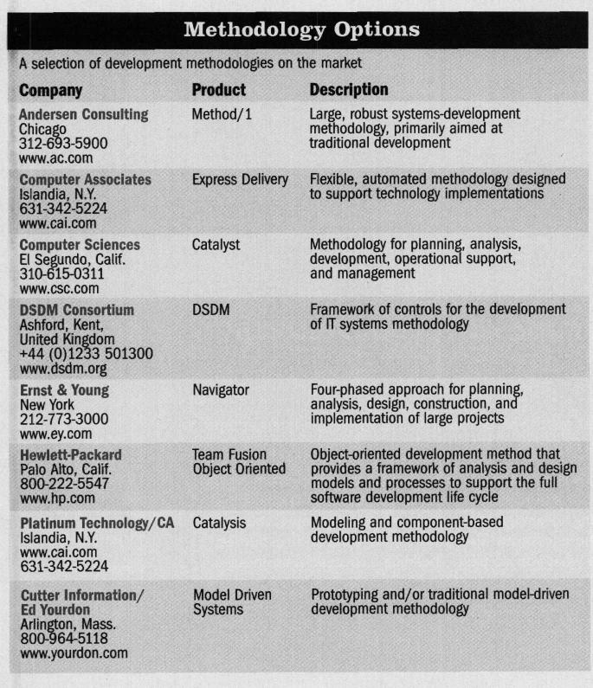
Development methodology products found in the market today.

Slide 40
Overall Message
What is systems development methodology?
Why is it important?
What are the roles & responsibilities?
What is the Systems Development Lifecycle
What are its common components?
Do companies really use development methodology?
Best Practices & Lessons Learned

Slide 41
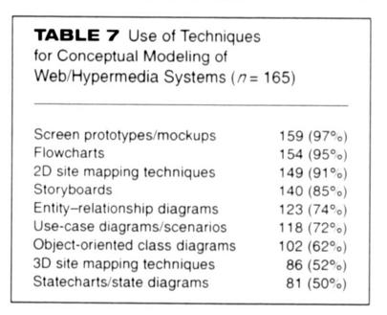
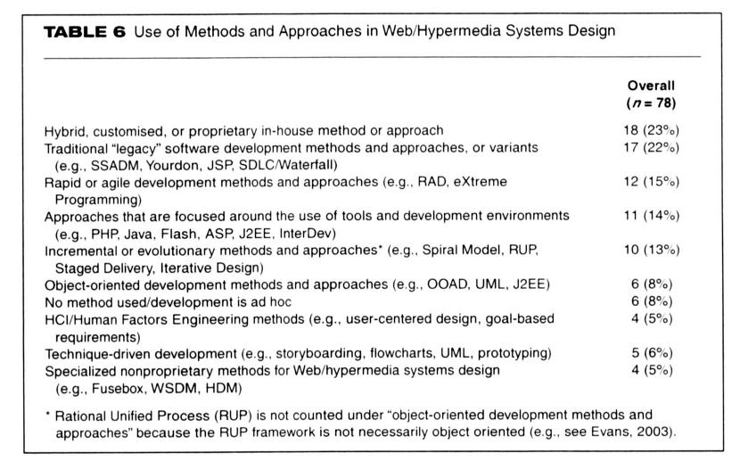
Research Shows….
Research by: Lang & Fitzgerald Format: Web & Postal Survey
Location: Ireland Original Population: 438
Response Rate: 45%

Slide 42
Fortune 1000 Company
Case Study #1
SADM Implementation
Effectiveness
185 Application Developers
Going from no methodology to a comprehensive company wide methodology.
Methodology was adaptable to many project types.
Training: 150 page guide and access to online version with links to tools & templates
CIO Support: All developers received a formal written policy to begin using methodology for all projects.
Measurable improvements within 6 months
Based on comparison of 2,251 projects before methodology & 280 projects after:
  18% increase in on-budget performance
  26% reduction in number of late projects
  25% reduction in average days late
  Higher customer satisfaction
  Less training time required for new hires and transfers among teams

Slide 43
A More Detailed Look
Fortune 100 Company - Case Study #2
Revenues
Sector: Financial
Lines of Business:
  Community Banking
  Home and Consumer Finance (HCFG) *
  Wholesale Banking
Total Revenue (2006): $35,691MM
Employees:
  Total Employees—158,000 +
  IT Employees—6,800
IT Support Group: Technology Information Group (TIG)

Slide 44
Technology Information Group (TIG)
8 – Divisions / 6,800 Employees
CEO
TIG CIO
Info Services
Tech Infrastructure
Tech & Enterprise Services
Wireless & Tech Shared Services
EACO
Finance
Accounting
Human Resources
CIO
HCFG
Relationship Manager
Technology Officer
(HCFTG)
Application Officer
Architect
Quality Assurance Officer
Infrastructure Relationship Manager
CIO
LOB 2
CIO
LOB 3
CIO
LOB 4
CIO
LOB 5
Information Services = largest division within TIG focus on application development.
5 CIO Groups within Information Systems
Each CIO group supports a distinct line of business (LOB)
Each CIO group has 6 unique CIO Councils
LARGE
COMPLEX
DECENTRALIZED

Slide 45
Fortune 100 Company
“How We Use Technology”
“Technology enables our customers to control when, where and how they want to be served. It is also the single most important cause of the convergence of the financial services industry….. Technology, alone, does not give us a competitive advantage. What’s important is the creativity and speed with which we use it.” Quote by company CEO found on company webpage

Slide 46
Fortune 100 Company
“Management Philosophy”
“Best Practices”
“Adapting to Change”
“We learn from each other….We share idea’s, give idea’s, find ideas, and copy ideas from whoever has them. We’re always searching across the company for “Best Practices”….to improve the customer experience, keep customers, attract new ones, increase revenue and reduce expenses.”
Quote by company CEO found on company webpage
“We subscribe to the Darwinian philosophy of success: it’s not the strongest or most intelligent who will survive the challenges of the future but those who best adapt to change.”
Quote by company CEO found on company webpage

Slide 47
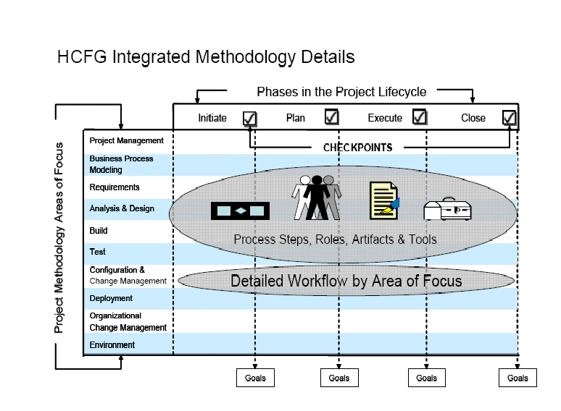
“The Integrated Methodology (IM)”
HCFG’s Project Roadmap
“Is a scalable project methodology that integrates the best project management practices and procedures into one common, high level, end-to-end business and technical project methodology.”
Is designed to provide guidance to project teams by enabling them to meet:
  Project objectives
  Business objectives
  Production objectives
  Audit and OCC requirements

Slide 48
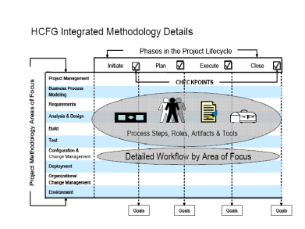
Organization Goals
& IM Benefits
GOALS
IM BENEFITS
Better understanding & preparation of the functionality being implemented
Improved accuracy in meeting the business needs
Enhanced communication; teamwork; and job performance
Earlier detection of issues & errors
Fewer project delays & lower costs
Proactive planning vs. reactive firefighting
Delivers one common methodology
IM incorporates proven best practices to leverage gains already made
A single process that enables easier methodology maintenance
Quality is built into the process rather than focus on outputs
Flexibility –unique solutions have unique needs
Supports both iterative and waterfall system development approaches
Supports both technical and non-technical projects

Slide 50

IM Key Components
Project Phases
Goals & Checkpoints
Goals define the focus and intent of work completed during a specific phase.
Checkpoints provide a way to evaluate the work completed during each phase and determine if the project is ready to move on to next phase.
Areas of Focus
Initiate → Plan →Execute → Close
An area of focus is a collection of related activities that are related to a major “area of concern” within the overall project.

Slide 51
IM Key Components con’t…
Artifacts
Project documents that help preserve the results of key project activities.
Project Role
Defines the responsibilities of an individual, or a set of individuals.
Tools
Support mechanisms for project teams Includes: software tools and checklists
(R)= Required; (CR)= Conditionally Required; (BP)= Best Practice
Process Steps
Defined by each area of focus. High-level activities which tell the project team what needs to be done. Include: workflow, prerequisites, required sign-off, roles, artifacts produced, & support tools.

Slide 52

“Scalability Guidelines”
Dictate the Level of IM Adherence
Attributes | SL1 | SL2 | SL3 | SL4
Project Cost | > $1 MM | $600K - $999K | $300K - $599K | See LOB
Risk Assessment Score | > 600 | 360 – 599 | 130 – 359 | See LOB
Return on Investment | > $1 MM | $600K - $999K | $300K - $599K | See LOB
IM Scalability Guidelines
  Defines the artifacts & goals required for a project based on its “Scalability Level” (SL)
  SL’s take into consideration
    project types
    budget amounts
    risks and complexity
Notes:
SL4 procedures and governance are defined at the Entity, Line of Business, or departmental level
All projects with technology component will have a minimum of SL3 designation
IM/SL Exceptions:
Construction of facilities
Merger/Acquisitions

Slide 53

IM Governance
Project Methodology & Process Council (PMAP) | HCFTG Quality Assurance Oversight & Measurement Team | IM Metrics Functional Team
Established mid-2005 Scope: to streamline & enhance SDLC processes and artifacts PMAP Team: assists HCFG project teams successfully use IM processes Project Information Channel: to support continuous process improvement | IT professionals They identify significant project issues at the point of origin & resolve before they impact project success. | Established by PMAP Council They identify, analyze, & manage IM improvements and processes. Project Success: Must meet all project, business, & production objectives. Audit & OCC compliance IM Compliance: Enterprise PM (EPM) OCC

Slide 54
Overall Message
What is systems development methodology?
Why is it important?
What are the roles & responsibilities?
What is the Systems Development Lifecycle
What are its common components?
Do companies really use development methodology?
Best Practices & Lessons Learned

Slide 55
Systems Analysis & Design
“The Challenge”
Does One Methodology
Fit All Problem Situations?
Problem Situations
One method is likely not suitable for all project types. Factors to consider:
Project Factors – size; objectives; timeframe; requirements; approval; risk; decision support
Technical Factors – application/system type, design flexibility, developer knowledge
Organizational Factors– user group knowledge & support, job function impact
Project Team Factors - resources needed; knowledge/experience
CLASS I: Well structured problem situation with well defined problem and requirements.
CLASS II: Well structured problem with clear objectives but uncertain user requirements.
CLASS III: Unstructured problem situation where objectives are unclear or conflicting among groups.
CLASS IV: High user interaction with system and/or user acceptance is important.
CLASS V: Complex problem situations requiring a contingency approach to information systems.

Slide 56
Lessons Learned & Best Practices
RESEARCH
INTERVIEW
Stakeholder support & participation
Senior management commitment
Well balanced project team
Clear business objectives
SADM must fit project/problem situation
Thorough requirements/needs analysis & proper documentation
Smaller is better
Ensure accountability
Project retrospectives
Commit to building a working relationship between IT & the business
IT must treat business like a customer
Use Best Practices—”Do Not Reinvent the wheel”
Project Governance
Amenable to change
Keep it simple
Deliver project in phases
IT account manager for each business team… “One Stop Shop”

Slide 57

Q & A

Slide 58
Additional References
Finlay, Paul N, Mitchell, Andrew C. “Perceptions of the benefits from introduction of CASE: An Empirical Study”. MIS Quarterly. Dec 1994. Volume 18. No. 4. Pp. 353
Hugos, Michael. “How to Sponsor A Project”. Computerworld. Mar 21, 2005. Vol. 39. No. 12. Pp. 29
Larman, Craig, Basili, Victor R. “Iterative and Incremental Development: A Brief History”. IEEE Computer Society. June 2003. pp. 47
Livari, Juhani. “The Relationship Between Organizational Culture and the Deployment of Systems Development Methodologies”. MIS Quarterly. March 2007. Vol. 31. No. 1. pp. 35
Jiang, James, Klein, G., Balloun, J. “Systems Analysts’ Attitudes Toward Information Systems Development”. Information Resources Management Journal. Fall 1998. Vol 11. No 4. pp. 5
Middleton, Peter. “Barriers to the efficient and effective use of Information Technology” The International journal of Public sector Management, Vol 13, 1, 2000, pp 85
Pratt, Mary, “What Do Users Want”. Computerworld. June 26, 2006. Vol. 40. No. 26. Pp. 40
Roberts, Tom, Leigh, W, Purvis, R. “Perceptions on Stakeholder Involvement In the Implementation of Systems Development Methodologies”. The Journal of Computer Information Systems. Spring 2000. Vol. 40. No. 3. Pp. 78
http://www.methodsandtools.com viewed Oct, 5, 2007.
http://www.stsc.hill.af.mil/crosstalk/1995/01/Comparis.asp viewed, Sep 20, 2007.

