Slide 1
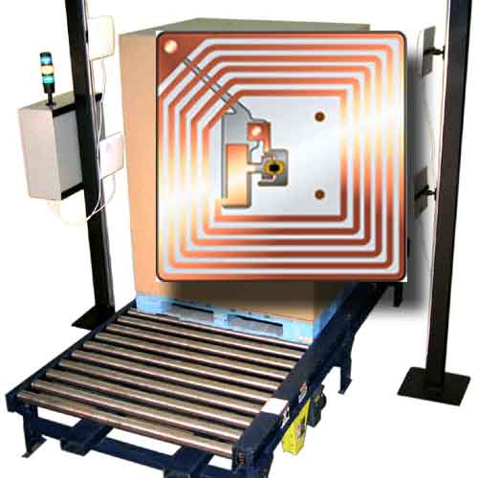
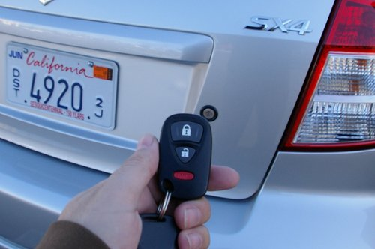
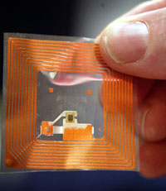
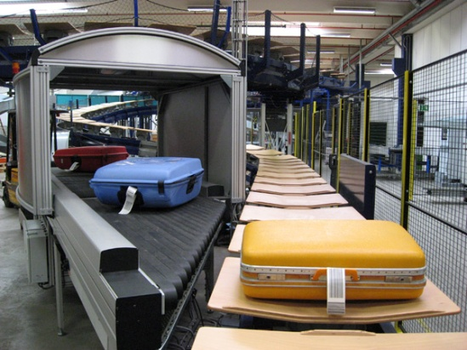
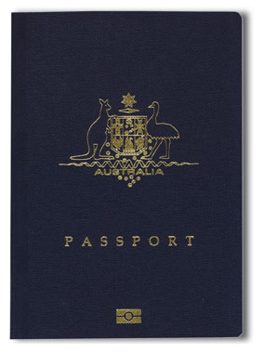
Radio Frequency Identification (RFID)
Jin Li
Varuni Mallikaarachchi
Rob Schiber
Lanae Simon
Reyesh Singh

Slide 2
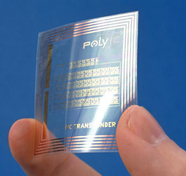
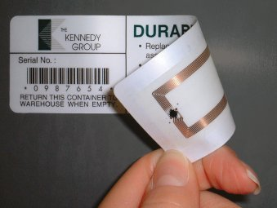
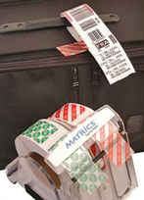
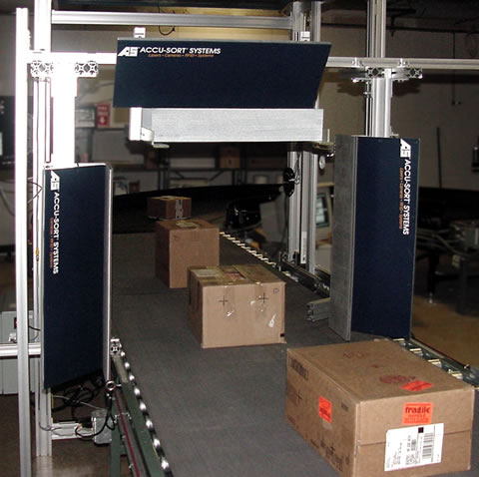
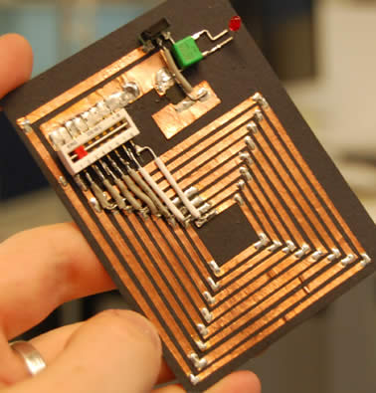
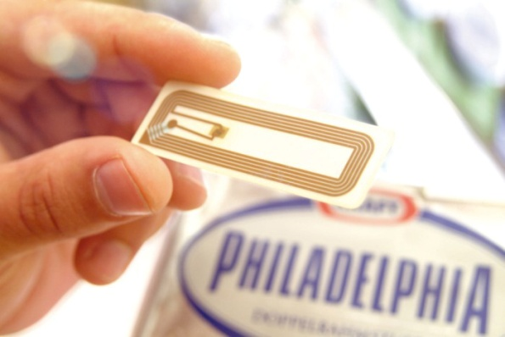
Introduction to RFID
What is RFID?
History of RFID?
Types of RFID?
How does RFID work?
How is RFID important to managers?

Slide 3
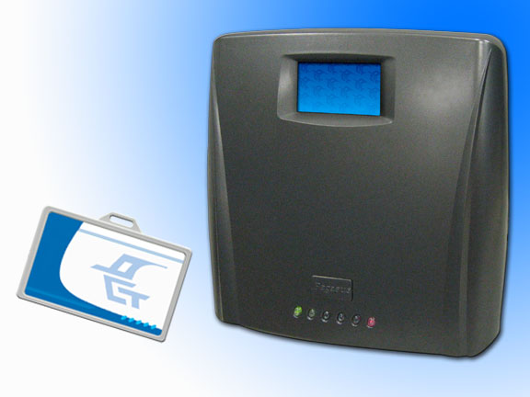
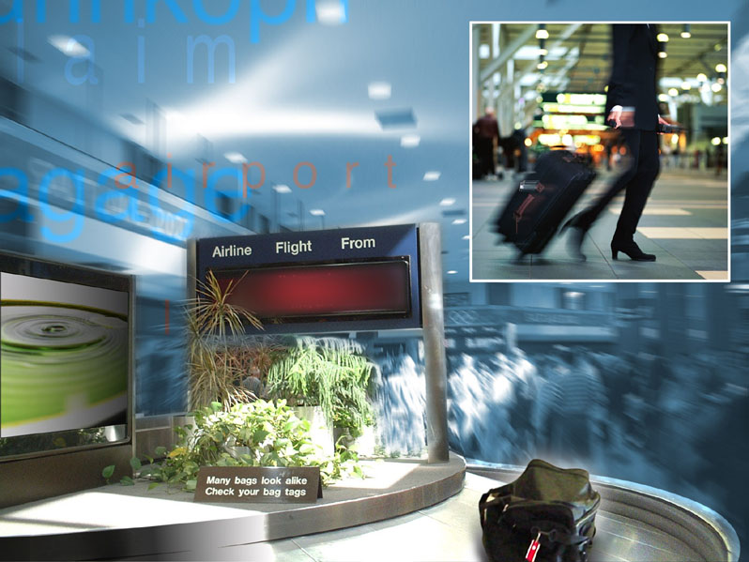
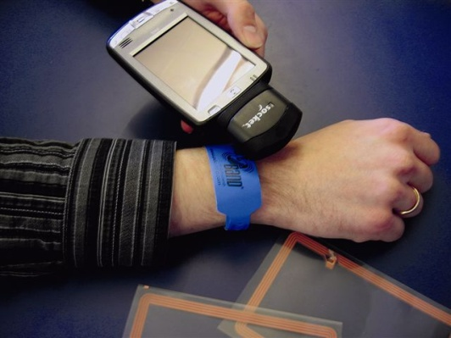
What is RFID?
“Radio Frequency Identification is the use of an object (typically referred to as an RFID tag) applied to or incorporated into a product, animal, or person for the purpose of identification and tracking using radio waves.”
Wikipedia Definition of RFID

Slide 4
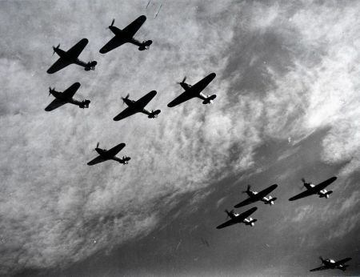
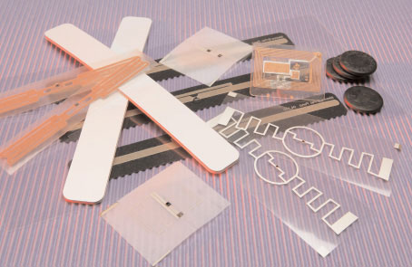
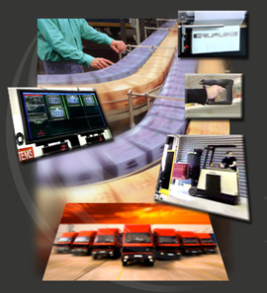
History of RFID
Decade | Event
1940-1950 | Radar refined and used, major World War II development effort. RFID invented in 1948.
1950-1960 | Early explorations of RFID technology, laboratory experiments.
1960-1970 | Development of the theory of RFID. Start of applications field trials.
1970-1980 | Explosion of RFID development. Tests of RFID accelerate. Very early adopter implementations of RFID.
1980-1990 | Commercial applications of RFID enter mainstream.
1990-2000 | Emergence of standards. RFID widely deployed. RFID becomes a part of everyday life.

Slide 5
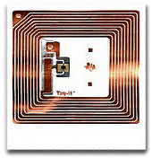
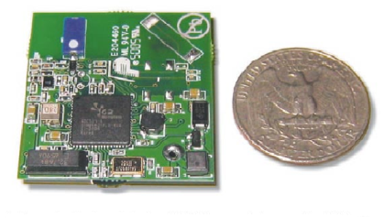
Types of RFID
 | Active RFID Tag | Passive RFID Tag
Power Source | Internal | Transferred energy from reader
Internal Battery | YES | NO
Availability of Power | Continuous | Only within range of reader
Required Signal Strength | Very Low | Very High
Range | 100 feet + or up to over 300 feet with additional batteries | Around 20 feet
Multi-tag reading | 1000’s of tags | A couple hundred within reader range
Data Storage | 128Kb of read/write with search and access | 128 bytes of read/write only
Cost | HIGH (usually a quoted price depending on its use) | LOW (between 5-20 cents)

Slide 6
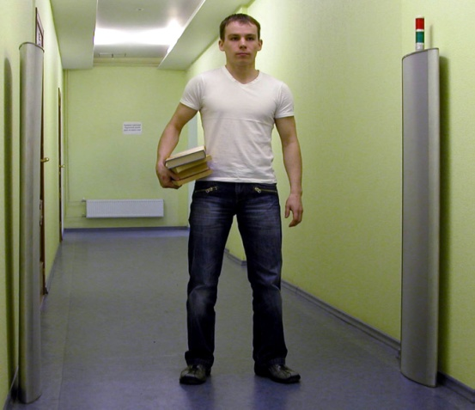
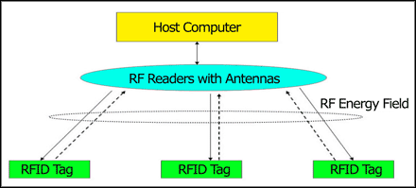
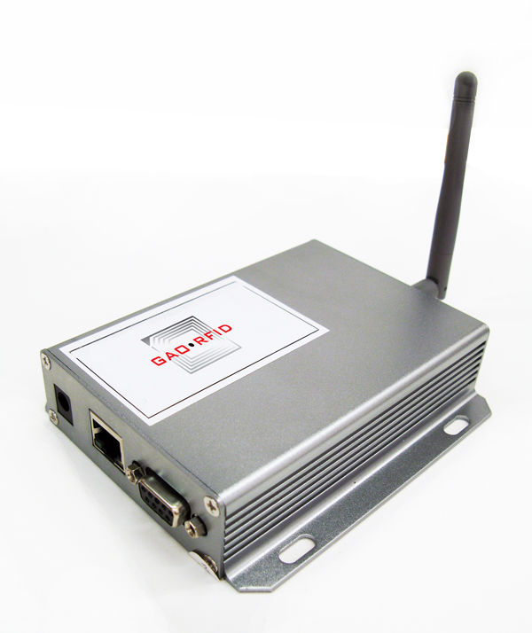
How it works
Information is stored on the RFID tags microchip
The tag receives the signal from an RFID readers antenna
The tag sends the information back to the reader with radio waves
The reader uses the radio waves to interpret it into useful data

Slide 7
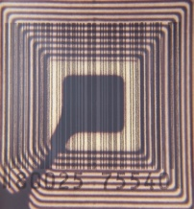
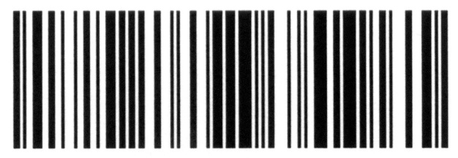
RFID? Or Barcode?
 | RFID | Barcode
Line of Site | Not Required | Required
Read Range | Up to 100’s of feet | Inches to a few Feet
Read Rate | 10’s-1000’s at once | One at a time
Identification | Unique to each item tagged | Typically identify one item (UPC) but no uniquely
Read/Write | Many are Read/Write | Read only
Technology | Radio Frequency | Laser
Interference | Some don’t like metal or liquid. Can cause interference with some Frequencies. | Cant be read when obstructed (Dirty, torn, etc.)
Automation | Don’t require human involvement to collect data | Most scanners require human labor

Slide 8
RFID by country

Slide 9
How is RFID important to managers?
RFID can decrease the number of errors and increase efficiency
Compared to bar coding, Scanning
an RFID item can return a variety of data.
Tags can be read through a variety
of visually and environmentally challenging conditions such as
snow, ice, fog, paint, grime, etc.
Notes:
Compared to bar coding, Scanning an RFID item can return a variety of data including the manufacturer, item information, supplier information, etc.

Slide 10
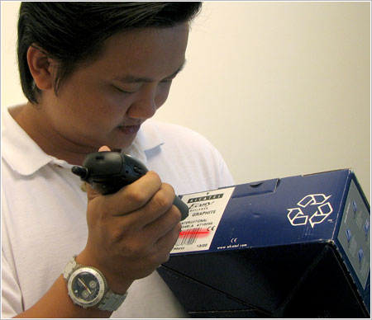
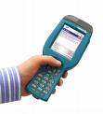
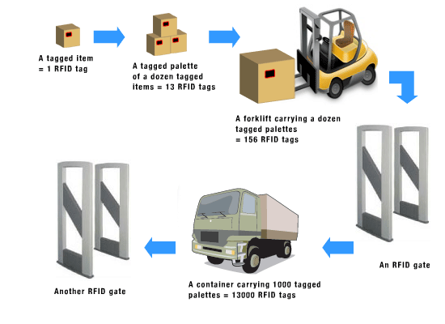
How is RFID important to managers?
RFID helps reduce the labor cost and minimize risks.
A hand transceiver can simply move within range
of the items to be read,
and will capture all the information.
The lack of human interaction with the products avoids damage
to the inventory and miscounts.
Notes:
1.A typical RFID system consists of transceivers, tags, and a computer system to process the information. 2.Bar codes require a "line of sight," and the scanner usually must be within a foot of the actual product. If an inventory manager has a case of various items, he or she must unload the case, scan each item, and then repackage the case. This interaction can result in increased labor costs and the possibility of damage to items.

Slide 11
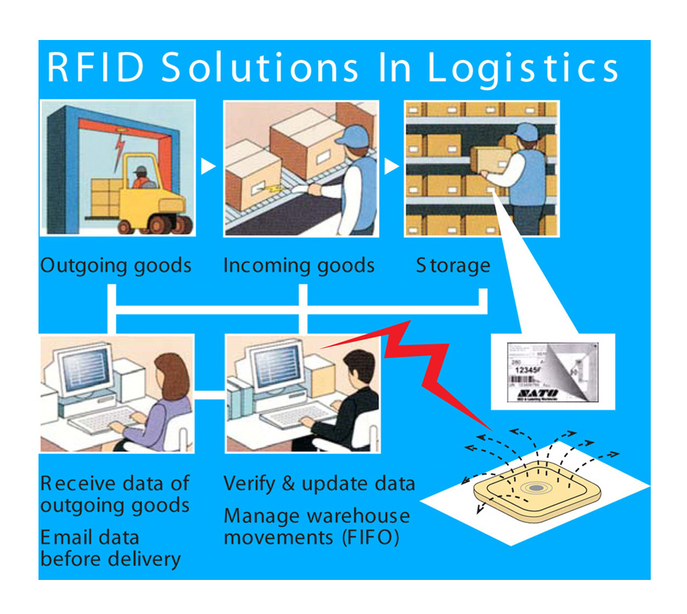
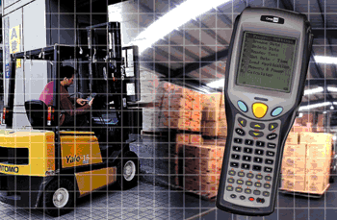
How is RFID important to managers?
Benefit for Inventory Costing and Inventory Management
Units can be tracked on an individual basis, physical inventory, tracking of lost items, shelf reading along with many other inventory applications.
Notes:
Each item can have a tag, and each tag can transmit manufacturer codes, product codes, exact associated costs, date manufactured, length of time on the shelf, and other useful information. Since exact costs are available at any time over the course of the year, a snapshot of the company's inventory can be taken. Precise inventory levels, cost of goods sold, and a more accurate net income can be obtained at any time.

Slide 12
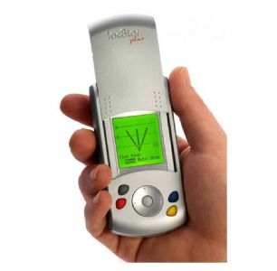
How is RFID important to managers?
Improved Security and Service
Validating information relating to an item enables increased security.
Ability to authenticate information can prevent activities like fraud and counterfeiting.
Decreased Cycle Time and Taking Costs Out
RFID scanning is not a tedious process, like traditional Barcode scanning, so the business can perform identical tasks quicker.
Processing moving goods through a supply chain is much more efficient and reduces the need for larger inventories.

Slide 13
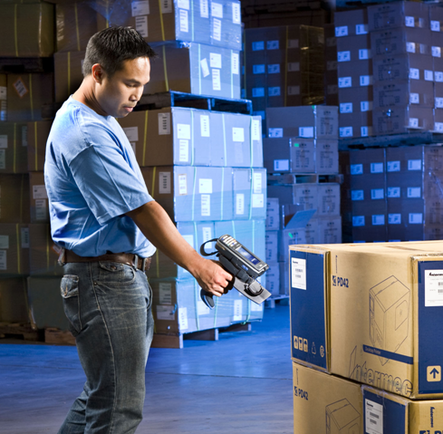
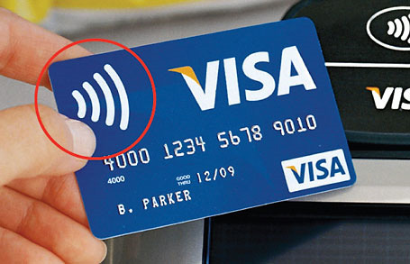
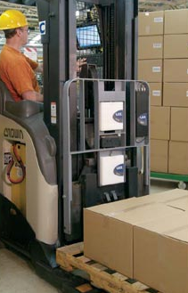
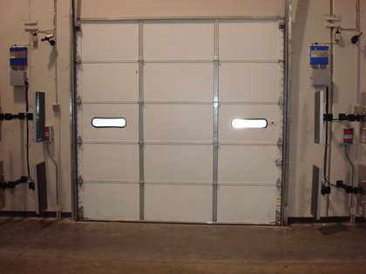
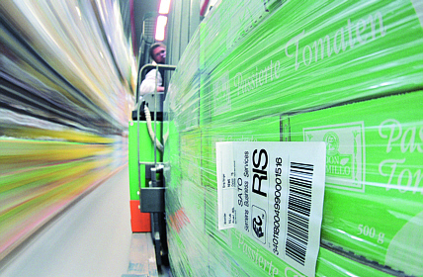
RFID Applications
Examples of RFID applications
And just how big is this market?

Slide 14
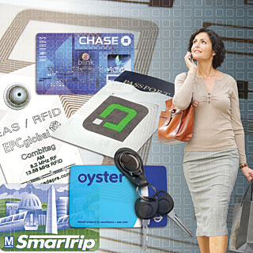
RFID Applications by Market
Tag Location | Number of tags supplied in 2008 (millions)
Smart cards/payment key fobs | 559
Smart tickets | 325
Retail CPG Pallet/case | 200
Apparel | 130
Retail apparel | 130
Other Applications | 130
Animals | 90
Books | 85
Manufacturing parts, tools | 70
Passport page/secure documents | 65
Air baggage | 60
Military | 55
Car clickers | 48
Conveyances/Rollcages/ULD/Totes | 28
Other Healthcare | 15
Drugs | 10
Archiving (documents/samples) | 9
Consumer goods | 8
Vehicles | 7
Postal | 2
Total | 1,968

Slide 15
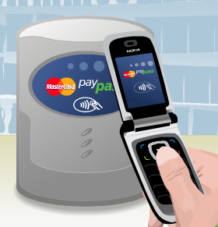
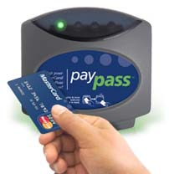
Smart Cards and Payment
“Tap & Go” Payment
Payment information is sent and received and you are on your way
Personal encryption and Zero Liability for security
Access cards, ID cards, security cards

Slide 16
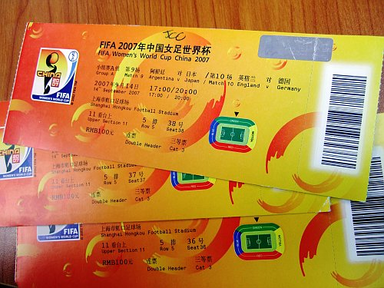
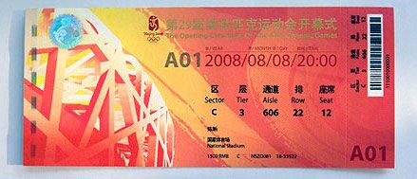
Smart Tickets
Prevent counterfeiting and scalping
World Cup Finals
Beijing Olympics
Tickets get registered to individuals
RFID readers read tickets upon entering

Slide 17
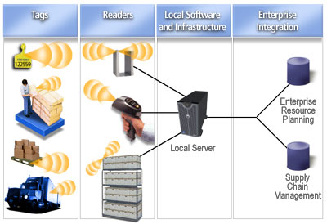
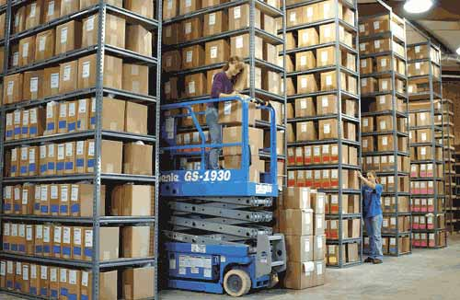
Supply Chain Management & Logistics
Product tracking
Automatic Payment
Theft Prevention
Warehouse Management
Inventory Management

Slide 18
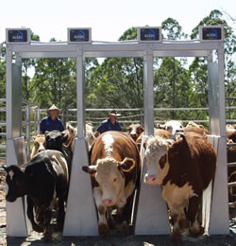
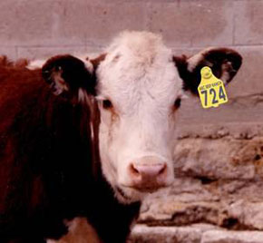
Agriculture
Livestock ID
ID chips for tracking location, nutrition needs, vaccination data, and more!
Automated feeding stations
Slaughterhouses
Disease prevention and
isolation
Pets
ID chips for identification if
your pet gets lost

Slide 19
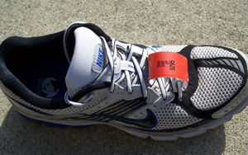
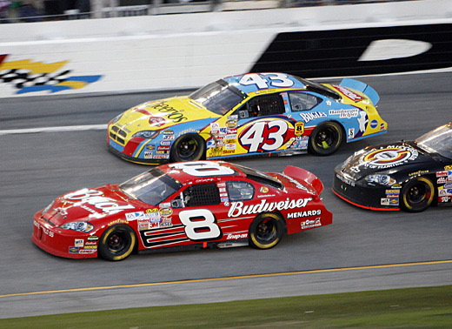
Timing Devices
Real time tracking for race events
Time from starting line to finish line

Slide 20
AND MANY MORE!!!
Other industries using RFID
Aerospace
Chemical
Defense
Automotive
Waste Management
Security
Packaged Goods
Timing Devices

Slide 21
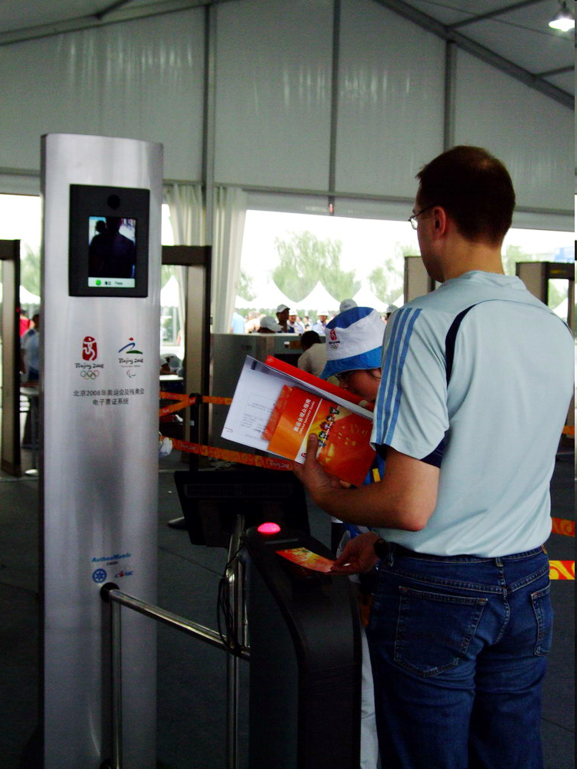
RFID Olympic Games Tickets
First time RFID was used at the 2008 Olympic games
RFID chips were imbedded in more than 16 million tickets
Developed by China’s Tsinghua University

Slide 22
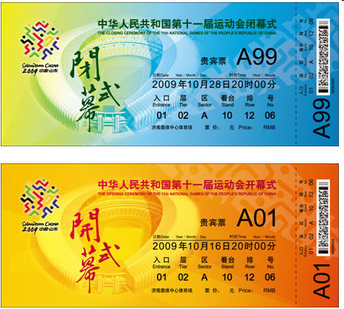
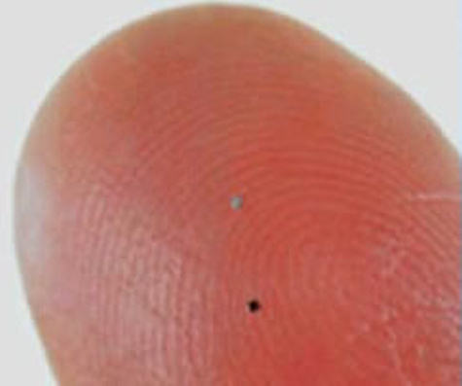
RFID Olympic Games Tickets
Features of the RFID tickets:
Small enough RFID chip to be embedded into paper
RFID chips in tickets contain the holder’s
photographs
passport details,
address,
e-mail address
phone numbers
which makes them non-transferable.

Slide 23
RFID Olympic Games Tickets
RFID’s technology can limit fake ticket sales
Simplify ticket checking procedures
Provide useful information on seating and venues in Beijing.

Slide 24
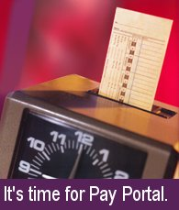
Holroyd Inc. Allaura
Concrete company located in Washington
Had yard management problems and people wasting time on the clock
Wanted time clock on their gate for “real-time” hours
Had to hire a yard supervisor.
PayPortal
Time and attendance program for daily delivery truck companies
Greg Stewart

Slide 25
Holroyd Inc.
Reader on top of pole
Gray RF LAN box sends data to the office
Driver display on bottom of pole
RFID on top of truck next to GPS
PayPortal covers both in and out lanes

Slide 26
WAL-MART RFID
Founded in 1962 in Rogers, Arkansas
Revenue (2009) $409.16 billion
Employees – approx 2.1 million (2008)
1,000’s of suppliers
10,000’s products
More than 2,000 stores
Each week about 100 million customers (nearly 1/3rd of US population) visit US
Wal-Mart stores
http://en.wikipedia.org/wiki/Wal-Mart
http://walmartstores.com/AboutUs/7606.aspx

Slide 27
WAL-MART RFID
June 2003 – announced its Electronic Product Code (EPC) program, top 100 suppliers to begin tagging pallets by January 2005
April 2004 – begins its RFID trial in Sanger, TX, with participation from eight suppliers
Expects – to improve its supply chain, and save billions of dollars
Out of Stock – loss to retailer 40% & loss to producer 30%
http://www.scdigest.com/assets/On_Target/09-02-23-1.php?cid=2275&ctype=content
Hardgrave, B; Langford, S.; Waller, Miller, R. (2008) “Measuring the Impact of RFID on Out of Stocks at Wal-Mart” MIS Quarterly Executive Vol. 7 No. 4 / Dec 2008

Slide 28
WAL-MART RFID
Commissioned a study to measure the impact of technology in 2005 for 29 weeks
16% reduction in products out of stock
RFID-equipped stores - 63% more effective in replenishing inventory than non-RFID stores
By October 2008 – 104 RFID enabled stores, and deployed RFID application to more than 1300 stores
Hardgrave, B; Langford, S.; Waller, Miller, R. (2008) “Measuring the Impact of RFID on Out of Stocks at Wal-Mart” MIS Quarterly Executive Vol. 7 No. 4 / Dec 2008
http://www.informationweek.com/news/mobility/RFID/showArticle.jhtml?articleID=172301246

Slide 29
WAL-MART RFID
Announces major change – focuses on shipments going to Sam’s Club, and products going to Wal-Mart stores & tests to see RFID’s impact in improving management in these areas.
January 2008 – penalties against suppliers for failure to tag product shipments to Sam’s Club
January 2009 – lowers penalty from $2-$3 to 12 cents (their cost of tagging it themselves)
http://www.scdigest.com/assets/On_Target/09-02-23-1.php?cid=2275&ctype=content

Slide 30
WAL-MART RFID
Success story – Pacific Coast Producers
$450 million company
Producer of canned vegetables / fruit for Wal-Mart
Download data from Wal-Mart’s RetailLink supply chain systems to its Oats Systems RFID systems
Went from having no way to analyze inventory, to having a complete picture
Bottom line: out-of-stocks have been reduced by about 50%
http://www.networkworld.com/news/2008/091508-wal-mart-rfid.html

Slide 31
WAL-MART RFID
Riding the Wave: Haier America Implements RFID Technology…….
Increased co-ordination & higher level of efficiency between Haier and Wal-Mart
Equipped to handle Wal-Mart’s mandated RFID system, as well as anticipating future requirements of other big-box retailers
Later tags freezers and fridges with RFID
http://www.vai.net/news/archive-2007/contentParagraph/01111116/contentParagraph2/0117/pdfLink/Haier%20America.pdf
http://www.rfidjournal.com/article/articleview/3308/1/1/

Slide 32
WAL-MART RFID
Downside / Negative publicity
Going over like a lead balloon
Suppliers had to not only comply but had to figure their own ROI.
Wal-Mart Sued For Alleged Patent Violation
February 2007: The Wall Street Journal runs an article entitled "Wal-Mart's Radio-Tracked Inventory Hits Static.“
http://www.rfidgazette.org/walmart/
http://www.scdigest.com/assets/On_Target/09-02-23-1.php?cid=2275&ctype=content
http://www.rfidjournal.com/article/view/4619

Slide 33
WAL-MART RFID
Downside …….
February 2009: Proctor & Gamble halts tagging of promotional displays, implying Wal-Mart is not acting on the information to improve store execution
http://www.scdigest.com/assets/On_Target/09-02-17-2.php?cid=2264&ctype=content

Slide 34
SMARTTRACK RFID
Small-medium sized Museum Gallery (50,000+ Objects)
Implementation of RFID
Cost benefit analysis
By implementing RFID they
would:
Gain staff efficiency and accuracy
Locate misplaced items quickly
Increase productivity (accurate record keeping)
Inventory management
“A cost-benefit analysis of RFID for museum and Art Gallery collections November 2008”, ©Smarttrack RFID Pty Ltd ABN 97 133 696 867

Slide 35
SMARTTRACK RFID
Problems with:
Manual systems
Often have 10% error
Incorrect /double entry
Misidentification
Barcodes & Manual systems
Significant handling of object
The number/barcodes can deteriorate or degrade
Misfiled items are almost as good as lost
“A cost-benefit analysis of RFID for museum and Art Gallery collections November 2008”, ©Smarttrack RFID Pty Ltd ABN 97 133 696 867

Slide 36
SMARTTRACK RFID
RFID Cost Benefits
Efficiency savings in time spent looking for lost, misplaced items
Efficiency savings in documenting collection movements
Efficiency savings in documenting loans and items going on display
“A cost-benefit analysis of RFID for museum and Art Gallery collections November 2008”, ©Smarttrack RFID Pty Ltd ABN 97 133 696 867

Slide 37
SMARTTRACK RFID
Real-life collection scenario
Estimation of cost for managing (assumption)
Collection of 50,000 items
10,000 items have their number read every year
Cost taken into account
Attachment cost
Reading-time cost
Then cost calculation over 3 years
Assumption of annual salary of $50,000
“A cost-benefit analysis of RFID for museum and Art Gallery collections November 2008”, ©Smarttrack RFID Pty Ltd ABN 97 133 696 867

Slide 38
SMARTTRACK RFID
1. Attachment Cost
Tag / Number Type | Estm. Tag / Number cost per item | Estimated Time take to attach Tag / Number | Estimated Attachment cost per Tag / Number
Number only (Manual) | $0.02 | 5 minutes | $2.12
Barcodes | $0.10 | 1 min | $0.52
RFID | $0.50 | 1 min | $0.92
“A cost-benefit analysis of RFID for museum and Art Gallery collections November 2008”, ©Smarttrack RFID Pty Ltd ABN 97 133 696 867

Slide 39
SMARTTRACK RFID
2. Reading-Time Cost
Reading type | Estimated average reading time per item | Reading cost per item*
Number only (Manual) | 5 minutes (Includes time for opening boxes, handling objects, correcting 10% error-rate and manually loading data into CMS.) | $2.10
Barcodes | 1 minute (Includes time for opening boxes, handling objects, and interacting with barcode reader (e.g. selecting location from a drop-down list). Assumes location data is automatically loaded to CMS.) | $0.42
RFID | 0.5 seconds (Includes time required to interact with handheld reader (e.g. selecting location from a drop-down list). Assumes location data is automatically loaded to the CMS.) | $0.0035
“A cost-benefit analysis of RFID for museum and Art Gallery collections November 2008”, ©Smarttrack RFID Pty Ltd ABN 97 133 696 867

Slide 40
SMARTTRACK RFID
3. Attachment and Reading-Time Cost
Reading Type | Atta. cost per item* | Reading cost per item | Estimated cost to read 10,000 items per year – year 1 (attachment plus reading cost) | Estimated cost to read 10,000 items per year - year 2 (reading cost only) | Estimated cost to read 10,000 items per year - year 3 (reading cost only)
Number only (Manual) | $2.12 | $2.10 | $42,200.00 | $20,100.00 | $20,100.00
Barcodes | $0.52 | $0.42 | $9,400.00 | $4,200.00 | $4,200.00
RFID | $0.92 | $0.0035 | $9,234.00 | $35.00 | $35.00
“A cost-benefit analysis of RFID for museum and Art Gallery collections November 2008”, ©Smarttrack RFID Pty Ltd ABN 97 133 696 867

Slide 41
Avery Dennison Success Story
Business Challenge
Santa Fe Optical – successful retailer for designer eyeglasses in Austin, Texas
Store was losing up to $5,000 worth of designer frames in a month from what was thought to be organized theft
Owner knows that “locking up” the merchandise or keeping them inside the cabinets was the least desirable solution for reducing losses
Avery Dennison Success Story ©2008 Avery Dennison Corporation. All rights reserved.

Slide 42
Avery Dennison Success Story
Success Story
Electronic Inventory Solutions and Avery Dennison partnered for the solution
Developed a small, flexible RFID tag to be easily placed on the frames
Store associates remove tags from the purchased frames
Not a single lost frame in the months following the introduction of RFID
Avery Dennison Success Story ©2008 Avery Dennison Corporation. All rights reserved.

Slide 43
Avery Dennison Success Story
Additional Benefits
If ever stolen, they could be immediately tracked using the unique RFID tags
It provides Santa Fe Optical with the benefit keeping track of inventory
Inventory time was reduced by 80% & sales increased
Store associates can quickly locate any frames misplaced on shelves
by a customer
Avery Dennison Success Story ©2008 Avery Dennison Corporation. All rights reserved.

Slide 44
The Future of RFID
Digestible Tags
Food Safety
Verichip

Slide 45
Digestible RFID Tags
In 2007, Kodak applied for a
patent for digestible RFID tags.
Uses:
verifying proper drug usage
monitoring drug interactions
controlling dosage
maintaining inventory control

Slide 46
Food Safety
British Telecommunications
launched a new online food traceability system providing real-time data on current and past status of all stock items as they pass through the supply chain
FreshtimeTM semi active RFID tags sense temperature and can determine the shelf life of a product
RFID can be used to ensure that food products remain within a safe temperature range during transportation and storage.

Slide 47
Verichip
First human-implantable
passive RFID microchip and
corresponding personal health
record, cleared for medical use
in October 2004 by the FDA.
new 8 millimeter microchip for
use in Medical Components, Inc.'s
(Medcomp) vascular access
medical devices
glucose-sensing RFID microchip
currently under development
Plan to provide identification technologies
and tools to protect consumers and
businesses

Slide 48
Broader Adoption of RFID
“I have a well understood business issue, is an RFID-enabled solution the right answer for me?”
After Wal-Mart, companies wanted to see if RFID would catch on. Now, they are trying to use RFID in their business
The RFID business case focus is moving toward business process innovation
RFID vendors are trying to develop more complete solutions – it is not just about having the technology, but about having a focused solution that works

Slide 49
Future Technology
R&D on RFID technology in the near future will most likely focus on:
Achieving 100% read rates at a speed of conventional barcode technology
Improving reliability of RFID tag readers
Proper integration of RFID data collection with decision support tools for extracting useful information.
Researching to develop low-cost (less than 1 cent) RFID tags.

Slide 50
Disadvantages of using RFID
Dead Areas
Security
Cost
And a few more

Slide 51
Disadvantages of RFID
Dead Areas & Orientation Problems
Certain areas may have weaker
signals or interference
Security Concerns
Fraud, gaining access and to
unauthorized information
Consumer tracking
Ghost Tags
Proximity Issues
Difficulty reading tags
on metal or liquid containers

Slide 52
Disadvantages of RFID (cont.)
Cost
Falling costs but may still be expensive for some companies
Unread Tags
Out of sight tags not being read
Vulnerability to damage
Static discharge, high powered magnetic surges (lightning strikes), etc.

Slide 53
Conclusions of RFID
RFID can reduce human error and increase business efficiencies.
Has applications in a wide variety of markets
Rapidly growing technology with a wide range of future applications.
Many advantages and uses for RFID but also be aware of some of the drawbacks.
RFID is all around us we just may not realize it

Slide 54
Sources
Landt, J. (2001), “Shrouds of Time: The History of RFID”, an AIM Publication. Accessed at <http://www.transcore.com/pdf/AIM%20shrouds_of_time.pdf> on Sept 29, 2009
Bonsor, Kevin, and Candace Keener. "How RFID Works." November 05, 2007. HowStuffWorks.com. <http://electronics.howstuffworks.com/gadgets/high-tech-gadgets/rfid.htm> September 29, 2009.
Campbell, A. “Active vs. Passive RFID tags.” April 6, 2004. RFID-Weblog.com
< http://www.rfid-weblog.com/50226711/active_vs_passive_rfid_tags.php> September 29, 2009
www.allaura.com viewed September 30, 2009
http://www.inlogic.com/rfid/rfid_vs_barcode.aspx viewed September 30, 2009
< http://www.alphacard.com/id-cards/rfid-cards.shtml> September 30, 2009
Greg Stewart. President of Allaura. Interviewed by phone by Rob Schiber, September 30, 2009
Doug Hanson. Administrative Assistant of Holroyd, Inc. Interviewed by phone by Rob Schiber, September 30, 2009
< http://en.wikipedia.org/wiki/Radio-frequency_identification> October 6, 2009
< http://www.idautomation.com/rfid_faq.html#RFID_Advantages> October 13, 2009
< http://www.uhisrc.com/FTB/RFID/RFID%20Sep03.pdf> October 13, 2009
< http://www.dutchdpa.nl/downloads_av/AV29.pdf?refer=true&theme=purple> October 13, 2009
< http://www.mastercard.com/us/personal/en/aboutourcards/paypass/faqs.html> October 14, 2009
< http://www.idtechex.com/research/articles/rfid_market_forecasts_2009_2019_00001377.asp> October 10, 2009
Mohan, Sheena. (“RFID: World Cup Tickets Get Smart,” June 13, 2006. CIO-Insight.com
< http://www.mastercard.com/us/personal/en/aboutourcards/paypass/index.html> October 14, 2009
Bacheldor, Beth (2007), “Kodak’s RFID Moment,” RFID Journal, http://www.rfidjournal.com/article/articleview/3100, viewed October 20, 2009
“VeriChip Corporation Selects Raytheon Microelectronics España to Manufacture Its Products,” Business Wire, http://www.businesswire.com/news/google/20091005005797/en, viewed October 6, 2009
Payne, Tim (2008), “RFID Thoughts Leaders On the Current and Future State of RFID,” SupplyChainDigest, http://www.scdigest.com/assets/On_Target/08-09-15-1.php?cid=1924&ctype=content, viewed October 6, 2009

Slide 55
Sources (cont.)
http://www.idautomation.com/rfid_faq.html#RFID_Advantages October 13
http://www.uhisrc.com/FTB/RFID/RFID%20Sep03.pdf October 20
http://www.dutchdpa.nl/downloads_av/AV29.pdf?refer=true&theme=purple
Bacheldor, Beth (2007), “Kodak’s RFID Moment,” RFID Journal, http://www.rfidjournal.com/article/articleview/3100, viewed October 20, 2009
Kumar, P., Reinitz, H.W., Simunovic, J., Sandeep, K.P., and Franzon, P.D. (2009), “Overview of RFID Technology and Its Applications in the Food Industry,” Journal of Food Science, Vol. 74 No. 8, pp. R101-R106, http://www3.interscience.wiley.com/cgi-bin/fulltext/122596266/PDFSTART, viewed October 20, 2009
“VeriChip Corporation Selects Raytheon Microelectronics España to Manufacture Its Products,” Business Wire, http://www.businesswire.com/news/google/20091005005797/en, viewed October 6, 2009
Avery Dennison Success Story ©2008 Avery Dennison Corporation. All rights reserved
“A cost-benefit analysis of RFID for museum and Art Gallery collections November 2008”, ©Smarttrack RFID Pty Ltd ABN 97 133 696 867
http://www.scdigest.com/assets/On_Target/09-02-17-2.php?cid=2264&ctype=content October 14
http://www.rfidgazette.org/walmart/ October 23
http://www.scdigest.com/assets/On_Target/09-02-23-1.php?cid=2275&ctype=content October 20
http://www.rfidjournal.com/article/view/4619 October 23
http://www.vai.net/news/archive-2007/contentParagraph/01111116/contentParagraph2/0117/pdfLink/Haier%20America.pdf
http://www.rfidjournal.com/article/articleview/3308/1/1/ October 13
Markelevich, A. and Bell, R., “RFID: The Changes It Will Bring” Strategic Finance, August 2006, pp 46-49
http://goliath.ecnext.com/coms2/gi_0199-5634347/RFID-The-changes-it-will.html October 24
http://www.slais.ubc.ca/COURSES/libr500/04-05-wt2/www/T_Gnissios/benefits.htm October 24
http://www.rfidc.com/docs/introductiontorfid_business.htm October 14
http://www.psfk.com/2008/05/rfid-olympic-games-tickets.html October 28
http://www.securerf.com/RFID-Security-blog/?p=61 October 13
http://www.idtechex.com/research/articles/rfid_market_forecasts_2009_2019_00001377.asp October 28
http://www.idtechex.com/knowledgebase/en/breakdown.asp October 27

