Slide 1

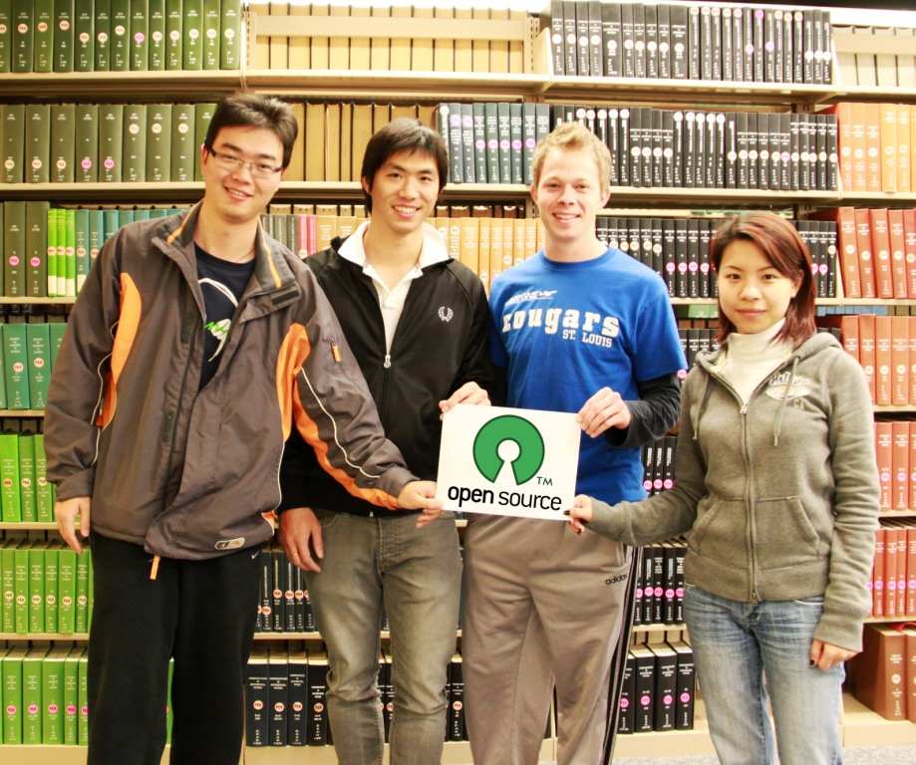
Open Source Software (OSS)
Presented by:
1. Su Fang
2. Jialou Guo
3. Mark Mathis
4. Chotirat Raksawin

Slide 2
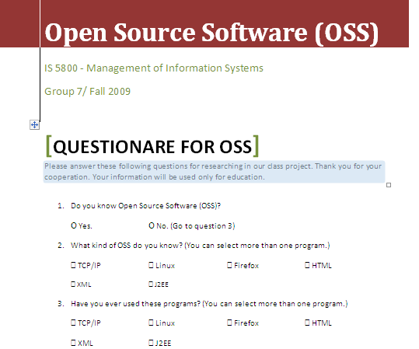

Have you ever heard of Open Source Software?
Notes:
Mark 2

Slide 3
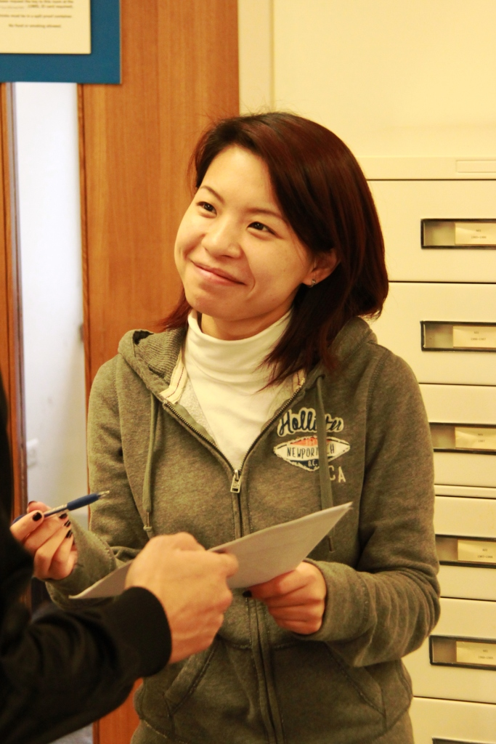
Survey of the usage of oss
We surveyed 100 students at UMSL about their knowledge of OSS
The students were asked to fill
out a small questionnaire.
Sample size: 100
Location: Computing lab (SSB 103),
MSC, Level 1-3
CCB, Level 1-2
Date: October 27th,2009
Notes:
Jialou 3-7

Slide 4
Results of the survey
Have you heard of Open Source Software (OSS)?
70% of the students
interviewed didn’t know
about OSS, but are they using OSS?

Slide 5
Results of the survey
What kind of OSS have you heard of?
36% know Firefox.
This may be because the Internet browsers in USML computer labs are all Firefox.

Slide 6
Results of the survey
Have you ever used these programs?
Most of the students
are using at least one
form of OSS. They just
don’t know the software
is OSS!

Slide 7


Drawbacks of the survey
This survey was done on campus, so the results show only the opinion of college students.
Part of the survey was conducted in a computer lab, so these students were more aware of Firefox and this is seen in the results.

Slide 8

Content
Background & Overview
  Definition of Open Source Software
  History of Open Source Systems
  Major Technical Components
OSS Vs Proprietary Systems
Three Interviews
What have we learned?
Best practices for Open Systems
Notes:
Mark 8

Slide 9
Open source software
Background
“Open Source Software (OSS) refers to software that is released under one of several licenses, the most prevalent of which is GPL (General Public License) from the Free Software Foundation.
According to the license, users have the freedom to run an OSS program for any purpose, have access to its source code, may modify the code, and may redistribute copies of either original or the modified code without having to pay royalties to previous developers.”
Birman, A. and Ritsko, J. “Preface to the Special Issue on Open Systems,” IBM Systems Journal, Vol. 44, 2, 2005. p. 213.
Notes:
Cho 9-10

Slide 10
Background
OSS Definition
Criteria
1. Free Redistribution
2. Source Code
3. Derived works
4. Integrity of the Author’s Source Code
5. No Discrimination Against Persons or Groups
6. No Discrimination Against Fields of Endeavor
7. Distribution of License
8. License Must Not Be Specific to a Product
9. License Must Not Restrict Other Software
10. License Must Be Technology-Neutral
http://www.opensource.org/docs/definition.php

Slide 11
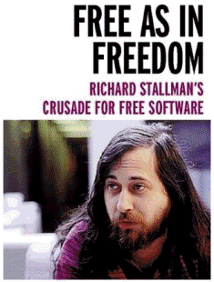
OSS History
Early 80’s: Richard Stallman (MIT) worked on Software using “sharing” concept.
1983: He released GNU Project.
1985: He founded Free Software Foundation
“Free software" is a matter of liberty,
not price. To understand the concept,
you should think of "free speech",
not "free beer.“
Background
http://static.userland.com/userLandDiscussArchive/msg019844.html
Notes:
FangSu 11-13
Find more info about GNU project!!!

Slide 12

OSS History (Cont’d)
1991: Linus Torvalds created “Linux”
– the innovation from GNU
I'm doing a (free) operating system (just a hobby, won't be big and professional like gnu) for 386(486) AT clones.
1997: Eric Raymond supported Stallman’s idea by writing “The Cathedral and The Bazaar”
1998: 1. Netscape -> Mozilla Firefox 2. “Open Source” term invention 3. Open Source Initiative was founded
Background
http://static.userland.com/userLandDiscussArchive/msg019844.html
Notes:
Find more info about he Cathedral and The Bazaar!!!

Slide 13
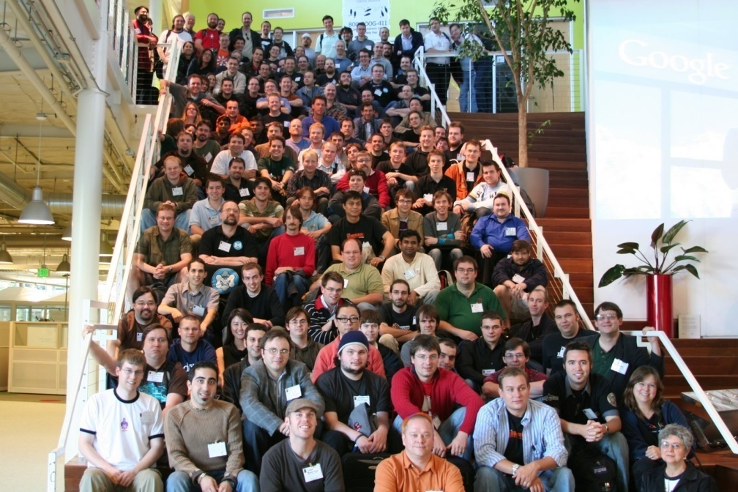
Overview
What is happening around the World?
Google Summer of Code
Started in 2005.
The global program that offers students to develop OSS code for various OSS projects.
Brought together 3300 students and more than 5,000 mentors & co-mentors from 100 countries worldwide.
http://socghop.appspot.com/

Slide 14

The motivation in oss
Overview
Enjoyment-based intrinsic motivation-namely, how creative a person feels when working on the project is the strongest and most pervasive driver.
Intellectual stimulation derived from writing code, and improving programming skills are top motivators for project participation.
“Why Hackers Do What They Do: Understanding Motivation and Effort in Free/Open source software Projects”, Karim R.Lakhani and Robert G. wolf 2005 Massachusetts Institute of Technology
Notes:
Cho 14-17

Slide 15
Major Technical Components
Overview
OSS products | What is it? | Functions
IP (TCP/IP) | Communication protocol | Communicates remote systems
HTML | Markup language or presentation language | Publishes information from text
XML | A set of rules for encoding documents electronically | Encodes and stores data (ready to transmit )
J2EE | Java platform for server programming | Creates any portable and scalable enterprise application
Open Interchange | Application server or Web service | Interacts any kind of service
Open OS(Linux) | Operating system | Operates our computers
http://en.wikipedia.org/

Slide 16
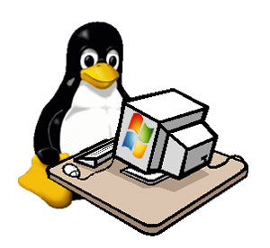

Example (1) of Open Source software
Overview
Linux
  Free Unix-type Operating System
  Created by Linus Torvalds (Aug. 1991)
  Free source code & “Distribution” concept
  One hundred companies released their own version of OS based on LINUX i.e. Red hat
  Compared to M. Windows: more stable & secure, cheaper, and less resources needed.
http://www.linux.org/dist/
Notes:
Kernel has been developed under the GNU General Public License

Slide 17
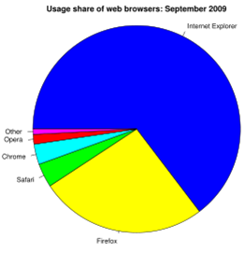

Example (2) of Open Source software
Overview
Mozilla FireFox
  The second most popular web browser after IE
  The current version 3.5.3,
  released on 09092009
  Free source code
  Runs on various OS platforms
  Google-Integrated search system
  Compared to IE: faster,
  more secure, customizable
???
The usage share of web browsers.
Source: Median values from summary table.
Internet Explorer (64.66%) Mozilla Firefox (26.08%)
Safari (3.74%) Google Chrome (3.17%)
Opera (1.53%) Other (0.82%)
http://www.mozilla.com/en-US/firefox/features/
http://en.wikipedia.org/wiki/Usage_share_of_web_browsers
Notes:
IE w/ M.Windows
Customers have no choice.
That’s why IE is more popular.

Slide 18

Content
Background & Overview
OSS Vs Proprietary Systems
  Advantages and disadvantages
  Cost
  Customizing
  Technical support
  Security
Three Interviews
What have we learned?
Best practices for Open Systems
Notes:
Mark 18

Slide 19



Proprietary software
Proprietary software is any computer software with restrictions on use or private modification, or with restrictions judged to be excessive on copying or publishing of modified or unmodified versions.
Examples:
Microsoft Windows, Adobe Flash Player, iTunes, Adobe Photoshop, Google Earth, Mac OS X, Skype, WinZip.
OSS Vs. private
Vijay Luthra (2009-06-04). "proprietary software". BusinessDictionary.com. Retrieved 2009-06-04
Notes:
Jialou 19-23

Slide 20
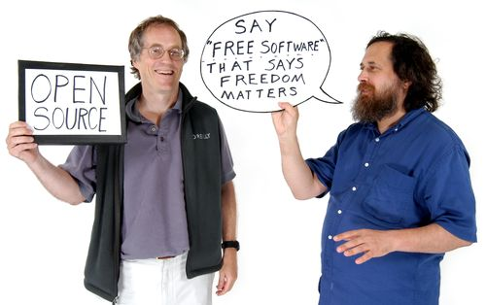
Advantages and disadvantages - OSS
Advantages of OSS
  A good way to achieve greater penetration of the market
  Helps to keep abreast all technology developments
  Saves cost
  More reliable
  Flexible and innovative
OSS Vs. private
http://software.ivertech.com/_ivertechArticle13894_OpenSourceSoftwarevsProprietarySoftware.htm
Notes:
Cut cost as long as it won’t affect the daily routine, they will use oss cause they will pay no license fee.

Slide 21
Advantages and disadvantages - OSS
Disadvantages of OSS
  Development process may not be well defined and the stages in the development process may be ignored.
  The unclear process, the late defect discovery and the lack of any empirical evidence could be the most important problems.
  It is difficult to design a commercially sound business model around the open source paradigm.
  Technical Barrier.
OSS Vs. private
http://software.ivertech.com/_ivertechArticle13894_OpenSourceSoftwarevsProprietarySoftware.htm
Notes:
Technical barrier, oss can’t have more market share. Some program only support the proprietary one.
We should use oss more.

Slide 22
Advantages and disadvantages – proprietary software
OSS Vs. private
Advantages of Proprietary software
  Vendor professional services.
  Proprietary software is easier to adopt.
  Reliable, professional support and training available.
  Packaged, comprehensive, modular formats.
  Regularly and easily updated.
http://software.ivertech.com/_ivertechArticle13894_OpenSourceSoftwarevsProprietarySoftware.htm

Slide 23
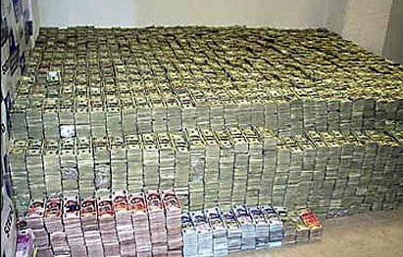
Advantages and disadvantages - proprietary software
OSS Vs. private
Disadvantages of Proprietary software
  Costly
  Has closed
  standards that
  hinder further
  development
http://software.ivertech.com/_ivertechArticle13894_OpenSourceSoftwarevsProprietarySoftware.htm
Notes:
Linkage: We have many recommendations for manager!!!

Slide 24
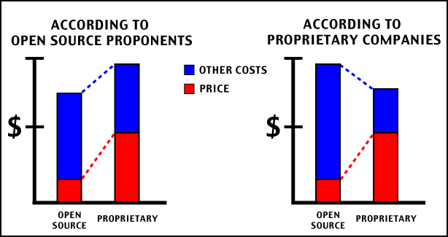
Cost is a big deal!
 | OSS | Proprietary
Price (License) | Low, even FREE! | High
Opportunity cost | High (incompatible with some software) | Low
Hardware | Low (fewer, older computers) | High
Training | Depends | Depends
OSS Vs. private
After a steep initial investment in technology and learning, the long-term costs are allegedly lower. Obviously, cutting out costly licenses saves money for other expenses.
Notes:
FangSu 24-28

Slide 25
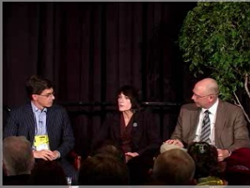
Cost is not the only consideration
EDUCAUSE
It is a nonprofit association whose mission is to advance higher education by promoting the intelligent use of information technology.
Melody Childs
Deputy CIO and Executive Director of User Support and Student IT Enablement of Louisiana State University.
Michael Korcuska
Currently Executive Director of the Sakai Foundation, an non-profit that supports the development of the Sakai CLE, an open-source learning management system.
David G. Swartz
Assistant VP and CIO of American-
University
http://educause.mediasite.com/mediasite/SilverlightPlayer/Default.aspx?peid=3f76ff6fc7354dbdb81202bb6a00146c
OSS Vs. private

Slide 26

Customizing
Open Source Software
Open source software is licensed under a free software license. This enables you to fine-tune your software to your organization's specific needs, giving you a much more tailored solution.
Proprietary Software
Proprietary software is protected by very strict copyright and licensing agreements which greatly affects what you can do with the software and how it can be used.
OSS Vs. private

Slide 27

Technology Support
Open Source Software
Although there isn't a formal support department, open source software has plenty of community-based support options.
Proprietary Software
If you want real tech support beyond the typical FAQ type questions, you'll have to pay a premium either in the form of costly support licenses or pay-per-call fees.
OSS Vs. private

Slide 28

Security
Open Source Software
Open source offers transparency and reliability of its source code. It has powerful potential security advantages by preventing spyware and promoting encryption.
Proprietary Software
Some proprietary software offers potentially robust security.
OSS Vs. private

Slide 29
OSS Vs Proprietary
OSS Vs. private
Topic | Interesting Facts
 | Linux | Windows
Server revenue market share (2009Q1) | 13.8% | 37.3%
Top 500 supercomputer operating system family share (June’09) | 443 (88.6%) | 5 (1%)
The most reliable internet hosting companies (2008) | 5 of 10 | Less than 5 of ten
Estimated Desktop Usage Share (Sept’09) | 0.95% | 91.61%
http://www.idc.com/getdoc.jsp?containerId=prUS21114208
http://www.top500.org/stats/list/33/osfam
http://news.netcraft.com/archives/2009/01/02/new_york_internet and_westhost_are_the_most_reliable_hosting_
companies_in_december_2008.html
http://marketshare.hitslink.com/operating-system-market-share.aspx?qprid=8
http://en.wikipedia.org/wiki/Comparison_of_Windows_and_Linux#cite_note-netapplications-14
Notes:
Cho 29-30
---------------------------
Out of the top 500 systems of supercomputer, 443 (88.6%) run a Linux distribution (June’09).⁸
In server revenue market share (2009Q1) Windows achieved 37.3% and Linux achieved 13.8% ⁹
2008, Linux powered five of the ten most reliable internet hosting companies¹⁰

Slide 30
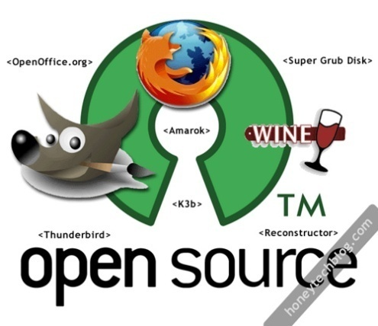
Software vendor strategy change
Microsoft is making significant investments and partnerships with the open source communities.
IBM System z is using a package to increase open source application availability and performance while reducing operational costs.
Oracle is clearly embracing and offering open source solutions as a viable choice for development and deployment.
OSS Vs. private
http://www.microsoft.com/opensource/
http://www-01.ibm.com/software/webservers/appserv/oscp/?S_CMP=from1008swnews
http://www.oracle.com/us/technologies/open-source/index.htm

Slide 31

Content
Background & Overview
OSS Vs Proprietary Systems
Three interviews
  Mary Fowler for UMSL
  Jermaine Holt for Sigma-Aldrich
  Elizabeth D. (Extra Finding)
What have we learned?
Best practices for Open Systems
Notes:
Mark 31: Why did we choose these cases?

Slide 32


Vision
ITS will continue to strive to bring innovations to UMSL; we need to make certain that our community participates fully and critically in the IT revolution that is changing the way we work, learn and grow.
Jim Krueger
Vice Chancellor for Managerial and Technological Services and Interim CIO
http://www.glvcsports.com/images/2007/7/31/UMSL_Trident-color.jpg
http://www.umsl.edu/technology/message.html
Notes:
Jialou 32-33

Slide 33
Organization Background
Cost Freezing: no CIO since Nov. ‘08
90 Computer geeks
Annual Budget $8 Million
  75% is fixed cost (i.e. License fees)
Various strategies to save cost!!!
Applications’ name | UMSL Application
PeopleSoft | MyView
Blackboard | MyGateway
Remedy | HelpDesk

Slide 34
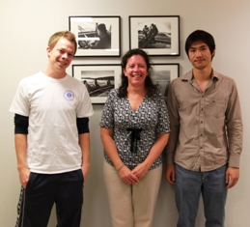
Mary K. Fowler
Director of User Services, ITS - UMSL
Work Experience
At UMSL since July 2001 – present
Manages all units within User Services
Prepares and provides oversight of each unit’s budget
Prepares strategic reports and policies teaching
Lecturer, School of Business Administration, Winter 1994
Education
Masters of Science, MIS,
UMSL, May 1993
Mary K. Fowler, Director of User Services, ITS, UMSL, interviewed in person by Chotirat Raksawin, Mark Mathis, and Su Fang, November 10, 2009
Notes:
Cho 34-37

Slide 35
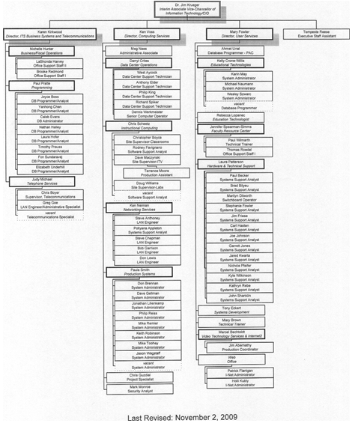
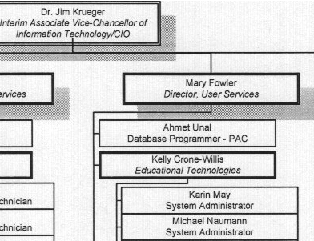
Organization Chart
Notes:
Report to CIO

Slide 36
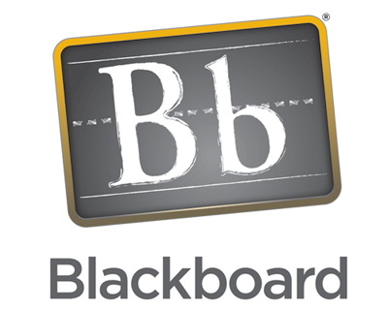
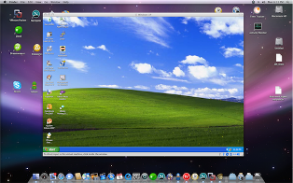
OSS mixed with Private
Linux as a Production system
  www.umsl.edu: From Solaris to Linux
FireFox as a web browser
  Does it run faster than IE?
Oracle
Cold Fusion
Blackboard
PeopleSoft
VMware
OSS
Private
http://www.vmware.com/virtualization/why-virtualize.html
http://www.adobe.com/products/coldfusion/

Slide 37
Why OSS?
Save Cost
  $20,000/ year: cost reduction for using Linux
  instead of Solaris
  Use for programming team
Challenge
Familiarity with OSS?
Focus on “Performance”
In the future…
Evaluate, adjust, use OSS when APPROPRIATE
“More systems on Linux
along with user perception”

Slide 38


Organization Background
Sigma Aldrich is a life science and high technology company
  Chemical and biochemical products used in scientific research, biotechnology, pharmaceutical development, diagnosis of disease, and as key components in high technology manufacturing.
  Brand names: Sigma, Aldrich, Fluka, Supelco, and SAFC
~8000 employees in 38 countries
$2.2 billion in revenues in 2008
http://www.sigma-aldrich.com/
Notes:
Jialou 38

Slide 39
Jermaine Holt
IS Manager
Work Experience
  At Sigma Aldrich for eight years, IS dept. for 3
  Specifically works in the Application Portfolio Management Dept. (Development)
  Started his own consulting firm for about a year
  Desktop Management at Best Buy
  Sigma-Aldrich
Education
  Graduated from Central Methodist University
  with a BA in IT
www.sigmaaldrich.com/ireland.html
Jermaine Holt, IS manager of Sigma-Aldrich, interviewed by phone by Chotirat Raksawin, Mark Mathis, Jialou Guo, and Su Fang, November 7, 2009
Notes:
FangSu 39-42

Slide 40
Organizational Chart
CEO
CFO
CIO
IS Director
IS Manager
Notes:
Report to CIO

Slide 41
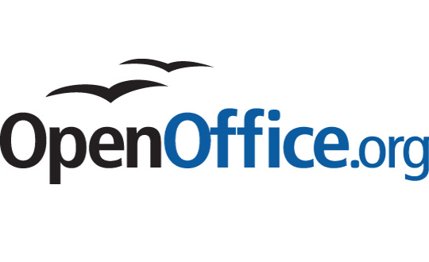
OSS mixed with Private
    OpenOffice
    Other Freeware applications used for project management and design
    SAP
    Web Sphere – Service-oriented architecture business applications and services
OSS
Private
http://freewarehome.com/
http://www-01.ibm.com/software/websphere/

Slide 42
Why does Sigma use OSS?
  Reduce costs
  Meet company needs
    Proprietary software is met with high license fees, so Sigma will always look for ways to reduce these costs while meeting the goals of the company
  However,
  Sigma-Aldrich has run into a few problems with OSS:
    User acceptance
    Versatility with other companies’ applications
www.sigmaaldrich.com/ireland.html

Slide 43


Side-by-side Comparison
Topics
Type of industry | Education | Biochemistry
Size of org. | Medium | Large
Org. Chart | Reports to CIO | Reports to IS director*
No. of employee | 90 | 8000 in 38 countries
Example OSSs | Linux, FireFox | OpenOffice, others
Reasons why they use OSS | Reduces cost | Reduces cost
Challenges | Familiarity, Performance | User acceptance, Versatility
Notes:
Jialou 43

Slide 44



Elizabeth Desrosiers
PMP, CGEIT
IT Portfolio Management Lead, Monsanto
25 years in IT with:
  Emerson
  McAir/ Boeing
  Anheuser Busch
  Monsanto
Emphasis in IT Governance and Project Management and Architecture
Strategy
Elizabeth Desrosiers, PMP, CGEIT, Monsanto, interviewed in person by Mark Mathis, and Su Fang, October 24, 2009
Notes:
Mark 44-49
Reasons for not comparing Monsanto with the other two. Unique to others
Focusing more on the risks of OSS

Slide 45
CIO
Infrastructure/Operations
Technology Acquisition
Application Development
Shared Service Segment
*IT Policy*
Software Compliance Team (Open Source Management)
Inventory Management
Strategy
Organization Chart
Procurement

Slide 46
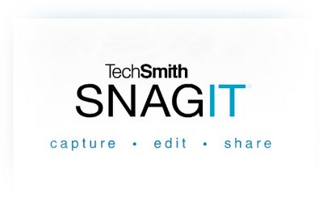
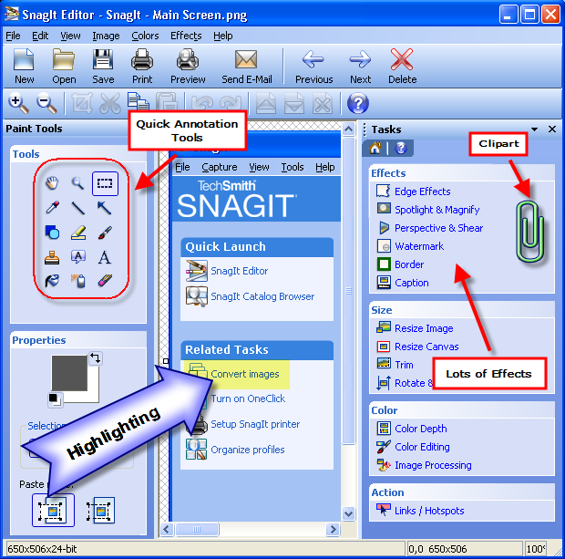
Problems With Open Source at AB
Snag-it
  Employee download of free software
  Agreement statements
  Danger of certain OSS programs for company
  Licensing fees
  Lawsuit exposure
http://images.google.com/imgres?imgurl=http://coad.net/blog/images/SnagItScreenCaptureUtility_A840/SnagItEditorAnnotated1.png&imgrefurl=http://ankitbansal15.blogspot.com/2009_02_01_archive.html&usg=__OuY0GohCNGx4Aj3clVxI9FU61ao=&h=613&w=620&sz=105&hl=en&start=1&um=1&tbnid=PWy4cALPRF3CjM:&tbnh=134&tbnw=136&prev=/images%3Fq%3Dsnag-it%26hl%3Den%26client%3Dfirefox-a%26rls%3Dorg.mozilla:en-US:official%26sa%3DN%26um%3D1
www.coderetard.com

Slide 47
Software (employee)
OLD
Software (internet)
SMS Push
Software Library
Admin. lock
Software
Data
USB
CURRENT
Application
Server
Browser
Data
“Dumb”
PC
Citrix
FUTURE
Application
Server
SMS Push
No USB
Software

Slide 48

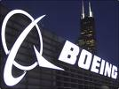
Essential Prerequisites to manage open source application software
Approved Tech List
  Standard build for PCs/servers
  Approved software by role – developer, architect, project manager
Ability to Inventory PCs
  SMS at AB
  Altiris at Monsanto
Well-defined deployment process with checkpoint

Slide 49
Essential Prerequisites to manage open source application software
IT Policy for:
  Unauthorized download
  Technology acquisition
  What can attach to network
Communication & Training on software acquisition processes and IT policies
  Acknowledgment - employees must prove that they’ve read the policies
  Lock Administration rights on PCs

Slide 50
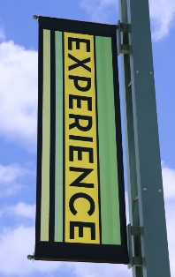
Content
Background & Overview
Case study
OSS Vs Proprietary Systems
What have we learned?
Best practices for Open Systems
Notes:
Jialou 50-51

Slide 51
What have we learned?
A lot of people are using some kind of OSS, but they do not know that it is an OSS.
OSS has advantages in management, such as cost reduction, customization, support, and security.
OSS is widely used in the supercomputer operating system family, while private software is more popular in desktops.
Even OSS accounts for a small part in the software usage of companies. It will be more popular in the future when those companies gain more educated staffs.

Slide 52

Content
Background & Overview
Case study
OSS Vs Proprietary Systems
What have we learned?
Best practices for Open Systems
Notes:
Mark 52-53

Slide 53
Best Practices for Managerial use of Open Source Systems
Use open systems in line with your corporate strategy
  Don’t just focus on cost savings
  Make sure OSS works in line with your proprietary software
Research other companies who have already used the OSS that you are thinking of using
Ensure your company has an IT policy restricting what programs your employees are and aren’t able to download (e.g. Snag-It)
Have the proper change management when integrating open systems into your business

Slide 54

Any Questions?
…Result of Competition
Notes:
Other than cost, what is another reason why companies are using OSS?
A set of rules for encoding documents electronically is
XML
HTML
IP
J2EE
What percentage of UMSL students in the survey knew about Firefox?
Write down at least three managerial concerns in the use of OSS?

Slide 55
References (1)
*These sources came from referred journals
Website:
1. http://socghop.appspot.com/
2. http://www.opensource.org/docs/definition.php
3. http://static.userland.com/userLandDiscussArchive/msg019844.html
4. http://en.wikipedia.org/
5. http://www.linux.org/dist/
6. http://www.mozilla.com/en-US/firefox/features/
7. http://en.wikipedia.org/wiki/Usage_share_of_web_browsers
8. www.coderetard.com
*9. www.macalester.edu/.../ActorMotivations.html
*10. http://software.ivertech.com/_ivertechArticle13894_OpenSourceSoftwarevsProprietarySoftware.htm
11. http://www.netc.orgopenoptionsimagesgiftco.gif
*12. http://www.netc.org/openoptions/pros_cons/tco.htm
*13.http://educause.mediasite.com/mediasite/SilverlightPlayer/Default.aspx?peid=3f76ff6fc7354dbdb81202bb6a00146c
*14. http://www.intranetjournal.com/articles/200807/ij_07_30_08a.html
*15. http://www.idc.com/getdoc.jsp?containerId=prUS21114208
*16. http://www.top500.org/stats/list/33/osfam
*17.http://news.netcraft.com/archives/2009/01/02/new_york_internet_and_westhost_are_the_most_reliable_hosting_companies_in_december_2008.html
*18. http://marketshare.hitslink.com/operating-system-market-share.aspx?qprid=8
19. http://en.wikipedia.org/wiki/Comparison_of_Windows_and_Linux#cite_note-netapplications-14
20. http://www.microsoft.com/opensource/
21. http://www-01.ibm.com/software/webservers/appserv/oscp/?S_CMP=from1008swnews
*22. Vijay Luthra (2009-06-04). "proprietary software". www.BusinessDictionary.com . Retrieved 2009-06-04

Slide 56
References (2)
Website :
23. http://www.oracle.com/us/technologies/open-source/index.htm
24. http://www.glvcsports.com/images/2007/7/31/UMSL_Trident-color.jpg
25. http://www.umsl.edu/technology/message.html
26. http://www.vmware.com/virtualization/why-virtualize.html
27. http://www.adobe.com/products/coldfusion
28. www.sigmaaldrich.com/ireland.html
29. http://freewarehome.com/
30. http://www-01.ibm.com/software/websphere
31.http://images.google.com/imgres?imgurl=http://coad.net/blog/images/SnagItScreenCaptureUtility_A840/SnagItEditorAnnotated1.png&imgrefurl=http://ankitbansal15.blogspot.com/2009_02_01_archive.html&usg=__OuY0GohCNGx4Aj3clVxI9FU61ao=&h=613&w=620&sz=105&hl=en&start=1&um=1&tbnid=PWy4cALPRF3CjM:&tbnh=134&tbnw=136&prev=/images%3Fq%3Dsnag-it%26hl%3Den%26client%3Dfirefox-a%26rls%3Dorg.mozilla:en-US:official%26sa%3DN%26um%3D1
Interview:
Mary K. Fowler, Director of User Services, ITS, UMSL, interviewed in person by Chotirat Raksawin, Mark Mathis, and Su Fang, November 10, 2009
Jermaine Holt, IS manager of Sigma-Aldrich, interviewed by phone by Chotirat Raksawin, Mark Mathis, Jialou Guo, and Su Fang, November 7, 2009
Elizabeth Desrosiers, PMP, CGEIT, Monsanto, interviewed in person by Mark Mathis, and Su Fang, October 24, 2009
Journal Articles:
Birman, A. and Ritsko, J. “Preface to the Special Issue on Open Systems,” IBM Systems Journal, Vol. 44, 2, 2005. p. 213.
“Why Hackers Do What They Do: Understanding Motivation and Effort in Free/Open source software Projects”, Karim R.Lakhani and Robert G. wolf 2005 Massachusetts Institute of Technology

Slide 57
References (3)
Additional information:
1. “Born Free”. Economist. http://web.ebscohost.com/ehost/detail?vid=6&hid=103&sid=7227cf88-dc3d-4a25-b645-0aed08bfeb12%40sessionmgr111&bdata=JnNpdGU9ZWhvc3QtbGl2ZQ%3d%3d#db=buh&AN=40628233
2. “Unlocking the Cloud.” Economist. http://web.ebscohost.com/ehost/detail?vid=4&hid=103&sid=7227cf88-dc3d-4a25-b645-0aed08bfeb12%40sessionmgr111&bdata=JnNpdGU9ZWhvc3QtbGl2ZQ%3d%3d#db=buh&AN=40626971
3. Fitzgerald, Brian. “Transformation of Open Source Software”. MIS Quarterly http://web.ebscohost.com.ezproxy.umsl.edu/ehost/detail?vid=14&hid=4&sid=f1f48fa3-9a7f-4165-9238-97af8b0bcdb1%40sessionmgr14&bdata=JnNpdGU9ZWhvc3QtbGl2ZQ%3d%3d#db=buh&AN=21940322
4. Hyatt, Josh. “The Oh-So-Practical Use of Open Source Innovation”. MIT Sloan Management Review
http://proquest.umi.com.ezproxy.umsl.edu/pqdweb?index=0&did=1570723481&SrchMode=1&sid=1&Fmt=6&VInst=PROD&VType=PQD&RQT=309&VName=PQD&TS=1259627554&clientId=45249
5. Landry, John. “Profiting From Open source”. Harvard Business Review; Sep/Oct2000, Vol. 78 Issue 5, p22-22
http://web.ebscohost.com.ezproxy.umsl.edu/ehost/detail?vid=18&hid=4&sid=f1f48fa3-9a7f-4165-9238-97af8b0bcdb1%40sessionmgr14&bdata=JnNpdGU9ZWhvc3QtbGl2ZQ%3d%3d#db=buh&AN=3521229
6. Norris, Robert C. “Why Rein in Linux”. ISACA. http://www.isaca.org/Content/ContentGroups/Journal1/20002/Why_Rein_in_Linux_.htm
7. Wilson, Scott; Kambil, Ajit; Schwartz, Jonathan; Levin, Eric; Pisano, Gary; Bevilacqua, Michael J. “Open Source Salvation or Suicide.” Harvard Business Review ; Apr2008, Vol. 86 Issue 4, p33-44. http://web.ebscohost.com.ezproxy.umsl.edu/ehost/detail?vid=16&hid=4&sid=f1f48fa3-9a7f-4165-9238-97af8b0bcdb1%40sessionmgr14&bdata=JnNpdGU9ZWhvc3QtbGl2ZQ%3d%3d#db=buh&AN=31372215

