Slide 1
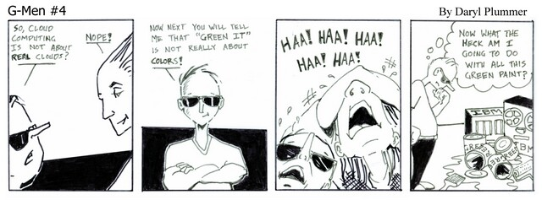
Green IT
Rob Baird
Brian Bray
Lou Howell
Shan Jiang

Slide 2
Dogs Playing Video Poker

Slide 3
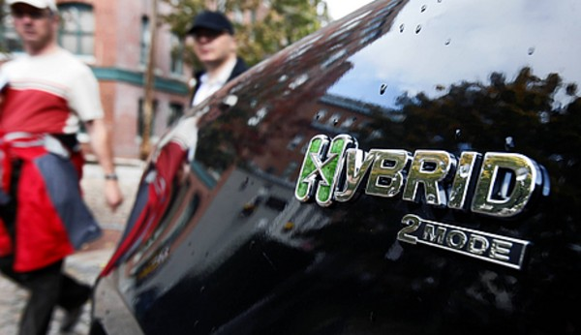
Myth vs. Reality
If I buy a hybrid car, better fuel economy will pay for the higher price

Slide 4
Agenda
So you think you know Green?
Consumer Perspective
Business Perspective
Takeaways and Best Practices
Green Gotchas!
Real World Green
Cleaner Technology vs. Technology as a Tool
Top Green Companies
Case Studies
Soft Reasons Hard Reasons
Datacenter Technology
Green History
Original Research
Terms

Slide 5
Green Terms
CARBON FOOTPRINT
Metric of greenhouse gases produced in environment
CARBON NEUTRAL
Entity producing no net carbon emissions
ENERGY STAR
International standard for energy efficient consumer products
LEED
Leadership in Energy and Environmental Design

Slide 6
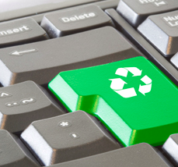
Green Terms
VIRTUALIZATION
Dividing the computing power of servers into multiple virtual machines to increase utilization
EXERGY
Concept of combining sustainable
energy with technology
GREENWASHING
Intentionally false claims about green benefits
SUSTAINABLE
Meet present needs without sacrificing the future

Slide 7
Data Sources
Green IT Books
Referenced IDC and Gartner Studies
Original Research:
Nestle Purina Telepresence Room and Datacenter
Scottrade Datacenter
Interview IT Director at Indeeco
Seminar on Cloud Computing
Krishna Kumar at Microsoft
UMSL Telepresence Room

Slide 8
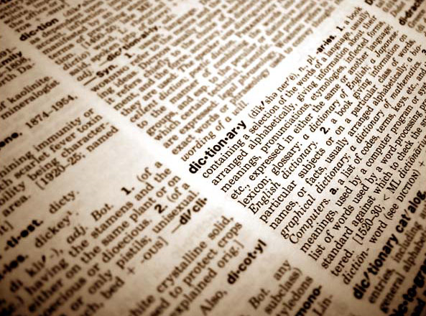
Our Definition
Green Information Technology -
The natural evolution of the application of information systems to operate in a more cost efficient manner, which has the benefit of protecting the environment

Slide 9
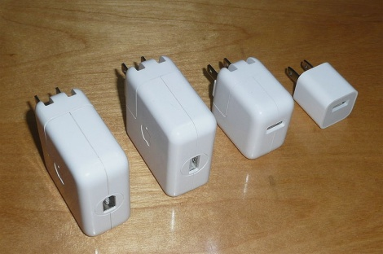
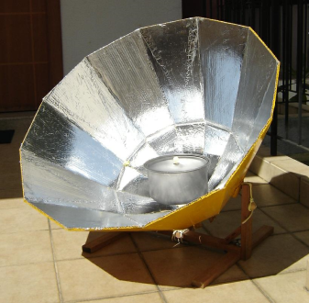
Ends and Means
Cleaner Technology
Technology as a Tool
Low-power processors
Miniaturization
Less space
Fiber optics
Wireless technology
Advances consume fewer resources
Telecommunications decrease travel
Work from home efficiently
Automate
Lighting
Shutoffs
Find new ways to achieve sustainability using information systems

Slide 10
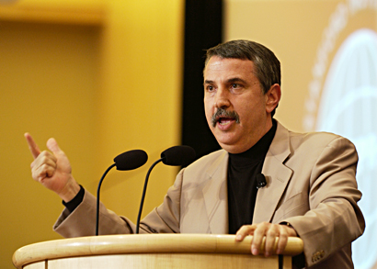
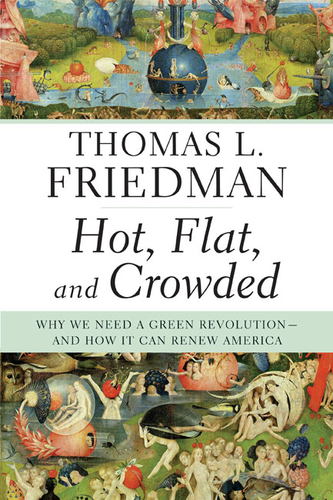
Hot, Flat, and Crowded
Government regulations
Soaring energy costs
New source of jobs in US
Adds “Green” to the bottom line
Notes:
Hot, Flat and Crowded, Friedman Thomas

Slide 11
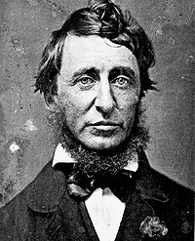
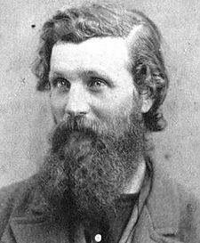
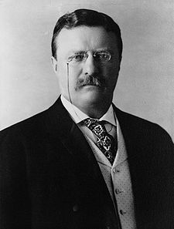
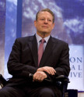
Roots of the Green Movement
Henry David Thoreau 1850
John Muir
1880
Theodore Roosevelt 1920
Rachel Carson
1960
Al Gore
2007

Slide 12
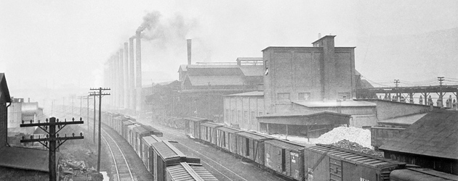
Green History
Industrial Revolution 1820
The “Donora Death Fog” 1948
States and Localities Responsible
Clean Air Act of 1955
EPA 1970
Notes:
http://www.time.com/time/magazine/article/0,9171,853334,00.html

Slide 13
Myth vs. Reality
Green products and saving the environment are the top concern for consumers today

Slide 14
Agenda
So you think you know Green?
Consumer Perspective
Business Perspective
Takeaways and Best Practices
Green Gotchas!
Real World Green
Cleaner Technology vs. Technology as a Tool
Top Green Companies
Case Studies
Soft Reasons Hard Reasons
Datacenter Technology
Green History
Original Research
Terms

Slide 15
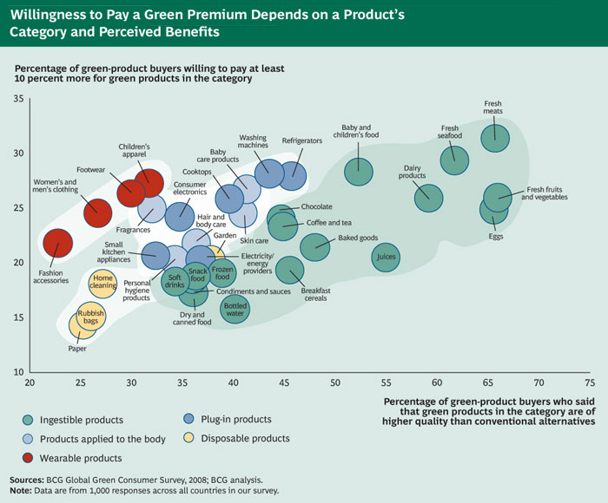
Premiums Paid by Consumers
Notes:
http://www.bcg.com/

Slide 16
Watts → CO²
A human creates 100 watts in a day
A laptop consumes 100 watts per hour
To power a laptop for one year burns enough coal to releases 1,852 pounds of carbon dioxide

Slide 17
Minimize the Impact
Switch off unused equipment
Energy saving modes for PCs, peripherals
Energy consumption can be reduced up to 75 percent per year
Monitors off when not being used
Energy consumption can be reduced up to 90 percent per year
Notes:
Put in with consumers at slide 14-15

Slide 18
2009 Top Users of Green IT
Mohawk Fine Papers
KPMG
State Street
Seventh Generation
AllState Insurance
Office Depot
Citigroup
Burt’s Bees
PricewaterhouseCoopers
Marriot International
State of Indiana
Austin Energy

Slide 19
Criteria of Top Users
Top Level
Executives active part of planning programs
Subscribe to green consortium
Monitor/Measure
IT managers analyze utility bills
Team with areas to reduce energy consumption
Data Center/Facilities
Uses power management software
Uses alternative energy sources for power
Reduced IT energy use by 5% in last 12 months
Revised data center layout and uses virtual servers

Slide 20
Burt’s Bees
“The greenest personal care company on earth.”
Employee bonuses tied to being green
LEED certified buildings
2020 goal of 100% renewable energy

Slide 21
New data center 220 ft below ground
Underground water supply at 55F
Security guards adjust temperatures reduce energy by 15%

Slide 22
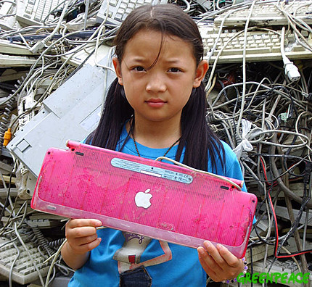
Myth vs. Reality
I can rely on companies to recycle my IT equipment
ISO 9001:2008 and ISO 14001:2004
Notes:
http://www.computerworld.com/s/article/338311/IT_Recycling_Pitfalls

Slide 23
Agenda
So you think you know Green?
Consumer Perspective
Business Perspective
Takeaways and Best Practices
Green Gotchas!
Real World Green
Cleaner Technology vs. Technology as a Tool
Top Green Companies
Case Studies
Soft Reasons Hard Reasons
Datacenter Technology
Green History
Original Research
Terms

Slide 24
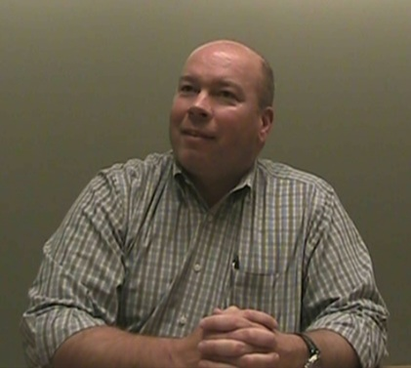
Professional Perspective
Dave Knoebel, CFO, IT Director, INDEECO
Operating efficiencies lead the way for Green IT
Green must be linked to the business strategy
Notes:
http://www.ecommercetimes.com/story/critical-issues/68421.html
http://www.reuters.com/article/pressRelease/idUS110956+02-Mar-2009+BW20090302

Slide 25
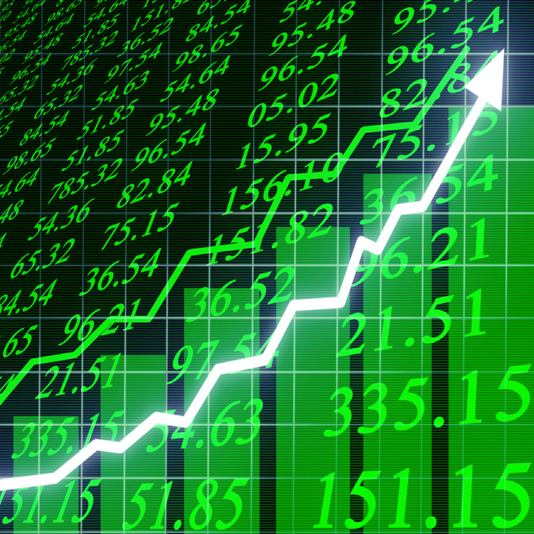
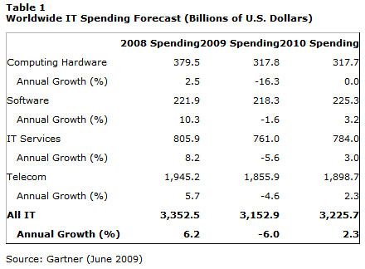
Market Growth
Green Market as $47 billion in 2009
Expect growth to $237.3 billion by 2013
CAGR of 38%
Notes:
"NextGen Research: Green Computing Sector to Reach $223.7 Billion in 2013. " Wireless News 2 Oct. 2009: ABI/INFORM Trade & Industry, ProQuest. Web. 31 Oct. 2009
IT industry could save global economy $800 billion by 2020
Green IT for Dummies, p18

Slide 26
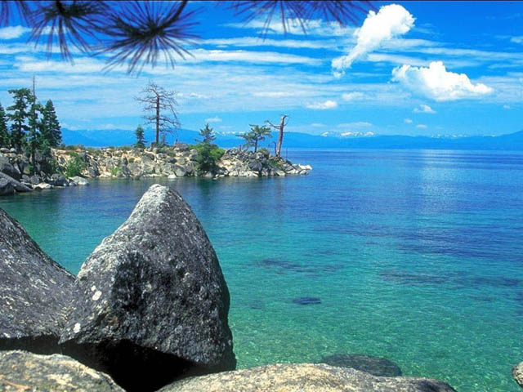
Myth vs. Reality
If I use my screensavers, I will save energy

Slide 27
Original Research
Nestlé Purina
Telepresence Center
Datacenter
Scottrade
Datacenter
UMSL
Telepresence Room
Bigger than Purina’s!
Seminar on Cloud Computing
Krishna Kumar, Microsoft
Notes:
brian

Slide 28
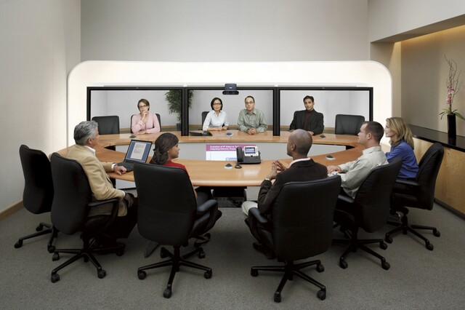
Cisco Telepresence
Closest thing to being in the same room
Reduces travel costs
Frees up vital human capital
Notes:
lou

Slide 29
Largest Datacenter in Saint Louis
John Spitznagel
Director of IT Data Center Planning Services
“Datacenters by nature are not Green, they are built for reliability”
Consolidation offers benefits in scalability and design opportunities
CEO will refund a customer who suffers a loss due to a system outage
Notes:
http://datacenterjournal.com/index.php
http://datacenterjournal.com/content/view/3271/40/
Krishna Kumar from MS

Slide 30
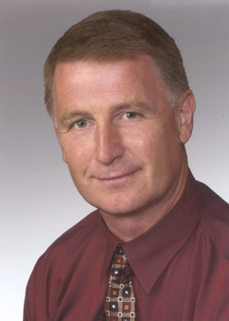
Infrastructure or Energy
Infrastructure is a bigger concern
Vernon Turner, SVP IDC Enterprise Infrastructure
“…infrastructure remains underutilized, green IT policies can help… to utilize their assets.“
How to convince stakeholders:
Sell a “Lean IT” approach
Largest investment in
infrastructure is datacenters
Notes:
Shan
http://www.reuters.com/article/pressRelease/idUS103185+24-Sep-2009+BW20090924
http://datacenterjournal.com/content/view/1709/44/

Slide 31
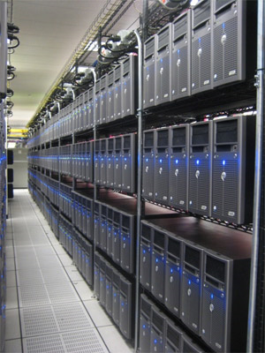
Datacenters
Server Room
Center of IT operations
Continuity
Redundancy
Backup power
LEED – Built for Green
Fiber optic cabling and wireless
Outside air for cooling
Notes:
rob

Slide 32
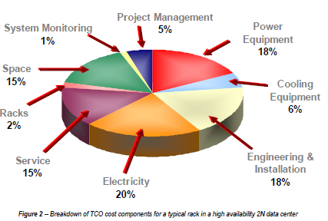
Datacenter Challenges
Require a lot of energy
Account for 1.5% of U.S. electricity,
same as Florida
Cooling and energy costs account for 50% of the cost of IT equipment
Increase to 70% by 2011
Companies will add servers before consolidating or using virtualization
Notes:
brian

Slide 33
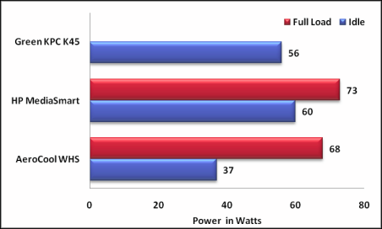
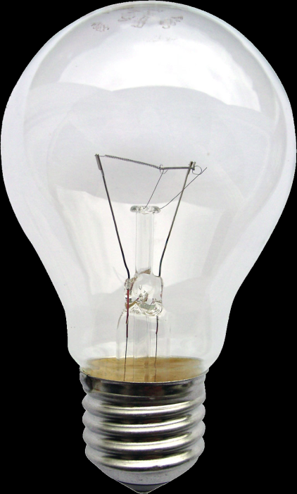
Advances in Server Technology
A 40 watt light bulb uses more energy than a new server
Notes:
brian

Slide 34
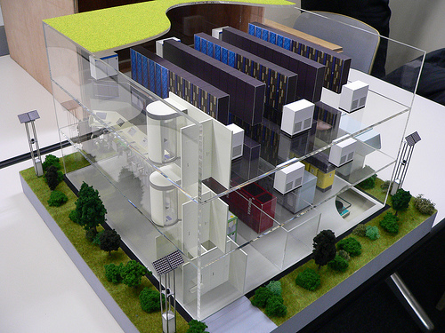
Green Datacenter Ideas
Remove redundant rack mounted UPS
Redesign the Cooling System
Automate Power Management
Virtualization can reduce energy use and server costs by almost 40%¹
Notes:
rob

Slide 35
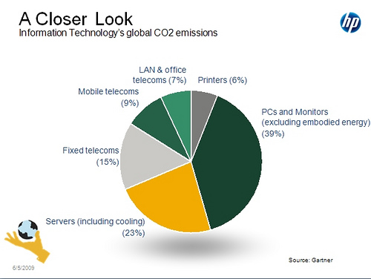
PCs vs. Servers
Notes:
rob
Servers remain more efficient than a PC

Slide 36
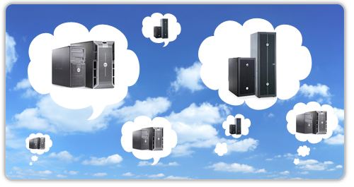
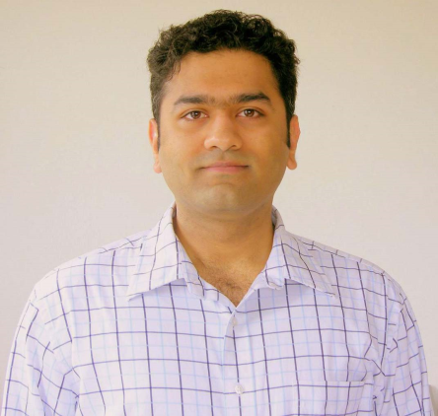
Cloud Computing
Dynamically allocates the processing power of several connected servers (the cloud) to a client
Cutting edge virtualization
Increases utilization of servers
Scale up and down on-demand
Pay for what you use
IT Asset Lifecycle – Less to Recycle
Thin clients require fewer resources
Upgraded dynamically with the cloud
Notes:
http://www.brighthub.com/environment/green-computing/articles/10026.aspx rob

Slide 37
E-Waste
One of the largest challenges to Green IT
Gartner: 133,000 computers junked each day
Costly to recycle
Data security
Threat to the environment
Includes many non-renewable resources
Harmful elements such as lead and mercury
Notes:
Obselete
http://www.greenit.net/downloads/Green%20Machines%20Converge%20Magazine%20May%202007.pdf
Green IT is important to reduce this
http://www.eweek.com/c/a/Green-IT/Dell-HP-and-IBM-Are-Among-9-Meeting-IDC-Green-Certification-821401/

Slide 38
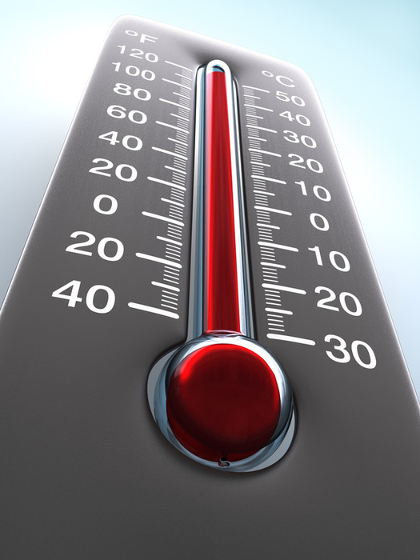
Myth vs. Reality
The term greenhouse effect
originated in St. Louis

Slide 39
Agenda
So you think you know Green?
Consumer Perspective
Business Perspective
Takeaways and Best Practices
Green Gotchas!
Real World Green
Cleaner Technology vs. Technology as a Tool
Top Green Companies
Case Studies
Soft Reasons Hard Reasons
Datacenter Technology
Green History
Original Research
Terms

Slide 40
Intelligent Lighting Systems
Rogers Centre Toronto
7,000 light fixtures
Cut energy use by 77% annually
Saves $300,000 per year
Notes:
http://www.itbusiness.ca/it/client/en/Home/News.asp?id=53664&cid=70

Slide 41
Savings in Green
1990 – 2007
saved > $310 million through energy conservation actions
Saved $97 million in travel costs by using online collaboration
Since 2000
Saved more than $80 million through various green packaging initiatives¹
Notes:
http://www-03.ibm.com/technology/resources/technology_greeninnovations_pdf_AMR_Research_REPORT_20313-Big_Green_IBM_and_the_ROI_of_Environmen.pdf

Slide 42
History of Green IT
1940’s: Treatment of industrial wastewater at plants
1971: First protection goals: “guard against adversely affecting the environment.”
1989 – 2005: Global Asset Recovery Service collected > 1.3 billion lbs. of hardware
1990: Published annual environmental report
1997: FIRST multi-national to earn global registration to ISO 14001
1990 – 2007: Avoided energy-use CO2 emissions = to 45% of IBM’s 1990 use
Since 1987: IBM has decreased hazardous waste by 94.7%
What’s Next?

Slide 43
Case of University of Michigan Desktop Best Practices
Get buy-in
Find out how much energy the systems are really using and share it
Establish practical energy-saving settings
Promote energy-saving Behavior
Share energy-saving information and available materials with other users
Buy smart
Replace CRT monitors with LCDs
Re-evaluate the printing environment
Consolidate to fewer, shared, printers
Notes:
Shan

Slide 44
Green Resources Top Online Green IT Calculators
Calculators that estimate the benefits of different green IT projects:
1. Forrester's Green IT Calculator
2. VMware's Total Cost of Ownership Calculator
3. Microsoft's Virtualization Calculator
Notes:
Shan – why to use

Slide 45
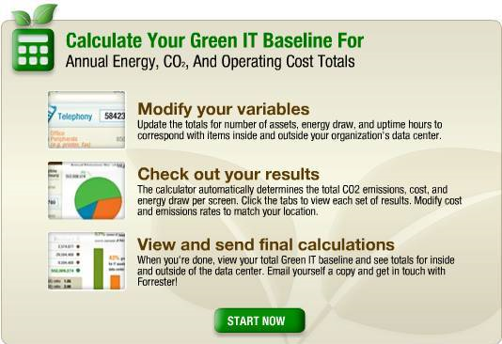
IT Calculators
Forrester's Green IT Calculator
Estimates the energy usage of computers, monitors, and telecom
Walks through the key Green IT baseline assumptions
number of IT assets
energy draw
up-time
Offers snapshot of current
IT energy consumption

Slide 46
Agenda
So you think you know Green?
Consumer Perspective
Business Perspective
Takeaways and Best Practices
Green Gotchas!
Real World Green
Cleaner Technology vs. Technology as a Tool
Top Green Companies
Case Studies
Soft Reasons Hard Reasons
Datacenter Technology
Green History
Original Research
Terms

Slide 47
Best Practices
Align Green IT with business
Utilize metrics to determine Green opportunities
Datacenters are low hanging fruit
Plan with short and long term goals with measurable ROIs
Monitor and follow regulations
Create Asset Life Cycle Management Plan

Slide 48
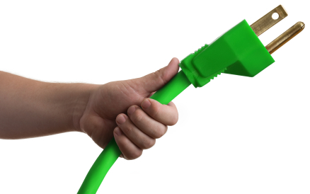
Myth vs. Reality
When I turn off my appliances, they stop drawing power

Slide 49
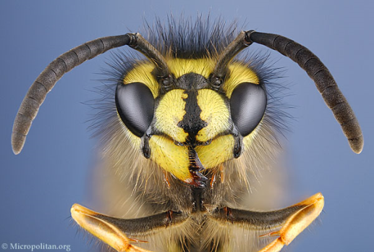
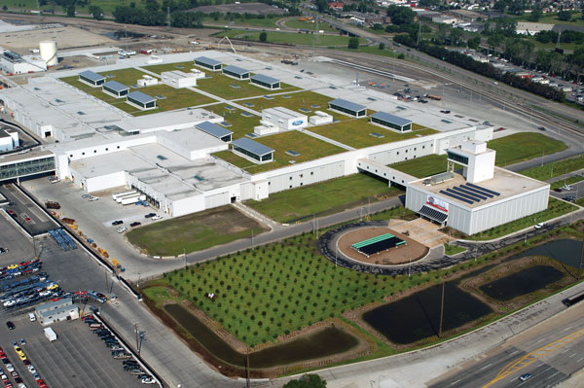
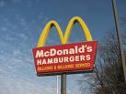
Green Gotchas!
The Warehouse and Wasps
Ford Motor Company
Monsanto Seed
McDonald's and the US
Notes:
http://www.computerworld.com/s/article/338311/IT_Recycling_Pitfalls
Green to gold, esty and winston

Slide 50
Final Thought
Organizations should view the evaluation of Green IT opportunities as a best practice
Modern technology owes
ecology an apology
~Alan M. Eddison

Slide 51
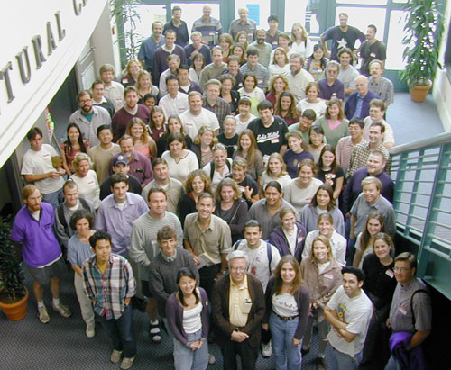
Myth vs. Reality
One person cannot make a difference…

Slide 52
Bibliography
Esty, Daniel C. and Winston, Andrew S.(2006), Green to Gold: How Smart Companies use Environmental Strategy To Innovate, Create Value, and Build Competitive Advantage, John Wiley & Sons, Hoboken, New Jersey.
Friedman, Thomas L.(2008), Hot, Flat, and Crowded: Why We Need a Green Revolution and How It Can Renew America, Farrar, Straus, and Giroux, New York.
Lamb, John,(2009), The Greening of IT: How Companies Can Make a Difference for the Environment, IBM Press, Upper Saddle River, New Jersey.
Rivoli, Pietra.(2009), The Travels of a T-Shirt in the Global Economy:An Economist Examines the Markets, Power, and Politics of World Trade, John Wiley & Sons, Hoboken, New Jersey.
Rogers, Everett M.(2003), Diffusion of Innovations, Free Press, New York.

