Slide 1
Grammar as a rhetorical choice
“It is our choices that show what we truly are, far more than our abilities.” – J.K. Rowling

Slide 2
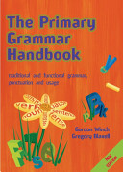
Traditional definition of “grammar”
Many people believe that learning grammar involves learning a set of inflexible rules that you can break once you know them. But linguists and compositional theorists have challenged this misconception.

Slide 3
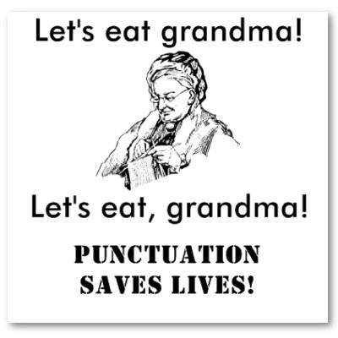
New definition of “grammar”
“Principles” instead of “rules”
Grammar allows writers to achieve certain rhetorical effects. That is, writers punctuate according to their intended meaning or emphasis.

Slide 4
Independent clauses
All prose consists of independent clauses. In other words, independent clauses reveal the underlying structure of the entire system.
Sentences = less important.

Slide 5
Independent clauses
An independent clause is a complete thought with a subject and verb. It can stand alone.
Ex. The Rams lost.
With an underlying independent clause, the missing elements can be readily provided by a native English speaker.
Ex. Where are you going? Home.
Ex. We went to the beach. And enjoyed the sun.

Slide 6
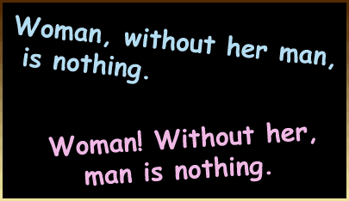
Punctuation marks
Punctuation is a matter of showing the relationships between independent clauses.

Slide 7
Punctuation marks
How are the three sentence combinations below different? In other words, how is the effect or meaning different?
1. First it was rain. Then it was snow.
2. First it was rain; then it was snow.
3. First it was rain, then it was snow.

Slide 8
Punctuation marks
Punctuation marks indicate the degree of separation between independent clauses.
Hierarchy of Punctuation Marks
Mark Degree of Separation
Sentence final (. ? !) Maximum
Semicolon (;) Medium
Colon (:) Medium (anticipatory)
Dash (-) Medium (emphatic)
Comma (,) Minimum
Zero None (that is, connection)

Slide 9
Grammar “rules” as social constructs
Remember that constructs are ideas that have been built up over time, so much so that they seem to be natural or inevitable (possible examples include plagiarism, evidence, freedom, justice, wealth)

Slide 10
Grammar “rules” as social constructs
Consider how grammar has changed from 100 years ago…
Ex. “He searches for the lamppost with his cane, like a tennis player swinging backhand, and, if he loses his bearings and bumps against something, he jerks abruptly back, like a cavalier insulted, looking gaunt and fierce.”
…compared to today.
Ex. “He searches for the lamppost with his cane like a tennis player swinging backhand, and if he loses his bearings and bumps against something, he jerks abruptly back like a cavalier insulted, looking gaunt and fierce.” –Edward Hoagland

Slide 11
Grammar “rules” as social constructs
Consider how grammar is different in America…
Ex. “So Two Cheers for Democracy: one because it admits variety and two because it permits criticism.” – E.M. Forester
…compared to the grammar in Britain.
Ex. “So Two Cheers for Democracy; one because it admits variety and two because it permits criticism.”

Slide 12
Strategies for improving your grammar
Read and write a lot.
Read your paper out loud.
Read your paper backwards, sentence-by-sentence.
Have others read your paper out loud.
Ask me to do a diagnostics test on your paper.
Learn about grammar and punctuation rules using handbooks or on academic websites like OWL Purdue.
Develop rhetorical awareness.

